Slide 1
A Manila Ramen Food Business Expansion Project
A Recipe for Success for Food Businesses by the Identification and Selection of the Correct Neighboring Venues

Slide 2
Description of the Problem
Yummy Tokyo, a ramen restaurant in Manila wants to identify new locations where they can put up new branches. The objectives of the study is to answer:
What are the types of neighboring venues that help in the success of a (food) business? What is the norm that existing businesses follow?
Which places, specifically Barangays in Metro Manila, is it ideal to start a business or add a new branch?

Slide 3
Data Used for the Study
2015 census of Metro Manila that was scraped from Wikipedia using BeautifulSoup
Coordinates of the cities and barangays acquired using Python Geocoder library
Manila json file from Github created by altcoder
Yummy Tokyo branches location taken from Google Maps
Names and locations of other Ramen/Japanese restaurants acquired from FourSquare
Venues near the different Yummy Tokyo branches acquired from FourSquare
Venues near the other Ramen/Japanese restaurants acquired from FourSquare
Venues in each barangay acquired from FourSquare

Slide 4
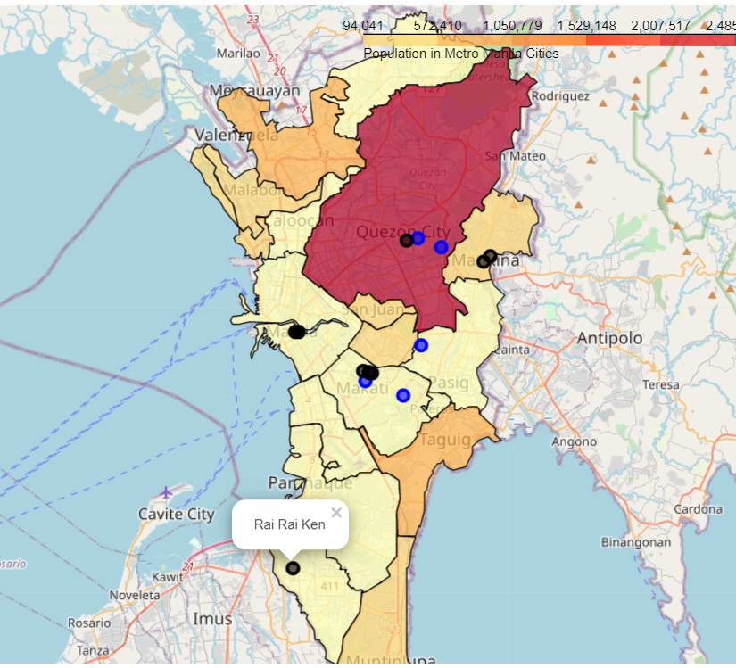
Choropleth Map of City Population Sizes with Yummy Tokyo Branches & Other Restaurants
Yummy Tokyo Branches
Other Ramen/Japanese Restaurants

Slide 5
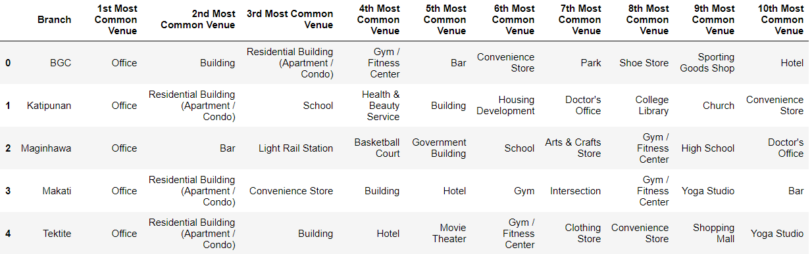
10 Most Common Venues Near the Yummy Tokyo Branches

Slide 6
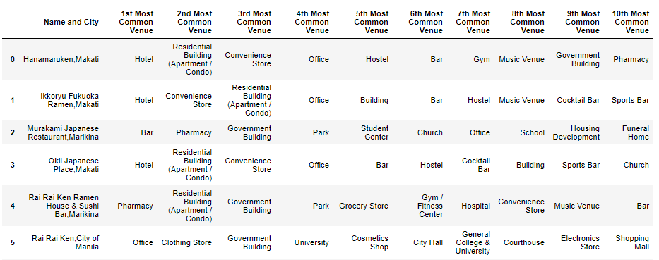
10 Most Common Venues Near the Yummy Tokyo Branches
*Only 5 of the 14 Restaurants are shown

Slide 7
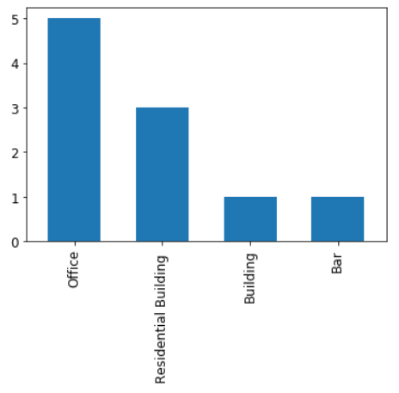
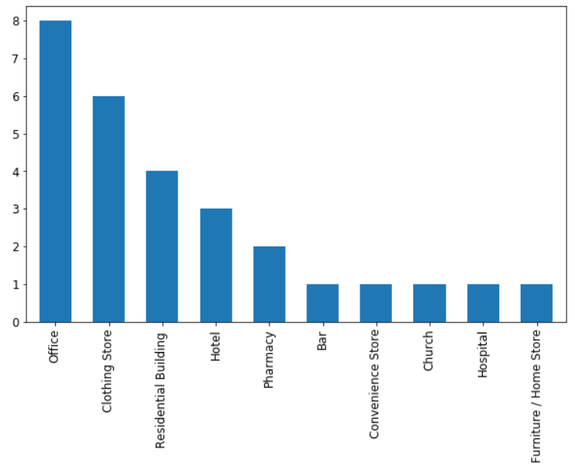
Most Mentioned as either 1st or 2nd Most Common Venues are (1) OFFICES, (2) CLOTHING STORES, and (3) RESIDENTIAL BUILDINGS
YUMMY TOKYO
OTHER RESTAURANTS

Slide 8
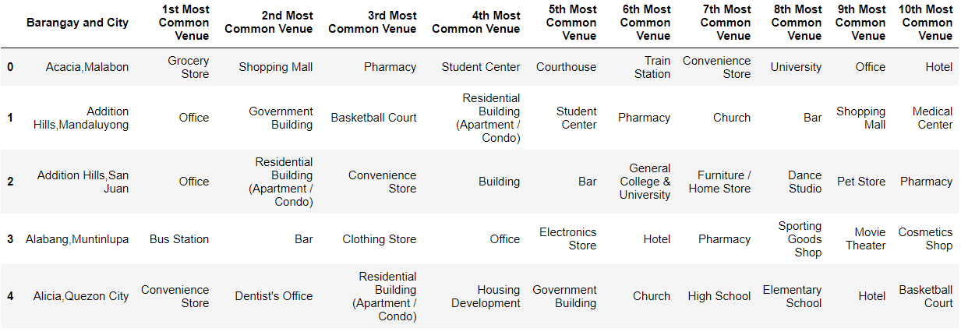
10 Most Common Venues in the Barangays
*Only 5 of the 421 Barangays are shown

Slide 9
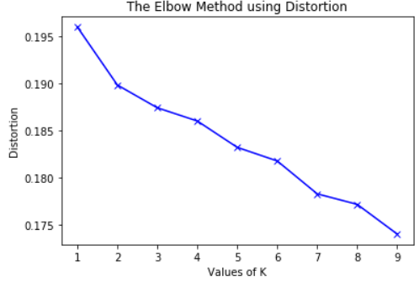
SELECTION OF OPTIMUM NUMBER OF CLUSTERS

Slide 10
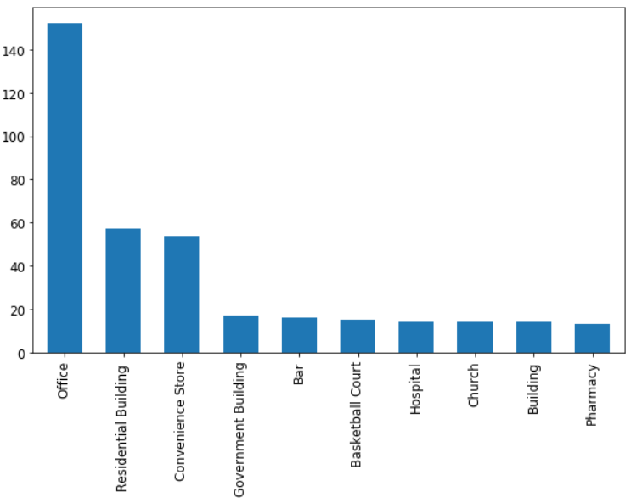
Most Common Venues for Cluster 1 are Offices, Residential Buildings and Convenience Stores

Slide 11
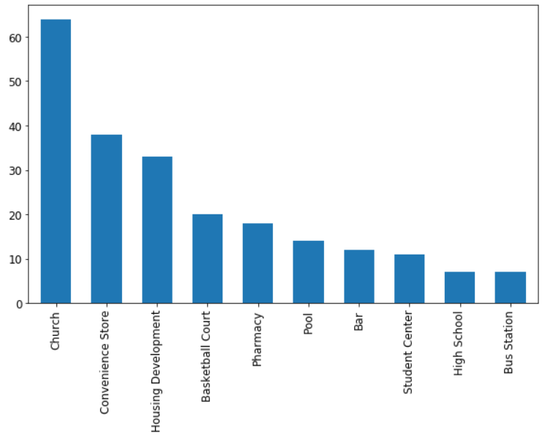
Most Common Venues for Cluster 2 are Churches, Convenience Stores, and Housing Developments

Slide 12
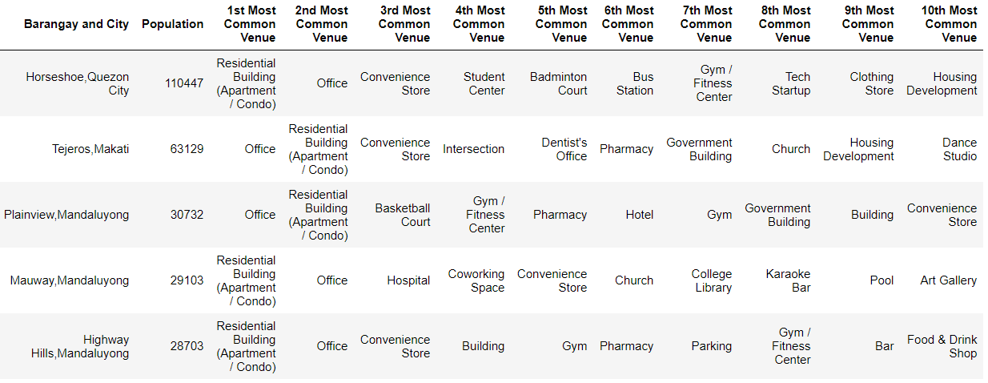
Filtered Barangays that have Offices and Residential Buildings as 1st and 2nd Most Common Venue in Cluster 1
*Only 5 of the 27 Barangays are shown

Slide 13
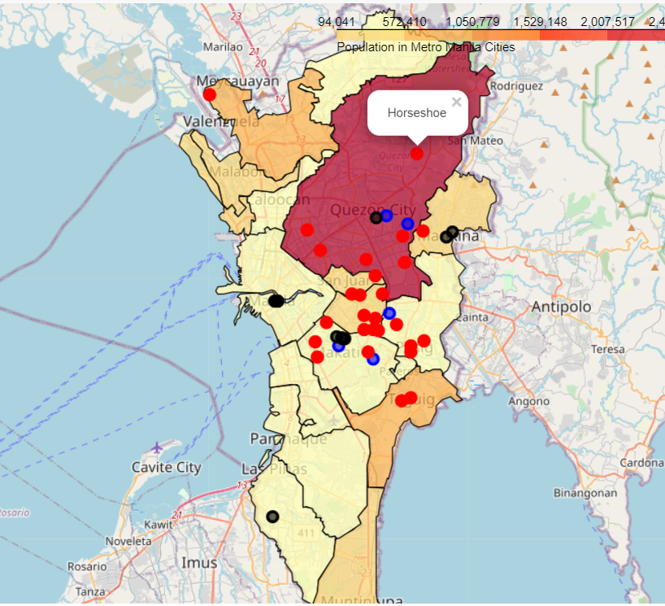
Choropleth Map of City Population Sizes with Yummy Tokyo Branches, Other Restaurants, and Recommended Locations
Yummy Tokyo Branches
Other Ramen/Japanese Restaurants
Recommended Locations

Slide 14
Conclusion 1
The Yummy Tokyo branches, whose main target markets are professionals and families, have located their branches near offices and residential buildings.
The other Ramen/Japanese restaurants also set up their stores near offices, residential buildings, as well as in clothing stores (malls).
Setting up food stores near offices and residential buildings are beneficial to the sales and revenue.

Slide 15
Conclusion 2
A total of 252 barangays were identified in Cluster 1 which majority of the nearby venues are Offices and Residential Buildings.
Further filtering the data to those who have these 2 venues as their 1st and 2nd, 27 barangays were identified.
With the use of the FourSquare API, KMeans clustering method, and data analysis, ideal locations for the new branches were identified.

