Slide 1
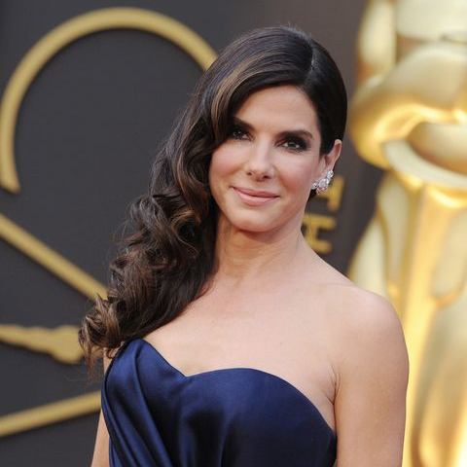
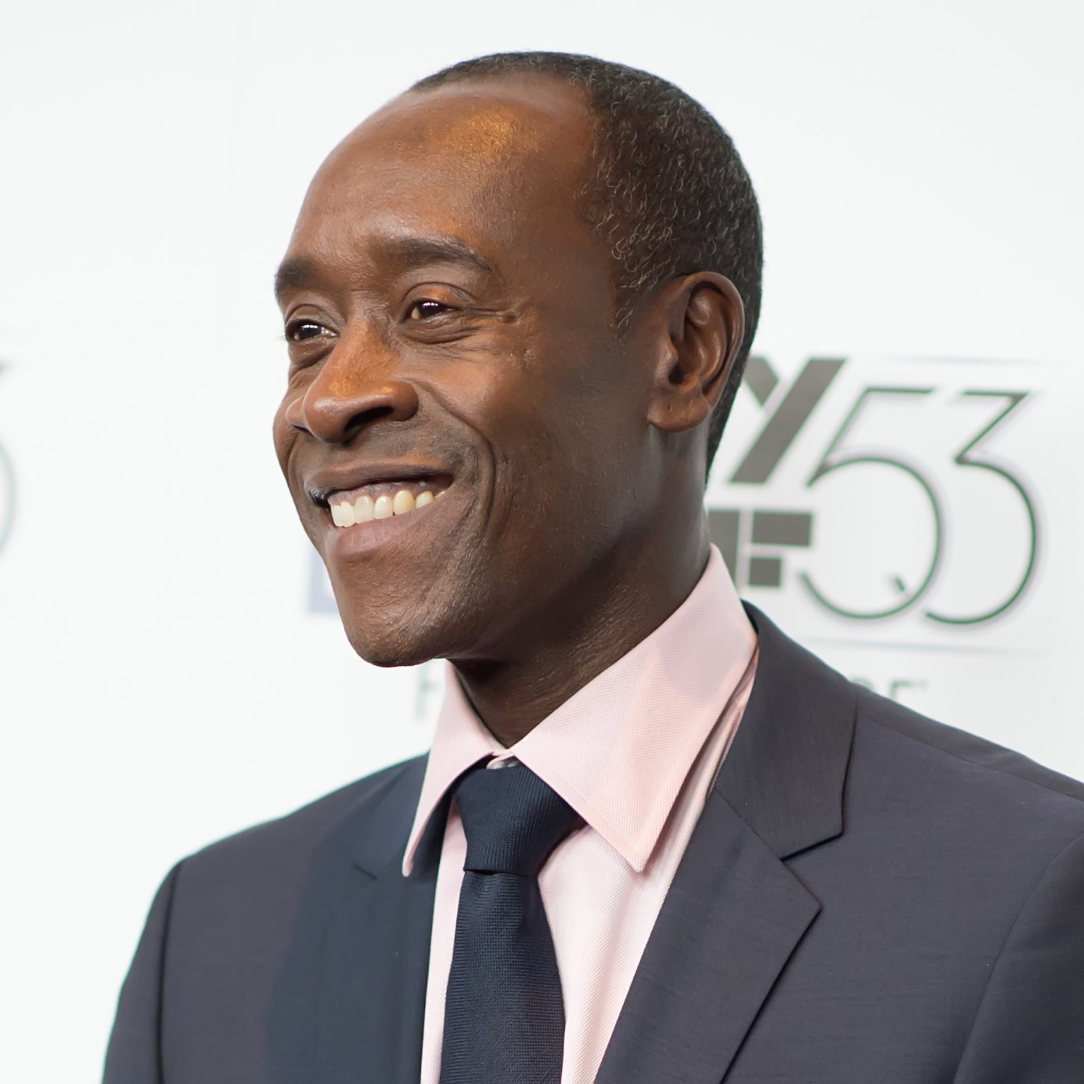
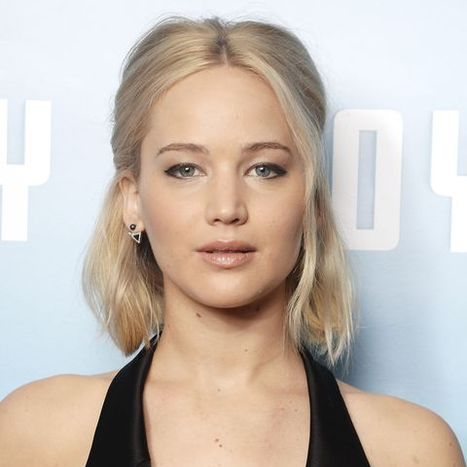
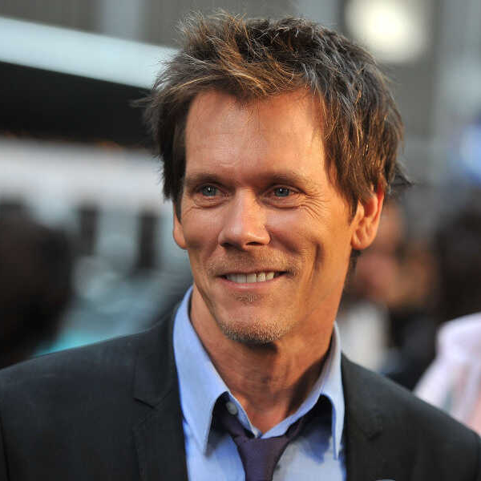
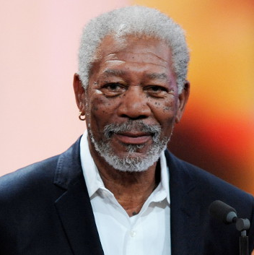
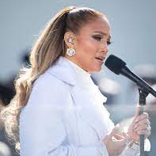
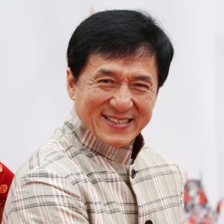
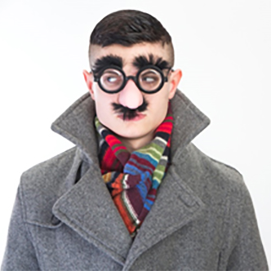
2
Susan Davis
🎬 Bonnie Holocaust
1
1
Rip Crawford
Fay Winslet
🎬 Polish Brooklyn
🎬 American Circus
🎬 Polish Brooklyn
Kevin Bloom
🎬 Trouble Date
1
1
🎬 Juggler Hardly
Morgan Williams
Jada Ryder
2
🎬❓
Ed Guiness
Who Else?
3

