Slide 1
Introduction to Xamarin.Android
AND101
Notes:
Note: slide notes marked with [Instructor Notes] are intended as additional learning notes for instructors. These are to help you understand the slide in more depth and potentially provide additional background information.
[Instructor Notes]
Add your name and email to this slide so it is visible to students (Optional).
Make sure to read the Lecture Preparation Steps
Remember the timing is intended to be 1min/slide.
Welcome everyone to Xamarin University.
Introduce yourself.
Say the course name and duration (3 hours).
Take attendance and have students introduce themselves.
Confirm that the students have downloaded the materials, show them StartHere.html.
Encourage interactivity and verbal questions but ask students to mute their microphone when they aren’t talking to the group.

Slide 3

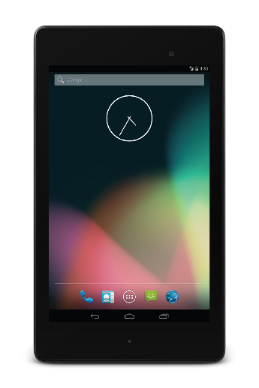



Objectives
Create a Xamarin.Android project
Decompose an app into Activities
Build an Activity's UI
Write an Activity's behavior
Update your Android SDK
Notes:
Our goal today is to create a complete Android application:
Objective 1: Overview of Xamarin.Android and how to create a project using the development environment of your choice.
Objective 2: Architecture of an Android app.
Objective 3: Build a UI, partly by hand and partly with the Xamarin Android Designer.
Objective 4: Write code to respond to user actions.
Objective 5: Install the latest Android APIs and build tools on your development machines so you can target the most-recent version of Android.
By the end of the class, you will have seen all the basic pieces of a Xamarin.Android Application. You will have gone through the entire development cycle from design to deployment and execution.
[Instructor Notes:]
Begin Timer
Timing estimates Objective 1: Create a Xamarin.Android project ~30min. Objective 2: Decompose an app into Activities ~15min. Objective 3: Build an Activity's UI ~40min Objective 4: Write an Activity's behavior ~35min Objective 5: Update your Android SDK ~30min

Slide 4
Notes:
Stop Timer
Thank everyone
Encourage them to do the survey in their profile
Stay on the line for further Q+A

