Slide 1
Signal Processing for Beyond-5G and 6G Communications
Waveforms • ultra-massive MIMO • RIS • ISAC • AI-native PHY
Dr. Markkandan S · Associate Professor
School of Electronics Engineering, Vellore Institute of Technology, Chennai · markkandan.s@vit.ac.in
Invited talk • 90 minutes • 2026
Notes:
Welcome; hook: 6G is, at its core, a signal processing problem. Five live MATLAB experiments are woven through the talk. Slides and code available at the end.

Slide 2
1
Opening & Motivation
Notes:
Section transition — Opening & Motivation. Pause, re-orient the audience, then move into the first slide.

Slide 3
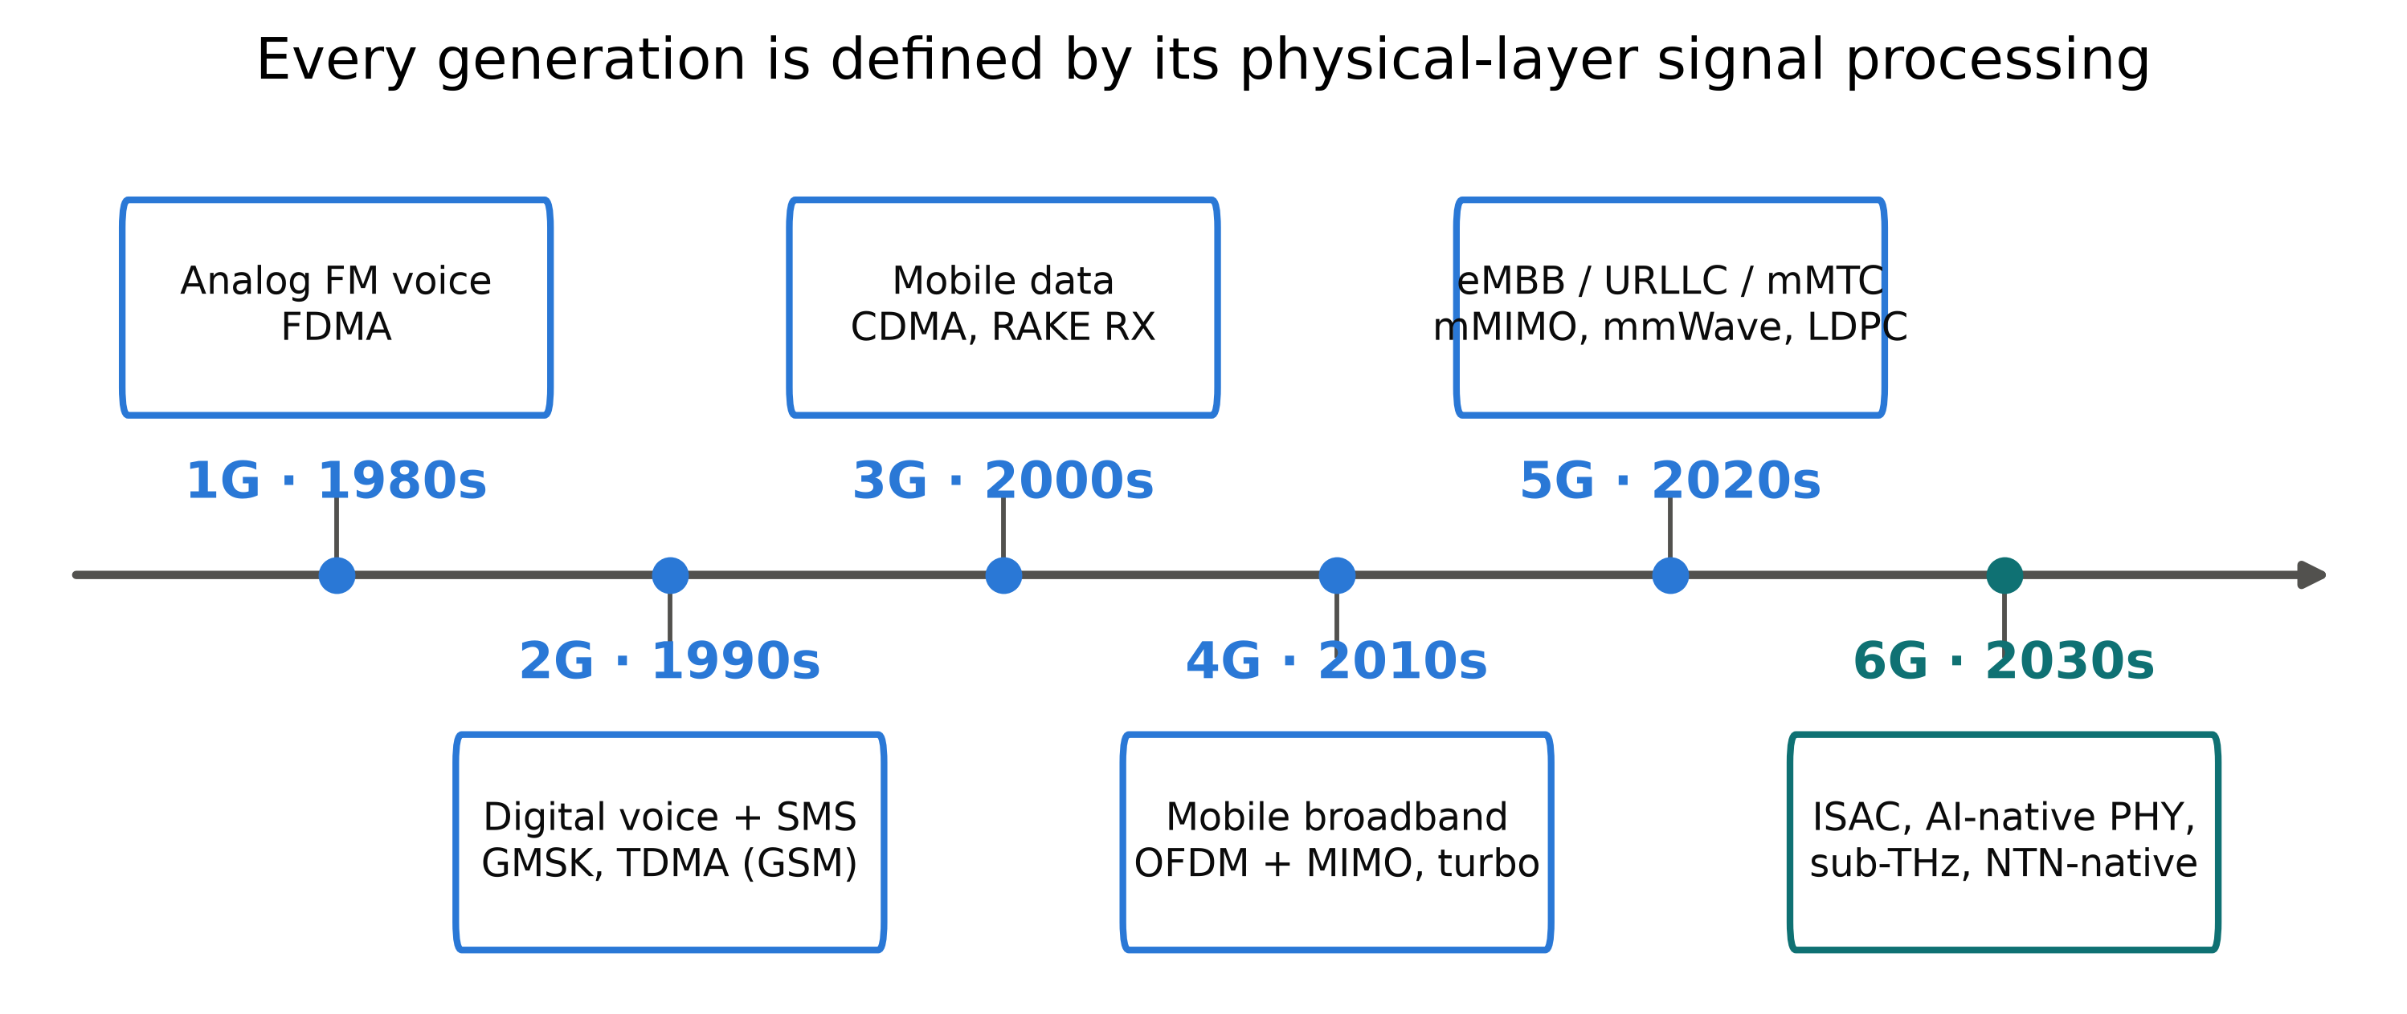
Six generations in forty years
▸ Each decade: a new generation, a 10–100× peak-rate jump
▸ The differentiator each time was the physical-layer signal processing choice: FDMA → TDMA → CDMA → OFDM/MIMO → mMIMO
3 / 86
Notes:
Walk the timeline left to right; generations are remembered by their PHY (3G=CDMA, 4G=OFDM+MIMO). The 6G research window is open now: ITU framework 2023, 3GPP study underway, spec by ~2029.

Slide 4
The IMT-2030 vision (ITU-R M.2160, Nov. 2023)
▸ Extended from 5G: immersive comm.; hyper-reliable low-latency; massive communication
▸ Genuinely new for 6G: Integrated Sensing & Communication; AI and communication; ubiquitous connectivity
▸ Design values: sustainability, security & resilience, connecting the unconnected, interoperability
4 / 86
Notes:
M.2160 is the official 'what is 6G' document. Three scenarios are upgrades of the 5G triangle; three are new. Two of the new ones (ISAC, AI) are Sections 6 and 7 — both signal processing problems.

Slide 5
KPI targets: IMT-2020 vs IMT-2030
KPI | 5G (IMT-2020) | 6G (IMT-2030, research)
Peak data rate | 20 Gb/s | 200 Gb/s – 1 Tb/s
User-plane latency | 1 ms | 0.1 – 1 ms
Connection density | 10⁶ /km² | 10⁶ – 10⁸ /km²
Positioning | m-level | cm-level (+ velocity)
Sensing | — | native KPI class
Energy | qualitative | first-class design value
▸ IMT-2030 gives ranges, not single numbers — targets are scenario-dependent
5 / 86
Notes:
Highlight three rows: 10× peak rate needs new spectrum (Sec 2); sensing appears as a KPI class for the first time (Sec 6); energy moves from marketing to KPI (Sec 10). Don't quote single-number 6G KPIs.

Slide 6
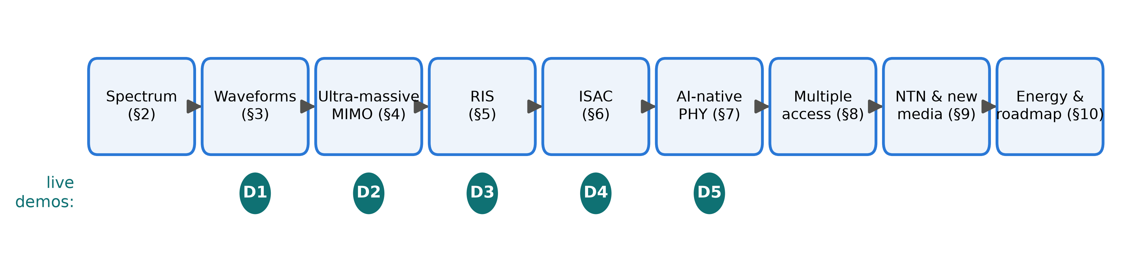
Why signal processing is the bottleneck and the enabler
▸ Near Shannon at sub-6 GHz → gains must come from new dimensions
▸ New dimensions: bandwidth (THz), aperture (arrays), environment (RIS), function (sensing), semantics (AI)
▸ Hardware gets worse as frequency rises — DSP must compensate
6 / 86
Notes:
The thesis slide. Every box on this roadmap is a DSP problem in a systems costume. The D1–D5 dots: five live MATLAB experiments, one after each core section.

Slide 7
2
New Spectrum Frontiers
Notes:
Section transition — New Spectrum Frontiers. Pause, re-orient the audience, then move into the first slide.

Slide 8
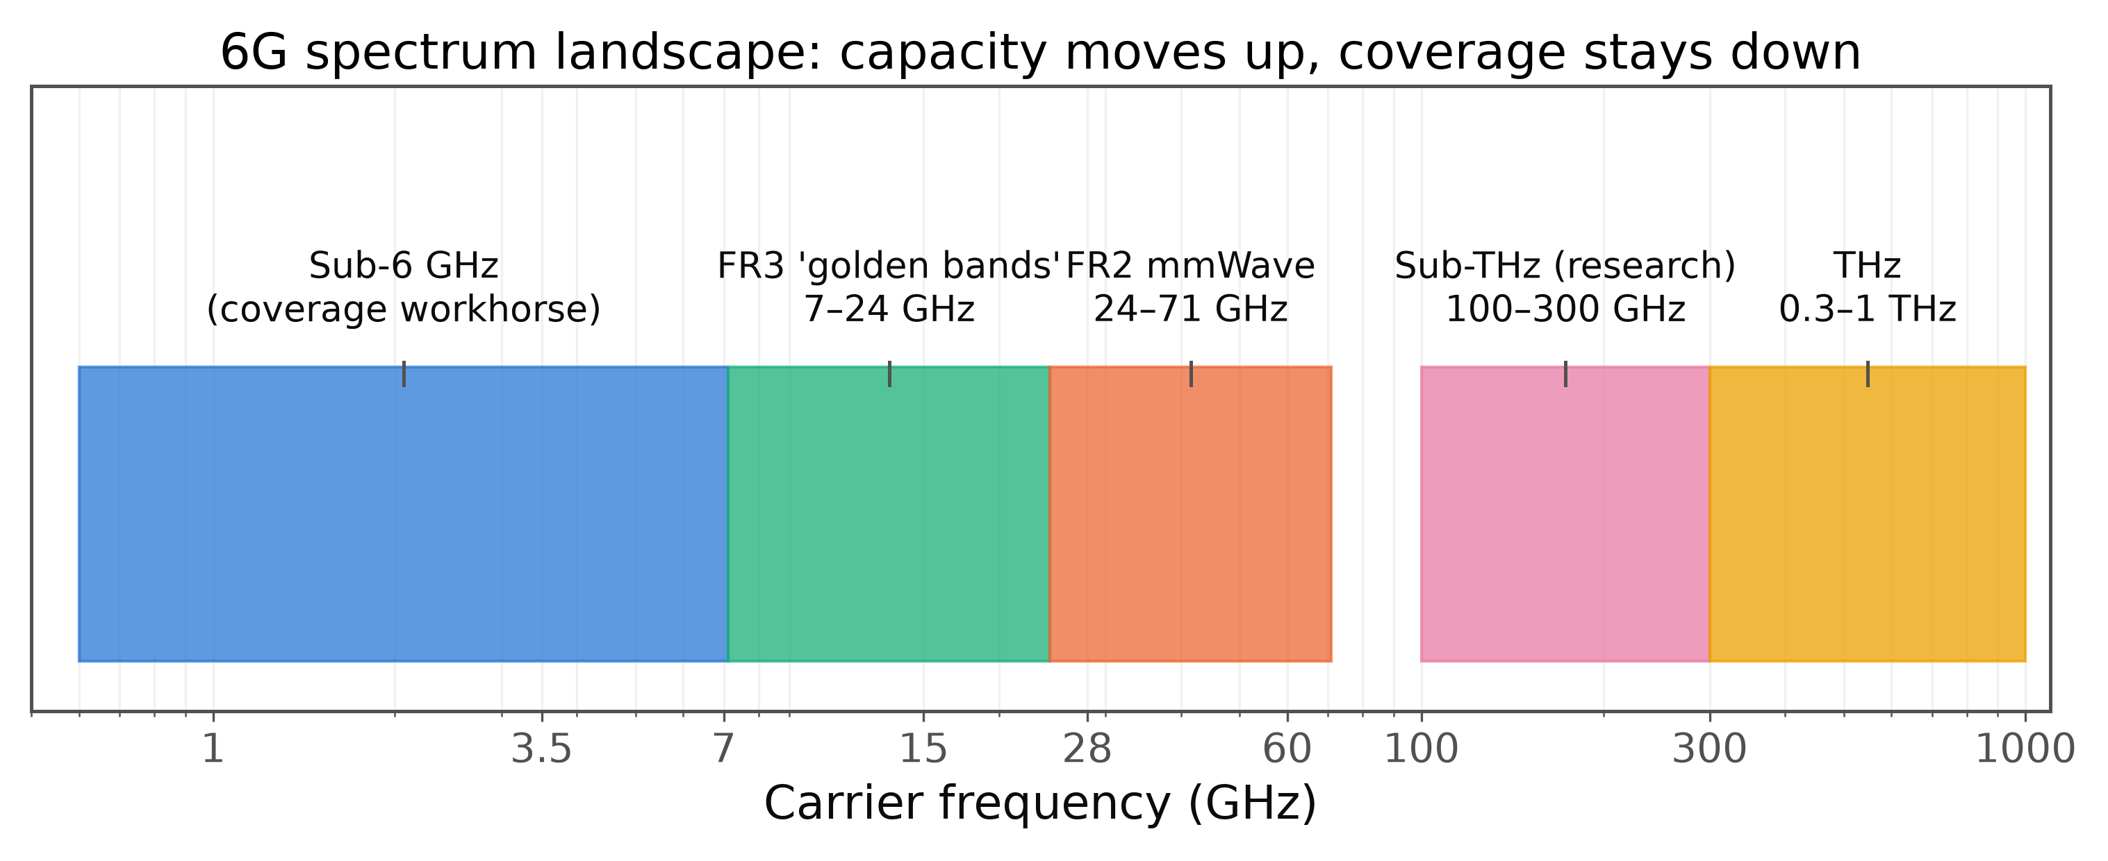
The 6G spectrum landscape
▸ Sub-6: coverage workhorse, congested • FR2 mmWave: deployed, niche
▸ FR3 (7–24 GHz): the pragmatic 6G capacity band; WRC-23 identified new IMT bands (region-dependent)
▸ Sub-THz 100–300 GHz: the research frontier
8 / 86
Notes:
Orient on the log axis. 6G is NOT just THz — first commercial 6G capacity most likely comes from FR3. Keep sub-THz honest: research frontier, short links.

Slide 9
FR3 / upper mid-band: the pragmatic 6G band
▸ 7–15 GHz: 2–4× more bandwidth than C-band with manageable path loss
▸ Same aperture → 4–9× more elements than at 3.5 GHz: massive MIMO scales naturally
▸ Coexistence with satellite/radar incumbents → sharing and sensing
▸ DSP price: beam squint, calibration, channel-estimation burden
9 / 86
Notes:
Operators love FR3: reuse the macro grid. Element count scales with wavelength, so the same panel holds an order of magnitude more elements. Foreshadows Section 4.

Slide 10
mmWave: what a decade taught us
▸ FR2 works — but blockage (hand/body 10–25 dB), dense small cells, beam-management overhead limited rollout
▸ Killer app became fixed wireless access, not mobility
▸ Lesson 1: link-budget math wins arguments
▸ Lesson 2: beam training overhead is a rate tax
10 / 86
Notes:
mmWave is not a failure, a recalibration. The two lessons are design constraints for everything that follows; sub-THz inherits both, amplified. A hand on the phone can erase 20 dB.

Slide 11
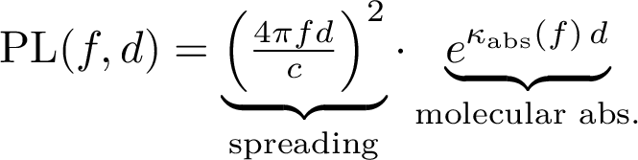
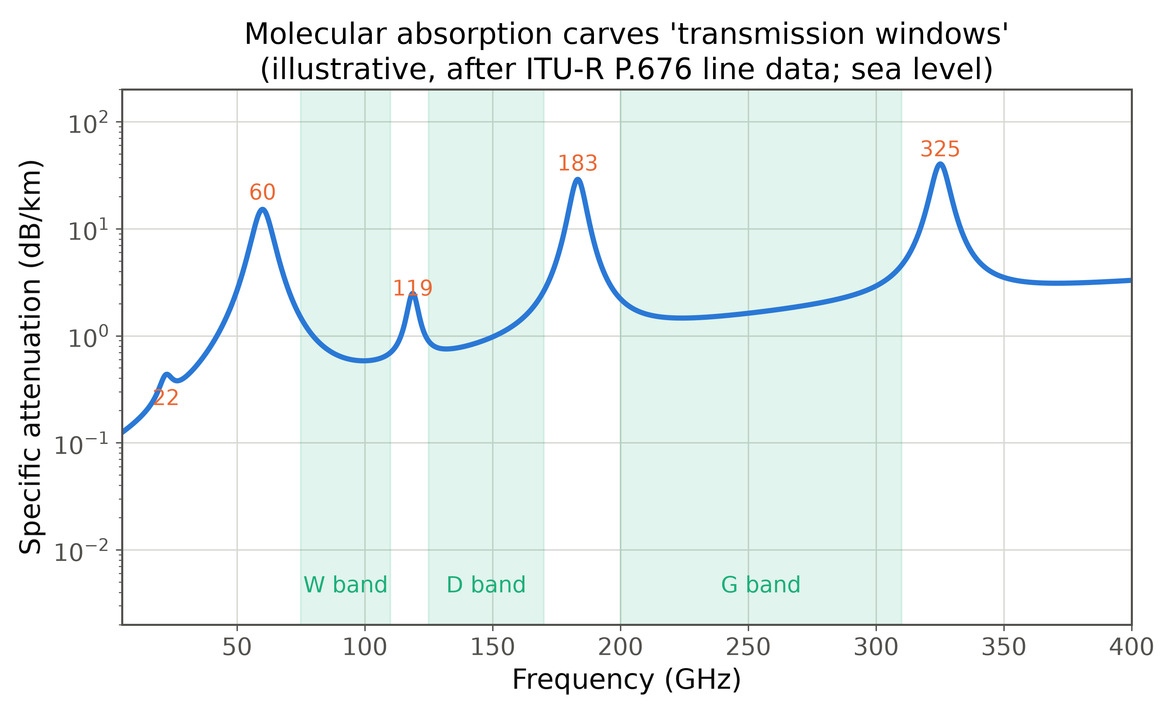
Sub-THz channels: 100–300 GHz
▸ O₂/H₂O resonances at 60, 119, 183, 325 GHz carve transmission windows
▸ Channel: sparse, specular, LoS-dominated
▸ Consequences: short links, pencil beams mandatory
11 / 86
Notes:
One equation to remember: spreading grows with f² at fixed aperture, and the exponential absorption term is frequency-selective. W/D/G windows are where sub-THz will live. Sparsity is good news for compressed sensing later.

Slide 12
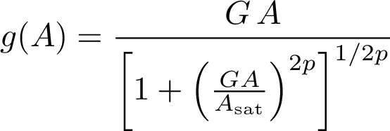
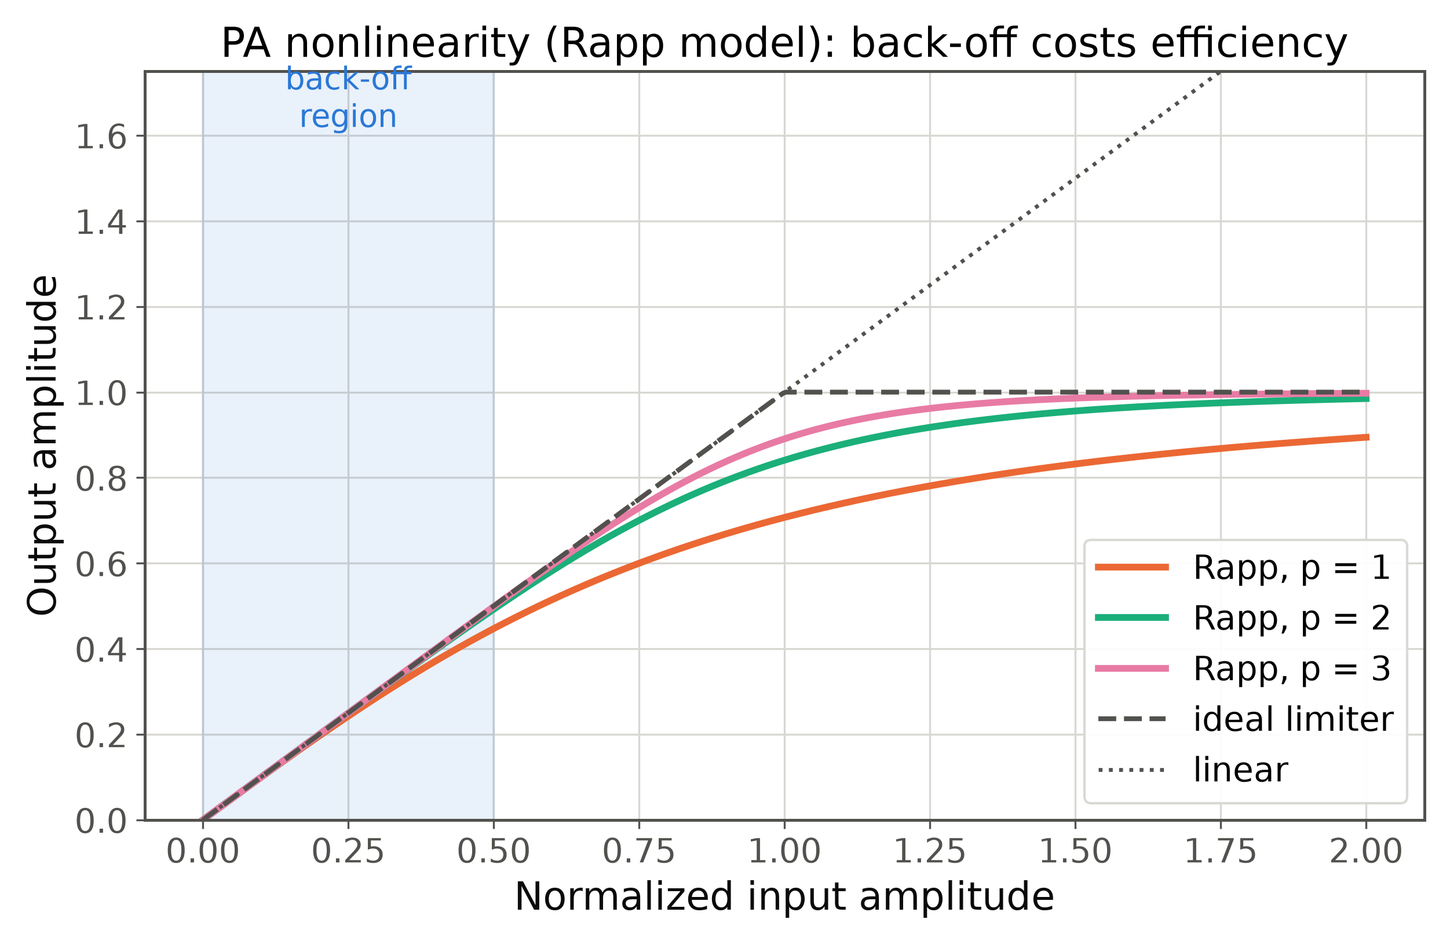
Hardware impairments dominate at high bands
▸ PA efficiency falls with f; back-off → PAPR is a first-class metric
▸ Phase noise power ∝ f_c²; low-resolution ADCs to save power
12 / 86
Notes:
'Dirty RF' mindset: at 140 GHz the waveform must be designed FOR the hardware. Two knobs: PAPR (PA back-off, coverage) and phase-noise robustness (subcarrier spacing / single-carrier). Bridge to waveforms.

Slide 13
Implications for waveform design
Requirement | sub-6 | FR3 | mmWave | sub-THz
Low PAPR | nice | nice | want | NEED
Phase-noise robustness | — | — | want | NEED
Doppler robustness | HST | HST | want | want
Spectral confinement | want | want | nice | nice
MIMO compatibility | NEED | NEED | NEED | want
▸ No single waveform wins every column → expect scenario-dependent waveform choices
▸ CP-OFDM's weak spots are exactly the columns that harden at high bands
13 / 86
Notes:
Read column-wise: the further right, the more requirements shift toward PAPR and phase noise, where OFDM is weakest. Transition to Section 3.

Slide 14
3
Waveforms Beyond OFDM
Notes:
Section transition — Waveforms Beyond OFDM. Pause, re-orient the audience, then move into the first slide.

Slide 15
CP-OFDM recap: why it won 4G and 5G
▸ One FFT turns a frequency-selective channel into N flat channels
▸ MIMO-friendly, flexible numerology, gigantic ecosystem
▸ Hidden assumption: channel constant over one symbol (quasi-static)
▸ That assumption is what high mobility and high carriers break
15 / 86
Notes:
Refresher framed as 'what did we sign up for?' The CP-makes-it-circular trick is the whole magic; it costs 7–25% overhead. The one-tap equalizer only exists if the channel sits still for a symbol.

Slide 16
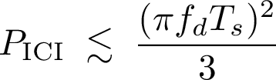
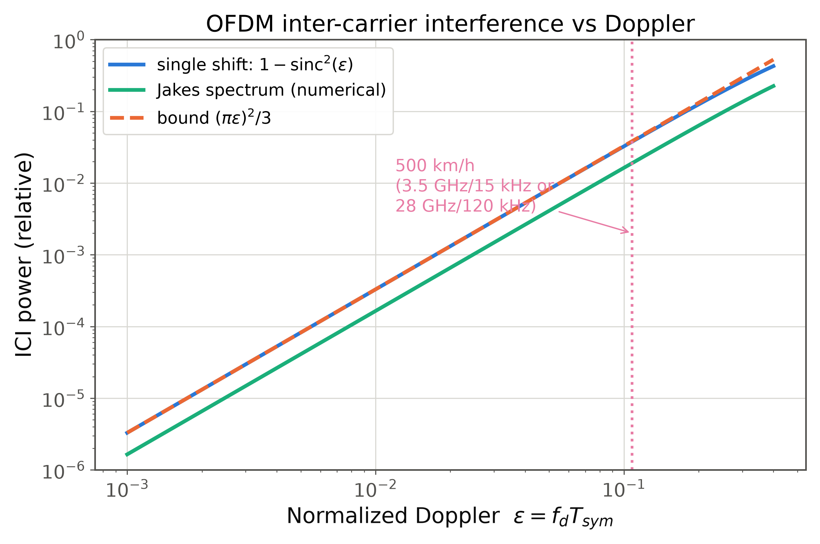
Where OFDM breaks: high Doppler, high bands
▸ Doppler spread destroys orthogonality → ICI
▸ 500 km/h at 28 GHz: f_d ≈ 13 kHz (ε ≈ 0.11)
▸ PAPR ~10–12 dB → PA back-off, worst fit for THz PAs
▸ Phase noise adds CPE + ICI on top
16 / 86
Notes:
ICI grows with the square of normalized Doppler; the pink marker is the 500 km/h working point — an SINR ceiling near 17 dB no matter the power. That ceiling becomes the BER floor in Demo 1.

Slide 17
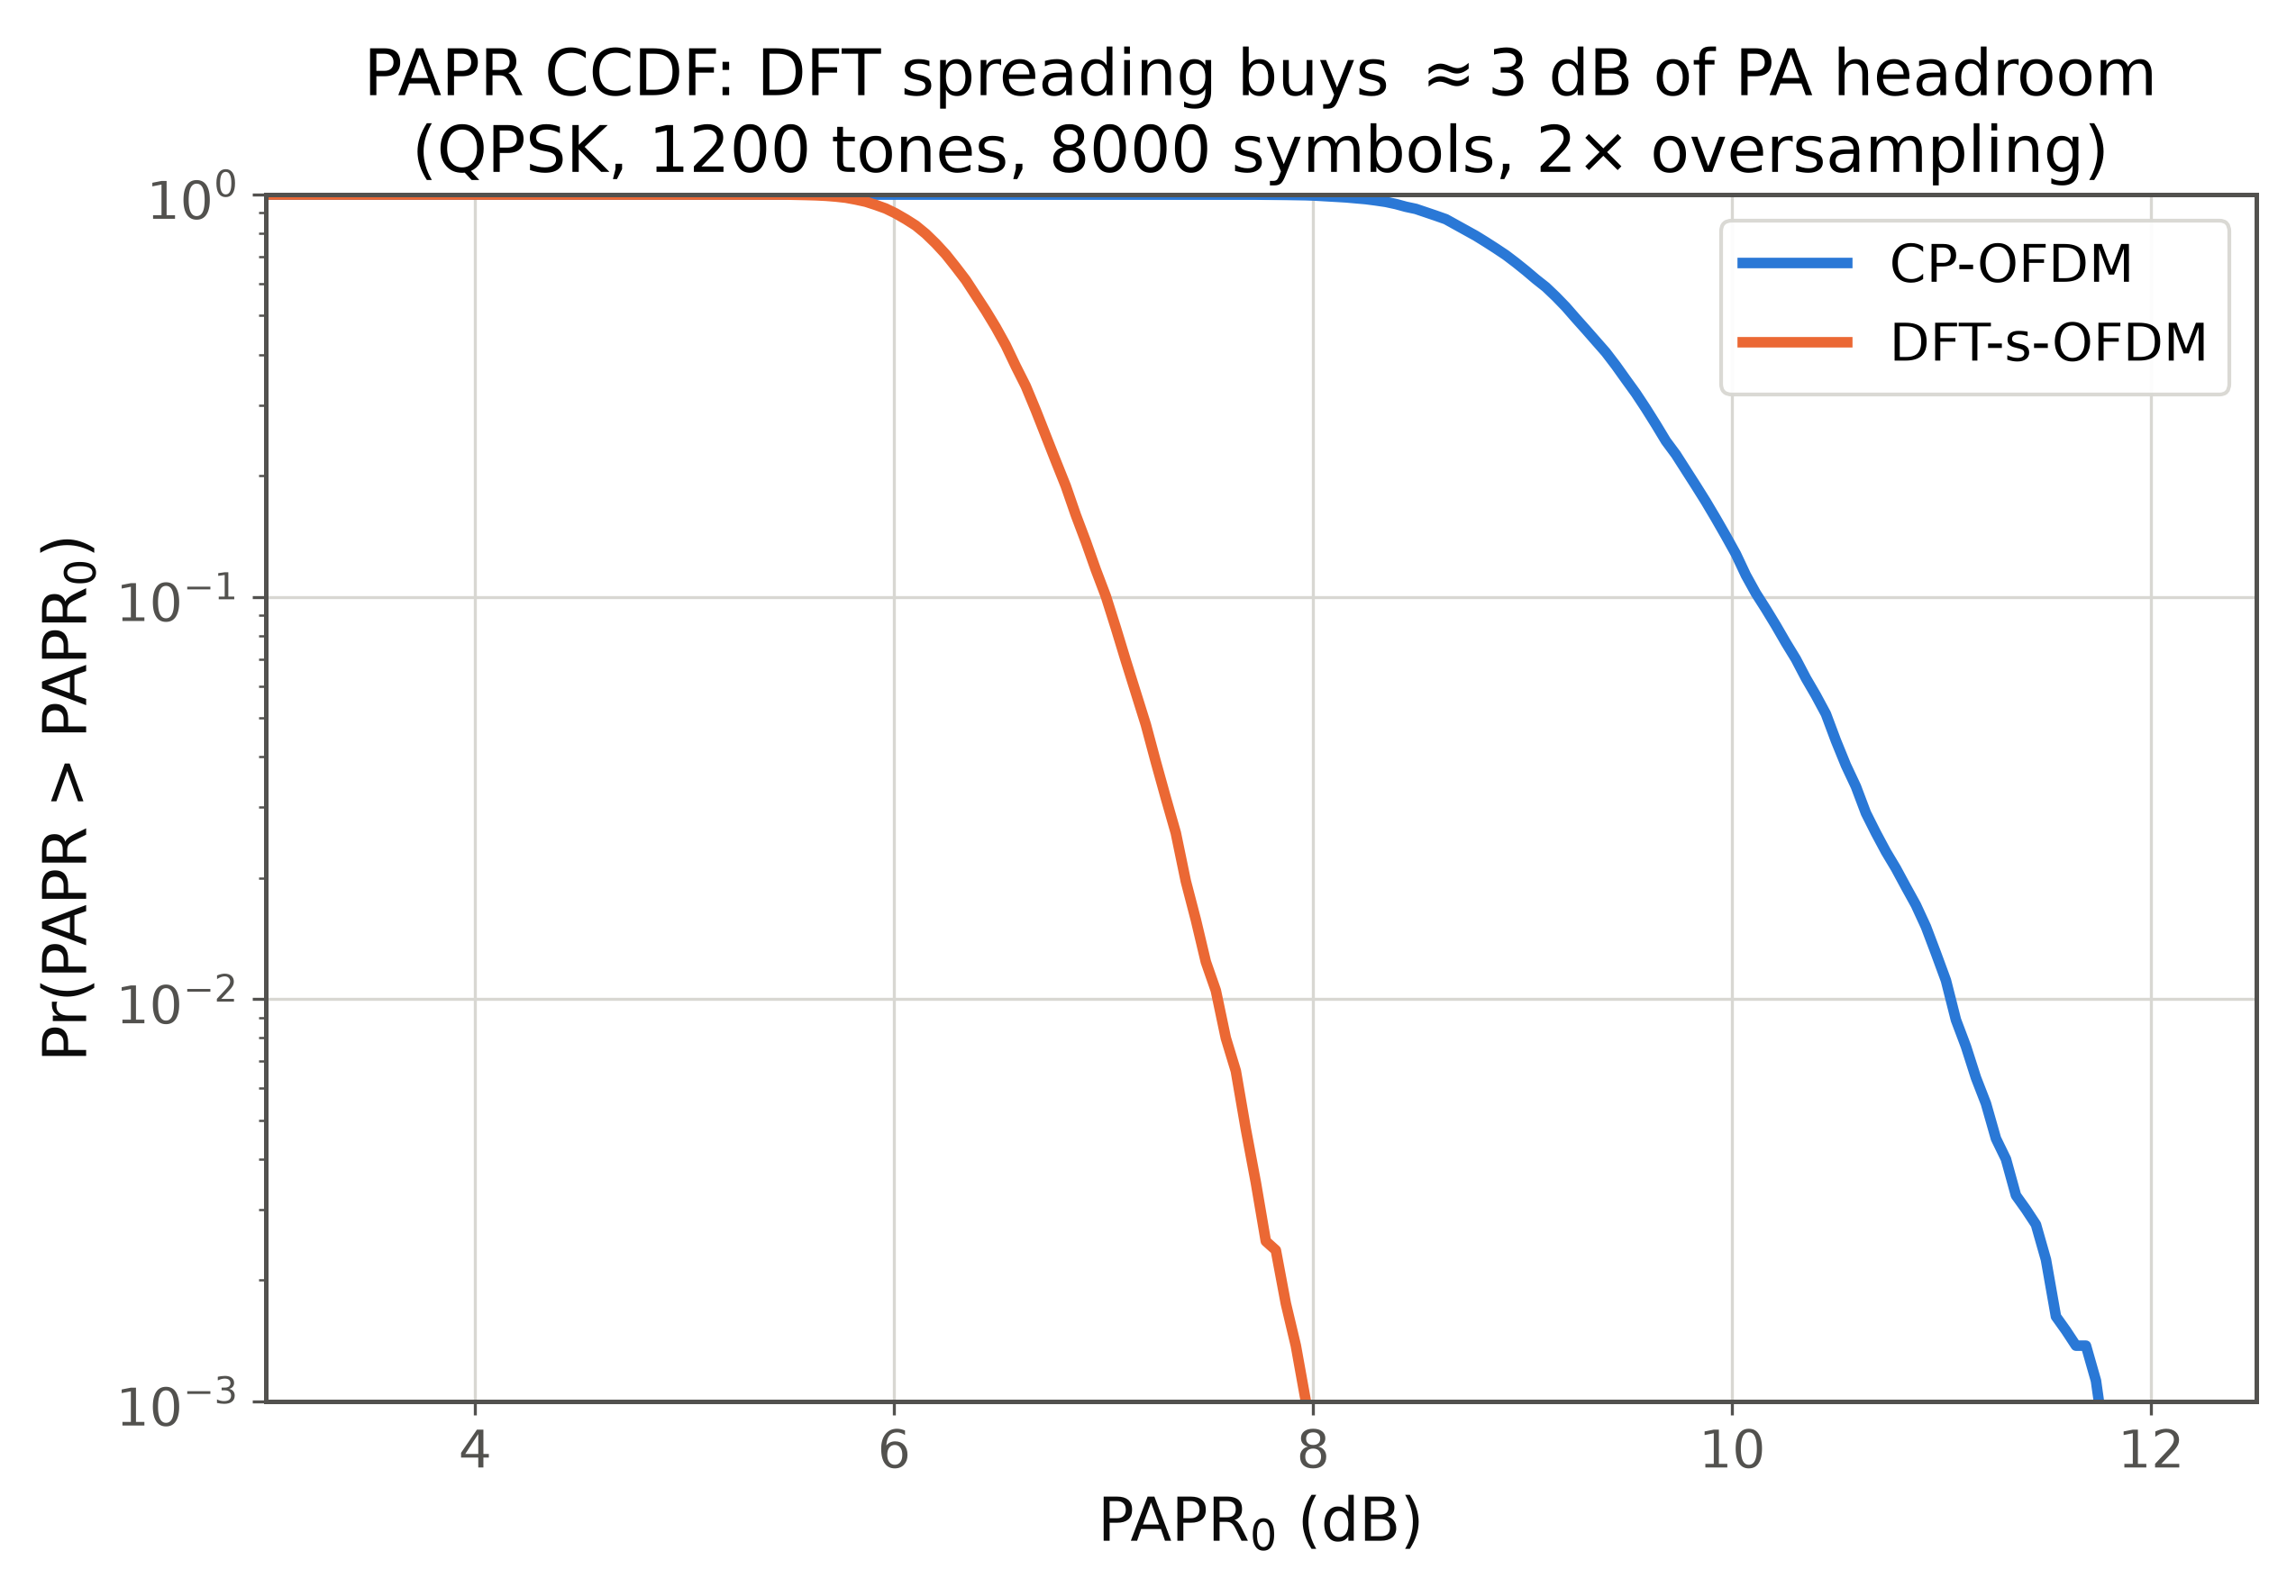
DFT-s-OFDM and the single-carrier comeback
▸ Quasi single-carrier envelope: ~3 dB PAPR advantage
▸ Already the 5G uplink workhorse — proven at scale
▸ Sub-THz proposals: SC-FDE; equalizer complexity moves to RX
▸ Leading candidate for 6G high bands
17 / 86
Notes:
CCDF plot is simulated (QPSK, 1200 tones). ~3 dB less back-off translates almost 1:1 into transmit power and link range at THz. The single-carrier vs multicarrier war is back.

Slide 18
Filtered multicarrier: lessons of the 5G bake-off
▸ Candidates c.2016: FBMC, UFMC, GFDM, f-OFDM — better spectral confinement, relaxed synchronicity
▸ Why they lost: MIMO integration pain, complexity, marginal gains after windowing
▸ What survived: spectral shaping as a TX implementation choice
▸ Meta-lesson: ecosystem inertia is a design constraint — radical waveforms need radical gains
18 / 86
Notes:
Flex slide — compress to 20 s if behind (say only the meta-lesson). OTFS/AFDM must enable something OFDM fundamentally cannot: the high-Doppler regime, not just a prettier PSD.

Slide 19
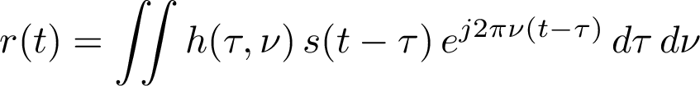
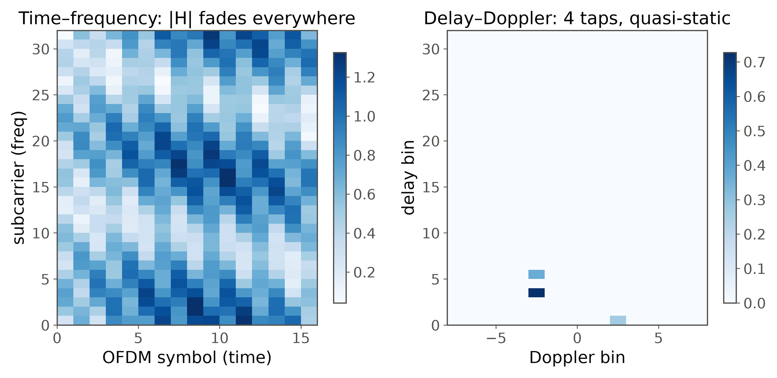
OTFS I: thinking in delay–Doppler
▸ In delay–Doppler the channel is sparse and quasi-static: a few (τ,ν) taps = physical reflectors with range & velocity
▸ Each DD symbol rides the entire TF channel → full-diversity potential
19 / 86
Notes:
Domain-change story with our own simulation: left, TF response (fading everywhere); right, the SAME channel in DD (a few still taps). TF is the weather; DD is the map of what causes it.

Slide 20
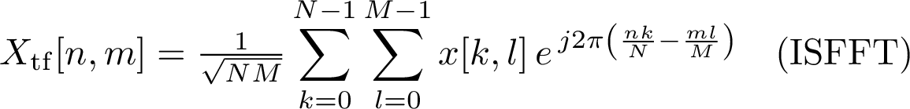
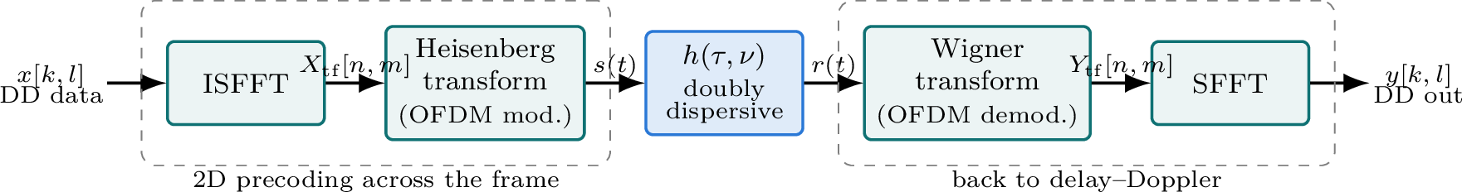
OTFS II: transceiver structure
▸ OTFS = 2D pre/post-processing around an OFDM modem → attractive migration path
20 / 86
Notes:
Walk the chain: ISFFT spreads every DD symbol over the whole TF frame; Heisenberg transform is the OFDM modulator in disguise; RX undoes both. No exotic hardware, an extra 2D FFT pair. Pilots: a single DD impulse with a guard box sounds the whole channel.

Slide 21
OTFS III: input–output relation and detection
▸ A 2D twisted circular convolution: each tap shifts data in delay and Doppler and adds a phase
▸ Sparsity → message-passing / low-complexity MMSE detectors
▸ Costs: frame-level latency, detection complexity, fractional-Doppler leakage
▸ Honest status: rich literature, strong results — not yet in 3GPP normative work
21 / 86
Notes:
OFDM's one-tap story upgraded to 2D: a small set of shifts of the whole grid. Detection is where OTFS pays its bill. Keep the standards status honest; it pays off in Q&A.

Slide 22
AFDM: the chirp-based challenger
▸ Multiplex on chirps; tune c₁ to the Doppler span → all paths separate in the DAFT domain
▸ Full diversity with 1D single-symbol processing (vs OTFS frame-level)
▸ FFT-based implementation; rising fast since 2023
▸ Open: MIMO integration, pilot design, robustness at scale
22 / 86
Notes:
AFDM gets OTFS-like diversity with lower latency because it works symbol-by-symbol. The chirp parameter is matched to max Doppler — channel-aware basis design. Keep-sentence: same benefit, smaller transceiver reorganization.

Slide 23
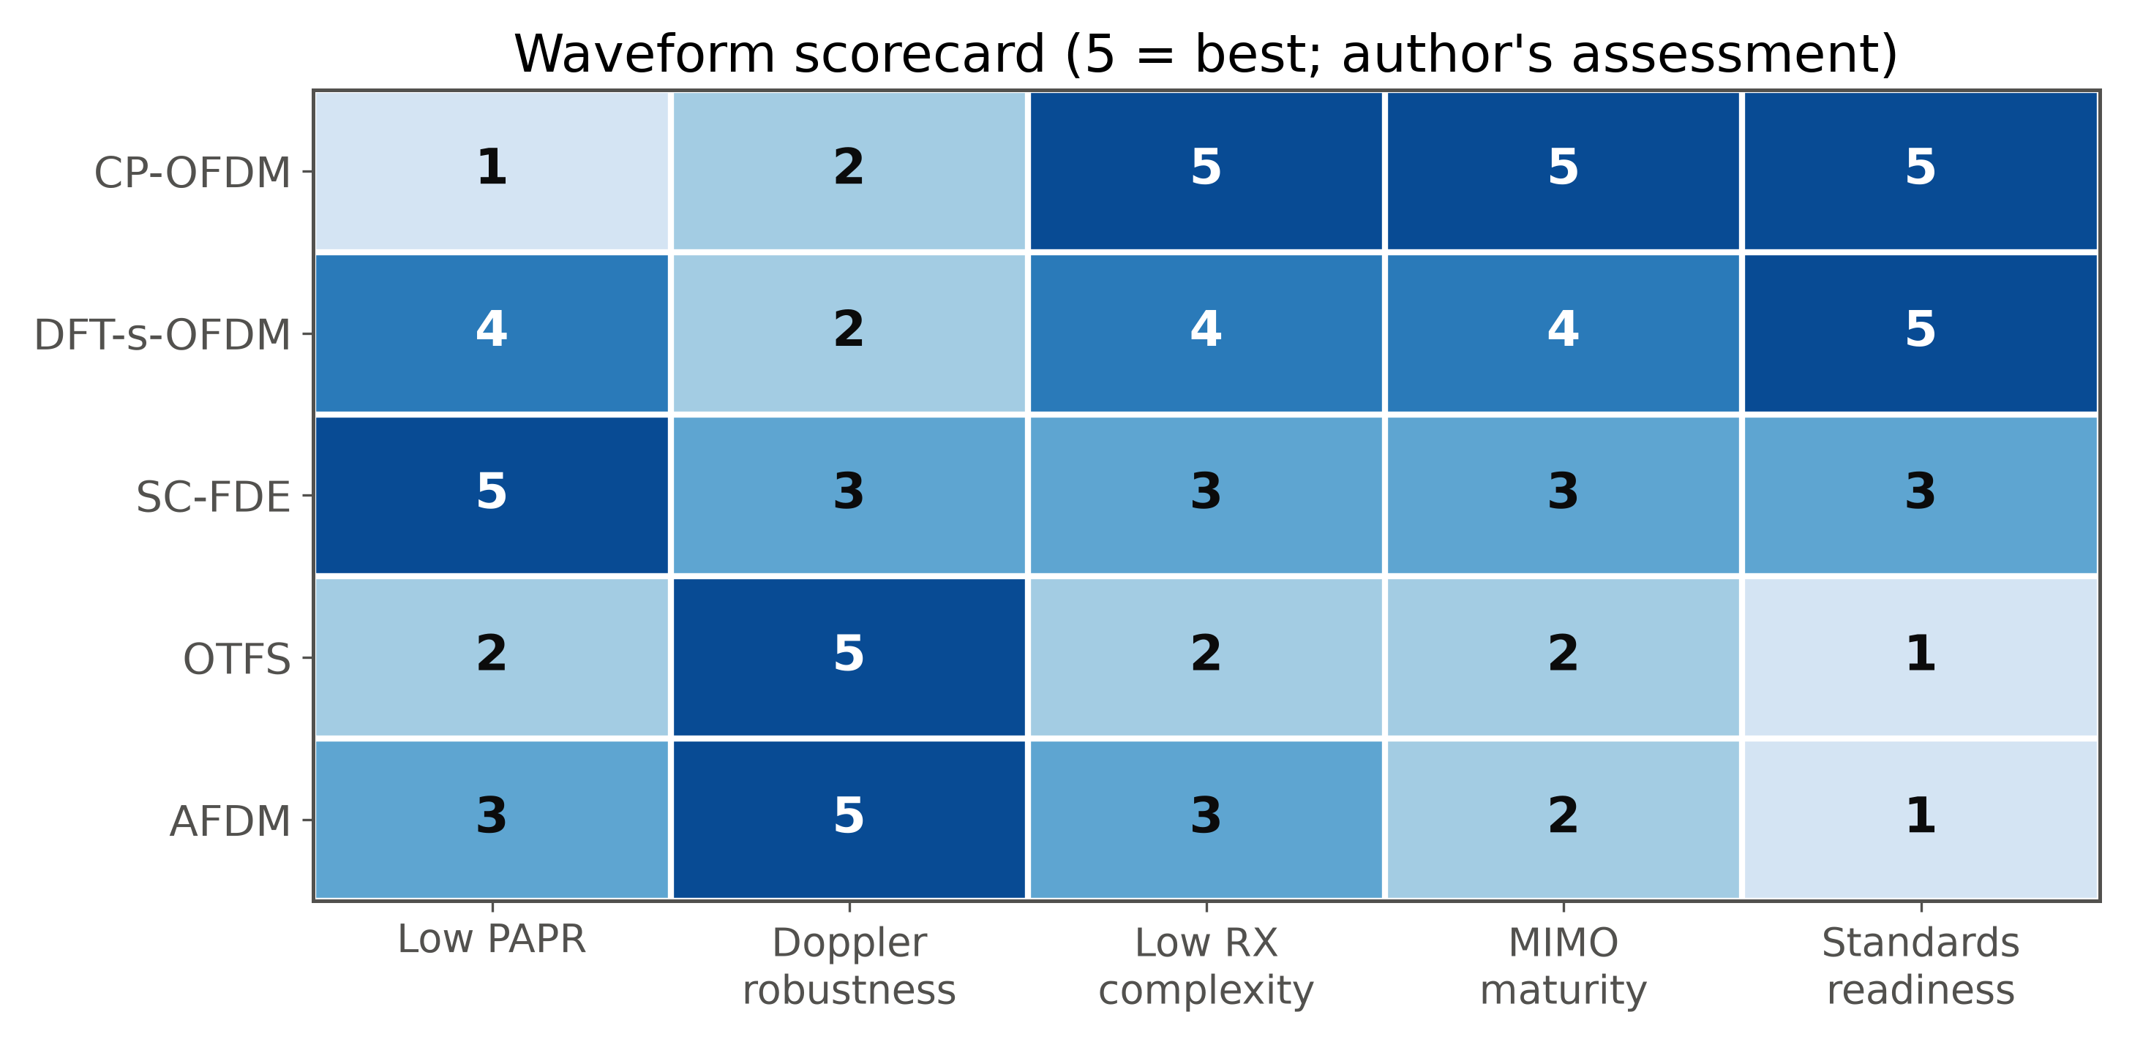
Waveform scorecard
▶ Live Demo 1 (3.5 min): OFDM vs OTFS at 500 km/h — watch the BER floor appear. [matlab/demo1_ofdm_vs_otfs]
23 / 86
Notes:
OFDM keeps the low-mobility mainstream; DD-domain waveforms own high mobility and pair with sensing. THEN SWITCH TO MATLAB. Recall the ICI ceiling, predict the floor, let the plot confirm. Expected: OFDM floors ~3e-2, OTFS falls past 1e-4. Fail → backup A1. Done by 0:26:30.

Slide 24
4
Ultra-Massive MIMO & Beamforming
Notes:
Section transition — Ultra-Massive MIMO & Beamforming. Pause, re-orient the audience, then move into the first slide.

Slide 25
From massive to ultra-massive
▸ 5G: 64 TRX at 3.5 GHz → 6G: 512–4096 elements at FR3/mmWave/sub-THz
▸ Same aperture at higher f → more elements, narrower beams, more EIRP
▸ New physics: near-field propagation, spatial non-stationarity
▸ The bill: RF chains, ADCs, calibration, fronthaul — DSP must economize
25 / 86
Notes:
Re-entry after Demo 1: from time-frequency games to space. Scaling is driven by aperture reuse. Every gain has a hardware price; the DSP refuses to pay full retail.

Slide 26
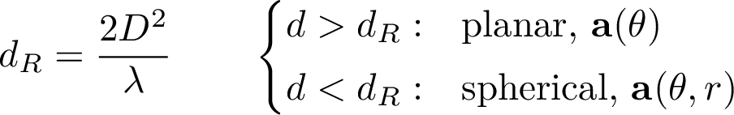
Near-field vs far-field
▸ D = 0.5 m at 30 GHz: d_R = 50 m — users are inside the near field
▸ Near field → beam focusing (range-selective!), not just steering
▸ Wavefront curvature carries range info — a gift for localization
26 / 86
Notes:
Everyone learned d_R once and forgot it because it used to be centimeters. Recompute live: half-meter array, 30 GHz, 50 m — the cell IS the near field. Beam focusing separates two users on the same bearing at different ranges: a new spatial DoF.

Slide 27
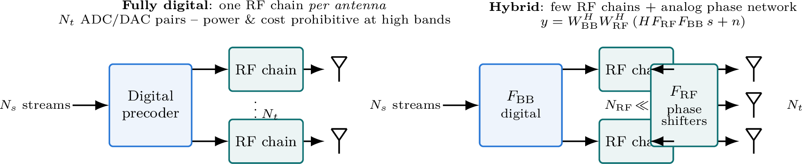
Hybrid analog–digital architectures
▸ Phase-only RF network; wideband arrays add true-time-delay units against beam squint
27 / 86
Notes:
Left: the fully digital ideal (an ADC/DAC pair per element, unaffordable at 1024). Right: the hybrid compromise — thin digital layer + cheap analog phases. The interesting constraint: RF entries are unit-modulus. Subarray variant trades gain for phase-shifter count.

Slide 28
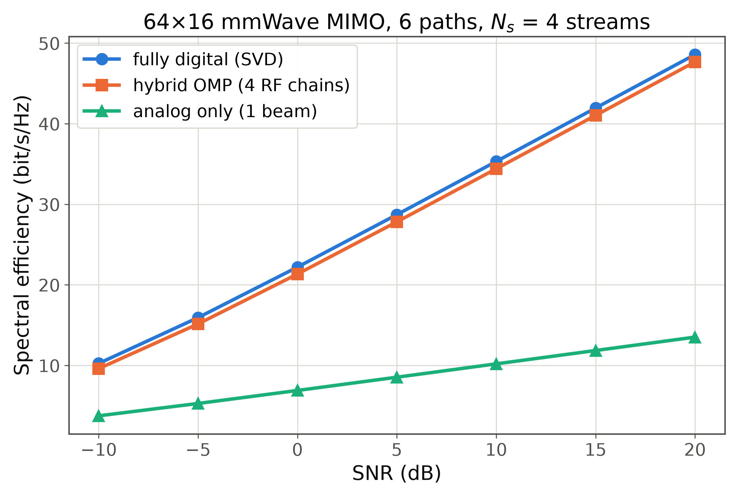
Designing the hybrid precoder: sparsity to the rescue
▸ mmWave channels sparse in angle → precoding ≈ sparse reconstruction → OMP (El Ayach et al. 2014)
▸ N_RF ≈ N_s chains already ≈ near-digital performance
28 / 86
Notes:
Curves are our own simulation (Demo 2 code): 64×16, 6 paths, 4 streams — 4-RF-chain OMP hybrid within a fraction of a bit of fully digital. The channel only has ~6 directions worth talking to.

Slide 29
Beam management: finding the needle
▸ 5G NR baseline: SSB sweep → CSI-RS refinement → tracking & recovery
▸ Overhead grows with codebook size → hierarchical search, ML prediction
▸ Sub-THz pencil beams: mobility and micro-blockage stress the loop
▸ Research: side-information beams (position, vision, radar), near-field codebooks (angle × range)
29 / 86
Notes:
Beam management is where array theory meets protocol reality: every training symbol is a symbol not carrying data (mmWave Lesson 2). The 6G twist: near-field codebooks sample angle AND range.

Slide 30
Cell-free massive MIMO
▸ Many distributed low-cost APs, coherent joint processing, no cells
▸ Uniform SNR replaces cell-edge misery; macro-diversity beats blockage
▸ Catches: fronthaul, synchronization, scalable processing (DCC)
▸ 6G angle: natural platform for distributed sensing and RIS integration
30 / 86
Notes:
Pitch: instead of a few big towers owning users, many small APs serve everyone. The 90-percentile user wins. Research lives in the 'catches': scalable combining and phase sync over fronthaul.

Slide 31
Channel estimation by compressed sensing
▸ Angular sparsity (L paths) → recovery from O(L log N) pilots via OMP/AMP
▸ Pilot savings make 1024-element arrays trainable at all
▸ Caveats: grid mismatch (off-grid), near-field dictionaries grow
▸ Same math returns in Section 8 for activity detection
31 / 86
Notes:
Connect to S9: physics gave sparsity, CS cashes it in. 64 paths of unknowns in a 1024-vector need a few hundred, not a few thousand, measurements. Off-grid is a good student-project generator.

Slide 32
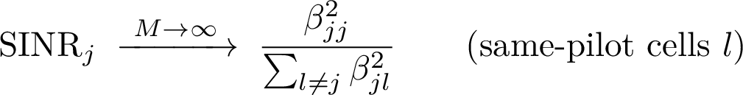
Pilot contamination
▸ Pilot reuse → correlated estimates → coherent interference that does NOT average out with more antennas
▸ Modern view (Björnson et al.): with multi-cell MMSE + spatial correlation, capacity grows without bound — a processing artifact
▸ Mitigations: pilot assignment, correlation-aware estimation, cell-free
32 / 86
Notes:
Two-act story: 2010 the asymptotic ceiling (most-cited limit); 2018 the ceiling dissolves under MMSE with unequal spatial correlations. 'Fundamental limits' sometimes encode assumptions; better DSP removes them.

Slide 33
Array frontier: open challenges
▸ Wideband beam squint at 10%+ fractional bandwidth: TTD-augmented hybrids
▸ Near-field CSI: dimensionality, codebooks, tracking
▸ Spatial non-stationarity: subarrays see different channels
▸ The honest metric: energy per beamformed bit, not array gain
▶ Live Demo 2 (3.5 min): 64-element array — steer the beam with a slider; digital vs OMP-hybrid SE. [matlab/demo2_hybrid_beamforming]
33 / 86
Notes:
Quick pass, then SWITCH TO MATLAB. Move the slider, the beam follows; grating-lobe moment beyond 60°. Then the SE bars: 4 chains vs 64. Fail → backup A2. Done by 0:40.

Slide 34
5
Reconfigurable Intelligent Surfaces
Notes:
Section transition — Reconfigurable Intelligent Surfaces. Pause, re-orient the audience, then move into the first slide.

Slide 35
RIS: programming the channel itself
▸ Passive metasurface, N tunable elements adding a controllable reflection phase; steered by a low-rate control link
▸ Paradigm shift: the channel becomes a design variable
35 / 86
Notes:
For a century the channel was fate — estimate and adapt. A RIS makes part of the environment a design variable: hundreds of passive elements, each adding a controllable phase. No PAs, no ADCs on the panel.

Slide 36
The cascaded channel model
▸ Product path loss ∝ (d₁ d₂)^(−α): the fundamental tax of passivity
▸ Estimation burden: cascaded coefficients scale as N×M; structure helps
▸ Large N at short range → the RIS itself operates in the near field
36 / 86
Notes:
Deceptively simple; two hard truths under it: dyadic path loss (why placement matters) and the estimation burden (the panel has no receivers). Both are active research veins.

Slide 37
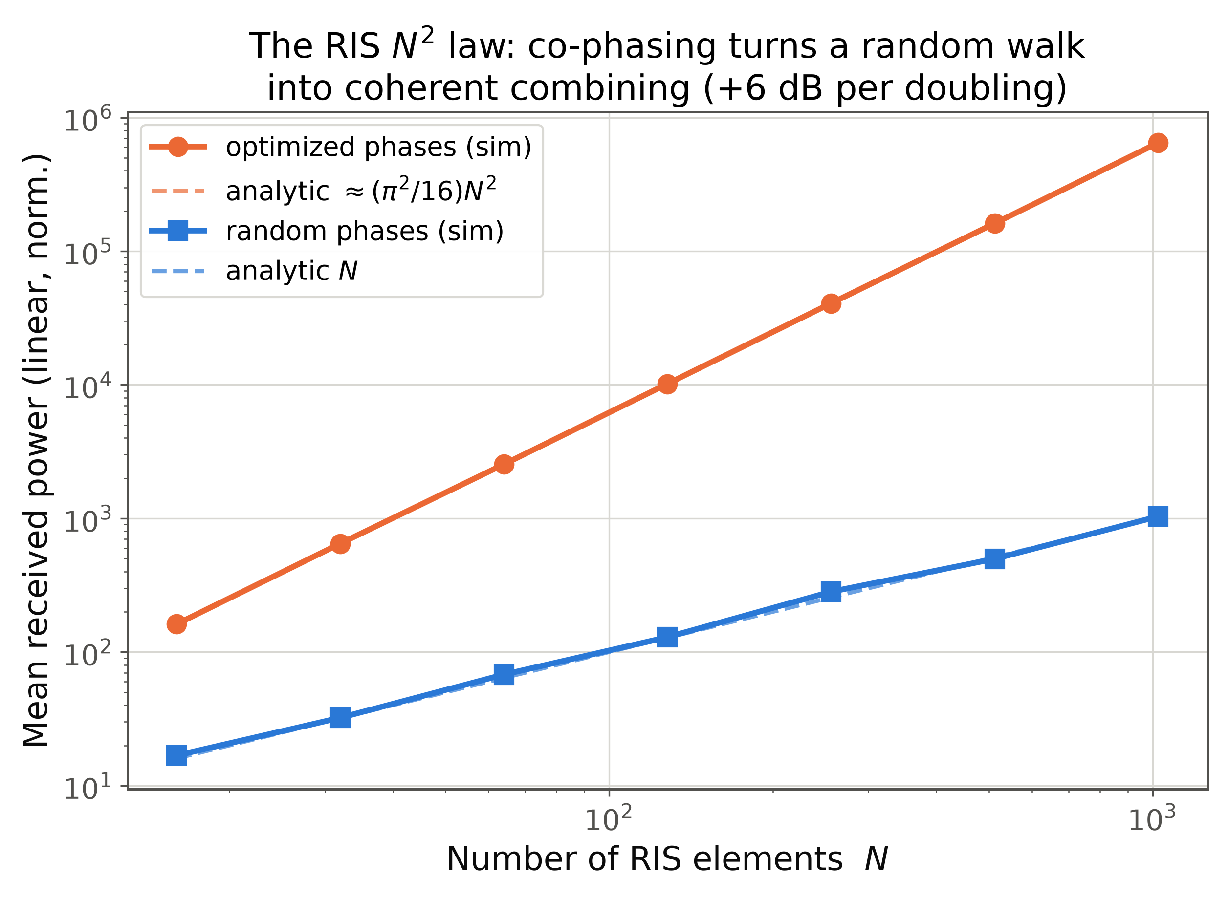
Phase optimization and the N² law
▸ Co-phasing: amplitude ∝ N → power ∝ N² (+6 dB per doubling)
▸ Random phases: 2D random walk → power ∝ N
▸ Multi-user/MIMO: non-convex → SDR, manifold, alternating optimization
37 / 86
Notes:
Derive in one breath: single-user SNR max separates per element; each element cancels its cascade phase. Plot has the analytic overlays: slopes 2.0 and 1.0. The N² rides on top of the dyadic loss — Demo 3.

Slide 38
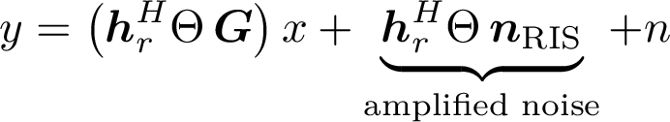
Active RIS and other variants
▸ Passive gain often eaten by dyadic loss → active RIS: amplification + an amplified-noise tax
▸ Variants: STAR-RIS (transmit + reflect), beyond-diagonal RIS, holographic surfaces
▸ The uncomfortable benchmark: does it beat a relay/small cell at equal cost/power?
38 / 86
Notes:
Keep it honest: add amplifiers and you must compare against a relay. Passive RIS shines where relays are impractical (facades, indoor panels). STAR-RIS: serve both sides of the surface.

Slide 39
Deployment: where RIS actually helps
▸ Sweet spots: mmWave/sub-THz blockage bypass, indoor dead zones, localized capacity boosts
▸ Placement rule: near TX or near RX — mid-path maximizes dyadic loss
▸ Overheads that gate practicality: channel estimation and control link, both scaling with N
▸ Field trials encouraging; standardization pre-normative
39 / 86
Notes:
Dyadic intuition: (d₁ d₂) is minimized at the ends — put the mirror next to the lamp or the book, not halfway. Estimation with almost no observations is a beautiful problem.

Slide 40
RIS: open problems
▸ CSI acquisition with no RF chains on the panel
▸ Wideband behavior: one phase per element, many subcarriers
▸ EM-consistent models: mutual coupling, non-ideal reflection
▸ RIS-aided sensing and localization: surfaces as programmable landmarks
▶ Live Demo 3 (2.5 min): the N² law — SNR gain from 16 to 1024 elements, random vs optimized phases. [matlab/demo3_ris_gain]
40 / 86
Notes:
Rapid-fire, then MATLAB. Demo 3 is the shortest: the two scaling lines draw themselves; ask the audience to call the slope difference (2 vs 1). Fail → backup A3. Done by ~0:48:30.

Slide 41
6
Integrated Sensing & Communication
Notes:
Section transition — Integrated Sensing & Communication. Pause, re-orient the audience, then move into the first slide.

Slide 42
Why ISAC
▸ One spectrum, one infrastructure, two functions: comm + radar-style sensing
▸ Drivers: spectrum scarcity; a dense grid is a ready-made sensor network; XR/V2X/drones need perception
▸ IMT-2030 lists ISAC as a defining scenario — not an add-on
▸ Economic pitch: sensing for free on waveforms you already transmit
42 / 86
Notes:
From programming the channel to reading it. The cellular network grows a sense of sight: every BS already illuminates the scene. The regulatory angle (spectrum reuse) is what makes operators care.

Slide 43
Radar refresher in one slide
▸ Bandwidth buys range resolution; coherent time buys velocity resolution
▸ Matched filtering + coherent integration = the SNR workhorses
▸ All classic DSP — 6G reuses it wholesale, on comm hardware
43 / 86
Notes:
Calibration slide: four formulas, no magic. For our demo: 30 MHz → 5 m range resolution; ~9 ms of symbols at 28 GHz → ~5 m/s velocity resolution. Demo 4 will print exactly these.

Slide 44
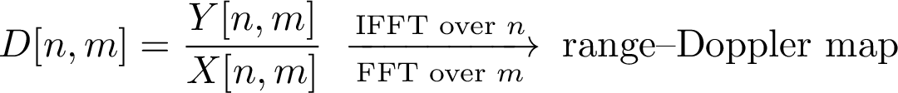
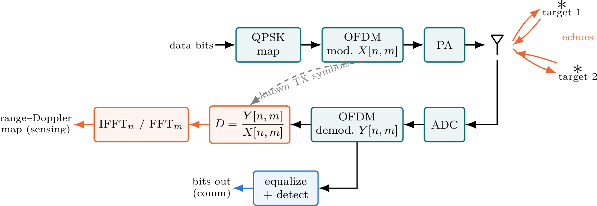
OFDM as a radar waveform
44 / 86
Notes:
The Sturm–Wiesbeck trick: the RX knows the transmitted grid X (it is the payload!), so element-wise division leaves pure channel; IFFT over subcarriers gives delay, FFT over symbols gives Doppler. One frame, two products.

Slide 45
Joint waveform design
▸ Design axes: power/subcarrier allocation, dedicated sensing symbols vs data reuse, beampattern shaping
▸ Inherent friction: comm wants randomness (capacity), radar wants determinism (clean ambiguity function)
▸ Recent theory: the 'random-data radar' penalty is quantifiable — often acceptably small
▸ Sensing-assisted comm: radar tracks feed beam prediction
45 / 86
Notes:
The philosophical core: cleanest radar waveforms are deterministic chirps; best comm signals are maximum-entropy noise. Joint design negotiates between them. The reverse (sensing helps comm) may ship first.

Slide 46
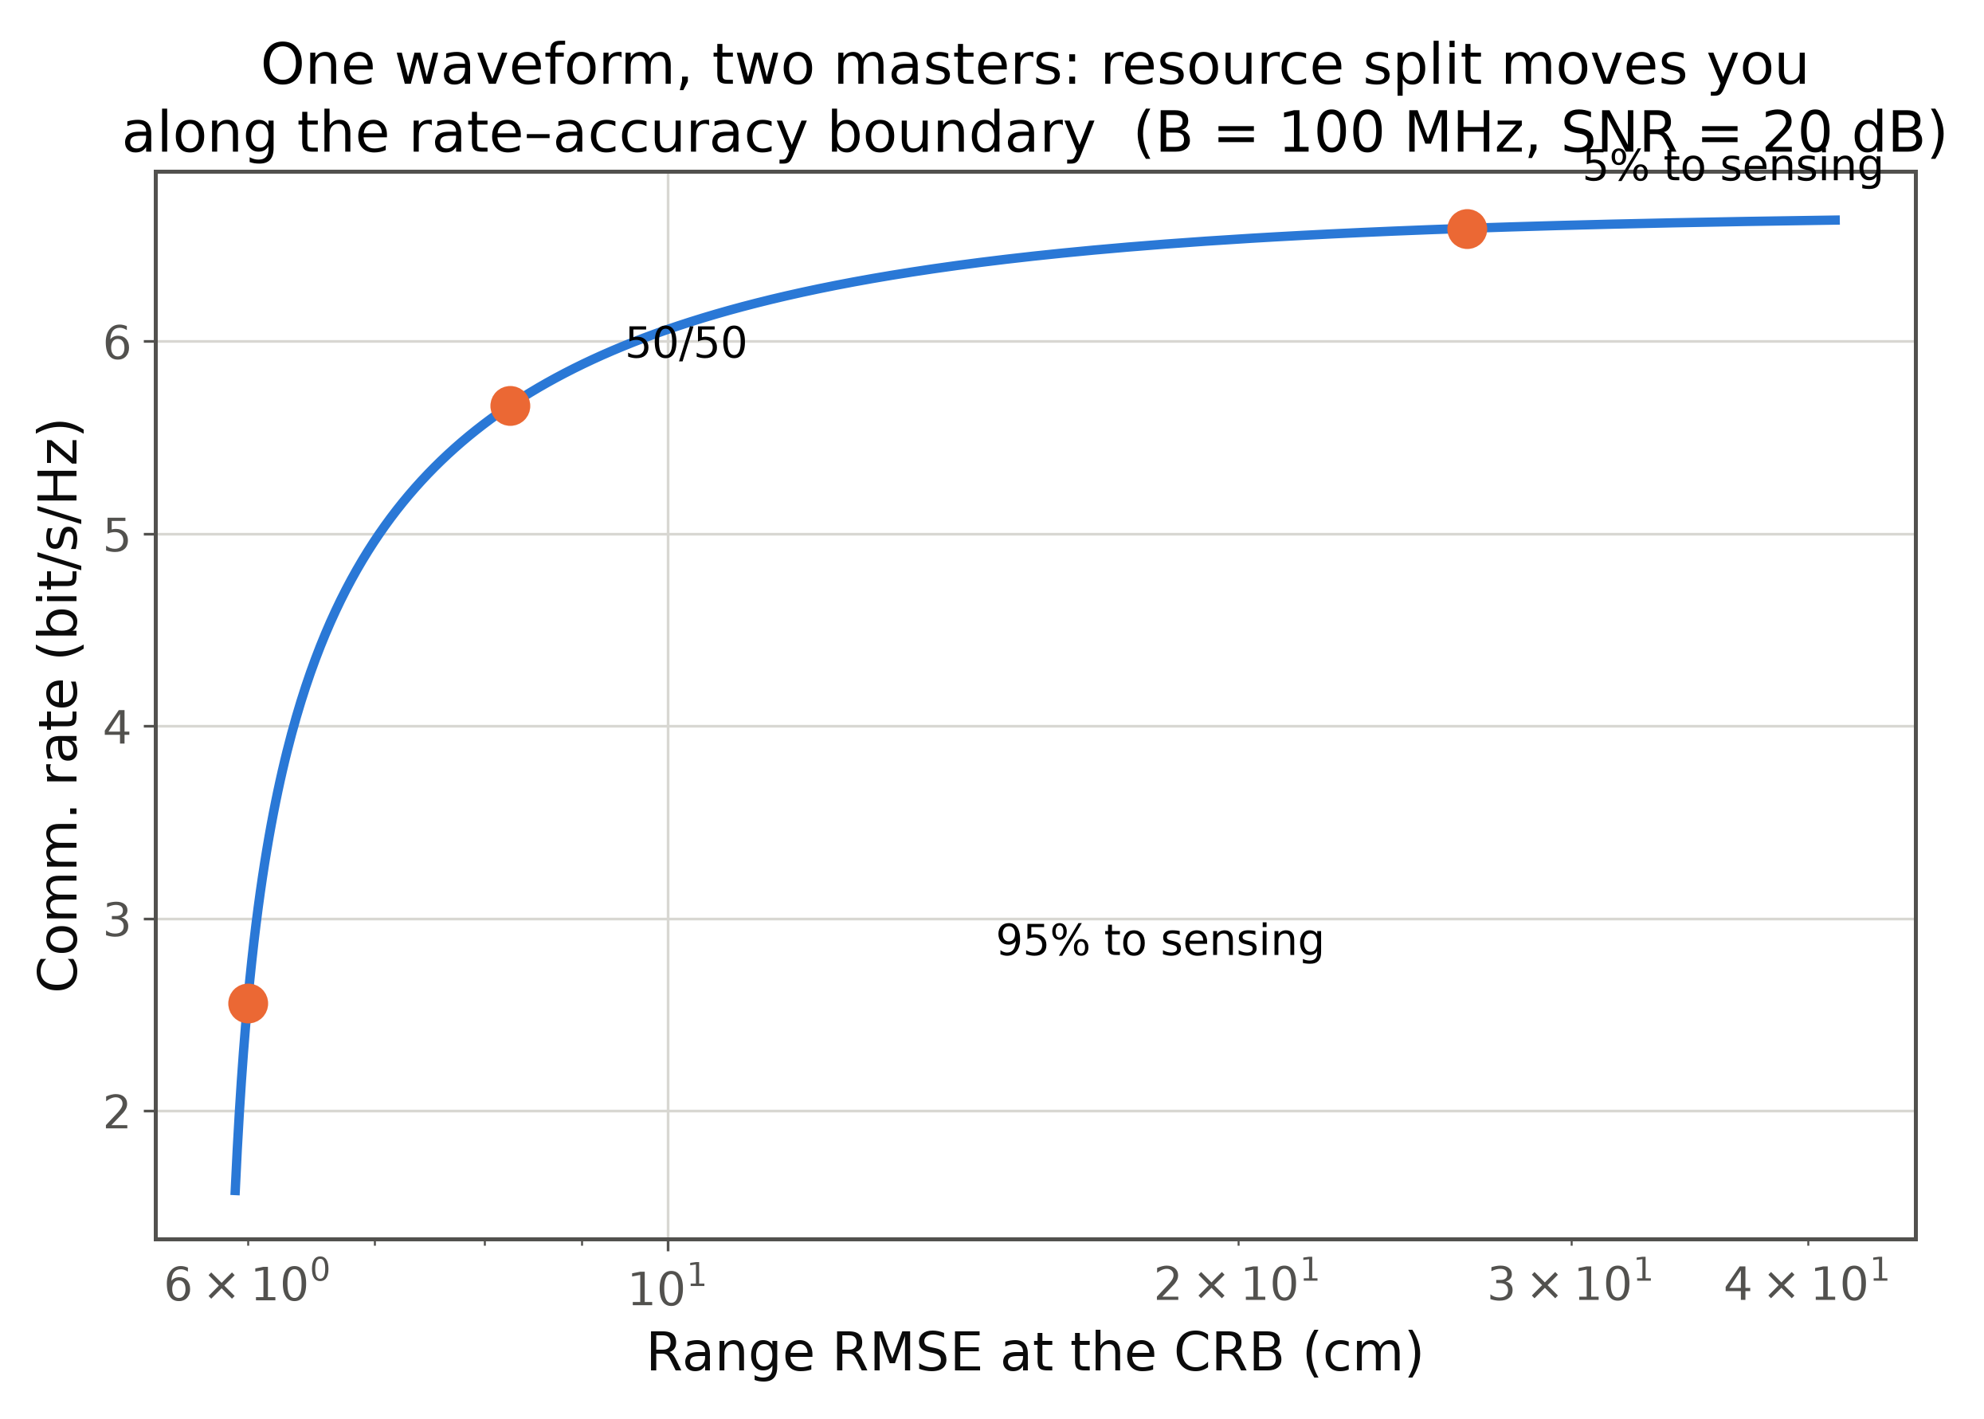
Fundamental limits: CRB vs rate
▸ Delay CRB: RMS bandwidth is king — edge subcarriers are gold for ranging
▸ Rate–CRB region: the capacity–distortion picture of ISAC
▸ Waterfilling for rate ≠ for sensing → principled compromises
46 / 86
Notes:
Ranging accuracy improves with RMS bandwidth, so band-edge power helps sensing but not capacity under flat channels — hence the trade-off. 5% of resources already buys cm-class CRB at these SNRs; the curve is steep at first — cheap lunches exist.

Slide 47
Monostatic, bistatic, and network sensing
▸ Monostatic: full waveform knowledge; but TX–RX self-interference is brutal (full duplex / quasi-CW)
▸ Bistatic (BS→UE, BS→BS): no self-interference; sync and clock offsets bite instead
▸ Network/multistatic: fusion across cells — geometry diversity, coverage; cellular timing helps
47 / 86
Notes:
Monostatic is clean (Demo 4 assumes it) but hides the hardest RF problem: your own TX is 120 dB above the echo. Bistatic swaps that for a sync problem. Network sensing is where cellular can beat radar.

Slide 48
ISAC in 3GPP
▸ Rel-19: dedicated channel-model study for ISAC (targets with RCS enter the stochastic model); SA1 use cases feed RAN
▸ Rel-20 (6G study): sensing among candidate native features; ETSI ISG ISAC in parallel
▸ Honest status: pre-normative — first commercial 'sensing' likely positioning-class, then micro-Doppler apps
▶ Live Demo 4 (3 min): two moving targets on a range–Doppler map — from a frame carrying QPSK data. [matlab/demo4_isac_range_doppler]
48 / 86
Notes:
Standards in 30 s, then MATLAB. The frame carries random QPSK — point at the console line confirming data demod, then the map: two blobs at 40 m/+15 m/s and 75 m/-25 m/s, within one bin of truth. Second peak a few dB lower (scalloping). Fail → backup A4. Done by ~0:59:30.

Slide 49
7
AI-Native Physical Layer
Notes:
Section transition — AI-Native Physical Layer. Pause, re-orient the audience, then move into the first slide.

Slide 50
What 'AI-native' actually means
▸ 5G: AI bolted on (SON, scheduling). 6G: AI as a design principle inside the air interface
▸ Model deficit: no faithful math model (hardware nonlinearity) → learn the model
▸ Algorithm deficit: model known, optimal algorithm intractable → learn the algorithm
▸ Integration spectrum: replace a block → co-design blocks → end-to-end learned PHY
50 / 86
Notes:
The deficit taxonomy (Shlezinger/Eldar) is the best sorting hat: it predicts where learning helps. Channel coding: no deficit, learning adds little. PA distortion: model deficit, learning shines.

Slide 51
Deep learning for channel estimation
▸ Treat the pilot-grid estimate as a noisy image → CNN denoising / super-resolution across time–frequency
▸ Learned estimators approach MMSE without knowing channel statistics
▸ Gains largest at low SNR and under model mismatch
▸ Costs: training data, generalization, µs-latency inference
51 / 86
Notes:
Exactly Demo 5's setting — hold the thought. The image analogy is not decoration: the TF channel grid has local correlation like natural images, so vision architectures transfer.

Slide 52
Autoencoder end-to-end PHY
▸ O'Shea & Hoydis 2017: TX–channel–RX as one autoencoder; learn constellation and demapper jointly
▸ Learned constellations rediscover — and under impairments beat — hand-designed ones
▸ Needs a differentiable channel → surrogate models or RL for the real world
52 / 86
Notes:
The paper that launched the field: the whole link as one differentiable function. Realism check: block-based systems won't vanish — certification, interoperability, debugging favor structure. Hybrids win in practice.

Slide 53
Neural receivers
▸ Replace equalization + demapping with one trained network over the received grid (channel estimate optional)
▸ Demonstrated at 3GPP-compatible scale (multi-user MIMO neural receivers, Sionna-class toolchains)
▸ Robustness from training over channel distributions; complexity tamed by pruning/quantization
▸ Open: retraining cadence vs channel drift
53 / 86
Notes:
The pragmatic middle ground vendors prototype: keep the OFDM frame, swap the inner receiver. Good neural receivers can skip explicit channel estimation — pilots become input features.

Slide 54
Model-based deep learning: deep unfolding
▸ Unroll K iterations into a K-layer network; learn the knobs (steps, thresholds, matrices)
▸ Order-of-magnitude fewer iterations at equal accuracy; keeps interpretability
▸ PHY wins: unfolded detection, beamforming, sparse channel estimation
54 / 86
Notes:
Best of both worlds: your favorite iterative algorithm, after weight training — same skeleton, data-tuned parameters, priors survive. For faculty: unfolding is a paper machine. This is the cheat-sheet's centerfold.

Slide 55
Semantic communications
▸ Shift from bit fidelity to task fidelity: transmit what the receiver needs to act
▸ Neural joint source–channel coding: graceful degradation, no cliff effect
▸ Open theory: a semantic information measure; separation theorem; standardizable interfaces
▸ Fair positioning: promising for constrained links (XR, satellite IoT); not a day-one feature
55 / 86
Notes:
Flex slide — can merge into the next. Example: transmitting a face for a video call needs the expression, not the pixels. Cliff-effect contrast: digital dies at threshold; learned JSCC degrades like analog TV.

Slide 56
The hard problems: data, generalization, trust
▸ Data: channel measurements are vendor-siloed; sim-to-real is the quiet blocker
▸ Generalization: across cells, hardware, mobility; distribution-shift monitoring
▸ Budget: µs inference, joules per inference, PHY real-time constraints
▸ Trust: testability, certification, explainability
▸ Opening: standardized channel datasets & benchmarks would be a real service
56 / 86
Notes:
The referee-hat slide. A well-curated public dataset + benchmark for one PHY task can out-impact another architecture paper.

Slide 57
AI/ML in 3GPP
▸ Rel-18 study → Rel-19 normative first steps; three use cases: CSI feedback compression, beam prediction, positioning
▸ Two-sided models (UE encoder / network decoder): the interoperability puzzle
▸ 6G study (Rel-20): AI-native candidates; the real spec work is life-cycle management
▶ Live Demo 5 (2.5 min): LS vs MMSE vs a small neural network for OFDM channel estimation. [matlab/demo5_dl_channel_estimation]
57 / 86
Notes:
Standards in three bullets, then the last MATLAB switch. LS is the statistics-free baseline; MMSE knows the true covariance (unfair); the small NN learns from data and lands within a fraction of a dB of MMSE. First to skip if late → backup A5. Done by ~1:10.

Slide 58
8
Multiple Access & Spectrum Sharing
Notes:
Section transition — Multiple Access & Spectrum Sharing. Pause, re-orient the audience, then move into the first slide.

Slide 59
Beyond orthogonal access
▸ OMA is capacity-optimal only in corner cases; 6G stress: massive connectivity + heterogeneous QoS
▸ Landscape: power-domain NOMA, code-domain (SCMA), RSMA, grant-free
▸ 5G reality: NOMA studied (MUST), not widely deployed — SIC complexity vs modest gains
▸ Reframe: multiple access = an interference-management philosophy
59 / 86
Notes:
Last stretch of theory — keep energy up. The philosophy: OMA avoids interference, NOMA decodes it fully at one side, RSMA decodes exactly the part worth decoding.

Slide 60
Power-domain NOMA and SIC
▸ Superpose users in power; near user decodes far user's signal, cancels, then decodes its own
▸ Gains hinge on channel disparity (|h_n| ≫ |h_f|)
▸ Taxes: SIC error propagation, CSI sensitivity — degrades with mobility
60 / 86
Notes:
Two-user intuition: the far user treats the near user as noise; the near user decodes the strong far-user signal first and subtracts it. Everything good about NOMA lives in that asymmetry — and everything fragile too.

Slide 61
Rate-splitting multiple access (RSMA)
▸ Split each message: common part (decoded by all) + private part (own)
▸ One SIC step: decode common, subtract, decode private
▸ Spans SDMA ↔ NOMA ↔ multicast as special cases of one framework
61 / 86
Notes:
Killer property: robustness to imperfect CSIT — the common stream soaks up interference you failed to precode away, and RSMA is DoF-optimal under imperfect CSIT where SDMA collapses. That safety net is why it keeps gaining momentum.

Slide 62
Grant-free and unsourced random access
▸ mMTC: short packets, sporadic activity, handshakes cost more than the payload
▸ Activity detection = compressed sensing again: sparse recovery / covariance methods
▸ Unsourced RA: all users share one codebook; decoder returns an unordered message list
▸ Same sparsity toolbox as Section 4 — third billing for the same math
62 / 86
Notes:
Connect to S27: different matrix, identical math. Unsourced RA: nobody says who they are; the decoder outputs WHAT was said. Elegant, and increasingly practical.

Slide 63
Why RSMA keeps gaining traction for 6G
▸ One framework unifying the access zoo — fewer special cases to standardize
▸ Graceful degradation under imperfect CSIT (the regime real networks live in)
▸ Documented synergies with multi-antenna ISAC and RIS beamforming
▸ Entry fee: encoder/scheduler complexity, common-rate control signaling
▸ “Split, superpose — and let SIC do bounded work.”
63 / 86
Notes:
30-second summary + the quotable line. Transition: so far everything sat on towers; 6G coverage does not stop at the horizon.

Slide 64
9
Coverage from the Sky & New Media
Notes:
Section transition — Coverage from the Sky & New Media. Pause, re-orient the audience, then move into the first slide.

Slide 65
Non-terrestrial networks: the 3D architecture
▸ Layers: LEO mega-constellations (300–1200 km), HAPS (~20 km), UAV relays
▸ 6G goal: one 3GPP-native fabric — common waveform family, seamless sky↔ground mobility
▸ Direct-to-device NTN is already commercially real; scaling it is the 6G task
65 / 86
Notes:
Coverage becomes 3D: three altitude layers with different delay/Doppler/link-budget personalities. 5G retrofitted NTN in Rel-17; 6G designs for it from day one. Phones already talk to satellites.

Slide 66
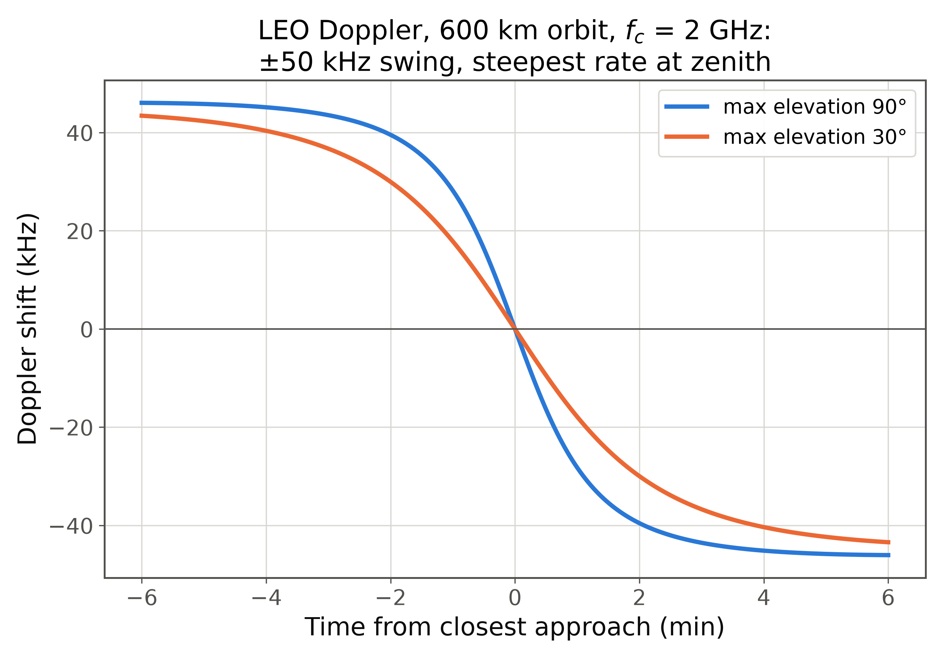
The LEO signal processing problem: Doppler
▸ Doppler rate up to ~kHz/s near zenith; RTT 2–25 ms breaks HARQ timing
▸ The gift: ephemeris is known → pre-compensate, track only the residual
▸ DD-domain waveforms (Section 3) are natural fits here
66 / 86
Notes:
The S-curve is computed from real orbital geometry (600 km). Half the swing happens in the two minutes around zenith — the tracking stress test. Unlike a car, a satellite tells you its velocity in advance; open-loop pre-compensation removes ~95%.

Slide 67
NTN in 3GPP: status in one minute
▸ Rel-17: NR-NTN baseline (transparent payloads, timing/Doppler handling)
▸ Rel-18/19: coverage & mobility enhancements, IoT-NTN, regenerative payloads on the way
▸ 6G: NTN native from the start — inter-satellite routing, store-and-forward IoT, unified mobility
67 / 86
Notes:
Flex slide — one breath per bullet, or skip. Transparent vs regenerative in one line: bent pipe versus a base station in orbit.

Slide 68
Optical wireless and VLC
▸ IM/DD constraint: real, non-negative signals → DCO-/ACO-OFDM adaptations
▸ LiFi: dense indoor capacity, security by physics; FSO: fiber-class backhaul incl. ground–satellite
▸ Challenges: alignment, ambient light, uplink asymmetry
▸ Honest niche: industrial floors, cabins, RF-denied environments
68 / 86
Notes:
Optical is a complement, not a competitor: where RF is denied or congested, photons commute. IM/DD kills negative amplitudes, so OFDM needs DC bias or asymmetric clipping — same toolbox, new constraint.

Slide 69
Quantum-secured links (brief)
▸ QKD: key distribution whose security rests on physics; fiber and satellite demos exist
▸ Realism: point-to-point, modest key rates → practical path is hybrid QKD + post-quantum crypto
▸ For 6G: primarily a security-architecture topic, not a PHY-DSP one — one slide on purpose
69 / 86
Notes:
Deliberately brief — acknowledge the buzzword, place it correctly, move on. In Q&A: the DSP-adjacent part is CV-QKD receivers (coherent detection, error reconciliation).

Slide 70
10
Energy, Standardization & Roadmap
Notes:
Section transition — Energy, Standardization & Roadmap. Pause, re-orient the audience, then move into the first slide.

Slide 71
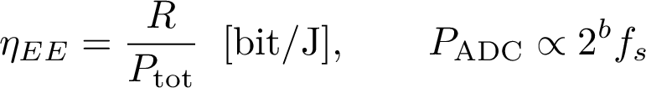
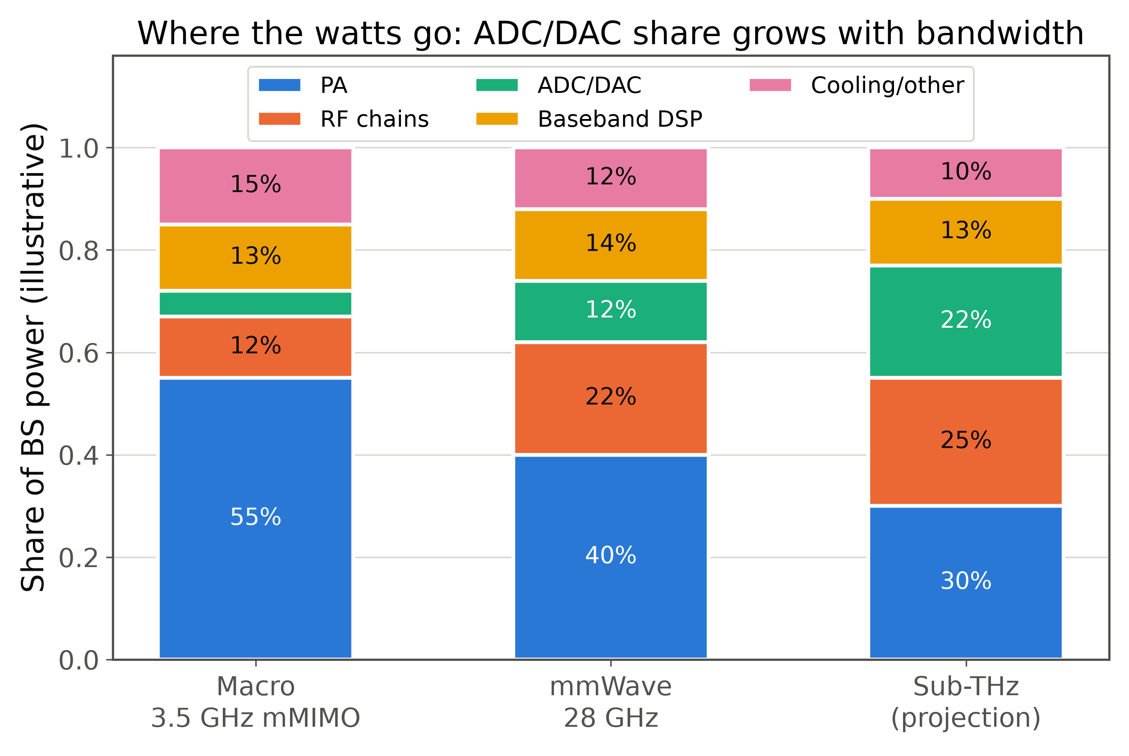
Energy-efficient PHY design
▸ Network energy: OPEX + sustainability KPI (an IMT-2030 design value)
▸ Levers: PA operating point (waveform!), low-resolution ADCs, sleep-aware design, lean always-on signals
▸ Design shift: bit/J next to bit/s/Hz
71 / 86
Notes:
Tie the loop closed: the PAPR discussion IS an energy topic — back-off is wasted watts. The ADC/DAC share grows with bandwidth (illustrative bars): the converter wall is why low-resolution and hybrid keep winning.

Slide 72
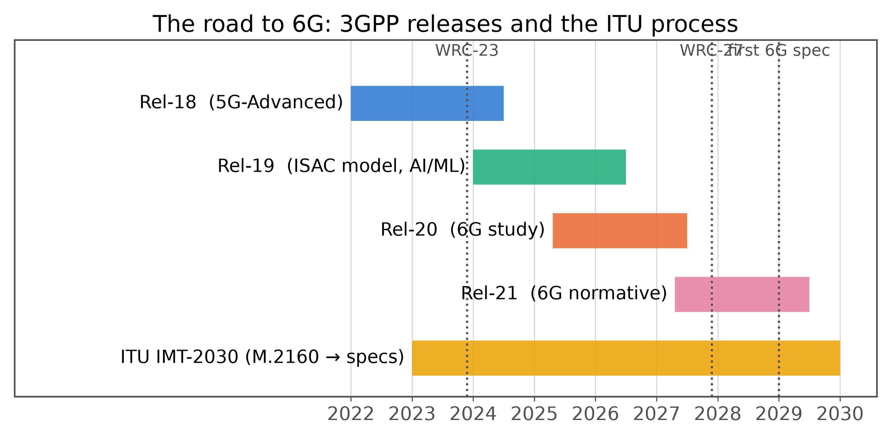
The 3GPP road to 6G
▸ Rel-19 carries the studies that matter (ISAC model, AI/ML); Rel-20 opens the 6G study; Rel-21 goes normative → first spec ≈ 2028–29
72 / 86
Notes:
Practical advice: watch study-item technical reports (TR 38.8xx/9xx) — they tell you what industry will ask of academia two years ahead. WRC-27 settles new spectrum; influence windows are open now.

Slide 73
The ITU IMT-2030 process
▸ M.2160 framework (2023) → requirements & evaluation (2024–26) → submissions → IMT-2030 specs ≈ 2029–30
▸ Same machinery that turned IMT-2020 into '5G' — history rhymes
▸ Feeding programs: Hexa-X-II (EU), Next G Alliance (US), IMT-2030 Promotion Group (CN), Bharat 6G (IN)
73 / 86
Notes:
De-mystify the acronym soup: ITU defines what counts as 6G and evaluates candidates; 3GPP writes the technology submitted. Aligning grant objectives with the IMT-2030 capability list is free reviewer goodwill.

Slide 74
A research roadmap for this room
▸ Start now (paper-sized): DD-domain receivers & AFDM; near-field CSI & codebooks; ISAC CRB–rate trade-offs; deep-unfolded PHY
▸ Build toward (project-sized): cell-free + RIS testbeds; AI life-cycle management; sub-THz prototyping; public channel datasets
▸ Choose problems where DSP insight beats brute force — our comparative advantage
74 / 86
Notes:
Match problems to resources: the first group needs MATLAB and stubbornness; the second needs infrastructure and consortia. The closing line is career advice.

Slide 75
The 6G signal-processing map
▸ Recurring themes: sparsity • domain transforms • hardware-aware design • model + data hybrids
75 / 86
Notes:
Same roadmap as slide 5, now earned. Name the four themes slowly — they are the intellectual through-line; every section used at least two.

Slide 76
11
Takeaways & Q&A
Notes:
Section transition — Takeaways & Q&A. Pause, re-orient the audience, then move into the first slide.

Slide 77
Five demos, five lessons
▸ D1 OFDM vs OTFS: at high Doppler, change the domain, not the SNR
▸ D2 Hybrid beamforming: in sparse channels, 4 RF chains ≈ 64
▸ D3 RIS: co-phasing turns a random walk into N² combining
▸ D4 ISAC: a data-carrying frame can image two moving targets
▸ D5 Learned estimation: ≈ MMSE without knowing the statistics
77 / 86
Notes:
Each demo compressed to its aphorism — read all five with rhythm. This is the recap that makes the demos stick. All code goes home.

Slide 78
Key takeaways
▸ 6G = new spectrum + new geometry (near-field) + new functions (sensing) + new tools (learning)
▸ OFDM is not dead — it has new roommates; expect scenario-adaptive PHY
▸ Three formulas organize half the field: P ∝ N² • d_R = 2D²/λ • var(τ̂) ≥ 1/(8π²β²·SNR)
▸ Signal processing turns physics into throughput
78 / 86
Notes:
THE LANDING SLIDE — if the schedule collapsed, jump straight here. Deliver the four lines slowly. The three-formulas bullet earns the photo of the talk; pause on it.

Slide 79
Open problems worth a PhD
▸ Unified DD-domain ISAC: one waveform, provably optimal for both jobs
▸ Near-field channel estimation & codebooks at N > 10³
▸ EM-consistent RIS models (coupling, wideband) that stay tractable
▸ Trustworthy neural PHY: certification, monitoring, graceful fallback
▸ Energy-optimal waveform + PA co-design for sub-THz
▸ Grant-free access at 10⁸ devices/km²: CS at societal scale
79 / 86
Notes:
Aimed at the research scholars: each line is a defensible thesis statement with its entry toolbox. Offer to discuss any in Q&A or by email.

Slide 80
References & resources
[1] ITU-R Rec. M.2160-0, “Framework and overall objectives of the future development of IMT for 2030 and beyond,” Nov. 2023.
[2] W. Saad, M. Bennis, M. Chen, “A vision of 6G wireless systems,” IEEE Network, vol. 34, no. 3, 2020.
[3] H. Tataria et al., “6G wireless systems: Vision, requirements, challenges, insights, and opportunities,” Proc. IEEE, vol. 109, no. 7, 2021.
[4] R. Hadani et al., “Orthogonal time frequency space modulation,” Proc. IEEE WCNC, 2017.
[5] Z. Wei et al., “Orthogonal time-frequency space modulation: A promising next-generation waveform,” IEEE Wireless Commun., vol. 28, no. 4, 2021.
[6] A. Bemani, N. Ksairi, M. Kountouris, “AFDM: Affine frequency division multiplexing for next generation wireless,” IEEE Trans. Wireless Commun., 2023.
[7] O. El Ayach et al., “Spatially sparse precoding in millimeter wave MIMO systems,” IEEE Trans. Wireless Commun., vol. 13, no. 3, 2014.
[8] E. Björnson, J. Hoydis, L. Sanguinetti, “Massive MIMO has unlimited capacity,” IEEE Trans. Wireless Commun., vol. 17, no. 1, 2018.
[9] Q. Wu, R. Zhang, “Intelligent reflecting surface enhanced wireless network via joint active and passive beamforming,” IEEE Trans. Wireless Commun., vol. 18, no. 11, 2019.
[10] M. Di Renzo et al., “Smart radio environments empowered by reconfigurable intelligent surfaces,” IEEE JSAC, vol. 38, no. 11, 2020.
[11] F. Liu et al., “Integrated sensing and communications: Toward dual-functional wireless networks for 6G and beyond,” IEEE JSAC, vol. 40, no. 6, 2022.
[12] C. Sturm, W. Wiesbeck, “Waveform design and signal processing aspects for fusion of wireless communications and radar sensing,” Proc. IEEE, vol. 99, no. 7, 2011.
[13] T. O'Shea, J. Hoydis, “An introduction to deep learning for the physical layer,” IEEE Trans. Cogn. Commun. Netw., vol. 3, no. 4, 2017.
[14] N. Shlezinger, J. Whang, Y. C. Eldar, A. J. Goldsmith, “Model-based deep learning,” Proc. IEEE, vol. 111, no. 5, 2023.
[15] Y. Mao, O. Dizdar, B. Clerckx, R. Schober, P. Popovski, H. V. Poor, “Rate-splitting multiple access: Fundamentals, survey, and future research trends,” IEEE Commun. Surveys Tuts., vol. 24, no. 4, 2022.
Tools: MATLAB (SPT / CommT / DLT) • NVIDIA Sionna • this talk's code
80 / 86
Notes:
Don't read — point: fifteen well-chosen surveys and landmark papers; the handout has the same list. Every item is genuine and widely-cited; volume/number details were compiled from memory — spot-check before printing.

Slide 81
Thank you!
Dr. Markkandan S · Associate Professor, SENSE, VIT Chennai
markkandan.s@vit.ac.in
Slides, MATLAB demos & Python verification code ship together.
Notes:
Land warmly; invite collaboration explicitly — faculty for joint proposals, scholars for co-supervision. Keep MATLAB open: the best Q&A reuses a demo with a parameter changed live.

Slide 82
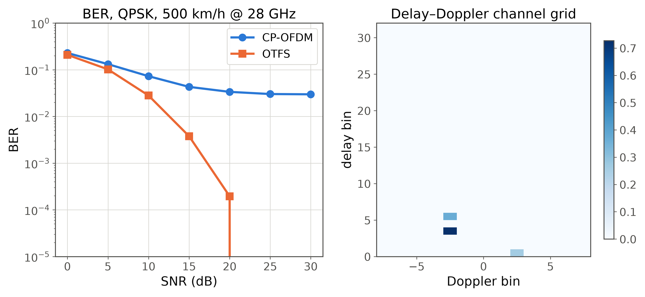
Backup A1: pre-computed result — Demo 1 (OFDM vs OTFS)
Backup: pre-computed result
82 / 86
Notes:
Only if Demo 1 fails live. OFDM floors near 3e-2 from ICI; OTFS falls past 1e-4 by 20 dB. Right: the delay-Doppler channel the frame saw.

Slide 83
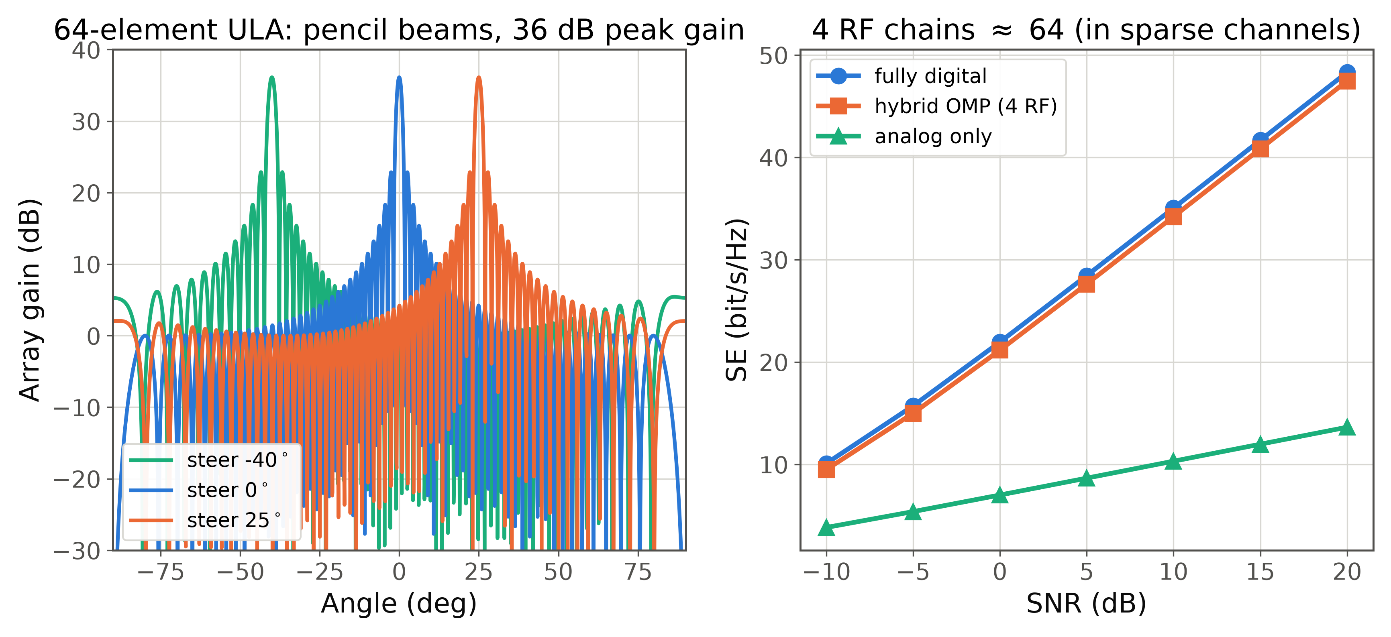
Backup A2: pre-computed result — Demo 2 (hybrid beamforming)
Backup: pre-computed result
83 / 86
Notes:
Only if Demo 2 fails live. Left: 64-element ULA patterns, 18 dB peak gain. Right: OMP hybrid with 4 RF chains tracks fully digital.

Slide 84
Backup A3: pre-computed result — Demo 3 (RIS N² law)
Backup: pre-computed result
84 / 86
Notes:
Only if Demo 3 fails live. Log-log slopes: optimized 2.0 (the N² law), random 1.0. Analytic overlays sit on the simulation.

Slide 85
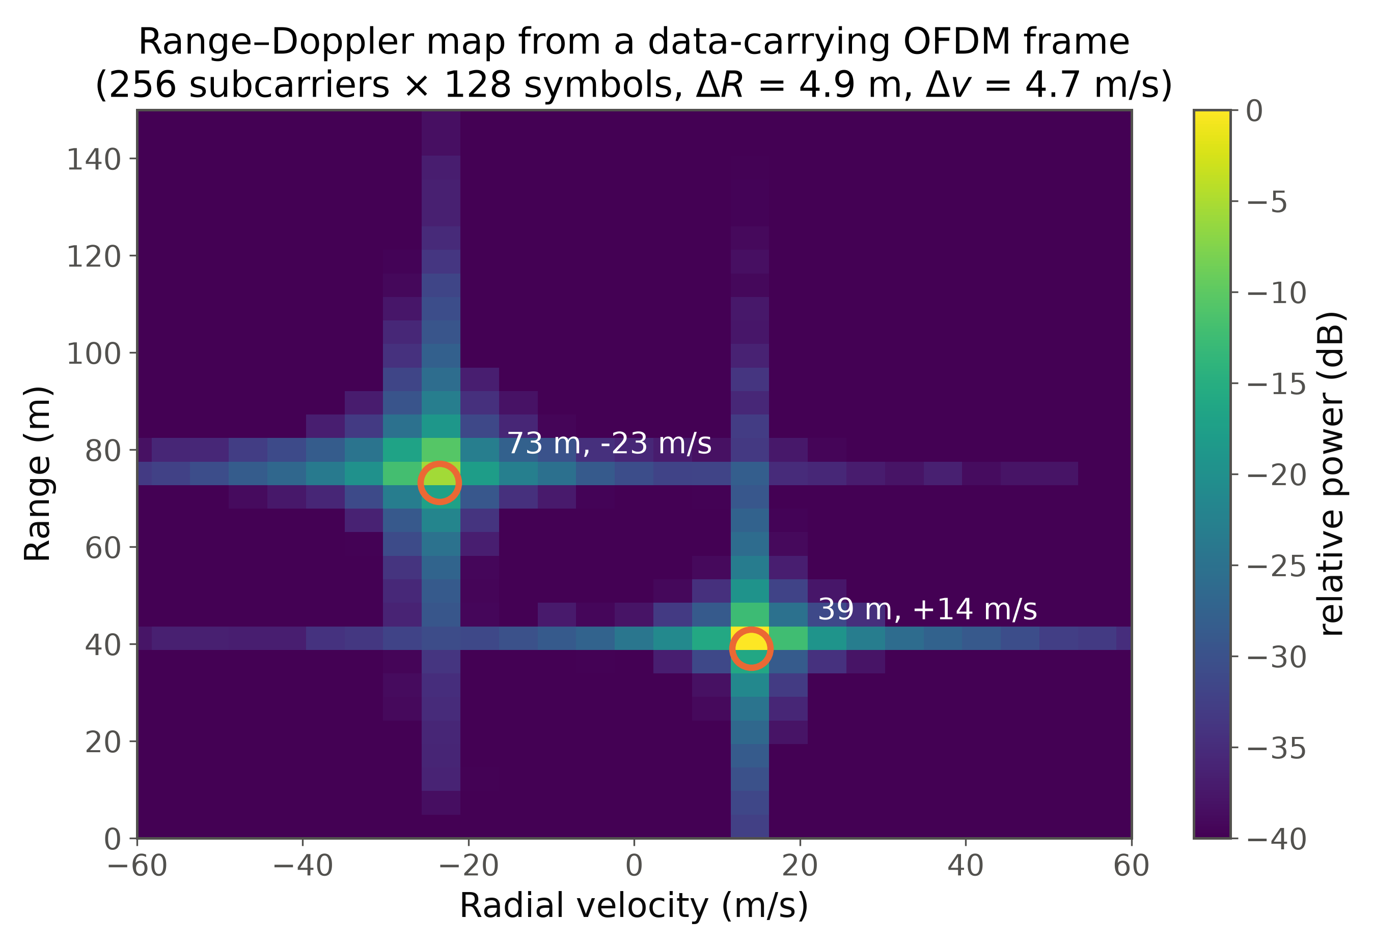
Backup A4: pre-computed result — Demo 4 (ISAC range–Doppler)
Backup: pre-computed result
85 / 86
Notes:
Only if Demo 4 fails live. Two targets recovered within one bin each (40 m/+15 m/s and 75 m/-25 m/s) from a QPSK-carrying frame.

Slide 86
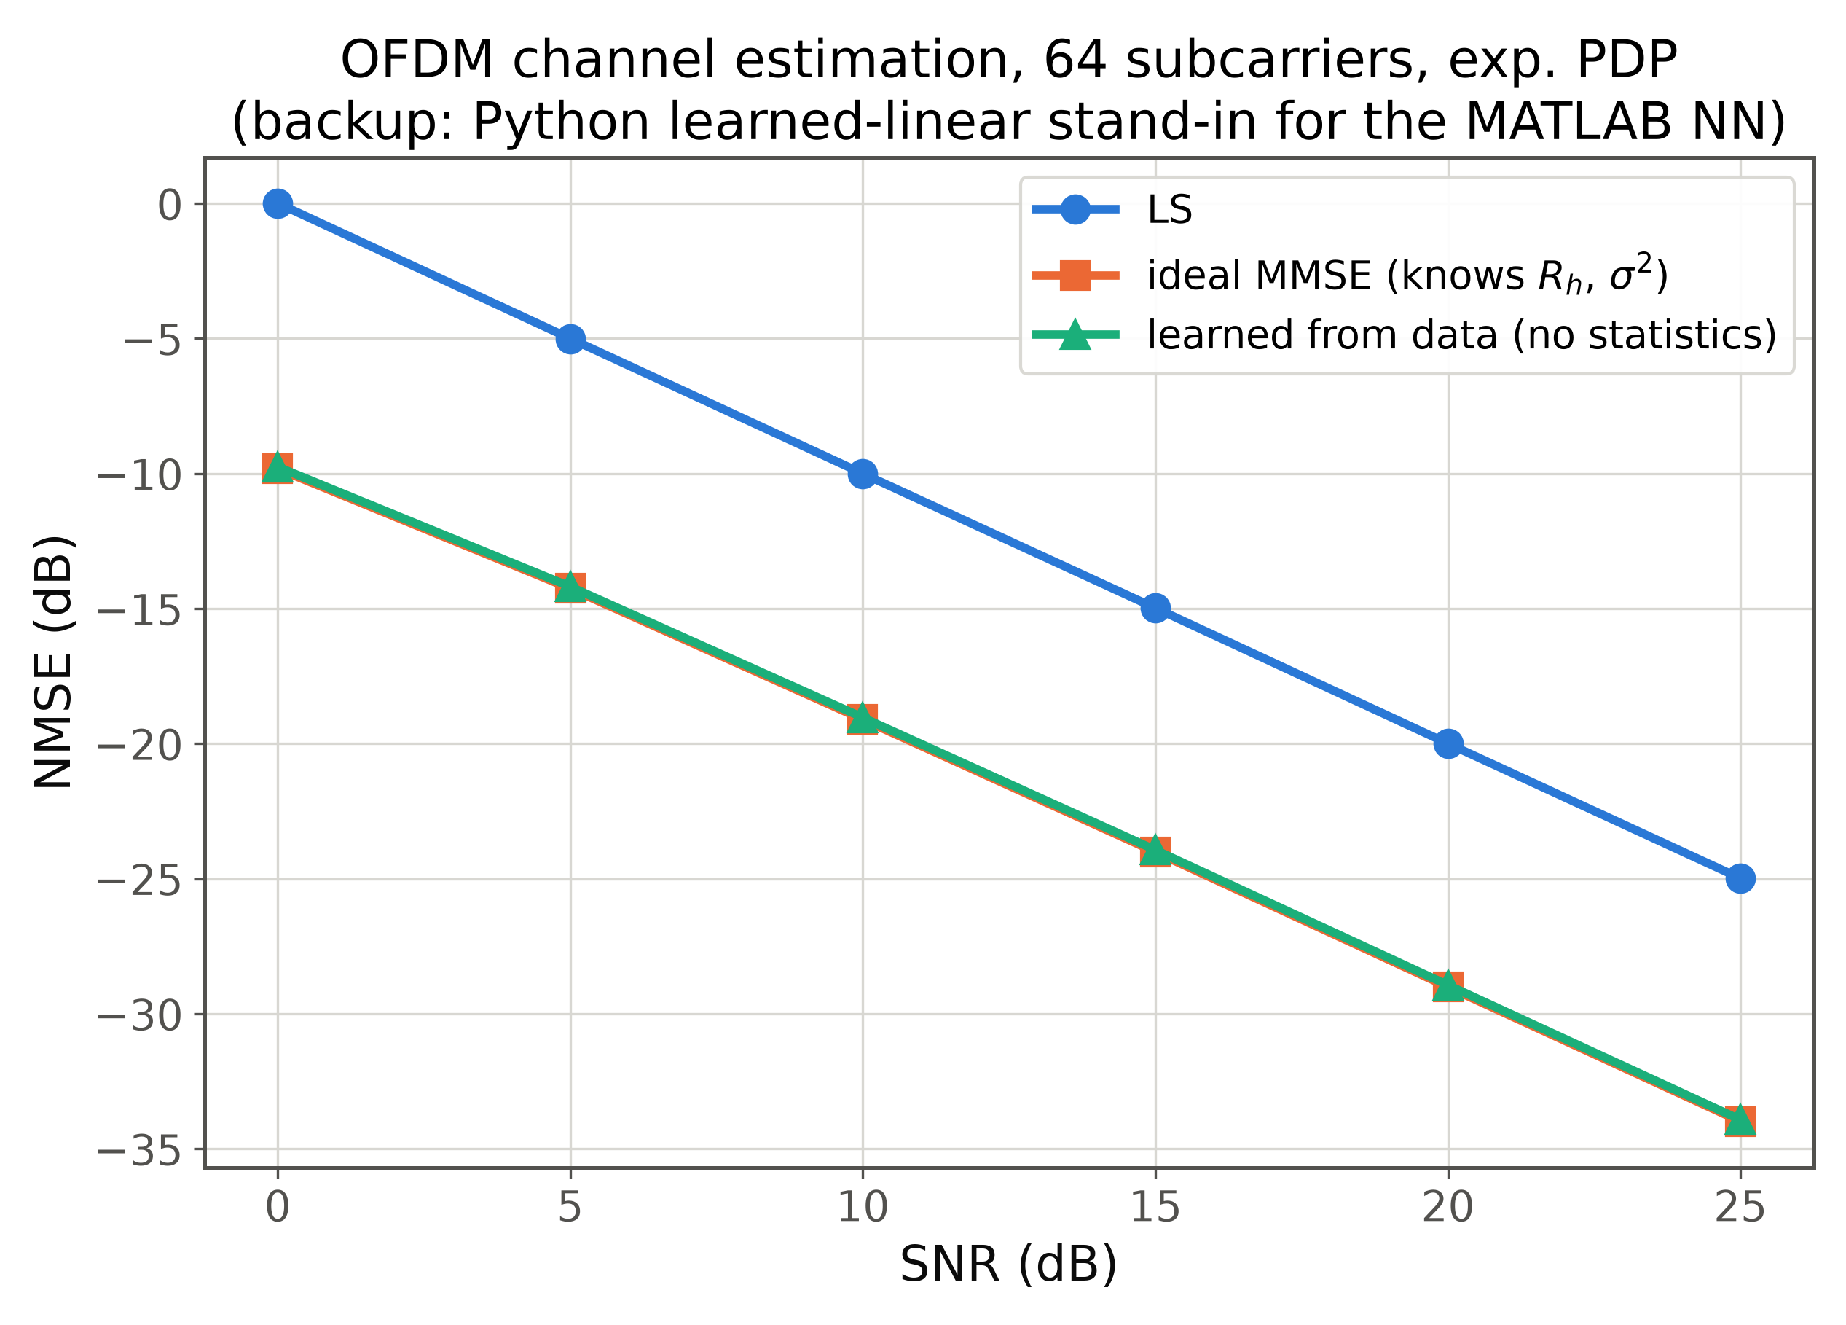
Backup A5: pre-computed result — Demo 5 (learned estimation)
Backup: pre-computed result
86 / 86
Notes:
Only if Demo 5 fails live. LS tracks σ²; ideal MMSE gains ~9–10 dB using true statistics; the learned estimator matches MMSE within a fraction of a dB from data alone.

