Slide 1

techGine
tG
Simplify your searches, while raising your results
Project one – team one
< Sade Browne / Jenn Chu / Mark Kazanski / Alize nguyen / Nick Sladden >

Slide 2
AGENDA
tG
PRODUCT SCOPE
PRODUCT DESIGN
PRODUCT TECHNOLOGIES
PRODUCT IMPROVEMENT
PRODUCT DEMO

Slide 3
PRODUCT SCOPE
tG
CONCEPT:
One-stop search platform
Output of aggregated product reviews and ratings
DEVELOPMENT:
“Simplify your searches while raising your results”
Reduce search time
Reliable results
Media reviews integration
Notes:
<Sade>
CONCEPT:
- Project provides one-stop platform allowing users to research and compare electronics and tech products across an array of sources
- Users get aggregated product searches to generate ratings and reviews along with trending news and social media mentions
DEVELOPMENT:
- “Simplify your searches while raising your results”
- techGine assists the user in simplifying and reducing the time needed to research a product yet still returning reliable results. Social trends and media news are also integrated into the product search.

Slide 4
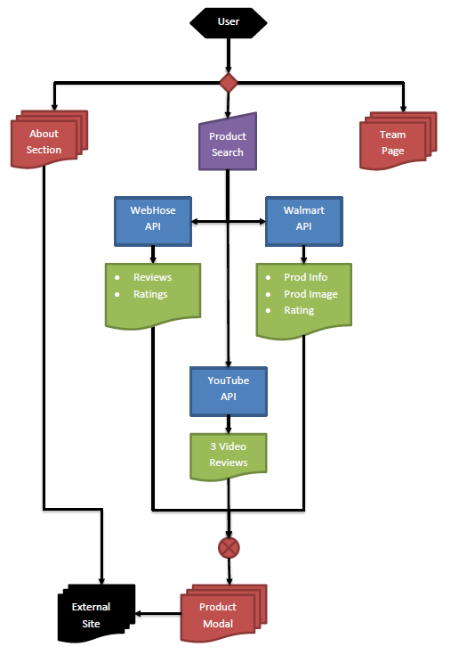
PRODUCT DESIGN
tG
Notes:
<Jenn>

Slide 5
PRODUCT TECHNOLOGIES
tG
User Input Capability
Various APIs
Product Retailer: Walmart
Data Extrator: Webhose
Social Platform: YouTube
jQuery JavaScript library
AJAX client-side script
Materialize CSS Framework
Notes:
<Nick>

Slide 6
PRODUCT IMPROVEMENTS
tG
Obstacles
API availability and usage
Identical product availability
Asynchronous programming
Cross-origin resource sharing
Improvements
Wider range of aggregated ratings/reviews
Code design methodology and implementation
Real-time product trends on web media
Notes:
<Mark>

Slide 7
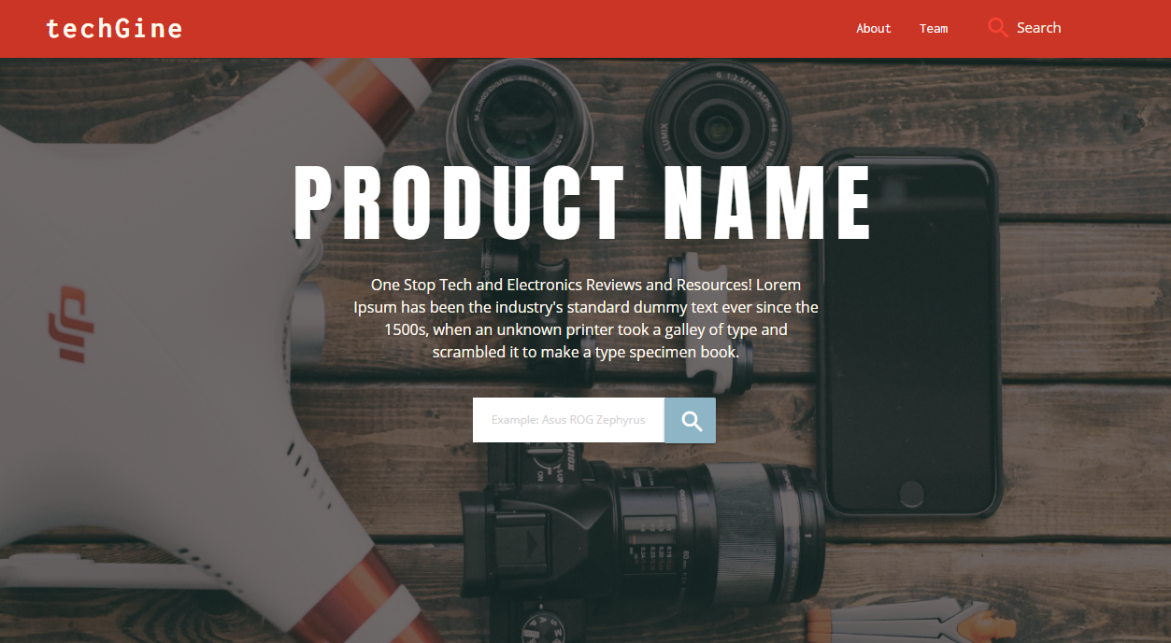
PRODUCT DEMO
tG
Notes:
<Alize>

