Slide 1


Mark Khusid
December 03, 2022

Slide 2

Outline
Executive Summary
Introduction
Methodology
Results
Conclusion

Slide 3
Executive Summary
In this study, we attempt to predict whether a Falcon 9 booster will land successfully.
This prediction will allow a SpaceX competitor to come up with a competitive launch price.
In this study, we will look at how the payload mass, launch site, number of first stage flights and orbits affect the success rate of the first stage landing.
The methodology employed was:
  Obtaining data from the SpaceX API and Wikipedia entry.
  Exploratory Data Analysis (EDA) by plotting and Structured Query Language (SQL) queries.
  Visual analytics with Folium and interactive dashboards with Dash.
  Predicting mission success with machine learning models and selecting the best model type.
Summary of all results:
  It appears that VAFB SLC 4E and KSC LC 39A had superior mission success rates.
    KSC LC-39A had the highest percentage of successful launches, where over ¾ of the launches from this site were successful.
  Over time there is a trend towards increasing mission success rates and the plots of the data suggest that there are ranges of payload masses and specific locations where mission success is more prevalent.
  Plots of the data also suggested that the ES-L1, GEO, HEO, and SSO orbits had the best results, while the SO orbit had the worst.
  SQL queries of the data showed that the boosters which have successfully landed on a drone ship had payload masses greater than 2000kg, but less than 6000kg; particularly for the “FT” booster version.
  The K Nearest Neighbors and the Support Vector Machine models had the highest and most reliable accuracy and best scores.

Slide 4
Introduction
Project background and context:
From Week 1 of the course:
  “SpaceX advertises Falcon 9 rocket launches on its website for a cost of 65 million dollars; other providers cost upwards of 165 million dollars each.” Much of the savings is derived from (sic) SpaceX’s ability to reuse the first stage.” [1]
The goal of this project is to predict if the Falcon 9 first stage will land successfully.
If we can determine if the first stage will land, then we can determine the cost of the launch.
This information can be used by a competitor of SpaceX to bid against SpaceX.
We wish to find the answers to:
  How the payload mass, launch site, number of first stage flights and orbits affect the success rate of the first stage landing.
[1] IBM Data Science Capstone Project Course Material

Slide 5

Section 1

Slide 6
Methodology: Obtain and Clean the Data (1/2)
Data was collected from:
    SpaceX REST API.
    Web scraping from the SpaceX Wikipedia entry.
After collection, data wrangling was performed:
  SpaceX REST API:
    Filtering the data to only include Falcon 9 launches.
    Dealing with missing values.
  Web scraping from Wikipedia:
    Extracting column and variable names from HTML table headers.
    Extracting the table data.
    Creating a Pandas DataFrame from the column names, variable names and table data.

Slide 7
Methodology: Analyze the Data (2/2)
After the data was obtained and cleaned, it was analyzed by:
  Performing exploratory data analysis (EDA) using visualization and SQL.
  Performing interactive visual analytics using Folium and Plotly Dash.
  Performing predictive analysis using classification models.

Slide 8
Data Collection: SpaceX API Data
GitHub Link: Data Collection API

Slide 9
Data Collection: SpaceX API Data Collection Flowchart
Obtain launch data from SpaceX API
Decode the response content as JSON and convert to DataFrame
Filter and condition DataFrame to only include data pertinent to analysis
Extract lists from DataFrame using custom functions to create a dictionary
Filter new DataFrame to only include Falcon9 launches
Export DataFrame to CSV format for further processing
Handle missing values in the DataFrame
Filter new DataFrame to only include Falcon9 launches

Slide 10
Data Collection: SpaceX API Data Collection (1/8)
Method of obtaining SpaceX API data
  A static URL was used for consistent output on this project:
  static_json_url='https://cf-courses-data.s3.us.cloud-object-storage.appdomain.cloud/IBM-DS0321EN-SkillsNetwork/datasets/API_call_spacex_api.json'
  The response was captured as shown below:
  response = requests.get(static_json_url)
  response.json()
  [{'fairings': {'reused': False,
  'recovery_attempt': False,
  'recovered': False,
  'ships': []},
  'links': {'patch': {'small': 'https://images2.imgbox.com/3c/0e/T8iJcSN3_o.png',
  'large': 'https://images2.imgbox.com/40/e3/GypSkayF_o.png'},
  'reddit': {'campaign': None,
  'launch': None,
  'media': None,
  'recovery': None},
  …
  Complete data can be viewed at: https://github.com/markkhusid/Applied_Data_Science_Capstone
Obtain launch data from SpaceX API
Decode the response content in json format

Slide 11
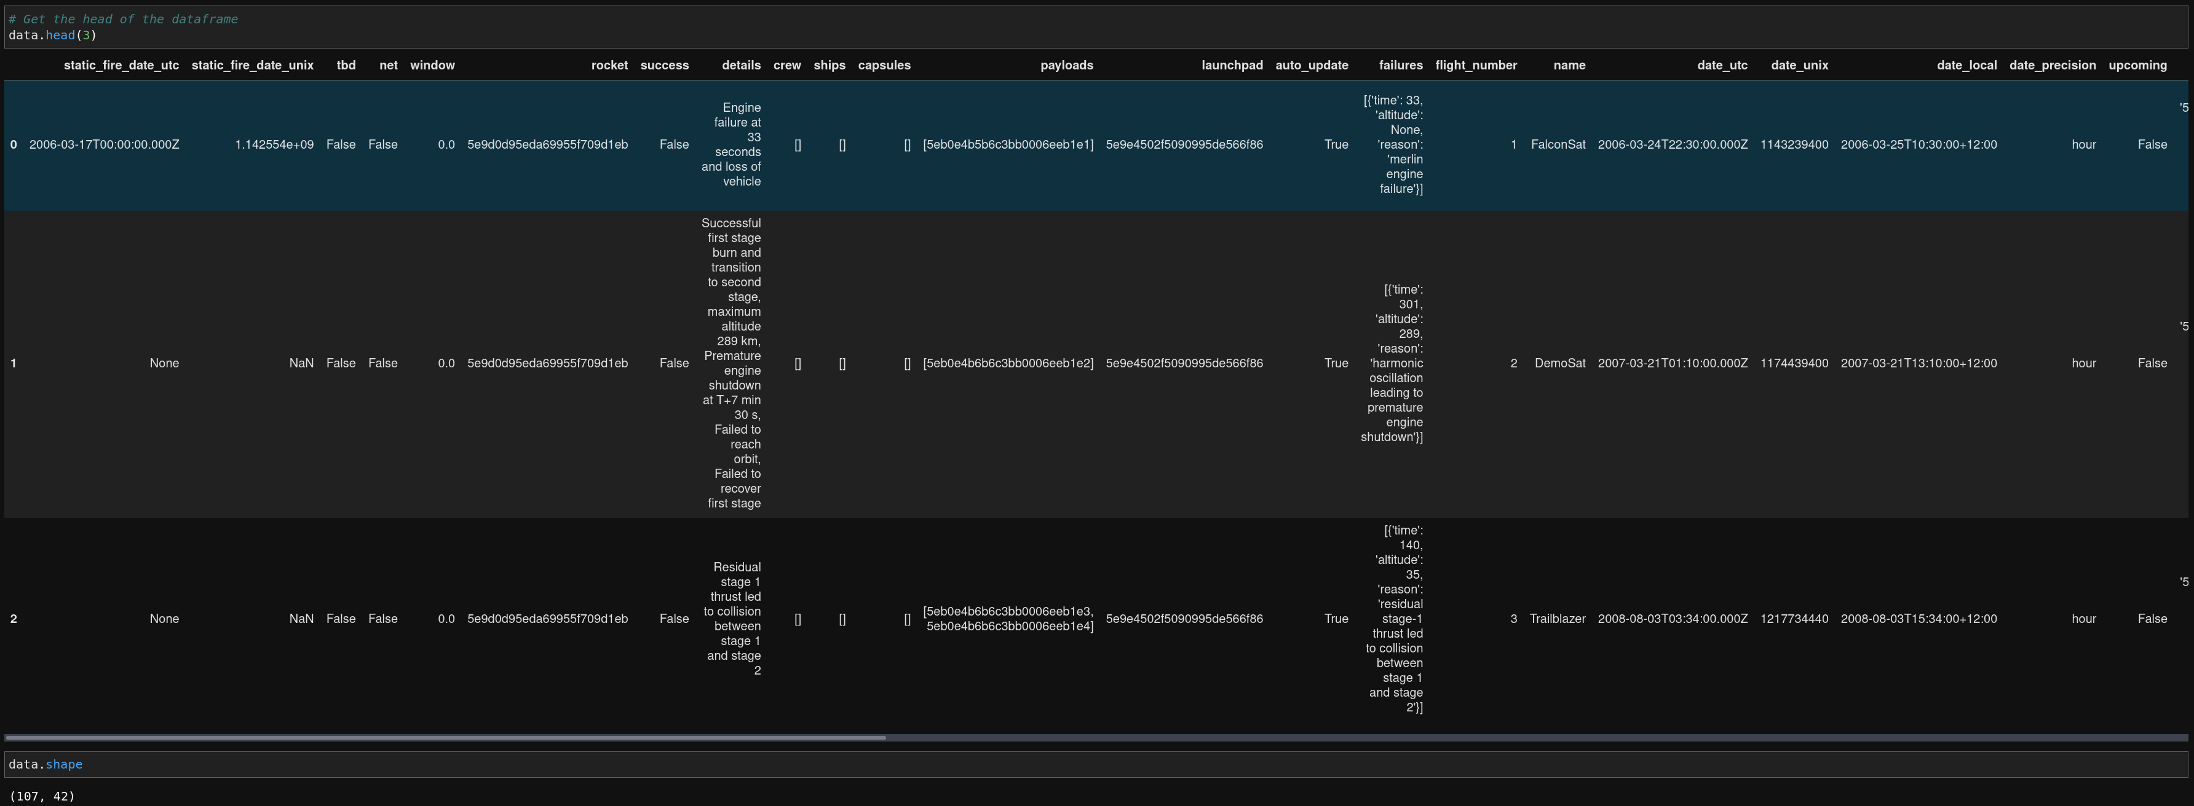
Data Collection: SpaceX API Data Collection (2/8)
The JSON data was then converted into a Pandas Dataframe.
# Use json_normalize method to convert the json result into a dataframe
data = pd.json_normalize(response.json())
Convert JSON and content into a DataFrame

Slide 12
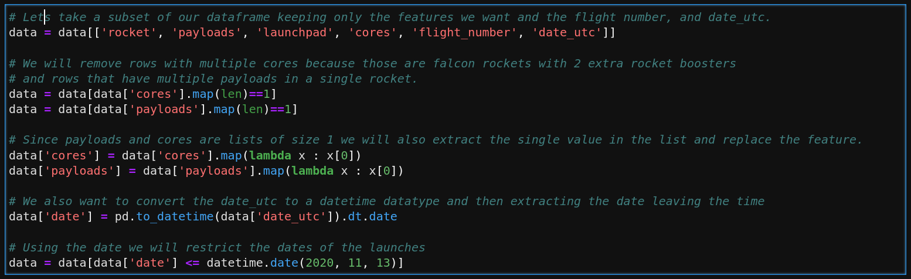
Data Collection: SpaceX API Data Collection (3/8)
The raw dataframe contained allot of information that was not pertinent to our analysis.
This information was filtered out.
Relevant data was conditioned to remove redundancies for multiple cores and was converted into the proper data structures:
Filter and condition DataFrame to only include data pertinent to analysis

Slide 13
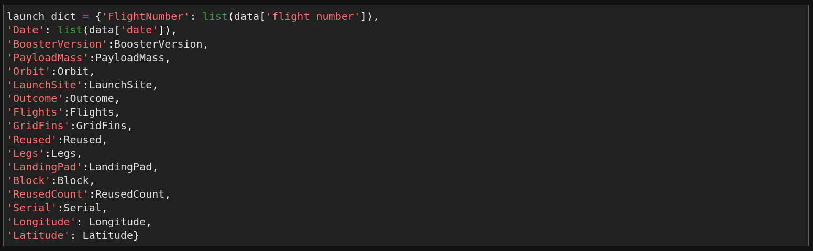
Data Collection: SpaceX API Data Collection (4/8)
The conditioned dataframe was then parsed out by column to create a dictionary data structure
The keys for the dictionary are the final column names, and the values are lists that were extracted using custom functions.
Extract lists from DataFrame using custom functions to create a dictionary
  The custom functions can be viewed at: https://github.com/markkhusid/Applied_Data_Science_Capstone

Slide 14
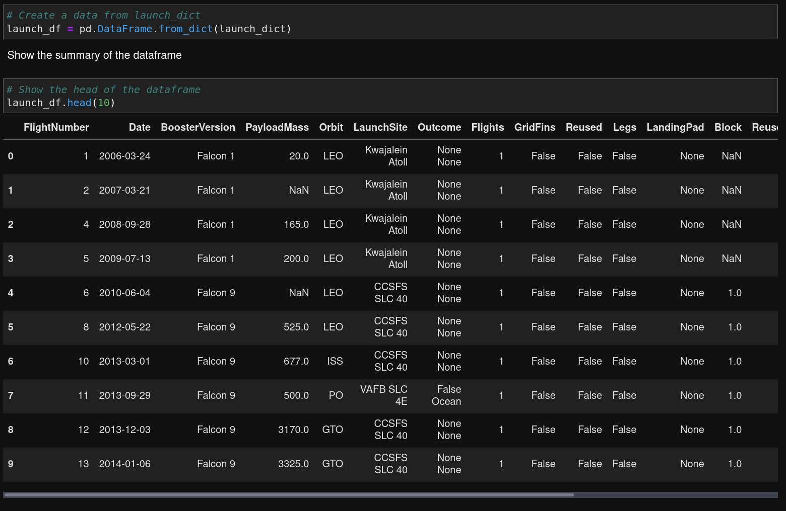
Data Collection: SpaceX API Data Collection (5/8)
The new Dataframe:
Extract lists from DataFrame using custom functions to create a dictionary
  The complete DataFrame can be viewed at:
  https://github.com/markkhusid/Applied_Data_Science_Capstone

Slide 15
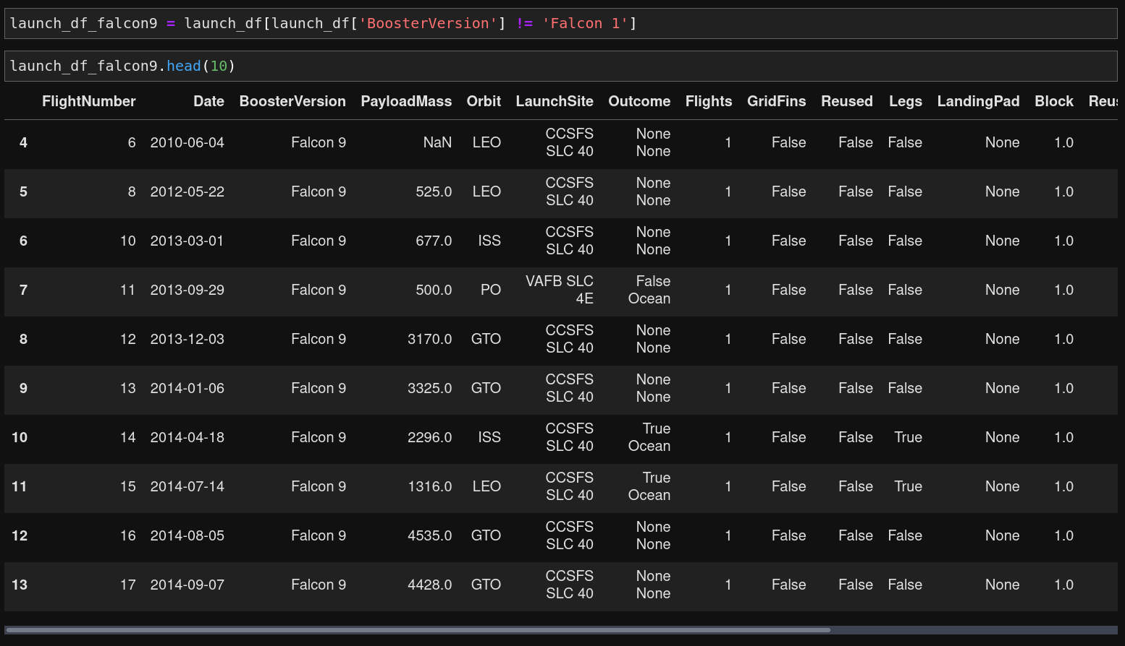
Data Collection: SpaceX API Data Collection (6/8)
The new contains entries for both the Falcon1 and Falcon9 launch vehicles.
Since our study is only focused on the Falcon9, we filter the DataFrame to only include Falcon9 launches.
Filter new DataFrame to only include Falcon9 launches
  The complete DataFrame can be viewed at:
  https://github.com/markkhusid/Applied_Data_Science_Capstone

Slide 16
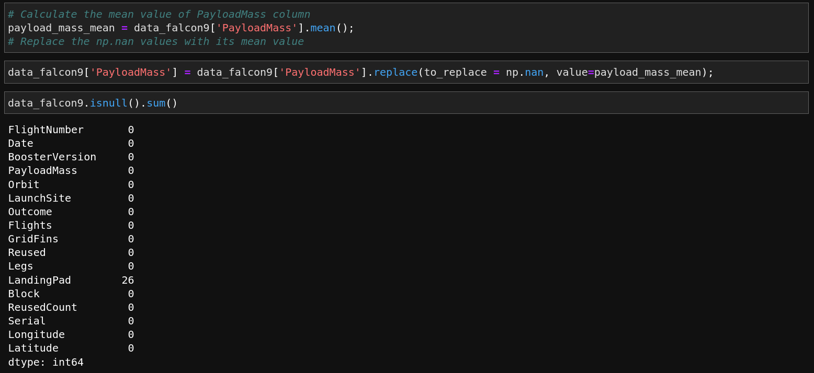
Data Collection: SpaceX API Data Collection (7/8)
The Falcon9 DataFrame contains some missing values.
Specifically, the Payload Mass column has 5 entries that were NaN.
  These will be filled in with the mean of the column.
Handle missing values in the DataFrame

Slide 17
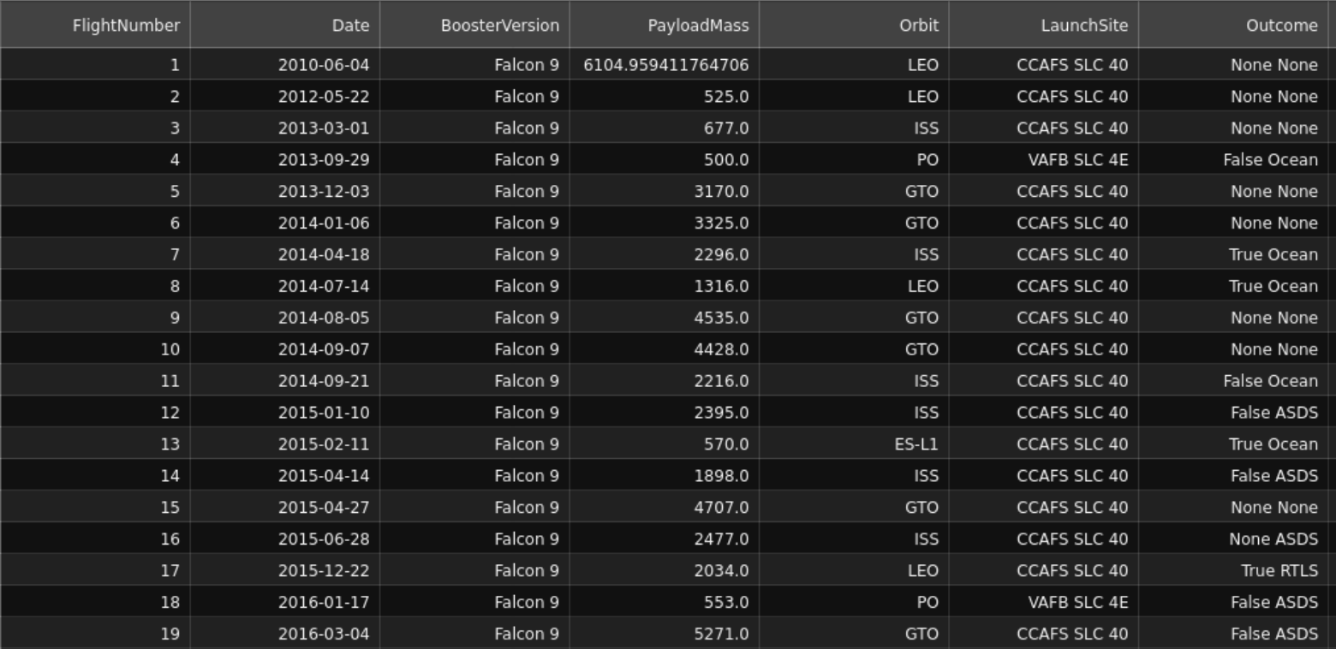
Data Collection: SpaceX API Data Collection (8/8)
Finally, the processed DataFrame is exported as a CSV file for further processing.
data_falcon9.to_csv('dataset_part_1.csv', index=False)
Export DataFrame to CSV format for further processing

Slide 18
Data Collection: SpaceX Wikipedia Entry Scraping
GitHub Link: Web Scraping

Slide 19
Data Collection – Scraping (boilerplate)
Present your web scraping process using key phrases and flowcharts
Add the GitHub URL of the completed web scraping notebook, as an external reference and peer-review purpose
Place your flowchart of web scraping here

Slide 20
Data Collection/Wrangling: SpaceX Wikipedia Entry Scraping Flowchart
Obtain Falcon9 launch data from SpaceX Wikipedia entry
Create a BeautifulSoup object from the returned HTML
Extract table headers to create column names
Extract table data from the HTML tables
Combine table headers and table data into a dictionary
Web Scraping
Data Wrangling
Export DataFrame to CSV format for further processing
Create a DataFrame from the dictionary
We will now discuss web scraping data from the SpaceX Wikipedia entry.

Slide 21
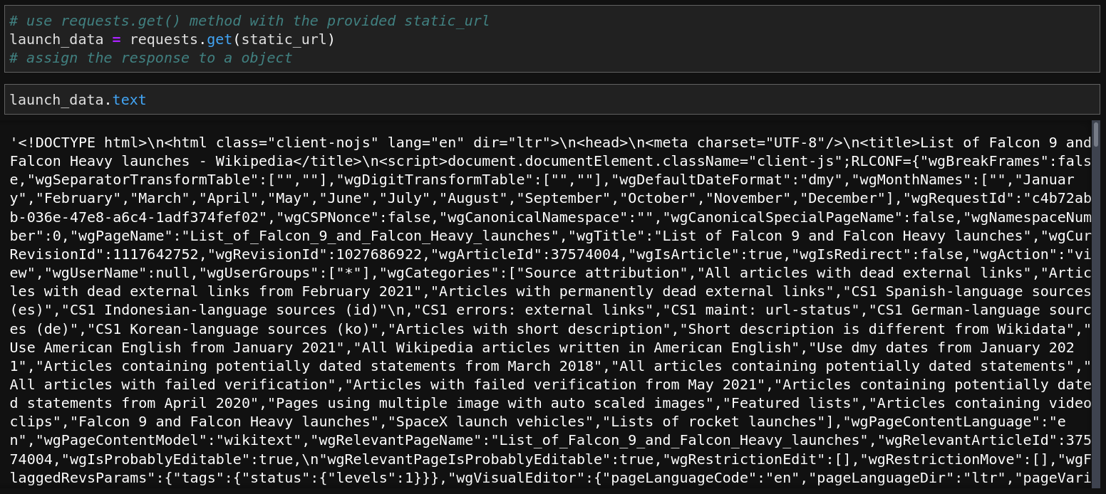
Data Collection: SpaceX Wikipedia Entry Scraping (1/1)
To obtain additional data for our analysis, the SpaceX Wikipedia entry’s tables were scraped.
  This involved loading the entire HTML contents of the Wikipedia webpage into a variable “launch_data”.
static_url = "https://en.wikipedia.org/w/index.php?title=List_of_Falcon_9_and_Falcon_Heavy_launches&oldid=1027686922"
Obtain Falcon9 launch data from SpaceX Wikipedia entry

Slide 22
Data Wrangling
GitHub Link: Data Wrangling

Slide 23
Data Collection/Wrangling: SpaceX Wikipedia Entry Scraping Flowchart
Obtain Falcon9 launch data from SpaceX Wikipedia entry
Create a BeautifulSoup object from the returned HTML
Extract table headers to create column names
Extract table data from the HTML tables
Combine table headers and table data into a dictionary
Web Scraping
Data Wrangling
Export DataFrame to CSV format for further processing
Create a DataFrame from the dictionary
We will now discuss Data Wrangling the Web Scraped Data from the SpaceX Wikipedia entry.

Slide 24
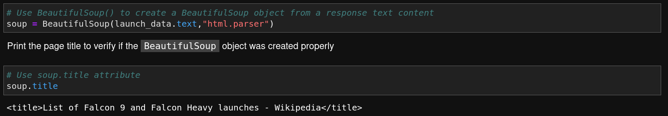
Data Wrangling: SpaceX Wikipedia Entry Scraping (1/8)
In order to parse the raw HTML data, the BeautifulSoup Python module was used
Create a BeautifulSoup object from the returned HTML

Slide 25
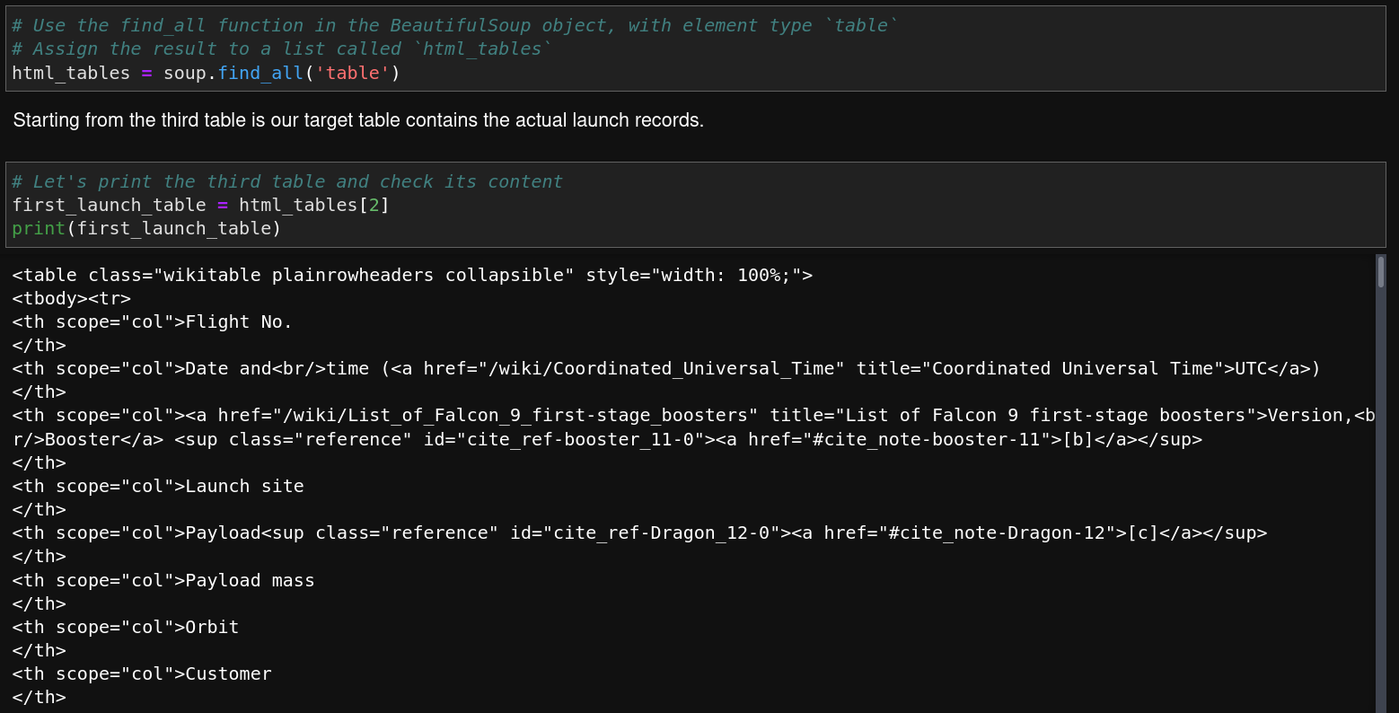
Data Wrangling: SpaceX Wikipedia Entry Scraping (2/8)
BeautifulSoup is used to extract all of the tables from the HTML.
The data we are interested in is contained in the third table:
Extract table headers to create column names

Slide 26
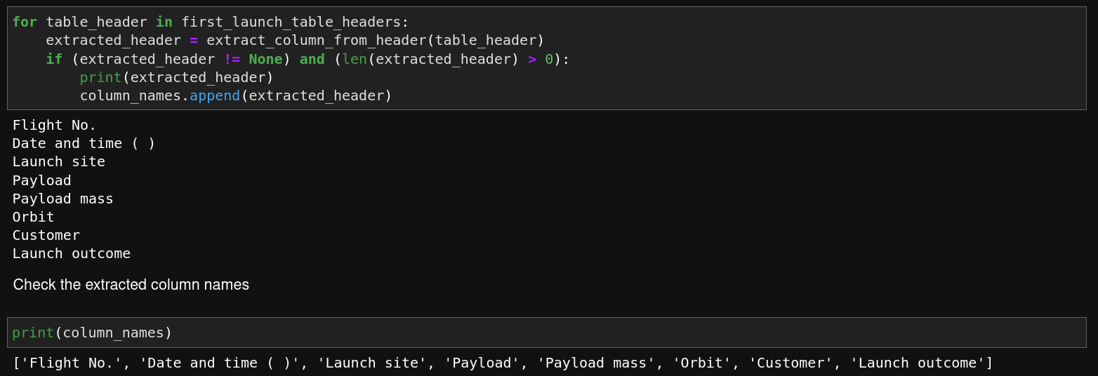
Data Wrangling: SpaceX Wikipedia Entry Scraping (3/8)
A loop and an extraction function are used to extract the column names from the table headers:
Extract table headers to create column names

Slide 27
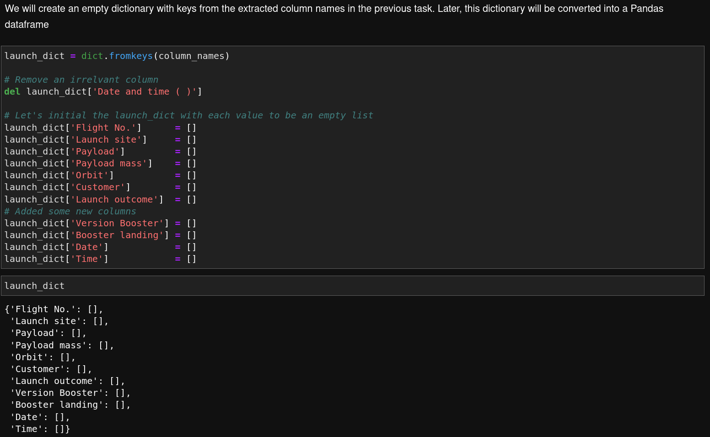
Data Wrangling: SpaceX Wikipedia Entry Scraping (4/8)
Now that the column names are extracted, a dictionary is setup where the keys are the column names and the values are empty lists that will hold the extracted table data:
Extract table data from the HTML tables

Slide 28
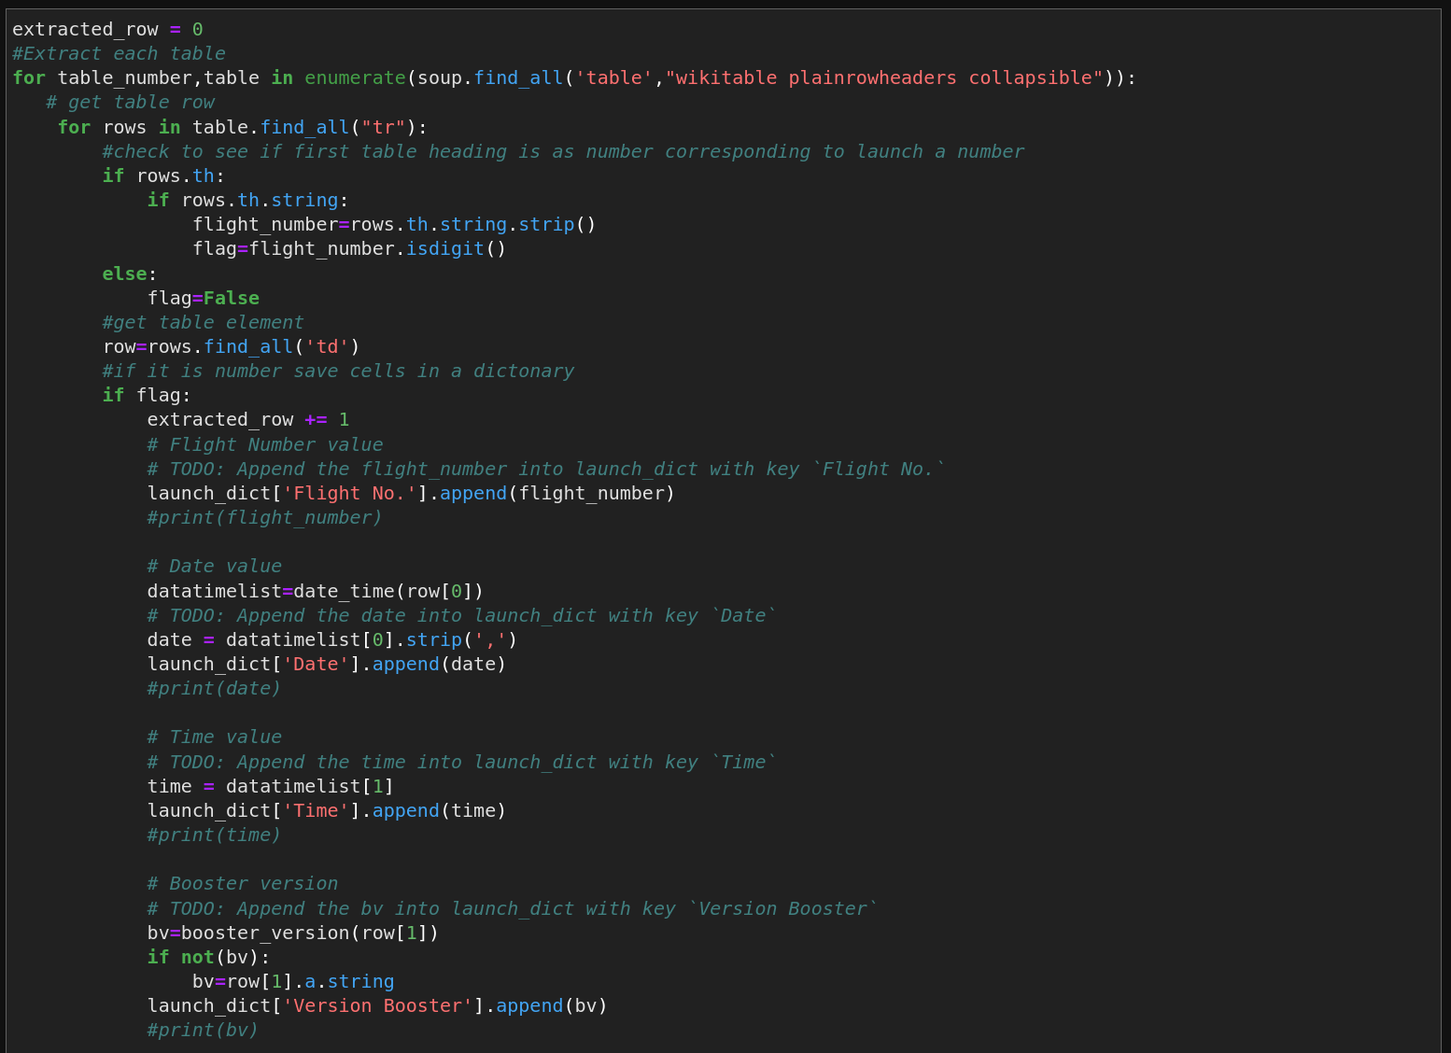
Data Wrangling: SpaceX Wikipedia Entry Scraping (5/8)
A loop is setup and in each run a table row is processed so that the appropriate entry lists in the dictionary are appended.
Combine table headers and table data into a dictionary

Slide 29
Data Wrangling: SpaceX Wikipedia Entry Scraping (6/8)
A loop is setup and in each run a table row is processed so that the appropriate entry lists in the dictionary are appended.
Combine table headers and table data into a dictionary

Slide 30
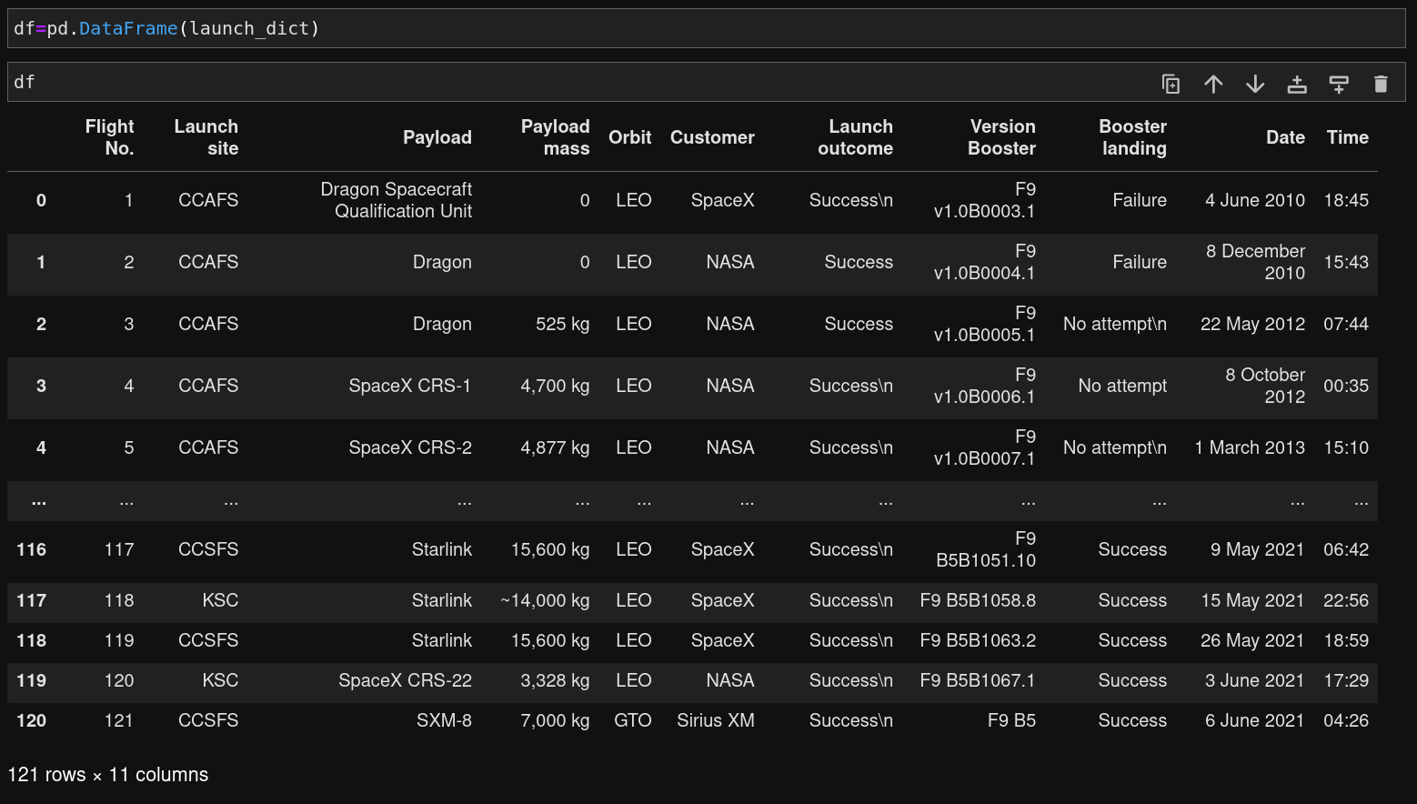
Data Wrangling: SpaceX Wikipedia Entry Scraping (7/8)
Now that the dictionary is filled up with the data that is pertinent to this analysis, we create a DataFrame from the dictionary:
Create a DataFrame from the dictionary

Slide 31
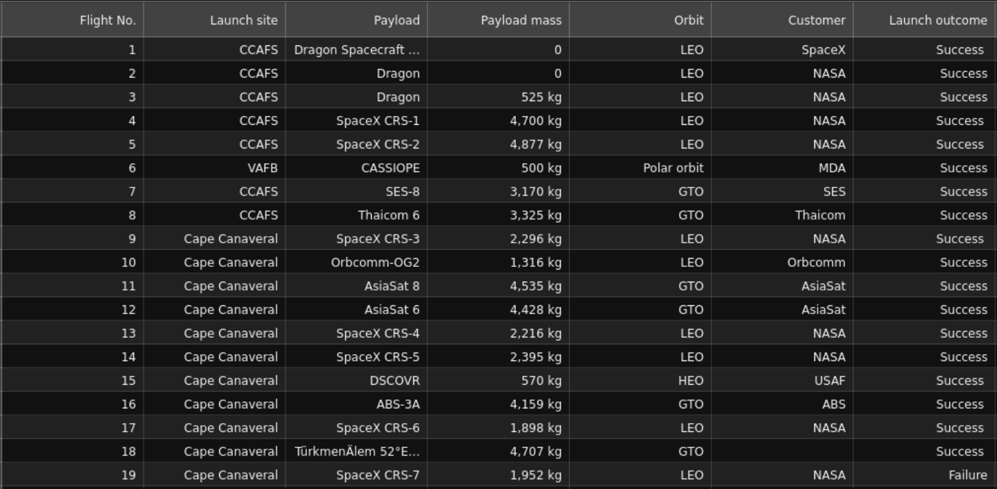
Data Wrangling: SpaceX Wikipedia Entry Scraping (8/8)
Finally, we export the DataFrame as a CSV file for further processing
df.to_csv('spacex_web_scraped.csv', index=False)
Export DataFrame to CSV format for further processing

Slide 32
Exploratory Data Analysis (EDA) with Data Visualization
GitHub Link: EDA with Data Visualization

Slide 33
EDA with Data Visualization (1/2)
To facilitate the study, an Exploratory Data Analysis (EDA) was undertaken by plotting the data to glean relationships between features.
A summary of plotted charts is as follows:
  A category plot of Payload Mass vs. Flight Number, with the category being mission success or failure.
    This is to glean a relationship between mission success and payload mass.
  A category plot of Launch Site vs. Payload Mass, with the category being mission success or failure.
    This is to glean a relationship between the launch site, payload mass, and mission success or failure.
  A bar plot of the normalized average success rate over all orbit types vs. Orbit Type.
    This is to assess which orbit types have a higher mission success rate.

Slide 34
EDA with Data Visualization (2/2)
  A category plot of the Orbit Type vs Flight Number
    This is to glean a relationship between the Orbit Type and the mission success rate.
  A category plot of the Orbit Type and the Payload Mass, with the category being the mission success rate.
    This is to glean a relationship between the Orbit Type, the Payload Mass and the mission success rate
  A line plot of the normalized mission success rate vs time in years.
    This is to see the relationship of the reliability of a successful mission over time.

Slide 35
Exploratory Data Analysis (EDA) with Structured Query Language (SQL)
GitHub Link: EDA with SQL

Slide 36
EDA with SQL (1/2)
For Exploratory Data Analysis (EDA), the data was entered into a database to enable search queries. The following queries were performed:
Task 1: A listing of all distinct launch sites.
Task 2: A listing of 5 records from the data where the launch sites begin with the string “CCA”
Task 3: A display of the total payload mass in kg launched by NASA (CRS)
Task 4: A display of the average payload mass in kg carried by the booster version F9 v1.1
Task 5: A display of the first date that a successful outcome of landing on a ground pad was achieved.

Slide 37
EDA with SQL (2/2)
Task 6: A listing of the names of the boosters which have had success in landing on a drone ship, and have payload masses between 4000 kg and 6000 kg.
Task 7: A listing of the total number of successful and failure mission outcomes.
Task 8: A listing of the names of the booster versions which have carried the maximum payload mass in kg.
Task 9: A listing of the records which will display the month names, failed landing outcomes in drone ship, booster versions, and the launch site for the months in year 2015.
Task 10: Rank the count of successful landing_outcomes between the date 04-06-2010 and 20-03-2017 in descending order.

Slide 38
Interactive Visual Analytics with Folium
GitHub Link: Interactive Visual Analytics with Folium

Slide 39
Build an Interactive Map with Folium (1/2)
In order to assess the affects of launch site to mission success, the launch sites were plotted on an interactive map, along with distance calculations to various topographical features. The process was:
  Task 1: Mark All Launch Sites on a Map
    Folium’s Circle object was used to add circle map markers to the map at the locations of the launch sites
  Task 2: Mark the Success/Failed Launches for Each Site on the Map
    Folium’s MarkerCluster object was used to mark the mission successes or failures for each launch site.
  Task 3: Calculate the Distances Between a Launch Site and Various Map Items
    Folium’s mouse position meter was added to the map and the coordinates of various map items near to the launch sites were noted.
    Using the geometry of rectangular coordinates, the distances from the launch sites to the various map items were calculated.
    A line was then drawn from the launch site to each map item and a distance marker was added.
Finally, questions were asked about the launch site’s distance to the various items on the map.

Slide 40
Build an Interactive Map with Folium (2/2)
The questions to answer were:
Question 1) Are launch sites in close proximity to railways?
Answer 1) Yes, CCAFS SLC-40 is about 1.28km away from a railway. A railway is critical to supplying material to the launch site.
Question 2) Are launch sites in close proximity to highways?
Answer 2) Yes, CCAFS SLC-40 is about 0.6km away from a highway. A highway is critical to supplying personnel and material to the launch site.
Question 3) Are launch sites in close proximity to coastline?
Answer 3) Yes, CCAFS SLC-40 is about 0.87kn away from the coastline. The vehicle is launched Eastward over the ocean for safety reasons; therefore, close proximity to a coast is advantageous.
Question 4) Do launch sites keep certain distance away from cities?
Answer 4) Yes, CCAFS SLC-40 is about 51.74km away from the city of Melbourne. This is done for safety reasons.

Slide 41
Interactive Visual Analytics with Plotly Dash
GitHub Link: Interactive Visual Analytics with Plotly Dash

Slide 42
Build a Dashboard with Plotly Dash
To enhance this study, an interactive dashboard application was created with Plotly Dash. The dashboard items are as follows:
Task 1: A dropdown box that allows for the selection of all or specific launch sites. When a choice is selected, this triggers the replotting of plots on the dashboard.
Task 2: A pie chart showing the:
  Success rate of all launch sites if “All Sites” is selected in the dropdown box, or
  The success and failure rate of a specific launch site when that launch site is selected from the dropdown box.
Task 3: A range slider that allows for the filtering of payload masses to values between 0kg to 10,000kg. Upon selection of a range, the scatter plot in Task 4 is updated.
Task 4: A scatter plot of:
  All mission success or failures vs payload mass as selected by the range slider in Task 3 if “All Sites” is selected from the drop down box, or
  The mission success or failures vs payload mass as selected by the range slider in Task 3 for a specific launch site as selected by the dropdown box.
  In all cases of the dropdown box and range slider settings, the color of the plotted points represents the mission success or failure.

Slide 43
Predictive Analysis (Classification)
GitHub Link: Predictive Analysis (Classification)

Slide 44
Predictive Analysis (Classification) (1/3)
In furtherance of the study, predictive analysis was used to create several machine learning models that attempt to predict mission success vs various features, such as:
Flight number
Payload mass
Number of flights
Booster version
Orbit type
Whether booster was resused
If booster was equipped with grid fins and/or legs.

Slide 45
Predictive Analysis (Classification) (2/3)
These features were fed into various models as training data, with the target being mission success or not.
Task 1,2: The features were normalized using SciKit Preprocessing StandardScaler.
Task 3: The features data was then split into a training and test set by a ratio of 80% training and 20% testing.
  This resulted in 72 rows of training data and 18 rows of test data, for a total of 90 rows.
  The training and test features data had 83 columns.

Slide 46
Predictive Analysis (Classification) (3/3)
With training and test data ready, the following models were created and tested:
  Task 4,5: Logistic Regression
  Task 6,7: Space Vector Machine
  Task 8,9: Decision Tree Classifier
  Task 10, 11: K Nearest Nearest Neighbor
For all models:
  A grid search was setup to tune for the best hyperparameters specific to the model.
  A confusion matrix was generated to assess the model’s accuracy.
Finally, the accuracy scores and best run scores were plotted to assess which model produced the best performance.

Slide 47

Section 2

Slide 48
Exploratory Data Analysis (EDA) with Data Visualization
GitHub Link: EDA with Data Visualization

Slide 49
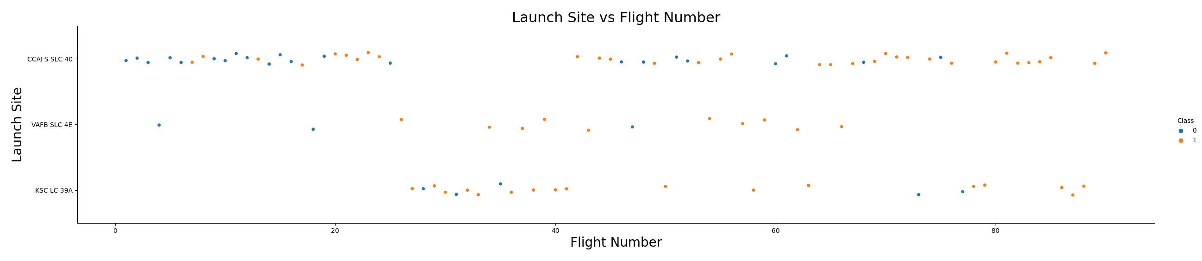
EDA with Data Visualization: Launch Site vs Flight Number
In the above figure, we can see the relationship between the various launch sites, flight numbers and mission success.
In the above figure, it appears that VAFB SLC 4E and KSC LC 39A had good mission success rates, while CCAFS SLC 40 appears to be 50/50.
The figure also shows a trend towards increasing mission success rates.

Slide 50
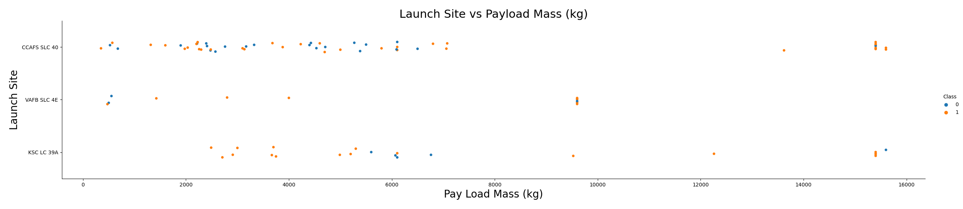
EDA with Data Visualization: Launch Site vs Payload Mass (kg)
In the above figure, we can see the relationship between the various launch sites, payload mass in kg and mission success.
The figure suggests that there are ranges of payload masses and specific locations where mission success is more prevalent.

Slide 51
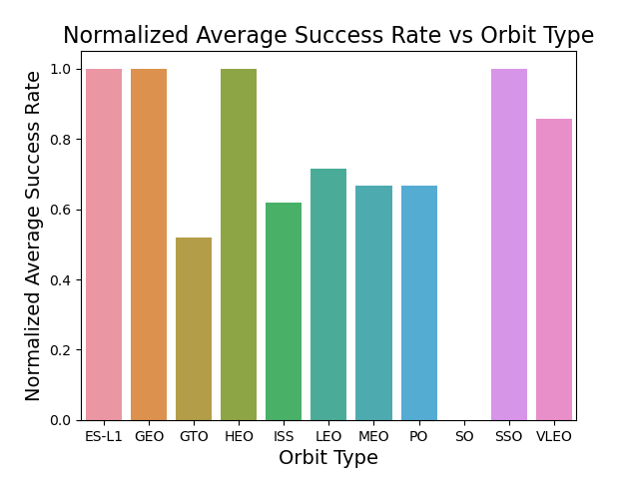
EDA with Data Visualization: Normalized Average Success Rate vs Orbit Type
To make the above figure, the data were grouped by orbit type, and the normalized average success rate for that orbit was calculated.
From the above figure, we can see that the ES-L1, GEO, HEO, and SSO orbits had the best results, while the SO orbit had the worst.

Slide 52
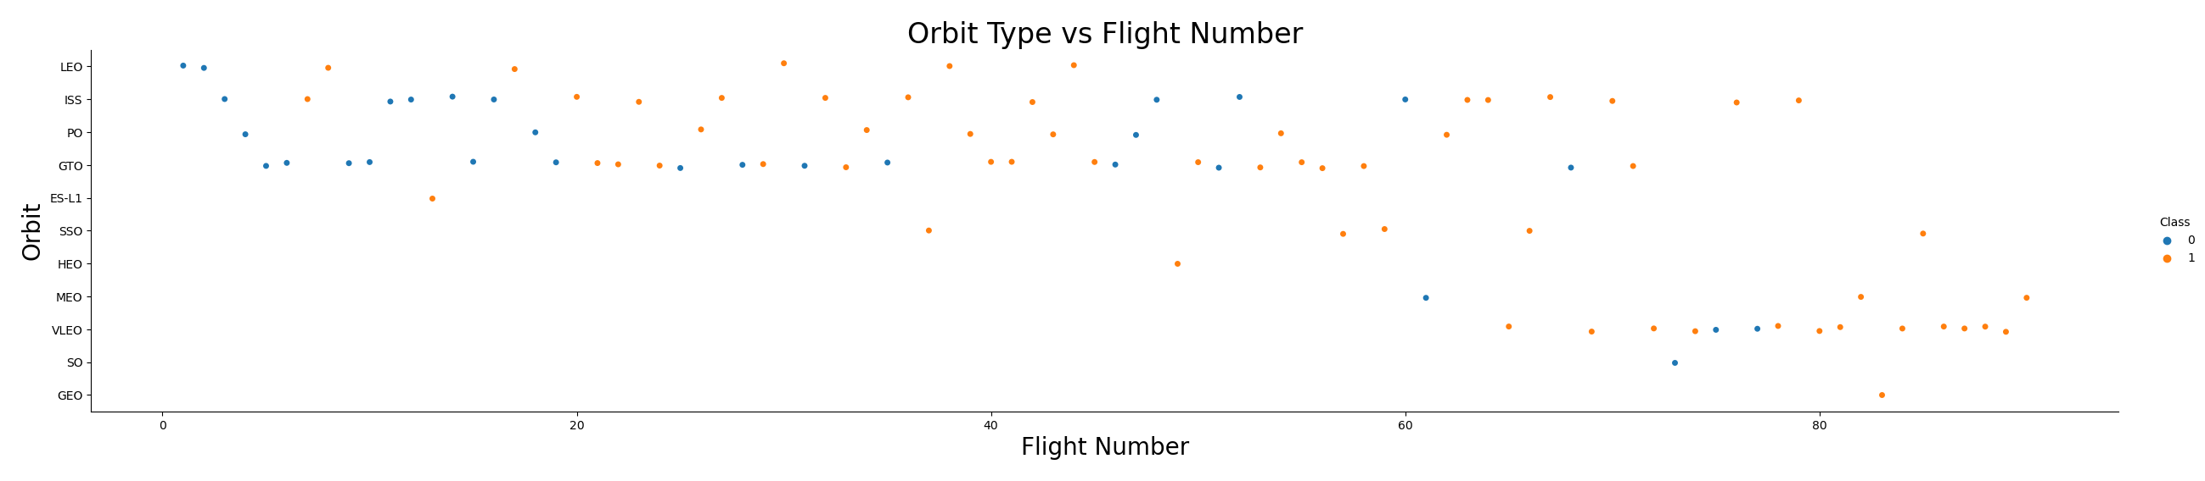
EDA with Data Visualization: Orbit Type vs Flight Number
In the above figure, we can see the relationship between the various orbit types, flight numbers and mission success.
It can be seen that the graph on the previous slide doesn’t tell the whole story with regards to high normalized average success rate.
A better insight in the mission success rate can be obtained by looking at orbit types that have more data points.

Slide 53
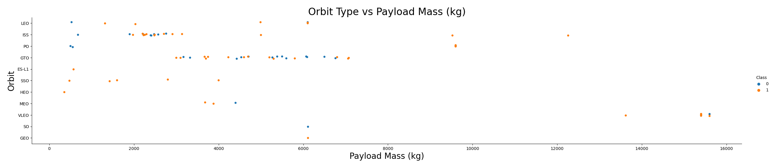
EDA with Data Visualization: Orbit Type vs Payload Mass (kg)
In the above figure, we can see the relationship between the various orbit types, payload mass and mission success.
The figure suggests that there are ranges of payload masses and orbit types where mission success is more prevalent.

Slide 54
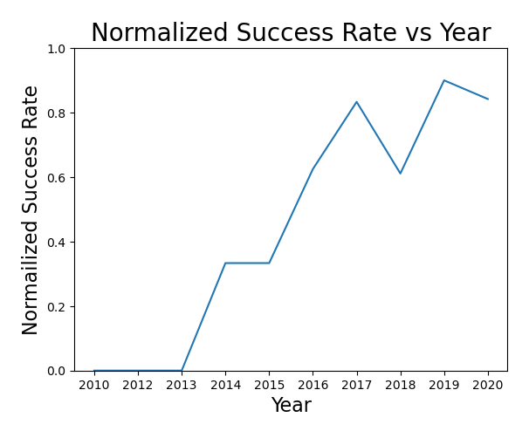
EDA with Data Visualization: Normalized Average Success Rate vs Orbit Type
To make the above figure, the data were grouped by launch year, filtered for success rate and the average of the success rate was taken for that year.
From the above figure, we can see that mission success rate generally trends upwards in time, despite a drop in the 2018 and 2020 time periods.

Slide 55
Exploratory Data Analysis (EDA) with Structured Query Language (SQL)
GitHub Link: EDA with SQL

Slide 56
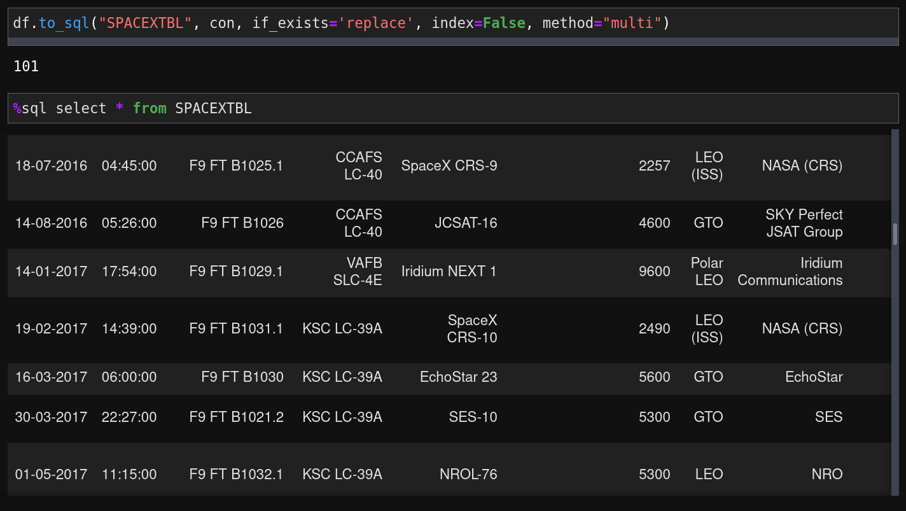
EDA with SQL: Create Table from DataFrame
The conditioned Dataframe was converted into a SQLite Table as shown below:

Slide 57
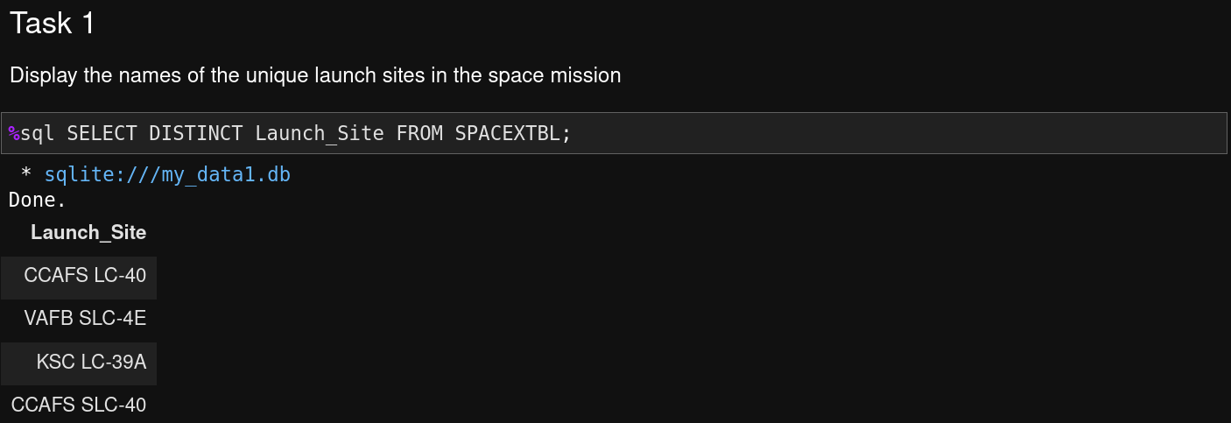
EDA with SQL: All Launch Site Names
From the above query response, we can see the names of the distinct launch sites used by SpaceX in this study.

Slide 58
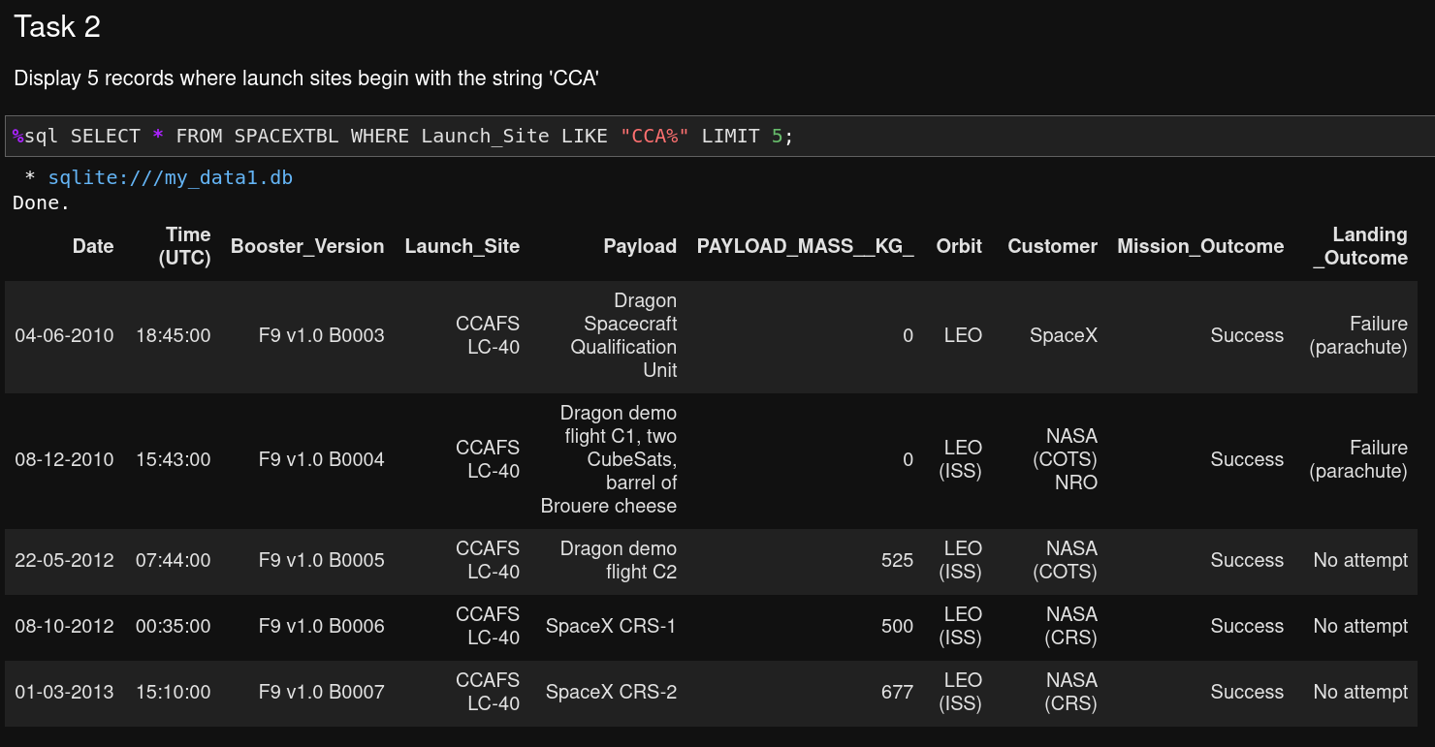
EDA with SQL: Launch Site Names that Begin with 'CCA'
In this query request, we find 5 records where launch sites begin with “CCA”.

Slide 59
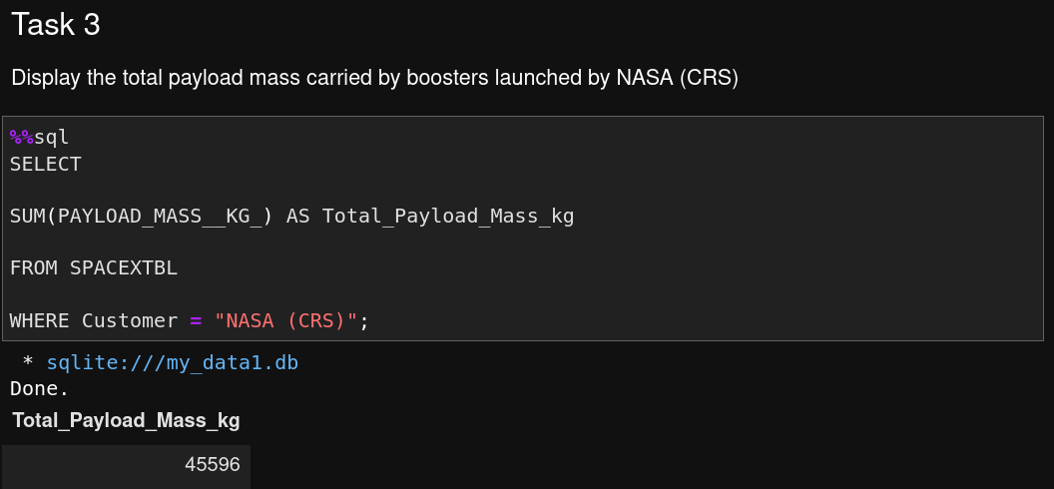
EDA with SQL: Total Payload Mass
The total payload mass in kg launched from NASA (CRS) is calculated and shown as a query results.

Slide 60
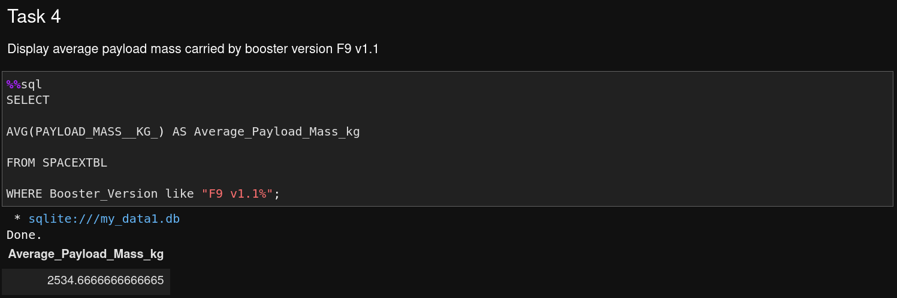
EDA with SQL: Average Payload Mass by F9 v1.1
The average payload mass carried by booster version F9 v1.1 was then queried and the results are shown above.

Slide 61
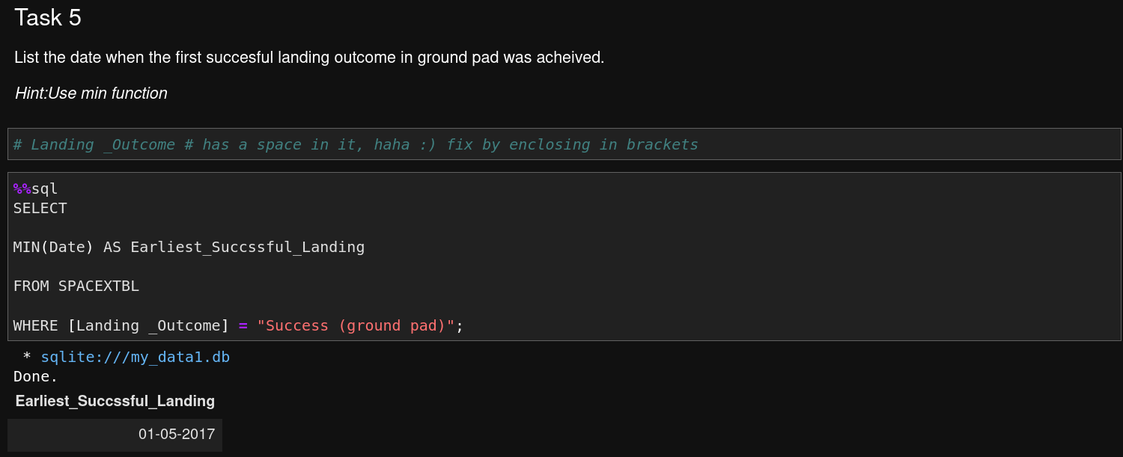
EDA with SQL: First Successful Ground Landing Date
The dates of the first successful landing outcome on ground pad was then queried and the results are shown above.

Slide 62
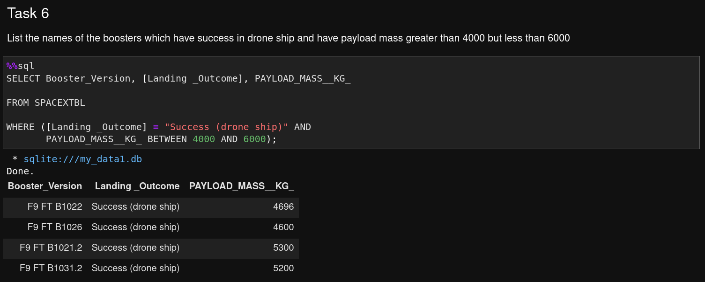
EDA with SQL: Successful Drone Ship Landing with Payload between 4000 and 6000
In the above query, the names of boosters which have successfully landed on a drone ship and had payload mass greater than 4000 but less than 6000 are shown.

Slide 63
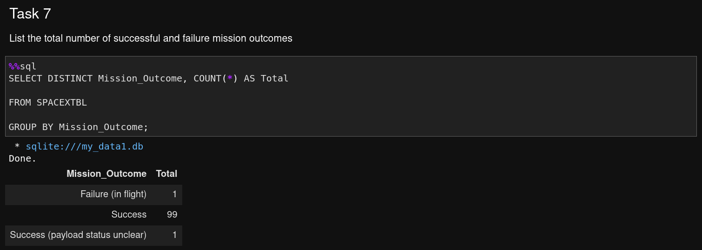
EDA with SQL: Total Number of Successful and Failure Mission Outcomes
The above query shows the total number of successful and failure mission outcomes.

Slide 64
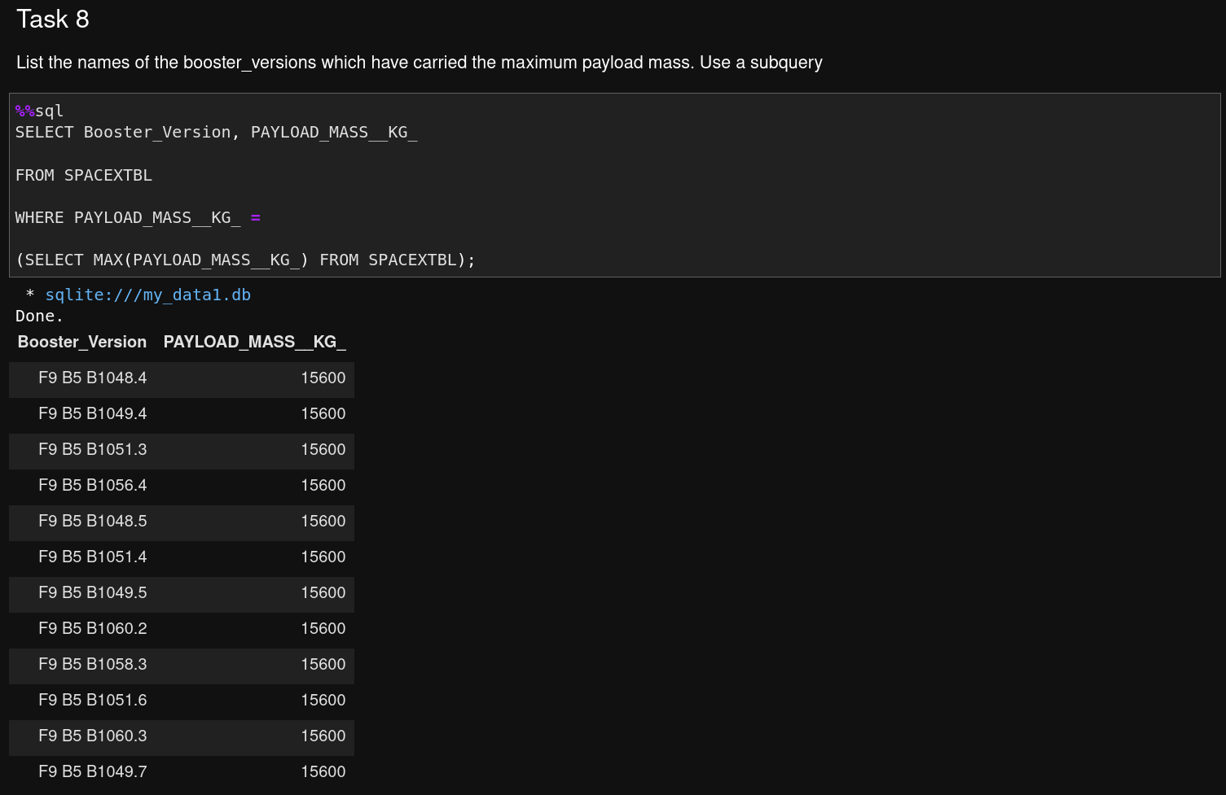
EDA with SQL: Boosters Carried Maximum Payload
The query shown lists the names of the booster which have carried the maximum payload mass.

Slide 65
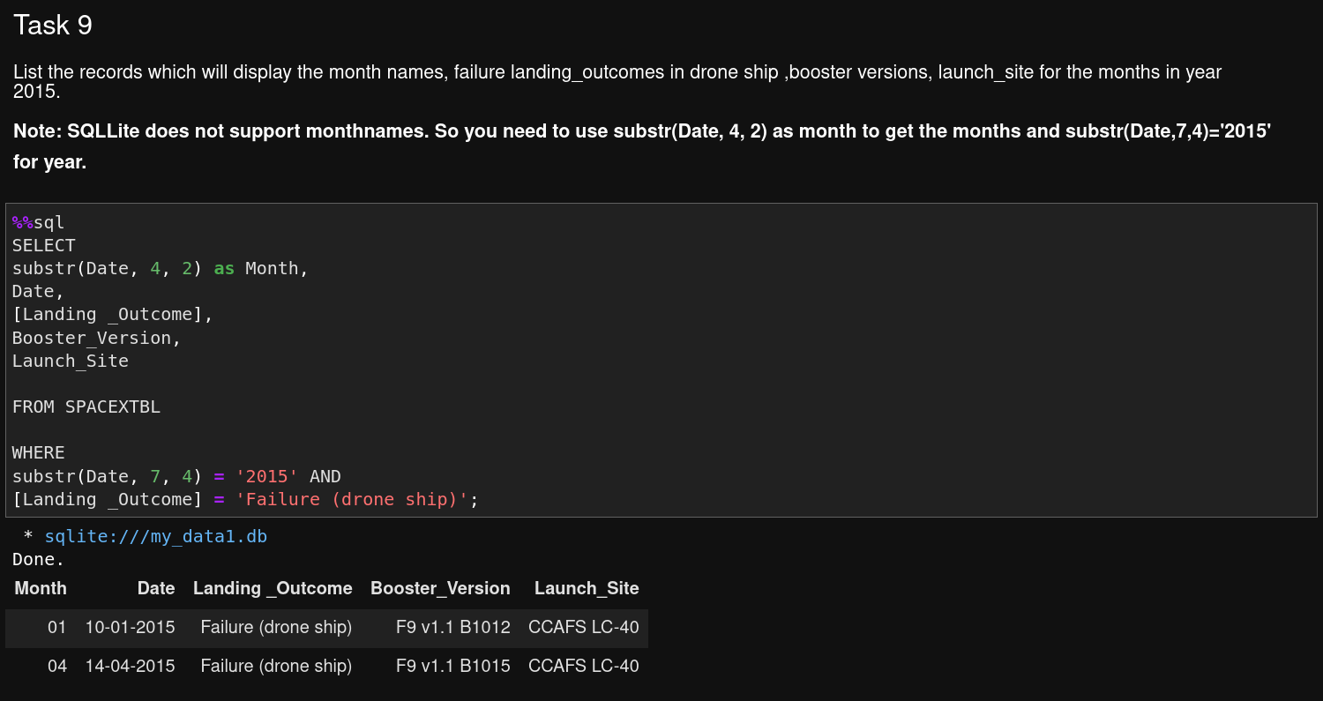
EDA with SQL: 2015 Launch Records
The query shown lists the failed landing_outcomes in drone ship, their booster versions, and launch site names for in year 2015

Slide 66
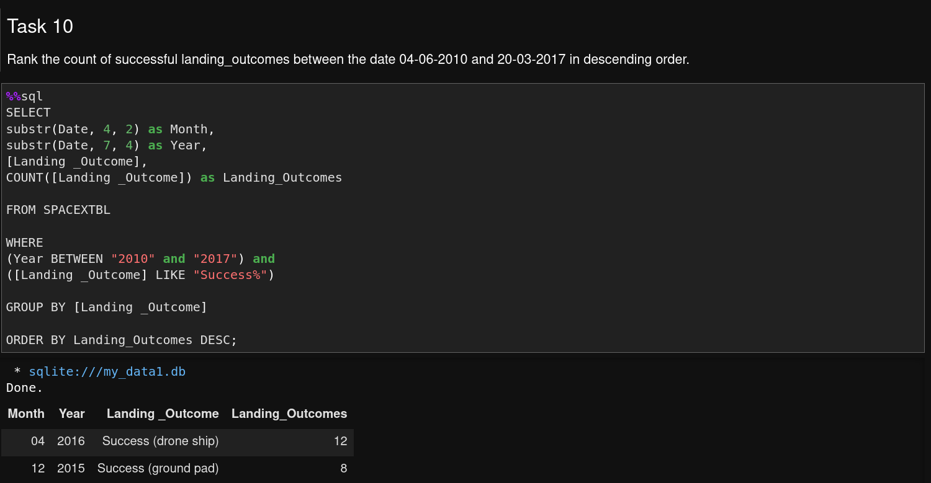
EDA with SQL: Rank Landing Outcomes Between 2010-06-04 and 2017-03-20
Rank the count of landing outcomes (such as Failure (drone ship) or Success (ground pad)) between the date 2010-06-04 and 2017-03-20, in descending order.

Slide 67

Section 3

Slide 68
Interactive Visual Analytics with Folium
GitHub Link: Interactive Visual Analytics with Folium

Slide 69
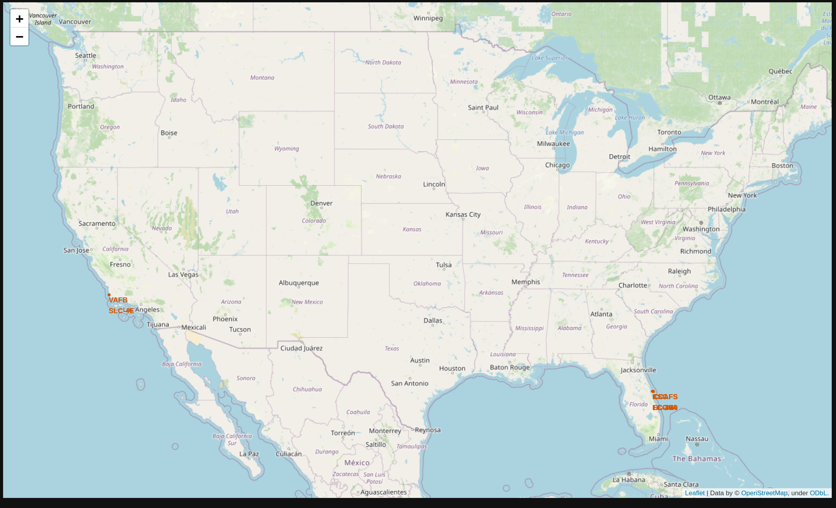
Launch Site Proximities Analysis: SpaceX Launch Sites
The generated map shows the SpaceX launch sites considered in this study.
As can be seen in the screenshots, there are launch sites on the West and East coasts of the Unite States.

Slide 70
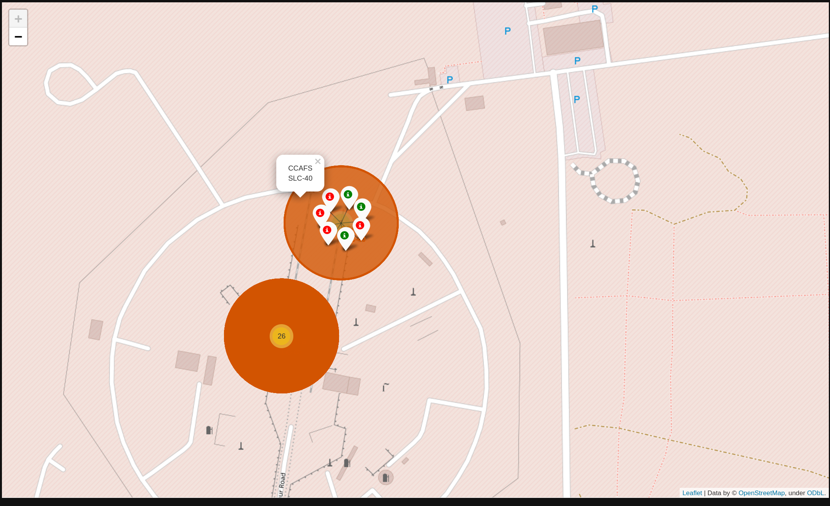
Launch Site Proximities Analysis: Mission Success or Failure (1/2)
The map to the right shows the mission successes (in green) and the mission failures (in red) for the launch site CCAFS SLC-40.
There were 7 total launches at this site.
The site adjacent to CCAFS SLC-40 is called CCAFS LC-40 and had a total of 26 launches.
This site is shown on the next slide.

Slide 71
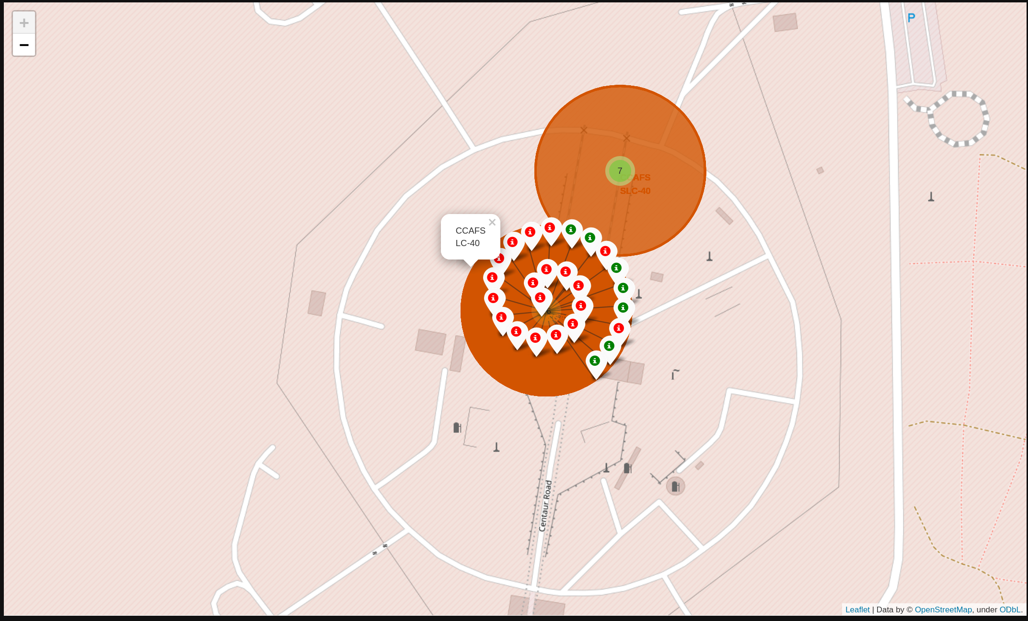
Launch Site Proximities Analysis: Mission Success or Failure (2/2)
The map to the right shows the mission successes (in green) and the mission failures (in red) for the launch site CCAFS LC-40.
There were 26 total launches at this site.
Greater than half of the launches at this site resulted in mission failure.

Slide 72
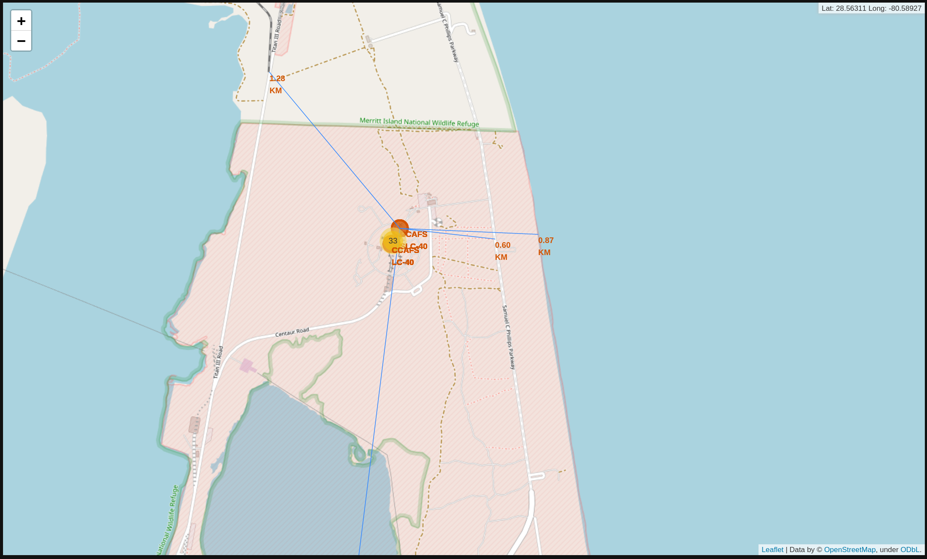
Launch Site Proximities Analysis: Vectors to Map Features (1/2)
As can be seen from the annotated map on the right, the launch site CCAFS SLC-40 is about:
  1.28km from a railroad
  0.6km away from a highway
  0.87km away from the coast

Slide 73
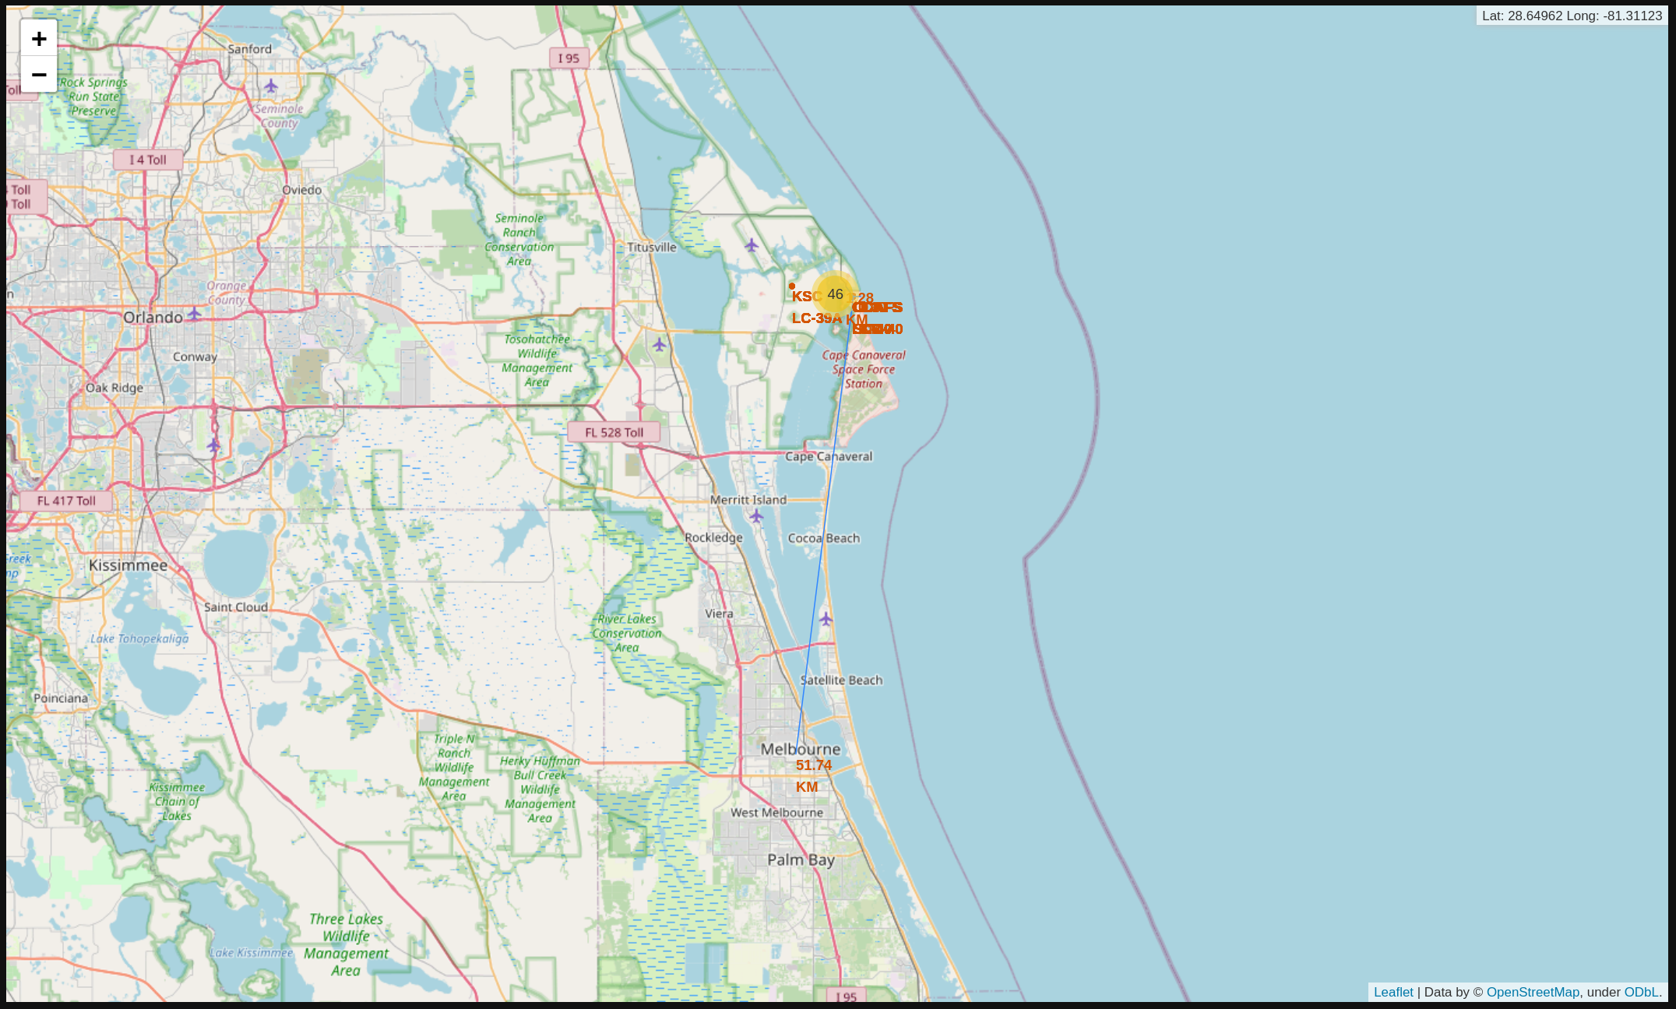
Launch Site Proximities Analysis: Vectors to Map Features (2/2)
As can be seen from the annotated map on the right, the launch site CCAFS SLC-40 is about:
  51.74km from the City of Melbourne

Slide 74

Section 4

Slide 75
Build a Dashboard with Plotly Dash
GitHub Link: Build a Dashboard Application with Plotly Dash

Slide 76
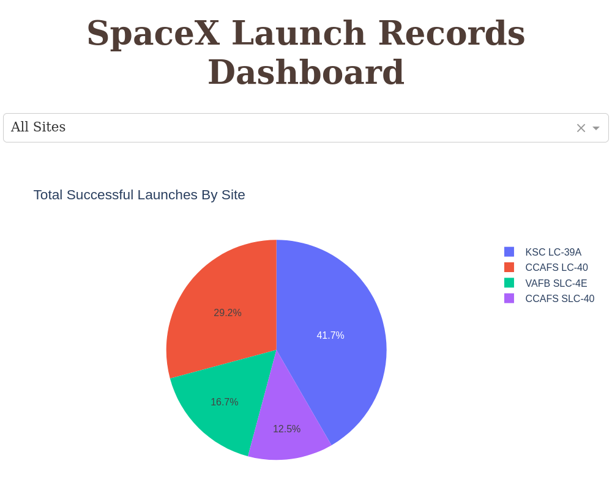
Plotly Dash Dashboard: Total Successful Launches by Site Pie Chart
The pie chart on the right displays , on a percentage basis, the total successful launches by site.
As can be seen from the pie chart, a large percentage of successful launches originated from KSC LC-39A and CCAFS LC-40.

Slide 77
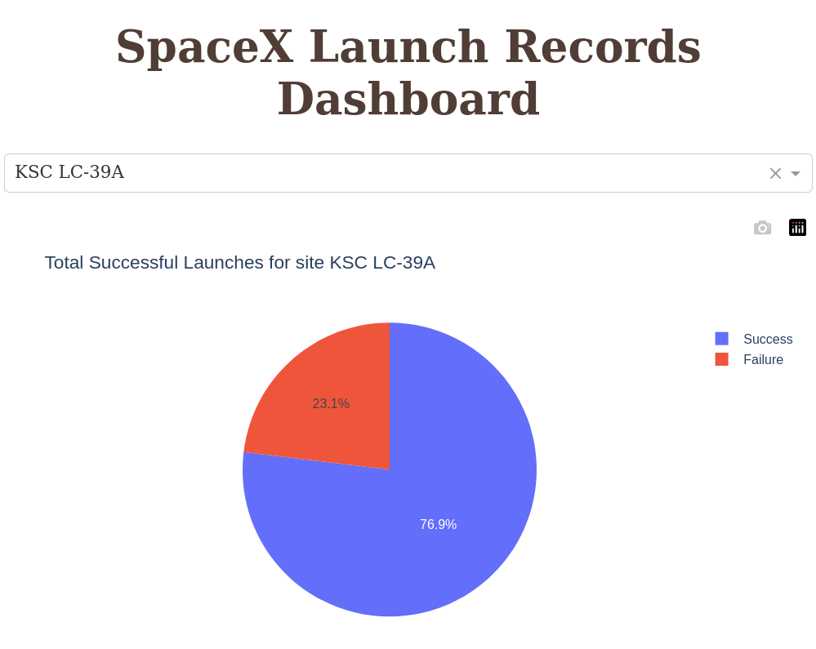
Plotly Dash Dashboard: Total Successful Launches from KSC-LC39A
Since KSC LC-39A had the highest percentage of successful launches, we examine it in greater detail.
By selecting this launch site from the drop down list, we can see that over ¾ of the launches from this site were successful.

Slide 78
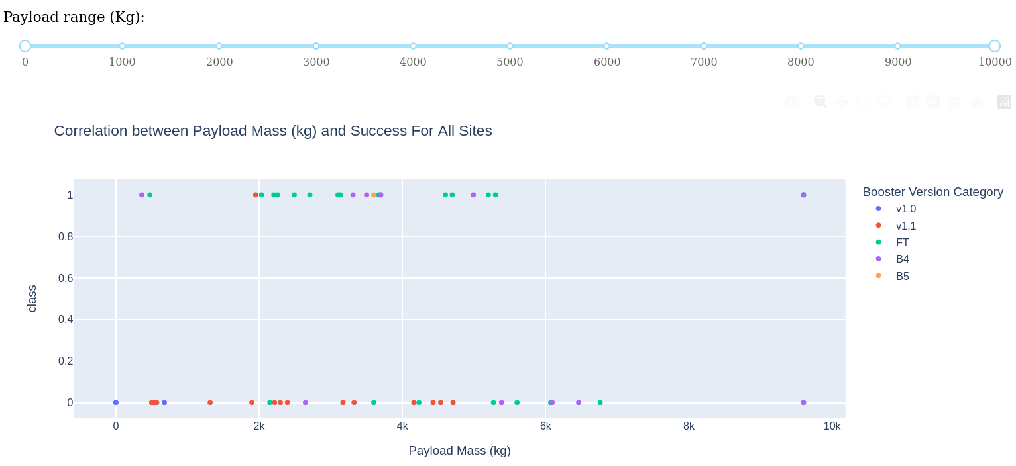
Plotly Dash Dashboard: Payload Mass vs Launch Outcome for All Sites
We now look for the launch outcomes based on payload mass in kg and booster version.
From the dashboard above, we can see a clustering of successful launch outcomes for payload masses between 2000kg and 6000kg.
In the next slide, we will use the slider to select this payload mass range.

Slide 79
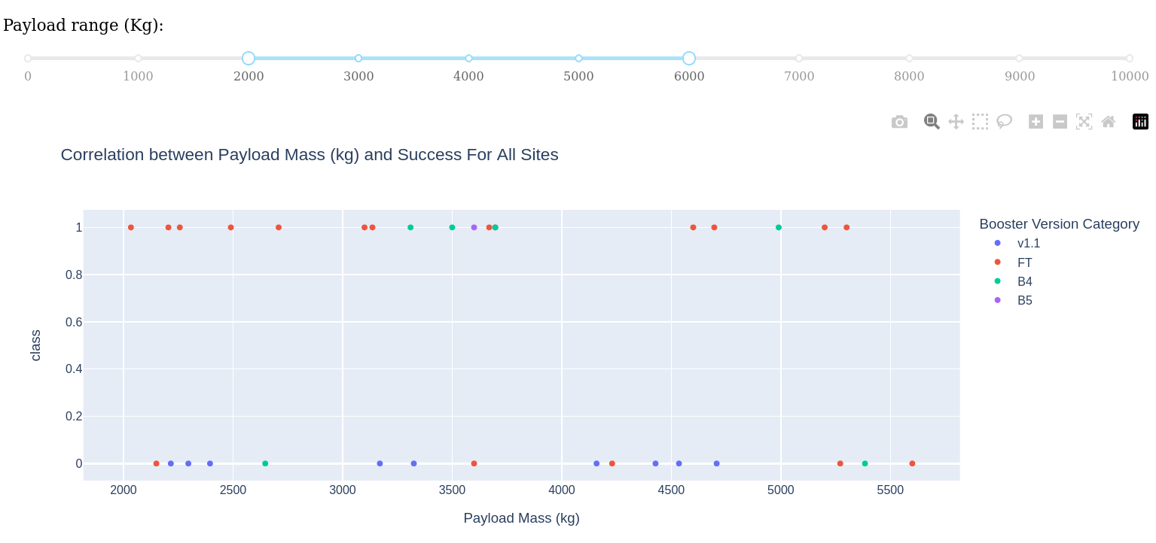
Plotly Dash Dashboard: Payload Mass vs Launch Outcome for All Sites
Zooming into the payload mass range of 2000kg to 6000kg, we can see a high mission success rate, particularly for the “FT” booster version.

Slide 80

Section 5

Slide 81
Predictive Analysis (Classification)
GitHub Link: Predictive Analysis Classification

Slide 82
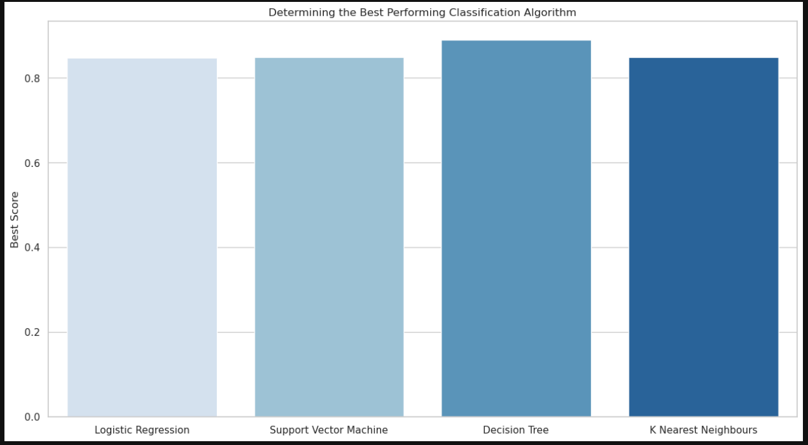
Classification Accuracy: Best Score
From the bar chart above, we can determine that the Decision Tree model had the highest best score; however, this may be misleading.
In the next chart we will see why...

Slide 83
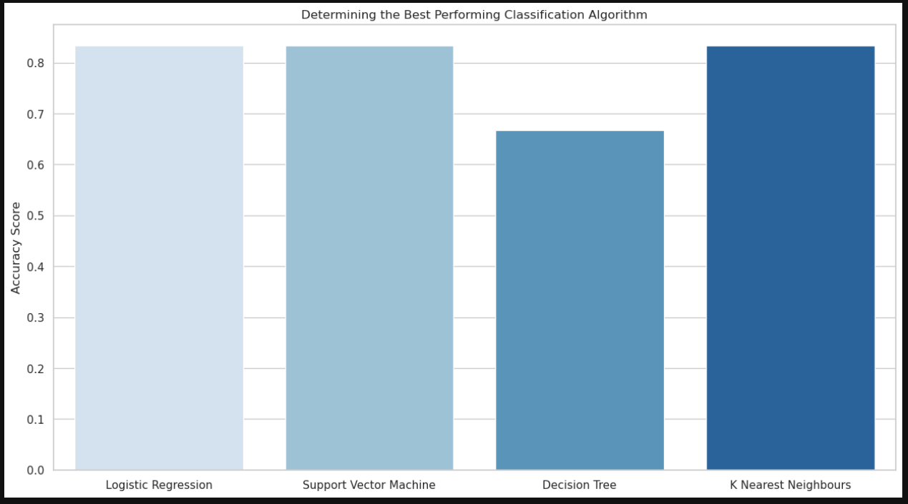
Classification Accuracy: Accuracy Score
In this chart we can see that although the Decision Tree model had the best score for a particular run, it does not have the best overall accuracy.

Slide 84
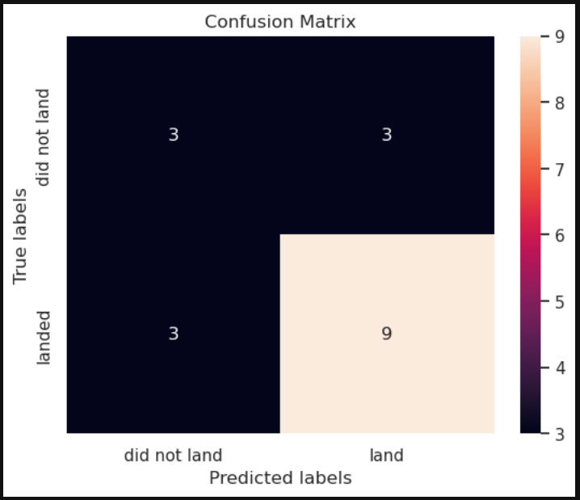
Classification Accuracy: Decision Tree Confusion Matrix
In this chart we can see the Confusion Matrix for the Decision Tree model.
The Confusion Matrix shows that the model incorrectly classified 3 as landed which actually did not land, and vice versa.

Slide 85
Classification Accuracy: Best Overall Model
Since the Decision Tree model had a lower accuracy score, we can look at the other models for higher accuracy.

Slide 86
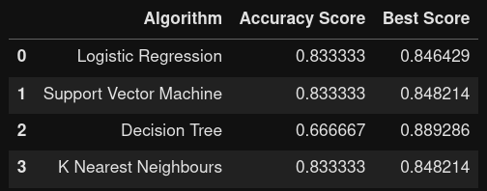
Classification Accuracy: Table of Model Performance
In this chart we can see that the K Nearest Neighbors and the Support Vector Machine models had the highest and more reliable accuracy and best scores.

Slide 87
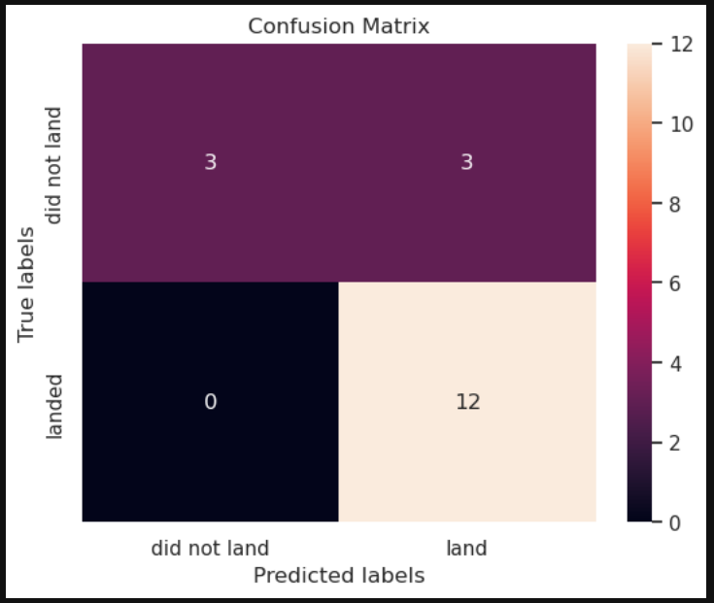

Confusion Matrix
K Nearest Neighbor
Support Vector Machine
From the above Confusion Matrices, we can see that the KNN and SVM models had similar performances.

Slide 88
Conclusions

Slide 89
Conclusions from Study: EDA with Pandas and Matplotlib
Insights drawn from EDA with Pandas and Matplotlib:
  It appears that VAFB SLC 4E and KSC LC 39A had good mission success rates, while CCAFS SLC 40 appears to be 50/50.
  Over time there is a trend towards increasing mission success rates.
  The plots of the data suggest that there are ranges of payload masses and specific locations where mission success is more prevalent.
  Plots of the data also suggested that the ES-L1, GEO, HEO, and SSO orbits had the best results, while the SO orbit had the worst.

Slide 90
Conclusions from Study: EDA with SQL
Insights drawn from EDA with SQL:
  Since the data suggests a range of payload masses where mission success is more prevalent, we used an SQL query to home in on this mass range.
  The query showed that the boosters which have successfully landed on a drone ship had payload masses greater than 4000kg. but less than 6000kg.

Slide 91
Conclusions from Study: Interactive Visual Analytics with Folium Analysis
Insights drawn from the Interactive Visual Analytics with Folium Analysis:
  The study looked at two launch sites:
    CCAFS LC-40 and
      There were 7 total launches at this site.
      3/7 of the launches at this site resulted in mission success
    CCAFS SLC-40
      There were 26 total launches at this site.
      Less than half resulted in mission success.
  An analysis of the proximity of these launch sites to other features on the map such as highways, the coast, railroads and nearest city showed that the launch sites were close to a highway, a railroad, the coast, but were far away from the city of Melbourne.

Slide 92
Conclusions from Study: Dashboard with Plotly Dash Analysis
Insights drawn from Dashboard with Plotly Dash Analysis:
  A pie chart plot indicates that a large percentage of successful launches originated from KSC LC-39A and CCAFS LC-40.
  KSC LC-39A had the highest percentage of successful launches, where over ¾ of the launches from this site were successful.
  With a payload mass range of 2000kg to 6000kg, we can see a high mission success rate, particularly for the “FT” booster version.

Slide 93
Conclusions from Study: Predictive Analysis (Classification)
Insights drawn from Predictive Analysis (Classification):
  The Decision Tree model had the best predictive score but lowest overall accuracy.
  The K Nearest Neighbors and the Support Vector Machine models had the highest and more reliable accuracy and best scores.

Slide 94


