Slide 1
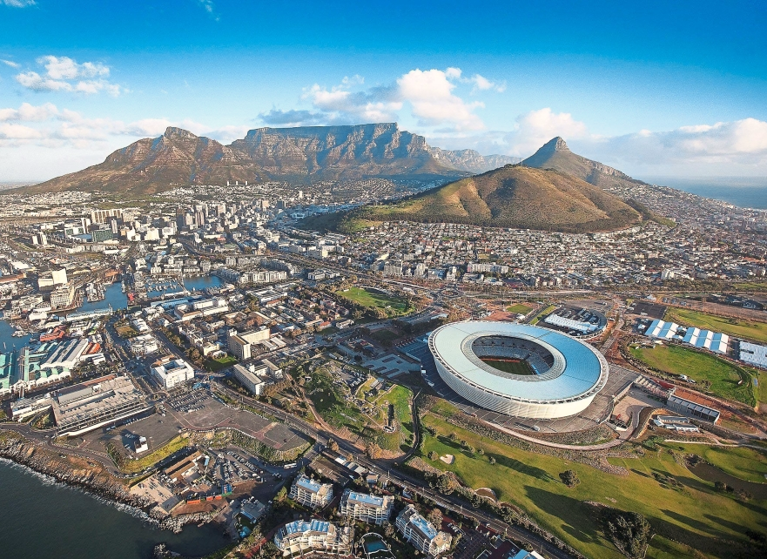
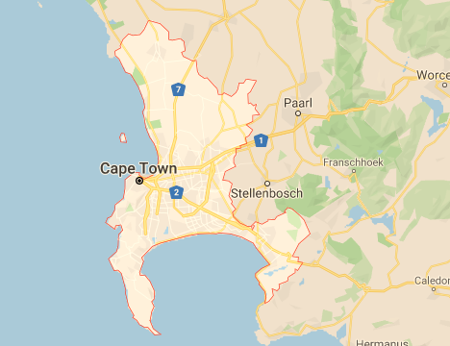
Where to settle a hotel business in Cape town?
Chokchai kla-aim
JUNe 1, 2020

Slide 2
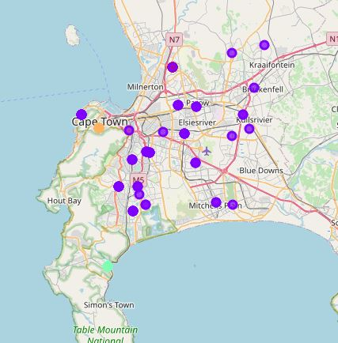
Cape town
Urban-friendly area
1.Coffee shops
2.Coveninent stores
3.Hotel

Slide 3
Cape town
Natural area
1.Hotels
2.Coffee shops
3.Farm

Slide 4
Cape town
Beach and party area
1.Seafood restaurants
2.Grocery Stores
3.Pubs

Slide 5
Recommendation
Beach and party area
1.Lower density of hotels
2.Business expansion
&integration opportunities

