Slide 1

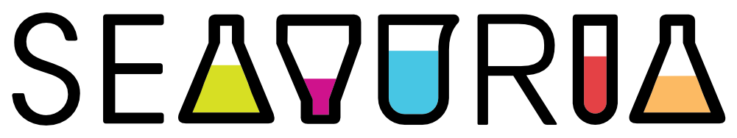
GRADE 10 BIOLOGY · CELL STRUCTURE · LESSON 1 OF 12 · 40 MINUTES
TODAY’S LESSON
The Healing Cut
Predict
Observe
Explain
Launching our investigation: why do the cells in our body look so different from each other?
Driving Question Board
Model Building
© 2026 SeaVuria & ARES Education · CC BY-NC 4.0 · Biology G10 · Cell Structure · Lesson 1
Notes:
LESSON 1 — THE HEALING CUT (40 minutes)
PURPOSE OF THIS LESSON
This lesson does not teach content. Its job is to make students curious. Students meet a puzzle (a cut finger that heals), write their first ideas, and ask questions. You will NOT give answers today. The lesson ends with students still wondering — that is the goal.
BEFORE CLASS (see the hidden slides 2 and 3 for the full checklist)
• Make the Driving Question Board (DQB): a large sheet of paper with two columns — “What do we notice?” and “What do we wonder?”. Write the driving question across the top, then COVER it with a folded sheet. You will uncover it near the end.
• Two colours of sticky notes, 2 per student (yellow and blue). No sticky notes? Use small squares of paper and tape.
• A timer you can show or call out (a phone is fine).
• Students need their science notebooks.
• No projector? Every slide can be read aloud. The notes tell you what to say.
Presenter View lets you read these notes while students see only the slide.

Slide 2

TEACHER ONLY · HIDDEN
How these lessons work: one routine, five phases
This slide is hidden. It will not show when you present.
Predict
Students write their own idea BEFORE anyone teaches. Writing first gives every student a starting point.
Three habits, every lesson
Wait time. Count silently to 5–10 seconds after a question. Do not rephrase.
Do not correct yet. In Predict and Observe, record ideas exactly as students say them.
Call on everyone. Choose students who do not usually raise a hand.
Observe
Students look at evidence: a story, pictures, diagrams, a practical. They record what they see.
Explain
You help students make sense of the evidence. Now you correct ideas — using the evidence.
Question Board
The Driving Question Board shows what the class knows and still wonders. Update it every lesson.
Model Building
Each student keeps one model that they revise across the unit. Revising IS the learning.
A “Check for understanding” label means this slide includes a formative check. The Notes tell you what to look for.
© 2026 SeaVuria & ARES Education · CC BY-NC 4.0 · Biology G10 · Cell Structure · Lesson 1
Notes:
TEACHER ONLY — HIDDEN SLIDE
HOW TO USE THE NOTES
Every slide has notes written for you, in the same order:
• TIME — how long to spend.
• DO — what to do, step by step.
• SAY — words you can read aloud. Change them to suit your class.
• WAIT TIME — how long to stay silent after a question.
• LOOK FOR — what to listen and look for. This is your formative assessment.
• IF… — what to do when students are stuck or something goes wrong.
• WHY THIS WORKS — the reason behind the strategy, so you can use it in other lessons too.
Tip: In PowerPoint, use Presenter View (Slide Show → Use Presenter View) so you can read these notes while students see only the slide.

Slide 3


TEACHER ONLY · HIDDEN
Lesson 1 at a glance
PHASE
TIME
WHAT STUDENTS DO
Prepare before class
DQB poster, driving question covered
Yellow + blue sticky notes (2 per student)
Timer
Science notebooks
Projector OR read the image descriptions aloud
Predict
5 min
Listen to Amina’s story with eyes closed. Write: “What is happening inside her finger right now?”
Observe
10 min
Share predictions in pairs. Look at four pictures of a healing cut. Pairs share ideas; you write their exact words.
Explain
7 min
Answer three questions, one at a time. Hear the “bridging statement”. No answers given.
Question Board
10 min
Write one “notice” and one “wonder” sticky note. Post them on the DQB. Meet the driving question.
ARES RESOURCES
Model Building
5 min
Draw Version 0: “What do I think a cell looks like?”
Wound Healing Process — CK-12 (best match)
Organization in the human body — Khan video
Question Board
3 min
Summary Table: start in class, finish at home.
Cell parts & functions — Khan (optional)
© 2026 SeaVuria & ARES Education · CC BY-NC 4.0 · Biology G10 · Cell Structure · Lesson 1
Notes:
TEACHER ONLY — HIDDEN SLIDE
RESOURCES FROM THE SCHEME OF WORK
• Best match for today: “Wound Healing Process” (CK-12 PLIX). Use it to prepare yourself, or show it instead of the four pictures on slides 9–12.
• “Organization in the human body” (Khan Academy video): background for you. Not needed in class today.
• The Scheme of Work also lists “Cell parts and their functions”, “Cell structures and their functions”, “Comparing animal and plant cells”, “Plant vs animal cells”, “Overview of animal and plant cells” and “Apply: cell parts and functions”. These are marked “not an exact match” for this lesson. Do not show them today — they would give students answers before they have asked the questions. They fit Lessons 4 and 5.
To open a resource, click its button (it opens in ARES). If a button does not open, search ARES for the resource title.

Slide 4
UNIT MAP
Where we are in the unit
YOU ARE HERE
1
2
3
4
5
6
7
8
9
10
11
12
The healing cut
What is a cell?
Prokaryotes & eukaryotes
Plant cells
Animal cells
Onion cells (practical)
Cheek cells (practical)
Specialised animal cells
Specialised plant cells
Cell organisation
Putting it together
Final explanation
Today
We start with something everyone has seen: a cut finger that heals.
Driving question for the whole unit
Why do cells in our body look so different from each other — and how does the shape of a cell determine the job it can do?
© 2026 SeaVuria & ARES Education · CC BY-NC 4.0 · Biology G10 · Cell Structure · Lesson 1
Notes:
TIME: 1 minute
DO
• Show the 12 circles. Tell students this is the journey for the next few weeks.
• Do not read the driving question aloud yet. You will reveal it on the Question Board later in the lesson. If students ask, say: “Hold that thought — we will come back to it.”
SAY
• “Over the next 12 lessons we are going to solve a puzzle about our own bodies. Today is lesson 1. Today we ask questions. We do not answer them yet.”
WHY THIS WORKS
• Students learn better when they know where a lesson fits. A unit map gives them the big picture before the details.

Slide 5


TODAY
By the end of this lesson you can…
Observe what happens to a finger as a cut heals.
Predict what might be happening inside the finger — there are no wrong answers today.
Ask questions that will guide our next 11 lessons.
© 2026 SeaVuria & ARES Education · CC BY-NC 4.0 · Biology G10 · Cell Structure · Lesson 1
Notes:
TIME: 1 minute
DO
• Read the three goals aloud.
SAY
• “Today, nobody can be wrong. I want your honest ideas, not the ‘right answer’.”
WHY THIS WORKS
• Saying “no wrong answers” out loud makes it safe for students to share half-formed ideas. You need those ideas to see what they already think.

Slide 6

PREDICT
Close your eyes.
Listen to Amina’s story.
© 2026 SeaVuria & ARES Education · CC BY-NC 4.0 · Biology G10 · Cell Structure · Lesson 1
Notes:
PREDICT PHASE (5 minutes total)
TIME: 2 minutes
DO
• Ask students to close their eyes.
• Read the story below slowly, with feeling. Pause at each full stop.
SAY
• “Amina is in the kitchen in Eastleigh, helping her mother prepare supper. She is slicing onions — the smell is sharp, her eyes are beginning to water. Then the knife slips. She looks down and sees a thin line of red appear on her fingertip. She presses it with her thumb. After about a minute, the bleeding is already slowing down. A dark, sticky material begins to form… What is happening inside that finger right now?”
WHY THIS WORKS
• A story about an everyday event in a familiar place makes the science feel real. Closing eyes helps students picture it and focus.

Slide 7


PREDICT
What do you think is happening inside Amina’s finger right now?
2:00
Write in your notebook.
Write anything that comes to mind.
Do not talk. Do not look at your neighbour.
There are no wrong answers today.
© 2026 SeaVuria & ARES Education · CC BY-NC 4.0 · Biology G10 · Cell Structure · Lesson 1
Notes:
TIME: 3 minutes (2 minutes of silent writing)
DO
• Students open their eyes and write.
• Start a 2-minute timer. Stay silent. Walk slowly between the rows.
• Read over shoulders WITHOUT commenting.
SAY
• “I want everyone to write in your notebook. Do not talk yet. Do not look at your neighbour. Just write what you think. You have 2 full minutes.”
WAIT TIME
• The full 2 minutes. Do not hint or prompt. Your silence tells students that thinking time is real.
LOOK FOR (formative check)
• What range of ideas do students have? Do they mention blood clotting, skin repair, germs/bacteria, or specific cells (platelets, white blood cells)?
• Or do they only describe the outside of the wound (“it bleeds, then it stops”)?
• Make a mental note. You will use it to guide the class discussion.
WHY THIS WORKS
• Writing BEFORE talking means every student has their own idea — not just the confident ones. These notebook entries are their starting point. In Lesson 12 they will compare them with what they finally understand.

Slide 8

OBSERVE
Share with your partner
Read your prediction to your partner.
What is the same?
What is different?
1:30
© 2026 SeaVuria & ARES Education · CC BY-NC 4.0 · Biology G10 · Cell Structure · Lesson 1
Notes:
OBSERVE PHASE (10 minutes total)
TIME: 2 minutes
DO
• Pairs share their written predictions for 90 seconds.
• Circulate and listen. Note one or two interesting or surprising ideas to call on later.
SAY
• “Turn to your partner. Read what you wrote. Find one thing that is the same and one thing that is different. You have 90 seconds.”
WHY THIS WORKS
• Talking in pairs before the whole class lets quieter students rehearse their ideas in a safe space.

Slide 9
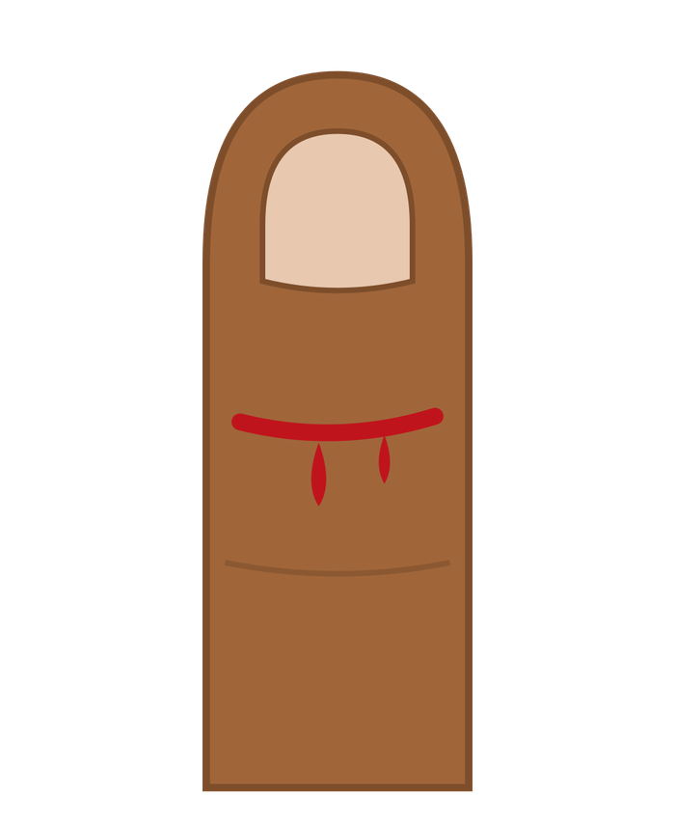
OBSERVE
Look carefully. What changed between each picture?
?
?
?
1. The cut
just now
2. A clot forms
a few minutes later
3. A scab
two days later
4. New skin
about a week later
© 2026 SeaVuria & ARES Education · CC BY-NC 4.0 · Biology G10 · Cell Structure · Lesson 1
Notes:
TIME: 5 minutes for all four pictures (slides 9–12)
DO
• Show one picture at a time. Each click adds the next picture.
• For each picture, ask “What do you notice?” then wait.
• Students add anything new to their notebook prediction.
• No projector? Read the picture description below aloud instead.
SAY
• “Look carefully. What do you notice?”
WAIT TIME
• 5 full seconds after you ask, before you take any answer. Observation needs thinking time.
PICTURE 1 (read aloud if needed): A fresh cut across the fingertip. A line of red blood, with drops running down.

Slide 10
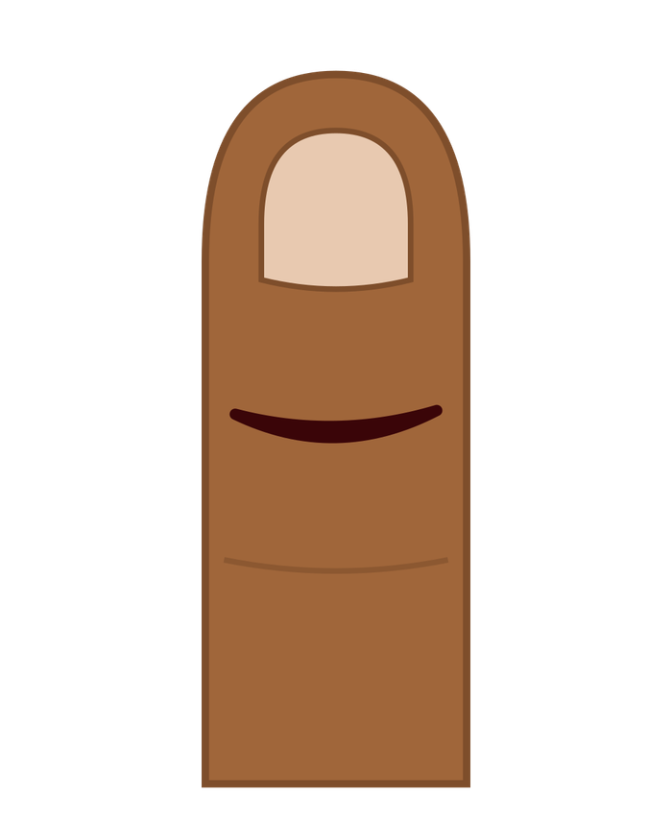
OBSERVE
Look carefully. What changed between each picture?
?
?
1. The cut
just now
2. A clot forms
a few minutes later
3. A scab
two days later
4. New skin
about a week later
© 2026 SeaVuria & ARES Education · CC BY-NC 4.0 · Biology G10 · Cell Structure · Lesson 1
Notes:
TIME: about 1 minute
DO
• Click to show the next picture. Ask: “What changed between this picture and the last one?”
SAY
• “What changed between picture 1 and picture 2?”
WAIT TIME
• 5 full seconds after you ask, before you take any answer. Observation needs thinking time.
PICTURE 2 (read aloud if needed): The bleeding has stopped. A dark red, sticky clot fills the cut.

Slide 11
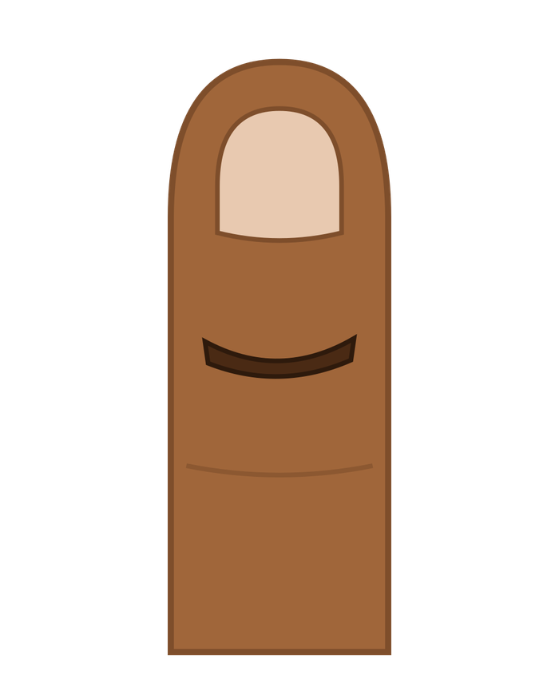
OBSERVE
Look carefully. What changed between each picture?
?
1. The cut
just now
2. A clot forms
a few minutes later
3. A scab
two days later
4. New skin
about a week later
© 2026 SeaVuria & ARES Education · CC BY-NC 4.0 · Biology G10 · Cell Structure · Lesson 1
Notes:
TIME: about 1 minute
DO
• Click to show the next picture. Ask: “What changed between this picture and the last one?”
SAY
• “What changed between picture 2 and picture 3?”
WAIT TIME
• 5 full seconds after you ask, before you take any answer. Observation needs thinking time.
PICTURE 3 (read aloud if needed): The clot has dried into a hard, dark brown scab.

Slide 12
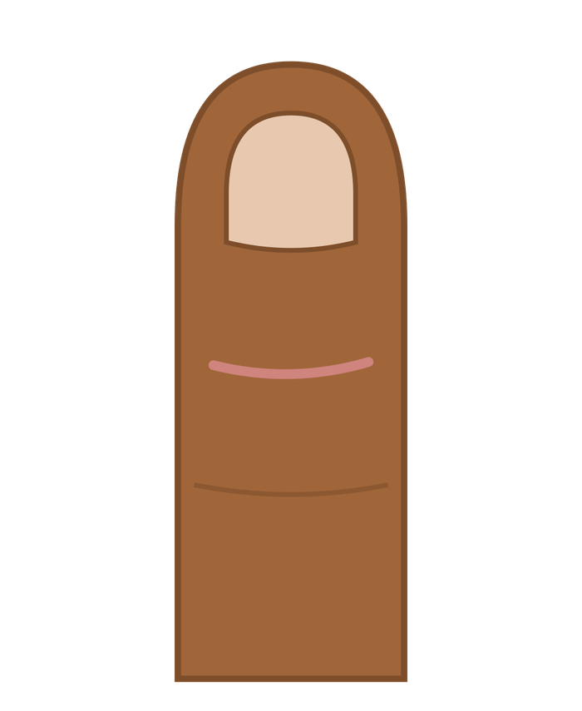
OBSERVE
CHECK FOR UNDERSTANDING
Look carefully. What changed between each picture?
1. The cut
just now
2. A clot forms
a few minutes later
3. A scab
two days later
4. New skin
about a week later
© 2026 SeaVuria & ARES Education · CC BY-NC 4.0 · Biology G10 · Cell Structure · Lesson 1
Notes:
TIME: about 1 minute
DO
• Click to show the next picture. Ask: “What changed between this picture and the last one?”
SAY
• “What changed between picture 3 and picture 4?”
WAIT TIME
• 5 full seconds after you ask, before you take any answer. Observation needs thinking time.
LOOK FOR (formative check)
• Has any student mentioned cells (platelets, white blood cells, skin cells)? If yes, note the name — this is a bridge to Lesson 8.
• If nobody talks about cells, that is expected. It confirms why we need this unit.
WHY THIS WORKS
• Showing the pictures one at a time slows students down and makes them compare. Comparing “before” and “after” is a core science skill.
PICTURE 4 (read aloud if needed): The scab has fallen off. Only a faint pink line of new skin is left.

Slide 13

OBSERVE
CHECK FOR UNDERSTANDING
What did your pair notice?
Your teacher will write your ideas on the board
exactly as you say them.
Nobody is right or wrong yet. Every idea is useful data.
© 2026 SeaVuria & ARES Education · CC BY-NC 4.0 · Biology G10 · Cell Structure · Lesson 1
Notes:
TIME: 3 minutes
DO
• Ask 3–4 pairs to share. Choose students who do not usually raise their hand.
• Write their key phrases on the board WORD FOR WORD. For example: “the blood goes hard”, “white cells come”, “skin grows back”.
• Do not correct or praise any idea yet. Keep this list — you will use it later in the unit.
SAY
• “I am writing your ideas exactly as you said them. I am not telling you yet whether they are right or not. Every idea here is valuable data — it tells us what we already know and what we still need to find out.”
LOOK FOR (formative check)
• This board list is your map of what the class already knows. Note which ideas are common and which are rare.
WHY THIS WORKS
• Recording ideas without judging them is what scientists do: observe first, interpret later. It also makes students feel safe to share ideas they are unsure about.

Slide 14
EXPLAIN
Question 1 of 3
You said the bleeding slows.
What do you think causes that?
© 2026 SeaVuria & ARES Education · CC BY-NC 4.0 · Biology G10 · Cell Structure · Lesson 1
Notes:
EXPLAIN PHASE (7 minutes total)
TIME: 1–2 minutes
DO
• Ask the question. Wait. Take 2–3 answers.
• Reply to each answer with another question — do NOT say “right” or “wrong”.
SAY
• If a student says “the blood goes hard”: “Interesting — what do you think makes it go hard? Is that a chemical change? A physical change? Something else?”
WAIT TIME
• 5 seconds before taking answers.
WHY THIS WORKS
• These questions move students from describing (“the bleeding slows”) to asking about causes (“what makes it slow?”). Answering with a question keeps students thinking instead of waiting for you to give the answer. This is called Socratic questioning.

Slide 15
EXPLAIN
Question 2 of 3
You said the skin grows back.
Do you think ONE thing does that job — or MANY things?
© 2026 SeaVuria & ARES Education · CC BY-NC 4.0 · Biology G10 · Cell Structure · Lesson 1
Notes:
TIME: 1–2 minutes
DO
• Ask the question. Wait. Take 2–3 answers.
• Keep probing: “Why do you think that?”
WAIT TIME
• 5 seconds before taking answers.
LOOK FOR (formative check)
• Can students imagine MANY things working at once, or only one cause? Students who describe several processes without being prompted are ready for the idea of cell specialisation.

Slide 16
EXPLAIN
Question 3 of 3
If many different things are doing different jobs inside the wound…
what might those things look like? Are they all the same, or different?
0:10
Think silently before you answer.
© 2026 SeaVuria & ARES Education · CC BY-NC 4.0 · Biology G10 · Cell Structure · Lesson 1
Notes:
TIME: 2 minutes
DO
• Show the 10-second timer. Count silently to 10. Do not rephrase the question.
• Take 2–3 answers.
WAIT TIME
• A FULL 10 seconds — this is the hardest question. Resist the urge to help. Silence is harder for the teacher than for the students.
LOOK FOR (formative check)
• Listen for students who say “they would look different” and can give a reason.
IF…
• If nobody answers after 10 seconds: “Talk to your partner for 30 seconds, then I will ask again.”

Slide 17
EXPLAIN
Scientists looked at healing wounds under a microscope.
They found many different kinds of tiny structures, all working at the same time — each doing a different job, and each looking completely different.
Does that surprise you? Why?
© 2026 SeaVuria & ARES Education · CC BY-NC 4.0 · Biology G10 · Cell Structure · Lesson 1
Notes:
TIME: 2 minutes
DO
• Read the statement slowly. This is a “bridging statement”: it is NOT an answer. It sets up the big question.
• Pause. Then ask: “Does that surprise you? Why?” Take 2–3 answers.
SAY
• “That raises a very big question, which we are going to investigate for the next several weeks.”
WHY THIS WORKS
• The statement creates a puzzle: if so many different structures are at work, why do they look different? A puzzle makes students want to find out. Do not name the cells yet — that comes in Lesson 8.

Slide 18
QUESTION BOARD
Notice and wonder
Your turn
Yellow note: one thing you NOTICE.
Blue note: one real question you WONDER.
Post them on our Question Board.
I notice…
…the cut looked healed after just a few days.
I wonder…
…how the body knows exactly what shape to rebuild the skin in?
3:00
© 2026 SeaVuria & ARES Education · CC BY-NC 4.0 · Biology G10 · Cell Structure · Lesson 1
Notes:
DRIVING QUESTION BOARD (10 minutes total)
TIME: 7 minutes
DO
• Model first: read the two example notes on the slide as YOUR notes (“think aloud”).
• Give each student one yellow and one blue sticky note. 3 minutes to write.
• Students come up in groups of 6–8 and post notes under the two columns.
• Read some “wonder” questions aloud. Group similar ones together on the poster.
SAY
• “I notice in the pictures that the wound looks completely healed after just a few days — that is my notice note. I wonder how the body knows exactly what shape to rebuild the skin in — that is my wonder note.”
• “Your wonder note should be a real question you actually have — not a question you think I want to hear.”
• After posting: “Every single question on this board is legitimate. Some we will answer in this unit. Some might take years of science to answer. All of them matter.”
WHY THIS WORKS
• Separating “notice” (observation) from “wonder” (question) teaches a basic science skill. When students see their own questions on the board, they own the investigation. Modelling the task first shows students exactly what a good note looks like.

Slide 19
QUESTION BOARD
OUR DRIVING QUESTION
Why do cells in our body look so different from each other — and how does the shape of a cell determine the job it can do?
What is your very first reaction to this question?
© 2026 SeaVuria & ARES Education · CC BY-NC 4.0 · Biology G10 · Cell Structure · Lesson 1
Notes:
TIME: 3 minutes
DO
• Uncover the driving question at the top of the poster. Read it aloud slowly.
• Wait 8 seconds in silence. Then ask: “What is your very first reaction to this question?” Take 2–3 answers.
• Explain that this question will be answered piece by piece, and the board will be updated at the end of every lesson.
• After class: photograph the board.
WAIT TIME
• 8 seconds after reading the question.
LOOK FOR (formative check)
• After class, sort the “wonder” notes into: (a) questions this unit will answer, (b) questions that show a misconception, (c) questions that show sophisticated thinking. Use this to plan Lessons 2–5.
WHY THIS WORKS
• The driving question comes AFTER students post their own questions, so they can see their questions connect to it. It feels like THEIR investigation, not the teacher’s.

Slide 20

MODEL BUILDING
CHECK FOR UNDERSTANDING
Version 0: Draw what you think a cell looks like
3:00
Draw from memory and imagination.
Label anything you think might be inside a cell.
This is not an art competition. It is not a test.
It is a snapshot of what you know today.
Head the page: VERSION 0 — and today’s date
You will compare this drawing with your final model in Lesson 11.
© 2026 SeaVuria & ARES Education · CC BY-NC 4.0 · Biology G10 · Cell Structure · Lesson 1
Notes:
MODEL BUILDING PHASE
TIME: 5 minutes
DO
• Give NO diagrams or books. Students draw only from what they already know.
• Give a full 3 minutes. Show the timer.
• Circulate. Ask individual students: “What made you draw it that way?” or “What is this part doing?” Do not correct any drawing.
SAY
• “This is not an art competition and it is not a test. It is a snapshot of what you already know. Draw whatever comes to mind — a box, a circle, dots inside, labels — anything at all.”
LOOK FOR (formative check)
• After class, look at the drawings (or photograph a few). Common patterns:
• a circle with nothing inside;
• a circle with only a nucleus;
• several named parts (some prior learning);
• cells drawn as bricks or boxes (because of the word “cell”).
• Use these patterns to plan Lesson 2.
WHY THIS WORKS
• This drawing is the baseline. Students will revise their model in nearly every lesson. Seeing how their own drawing changes shows them that learning is revision — being wrong at the start is normal.

Slide 21
QUESTION BOARD
Summary Table: Lesson 1
Fill in the first row of your Summary Table. Start now, and finish at home.
1
2
3
What did I observe?
What did I learn?
How does this explain the phenomenon?
What happened to Amina’s finger, step by step?
What did we find out today — even if it is mostly questions?
What can we explain yet? What can’t we explain?
Hold onto your predictions. We will need them again.
© 2026 SeaVuria & ARES Education · CC BY-NC 4.0 · Biology G10 · Cell Structure · Lesson 1
Notes:
TIME: 3 minutes
DO
• Students start the first row of their Summary Table. They finish it at home.
• Close by returning to Amina. Say the closing line slowly. Pause after the word “predictions”.
SAY
• “In Lesson 2, we will begin to look at what a cell actually is. But today, you have already done something scientists do every time they start an investigation — you observed carefully, asked good questions, and made your first predictions. Hold onto those predictions. We will need them again.”
ANSWER KEY
• Observe: When a finger is cut, the bleeding slows, a clot forms, a scab develops, and new skin appears over several days.
• Learn: This familiar process is made up of many events happening at the same time. Scientists have found many different types of tiny structures working together during healing.
• Explain: We cannot yet explain why the structures look different or how each one knows its job. Our Driving Question Board will help us answer that over the next eleven lessons.
TEACHER REFLECTION (after the lesson)
• Did students write real “wonder” questions, or what they thought you wanted?
• Were students willing to share incomplete ideas? If not, what held them back?
• Did you really wait 8–10 seconds after the hardest questions?
• Did anyone already mention platelets or white blood cells? Plan how to use that knowledge later without making others feel behind.
• Are the wonder questions rich enough to drive 12 lessons, or do you need to add a few of your own in Lesson 2?

