Slide 1


GRADE 10 BIOLOGY · CELL STRUCTURE · LESSON 2 OF 12 · 80 MINUTES
TODAY’S LESSON
What Is a Cell?
Predict
Observe
Explain
Introduction to cell theory — and what ALL cells have in common.
Question Board
Model Building
© 2026 SeaVuria & ARES Education · CC BY-NC 4.0 · Biology G10 · Cell Structure · Lesson 2
Notes:
LESSON 2 — WHAT IS A CELL? (80 minutes, double lesson)
PURPOSE OF THIS LESSON
Students learn the three ideas of cell theory and the difference between prokaryotic and eukaryotic cells. They start their own cell model (Version 1), which they will revise in later lessons. Everything links back to Amina’s healing finger from Lesson 1.
BEFORE CLASS (full checklist on hidden slide 3)
• Put the Lesson 1 Driving Question Board where everyone can see it.
• Print one set of 12 feature cards per group of four (print slide 13 and cut it up), or write the cards on paper.
• Diagrams: show slides 9–11, or print them on A3, or use the ARES resource cards.
• Coloured pencils: green, blue, red — at least one set per group.
• Sticky notes: yellow and green, one each per student. Star stickers, or students draw a star with a pen.
• Bring the Version 0 drawings back from Lesson 1.

Slide 2

TEACHER ONLY · HIDDEN
How these lessons work: one routine, five phases
This slide is hidden. It will not show when you present.
Predict
Students write their own idea BEFORE anyone teaches. Writing first gives every student a starting point.
Three habits, every lesson
Wait time. Count silently to 5–10 seconds after a question. Do not rephrase.
Do not correct yet. In Predict and Observe, record ideas exactly as students say them.
Call on everyone. Choose students who do not usually raise a hand.
Observe
Students look at evidence: a story, pictures, diagrams, a practical. They record what they see.
Explain
You help students make sense of the evidence. Now you correct ideas — using the evidence.
Question Board
The Driving Question Board shows what the class knows and still wonders. Update it every lesson.
Model Building
Each student keeps one model that they revise across the unit. Revising IS the learning.
A “Check for understanding” label means this slide includes a formative check. The Notes tell you what to look for.
© 2026 SeaVuria & ARES Education · CC BY-NC 4.0 · Biology G10 · Cell Structure · Lesson 2
Notes:
TEACHER ONLY — HIDDEN SLIDE
HOW TO USE THE NOTES
Every slide has notes written for you, in the same order:
• TIME — how long to spend.
• DO — what to do, step by step.
• SAY — words you can read aloud. Change them to suit your class.
• WAIT TIME — how long to stay silent after a question.
• LOOK FOR — what to listen and look for. This is your formative assessment.
• IF… — what to do when students are stuck or something goes wrong.
• WHY THIS WORKS — the reason behind the strategy, so you can use it in other lessons too.
Tip: In PowerPoint, use Presenter View (Slide Show → Use Presenter View) so you can read these notes while students see only the slide.

Slide 3


TEACHER ONLY · HIDDEN
Lesson 2 at a glance
PHASE
TIME
WHAT STUDENTS DO
Prepare before class
Lesson 1 Question Board on display
12 feature cards per group (print slide 13)
Cell diagrams: projected, A3 or ARES cards
Green, blue, red pencils
Yellow + green sticky notes; stars
Version 0 drawings from Lesson 1
Predict
8 min
Write 3 sentences: “I think all cells share… because…”. Pair-share. You record predictions.
Observe
12 min
A. The ugali kitchen analogy: map kitchen features to cell features.
Observe
18 min
B. Study three cell diagrams. Fill in the Cell Theory Evidence Table.
Observe
10 min
C. Sort 12 feature cards: prokaryote or eukaryote? Justify.
ARES RESOURCES
Explain
16 min
Short teaching on cell theory and cell types. Colour-code the diagrams. Write a CER paragraph.
Prokaryotic & eukaryotic cells — Khan video
Question Board
4 min
Star answered questions. Post one new question or new understanding.
Prokaryotic & Eukaryotic Cells — CK-12
Model Building
12 min
Draw Version 1 of the cell model, with a key and a limitation statement.
The Cell Theory Practice — CK-12
© 2026 SeaVuria & ARES Education · CC BY-NC 4.0 · Biology G10 · Cell Structure · Lesson 2
Notes:
TEACHER ONLY — HIDDEN SLIDE
RESOURCES FROM THE SCHEME OF WORK
Good matches for this lesson:
• “Prokaryotic and eukaryotic cells” (Khan Academy video). Good for you to watch before class, or to show at the start of the Explain phase.
• “Prokaryotic and Eukaryotic Cells” (CK-12 FlexBook reading) and “Prokaryotic and Eukaryotic Cells Practice” (CK-12).
• “The Cell Theory Practice” (CK-12) and “Introduction to cells” (Khan Academy exercise): good for homework.
Marked “not an exact match” — preview before use:
• “Organelles in eukaryotic cells” — better for Lessons 4–5.
• “Comparing animal and plant cells” — better for Lesson 5.
• “Endosymbiosis theory” — beyond this lesson. Do not use it today.
Click a button to open the resource in ARES. If a button does not open, search ARES for the title.

Slide 4
UNIT MAP
Where we are in the unit
YOU ARE HERE
1
2
3
4
5
6
7
8
9
10
11
12
The healing cut
What is a cell?
Prokaryotes & eukaryotes
Plant cells
Animal cells
Onion cells (practical)
Cheek cells (practical)
Specialised animal cells
Specialised plant cells
Cell organisation
Putting it together
Final explanation
Last lesson
Amina cut her finger. We noticed, wondered, and drew our first idea of a cell (Version 0).
Driving question for the whole unit
Why do cells in our body look so different from each other — and how does the shape of a cell determine the job it can do?
© 2026 SeaVuria & ARES Education · CC BY-NC 4.0 · Biology G10 · Cell Structure · Lesson 2
Notes:
TIME: 1 minute
DO
• Point to Lesson 1 (done) and Lesson 2 (today). Read the driving question aloud together.
SAY
• “Last lesson we asked questions. Today we start to find answers — beginning with the most basic question of all: what is a cell?”

Slide 5



TODAY
By the end of this lesson you can…
State the three ideas of cell theory.
Key words
cell
the basic unit of all living things
cell theory
three ideas about cells that apply to all life
prokaryote
a cell with no nucleus, e.g. bacteria
eukaryote
a cell whose DNA is inside a nucleus
organelle
a structure inside a cell with a job
Compare prokaryotic and eukaryotic cells.
Explain where Amina’s new skin cells came from.
© 2026 SeaVuria & ARES Education · CC BY-NC 4.0 · Biology G10 · Cell Structure · Lesson 2
Notes:
TIME: 1 minute
DO
• Read the goals. Students copy the key words into their notebooks (they can finish this later).

Slide 6


PREDICT
What do ALL cells have in common?
In Amina’s finger, many different cells — and tiny cell fragments called platelets — worked together to heal the cut. They all look different.
3:00
Write 3 sentences in your notebook:
“I think all cells share… because…”
Then share with a partner and agree on one idea.
1:30
© 2026 SeaVuria & ARES Education · CC BY-NC 4.0 · Biology G10 · Cell Structure · Lesson 2
Notes:
PREDICT PHASE (8 minutes total)
TIME: 5 minutes
DO
• Have this slide showing as students come in.
• 3 minutes of silent writing. Then 90 seconds of pair-share.
SAY
• “Before we learn anything new today, I want you to predict. Look at Amina’s finger. All those different cells working together — what do you think every single one of them has in common? Write three sentences starting with: I think all cells share… because…”
WAIT TIME
• Do not speak for the full 3 minutes.
LOOK FOR (formative check)
• Do students mention a membrane? Genetic material (DNA)? A “control centre”?
• Common misconception: “all cells have a nucleus”. Note it — today’s lesson will challenge it.
• Note any student who writes “I don’t know”. Support them in the Observe phase.
WHY THIS WORKS
• When students commit to a prediction BEFORE instruction, they want to find out if they were right. They pay closer attention to evidence that supports or challenges their idea.

Slide 7

PREDICT
CHECK FOR UNDERSTANDING
Our predictions
What did you and your partner agree on?
Your teacher will write your key words on the board. We will test these ideas today.
© 2026 SeaVuria & ARES Education · CC BY-NC 4.0 · Biology G10 · Cell Structure · Lesson 2
Notes:
TIME: 3 minutes
DO
• Cold-call 3 pairs. Choose a mix — not only raised hands.
• Write their key words on the board in a column headed OUR PREDICTIONS. Keep it up all lesson.
• Do not correct errors.
SAY
• “Pair at the window table — what did you agree on?”
• After each answer: “Interesting — let’s hold that idea and test it today.”
LOOK FOR (formative check)
• Which ideas are common? You will return to this column at the end of the Explain phase and ask: “Which of our predictions were supported?”
WHY THIS WORKS
• Writing predictions publicly creates accountability: students want to check their own words against the evidence later.

Slide 8





OBSERVE
The ugali kitchen: every kitchen has the same basics
A home kitchen in Kericho and a hospital canteen in Nairobi have the same basic tools — set up differently, for a different job. Cells are like that too.
KITCHEN FEATURE
CELL FEATURE
The walls and the door
?
The recipe book
?
The jiko (stove)
?
Sufuria, mwiko, chopping board
?
The space where the cook works
?
Which part of the kitchen is like the cell membrane — the part that controls what comes in and goes out?
© 2026 SeaVuria & ARES Education · CC BY-NC 4.0 · Biology G10 · Cell Structure · Lesson 2
Notes:
OBSERVE PHASE (40 minutes total: A 12 min, B 18 min, C 10 min)
TIME: Part A — 12 minutes
DO
• Sketch a simple kitchen on the board as you talk.
• Groups of four copy the two-column Analogy Mapping Table into their notebooks: Kitchen feature → Cell feature.
• Ask the membrane question on the slide. Wait. Cold-call 2 students.
• Groups complete the rest of the table (6–7 minutes). Then take answers.
SAY
• “Every kitchen in Nairobi — whether in a Kibera home or a Westlands restaurant — has these basics. But the kitchen in a hospital canteen is set up differently from a home kitchen in Kericho. Same tools, different arrangement, different job. That is exactly what we will discover about cells.”
• Ask: “Which part of the kitchen is like the cell membrane — the thing that controls what comes in and out?”
WAIT TIME
• 12 seconds after the membrane question.
LOOK FOR (formative check)
• Check two tables per group. Aim for at least 5 sensible mappings per table.
IF…
• If a group gives a different mapping with a good reason, accept it. The reasoning matters more than one “right” match.
WHY THIS WORKS
• An analogy links new words to something students know well, so the new vocabulary is easier to hold in mind. Finish by asking: “Where does this analogy break down?” (For example: a kitchen cannot make a copy of itself, but a cell can divide.) Discussing the limits of an analogy is itself good science thinking.
ANSWER KEY
• Walls and door → cell membrane (controls what goes in and out)
• Recipe book → DNA, kept in the nucleus (the instructions)
• Jiko (stove) → mitochondria (release energy)
• Sufuria, mwiko, chopping board → other organelles (each tool has its own job)
• Space where the cook works → cytoplasm (where the work happens)

Slide 9
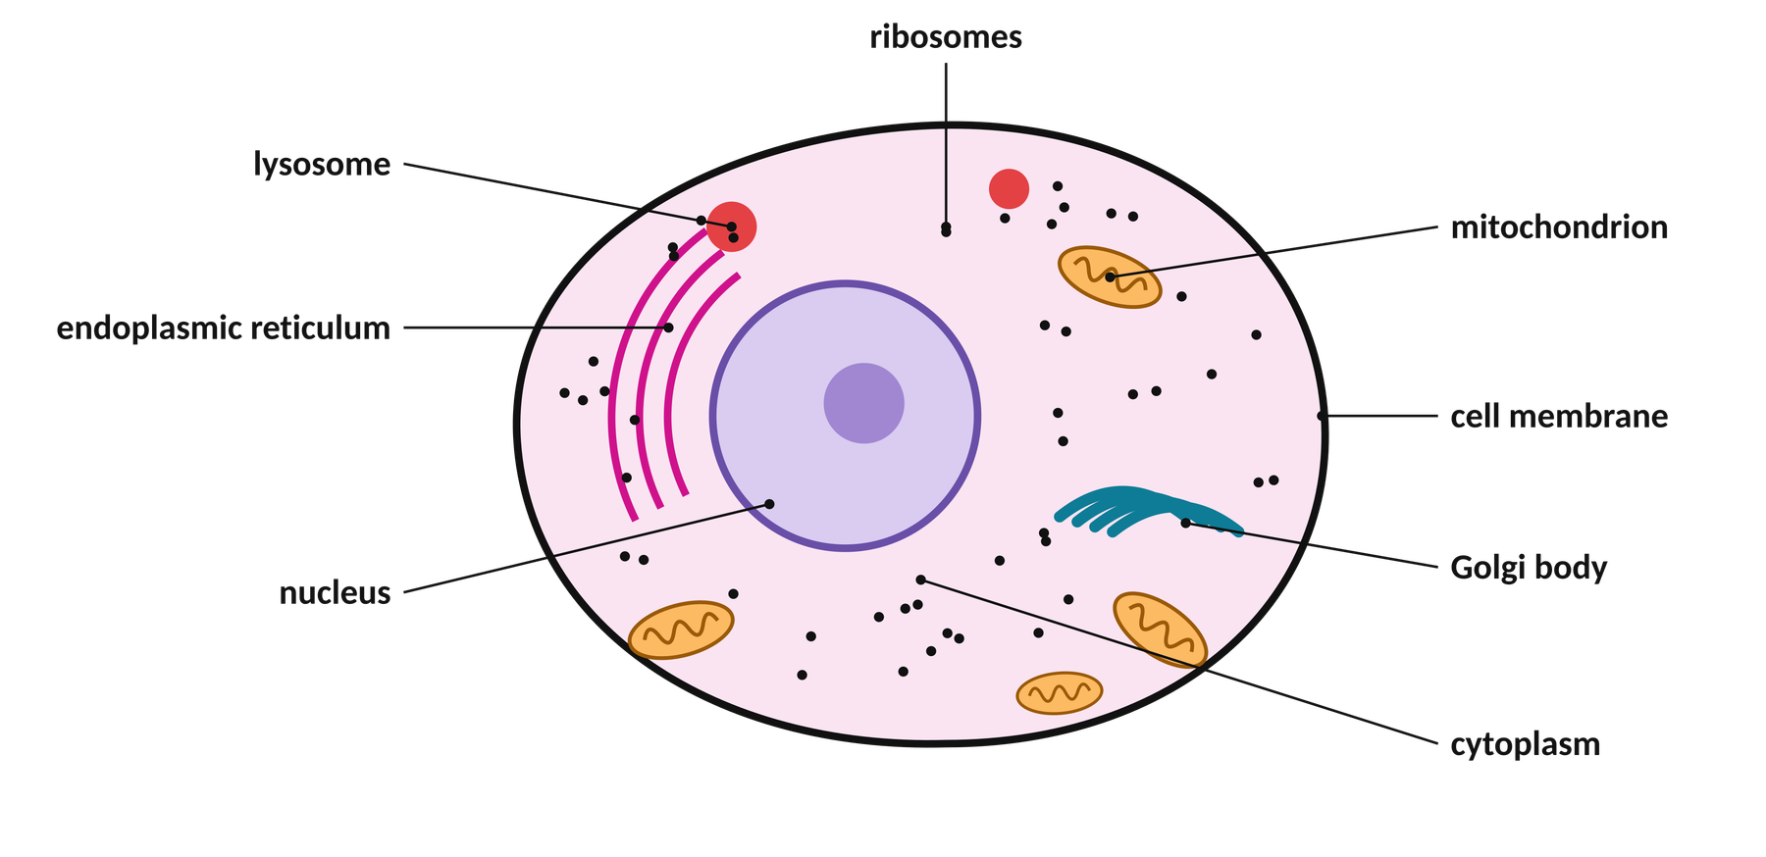
OBSERVE
An animal cell (eukaryote)
Animal cells, like the skin cells in Amina’s finger, have a nucleus and many organelles — but no cell wall.
© 2026 SeaVuria & ARES Education · CC BY-NC 4.0 · Biology G10 · Cell Structure · Lesson 2
Notes:
TIME: Part B — 18 minutes for slides 9–12
DO
• Show the three diagrams (slides 9–11), or hand out the A3 sheets or ARES resource cards.
• Students study the diagrams, then read about cell theory and fill in the Evidence Table (slide 12).
NOTE: These diagrams are simplified, labelled drawings. Ribosomes are shown as small black dots in all three cells.

Slide 10
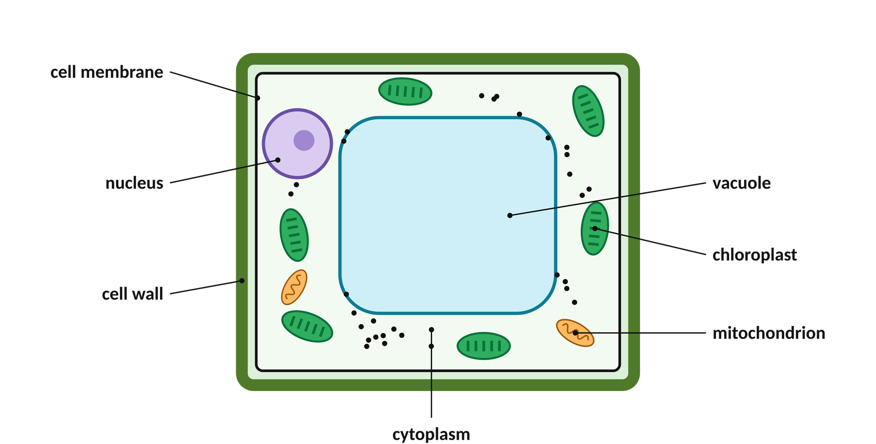
OBSERVE
A plant cell (eukaryote)
Plant cells also have a nucleus and organelles — plus a cell wall, a large vacuole and chloroplasts.
© 2026 SeaVuria & ARES Education · CC BY-NC 4.0 · Biology G10 · Cell Structure · Lesson 2
Notes:
DO
• Keep this diagram up while students work, or let them flip between slides 9–11.

Slide 11
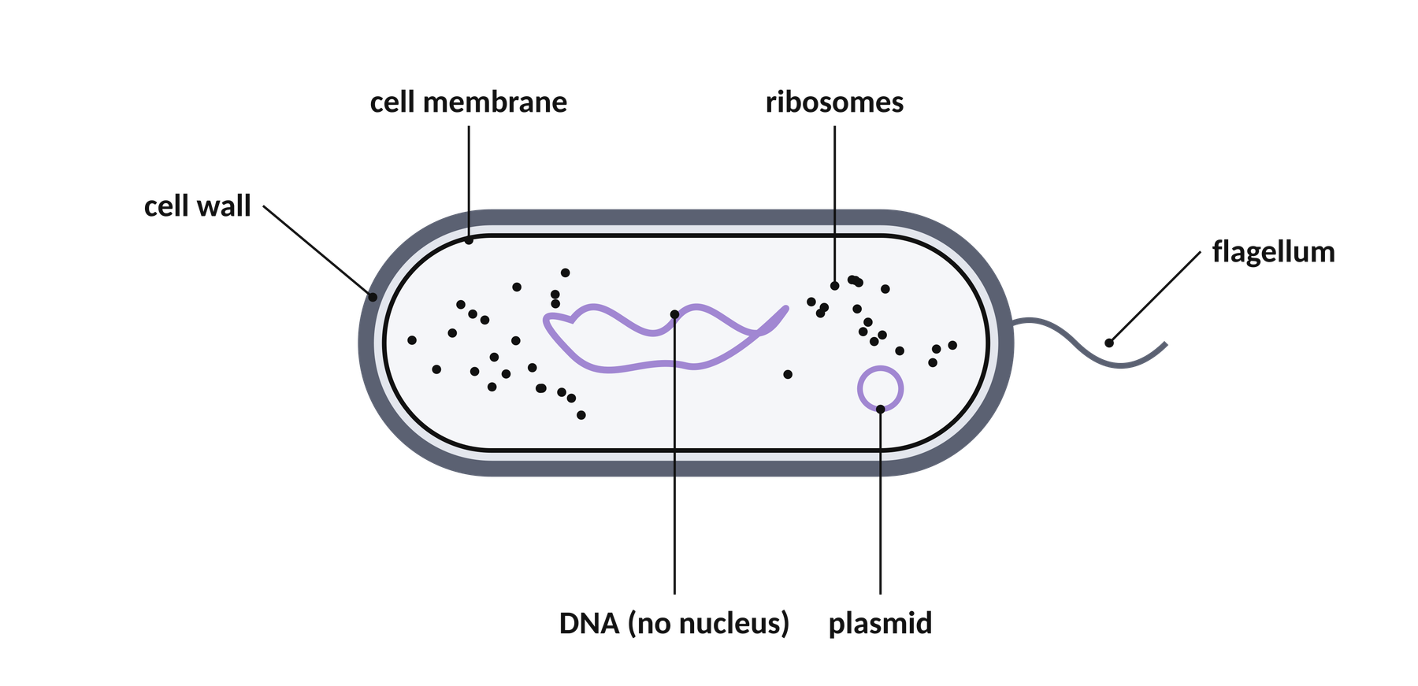
OBSERVE
A bacterium, E. coli (prokaryote)
Bacteria are much smaller. Their DNA is not inside a nucleus. E. coli can infect a cut — or nyama choma that is badly stored.
© 2026 SeaVuria & ARES Education · CC BY-NC 4.0 · Biology G10 · Cell Structure · Lesson 2
Notes:
DO
• Keep this diagram up while students work, or let them flip between slides 9–11.
The flagellum and plasmid are features of many bacteria. Students do not need to learn them today; they will see a flagellum again on sperm cells in Lesson 8.

Slide 12
OBSERVE
Cell Theory Evidence Table
Scientist
Where and when
What they found
How it connects to Amina’s finger
Matthias Schleiden
Theodor Schwann
Rudolf Virchow
Copy this table into your notebook. Fill it in as you read. The last column matters most!
© 2026 SeaVuria & ARES Education · CC BY-NC 4.0 · Biology G10 · Cell Structure · Lesson 2
Notes:
TIME: continues Part B
DO
• Students copy the table, read about the three scientists (ARES reading, textbook or printed text), and fill it in.
• Circulate. Use the prompt below with students who are stuck on the last column.
SAY
• “You will now read about three scientists — Schleiden, Schwann and Virchow — who each added one piece to the cell theory puzzle. As you read, fill in your Evidence Table. Most importantly: for each scientist, write one sentence connecting their idea to Amina’s healing finger.”
• Prompt: “Virchow said all cells come from pre-existing cells — how does that explain where the new skin cells on Amina’s finger came from?”
WAIT TIME
• 10 seconds after each prompt before you help.
LOOK FOR (formative check)
• Every row should have a completed last column. A blank last column means the student cannot yet connect the theory to the phenomenon — support them now.
ANSWER KEY
• Schleiden — Germany, 1838 (botanist) — all plants are made of cells. → Amina is a living thing, so her finger is made of cells too.
• Schwann — Germany, 1839 (studied animals) — animals are made of cells too; the cell is the basic unit of living things. → Her skin and blood are made of cells.
• Virchow — Germany, 1855 (doctor) — all cells come from pre-existing cells (“Omnis cellula e cellula”). → The new skin cells came from existing skin cells near the cut dividing.

Slide 13
OBSERVE
Card sort: prokaryote or eukaryote?
Has a nucleus
DNA floats freely in the cytoplasm
Has mitochondria
Found in bacteria
Has ribosomes
Has a cell membrane
Has organelles with membranes around them
Usually 1–5 micrometres long
Usually 10–100 micrometres across
Found in plants, animals and fungi
DNA is one loop (circular)
Has cytoplasm
Sort the cards into two columns: PROKARYOTE and EUKARYOTE. Be ready to justify every card.
8:00
© 2026 SeaVuria & ARES Education · CC BY-NC 4.0 · Biology G10 · Cell Structure · Lesson 2
Notes:
TIME: Part C — 10 minutes (8 minutes sorting + 2 minutes on the next slide)
DO
• Each group of four gets one set of 12 cards. (Print this slide and cut along the dashed lines, or copy the cards onto paper.)
• Groups sort the cards into two columns on their desk: PROKARYOTE and EUKARYOTE.
• Groups photograph or sketch their sort.
• Some cards belong in BOTH columns. Do not tell groups this. Let them argue. If a group asks “can a card go in both?”, answer: “What does your evidence say?”
SAY
• “Sort these into Prokaryote or Eukaryote. You have 8 minutes. Be ready to justify every card.”
LOOK FOR (formative check)
• Which cards are misplaced across many groups? “Has ribosomes” is the most common error (usually put under Eukaryote only). Note the errors — they are the focus of your Explain teaching.
WHY THIS WORKS
• Physically moving cards makes thinking visible. When group members disagree about a card, they have to explain their reasoning to each other — that talk is where the learning happens.
ANSWER KEY
• PROKARYOTE only: DNA floats freely in the cytoplasm; Found in bacteria; Usually 1–5 micrometres long; DNA is one loop (circular).
• EUKARYOTE only: Has a nucleus; Has mitochondria; Has organelles with membranes around them; Usually 10–100 micrometres across; Found in plants, animals and fungi.
• BOTH: Has ribosomes; Has a cell membrane; Has cytoplasm.

Slide 14
OBSERVE
CHECK FOR UNDERSTANDING
Where did you put these cards — and why?
Has ribosomes
Has a cell membrane
DNA floats freely in the cytoplasm
Prokaryote? Eukaryote? Both?
Prokaryote? Eukaryote? Both?
Prokaryote? Eukaryote? Both?
Give your evidence: which diagram shows it?
© 2026 SeaVuria & ARES Education · CC BY-NC 4.0 · Biology G10 · Cell Structure · Lesson 2
Notes:
TIME: 2 minutes
DO
• Cold-call one group per card. Ask for their reason, then ask another group if they agree.
• Do not give the answer yet — you will settle it in the Explain phase with the diagrams.
SAY
• “Group by the door — where did you put ‘Has ribosomes’, and why?”
LOOK FOR (formative check)
• How many groups put “Has ribosomes” in Eukaryote only? Start your Explain teaching there.
WHY THIS WORKS
• This is a quick formative check: you find out what the whole class thinks before you teach, so your teaching targets the real misconceptions.
ANSWER KEY
• Ribosomes: BOTH. Cell membrane: BOTH. DNA floats freely: PROKARYOTE only.

Slide 15
EXPLAIN
Cell theory: three ideas that apply to ALL living things
1
All living things are made of one or more cells.
Schleiden (plants, 1838) and Schwann (animals, 1839)
2
The cell is the basic unit of structure and function in living things.
Schleiden and Schwann
3
All cells come from cells that already exist.
Virchow, 1855 — “Omnis cellula e cellula”
Idea 3 explains Amina’s finger: new skin cells came from skin cells that were already there.
© 2026 SeaVuria & ARES Education · CC BY-NC 4.0 · Biology G10 · Cell Structure · Lesson 2
Notes:
EXPLAIN PHASE (16 minutes total)
TIME: 3 minutes
DO
• Students write the three ideas word for word in their notebooks.
• Link each scientist back to their Evidence Table.
SAY
• “These three ideas apply to every living thing — a bean plant, a bacterium, and Amina. Idea 3 is the one that explains how her finger healed.”
WHY THIS WORKS
• Now — after students have predicted, read and sorted — is the right time for direct teaching. Students have questions in their heads, so the explanation answers something they want to know.

Slide 16
EXPLAIN
Prokaryote or eukaryote: what is different?
Feature
Prokaryote
Eukaryote
Nucleus
No — DNA lies free in the cytoplasm
Yes — DNA is inside a nucleus with a membrane
Organelles with membranes (e.g. mitochondria)
No
Yes
Ribosomes
Yes
Yes
Cell membrane and cytoplasm
Yes
Yes
Usual size
1–5 micrometres
10–100 micrometres
Examples
Bacteria, e.g. E. coli
Plants, animals, fungi — and Amina’s skin cells
Ribosomes are in BOTH. Even the simplest bacteria make proteins — that is one reason bacteria in a wound can be dangerous.
© 2026 SeaVuria & ARES Education · CC BY-NC 4.0 · Biology G10 · Cell Structure · Lesson 2
Notes:
TIME: 5 minutes
DO
• Start with the card-sort error you saw most often (usually ribosomes).
• Point to the ribosomes (black dots) on the bacterium diagram (slide 11), then on the animal cell (slide 9).
• Go through each row of the table.
SAY
• “Let me address what I saw during the card sort. Ribosomes — almost every group put these under Eukaryote only. Let’s look at the diagram together… Ribosomes are actually present in BOTH. This matters — it means even the simplest bacteria can make proteins. That’s why bacteria in an infected wound can be so dangerous.”
LOOK FOR (formative check)
• Go back to the OUR PREDICTIONS column from slide 7: “Was ‘all cells have a nucleus’ supported? What is our evidence?”
WHY THIS WORKS
• You correct misconceptions using evidence the students have already seen, not just by telling them. This is how the Explain phase differs from a lecture.

Slide 17

EXPLAIN
Colour-code your three diagrams
GREEN
in BOTH prokaryotes and eukaryotes
Careful: the cell wall
Plant cells have a cell wall — and so do bacteria! But a bacterial cell wall is made of a different material. Colour it RED on the plant cell, and put a star next to it on the bacterium.
BLUE
in eukaryotes only
RED
in plant cells only
Label by label: which colour? Check with your partner.
© 2026 SeaVuria & ARES Education · CC BY-NC 4.0 · Biology G10 · Cell Structure · Lesson 2
Notes:
TIME: 3 minutes (students finish while you circulate)
DO
• Students colour the labels on their diagrams (A3 sheets, ARES cards, or their own copies).
• Circulate. Check ribosomes are GREEN (not blue).
LOOK FOR (formative check)
• Ribosomes GREEN; nucleus BLUE; chloroplasts and large vacuole RED; cell wall RED on the plant cell, with a star on the bacterium. Fix individual errors as you circulate.
WHY THIS WORKS
• Colour-coding turns looking at a diagram into sorting it. The patterns (what is shared, what is unique) become visible and easier to remember.
ANSWER KEY
• GREEN (both): cell membrane, cytoplasm, ribosomes, DNA.
• BLUE (eukaryotes only): nucleus, mitochondria, endoplasmic reticulum, Golgi body, lysosome.
• RED (plant cells only): chloroplast, large central vacuole, cell wall (★ bacteria also have a wall, made of a different material; fungi have walls too).
• Plasmid and flagellum (on the bacterium): leave uncoloured. Note: some eukaryotic cells also have a flagellum — students will meet the sperm cell in Lesson 8.

Slide 18
EXPLAIN
CHECK FOR UNDERSTANDING
Use cell theory to explain how Amina’s body made new skin cells to close the cut.
CLAIM
EVIDENCE
REASONING
Answer the question in one sentence.
Name a scientist or an idea of cell theory.
Connect the evidence to the claim.
Amina’s body made new skin cells by…
Virchow found that…
This explains the healing because…
Write 4 sentences in your notebook. Use “because” or “therefore” in your reasoning.
8:00
© 2026 SeaVuria & ARES Education · CC BY-NC 4.0 · Biology G10 · Cell Structure · Lesson 2
Notes:
TIME: 8 minutes
DO
• 8 minutes of silent writing. Circulate.
• Then cold-call 2 students to read their paragraph aloud.
• After each one, ask the class to show thumbs up/down.
• Collect 6 notebooks (two from each ability group) to read after class.
SAY
• “Your CLAIM answers: How did Amina’s body make new skin cells? Your EVIDENCE comes from Virchow. Your REASONING explains the mechanism.”
• If a student is stuck: “What did Virchow say about where new cells come from? Start there.”
• After reading aloud: “Thumbs up if their reasoning clearly connects cell theory to Amina’s finger.”
LOOK FOR (formative check)
• A clear CLAIM sentence.
• At least one piece of EVIDENCE that names a scientist or an idea of cell theory.
• A REASONING sentence using “because” or “therefore” that connects to Amina’s healing.
WHY THIS WORKS
• CER moves students from repeating facts (“Virchow said…”) to using them to explain something real (“therefore Amina’s body could…”). Explaining is the core skill of this whole unit.
ANSWER KEY
• Example: “Amina’s body made new skin cells when existing skin cells near the cut divided. Virchow found that all cells come from cells that already exist. Therefore the new skin cells could not appear from nothing; they were made when the skin cells around the cut divided to fill the gap. This is why the cut closed with new skin over a few days.”

Slide 19


QUESTION BOARD
Back to our Driving Question Board
Why do cells in our body look so different from each other — and how does the shape of a cell determine the job it can do?
1. Put a star on any Lesson 1 question that today’s lesson has started to answer.
2. Yellow note: a NEW question today raised for you.
3. Green note: something you now understand better.
4:00
© 2026 SeaVuria & ARES Education · CC BY-NC 4.0 · Biology G10 · Cell Structure · Lesson 2
Notes:
DRIVING QUESTION BOARD (4 minutes)
TIME: 4 minutes
DO
• Read the driving question aloud together.
• Hand out yellow and green sticky notes. 4 minutes of silent reflection, then students post.
• Read 3–4 notes aloud. Do not say who wrote them.
• After class: photograph the board.
SAY
• “Look at our Driving Question Board. Has today’s lesson answered any of the questions we put up in Lesson 1? If so, put a star on it. Then write your own note — either a new question or a sentence that shows your thinking has grown.”
• If someone asks where the FIRST cell came from: “That is a brilliant scientific question that researchers still study.”
• Close: “We still haven’t answered the big one. Hold it. We’ll get there.”
LOOK FOR (formative check)
• Every student posts at least one note. No note may mean disengagement or confusion — follow up.
• Check green notes for accuracy. A note like “I now understand that all cells are the same” is a misconception to fix at the start of Lesson 3.
• Count yellow vs green notes. Many more yellow than green? Plan a short review before Lesson 3.
WHY THIS WORKS
• The board shows students their thinking growing. The ratio of questions to understandings is a quick signal for you about the whole class.

Slide 20
MODEL BUILDING
CHECK FOR UNDERSTANDING
Version 1 of your cell model
Draw a eukaryotic cell — plant OR animal — on a full page. Head it: VERSION 1 — today’s date.
1. Label these
cell membrane
cell wall (plant only)
nucleus
cytoplasm
mitochondria
ribosomes
vacuole (plant only)
endoplasmic reticulum
2. Write a key
One sentence per label: what it looks like AND what it does.
Nucleus: oval, contains DNA, controls the cell’s activities.
3. Limitations
“This model does not yet show…”
List at least 2 things you do not understand yet.
12:00
© 2026 SeaVuria & ARES Education · CC BY-NC 4.0 · Biology G10 · Cell Structure · Lesson 2
Notes:
MODEL BUILDING PHASE (12 minutes)
TIME: 12 minutes (10 drawing + 2 partner share)
DO
• Students work silently and alone. Show the checklist.
• Circulate and comment on what you see, using names.
• In the last 2 minutes, partners read each other’s limitation statements.
• Collect the models at the end (or photograph them) and return them next lesson.
SAY
• “Every scientist who studies cells uses models. Models are never perfect — but they capture what we know right now. Today you will draw Version 1 of YOUR cell model. By Lesson 12, this same page will be full of revisions, additions, and corrections. That’s what science looks like.”
• While circulating: “I see Wanjiku has labelled the mitochondria and written that it produces energy — excellent. I see Otieno has drawn a cell wall on an animal cell — let’s check: do animal cells have cell walls?”
• Last 2 minutes: “Read your partner’s limitation. Do you agree those are real gaps? Add one of their gaps to your own list if you hadn’t thought of it.”
WAIT TIME
• 10 seconds after you point out an error, so the student can correct it themselves.
LOOK FOR (formative check)
• All 8 labels? If not, prompt without telling: “Count your labels — how many do you have?”
• Key sentences must give structure AND function. “Nucleus: it’s in the middle” is not enough — prompt for the job.
• At least 2 honest gaps in the limitation statement (e.g. “I don’t know how the membrane decides what to let in”).
WHY THIS WORKS
• A dated model that students revise (not replace) becomes a record of their own learning. Writing what the model CANNOT yet explain stops students thinking they are “finished”, and gives them reasons to keep investigating.

Slide 21
QUESTION BOARD
Summary Table: Lesson 2
Fill in the Lesson 2 row of your Summary Table.
1
2
3
What did I observe?
What did I learn?
How does this explain the phenomenon?
Which diagrams, cards and analogy did we use?
What are the three ideas of cell theory? How are prokaryotes and eukaryotes different?
Where did Amina’s new skin cells come from?
Next lesson: prokaryotes and eukaryotes — two worlds inside one body.
© 2026 SeaVuria & ARES Education · CC BY-NC 4.0 · Biology G10 · Cell Structure · Lesson 2
Notes:
TIME: at the end, or as homework
ANSWER KEY
• Observe: Labelled diagrams of animal, plant and prokaryotic cells; the prokaryote/eukaryote card sort; the ugali-kitchen analogy.
• Learn: The three ideas of cell theory (all living things are made of cells; the cell is the basic unit of life; all cells come from pre-existing cells) and the work of Schleiden, Schwann and Virchow. Prokaryotes have no nucleus and no membrane-bound organelles; eukaryotes have both.
• Explain: Virchow’s idea that all cells come from existing cells explains how new skin cells were made to heal Amina’s finger.
TEACHER REFLECTION (after the lesson)
1. Which card-sort features were most often misplaced? Does your Lesson 3 plan address them?
2. In the 6 CER paragraphs you collected, did students link Virchow directly to new skin cells, or write generally about cells? If generally, plan a 5-minute CER revisit at the start of Lesson 3.
3. Yellow vs green notes: if questions far outnumber understandings, consolidate before Lesson 3.
4. In the Version 1 models: are animal cells drawn with cell walls? Is the nucleus shown with a membrane? Plan your Lesson 3 opening around the patterns.
5. Wait time: did you hold the full 10–12 seconds, or answer for students? Longer wait time gives fuller answers.

