Slide 1
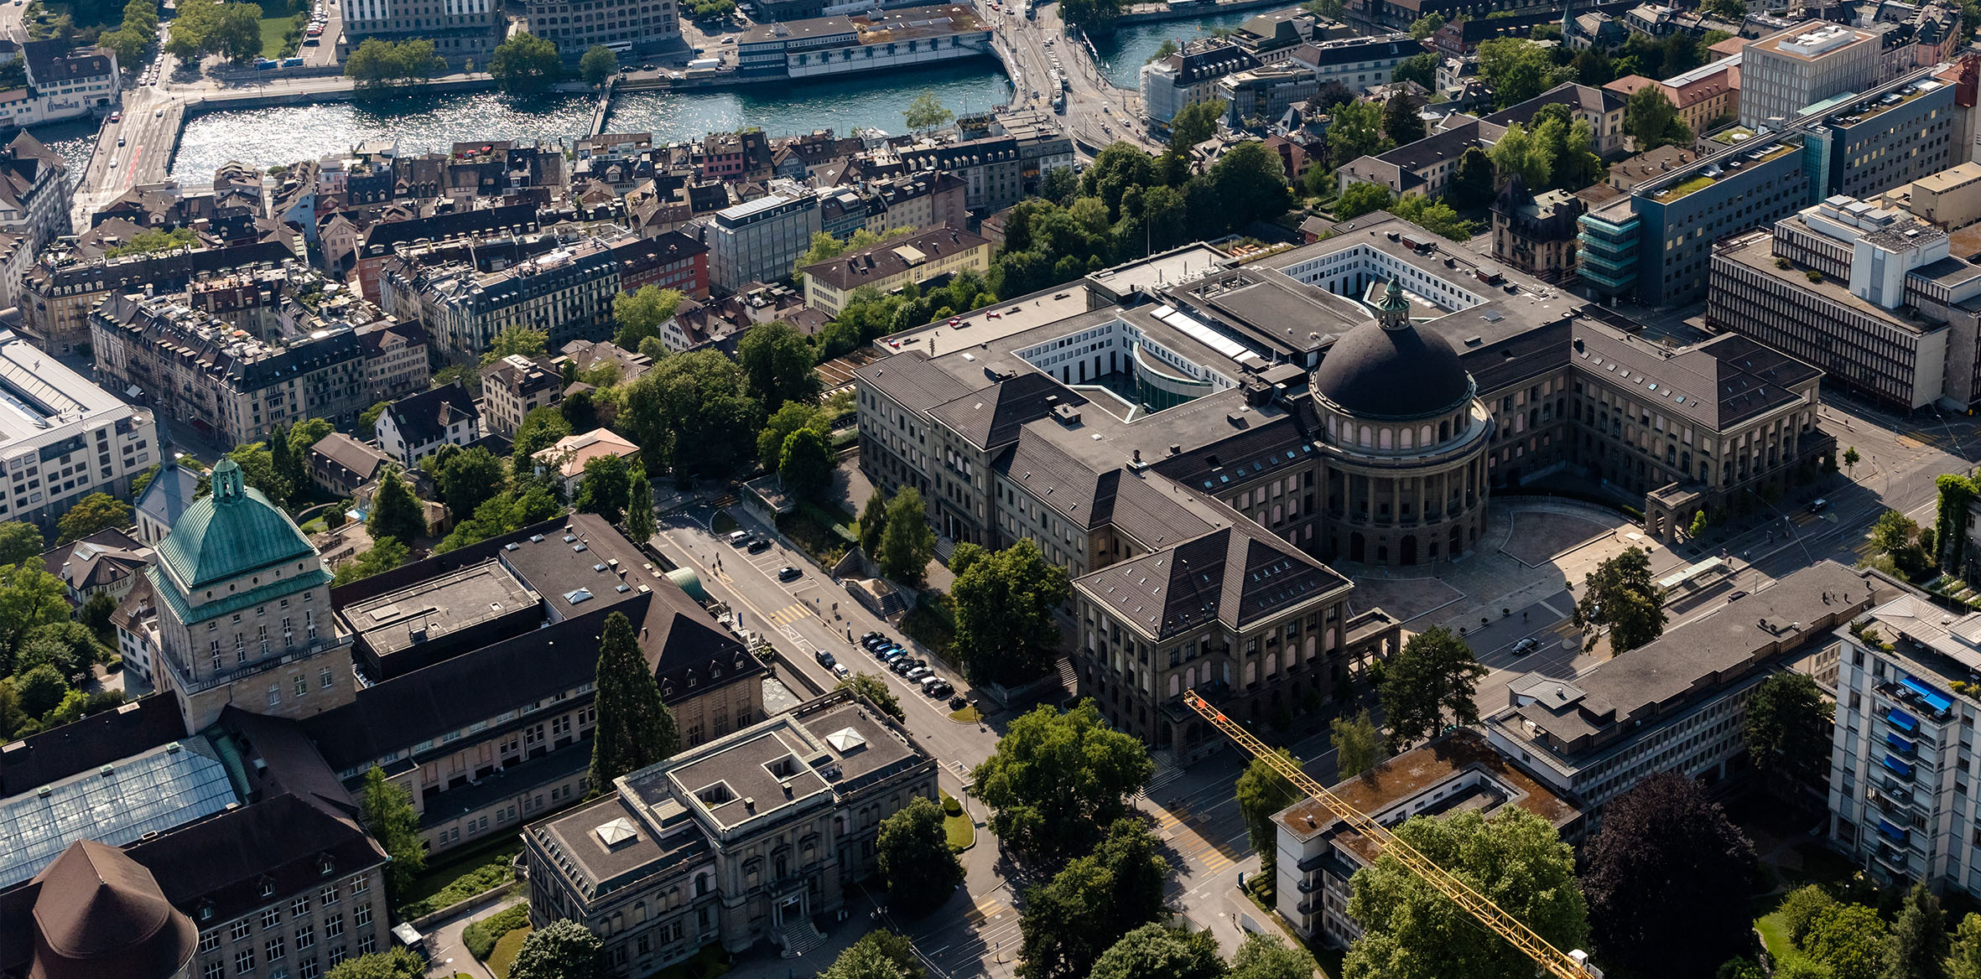
Robustness of Deep Learning Against Adversarial Examples
D-BAUG
ETH Zurich
Bingxin Ke
Geomatic Engineering MSc
10.12.2020, Zurich
Notes:
Good morning everyone, thanks for coming. The topic of my presentation is xxx

Slide 2
Agenda
What are adversarial examples?
How do adversarial examples work?
How to generate adversarial examples?
How to improve robustness?
Notes:
Here is today’s agenda. I use these four questions to help you and me understand this topic better.

Slide 3
What are adversarial examples?

Slide 4
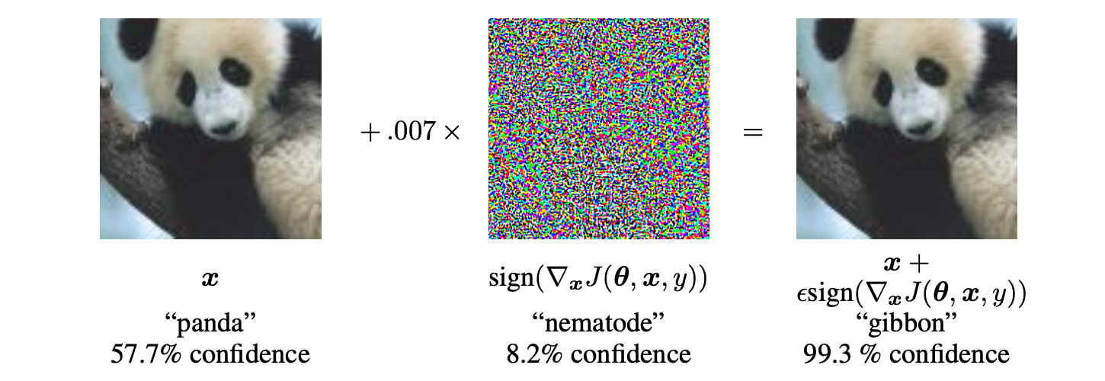
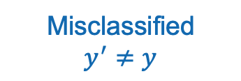
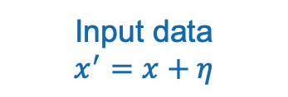
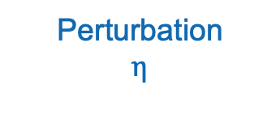
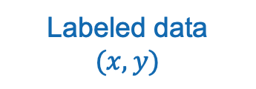
What is adversarial example
Adversarial examples are inputs formed by applying small but intentionally worst-case perturbations to examples from the dataset, such that the perturbed input results in the model outputting an incorrect answer with high confidence.^{[1]}
Misclassified
$$y^{′}≠y$$
Labeled data
$$(x, y)$$
Perturbation
$$η$$
Input data
$$x^{′}=x+η$$
[1] J. Goodfellow, J. Shlens, and C. Szegedy. Explaining and harnessing adversarial examples.arXiv preprint arXiv:1412.6572, 2014
Notes:
Firstly let’s see a very famous example, a cute panda. This is one definition of adversarial examples. Let’s see what does it mean
The left image is the original panda. For a image classifier, [click]original input x is the digital image and y is the label “panda”. And the classifier can distinguish that it’s a panda.
[click] Then a perturbation eta is intentionally generated. It’s small enough, even imperceptible, but it will cause the worst-case perturbation. So the input data becomes x prime.[click] This input lead the classifier to give out a wrong answer with high confidence. We can see that in this case, the confidence of wrong answer is even higher than the right answer.
So the input x prime is the perturbed input, is called adversarial example.

Slide 5
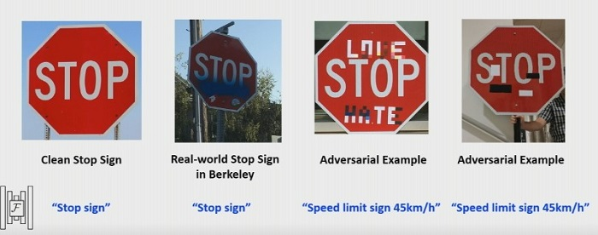
What is adversarial example
[7] Eykholt, K., Evtimov, I., Fernandes, E., Li, B., Rahmati, A., Xiao, C., ... & Song, D. (2018). Robust physical-world attacks on deep learning visual classification. In Proceedings of the IEEE Conference on Computer Vision and Pattern Recognition (pp. 1625-1634).
Notes:
This is another case. There are some drawing or in other word graffiti on this road sign. Of course, these graffiti are not random noise. They are designed on purpose to fool the model. And the model has a completely wrong answer. It regard this stop sign as a speed limit sign.
This may cause serious consequence. Image what if a self-driving vehicle misunderstood these signs.

Slide 6
How do adversarial examples work?

Slide 7
How do adversarial examples work
Speculative explanations:
extreme nonlinearity of deep neural networks
insufficient model averaging
insufficient regularization
Primary cause of neural networks’ vulnerability to adversarial perturbation is their linear nature.^{[1]}
Linear behavior in high-dimensional space is sufficient to cause adversarial examples.^{[1]}
[1] J. Goodfellow, J. Shlens, and C. Szegedy. Explaining and harnessing adversarial examples.arXiv preprint arXiv:1412.6572, 2014
Notes:
The cause of these adversarial examples was a mystery, and previous explanations have suggested it is due to extreme nonlinearity of deep neural networks, perhaps combined with insufficient model averaging and insufficient regularization of the purely supervised learning problem.
But in this paper, these hypotheses are proved unnecessary. The conclusion is that It’s the linear nature of a neural network that cause its vulnerary to adversarial examples. And the linear behavior in high-dimensional space is sufficient to cause adversarial examples. Of course, the model should have enough high dimensionality.
Let’s see how does linearity affect.

Slide 8
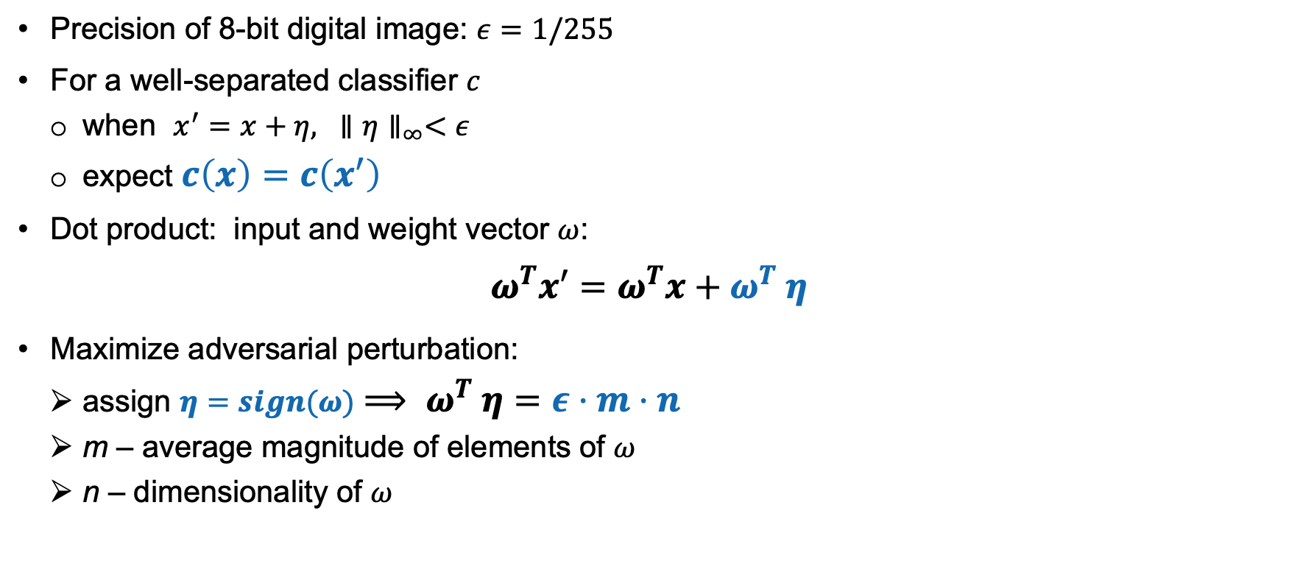
How do adversarial examples work Linear Explanation^{[1]}
Precision of 8-bit digital image: $ε=1/255$
For a well-separated classifier $c$
when $x^{′}=x+η, {∥η∥}_{∞}<ε$
expect $c\left(x\right)=c\left(x^{′}\right)$
Dot product: input and weight vector $ω$:
$$ω^{T}x′=ω^{T}x+ω^{T} η$$
Maximize adversarial perturbation:
assign $η=sign(ω)$ $⟹ ω^{T} η=ε·m·n$
m – average magnitude of elements of $ω$
n – dimensionality of $ω$
Activation growth
Simple linear model can have adversarial examples if its input has sufficient dimensionality^{[1]}.
[1] J. Goodfellow, J. Shlens, and C. Szegedy. Explaining and harnessing adversarial examples.arXiv preprint arXiv:1412.6572, 2014
Notes:
Here we take an image classifier as an example. The precision of an 8-bit image is 1/255, and it means that the image will discard all information below 1/255 of the dynamic range.
For a well-separated classifier, we expect it to assign the same class to x and x prime. when max norm of the perturbation eta is smaller than epsilon. But how would the classifier actually response to this perturbation? Let’s take dot product of input and weight vector omega.[click] Here the omega eta is the activation growth caused by the perturbation.
If we purposely maximize this growth by aligning eta to the sign of weights, the growth would be eta m n, where m is the average magnitude of elements and n is the dimensionality of weights.
Therefore, for high dimensional problems, we can make many infinitesimal changes into the input and add up to one large change to the output
[click] So, even simple model (linear regression) might be vulnerable to adversarial attack, which means adversaraial examples are not something special for deep network, it could be something dangerous to most kindes of machine learning models.

Slide 9
How to generate adversarial examples?

Slide 10
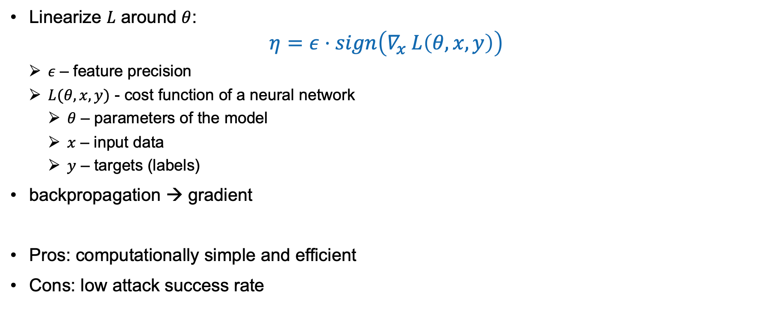
How to generate adversarial examples Fast Gradient Sign Method (FGSM)^{[1]}
Linearize $L$ around $θ$:
$$η=ε⋅sign\left(∇_{x} L\left(θ,x,y\right)\right)$$
$ε \text{–} \text{feature} \text{precision}$
$L(θ,x,y)$ - cost function of a neural network
$θ$ – parameters of the model
$x$ – input data
$y$ – targets (labels)
backpropagation → gradient
Pros: computationally simple and efficient
Cons: low attack success rate
[1] J. Goodfellow, J. Shlens, and C. Szegedy. Explaining and harnessing adversarial examples.arXiv preprint arXiv:1412.6572, 2014
[6] Kurakin, A., Goodfellow, I., & Bengio, S. (2016). Adversarial machine learning at scale. arXiv preprint arXiv:1611.01236.
Notes:
Firstly, I want to introduce fast gradient sign method. This method is generated from the linear view of adversarial examples we just saw. For non-linear models, in order to align the perturbation to the model gradient, we can linearize the cost function L around model parameter $θ$. And then we can get an optimal perturbation with max-norm constrain. Noting that this gradient can be calculated efficiently using backpropagation.
This method is simple and efficient but not so powerful.

Slide 11
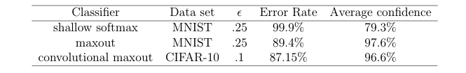
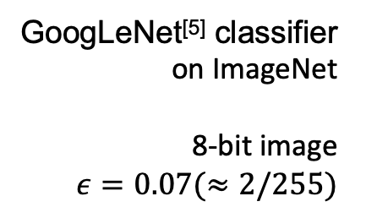
How to generate adversarial examples Fast Gradient Sign Method (FGSM)^{[1]}
GoogLeNet^{[5]} classifier
on ImageNet
8-bit image
$ε=0.07(≈2/255)$
Experiment Result of FGSM^{[1]}
[1] J. Goodfellow, J. Shlens, and C. Szegedy. Explaining and harnessing adversarial examples.arXiv preprint arXiv:1412.6572, 2014
[5] C. Szegedy, W. Liu, Y. Jia, P. Sermanet, S. Reed, D. Anguelov, D. Erhan, V. Vanhoucke, andA. Rabinovich. Going deeper with convolutions. InProceedings of the IEEE conference oncomputer vision and pattern recognition, pages 1–9, 2015
Notes:
Here is the experiment result. We’ve seen this example at the beginning, In this experiment, fast gradient sign method was applied to generate adversarial examples. They successfully change the classification of this panda example. But from the table below, we can find that it doesn’t cause a very high error rate or so called attack success rate.

Slide 12
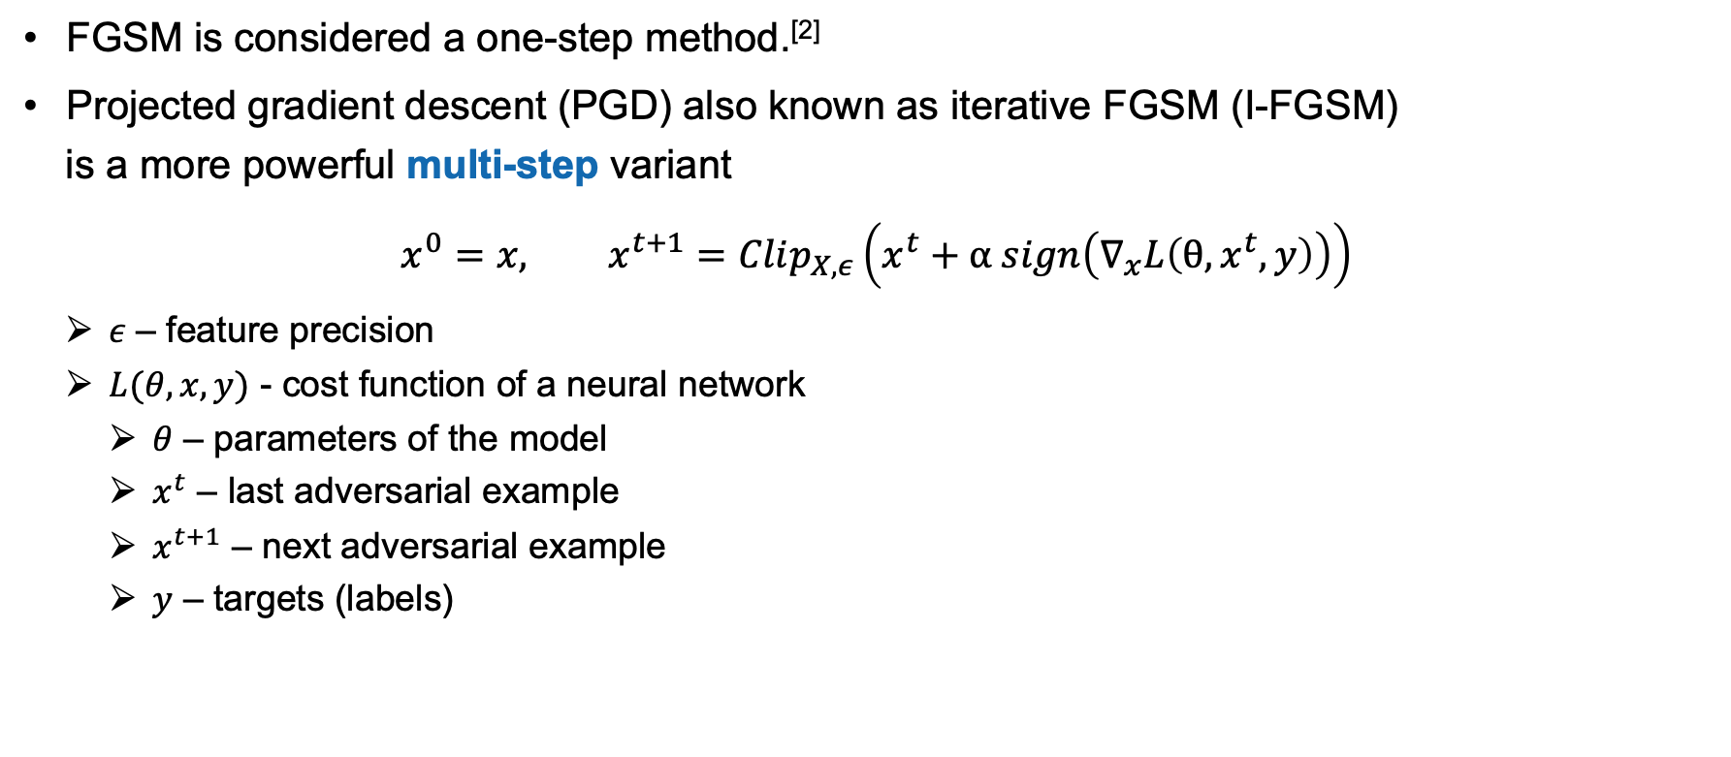
How to generate adversarial examples Projected Gradient Descent (PGD)^{[6]}
FGSM is considered a one-step method.^{[2]}
Projected gradient descent (PGD) also known as iterative FGSM (I-FGSM)
is a more powerful multi-step variant
$$x^{0}=x, x^{t+1}=Clip_{X,ε}\left(x^{t}+α sign\left(∇_{x}L\left(θ,x^{t},y\right)\right)\right)$$
$ε \text{–} \text{feature} \text{precision}$
$L(θ,x,y)$ - cost function of a neural network
$θ$ – parameters of the model
$x^{t}$ – last adversarial example
$x^{t+1}$ – next adversarial example
$y$ – targets (labels)
[2] A. Madry, A. Makelov, L. Schmidt, D. Tsipras, and A. Vladu. Towards deep learning modelsresistant to adversarial attacks.arXiv preprint arXiv:1706.06083, 2017.
[6] Kurakin, A., Goodfellow, I., & Bengio, S. (2016). Adversarial machine learning at scale. arXiv preprint arXiv:1611.01236.
Notes:
Here is a improved method to get more powerful adversarial. Considered that fast gradient sign method is a one-step method, we can iterate this and get a more powerful multi-step method. This is called iterative fast gradient sign method, and it essentially is a projected gradient descent on the negative loss function.
I choose not go into the details here, you can find the mathematical details in this No.6 reference
And of course there are other methods to generate adversarial examples provided in other researches.

Slide 13
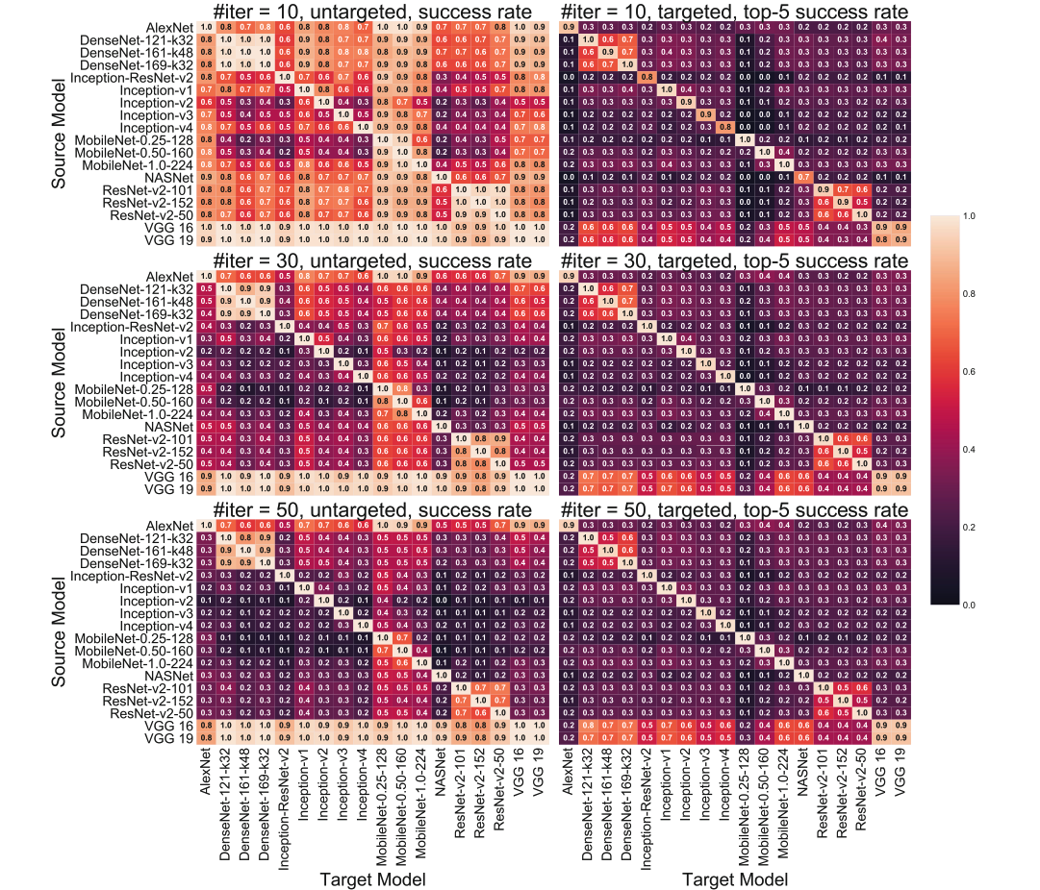
How to generate adversarial examples Transfer attack
Transferability of I-FGSM attack
over 18 ImageNet models ^{[4]}
[4] Su, H. Zhang, H. Chen, J. Yi, P.-Y. Chen, and Y. Gao. Is robustness the cost of accuracy?–a comprehensive study on the robustness of 18 deep image classification models. InProceedings of the European Conference on Computer Vision (ECCV), pages 631–648
Notes:
Attacks are not limited to the model it trained on, it can also be used to attack other models. This is called transfer attack,
There is an huge experiment with 18 models carried out by Su et al. The x axis and y axis are corresponding models. Row directions are the modesl used to generate adversarial examples, column directions are the models to be tested and the values are the error rate of the test. From the result,[click] let’s look at the values in these blue boxes. we can find that the adversarial examples generated by the VGG family can transfer very well to all the other 17 models, while most adversarial examples of other models can only transfer within the same model family. This is something we should be aware of.

Slide 14
How to improve robustness?

Slide 15

How to improve robustness A unified view of attacks and defenses (Saddle point problem)
Saddle point problem^{[2]} aims to summarize the attack-defense problem:
$$\min_{θ}{ρ}\left(θ\right), \text{where} ρ\left(θ\right)=E_{\left(x,y\right)∼𝒟}\left[\max_{δ∈𝓢}{L}\left(θ,x+δ,y\right)\right]$$
Inner maximization - to find an adversarial
Outer minimization – to minimize adversarial
[2] A. Madry, A. Makelov, L. Schmidt, D. Tsipras, and A. Vladu. Towards deep learning modelsresistant to adversarial attacks.arXiv preprint arXiv:1706.06083, 2017.
Notes:
In order to improve the robustness of a model, instead of just aim to attack a model, Madry et al summarized the attack-defense problem of adversarial samples into a Saddle point problem.
There are two key concepts:
Inner maximization is to find an adversarial version of a given data point x that achieves a high loss
And outer minimization is o find model parameters so that the “adversarial loss” given by the inner attack problem is minimized

Slide 16
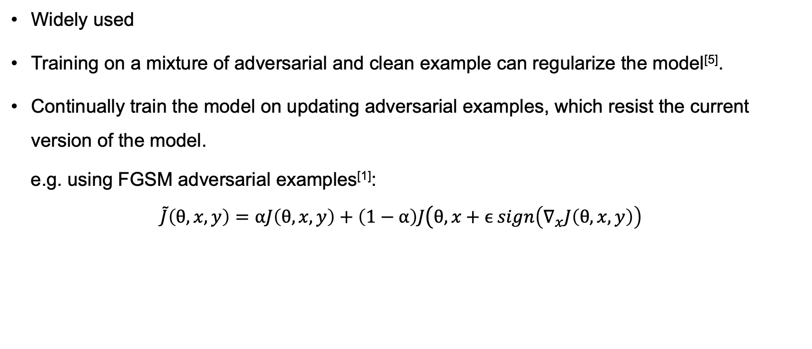
How to improve robustness Adversarial Training
Widely used
Training on a mixture of adversarial and clean example can regularize the model^{[5]}.
Continually train the model on updating adversarial examples, which resist the current version of the model.
e.g. using FGSM adversarial examples^{[1]}:
$$\tilde{J}\left(θ,x,y\right)=αJ\left(θ,x,y\right)+\left(1−α\right)J\left(θ,x+ϵ sign\left(∇_{x}J\left(θ,x,y\right)\right)\right.$$
Train the model with FGSM adversaries
Train on clean data
Generate FGSM adversaries on the model
[1] J. Goodfellow, J. Shlens, and C. Szegedy. Explaining and harnessing adversarial examples.arXiv preprint arXiv:1412.6572, 2014
[5] C. Szegedy, W. Liu, Y. Jia, P. Sermanet, S. Reed, D. Anguelov, D. Erhan, V. Vanhoucke, andA. Rabinovich. Going deeper with convolutions. InProceedings of the IEEE conference oncomputer vision and pattern recognition, pages 1–9, 2015
Notes:
From this point of view, there comes a widely used method., adversarial training. That is to train a model with not only natural examples but also adversarial examples.
in other words, augment the dataset with adversarial examples .
And the training can be repeated. That is to repletely train the model on adversarial examples that keep updating and resist the current version of the model
For example we can firstly train on the clean data set, and then use FGSM to generate a batch of adversarial examples, retrain the previous version model, and generate a new batch of adversarial input from this new model, train the model again, repeat and repeat.

Slide 17
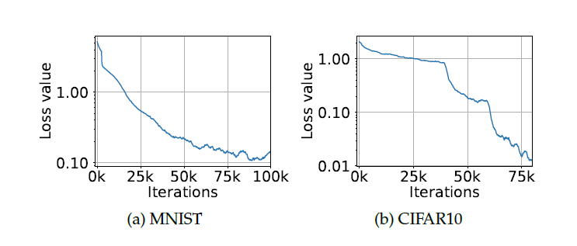
How to improve robustness Adversarial Training using PGD attacking^{[2]}
Input: PGD perturbed adversarial data + clean data
Use stochastic gradient descent to minimize the loss function.
Cross-entropy loss on adversarial examples during training^{[2]}
[2] A. Madry, A. Makelov, L. Schmidt, D. Tsipras, and A. Vladu. Towards deep learning modelsresistant to adversarial attacks.arXiv preprint arXiv:1706.06083, 2017.
Notes:
Here is another example. It has almost the same idea. Let’s think from the view of saddle point problem. For inner maximization, they perturb the inputs using projected gradient descent and normally train the network on the mixture of clean input and perturbed input.
And they use stochastic gradient descent to minimize the loss function, in other word, to solve the outer minimization of the saddle point formulation.
The graph below is the experiment result on MNIST data and (xi fa)CIFAR10 data.
This experiment illustrates that by applying adversarial training with these updating adversarial examples, we can consistently reduce the loss of the saddle point problem during training, therefore increasingly improve robustness of the model

Slide 18
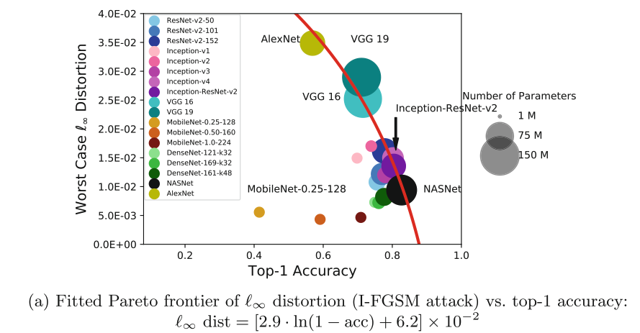
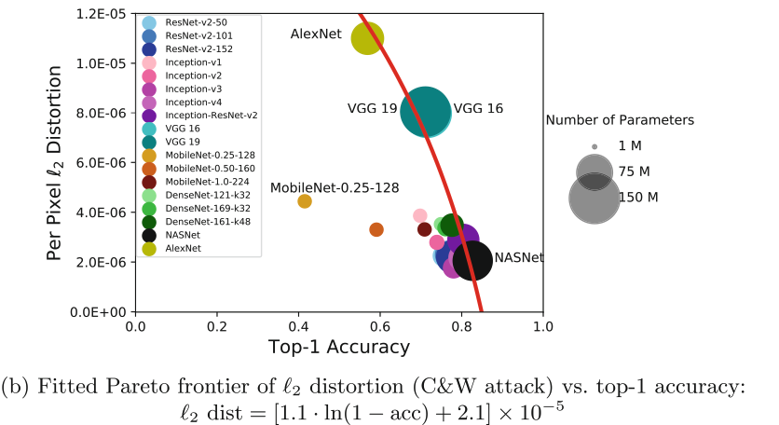
How to improve robustness Trade-off between robustness and accuracy
Robustness is scarified when solely pursuing a higher classification performance.^{[4]}
Robustness vs. classification accuracy plots of I-FGSM attack^{[4]}
Theoretical decomposition of the prediction error for adversarial examples^{[3]}$:$
$$ℛ_{rob}\left(f\right)=ℛ_{nat}\left(f\right)+ℛ_{bdy}\left(f\right)$$
[3] H. Zhang, Y. Yu, J. Jiao, E. P. Xing, L. E. Ghaoui, and M. I. Jordan. Theoretically principledtrade-off between robustness and accuracy.arXiv preprint arXiv:1901.08573, 2019.
[4] Su, H. Zhang, H. Chen, J. Yi, P.-Y. Chen, and Y. Gao. Is robustness the cost of accuracy?–a comprehensive study on the robustness of 18 deep image classification models. In Proceedings of the European Conference on Computer Vision (ECCV), pages 631–648
Notes:
There is one thing we should pay attention. We can not always get both high accuracy and good robustness, there is a trade-off between them.
From that 18-model experiment, they empirically found the relation between robustness and accuracy of different ImageNet models.
these graphs clearly show that the 2nd norm and max norm adversarial distortions scale almost linearly with the logarithm of model classification errors.
Therefore, the classifiers with very high accuracy are highly vulnerable to adversarial attacks .
But this doesn’t mean that models with low accuracy always have better robustness.
In order to find a guiding principle when design a adversarial robust network,[click] Zhang et al theoretically decompose the prediction error for adversarial examples (robust error) as the sum of the natural classification error and boundary error and provide a differentiable upper bound which is shown to be the tightest possible upper bound.

Slide 19
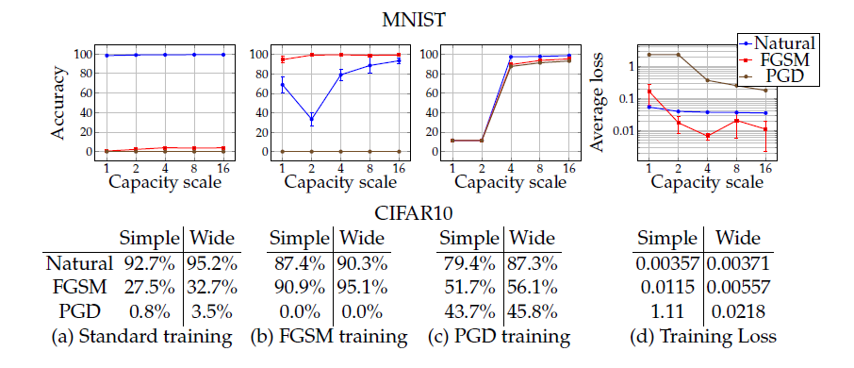
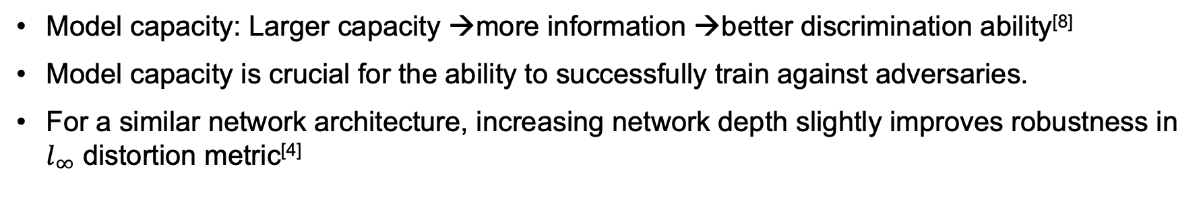
How to improve robustness Model Capacity
Model capacity: Larger capacity →more information →better discrimination ability^{[8]}
Model capacity is crucial for the ability to successfully train against adversaries.
For a similar network architecture, increasing network depth slightly improves robustness in $l_{∞}$ distortion metric^{[4]}
Fig. The effect of network capacity on the performance of the network^{[2]}
[2] A. Madry, A. Makelov, L. Schmidt, D. Tsipras, and A. Vladu. Towards deep learning modelsresistant to adversarial attacks.arXiv preprint arXiv:1706.06083, 2017.
[4] Su, H. Zhang, H. Chen, J. Yi, P.-Y. Chen, and Y. Gao. Is robustness the cost of accuracy?–a comprehensive study on the robustness of 18 deep image classification models. In Proceedings of the European Conference on Computer Vision (ECCV), pages 631–648
[8] Wang, H. Zhou, W. Xu, and X. Chen. Deep neural network capacity.arXiv preprintarXiv:1708.05029, 2017
Notes:
There are some other factor that affect robustness against adversarial examples.
Firstly I want to talk about model capacity. It is s an interesting property of a deep network and also related to robustness
What is model capacity? : A model with larger capacity can always deposit more information to improve the discrimination ability of the model
It’s crucial to the robustness against adversaries
The graphs below are the result of network with different capacity (x axis). These networks are trained on different kinds of data. From left to right, they are (a)natural examples, (b)mixture with FGSM adversaries, (c) mixture with PGD adversaries.
(1 row 1 graph) without adversarial training, improvement on capacity slightly improves the robustness against FGSM attack
(1 row 2 graph) shows that models trained with FGSM examples are not robust against PGD attack
(1 row 3 graph) indicates that the robustness of model trained with PGD adversaries are improved with the increase of model capacity..
in the 4th graph, the average loss (y axis) corresponds to the saddle point problem loss. This graph shows that models with larger capacity are more possible to be trained against adversarial examples
It’s also concluded that for a similar network architecture, increasing network depth slightly improves robustness against max norm distortion metric. And here the increase of depth corresponds to the increase of model capacity.
So , in general, increasing model capacity can some how improve the robustness against adversary

Slide 20
How to improve robustness Model Architecture
Network architecture has a larger impact on robustness than model size.^{[4]}
Some networks naturally have better robustness against adversarial examples,
e.g. RBF networks are resistant to adversarial examples.^{[1]}
There is no “best” network architecture, yet.
[1] J. Goodfellow, J. Shlens, and C. Szegedy. Explaining and harnessing adversarial examples.arXiv preprint arXiv:1412.6572, 2014
[4] Su, H. Zhang, H. Chen, J. Yi, P.-Y. Chen, and Y. Gao. Is robustness the cost of accuracy?–a comprehensive study on the robustness of 18 deep image classification models. In Proceedings of the European Conference on Computer Vision (ECCV), pages 631–648
Notes:
What’s more important is model architecture.
You might remember this graph from that 18-model experiment. Please look into these yellow circles, we can find that networks of a same family have a similar level of robustness, despite different depths and model sizes.
[click]And, it’s also mentioned that RBF networks are naturally immune to adversarial examples, since they default to predicting the the class is absent or have low confidence when they are ”fooled”.
[click]But we can’t say which model is the best or has the best robustness. It really depends on the application, data set and many other factors.

Slide 21
Reference
[1] J. Goodfellow, J. Shlens, and C. Szegedy. Explaining and harnessing adversarial examples.arXiv preprint arXiv:1412.6572, 2014
[2] A. Madry, A. Makelov, L. Schmidt, D. Tsipras, and A. Vladu. Towards deep learning models resistant to adversarial attacks.arXiv preprint arXiv:1706.06083, 2017.
[3] H. Zhang, Y. Yu, J. Jiao, E. P. Xing, L. E. Ghaoui, and M. I. Jordan. Theoretically principled trade-off between robustness and accuracy.arXiv preprint arXiv:1901.08573, 2019.
[4] Su, H. Zhang, H. Chen, J. Yi, P.-Y. Chen, and Y. Gao. Is robustness the cost of accuracy?–a comprehensive study on the robustness of 18 deep image classification models. In Proceedings of the European Conference on Computer Vision (ECCV), pages 631–648
[5] C. Szegedy, W. Liu, Y. Jia, P. Sermanet, S. Reed, D. Anguelov, D. Erhan, V. Vanhoucke, andA. Rabinovich. Going deeper with convolutions. In Proceedings of the IEEE conference on computer vision and pattern recognition, pages 1–9, 2015
[6] Kurakin, A., Goodfellow, I., & Bengio, S. (2016). Adversarial machine learning at scale. arXiv preprint arXiv:1611.01236.
[7] Eykholt, K., Evtimov, I., Fernandes, E., Li, B., Rahmati, A., Xiao, C., ... & Song, D. (2018). Robust physical-world attacks on deep learning visual classification. In Proceedings of the IEEE Conference on Computer Vision and Pattern Recognition (pp. 1625-1634).
[8] Wang, H. Zhou, W. Xu, and X. Chen. Deep neural network capacity.arXiv preprintarXiv:1708.05029, 2017

Slide 22
Take-home thinking
Thank you for listening
Can these ideas be used for other models (not only deep network)?
Can we still rely on existing ML applications?
...
Notes:
Here are something we can explore in the future.

Slide 23
Q&A Session

