Slide 1
電腦視覺原理及應用簡介
Lab8
Face Detection

Slide 2
流程
Cascade_Classifier_object = cv2.CascadeClassifier()
Declares a Cascade Classifier object
retval = cv2.CascadeClassifier.load(filename)
Loads a classifier from a file.
Human: data/lbpcascade_frontalface_improved.xml
Cat: data/lbpcascade_frontalcatface.xml
cv2.CascadeClassifier.detectMultiScale(image)
Detects objects of different sizes in the input image.
The detected objects are returned as a list of rectangles.

Slide 3
Assignment
按 a 時偵測人臉
按 s 時偵測貓臉
按 q 時離開

Slide 4
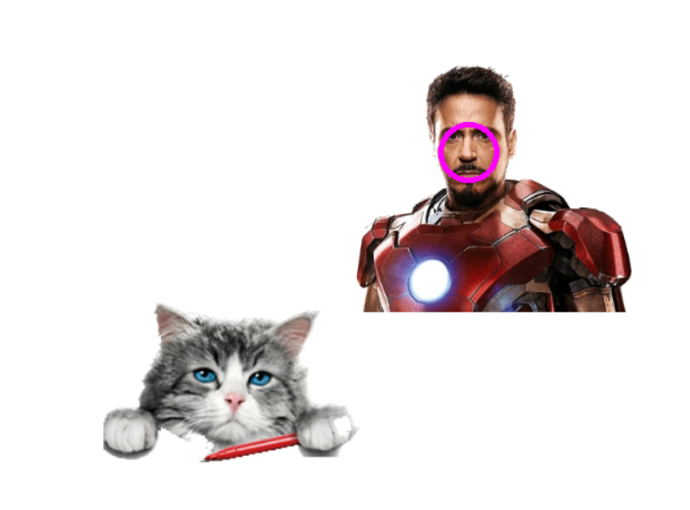
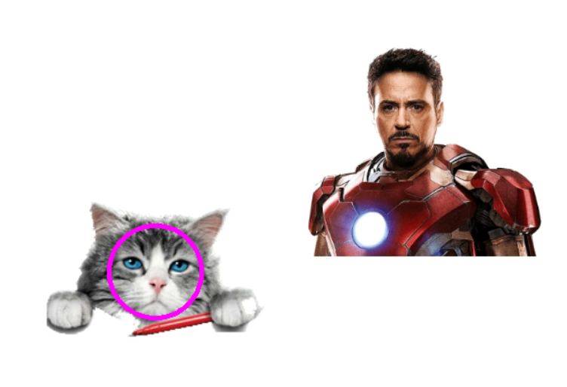
Demo
按 a
按 s

