Slide 1

Life Expectancy Around the world
Capstone Group 3: Abby Herrup, Mark Burton, Jim Worlein, & Clarence Robinson
Notes:
Clarence

Slide 2

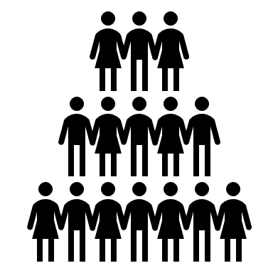

Overview
Overview of the Data Sets
Inspiration
Research Questions
Demo of Website
Our Conclusion
Possible Limitations or Biases
Future Work Recommendations
References
Notes:
Clarence

Slide 3
Data Set Overview
Life Expectancy & Demographic Data
Data collected by the World Health Organization (WHO) between 2000 – 2015 over numerous countries
Income Level Information
Collected this information from world bank
Net National Income per Capita
Notes:
Jim

Slide 4
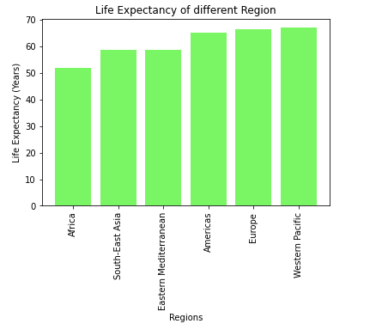
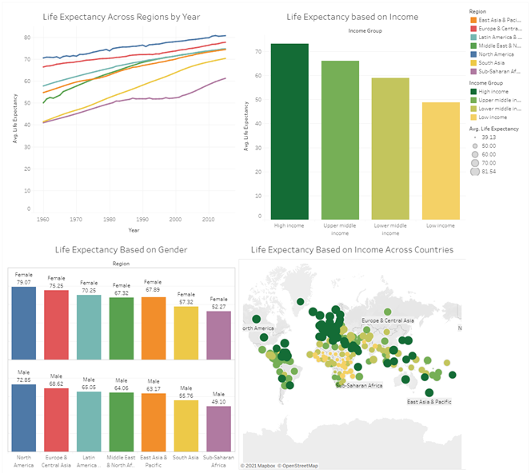
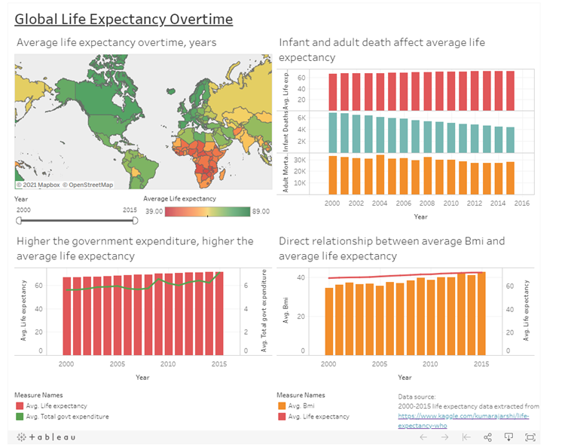
Inspiration
We wanted to learn how a country could possibly increase their life expectancy! We were inspired by data visualizations about the connection between demographics and life expectancy. We also were intrigued with how it could change over time
Notes:
Jim

Slide 5


Our research questions
What factors can influence the average life expectancy in a country?
Do wealthier countries have higher life expectancy?
How does life expectancy change if demographics change in a country?
What is the relationship between the health development index (HDI) and life expectancy?
Notes:
Abby

Slide 6
LET’S DIVE INTO THE WEBSITE
Notes:
Abby

Slide 7
Our conclusion(s)
The strongest influence on life expectancy ended up being the prevalence of HIV/AIDs related deaths
Higher income countries did tend to have higher life expectancies
There is a strong correlation between life expectancy and the Human Development Index
Notes:
Mark

Slide 8

Possible Limitations or Biases
Null values in the data
Lack of recent data (2015 was the latest year)
Data inconsistencies
Natural bias to assume wealthier countries have healthier people
Notes:
Mark

Slide 9
Future work recommendations
Update the data set for more recent years (2015-2021)
Add gender into the analysis
Research access to healthcare and vaccines and how that impacts life expectancy
Research the affect COVID-19 has taken on life expectancy
Notes:
Mark

Slide 10
References
https://data.worldbank.org/indicator/NY.ADJ.NNTY.PC.CD
https://www.kaggle.com/augustus0498/life-expectancy-who

