Slide 1
Determinants
PROPERTIES OF DETERMINANTS

Slide 2
PROPERTIES OF DETERMINANTS
Theorem 3: Let A be a square matrix
If a multiple of one row of A is added to another row to produce a matrix B, then det B = det A.
If two rows of A are interchanged to produce B, then det B = det A.
If one row of A is multiplied by k to produce B, then det B = k det A.

Slide 3
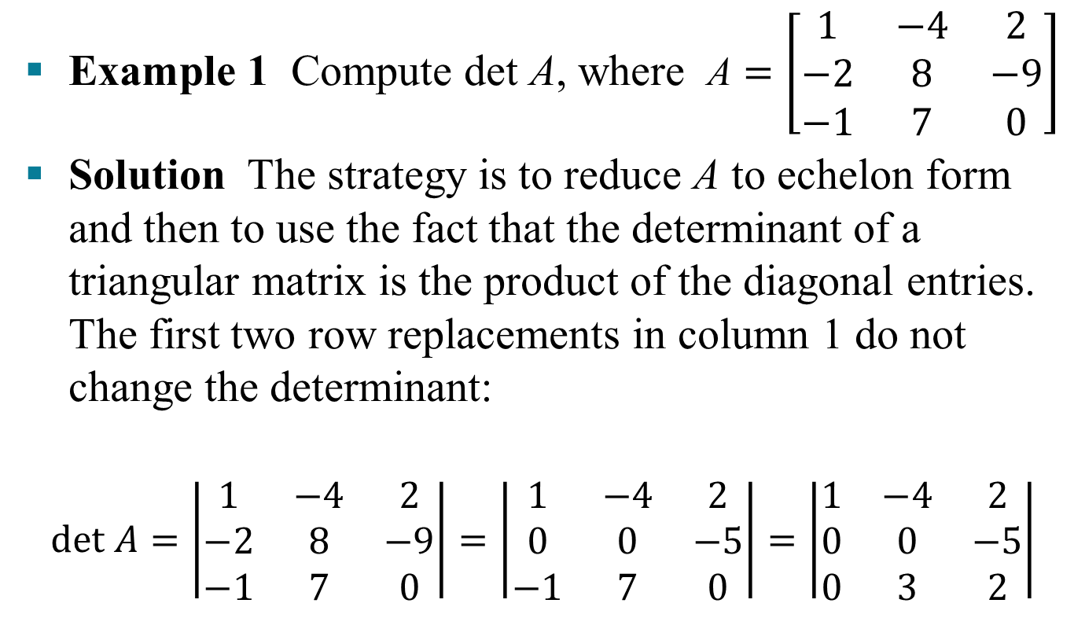
PROPERTIES OF DETERMINANTS
Example 1 Compute det A, where $\text{A}=\left[\begin{matrix}1 & −4 & 2 \\ −2 & 8 & −9 \\ −1 & 7 & 0\end{matrix}\right]$
Solution The strategy is to reduce A to echelon form and then to use the fact that the determinant of a triangular matrix is the product of the diagonal entries. The first two row replacements in column 1 do not change the determinant:
$$det A=\left|\begin{matrix}1 & −4 & 2 \\ −2 & 8 & −9 \\ −1 & 7 & 0\end{matrix}\right|=\left|\begin{matrix}1 & −4 & 2 \\ 0 & 0 & −5 \\ −1 & 7 & 0\end{matrix}\right|=\left|\begin{matrix}1 & −4 & 2 \\ 0 & 0 & −5 \\ 0 & 3 & 2\end{matrix}\right|$$

Slide 4

PROPERTIES OF DETERMINANTS
An interchange of rows 2 and 3 reverses the sign of the determinant, so
$$\text{det} \text{A}=−\left|\begin{matrix}1 & −4 & 2 \\ 0 & 3 & 2 \\ 0 & 0 & −5\end{matrix}\right|=−\left(1\right)\left(3\right)\left(−5\right)=15$$

Slide 5
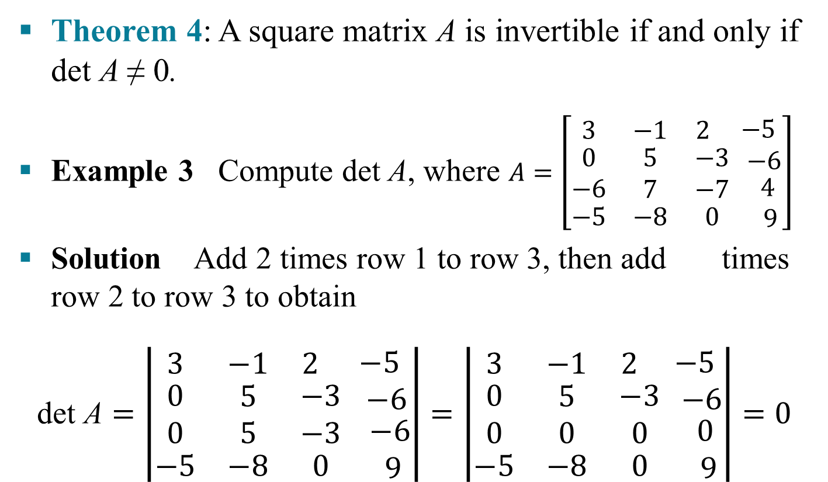
PROPERTIES OF DETERMINANTS
Theorem 4: A square matrix A is invertible if and only if det A ≠ 0.
Example 3 Compute det A, where $A=\left[\begin{matrix}3 & −1 & 2 \\ \begin{aligned}0 \\ −6\end{aligned} & \begin{aligned}5 \\ 7\end{aligned} & \begin{aligned}−3 \\ −7\end{aligned} \\ −5 & −8 & 0\end{matrix} \begin{matrix}\begin{aligned}−5 \\ −6\end{aligned} \\ 4 \\ 9\end{matrix}\right]$
Solution Add 2 times row 1 to row 3, then add times row 2 to row 3 to obtain
$\text{d}\text{et} \text{A}=\left|\begin{matrix}3 & −1 & 2 \\ \begin{aligned}0 \\ 0\end{aligned} & \begin{aligned}5 \\ 5\end{aligned} & \begin{aligned}−3 \\ −3\end{aligned} \\ −5 & −8 & 0\end{matrix} \begin{matrix}\begin{aligned}−5 \\ −6\end{aligned} \\ −6 \\ 9\end{matrix}\right|=\left|\begin{matrix}3 & −1 & 2 \\ \begin{aligned}0 \\ 0\end{aligned} & \begin{aligned}5 \\ 0\end{aligned} & \begin{aligned}−3 \\ 0\end{aligned} \\ −5 & −8 & 0\end{matrix} \begin{matrix}\begin{aligned}−5 \\ −6\end{aligned} \\ 0 \\ 9\end{matrix}\right|=0$

Slide 6
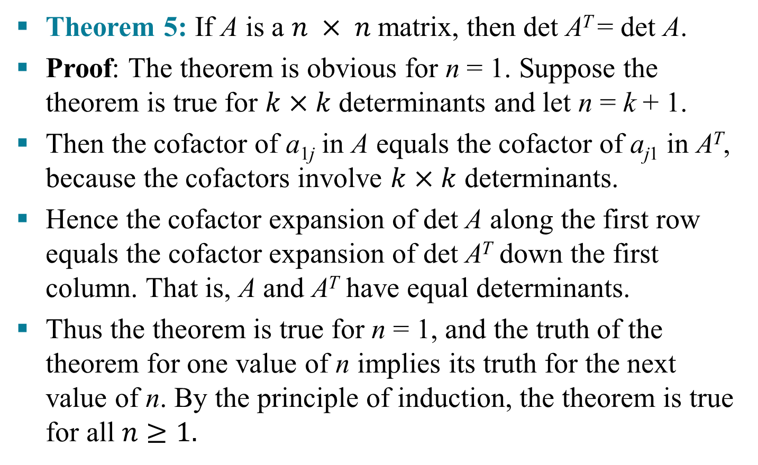
COLUMN OPERATIONS
Theorem 5: If A is a $n × n$matrix, then det A^{T} = det A.
Proof: The theorem is obvious for n = 1. Suppose the theorem is true for $k×k$ determinants and let n = k + 1.
Then the cofactor of a_{1j} in A equals the cofactor of a_{j1} in A^{T}, because the cofactors involve $k×k$ determinants.
Hence the cofactor expansion of det A along the first row equals the cofactor expansion of det A^{T} down the first column. That is, A and A^{T} have equal determinants.
Thus the theorem is true for n = 1, and the truth of the theorem for one value of n implies its truth for the next value of n. By the principle of induction, the theorem is true for all $n≥1.$

Slide 7
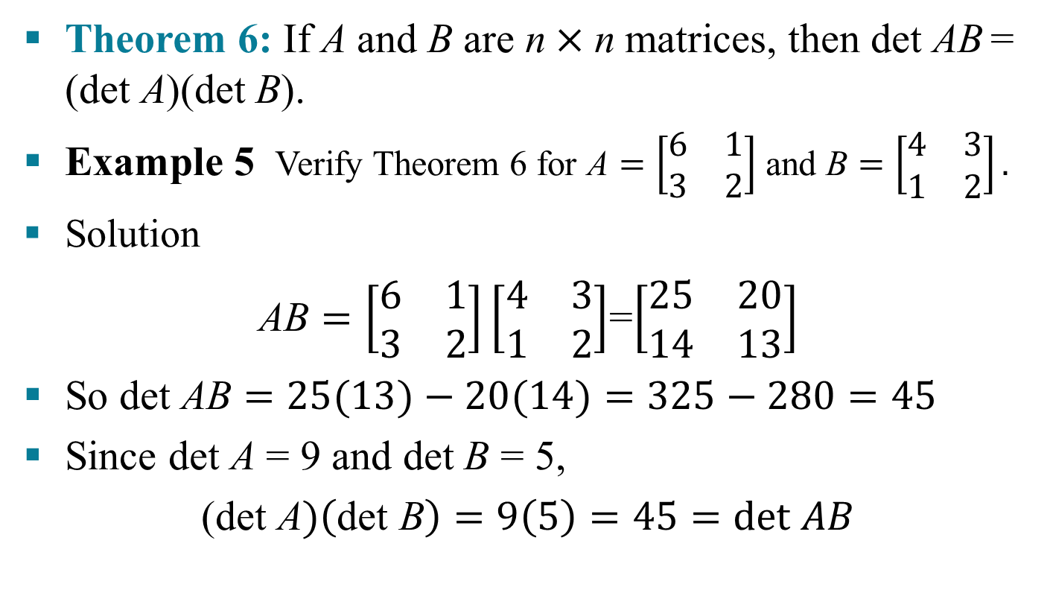
DETERMINANTS AND MATRIX PRODUCTS
Theorem 6: If A and B are $\text{n}×\text{n}$matrices, then det AB = (det A)(det B).
Example 5 Verify Theorem 6 for $\text{A}=\left[\begin{matrix}6 & 1 \\ 3 & 2\end{matrix}\right]$ and $\text{B}=\left[\begin{matrix}4 & 3 \\ 1 & 2\end{matrix}\right].$
Solution
$\text{A}\text{B}=\left[\begin{matrix}6 & 1 \\ 3 & 2\end{matrix}\right]\left[\begin{matrix}4 & 3 \\ 1 & 2\end{matrix}\right]$=$\left[\begin{matrix}25 & 20 \\ 14 & 13\end{matrix}\right]$
So det $\text{AB}=25(13)−20(14)=325−280=45$
Since det A = 9 and det B = 5,
(det$\text{A})\left(\text{det} \text{B}\right)=9\left(5\right)=45=det AB$

