Slide 1
Eigenvalues and Eigenvectors
EIGENVECTORS AND LINEAR TRANSFORMATIONS

Slide 2
LINEAR TRANSFORMATIONS
Let V be a vector space. An eigenvector of a linear transformation T: V V is a nonzero vector x in V such that T(x)=x for some scalar .
A scalar  is called an eigenvalue of T if there is a nontrivial solution x of T(x)=x.
Such a pair is referred to as an eigenvector x corresponding to the eigenvalue .

Slide 3
THE MATRIX OF A LINEAR TRANSFORMATION
Let V be an n-dimensional vector space and let T be any linear transformation from V to V.
To associate a matrix with T, choose any basis B for V.
For any x in V, the coordinate vector [x]_{B} is in ○^{n}, as is the image [T(x)]_{B} .
Moreover, [T(x)]_{B} =M[x]_{B} where
M = [[T(b₁)]_{B,} [T(b₂)]_{B,} ⋯ , [T(b_{n})]_{B}]

Slide 4
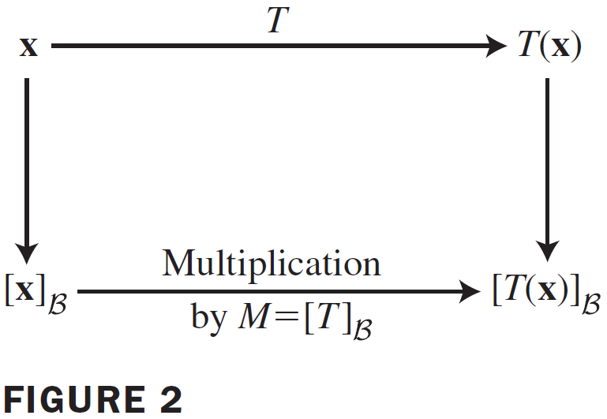
THE MATRIX OF A LINEAR TRANSFORMATION
The matrix, M, is a matrix representation of T, called the matrix for T relative to the basis B and denoted by [T]_{B} .

Slide 5
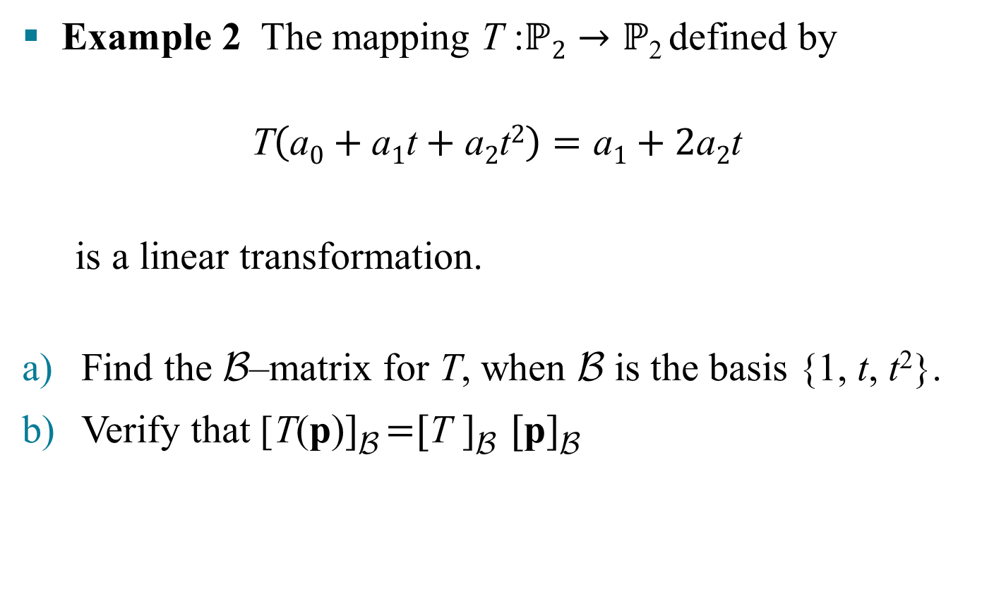
LINEAR TRANSFORMATIONS FROM V INTO V
Example 2 The mapping T :$ℙ2→ℙ$₂ defined by
$$\text{T}\left(\text{a}0+\text{a}1\text{t}+\text{a}2\text{t}2\right)=\text{a}1+2\text{a}2\text{t}$$
is a linear transformation.
Find the B–matrix for T, when B is the basis {1, t, t²}.
Verify that [T(p)]_{B} =[T ]_{B} [p]_{B}

Slide 6
LINEAR TRANSFORMATIONS FROM V INTO V
Solution
Compute the images of the basis vectors:
T(1) = 0
T(t) = 1
T(t²) = 2t
Then write the B-coordinate vectors of T(1), T(t), and T(t²) and place them together as the B-matrix for T.

Slide 7
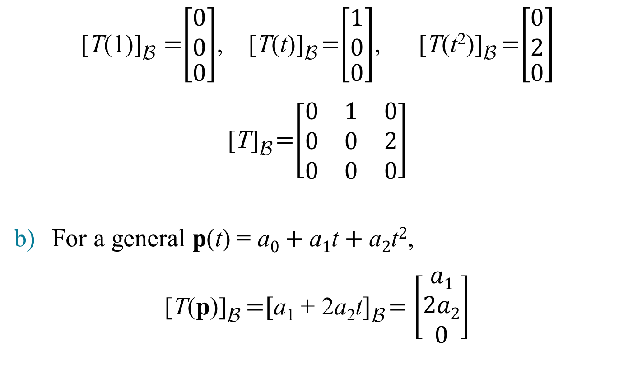
LINEAR TRANSFORMATIONS FROM V INTO V
[T(1)]_{B} =$\left[\begin{matrix}\begin{aligned}0 \\ 0\end{aligned} \\ 0\end{matrix}\right]$, [T(t)]_{B} =$\left[\begin{matrix}\begin{aligned}1 \\ 0\end{aligned} \\ 0\end{matrix}\right]$, [T(t²)]_{B} =$\left[\begin{matrix}\begin{aligned}0 \\ 2\end{aligned} \\ 0\end{matrix}\right]$
[T]_{B} =$\left[\begin{matrix}0 & 1 & 0 \\ 0 & 0 & 2 \\ 0 & 0 & 0\end{matrix}\right]$
For a general p(t) = $\text{a}0+\text{a}1\text{t}+\text{a}2\text{t}2$,
[T(p)]_{B} =[a₁ + 2a₂t]_{B} = $\left[\begin{aligned}a1 \\ 2a2 \\ 0\end{aligned}\right]$

Slide 8
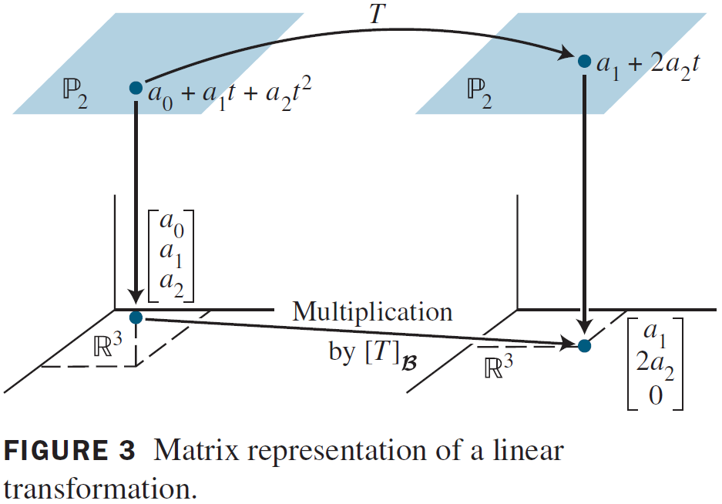

LINEAR TRANSFORMATIONS FROM V INTO V
=$\left[\begin{matrix}0 & 1 & 0 \\ 0 & 0 & 2 \\ 0 & 0 & 0\end{matrix}\right]\left[\begin{aligned}\text{a}0 \\ \text{a}1 \\ \text{a}2\end{aligned}\right]$= [T]_{B}[$\text{p}$]_{B}

Slide 9
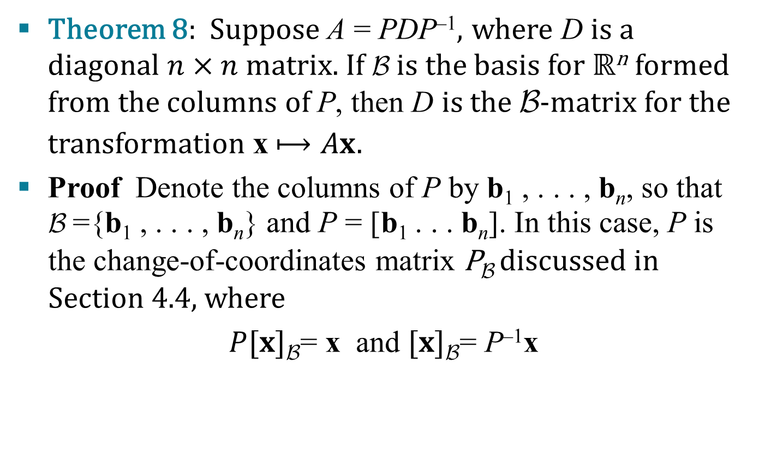
LINEAR TRANSFORMATIONS ON ℝ^{n}
Theorem 8: Suppose A = PDP^{–1}, where D is a diagonal $n×n$ matrix. If B is the basis for ℝ^{n} formed from the columns of P, then D is the B-matrix for the transformation x $⟼Ax.$
Proof Denote the columns of P by b₁ , . . . , b_{n}, so that
B ={b₁ , . . . , b_{n}} and P = [b₁ . . . b_{n}]. In this case, P is the change-of-coordinates matrix P_{B} discussed in Section 4.4, where
$P[x]\text{B}$= x and $[x]\text{B}$= P^{–1}x

Slide 10
LINEAR TRANSFORMATIONS ON ℝ^{n}
If T(x) = Ax for x in ℝ^{n} , then
[T]_{B} = [[T(b₁)]_{B} … [T(b_{n})]_{B}]
= [[Ab₁]_{B} … [Ab_{n}]_{B}]
= [P^{–1}Ab₁ … P^{–1}Ab_{n}]
= P^{–1}A[b₁ … b_{n}]
= P^{–1}AP
Since A = PDP^{–1}, we have [T]_{B} = P^{–1}AP = D.
Definition of [T]_{B}
Since T(x) = Ax
Change of coordinates
Matrix multiplication

Slide 11
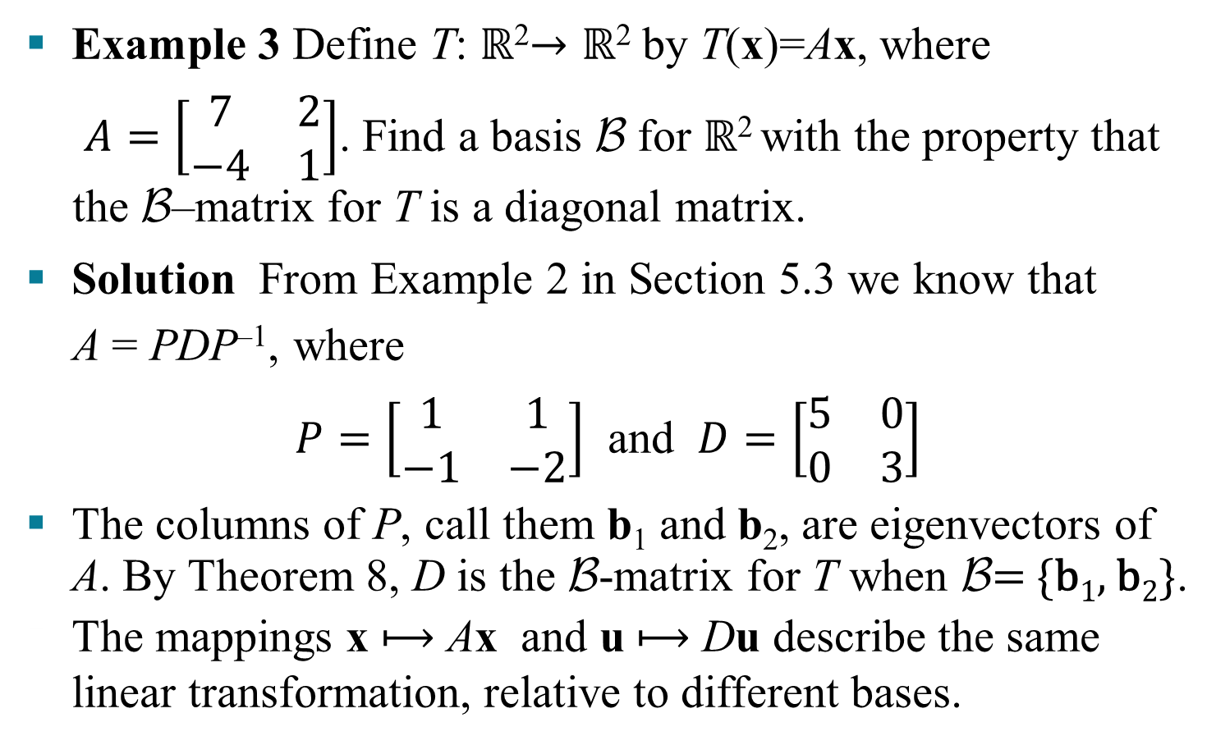
LINEAR TRANSFORMATIONS ON ℝ^{n}
Example 3 Define T: ℝ²$→\text{ℝ}\text{2}$ by T(x)=Ax, where
$A=\left[\begin{matrix}7 & 2 \\ −4 & 1\end{matrix}\right]$. Find a basis B for ℝ² with the property that the B–matrix for T is a diagonal matrix.
Solution From Example 2 in Section 5.3 we know that
A = PDP^{–1}, where
$P=\left[\begin{matrix}1 & 1 \\ −1 & −2\end{matrix}\right]$ and $D=\left[\begin{matrix}5 & 0 \\ 0 & 3\end{matrix}\right]$
The columns of P, call them b₁ and b₂, are eigenvectors of A. By Theorem 8, D is the B-matrix for T when B= {b₁, b₂}.
The mappings x $⟼$ Ax and u $⟼$ Du describe the same linear transformation, relative to different bases.

