Slide 1
Matrix Algebra
PARTITIONED MATRICES

Slide 2
PARTITIONED MATRICES
A key feature of our work with matrices has been the ability to regard matrix A as a list of column vectors rather than just a rectangular array of numbers.
This point of view has been so useful that we wish to consider other partitions of A, indicated by horizontal and vertical dividing rules, as in Example 1 on the next slide.

Slide 3

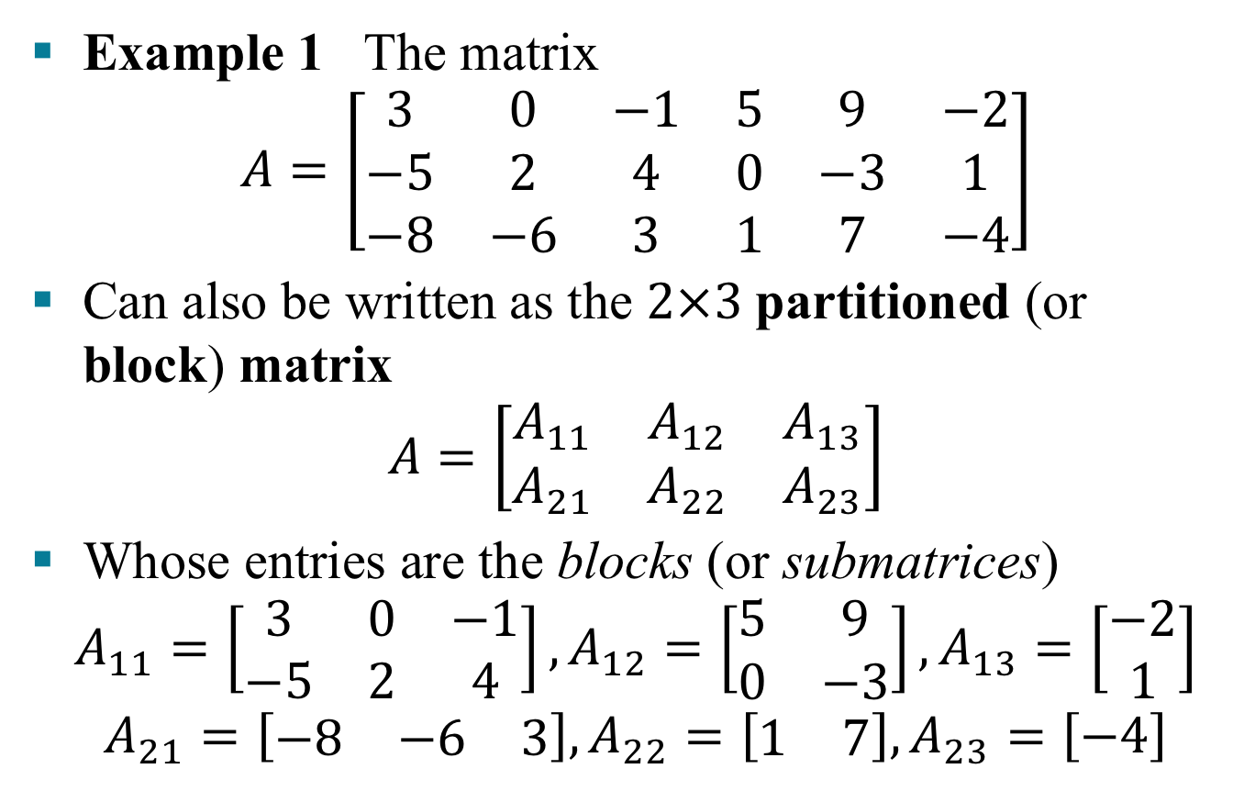
PARTITIONED MATRICES
Example 1 The matrix
$$A=\left[\begin{matrix}3 & 0 & −1 & 5 & 9 & −2 \\ −5 & 2 & 4 & 0 & −3 & 1 \\ −8 & −6 & 3 & 1 & 7 & −4\end{matrix}\right]$$
Can also be written as the $2×3$partitioned (or block) matrix
$$A=\left[\begin{matrix}A_{11} & A_{12} & A_{13} \\ A_{21} & A_{22} & A_{23}\end{matrix}\right]$$
Whose entries are the blocks (or submatrices)
$$A_{11}=\left[\begin{matrix}3 & 0 & −1 \\ −5 & 2 & 4\end{matrix}\right],A_{12}=\left[\begin{matrix}5 & 9 \\ 0 & −3\end{matrix}\right],A_{13}=\left[\begin{matrix}−2 \\ 1\end{matrix}\right]$$
$$A_{21}=\left[\begin{matrix}−8 & −6 & 3\end{matrix}\right],A_{22}=\left[\begin{matrix}1 & 7\end{matrix}\right],A_{23}=\left[−4\right]$$

Slide 4
ADDITION AND SCALAR MULTIPLICATION
If matrices A and B are the same size and are partitioned in exactly the same way, then it is natural to make the same partition of the ordinary matrix sum A + B.
In this case, each block of A + B is the (matrix) sum of the corresponding blocks of A and B.
Multiplication of a partitioned matrix by a scalar is also computed block by block.

Slide 5
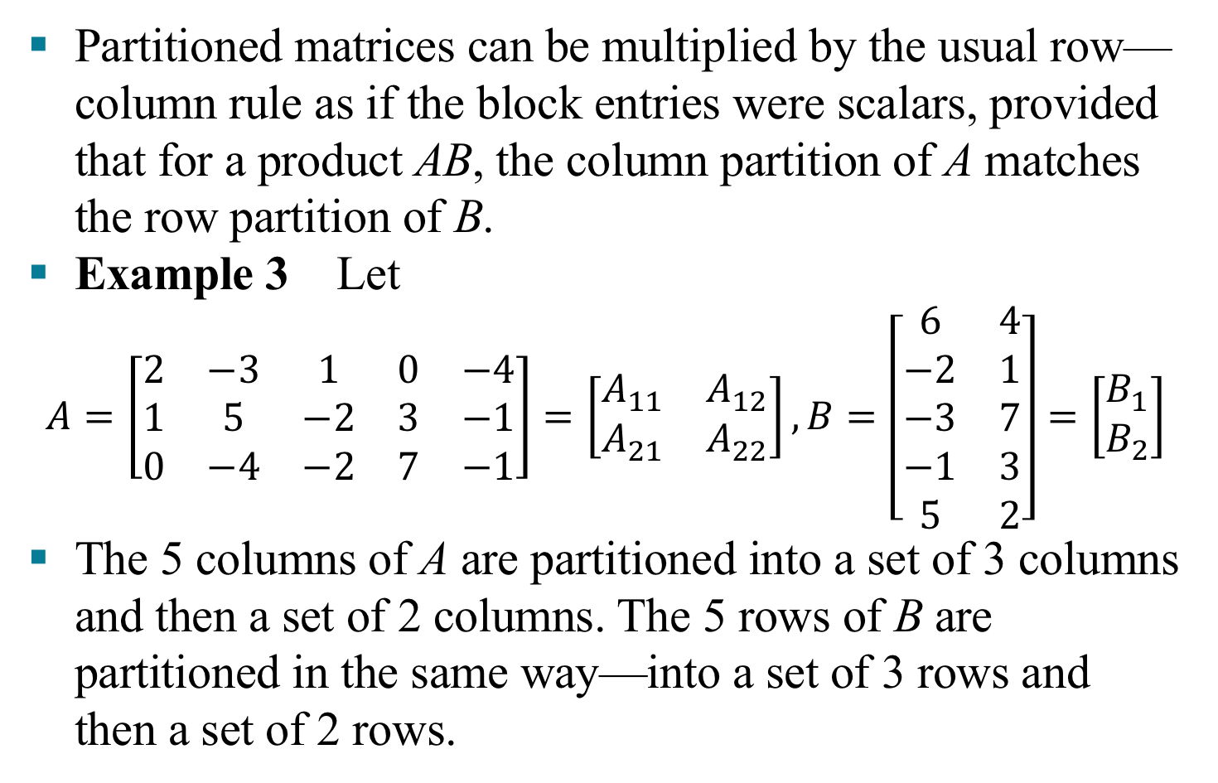
MULTIPLICATION OF PARTITIONED MATRICES
Partitioned matrices can be multiplied by the usual row—column rule as if the block entries were scalars, provided that for a product AB, the column partition of A matches the row partition of B.
Example 3 Let
$$A=\left[\begin{matrix}2 & −3 & 1 & 0 & −4 \\ 1 & 5 & −2 & 3 & −1 \\ 0 & −4 & −2 & 7 & −1\end{matrix}\right]=\left[\begin{matrix}A_{11} & A_{12} \\ A_{21} & A_{22}\end{matrix}\right],B=\left[\begin{matrix}6 & 4 \\ −2 & 1 \\ −3 & 7 \\ −1 & 3 \\ 5 & 2\end{matrix}\right]=\left[\begin{matrix}B_{1} \\ B_{2}\end{matrix}\right]$$
The 5 columns of A are partitioned into a set of 3 columns and then a set of 2 columns. The 5 rows of B are partitioned in the same way—into a set of 3 rows and then a set of 2 rows.

Slide 6
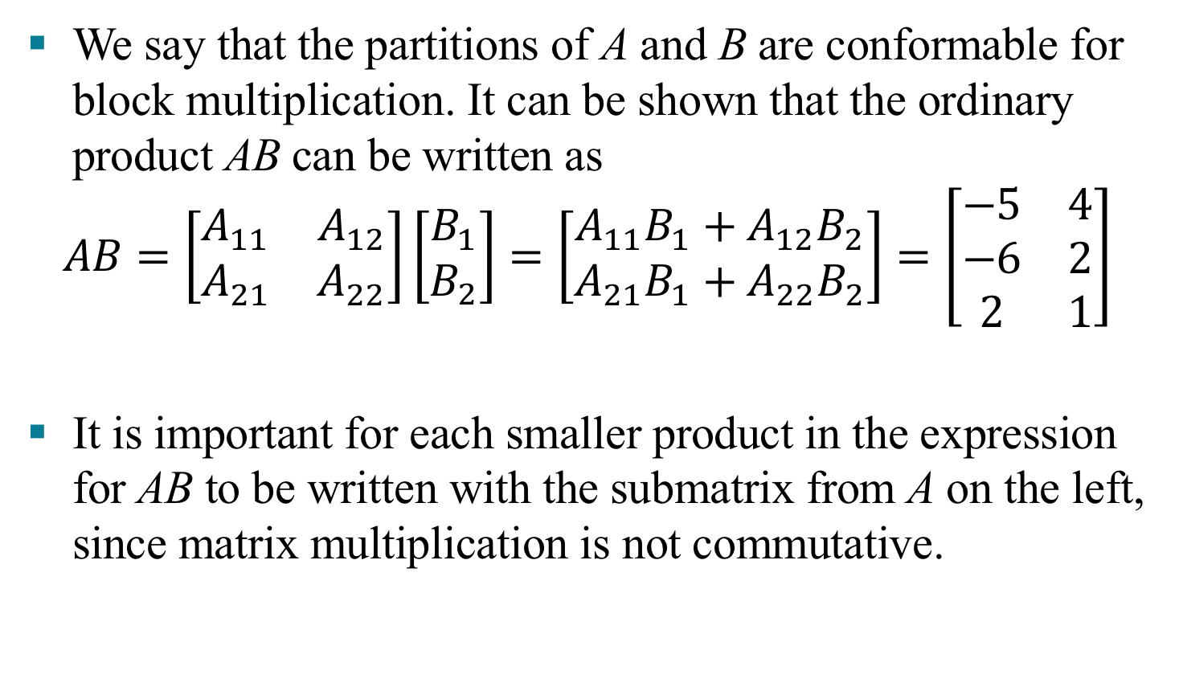
MULTIPLICATION OF PARTITIONED MATRICES
We say that the partitions of A and B are conformable for block multiplication. It can be shown that the ordinary product AB can be written as
$$AB=\left[\begin{matrix}A_{11} & A_{12} \\ A_{21} & A_{22}\end{matrix}\right]\left[\begin{matrix}B_{1} \\ B_{2}\end{matrix}\right]=\left[\begin{matrix}A_{11}B_{1}+A_{12}B_{2} \\ A_{21}B_{1}+A_{22}B_{2}\end{matrix}\right]=\left[\begin{matrix}−5 & 4 \\ −6 & 2 \\ 2 & 1\end{matrix}\right]$$
It is important for each smaller product in the expression for AB to be written with the submatrix from A on the left, since matrix multiplication is not commutative.

Slide 7
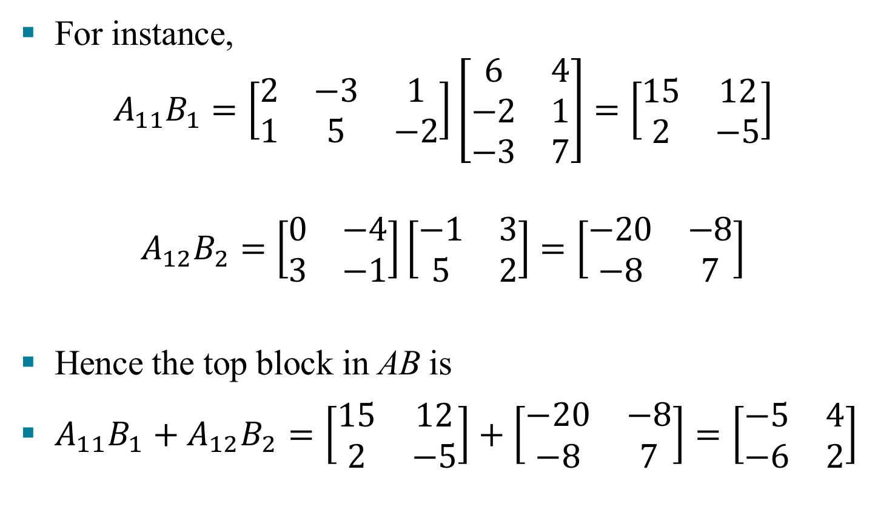
MULTIPLICATION OF PARTITIONED MATRICES
For instance,
$$A_{11}B_{1}=\left[\begin{matrix}2 & −3 & 1 \\ 1 & 5 & −2\end{matrix}\right]\left[\begin{matrix}6 & 4 \\ −2 & 1 \\ −3 & 7\end{matrix}\right]=\left[\begin{matrix}15 & 12 \\ 2 & −5\end{matrix}\right]$$
$$A_{12}B_{2}=\left[\begin{matrix}0 & −4 \\ 3 & −1\end{matrix}\right]\left[\begin{matrix}−1 & 3 \\ 5 & 2\end{matrix}\right]=\left[\begin{matrix}−20 & −8 \\ −8 & 7\end{matrix}\right]$$
Hence the top block in AB is
$A_{11}B_{1}+A_{12}B_{2}=\left[\begin{matrix}15 & 12 \\ 2 & −5\end{matrix}\right]+\left[\begin{matrix}−20 & −8 \\ −8 & 7\end{matrix}\right]=\left[\begin{matrix}−5 & 4 \\ −6 & 2\end{matrix}\right]$

Slide 8
MULTIPLICATION OF PARTITIONED MATRICES
Theorem 10: Column—Row Expansion of AB
Proof For each row index i and column index j, the (i, j)-entry in col_{k}(A)and b_{kj} from row_{k}(B) is the product of a_{ik} from col_{k}(A) and b_{kj} from row_{k}(B).
(1)

Slide 9
MULTIPLICATION OF PARTITIONED MATRICES
Hence the (i, j)-entry in the sum shown in equation (1) is
This sum is also the (i, j)-entry in AB, by the row—column rule.

Slide 10
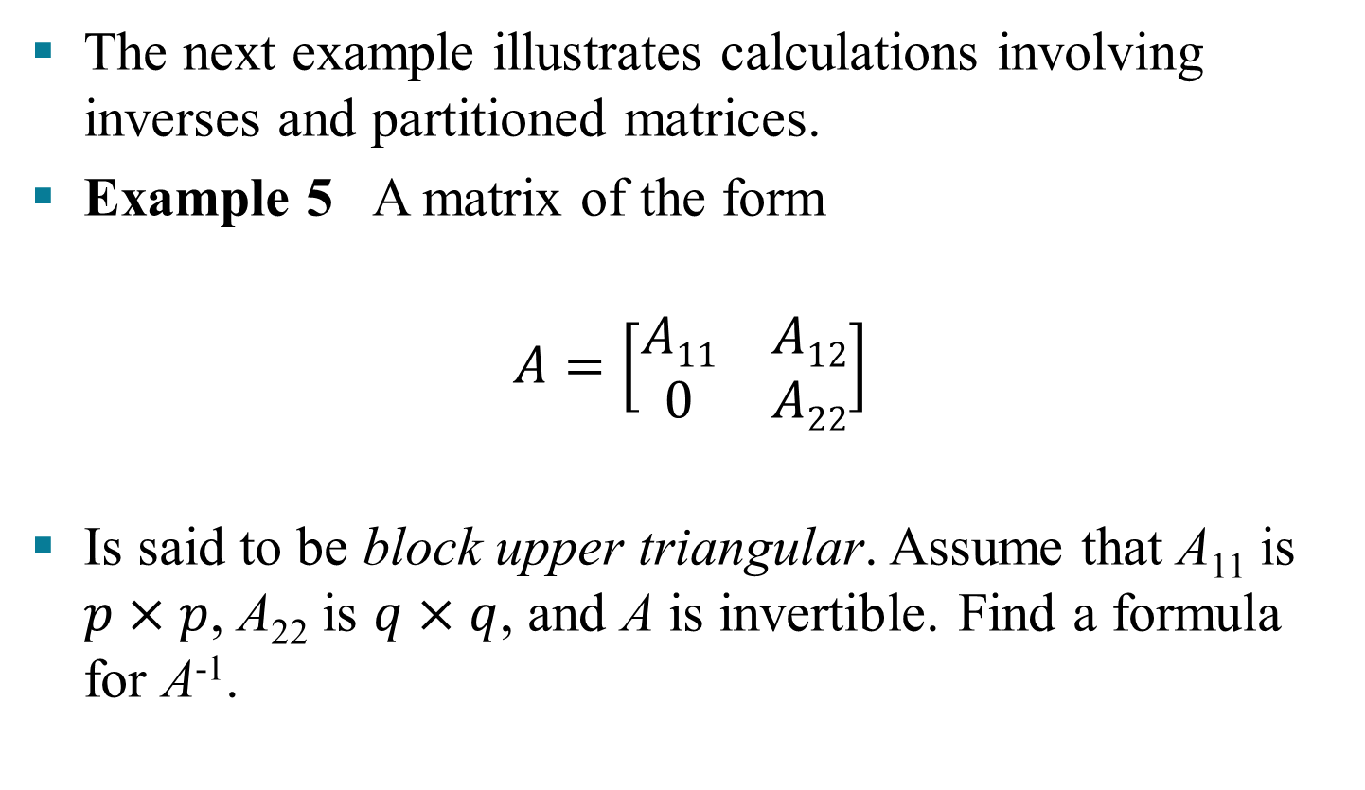
INVERSES OF PARTIONED MATRICES
The next example illustrates calculations involving inverses and partitioned matrices.
Example 5 A matrix of the form
$$A=\left[\begin{matrix}A11 & A12 \\ 0 & A22\end{matrix}\right]$$
Is said to be block upper triangular. Assume that A₁₁ is $p×p$, A₂₂ is $q×q$, and A is invertible. Find a formula for A⁻¹.

Slide 11
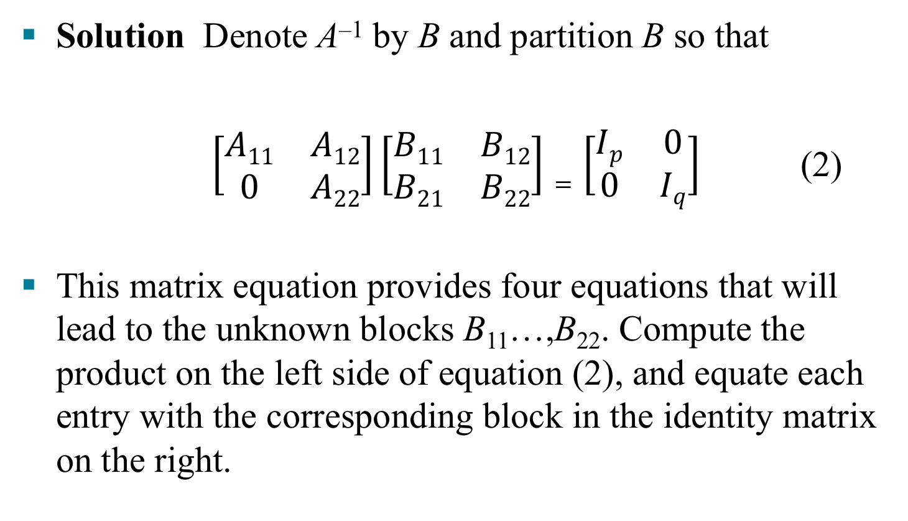
INVERSES OF PARTIONED MATRICES
Solution Denote A^{–1} by B and partition B so that
$\left[\begin{matrix}A11 & A12 \\ 0 & A22\end{matrix}\right]\left[\begin{matrix}B11 & B12 \\ B21 & B22\end{matrix}\right]=\left[\begin{matrix}Ip & 0 \\ 0 & Iq\end{matrix}\right]$ (2)
This matrix equation provides four equations that will lead to the unknown blocks B₁₁…,B₂₂. Compute the product on the left side of equation (2), and equate each entry with the corresponding block in the identity matrix on the right.

Slide 12
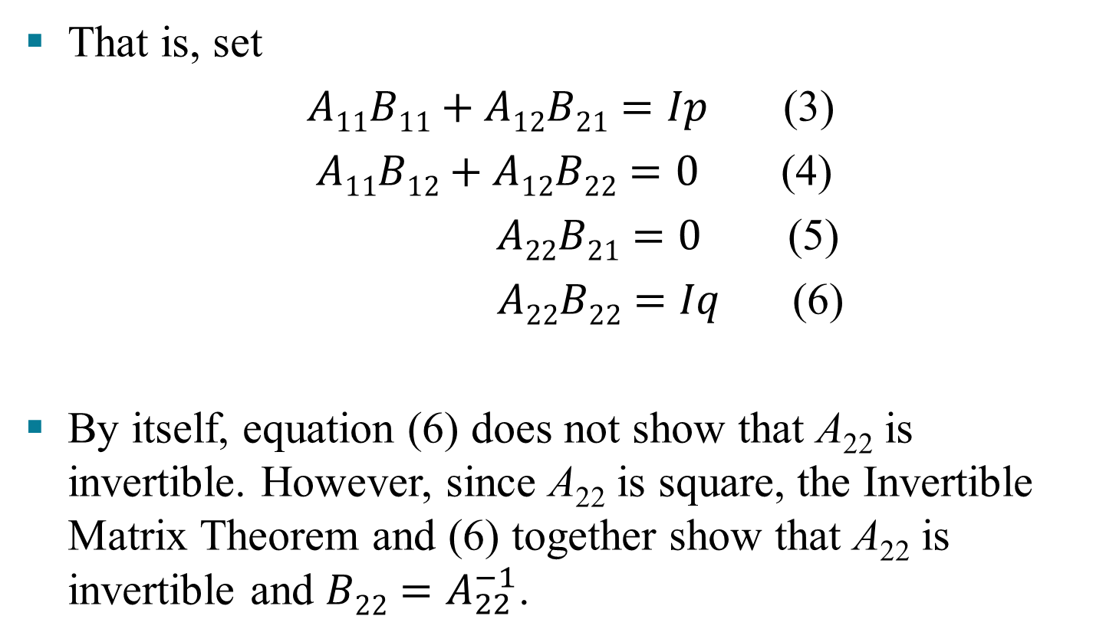
INVERSES OF PARTIONED MATRICES
That is, set
$A11B11+A12B21=Ip$ (3)
$A11B12+A12B22=0$ (4)
$A22B21=0$ (5)
$A22B22=Iq$ (6)
By itself, equation (6) does not show that A₂₂ is invertible. However, since A₂₂ is square, the Invertible Matrix Theorem and (6) together show that A₂₂ is invertible and $B22=A_{22}^{−1}$.

Slide 13
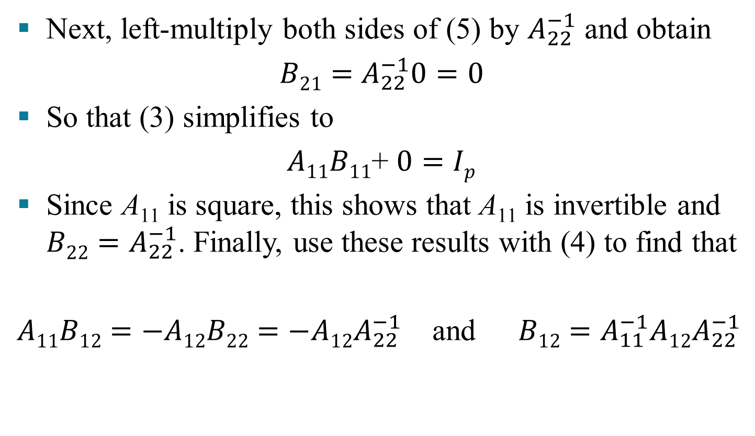
INVERSES OF PARTIONED MATRICES
Next, left-multiply both sides of (5) by $A_{22}^{−1}$ and obtain
$B21=$ $A_{22}^{−1}0=0$
So that (3) simplifies to
$A11B11$+ $0=Ip$
Since A₁₁ is square, this shows that A₁₁ is invertible and $B22=A_{22}^{−1}$. Finally, use these results with (4) to find that
$A11B12=−A12B22=$ $−A12A_{22}^{−1}$ and $B12=A_{11}^{−1}A12A_{22}^{−1}$

Slide 14
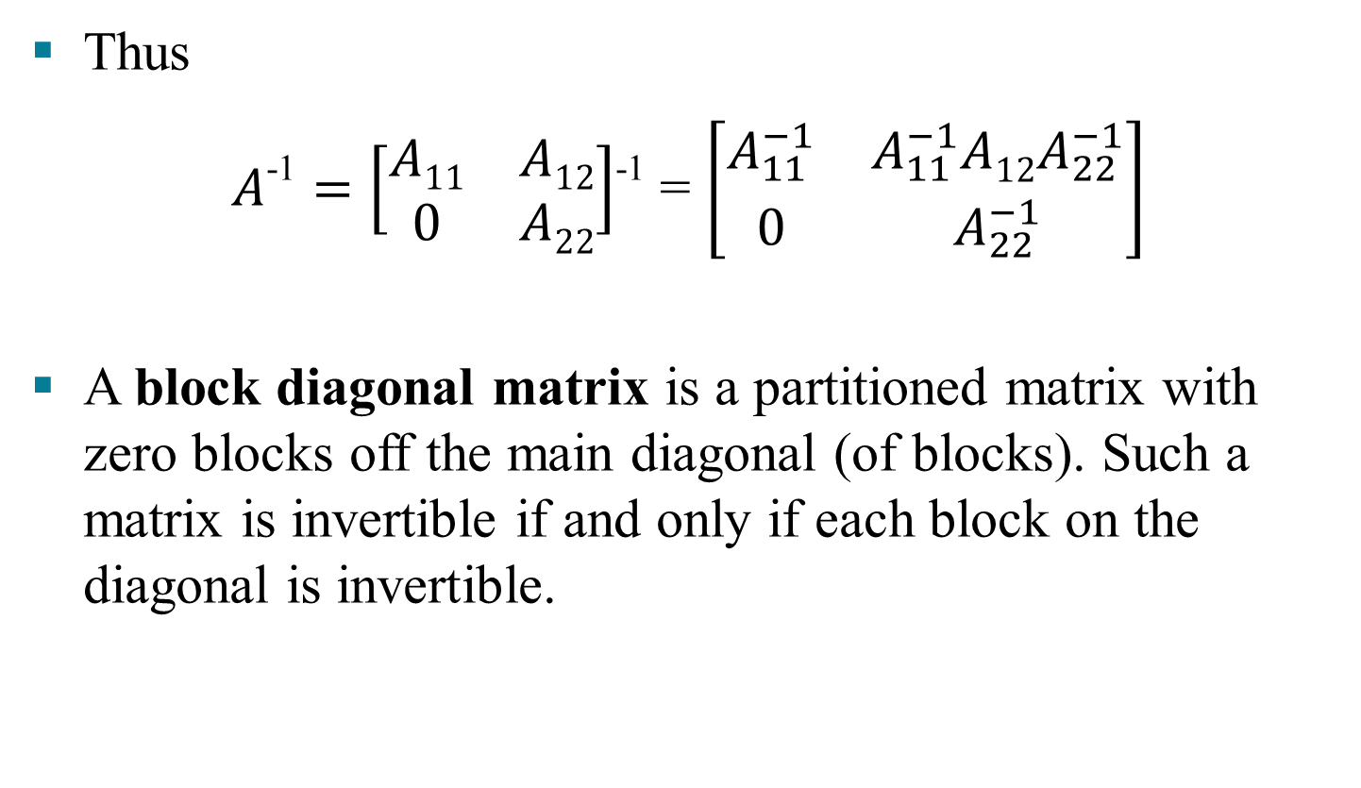
INVERSES OF PARTIONED MATRICES
Thus
$A\text{−1}=\left[\begin{matrix}A11 & A12 \\ 0 & A22\end{matrix}\right]$⁻¹ = $\left[\begin{matrix}A_{11}^{−1} & A_{11}^{−1}A12A_{22}^{−1} \\ 0 & A_{22}^{−1}\end{matrix}\right]$
A block diagonal matrix is a partitioned matrix with zero blocks off the main diagonal (of blocks). Such a matrix is invertible if and only if each block on the diagonal is invertible.

