Slide 1
Matrix Algebra
DIMENSION AND RANK

Slide 2
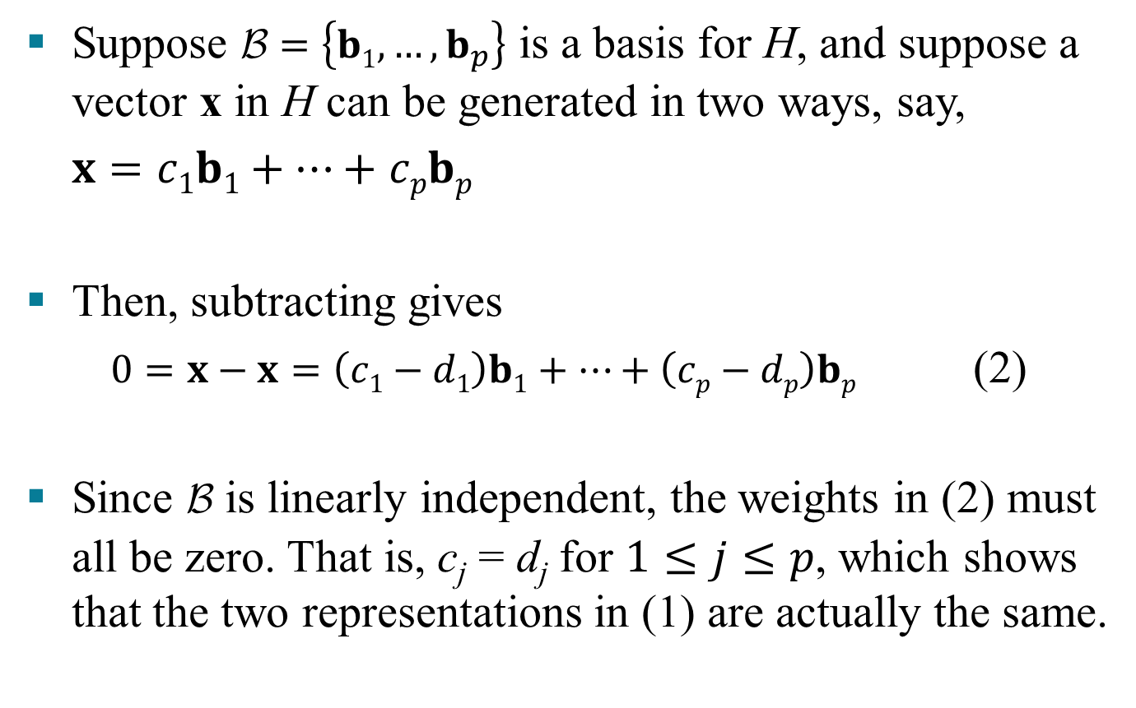

COORDINATE SYSTEMS
Suppose $\text{B}=\left\{b1,…, b_{p}\right\}$ is a basis for H, and suppose a vector x in H can be generated in two ways, say,
$x=c1b1+…+$ $cpbp$
Then, subtracting gives
$0=x−x=\left(c1−d1\right)b1+…+\left(cp−dp\right)bp$ (2)
Since B is linearly independent, the weights in (2) must all be zero. That is, c_{j} = d_{j} for $1≤j≤p$, which shows that the two representations in (1) are actually the same.
and $x=d1b1+…+$ $dpbp$ (1)

Slide 3
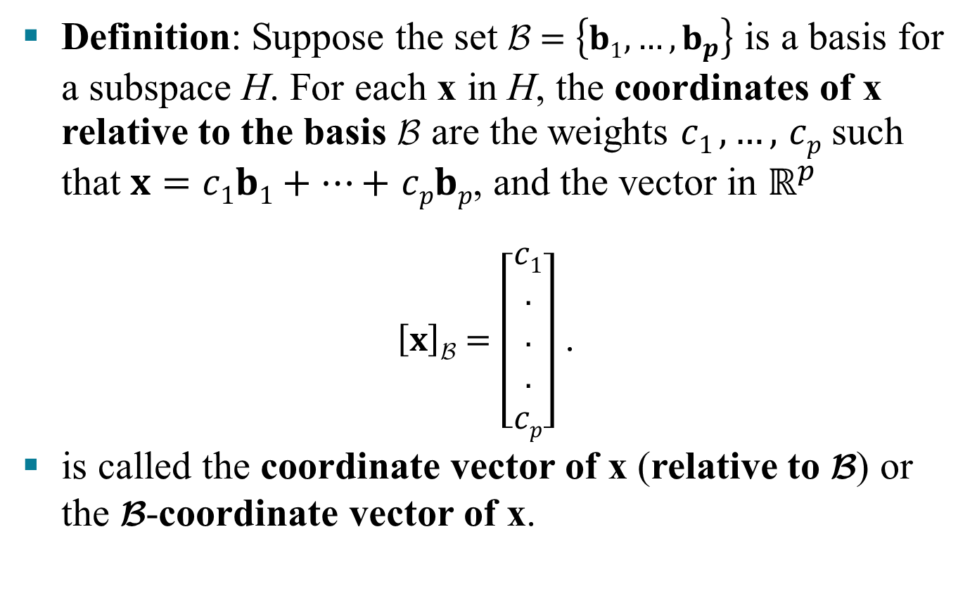
COORDINATE SYSTEMS
Definition: Suppose the set $\text{B}=\left\{b1,…, b_{p}\right\}$ is a basis for a subspace H. For each x in H, the coordinates of x relative to the basis B are the weights $c1 ,…,$ $cp$ such that $x=c1b1+…+$ $cpbp$, and the vector in $ℝ^{p}$
$\left[x\right]\text{B}=\left[\begin{aligned}c1 \\ . \\ . \\ . \\ cp\end{aligned}\right]$ .
is called the coordinate vector of x (relative to B) or the B-coordinate vector of x.

Slide 4
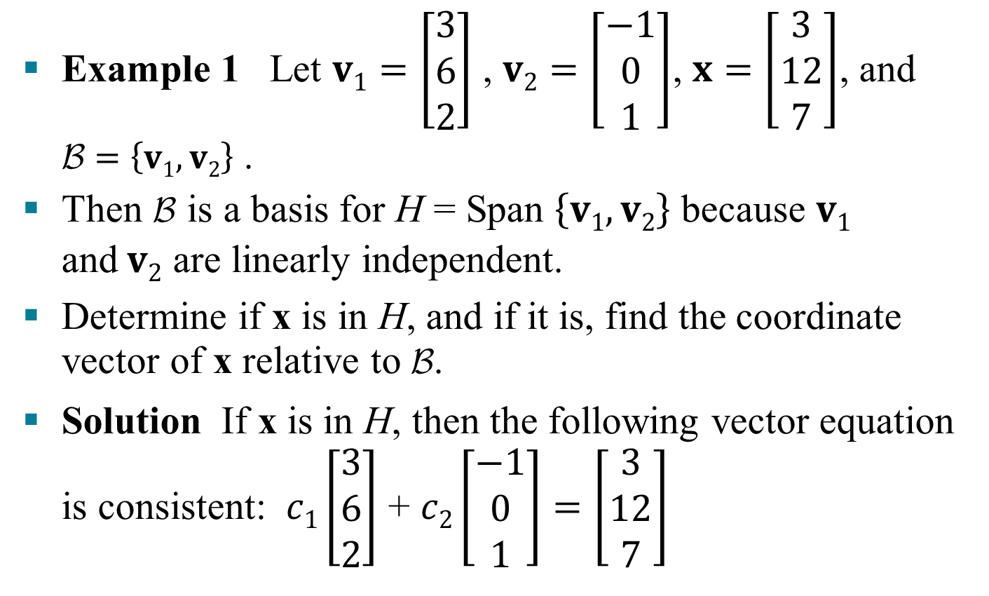
COORDINATE SYSTEMS
Example 1 Let $v1=\left[\begin{aligned}3 \\ 6 \\ 2\end{aligned}\right]$ , $v2=\left[\begin{aligned}−1 \\ 0 \\ 1\end{aligned}\right]$, $x=\left[\begin{aligned}3 \\ 12 \\ 7\end{aligned}\right]$, and $\text{B}=\left\{v1,v2\right\}$ .
Then B is a basis for H = Span $\left\{v1,v2\right\}$ because $v1$ and$v2$ are linearly independent.
Determine if x is in H, and if it is, find the coordinate vector of x relative to B.
Solution If x is in H, then the following vector equation is consistent: $c1\left[\begin{aligned}3 \\ 6 \\ 2\end{aligned}\right]$ + $c2\left[\begin{aligned}−1 \\ 0 \\ 1\end{aligned}\right]=\left[\begin{aligned}3 \\ 12 \\ 7\end{aligned}\right]$

Slide 5
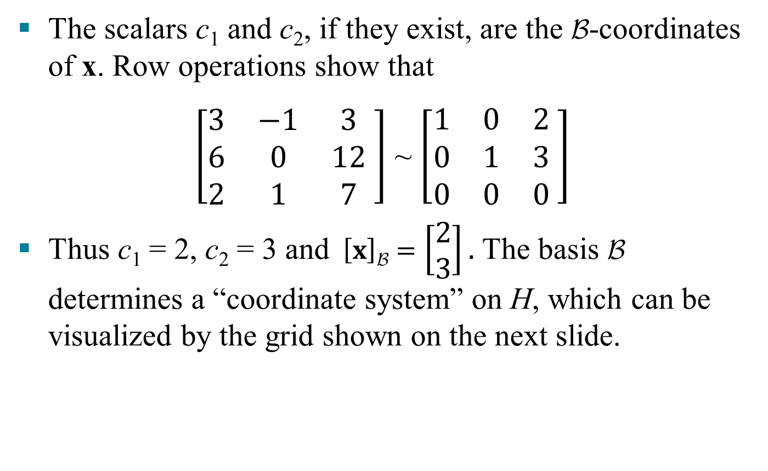
COORDINATE SYSTEMS
The scalars c₁ and c₂, if they exist, are the $\text{B}$-coordinates of x. Row operations show that
$\left[\begin{matrix}3 & −1 & 3 \\ 6 & 0 & 12 \\ 2 & 1 & 7\end{matrix} \right]$ ~ $\left[\begin{matrix}1 & 0 & 2 \\ 0 & 1 & 3 \\ 0 & 0 & 0\end{matrix} \right]$
Thus c₁ = 2, c₂ = 3 and $\left[x\right]\text{B}=$ $\left[\begin{aligned}2 \\ 3\end{aligned}\right].$The basis B determines a “coordinate system” on H, which can be visualized by the grid shown on the next slide.

Slide 6
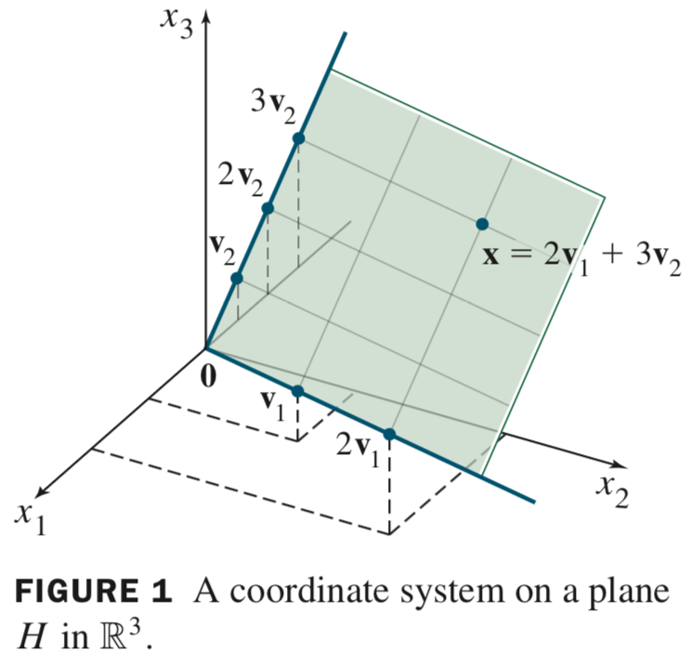
COORDINATE SYSTEMS

Slide 7
THE DIMESION OF A SUBSPACE
Definition: The dimension of a nonzero subspace H, denoted by dim H, is the number of vectors in any basis for H. The dimension of the zero subspace {0} is defined to be zero.
Definition: The rank of a matrix A, denoted by rank A, is the dimension of the column space of A.

Slide 8

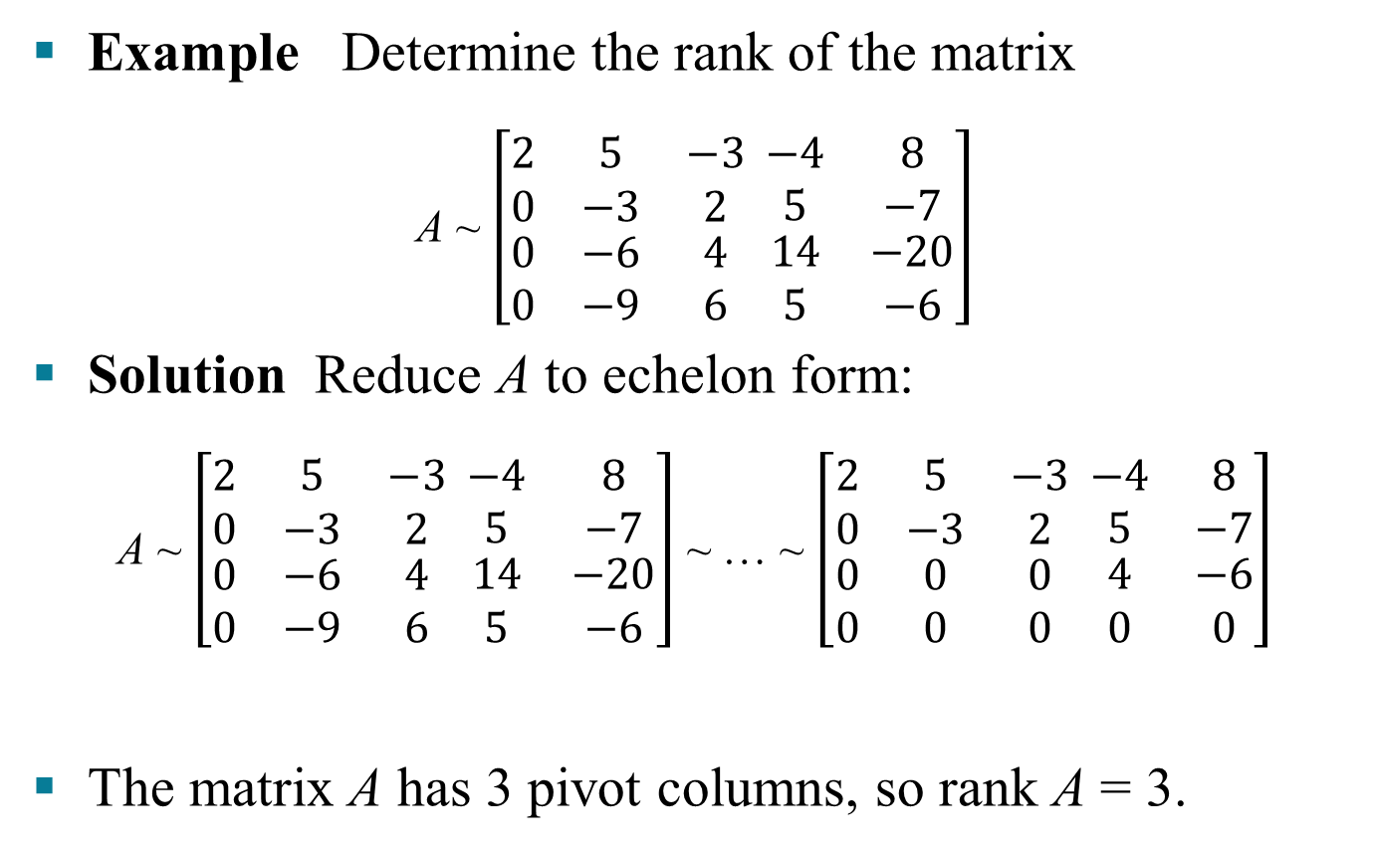
THE DIMESION OF A SUBSPACE
Example Determine the rank of the matrix
A ~ $\left[\begin{matrix}2 & 5 & −3 \\ 0 & −3 & 2 \\ \begin{aligned}0 \\ 0\end{aligned} & \begin{aligned}−6 \\ −9\end{aligned} & \begin{aligned}4 \\ 6\end{aligned}\end{matrix} \begin{matrix}−4 & 8 \\ 5 & −7 \\ \begin{aligned}14 \\ 5\end{aligned} & \begin{aligned}−20 \\ −6\end{aligned}\end{matrix}\right]$
Solution Reduce A to echelon form:
A ~ $\left[\begin{matrix}2 & 5 & −3 \\ 0 & −3 & 2 \\ \begin{aligned}0 \\ 0\end{aligned} & \begin{aligned}−6 \\ −9\end{aligned} & \begin{aligned}4 \\ 6\end{aligned}\end{matrix} \begin{matrix}−4 & 8 \\ 5 & −7 \\ \begin{aligned}14 \\ 5\end{aligned} & \begin{aligned}−20 \\ −6\end{aligned}\end{matrix}\right]$ ~ … ~ $\left[\begin{matrix}2 & 5 & −3 \\ 0 & −3 & 2 \\ \begin{aligned}0 \\ 0\end{aligned} & \begin{aligned}0 \\ 0\end{aligned} & \begin{aligned}0 \\ 0\end{aligned}\end{matrix} \begin{matrix}−4 & 8 \\ 5 & −7 \\ \begin{aligned}4 \\ 0\end{aligned} & \begin{aligned}−6 \\ 0\end{aligned}\end{matrix}\right]$
The matrix A has 3 pivot columns, so rank A = 3.
pivot columns

Slide 9
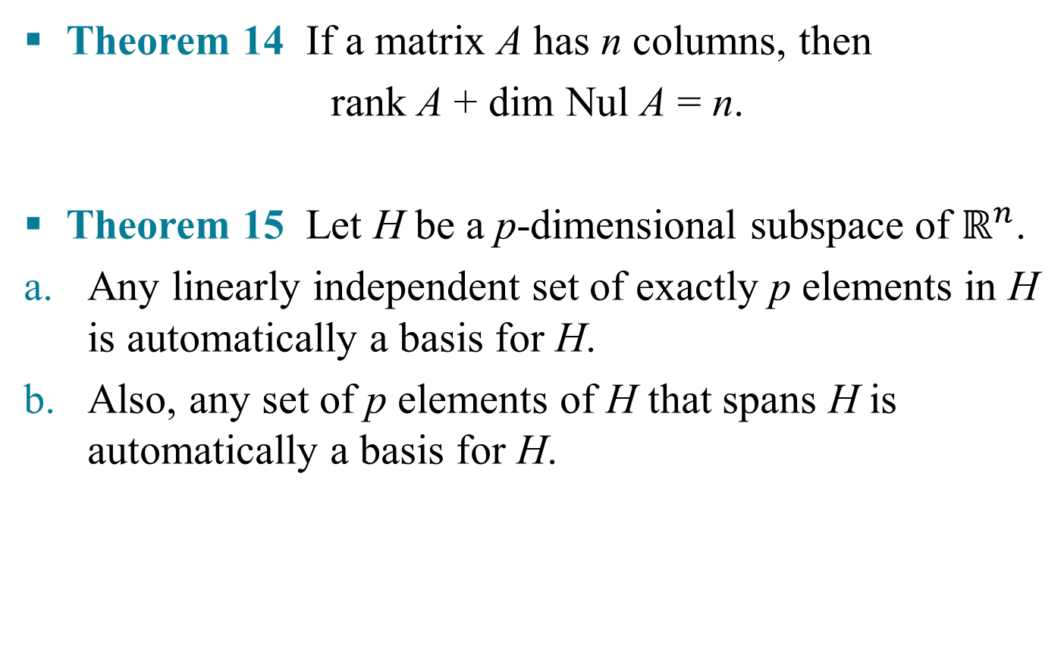
THE DIMESION OF A SUBSPACE
Theorem 14 If a matrix A has n columns, then
rank A + dim Nul A = n.
Theorem 15 Let H be a p-dimensional subspace of $ℝ^{n}$.
Any linearly independent set of exactly p elements in H is automatically a basis for H.
Also, any set of p elements of H that spans H is automatically a basis for H.

Slide 10
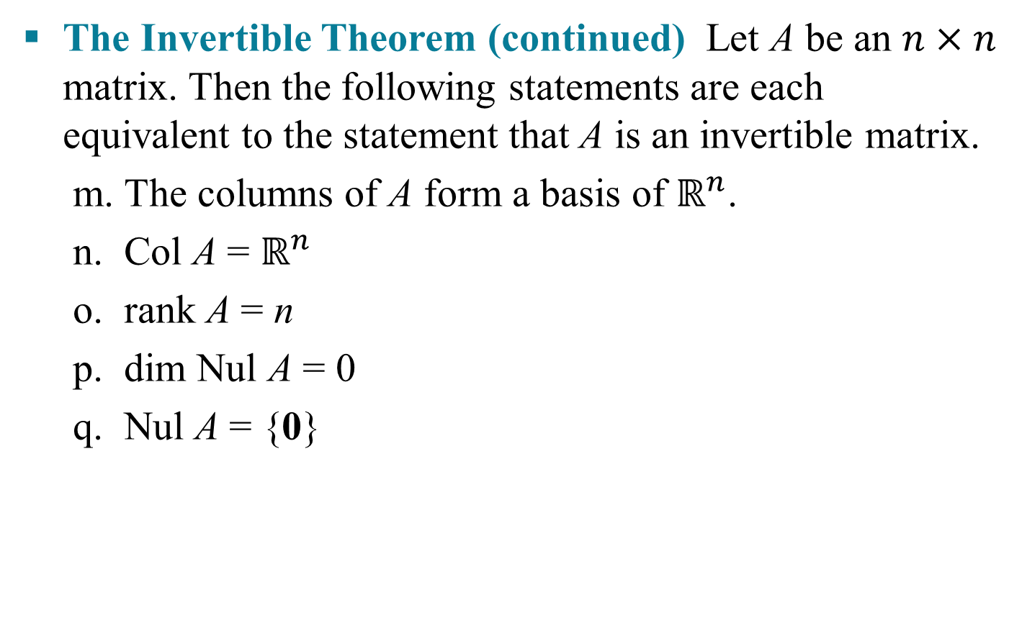
RANK AND THE INVERTIBLE MATRIX THEOREM
The Invertible Theorem (continued) Let A be an $n×n$ matrix. Then the following statements are each equivalent to the statement that A is an invertible matrix.
m. The columns of A form a basis of $ℝ^{n}$.
n. Col A = $ℝ^{n}$
o. rank A = n
p. dim Nul A = 0
q. Nul A = {0}

Slide 11
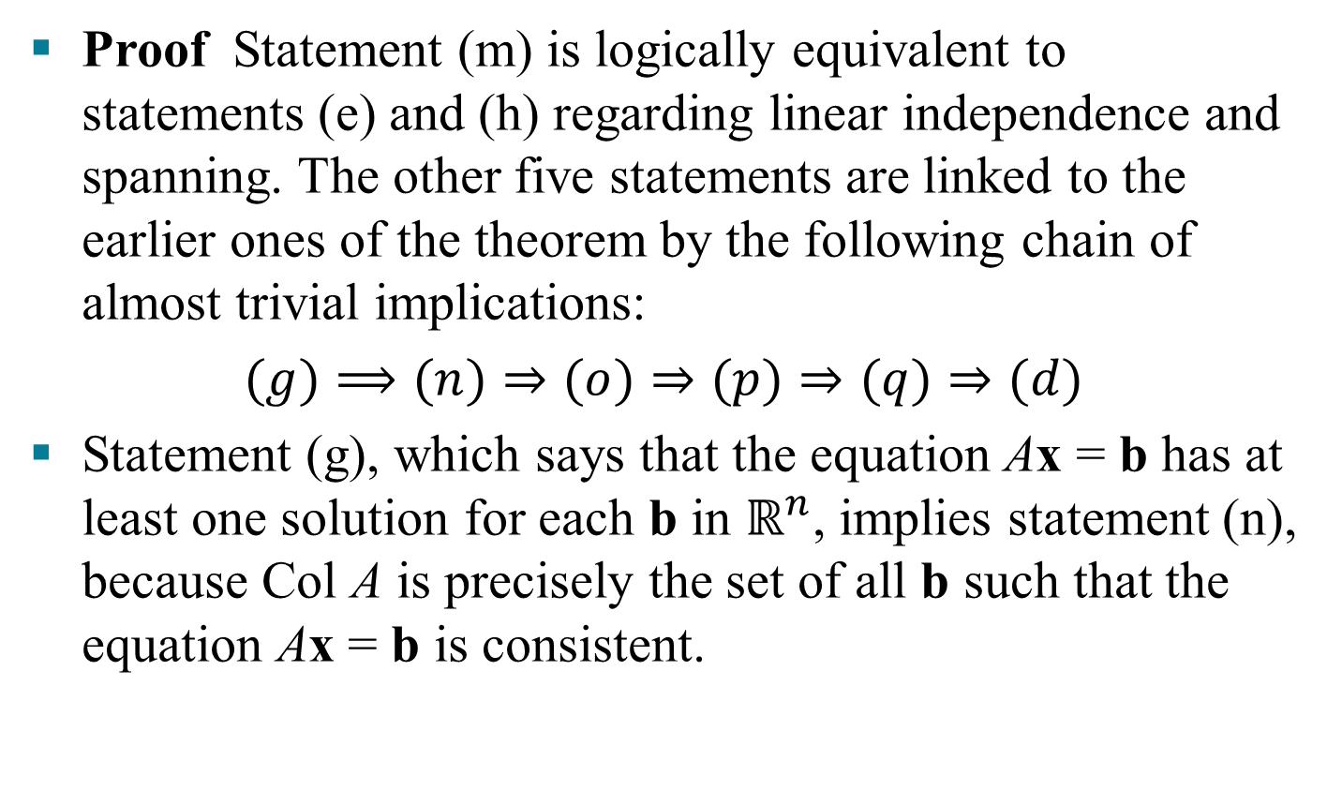
RANK AND THE INVERTIBLE MATRIX THEOREM
Proof Statement (m) is logically equivalent to statements (e) and (h) regarding linear independence and spanning. The other five statements are linked to the earlier ones of the theorem by the following chain of almost trivial implications:
$(g)⟹(n)⇒(o)⇒(p)⇒(q)⇒(d)$
Statement (g), which says that the equation Ax = b has at least one solution for each b in $ℝ^{n}$, implies statement (n), because Col A is precisely the set of all b such that the equation Ax = b is consistent.

Slide 12
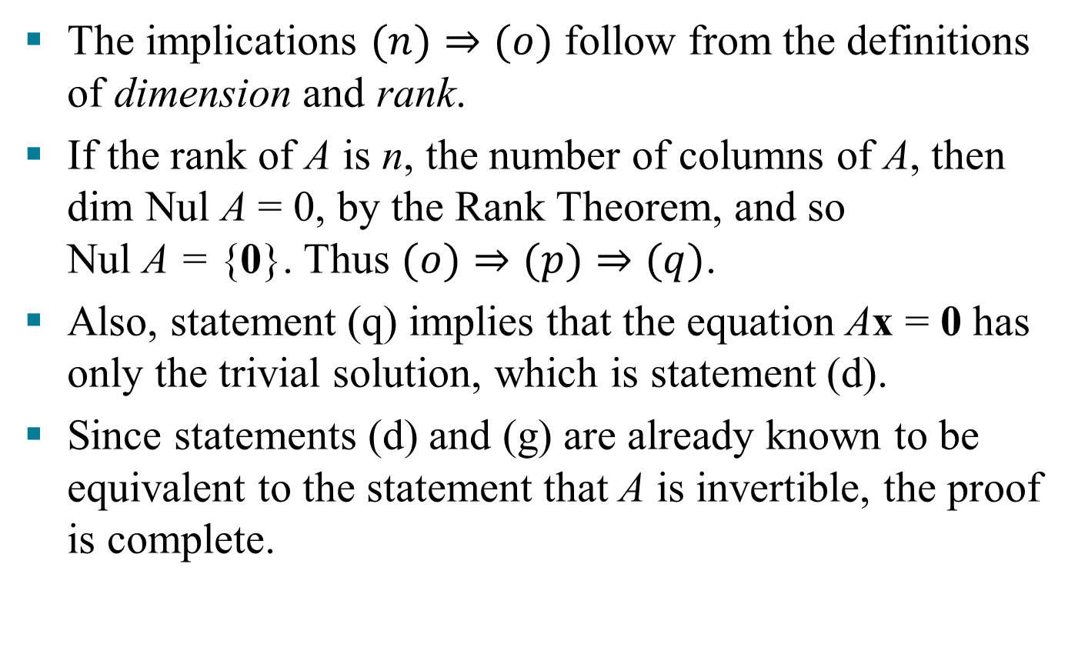
RANK AND THE INVERTIBLE MATRIX THEOREM
The implications $(n)⇒(o)$ follow from the definitions of dimension and rank.
If the rank of A is n, the number of columns of A, then dim Nul A = 0, by the Rank Theorem, and so Nul A = {0}. Thus $(o)⇒(p)⇒(q)$.
Also, statement (q) implies that the equation Ax = 0 has only the trivial solution, which is statement (d).
Since statements (d) and (g) are already known to be equivalent to the statement that A is invertible, the proof is complete.

