Slide 1
Vector Spaces
COORDINATE SYSTEMS

Slide 2
THE UNIQUE REPRESENTATION THEOREM
Theorem 8: Let B be a basis for vector space V. Then for each x in V, there exists a unique set of scalars c₁, …, c_{n} such that
(1)
Proof: Since B spans V, there exist scalars such that (1) holds.
Suppose x also has the representation
for scalars d₁, …, d_{n}.

Slide 3
THE UNIQUE REPRESENTATION THEOREM
Then, subtracting, we have
(2)
Since B is linearly independent, the weights in (2) must all be zero. That is, for .
Definition: Suppose B is a basis for V and x is in V. The coordinates of x relative to the basis B (or the B-coordinate of x) are the weights c₁, …, c_{n} such that .

Slide 4
THE UNIQUE REPRESENTATION THEOREM
If c₁, …, c_{n} are the B-coordinates of x, then the vector in
[x]_{B}
is the coordinate vector of x (relative to B), or the B-coordinate vector of x.
The mapping _{B} is the coordinate mapping (determined by B).

Slide 5

COORDINATES IN
When a basis B for is fixed, the B-coordinate vector of a specified x is easily found, as in the example below.
Example 1: Let , , , and
B . Find the coordinate vector [x]_{B} of x relative to B.
Solution: The B-coordinate c₁, c₂ of x satisfy
b₁
b₂
x

Slide 6
COORDINATES IN
or
(3)
This equation can be solved by row operations on an augmented matrix or by using the inverse of the matrix on the left.
In any case, the solution is , .
Thus and
.
b₁
b₂
x

Slide 7
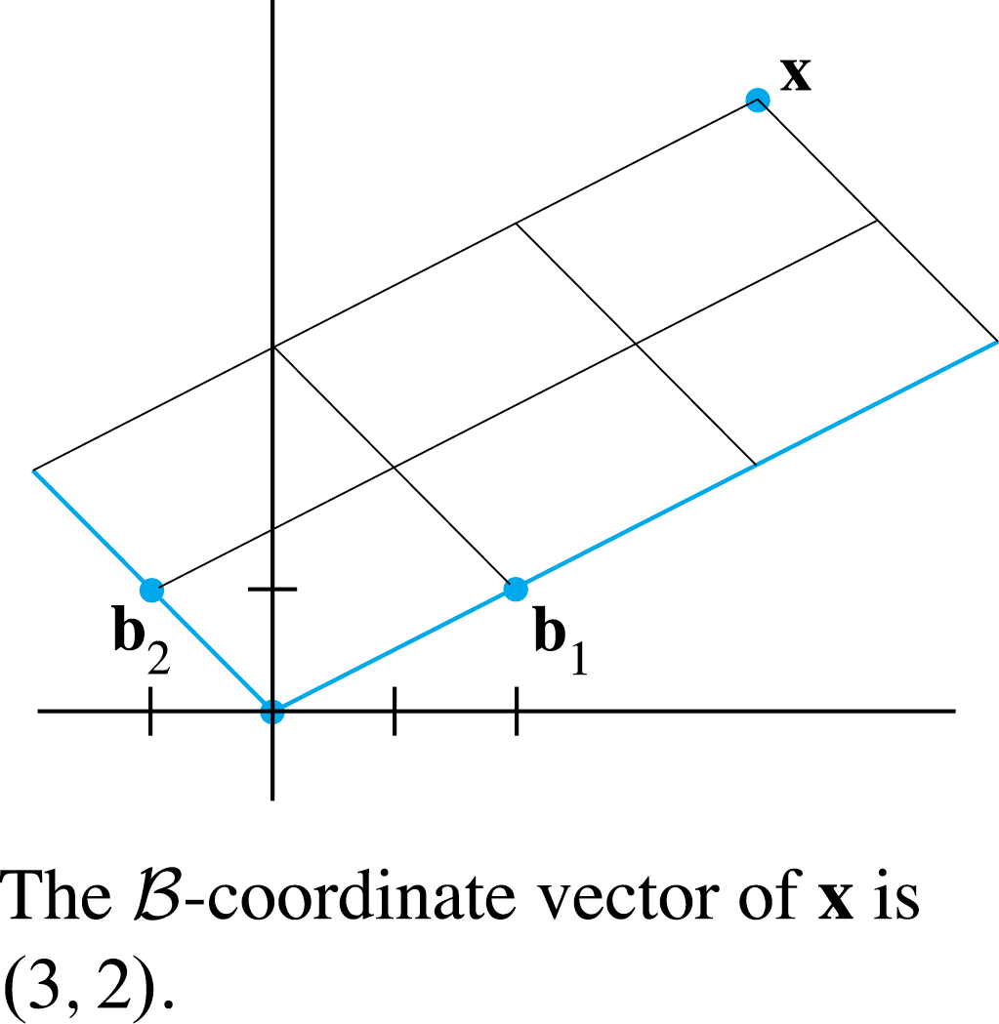
COORDINATES IN
See the following figure.
The matrix in (3) changes the B-coordinates of a vector x into the standard coordinates for x.
An analogous change of coordinates can be carried
out in for a basis B .
Let P_{B}

Slide 8
COORDINATES IN
Then the vector equation
is equivalent to
(4)
P_{B} is called the change-of-coordinates matrix from B to the standard basis in .
Left-multiplication by P_{B} transforms the coordinate vector [x]_{B} into x.
Since the columns of P_{B} form a basis for , P_{B} is invertible (by the Invertible Matrix Theorem).

Slide 9
COORDINATES IN
Left-multiplication by converts x into its B-coordinate vector:
The correspondence _{B}, produced by , is the coordinate mapping.
Since is an invertible matrix, the coordinate mapping is a one-to-one linear transformation from onto , by the Invertible Matrix Theorem.

Slide 10
THE COORDINATE MAPPING
Theorem 8: Let B be a basis for a vector space V. Then the coordinate mapping _{B} is a one-to-one linear transformation from V onto .
Proof: Take two typical vectors in V, say,
Then, using vector operations,

Slide 11
THE COORDINATE MAPPING
It follows that
So the coordinate mapping preserves addition.
If r is any scalar, then

Slide 12
THE COORDINATE MAPPING
So
Thus the coordinate mapping also preserves scalar multiplication and hence is a linear transformation.
The linearity of the coordinate mapping extends to linear combinations.
If u₁, …, u_{p} are in V and if c₁, …, cp are scalars, then
(5)

Slide 13
THE COORDINATE MAPPING
In words, (5) says that the B-coordinate vector of a linear combination of u₁, …, u_{p} is the same linear combination of their coordinate vectors.
The coordinate mapping in Theorem 8 is an important example of an isomorphism from V onto .
In general, a one-to-one linear transformation from a vector space V onto a vector space W is called an isomorphism from V onto W.
The notation and terminology for V and W may differ, but the two spaces are indistinguishable as vector spaces.

Slide 14
THE COORDINATE MAPPING
Every vector space calculation in V is accurately reproduced in W, and vice versa.
In particular, any real vector space with a basis of n vectors is indistinguishable from .
Example 2: Let , , ,
and B . Then B is a basis for
. Determine if x is in H, and if it is,
find the coordinate vector of x relative to B.

Slide 15
THE COORDINATE MAPPING
Solution: If x is in H, then the following vector equation is consistent:
The scalars c₁ and c₂, if they exist, are the B-coordinates of x.

Slide 16
THE COORDINATE MAPPING
Using row operations, we obtain
.
Thus , and [x]_{B} .

Slide 17
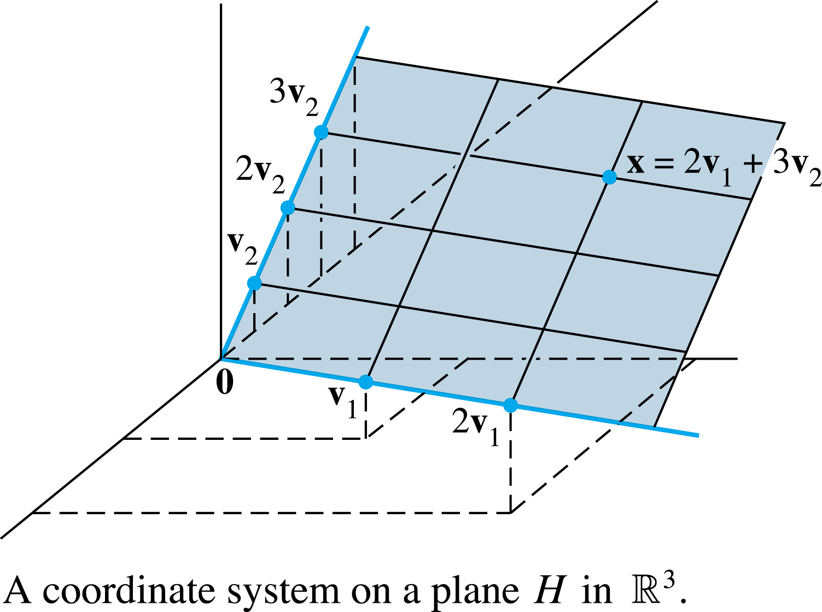
THE COORDINATE MAPPING
The coordinate system on H determined by B is shown in the following figure.

