Slide 1
Vector Spaces
CHANGE OF BASIS

Slide 2
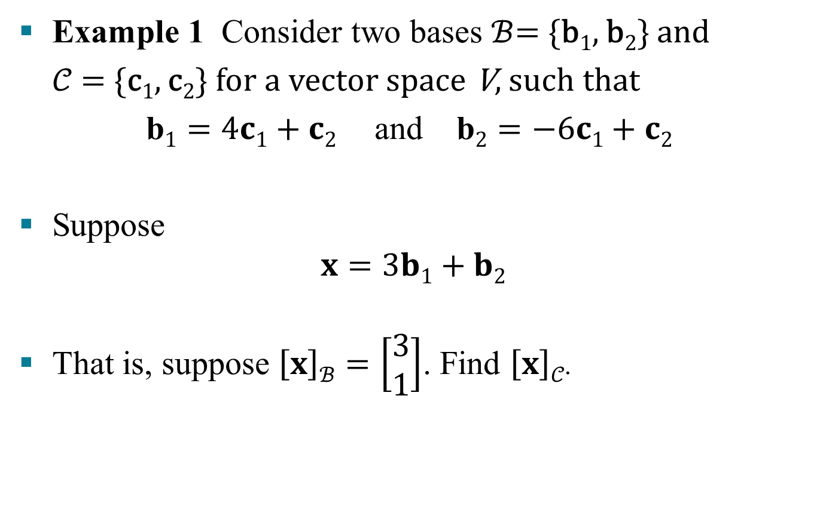
CHANGE OF BASIS
Example 1 Consider two bases $ℬ$= {b₁, b₂} and
𝒞 = {c₁, c₂} for a vector space V, such that
$\text{b}1=4c1+c2$and $\text{b}2=−6c1+c2$
Suppose
$$x=3b1+b2$$
That is, suppose $\left[x\right]ℬ=\left[\begin{aligned}3 \\ 1\end{aligned}\right]$. Find $\left[x\right]𝒞$.
(1)
(2)

Slide 3
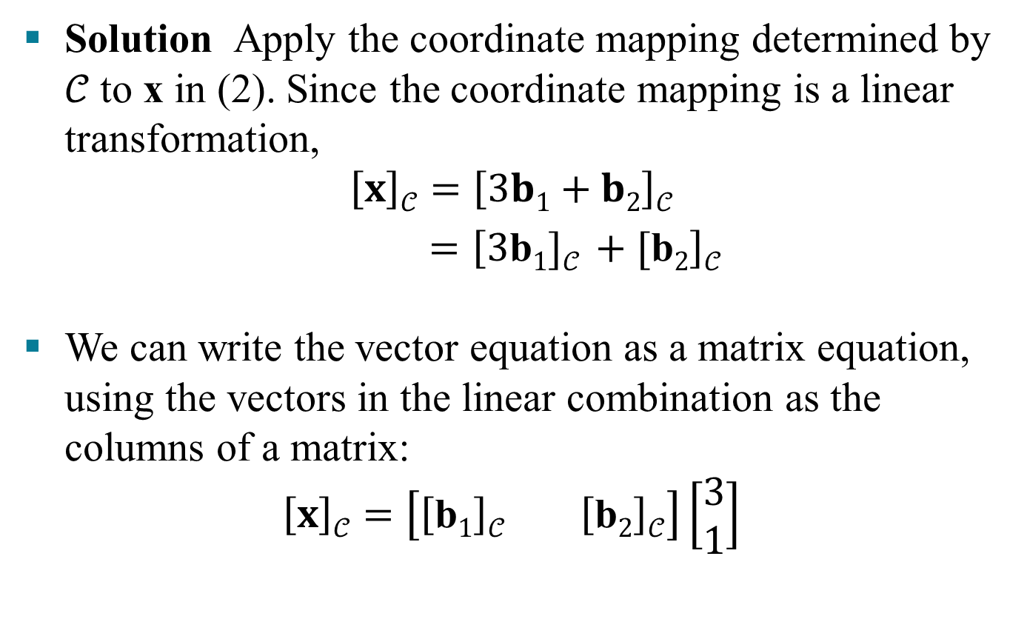
CHANGE OF BASIS
Solution Apply the coordinate mapping determined by 𝒞 to x in (2). Since the coordinate mapping is a linear transformation,
$$\left[x\right]𝒞=\left[3b1+b2\right]𝒞$$
$=\left[3\text{b}1]𝒞 +[\text{b}2\right]𝒞$
We can write the vector equation as a matrix equation, using the vectors in the linear combination as the columns of a matrix:
$$\left[x\right]𝒞=\left[\left[\text{b}1\right]𝒞 \left[\text{b}2\right]𝒞\right]\left[\begin{aligned}3 \\ 1\end{aligned}\right]$$
(3)

Slide 4
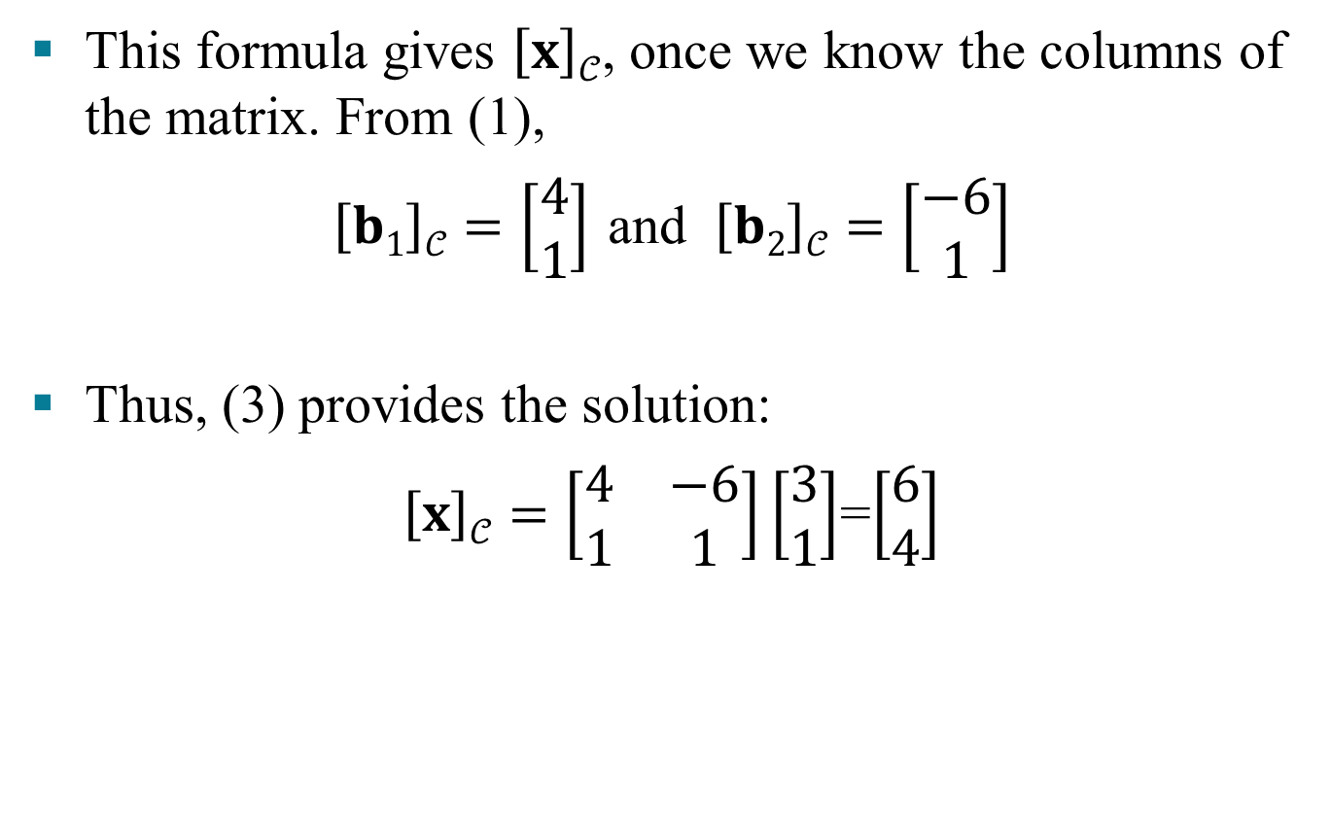
CHANGE OF BASIS
This formula gives $\left[x\right]𝒞$, once we know the columns of the matrix. From (1),
$\left[b1\right]𝒞=\left[\begin{aligned}4 \\ 1\end{aligned}\right]$ and $\left[b2\right]𝒞=\left[\begin{aligned}−6 \\ 1\end{aligned}\right]$
Thus, (3) provides the solution:
$\left[x\right]𝒞=\left[\begin{matrix}4 & −6 \\ 1 & 1\end{matrix}\right]\left[\begin{aligned}3 \\ 1\end{aligned}\right]$=$\left[\begin{aligned}6 \\ 4\end{aligned}\right]$

Slide 5
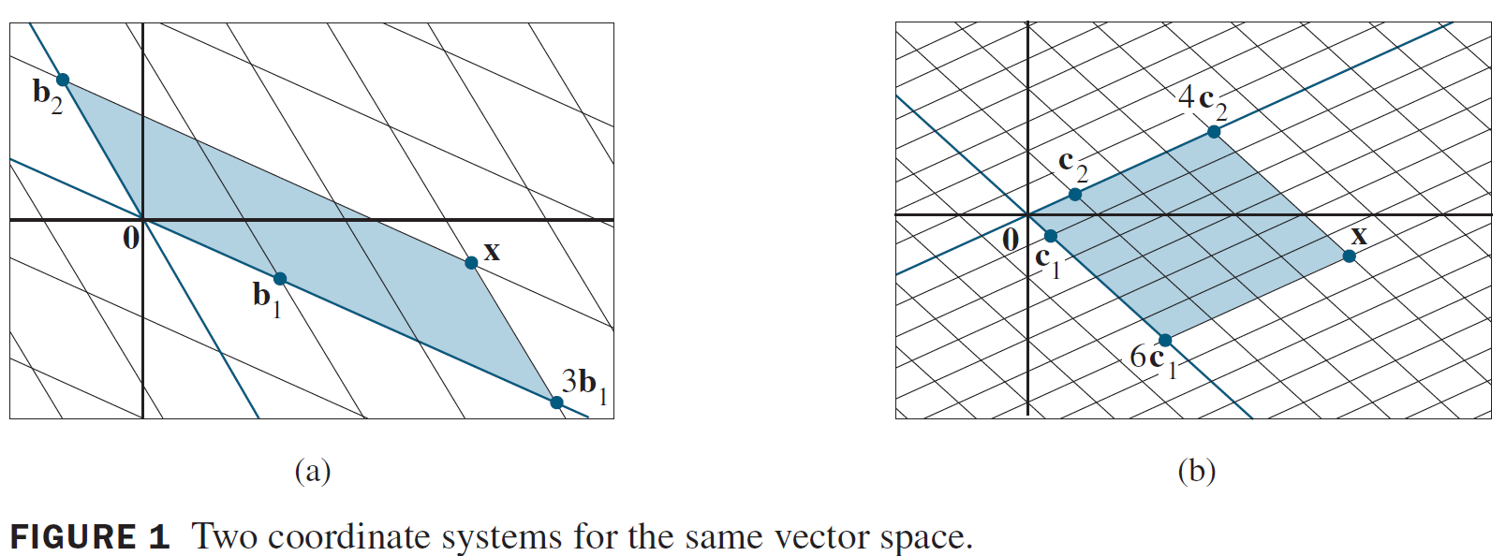
CHANGE OF BASIS

Slide 6
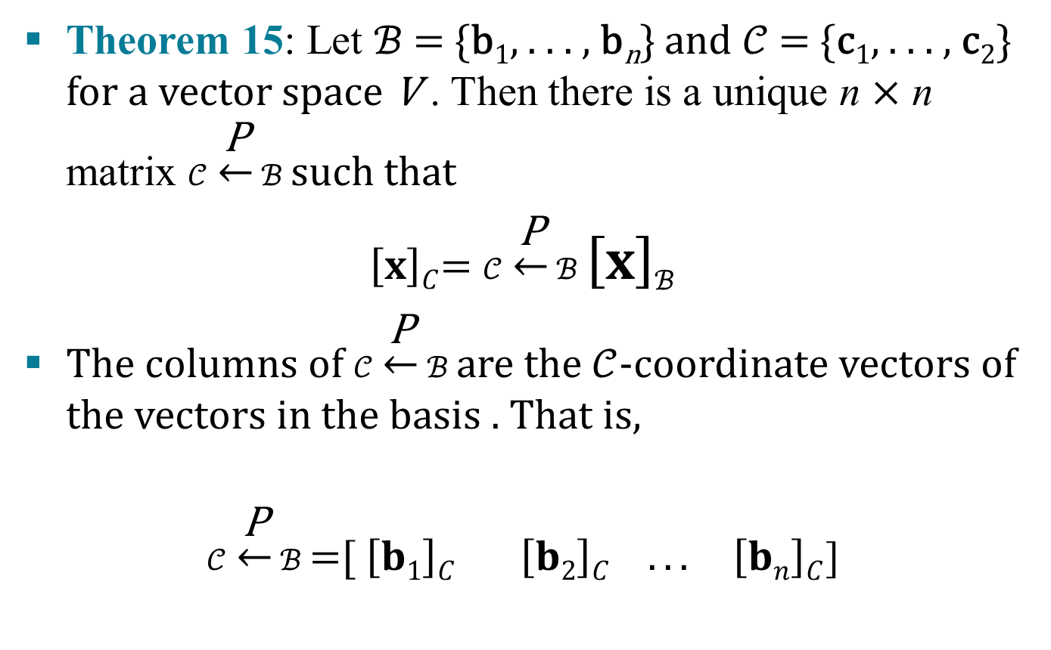
CHANGE OF BASIS
Theorem 15: Let $ℬ$= {b₁, . . . , b_{n}} and $𝒞$= {c₁, . . . , c₂} for a vector space V . Then there is a unique n $×$ n matrix $𝒞$ $\underset{←}{\text{P}}$ $ℬ$ such that
$\left[x\right]C$= $𝒞$ $\underset{←}{\text{P}}$ $ℬ$ $\left[x\right]ℬ$
The columns of $𝒞$ $\underset{←}{\text{P}}$ $ℬ$ are the $𝒞$-coordinate vectors of the vectors in the basis . That is,
$𝒞$ $\underset{←}{\text{P}}$ $ℬ$ =[$\left[b1\right]C$ $\left[b2\right]C . . . \left[bn\right]C$]
(4)
(5)

Slide 7
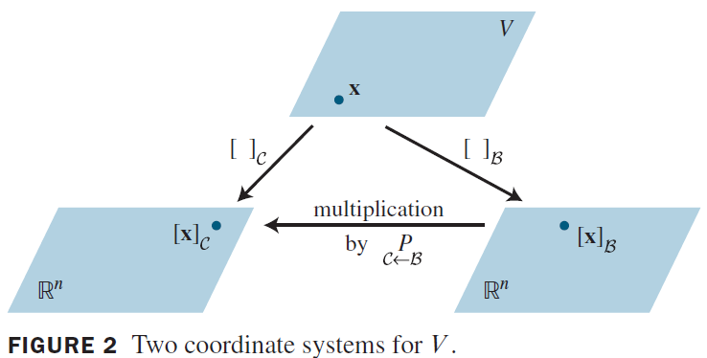
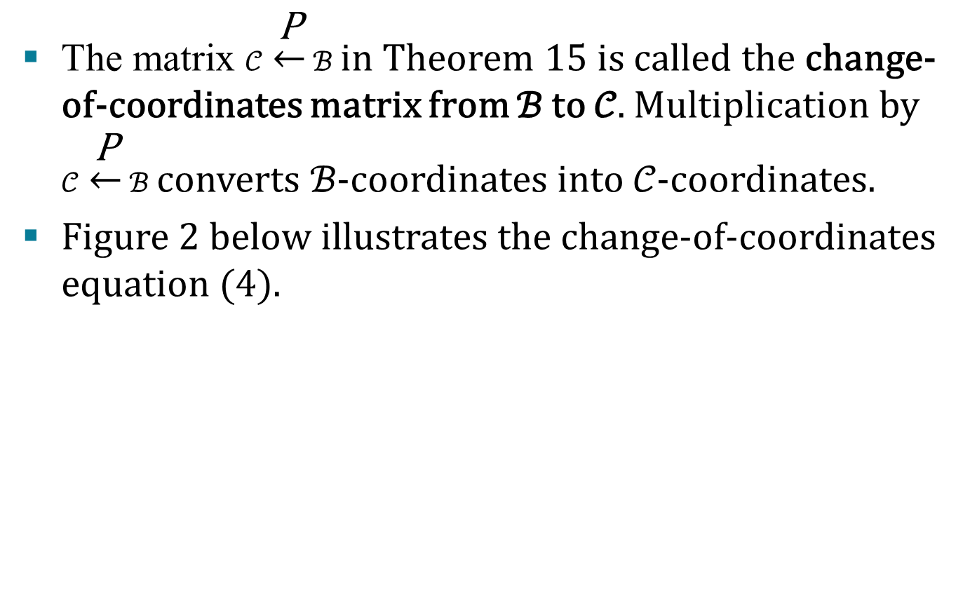
CHANGE OF BASIS
The matrix $𝒞$ $\underset{←}{\text{P}}$ $ℬ$ in Theorem 15 is called the change-of-coordinates matrix from ℬ to 𝒞. Multiplication by $𝒞$ $\underset{←}{\text{P}}$ $ℬ$ converts ℬ-coordinates into 𝒞-coordinates.
Figure 2 below illustrates the change-of-coordinates equation (4).

Slide 8
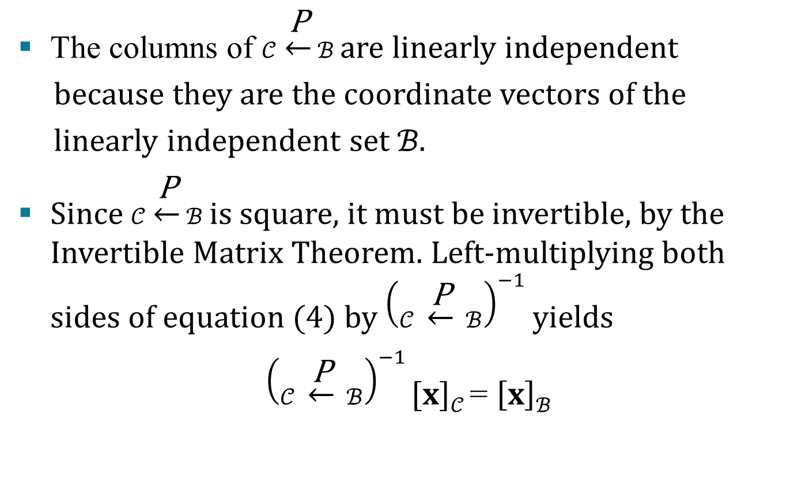
CHANGE OF BASIS
The columns of $𝒞$ $\underset{←}{\text{P}}$ $ℬ$ are linearly independent
because they are the coordinate vectors of the
linearly independent set ℬ.
Since $𝒞$ $\underset{←}{\text{P}}$ $ℬ$ is square, it must be invertible, by the Invertible Matrix Theorem. Left-multiplying both sides of equation (4) by ${\left(𝒞 \underset{←}{\text{P}} ℬ\right)}^{−1}$ yields
${\left(𝒞 \underset{←}{\text{P}} ℬ\right)}^{−1}\left[x\right]𝒞$= $\left[x\right]ℬ$

Slide 9

CHANGE OF BASIS
Thus ${\left(𝒞 \underset{←}{\text{P}} ℬ\right)}^{−1}$is the matrix that converts
𝒞-coordinates into ℬ–coordinates. That is,
${\left(𝒞 \underset{←}{\text{P}} ℬ\right)}^{−1}$= $ℬ$ $\underset{←}{\text{P}}$ $𝒞$
(6)

Slide 10
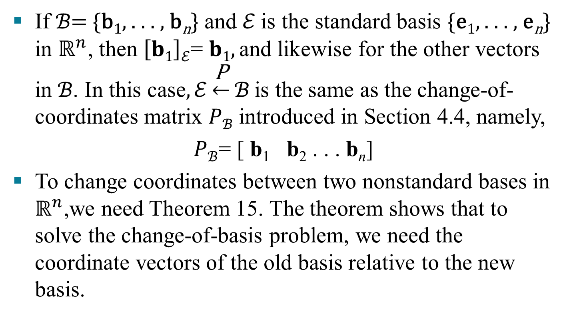

CHANGE OF BASIS IN $ℝ^{n}$
If ℬ= {b₁, . . . , b_{n}} and ℰ is the standard basis {e₁, . . . , e_{n}} in $ℝ^{n}$, then $\left[b1\right]ℰ$= $b1,\text{and} \text{likewise} \text{for} \text{the} \text{other} \text{vectors} \text{in} ℬ\text{. }\text{In} \text{this} \text{c}\text{ase}, ℰ\underset{←}{\text{P}}ℬ \text{is} \text{the}$same as the change-of-coordinates matrix $Pℬ$ introduced in Section 4.4, namely,
$Pℬ$= [ b₁ b₂ . . . b_{n}]
To change coordinates between two nonstandard bases in $ℝ^{n}$,we need Theorem 15. The theorem shows that to solve the change-of-basis problem, we need the coordinate vectors of the old basis relative to the new basis.

Slide 11
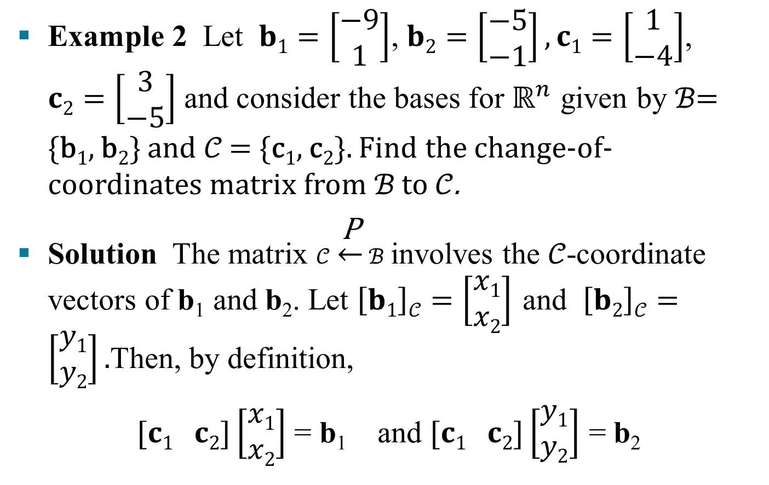
CHANGE OF BASIS IN $ℝ^{n}$
Example 2 Let $b1=\left[\begin{aligned}−9 \\ 1\end{aligned}\right]$, $b2=\left[\begin{aligned}−5 \\ −1\end{aligned}\right],c1=\left[\begin{aligned}1 \\ −4\end{aligned}\right]$, $c2=\left[\begin{aligned}3 \\ −5\end{aligned}\right]$ and consider the bases for $ℝ^{n}$ given by ℬ= {b₁, b₂} and 𝒞 = {c₁, c₂}. Find the change-of-coordinates matrix from ℬ to 𝒞.
Solution The matrix $𝒞$ $\underset{←}{\text{P}}$ $ℬ$ involves the 𝒞-coordinate vectors of b₁ and b₂. Let $\left[b1\right]𝒞=\left[\begin{aligned}x1 \\ x2\end{aligned}\right]$ and $\left[b2\right]𝒞=\left[\begin{aligned}y1 \\ y2\end{aligned}\right].$Then, by definition,
$[c1 c2]\left[\begin{aligned}x1 \\ x2\end{aligned}\right]$ = b₁ and $[c1 c2]\left[\begin{aligned}y1 \\ y2\end{aligned}\right]$ = b₂

Slide 12
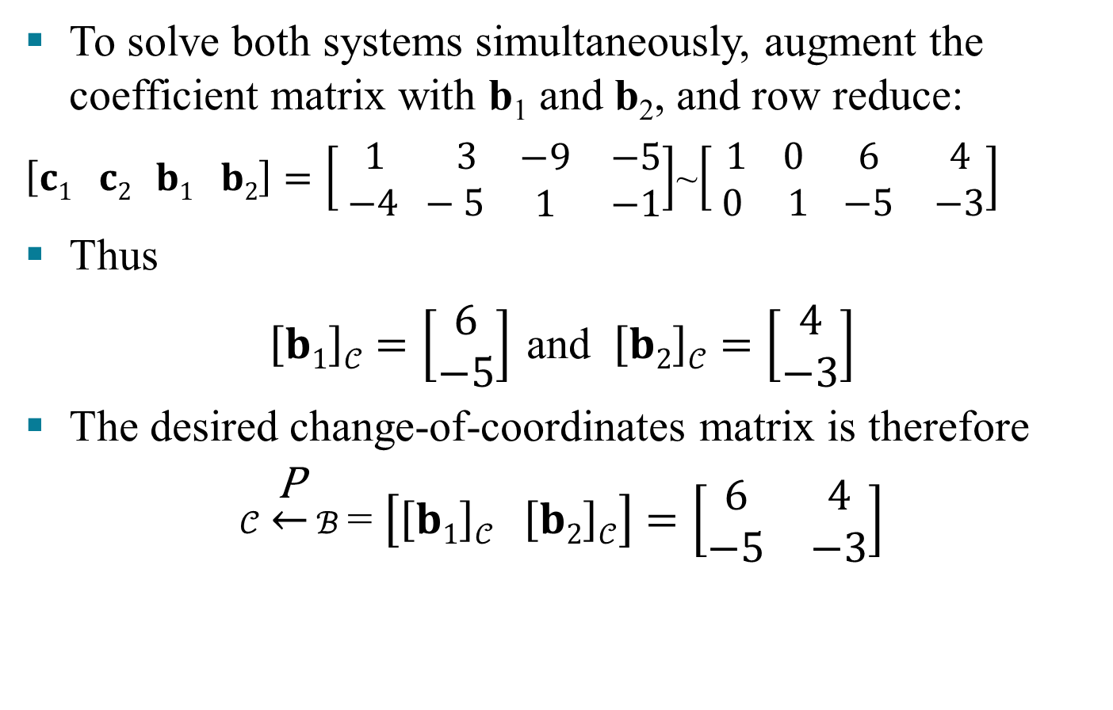
CHANGE OF BASIS IN $ℝ^{n}$
To solve both systems simultaneously, augment the coefficient matrix with b₁ and b₂, and row reduce:
$\left[c1 c2 b1 b2\right]=\left[ \begin{aligned} 1 3 \\ −4 −5\end{aligned} \begin{matrix}−9 & −5 \\ 1 & −1\end{matrix}\right]$~$\left[\begin{aligned} 1 0 \\ 0 1\end{aligned} \begin{matrix}6 & 4 \\ −5 & −3\end{matrix}\right]$
Thus
$\left[b1\right]𝒞=\left[\begin{aligned}6 \\ −5\end{aligned}\right]$ and $\left[b2\right]𝒞=\left[\begin{aligned}4 \\ −3\end{aligned}\right]$
The desired change-of-coordinates matrix is therefore
$𝒞$ $\underset{←}{\text{P}}$ $ℬ$ = $\left[\left[b1\right]𝒞 \left[b2\right]𝒞\right]=\left[\begin{matrix}6 & 4 \\ −5 & −3\end{matrix}\right]$
(7)

