Slide 1
Chapter 6
Digital Design and Computer Architecture: ARM® Edition
Sarah L. Harris and David Money Harris

Slide 2
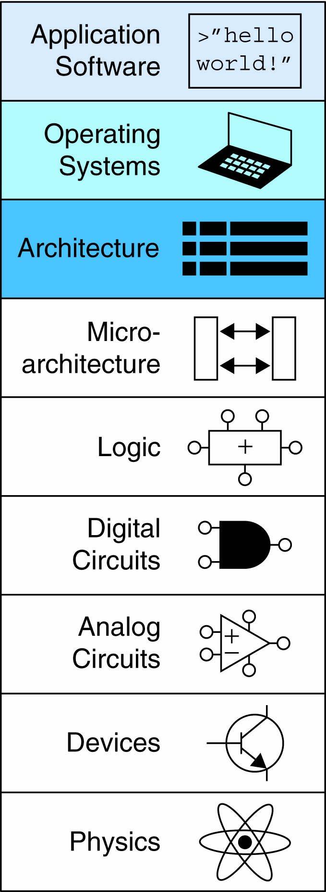
Chapter 6 :: Topics
Introduction
Assembly Language
Machine Language
Programming
Addressing Modes

Slide 3
Introduction
Jumping up a few levels of abstraction
Architecture: programmer’s view of computer
Defined by instructions & operand locations
Microarchitecture: how to implement an architecture in hardware (covered in Chapter 7)

Slide 4
Instructions
Commands in a computer’s language
Assembly language: human-readable format of instructions
Machine language: computer-readable format (1’s and 0’s)

Slide 5
ARM Architecture
Developed in the 1980’s by Advanced RISC Machines – now called ARM Holdings
Nearly 10 billion ARM processors sold/year
Almost all cell phones and tablets have multiple ARM processors
Over 75% of humans use products with an ARM processor
Used in servers, cameras, robots, cars, pinball machines, etc.

Slide 6
ARM Architecture
Developed in the 1980’s by Advanced RISC Machines – now called ARM Holdings
Nearly 10 billion ARM processors sold/year
Almost all cell phones and tablets have multiple ARM processors
Over 75% of humans use products with an ARM processor
Used in servers, cameras, robots, cars, pinball machines,, etc.
Once you’ve learned one architecture, it’s easier to learn others

Slide 7
Architecture Design Principles
Underlying design principles, as articulated by Hennessy and Patterson:
Regularity supports design simplicity
Make the common case fast
Smaller is faster
Good design demands good compromises

Slide 8
Instruction: Addition
ADD: mnemonic – indicates operation to perform
b, c: source operands
a: destination operand
C Code
a = b + c;
ARM Assembly Code
ADD a, b, c

Slide 9
Instruction: Subtraction
Similar to addition - only mnemonic changes
SUB: mnemonic
b, c: source operands
a: destination operand
C Code
a = b - c;
ARM assembly code
SUB a, b, c

Slide 10
Design Principle 1
Regularity supports design simplicity
Consistent instruction format
Same number of operands (two sources and one destination)
Ease of encoding and handling in hardware

Slide 11
Multiple Instructions
More complex code handled by multiple ARM instructions
C Code
a = b + c - d;
ARM assembly code
ADD t, b, c ; t = b + c
SUB a, t, d ; a = t - d

Slide 12
Design Principle 2
Make the common case fast
ARM includes only simple, commonly used instructions
Hardware to decode and execute instructions kept simple, small, and fast
More complex instructions (that are less common) performed using multiple simple instructions

Slide 13
Design Principle 2
Make the common case fast
ARM is a Reduced Instruction Set Computer (RISC), with a small number of simple instructions
Other architectures, such as Intel’s x86, are Complex Instruction Set Computers (CISC)

Slide 14
Operand Location
Physical location in computer
Registers
Constants (also called immediates)
Memory

Slide 15
Operands: Registers
ARM has 16 registers
Registers are faster than memory
Each register is 32 bits
ARM is called a “32-bit architecture” because it operates on 32-bit data

Slide 16
Design Principle 3
Smaller is Faster
ARM includes only a small number of registers

Slide 17
ARM Register Set
Name | Use
R0 | Argument / return value / temporary variable
R1-R3 | Argument / temporary variables
R4-R11 | Saved variables
R12 | Temporary variable
R13 (SP) | Stack Pointer
R14 (LR) | Link Register
R15 (PC) | Program Counter

Slide 18
Operands: Registers
Registers:
R before number, all capitals
Example: “R0” or “register zero” or “register R0”

Slide 19
Operands: Registers
Registers used for specific purposes:
Saved registers: R4-R11 hold variables
Temporary registers: R0-R3 and R12, hold intermediate values
Discuss others later

Slide 20
Instructions with Registers
Revisit ADD instruction
C Code
a = b + c
ARM Assembly Code
; R0 = a, R1 = b, R2 = c
ADD R0, R1, R2

Slide 21
Operands: Constants\Immediates
Many instructions can use constants or immediate operands
For example: ADD and SUB
value is immediately available from instruction
C Code
a = a + 4;
b = a – 12;
ARM Assembly Code
; R0 = a, R1 = b
ADD R0, R0, #4
SUB R1, R0, #12

Slide 22
Generating Constants
Generating small constants using move (MOV):
C Code
//int: 32-bit signed word
int a = 23;
int b = 0x45;
ARM Assembly Code
; R0 = a, R1 = b
MOV R0, #23
MOV R1, #0x45

Slide 23
Generating Constants
Generating small constants using move (MOV):
Constant must have < 8 bits of precision
C Code
//int: 32-bit signed word
int a = 23;
int b = 0x45;
ARM Assembly Code
; R0 = a, R1 = b
MOV R0, #23
MOV R1, #0x45

Slide 24
Generating Constants
Generating small constants using move (MOV):
Constant must have < 8 bits of precision
Note: MOV can also use 2 registers: MOV R7, R9
C Code
//int: 32-bit signed word
int a = 23;
int b = 0x45;
ARM Assembly Code
; R0 = a, R1 = b
MOV R0, #23
MOV R1, #0x45

Slide 25
Generating Constants
Generate larger constants using move (MOV) and or (ORR):
C Code
int a = 0x7EDC8765;
ARM Assembly Code
# R0 = a
MOV R0, #0x7E000000
ORR R0, R0, #0xDC0000
ORR R0, R0, #0x8700
ORR R0, R0, #0x65

Slide 26
Operands: Memory
Too much data to fit in only 16 registers
Store more data in memory
Memory is large, but slow
Commonly used variables still kept in registers

Slide 27
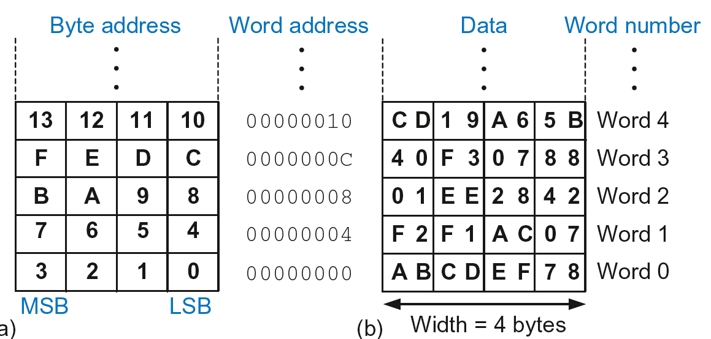
Byte-Addressable Memory
Each data byte has unique address
32-bit word = 4 bytes, so word address increments by 4

Slide 28
Reading Memory
Memory read called load
Mnemonic: load register (LDR)
Format:
LDR R0, [R1, #12]

Slide 29
Reading Memory
Memory read called load
Mnemonic: load register (LDR)
Format:
LDR R0, [R1, #12]
Address calculation:
add base address (R1) to the offset (12)
address = (R1 + 12)
Result:
R0 holds the data at memory address (R1 + 12)

Slide 30
Reading Memory
Memory read called load
Mnemonic: load register (LDR)
Format:
LDR R0, [R1, #12]
Address calculation:
add base address (R1) to the offset (12)
address = (R1 + 12)
Result:
R0 holds the data at memory address (R1 + 12)
Any register may be used as base address

Slide 31
Reading Memory
Example: Read a word of data at memory address 8 into R3

Slide 32
Reading Memory
Example: Read a word of data at memory address 8 into R3
Address = (R2 + 8) = 8
R3 = 0x01EE2842 after load
ARM Assembly Code
MOV R2, #0
LDR R3, [R2, #8]

Slide 33
Writing Memory
Memory write are called stores
Mnemonic: store register (STR)

Slide 34
Writing Memory
Example: Store the value held in R7 into memory word 21.

Slide 35
Writing Memory
Example: Store the value held in R7 into memory word 21.
Memory address = 4 x 21 = 84 = 0x54
ARM assembly code
MOV R5, #0
STR R7, [R5, #0x54]

Slide 36
Writing Memory
Example: Store the value held in R7 into memory word 21.
Memory address = 4 x 21 = 84 = 0x54
ARM assembly code
MOV R5, #0
STR R7, [R5, #0x54]
The offset can be written in decimal or hexadecimal

Slide 37
Recap: Accessing Memory
Address of a memory word must be multiplied by 4
Examples:
Address of memory word 2 = 2 × 4 = 8
Address of memory word 10 = 10 × 4 = 40

Slide 38
Big-Endian & Little-Endian Memory
How to number bytes within a word?

Slide 39
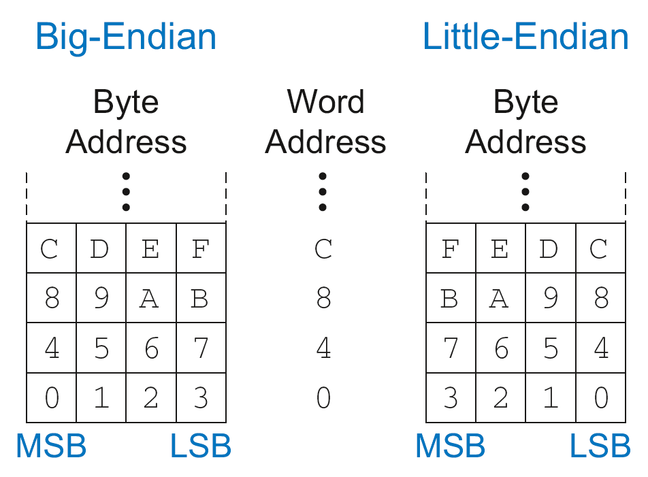
Big-Endian & Little-Endian Memory
How to number bytes within a word?
Little-endian: byte numbers start at the little (least significant) end
Big-endian: byte numbers start at the big (most significant) end

Slide 40
Big-Endian & Little-Endian Memory
Jonathan Swift’s Gulliver’s Travels: the Little-Endians broke their eggs on the little end of the egg and the Big-Endians broke their eggs on the big end
It doesn’t really matter which addressing type used – except when two systems share data

Slide 41
Big-Endian & Little-Endian Example
Suppose R2 and R5 hold the values 8 and 0x23456789
After following code runs on big-endian system, what value is in R7?
In a little-endian system?
STR R5, [R2, #0]
LDRB R7, [R2, #1]

Slide 42
Big-Endian & Little-Endian Example
Suppose R2 and R5 hold the values 8 and 0x23456789
After following code runs on big-endian system, what value is in R7?
In a little-endian system?
STR R5, [R2, #0]
LDRB R7, [R2, #1]

Slide 43
Big-Endian & Little-Endian Example
Suppose R2 and R5 hold the values 8 and 0x23456789
After following code runs on big-endian system, what value is in R7?
In a little-endian system?
STR R5, [R2, #0]
LDRB R7, [R2, #1]
Big-endian: 0x00000045
Little-endian: 0x00000067

Slide 44
Programming
High-level languages:
e.g., C, Java, Python
Written at higher level of abstraction

Slide 45

Ada Lovelace, 1815-1852
British mathematician
Wrote the first computer program
Her program calculated the Bernoulli numbers on Charles Babbage’s Analytical Engine
She was a child of the poet Lord Byron

Slide 46
Programming Building Blocks
Data-processing Instructions
Conditional Execution
Branches
High-level Constructs:
if/else statements
for loops
while loops
arrays
function calls

Slide 47
Programming Building Blocks
Data-processing Instructions
Conditional Execution
Branches
High-level Constructs:
if/else statements
for loops
while loops
arrays
function calls

Slide 48
Data-processing Instructions
Logical operations
Shifts / rotate
Multiplication

Slide 49
Logical Instructions
AND
ORR
EOR (XOR)
BIC (Bit Clear)
MVN (MoVe and NOT)

Slide 50
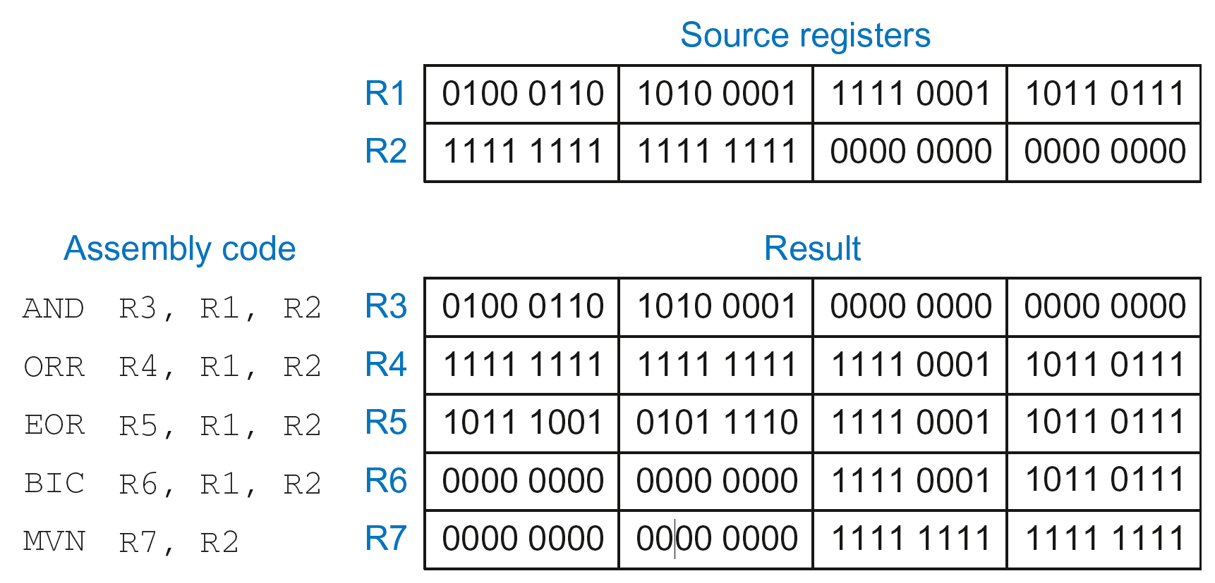
Logical Instructions: Examples

Slide 51
Logical Instructions: Uses
AND or BIC: useful for masking bits

Slide 52
Logical Instructions: Uses
AND or BIC: useful for masking bits
Example: Masking all but the least significant byte of a value
0xF234012F AND 0x000000FF = 0x0000002F
0xF234012F BIC 0xFFFFFF00 = 0x0000002F

Slide 53
Logical Instructions: Uses
AND or BIC: useful for masking bits
Example: Masking all but the least significant byte of a value
0xF234012F AND 0x000000FF = 0x0000002F
0xF234012F BIC 0xFFFFFF00 = 0x0000002F
ORR: useful for combining bit fields

Slide 54
Logical Instructions: Uses
AND or BIC: useful for masking bits
Example: Masking all but the least significant byte of a value
0xF234012F AND 0x000000FF = 0x0000002F
0xF234012F BIC 0xFFFFFF00 = 0x0000002F
ORR: useful for combining bit fields
Example: Combine 0xF2340000 with 0x000012BC:
0xF2340000 ORR 0x000012BC = 0xF23412BC

Slide 55
Shift Instructions
LSL: logical shift left
LSR: logical shift right
ASR: arithmetic shift right
ROR: rotate right

Slide 56
Shift Instructions
LSL: logical shift left
Example: LSL R0, R7, #5 ; R0 = R7 << 5
LSR: logical shift right
ASR: arithmetic shift right
ROR: rotate right

Slide 57
Shift Instructions
LSL: logical shift left
Example: LSL R0, R7, #5 ; R0 = R7 << 5
LSR: logical shift right
Example: LSR R3, R2, #31 ; R3 = R2 >> 31
ASR: arithmetic shift right
ROR: rotate right

Slide 58
Shift Instructions
LSL: logical shift left
Example: LSL R0, R7, #5 ; R0 = R7 << 5
LSR: logical shift right
Example: LSR R3, R2, #31 ; R3 = R2 >> 31
ASR: arithmetic shift right
Example: ASR R9, R11, R4 ; R9 = R11 >>> R4_{7:0}
ROR: rotate right

Slide 59
Shift Instructions
LSL: logical shift left
Example: LSL R0, R7, #5 ; R0 = R7 << 5
LSR: logical shift right
Example: LSR R3, R2, #31 ; R3 = R2 >> 31
ASR: arithmetic shift right
Example: ASR R9, R11, R4 ; R9 = R11 >>> R4_{7:0}
ROR: rotate right
Example: ROR R8, R1, #3 ; R8 = R1 ROR 3

Slide 60
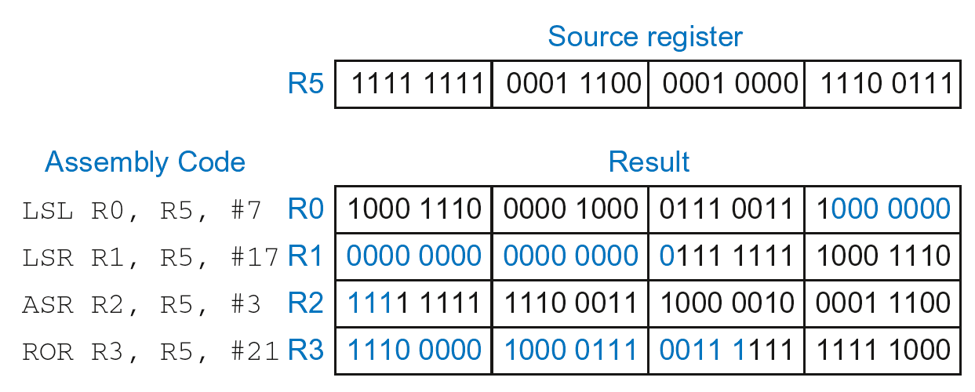
Shift Instructions: Example 1
Immediate shift amount (5-bit immediate)
Shift amount: 0-31

Slide 61
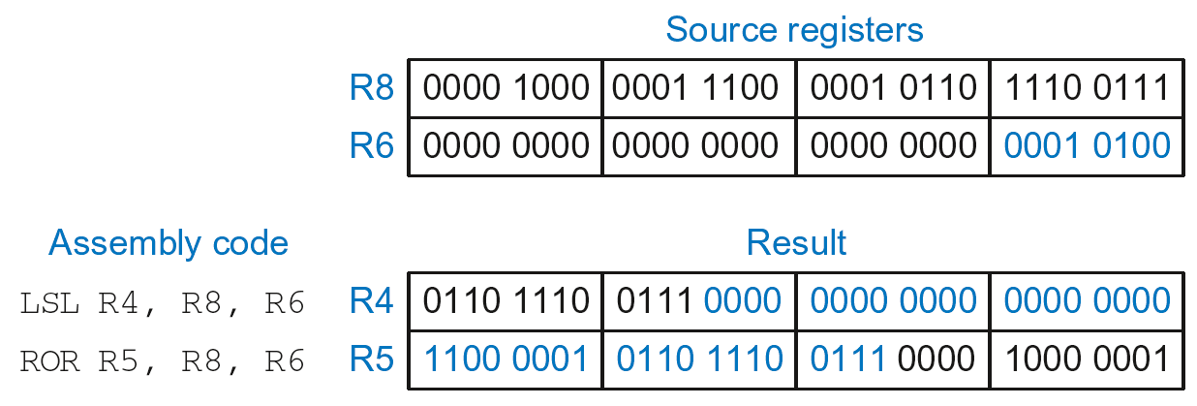
Shift Instructions: Example 2
Register shift amount (uses low 8 bits of register)
Shift amount: 0-255

Slide 62
Multiplication
MUL: 32 × 32 multiplication, 32-bit result
UMULL: Unsigned multiply long: 32 × 32 multiplication, 64-bit result
SMULL: Signed multiply long: 32 × 32 multiplication, 64-bit result

Slide 63
Multiplication
MUL: 32 × 32 multiplication, 32-bit result
MUL R1, R2, R3
Result: R1 = (R2 x R3)_{31:0}
UMULL: Unsigned multiply long: 32 × 32 multiplication, 64-bit result
SMULL: Signed multiply long: 32 × 32 multiplication, 64-bit result

Slide 64
Multiplication
MUL: 32 × 32 multiplication, 32-bit result
MUL R1, R2, R3
Result: R1 = (R2 x R3)_{31:0}
UMULL: Unsigned multiply long: 32 × 32 multiplication, 64-bit result
UMULL R1, R2, R3, R4
Result: {R1,R4} = R2 x R3 (R2, R3 unsigned)
SMULL: Signed multiply long: 32 × 32 multiplication, 64-bit result

Slide 65
Multiplication
MUL: 32 × 32 multiplication, 32-bit result
MUL R1, R2, R3
Result: R1 = (R2 x R3)_{31:0}
UMULL: Unsigned multiply long: 32 × 32 multiplication, 64-bit result
UMULL R1, R2, R3, R4
Result: {R1,R4} = R2 x R3 (R2, R3 unsigned)
SMULL: Signed multiply long: 32 × 32 multiplication, 64-bit result
SMULL R1, R2, R3, R4
Result: {R1,R4} = R2 x R3 (R2, R3 signed)

Slide 66
Programming Building Blocks
Data-processing Instructions
Conditional Execution
Branches
High-level Constructs:
if/else statements
for loops
while loops
arrays
function calls

Slide 67
Conditional Execution
Don’t always want to execute code sequentially
For example:
if/else statements, while loops, etc.: only want to execute code if a condition is true
branching: jump to another portion of code if a condition is true

Slide 68
Conditional Execution
Don’t always want to execute code sequentially
For example:
if/else statements, while loops, etc.: only want to execute code if a condition is true
branching: jump to another portion of code if a condition is true
ARM includes condition flags that can be:
set by an instruction
used to conditionally execute an instruction

Slide 69
ARM Condition Flags
Flag | Name | Description
N | Negative | Instruction result is negative
Z | Zero | Instruction results in zero
C | Carry | Instruction causes an unsigned carry out
V | oVerflow | Instruction causes an overflow

Slide 70
ARM Condition Flags
Flag | Name | Description
N | Negative | Instruction result is negative
Z | Zero | Instruction results in zero
C | Carry | Instruction causes an unsigned carry out
V | oVerflow | Instruction causes an overflow
Set by ALU (recall from Chapter 5)
Held in Current Program Status Register (CPSR)

Slide 71
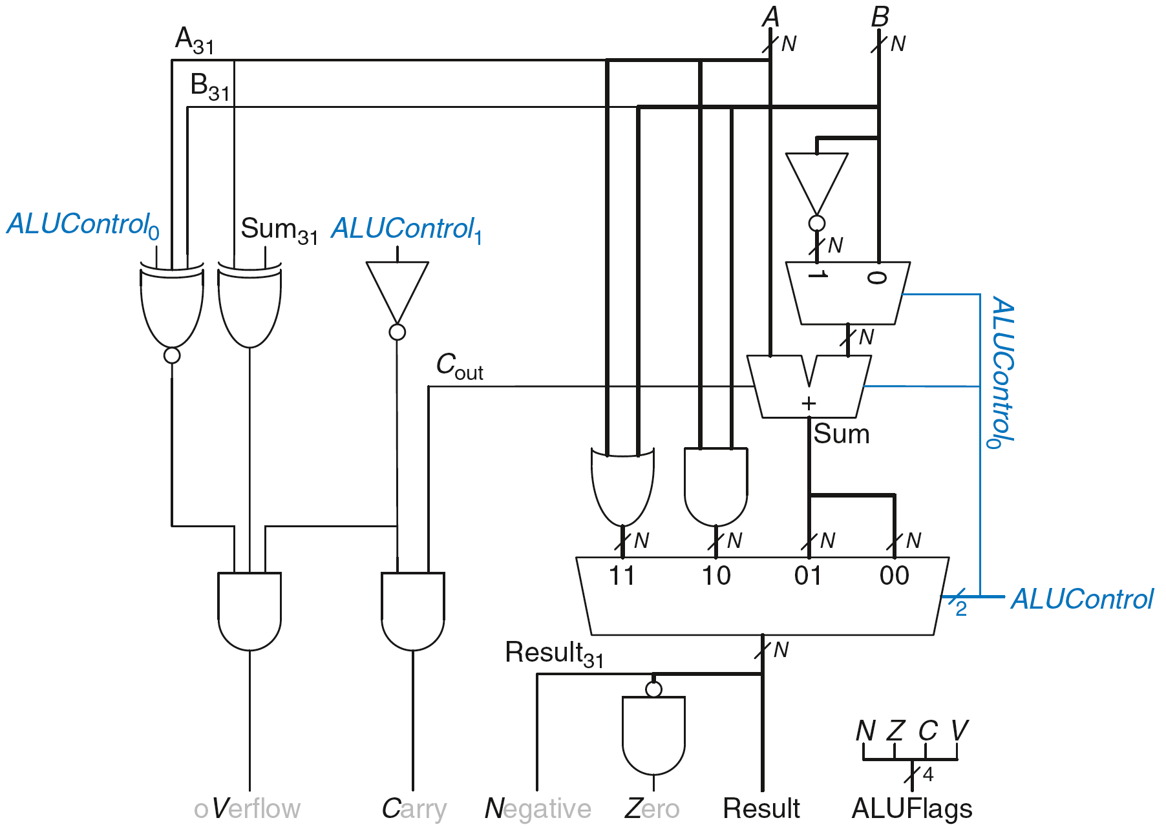
Review: ARM ALU

Slide 72
Setting the Condition Flags: NZCV
Method 1: Compare instruction: CMP
Example: CMP R5, R6
Performs: R5-R6
Does not save result
Sets flags

Slide 73
Setting the Condition Flags: NZCV
Method 1: Compare instruction: CMP
Example: CMP R5, R6
Performs: R5-R6
Does not save result
Sets flags. If result:
Is 0, Z=1
Is negative, N=1
Causes a carry out, C=1
Causes a signed overflow, V=1

Slide 74
Setting the Condition Flags: NZCV
Method 1: Compare instruction: CMP
Example: CMP R5, R6
Performs: R5-R6
Sets flags: If result is 0 (Z=1), negative (N=1), etc.
Does not save result
Method 2: Append instruction mnemonic with S

Slide 75
Setting the Condition Flags: NZCV
Method 1: Compare instruction: CMP
Example: CMP R5, R6
Performs: R5-R6
Sets flags: If result is 0 (Z=1), negative (N=1), etc.
Does not save result
Method 2: Append instruction mnemonic with S
Example: ADDS R1, R2, R3
Performs: R2 + R3
Sets flags: If result is 0 (Z=1), negative (N=1), etc.
Saves result in R1

Slide 76
Condition Mnemonics
Instruction may be conditionally executed based on the condition flags
Condition of execution is encoded as a condition mnemonic appended to the instruction mnemonic
Example: CMP R1, R2
SUBNE R3, R5, R8
NE: not equal condition mnemonic
SUB will only execute if R1 ≠ R2
(i.e., Z = 0)

Slide 77
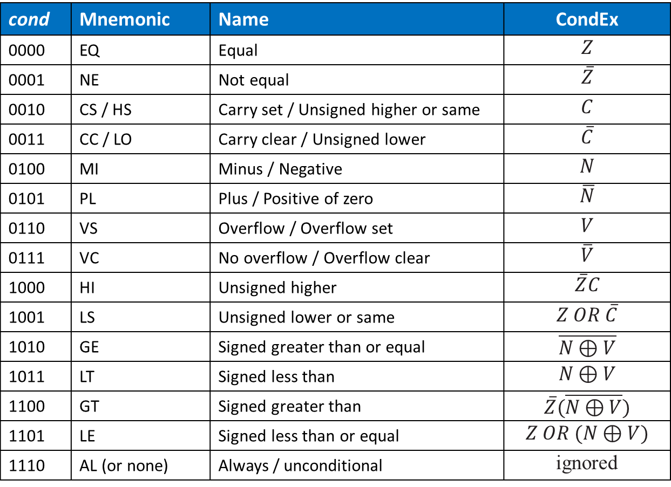
Condition Mnemonics
cond | Mnemonic | Name | CondEx
0000 | EQ | Equal | $$Z$$
0001 | NE | Not equal | $$\overline{Z}$$
0010 | CS / HS | Carry set / Unsigned higher or same | $$C$$
0011 | CC / LO | Carry clear / Unsigned lower | $$\overline{C}$$
0100 | MI | Minus / Negative | $$N$$
0101 | PL | Plus / Positive of zero | $$\overline{N}$$
0110 | VS | Overflow / Overflow set | $$V$$
0111 | VC | No overflow / Overflow clear | $$\overline{V}$$
1000 | HI | Unsigned higher | $$\overline{Z}C$$
1001 | LS | Unsigned lower or same | $$Z OR \overline{C}$$
1010 | GE | Signed greater than or equal | $$\overline{N⊕V}$$
1011 | LT | Signed less than | $$N⊕V$$
1100 | GT | Signed greater than | $$\overline{Z}(\overline{N⊕V})$$
1101 | LE | Signed less than or equal | $$Z OR (N⊕V)$$
1110 | AL (or none) | Always / unconditional | ignored

Slide 78
Conditional Execution
Example:
CMP R5, R9 ; performs R5-R9
; sets condition flags
SUBEQ R1, R2, R3 ; executes if R5==R9 (Z=1)
ORRMI R4, R0, R9 ; executes if R5-R9 is
; negative (N=1)

Slide 79
Conditional Execution
Example:
CMP R5, R9 ; performs R5-R9
; sets condition flags
SUBEQ R1, R2, R3 ; executes if R5==R9 (Z=1)
ORRMI R4, R0, R9 ; executes if R5-R9 is
; negative (N=1)
Suppose R5 = 17, R9 = 23:
CMP performs: 17 – 23 = -6 (Sets flags: N=1, Z=0, C=0, V=0)
SUBEQ doesn’t execute (they aren’t equal: Z=0)
ORRMI executes because the result was negative (N=1)

Slide 80
Programming Building Blocks
Data-processing Instructions
Conditional Execution
Branches
High-level Constructs:
if/else statements
for loops
while loops
arrays
function calls

Slide 81
Branching
Branches enable out of sequence instruction execution
Types of branches:
Branch (B)
branches to another instruction
Branch and link (BL)
discussed later
Both can be conditional or unconditional

Slide 82
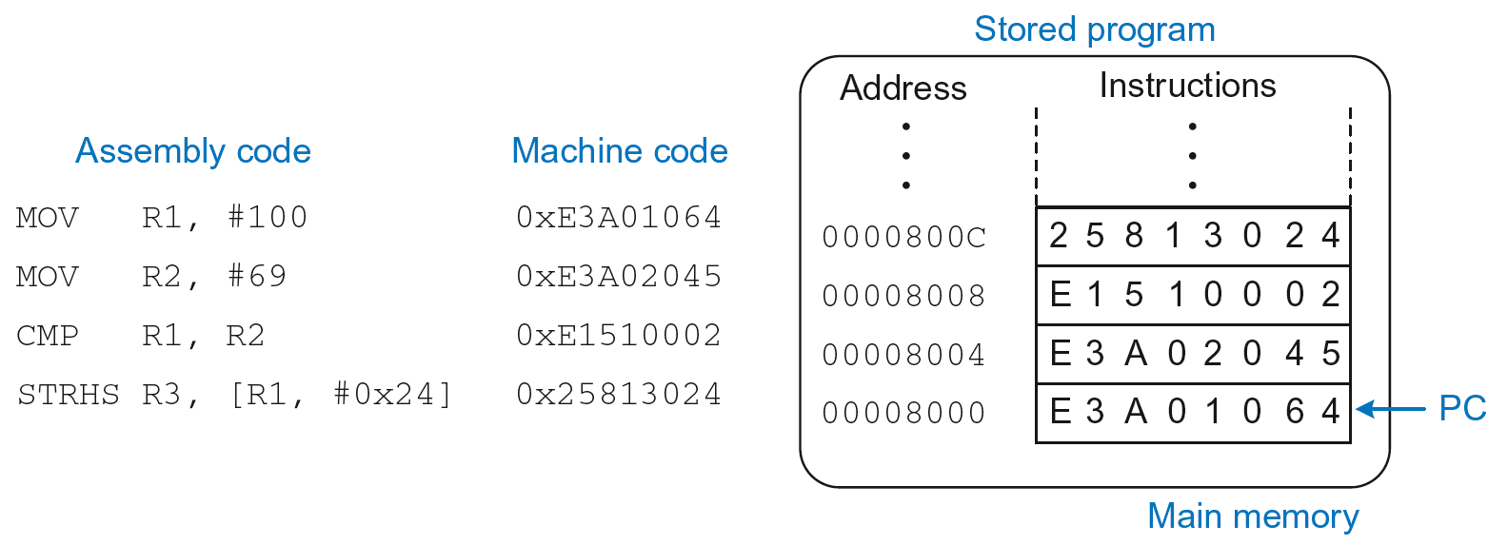
The Stored Program

Slide 83
Unconditional Branching (B)
ARM assembly
MOV R2, #17 ; R2 = 17
B TARGET ; branch to target
ORR R1, R1, #0x4 ; not executed
TARGET
SUB R1, R1, #78 ; R1 = R1 + 78

Slide 84
Unconditional Branching (B)
ARM assembly
MOV R2, #17 ; R2 = 17
B TARGET ; branch to target
ORR R1, R1, #0x4 ; not executed
TARGET
SUB R1, R1, #78 ; R1 = R1 + 78
Labels (like TARGET) indicate instruction location. Labels can’t be reserved words (like ADD, ORR, etc.)

Slide 85
The Branch Not Taken
ARM Assembly
MOV R0, #4 ; R0 = 4
ADD R1, R0, R0 ; R1 = R0+R0 = 8
CMP R0, R1 ; sets flags with R0-R1
BEQ THERE ; branch not taken (Z=0)
ORR R1, R1, #1 ; R1 = R1 OR R1 = 9
THERE
ADD R1, R1, 78 ; R1 = R1 + 78 = 87

Slide 86
Programming Building Blocks
Data-processing Instructions
Conditional Execution
Branches
High-level Constructs:
if/else statements
for loops
while loops
arrays
function calls

Slide 87
if Statement
C Code
if (i == j)
f = g + h;
f = f – i;

Slide 88
if Statement
C Code
if (i == j)
f = g + h;
f = f – i;
ARM Assembly Code
;R0=f, R1=g, R2=h, R3=i, R4=j
CMP R3, R4 ; set flags with R3-R4
BNE L1 ; if i!=j, skip if block
ADD R0, R1, R2 ; f = g + h
L1
SUB R0, R0, R2 ; f = f - i

Slide 89
if Statement
C Code
if (i == j)
f = g + h;
f = f – i;
ARM Assembly Code
;R0=f, R1=g, R2=h, R3=i, R4=j
CMP R3, R4 ; set flags with R3-R4
BNE L1 ; if i!=j, skip if block
ADD R0, R1, R2 ; f = g + h
L1
SUB R0, R0, R2 ; f = f - i
Assembly tests opposite case (i != j) of high-level code (i == j)

Slide 90
if Statement: Alternate Code
C Code
if (i == j)
f = g + h;
f = f – i;
ARM Assembly Code
;R0=f, R1=g, R2=h, R3=i, R4=j
CMP R3, R4 ; set flags with R3-R4
ADDEQ R0, R1, R2 ; if (i==j) f = g + h
SUB R0, R0, R2 ; f = f - i

Slide 91
if Statement: Alternate Code
Alternate Assembly Code
;R0=f, R1=g, R2=h, R3=i, R4=j
CMP R3, R4 ; set flags with R3-R4
ADDEQ R0, R1, R2 ; if (i==j) f = g + h
SUB R0, R0, R2 ; f = f - i
Original
CMP R3, R4
BNE L1
ADD R0, R1, R2
L1
SUB R0, R0, R2

Slide 92
if Statement: Alternate Code
Alternate Assembly Code
;R0=f, R1=g, R2=h, R3=i, R4=j
CMP R3, R4 ; set flags with R3-R4
ADDEQ R0, R1, R2 ; if (i==j) f = g + h
SUB R0, R0, R2 ; f = f - i
Original
CMP R3, R4
BNE L1
ADD R0, R1, R2
L1
SUB R0, R0, R2
Useful for short conditional blocks of code

Slide 93
if/else Statement
C Code
if (i == j)
f = g + h;
else
f = f – i;
ARM Assembly Code

Slide 94
if/else Statement
C Code
if (i == j)
f = g + h;
else
f = f – i;
ARM Assembly Code
;R0=f, R1=g, R2=h, R3=i, R4=j
CMP R3, R4 ; set flags with R3-R4
BNE L1 ; if i!=j, skip if block
ADD R0, R1, R2 ; f = g + h
B L2 ; branch past else block
L1
SUB R0, R0, R2 ; f = f – i
L2

Slide 95
if/else Statement: Alternate Code
C Code
if (i == j)
f = g + h;
else
f = f – i;
ARM Assembly Code
;R0=f, R1=g, R2=h, R3=i, R4=j
CMP R3, R4 ; set flags with R3-R4
ADDEQ R0, R1, R2 ; if (i==j) f = g + h
SUBNE R0, R0, R2 ; else f = f - i

Slide 96
if/else Statement: Alternate Code
Original
CMP R3, R4
BNE L1
ADD R0, R1, R2
B L2
L1
SUB R0, R0, R2
L2
Alternate Assembly Code
;R0=f, R1=g, R2=h, R3=i, R4=j
CMP R3, R4 ; set flags with R3-R4
ADDEQ R0, R1, R2 ; if (i==j) f = g + h
SUBNE R0, R0, R2 ; else f = f - i

Slide 97
while Loops
C Code
// determines the power
// of x such that 2^{x} = 128
int pow = 1;
int x = 0;
while (pow != 128) {
pow = pow * 2;
x = x + 1;
}
ARM Assembly Code

Slide 98
while Loops
C Code
// determines the power
// of x such that 2^{x} = 128
int pow = 1;
int x = 0;
while (pow != 128) {
pow = pow * 2;
x = x + 1;
}
ARM Assembly Code
; R0 = pow, R1 = x
MOV R0, #1 ; pow = 1
MOV R1, #0 ; x = 0
WHILE
CMP R0, #128 ; R0-128
BEQ DONE ; if (pow==128) ; exit loop
LSL R0, R0, #1 ; pow=pow*2
ADD R1, R1, #1 ; x=x+1
B WHILE ; repeat loop
DONE

Slide 99
while Loops
C Code
// determines the power
// of x such that 2^{x} = 128
int pow = 1;
int x = 0;
while (pow != 128) {
pow = pow * 2;
x = x + 1;
}
ARM Assembly Code
; R0 = pow, R1 = x
MOV R0, #1 ; pow = 1
MOV R1, #0 ; x = 0
WHILE
CMP R0, #128 ; R0-128
BEQ DONE ; if (pow==128) ; exit loop
LSL R0, R0, #1 ; pow=pow*2
ADD R1, R1, #1 ; x=x+1
B WHILE ; repeat loop
DONE
Assembly tests for the opposite case (pow == 128) of the C code (pow != 128).

Slide 100
for Loops
for (initialization; condition; loop operation)
statement
initialization: executes before the loop begins
condition: is tested at the beginning of each iteration
loop operation: executes at the end of each iteration
statement: executes each time the condition is met

Slide 101
for Loops
C Code
// adds numbers from 1-9
int sum = 0
for (i=1; i!=10; i=i+1)
sum = sum + i;
ARM Assembly Code

Slide 102
for Loops
C Code
// adds numbers from 1-9
int sum = 0
for (i=1; i!=10; i=i+1)
sum = sum + i;
ARM Assembly Code
; R0 = i, R1 = sum
MOV R0, #1 ; i = 1
MOV R1, #0 ; sum = 0
FOR
CMP R0, #10 ; R0-10
BEQ DONE ; if (i==10) ; exit loop
ADD R1, R1, R0 ; sum=sum + i
ADD R0, R0, #1 ; i = i + 1
B FOR ; repeat loop
DONE

Slide 103
for Loops: Decremented Loops
In ARM, decremented loop variables are more efficient

Slide 104
for Loops: Decremented Loops
In ARM, decremented loop variables are more efficient
C Code
// adds numbers from 1-9
int sum = 0
for (i=9; i!=0; i=i-1)
sum = sum + i;
ARM Assembly Code
; R0 = i, R1 = sum
MOV R0, #9 ; i = 9
MOV R1, #0 ; sum = 0
FOR
ADD R1, R1, R0 ; sum=sum + i
SUBS R0, R0, #1 ; i = i – 1
; and set flags
BNE FOR ; if (i!=0) ; repeat loop

Slide 105
for Loops: Decremented Loops
In ARM, decremented loop variables are more efficient
C Code
// adds numbers from 1-9
int sum = 0
for (i=9; i!=0; i=i-1)
sum = sum + i;
ARM Assembly Code
; R0 = i, R1 = sum
MOV R0, #9 ; i = 9
MOV R1, #0 ; sum = 0
FOR
ADD R1, R1, R0 ; sum=sum + i
SUBS R0, R0, #1 ; i = i – 1
; and set flags
BNE FOR ; if (i!=0) ; repeat loop
Saves 2 instructions per iteration:
Decrement loop variable & compare: SUBS R0, R0, #1
Only 1 branch – instead of 2

Slide 106
Programming Building Blocks
Data-processing Instructions
Conditional Execution
Branches
High-level Constructs:
if/else statements
for loops
while loops
arrays
function calls

Slide 107
Arrays
Access large amounts of similar data
Index: access to each element
Size: number of elements

Slide 108
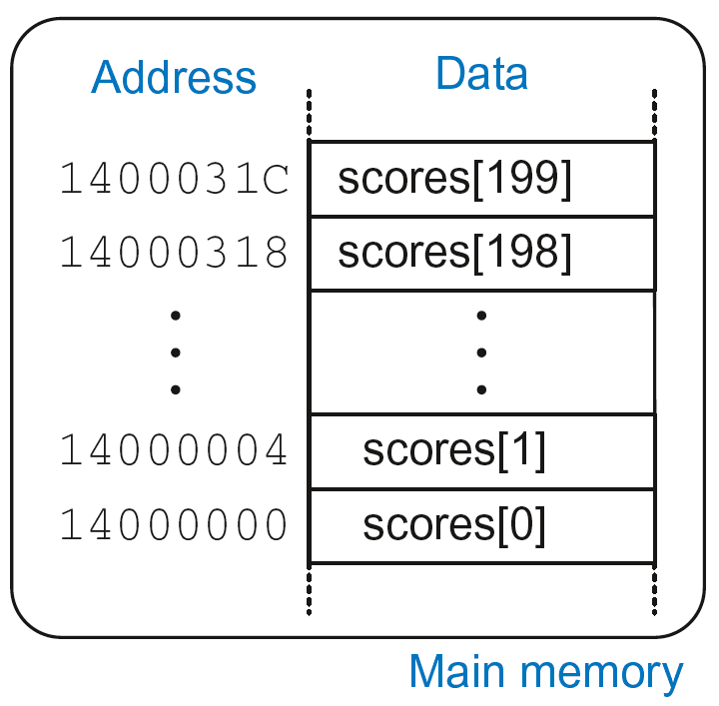
Arrays
5-element array
Base address = 0x14000000 (address of first element, scores[0])
Array elements accessed relative to base address

Slide 109
Accessing Arrays
C Code
int array[5];
array[0] = array[0] * 8;
array[1] = array[1] * 8;
ARM Assembly Code
; R0 = array base address

Slide 110
Accessing Arrays
C Code
int array[5];
array[0] = array[0] * 8;
array[1] = array[1] * 8;
ARM Assembly Code
; R0 = array base address
MOV R0, #0x60000000 ; R0 = 0x60000000
LDR R1, [R0] ; R1 = array[0]
LSL R1, R1, 3 ; R1 = R1 << 3 = R1*8
STR R1, [R0] ; array[0] = R1
LDR R1, [R0, #4] ; R1 = array[1]
LSL R1, R1, 3 ; R1 = R1 << 3 = R1*8
STR R1, [R0, #4] ; array[1] = R1

Slide 111
Arrays using for Loops
C Code
int array[200];
int i;
for (i=199; i >= 0; i = i - 1)
array[i] = array[i] * 8;
ARM Assembly Code
; R0 = array base address, R1 = i

Slide 112
Arrays using for Loops
C Code
int array[200];
int i;
for (i=199; i >= 0; i = i - 1)
array[i] = array[i] * 8;
ARM Assembly Code
; R0 = array base address, R1 = i
MOV R0, 0x60000000
MOV R1, #199
FOR
LDR R2, [R0, R1, LSL #2] ; R2 = array(i)
LSL R2, R2, #3 ; R2 = R2<<3 = R3*8
STR R2, [R0, R1, LSL #2] ; array(i) = R2
SUBS R0, R0, #1 ; i = i – 1
; and set flags
BPL FOR ; if (i>=0) repeat loop

Slide 113
ASCII Code
American Standard Code for Information Interchange
Each text character has unique byte value
For example, S = 0x53, a = 0x61, A = 0x41
Lower-case and upper-case differ by 0x20 (32)

Slide 114
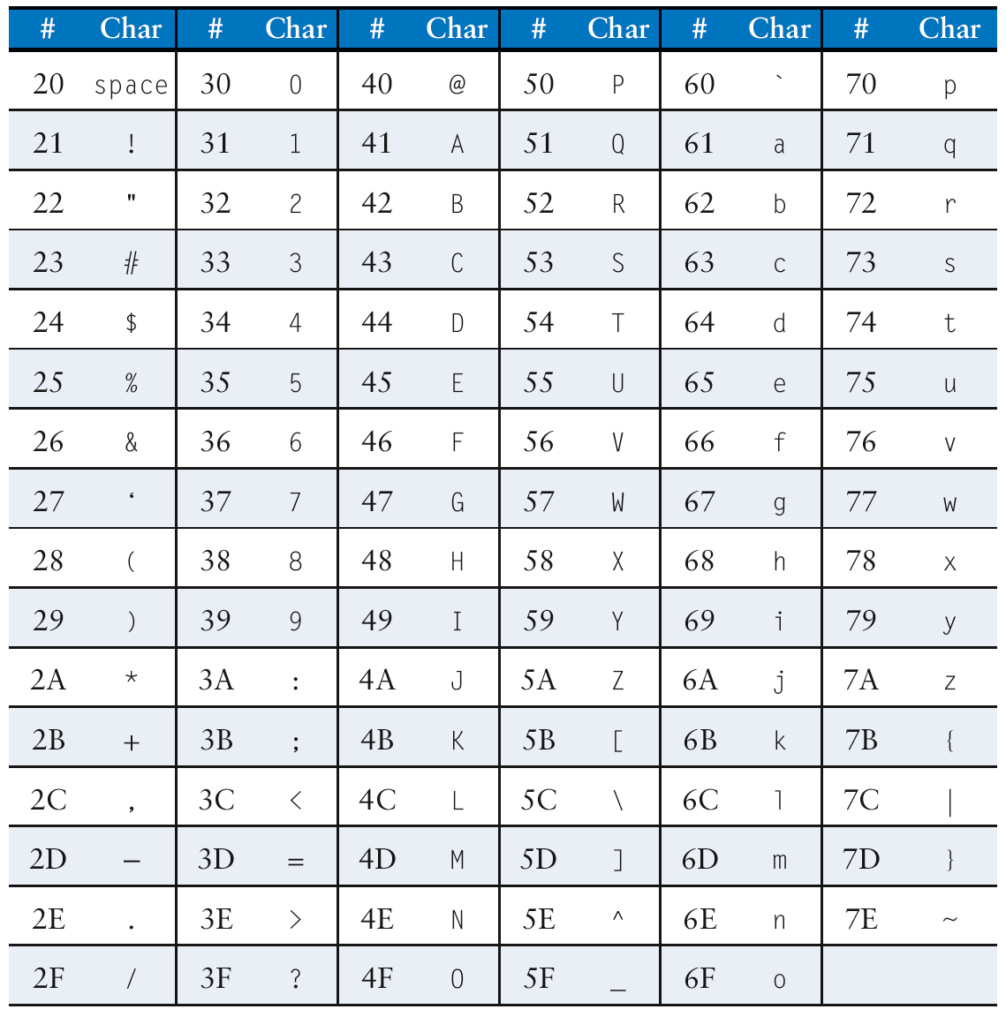
Cast of Characters

Slide 115
Programming Building Blocks
Data-processing Instructions
Conditional Execution
Branches
High-level Constructs:
if/else statements
for loops
while loops
arrays
function calls

Slide 116
Function Calls
Caller: calling function (in this case, main)
Callee: called function (in this case, sum)
C Code
void main()
{
int y;
y = sum(42, 7);
...
}
int sum(int a, int b)
{
return (a + b);
}

Slide 117
Function Conventions
Caller:
passes arguments to callee
jumps to callee

Slide 118
Function Conventions
Caller:
passes arguments to callee
jumps to callee
Callee:
performs the function
returns result to caller
returns to point of call
must not overwrite registers or memory needed by caller

Slide 119
ARM Function Conventions
Call Function: branch and link
BL
Return from function: move the link register to PC: MOV PC, LR
Arguments: R0-R3
Return value: R0

Slide 120
Function Calls
C Code
int main() {
simple();
a = b + c;
}
void simple() {
return;
}
ARM Assembly Code
0x00000200 MAIN BL SIMPLE
0x00000204 ADD R4, R5, R6
...
0x00401020 SIMPLE MOV PC, LR

Slide 121
Function Calls
C Code
int main() {
simple();
a = b + c;
}
void simple() {
return;
}
ARM Assembly Code
0x00000200 MAIN BL SIMPLE
0x00000204 ADD R4, R5, R6
...
0x00401020 SIMPLE MOV PC, LR
void means that simple doesn’t return a value

Slide 122
Function Calls
C Code
int main() {
simple();
a = b + c;
}
void simple() {
return;
}
ARM Assembly Code
0x00000200 MAIN BL SIMPLE
0x00000204 ADD R4, R5, R6
...
0x00401020 SIMPLE MOV PC, LR
BL branches to SIMPLE
LR = PC + 4 = 0x00000204
MOV PC, LR makes PC = LR
(the next instruction executed is at 0x00000200)

Slide 123
Input Arguments and Return Value
ARM conventions:
Argument values: R0 - R3
Return value: R0

Slide 124
Input Arguments and Return Value
C Code
int main()
{
int y;
...
y = diffofsums(2, 3, 4, 5); // 4 arguments
...
}
int diffofsums(int f, int g, int h, int i)
{
int result;
result = (f + g) - (h + i);
return result; // return value
}

Slide 125
Input Arguments and Return Value
ARM Assembly Code
; R4 = y
MAIN
...
MOV R0, #2 ; argument 0 = 2
MOV R1, #3 ; argument 1 = 3
MOV R2, #4 ; argument 2 = 4
MOV R3, #5 ; argument 3 = 5
BL DIFFOFSUMS ; call function
MOV R4, R0 ; y = returned value
...
; R4 = result
DIFFOFSUMS
ADD R8, R0, R1 ; R8 = f + g
ADD R9, R2, R3 ; R9 = h + i
SUB R4, R8, R9 ; result = (f + g) - (h + i)
MOV R0, R4 ; put return value in R0
MOV PC, LR ; return to caller

Slide 126
Input Arguments and Return Value
ARM Assembly Code
; R4 = result
DIFFOFSUMS
ADD R8, R0, R1 ; R8 = f + g
ADD R9, R2, R3 ; R9 = h + i
SUB R4, R8, R9 ; result = (f + g) - (h + i)
MOV R0, R4 ; put return value in R0
MOV PC, LR ; return to caller
diffofsums overwrote 3 registers: R4, R8, R9
diffofsums can use stack to temporarily store registers

Slide 127

The Stack
Memory used to temporarily save variables
Like stack of dishes, last-in-first-out (LIFO) queue
Expands: uses more memory when more space needed
Contracts: uses less memory when the space no longer needed

Slide 128
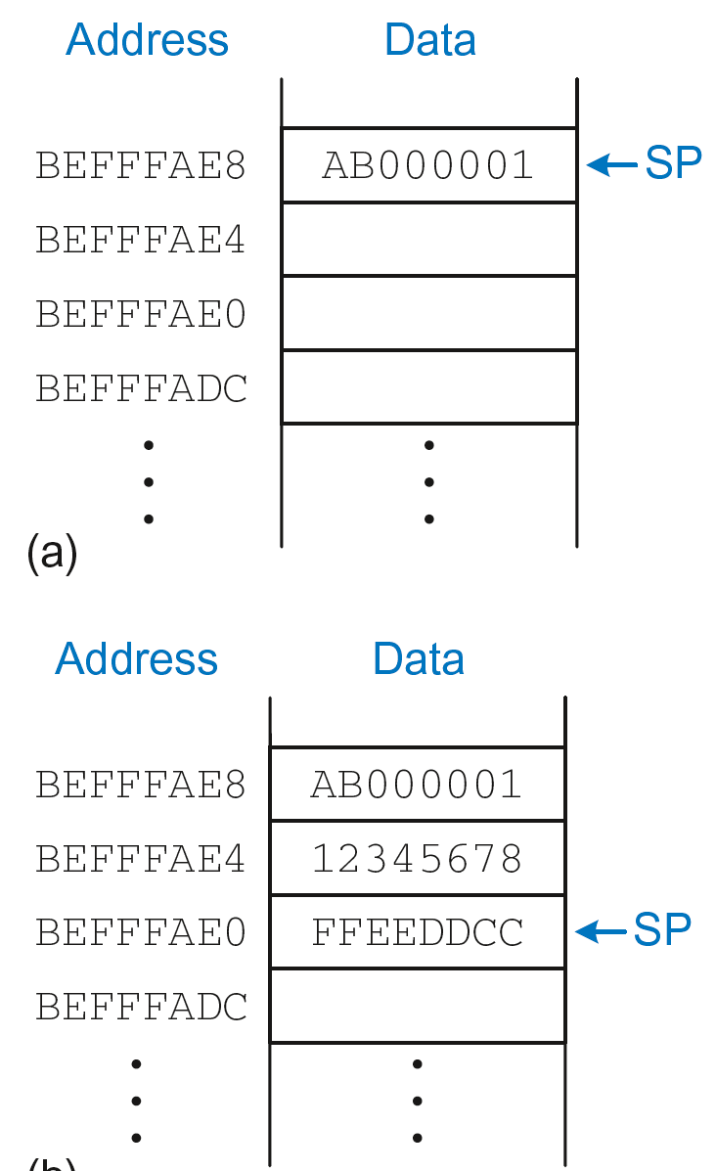
The Stack
Grows down (from higher to lower memory addresses)
Stack pointer: SP points to top of the stack
Stack expands by 2 words

Slide 129
How Functions use the Stack
Called functions must have no unintended side effects
But diffofsums overwrites 3 registers: R4, R8, R9
ARM Assembly Code
; R4 = result
DIFFOFSUMS
ADD R8, R0, R1 ; R8 = f + g
ADD R9, R2, R3 ; R9 = h + i
SUB R4, R8, R9 ; result = (f + g) - (h + i)
MOV R0, R4 ; put return value in R0
MOV PC, LR ; return to caller

Slide 130
Storing Register Values on the Stack
ARM Assembly Code
; R2 = result
DIFFOFSUMS
SUB SP, SP, #12 ; make space on stack for 3 registers
STR R4, [SP, #-8] ; save R4 on stack
STR R8, [SP, #-4] ; save R8 on stack
STR R9, [SP] ; save R9 on stack
ADD R8, R0, R1 ; R8 = f + g
ADD R9, R2, R3 ; R9 = h + i
SUB R4, R8, R9 ; result = (f + g) - (h + i)
MOV R0, R4 ; put return value in R0
LDR R9, [SP] ; restore R9 from stack
LDR R8, [SP, #-4] ; restore R8 from stack
LDR R4, [SP, #-8] ; restore R4 from stack
ADD SP, SP, #12 ; deallocate stack space
MOV PC, LR ; return to caller

Slide 131
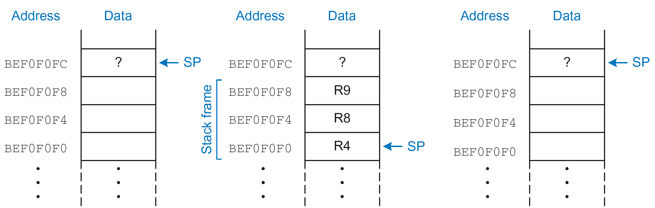
The Stack during diffofsums Call
Before call
During call
After call

Slide 132
Registers
Preserved Callee-Saved | Nonpreserved Caller-Saved
R4-R11 | R12
R14 (LR) | R0-R3
R13 (SP) | CPSR
stack above SP | stack below SP

Slide 133
Storing Saved Registers only on Stack
ARM Assembly Code
; R2 = result
DIFFOFSUMS
STR R4, [SP, #-4]! ; save R4 on stack
ADD R8, R0, R1 ; R8 = f + g
ADD R9, R2, R3 ; R9 = h + i
SUB R4, R8, R9 ; result = (f + g) - (h + i)
MOV R0, R4 ; put return value in R0
LDR R4, [SP], #4 ; restore R4 from stack
MOV PC, LR ; return to caller

Slide 134
Storing Saved Registers only on Stack
ARM Assembly Code
; R2 = result
DIFFOFSUMS
STR R4, [SP, #-4]! ; save R4 on stack
ADD R8, R0, R1 ; R8 = f + g
ADD R9, R2, R3 ; R9 = h + i
SUB R4, R8, R9 ; result = (f + g) - (h + i)
MOV R0, R4 ; put return value in R0
LDR R4, [SP], #4 ; restore R4 from stack
MOV PC, LR ; return to caller
Notice code optimization for expanding/contracting stack

Slide 135
Nonleaf Function
ARM Assembly Code
STR LR, [SP, #-4]! ; store LR on stack
BL PROC2 ; call another function
...
LDR LR, [SP], #4 ; restore LR from stack
jr $ra ; return to caller

Slide 136
Nonleaf Function Example
C Code
int f1(int a, int b) {
int i, x;
x = (a + b)*(a − b);
for (i=0; i<a; i++)
x = x + f2(b+i);
return x;
}
int f2(int p) {
int r;
r = p + 5;
return r + p;
}

Slide 137
Nonleaf Function Example
C Code
int f1(int a, int b) {
int i, x;
x = (a + b)*(a − b);
for (i=0; i<a; i++)
x = x + f2(b+i);
return x;
}
int f2(int p) {
int r;
r = p + 5;
return r + p;
}
ARM Assembly Code
; R0=a, R1=b, R4=i, R5=x
F1
PUSH {R4, R5, LR}
ADD R5, R0, R1
SUB R12, R0, R1
MUL R5, R5, R12
MOV R4, #0
FOR
CMP R4, R0
BGE RETURN
PUSH {R0, R1}
ADD R0, R1, R4
BL F2
ADD R5, R5, R0
POP {R0, R1}
ADD R4, R4, #1
B FOR
RETURN
MOV R0, R5
POP {R4, R5, LR}
MOV PC, LR
; R0=p, R4=r
F2
PUSH {R4}
ADD R4, R0, 5
ADD R0, R4, R0
POP {R4}
MOV PC, LR

Slide 138
Nonleaf Function Example
ARM Assembly Code
; R0=a, R1=b, R4=i, R5=x
F1
PUSH {R4, R5, LR} ; save regs
ADD R5, R0, R1 ; x = (a+b)
SUB R12, R0, R1 ; temp = (a-b)
MUL R5, R5, R12 ; x = x*temp
MOV R4, #0 ; i = 0
FOR
CMP R4, R0 ; i < a?
BGE RETURN ; no: exit loop
PUSH {R0, R1} ; save regs
ADD R0, R1, R4 ; arg is b+i
BL F2 ; call f2(b+i)
ADD R5, R5, R0 ; x = x+f2(b+i)
POP {R0, R1} ; restore regs
ADD R4, R4, #1 ; i++
B FOR ; repeat loop
RETURN
MOV R0, R5 ; return x
POP {R4, R5, LR} ; restore regs
MOV PC, LR ; return
; R0=p, R4=r
F2
PUSH {R4} ; save regs
ADD R4, R0, 5 ; r = p+5
ADD R0, R4, R0 ; return r+p
POP {R4} ; restore regs
MOV PC, LR ; return

Slide 139
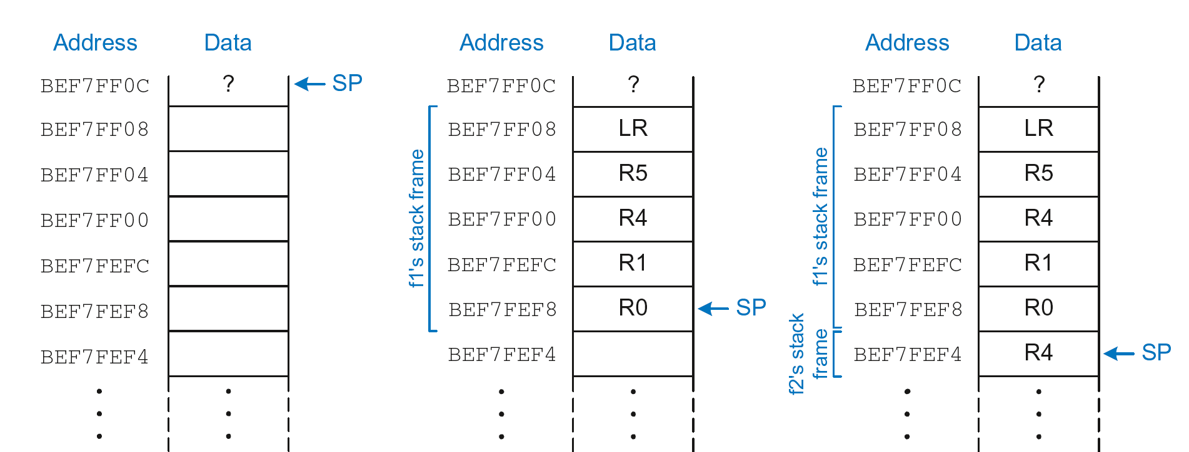
Stack during Nonleaf Function
At beginning of f1
Just before calling f2
After calling f2

Slide 140
Recursive Function Call
C Code
int factorial(int n) {
if (n <= 1)
return 1;
else
return (n * factorial(n-1));
}

Slide 141
Recursive Function Call
ARM Assembly Code
0x94 FACTORIAL STR R0, [SP, #-4]! ;store R0 on stack
0x98 STR LR, [SP, #-4]! ;store LR on stack
0x9C CMP R0, #2 ;set flags with R0-2
0xA0 BHS ELSE ;if (r0>=2) branch to else
0xA4 MOV R0, #1 ; otherwise return 1
0xA8 ADD SP, SP, #8 ; restore SP 1
0xAC MOV PC, LR ; return
0xB0 ELSE SUB R0, R0, #1 ; n = n - 1
0xB4 BL FACTORIAL ; recursive call
0xB8 LDR LR, [SP], #4 ; restore LR
0xBC LDR R1, [SP], #4 ; restore R0 (n) into R1
0xC0 MUL R0, R1, R0 ; R0 = n*factorial(n-1)
0xC4 MOV PC, LR ; return

Slide 142
Recursive Function Call
C Code
int factorial(int n) {
if (n <= 1)
return 1;
else
return (n * factorial(n-1));
}
ARM Assembly Code
0x94 FACTORIAL STR R0, [SP, #-4]!
0x98 STR LR, [SP, #-4]!
0x9C CMP R0, #2
0xA0 BHS ELSE
0xA4 MOV R0, #1
0xA8 ADD SP, SP, #8
0xAC MOV PC, LR
0xB0 ELSE SUB R0, R0, #1
0xB4 BL FACTORIAL
0xB8 LDR LR, [SP], #4
0xBC LDR R1, [SP], #4
0xC0 MUL R0, R1, R0
0xC4 MOV PC, LR

Slide 143
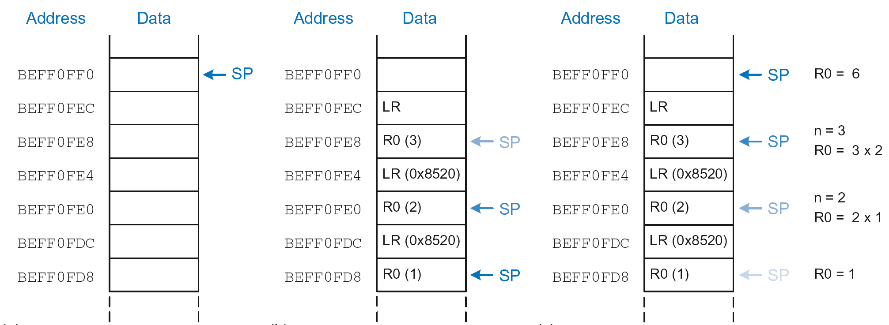
Stack during Recursive Call
Before call
During call
After call

Slide 144
Function Call Summary
Caller
Puts arguments in R0-R3
Saves any needed registers (LR, maybe R0-R3, R8-R12)
Calls function: BL CALLEE
Restores registers
Looks for result in R0
Callee
Saves registers that might be disturbed (R4-R7)
Performs function
Puts result in R0
Restores registers
Returns: MOV PC, LR

Slide 145
How to Encode Instructions?

Slide 146
How to Encode Instructions?
Design Principle 1: Regularity supports design simplicity
32-bit data, 32-bit instructions
For design simplicity, would prefer a single instruction format but…

Slide 147
How to Encode Instructions?
Design Principle 1: Regularity supports design simplicity
32-bit data, 32-bit instructions
For design simplicity, would prefer a single instruction format but…
Instructions have different needs

Slide 148
Design Principle 4
Good design demands good compromises
Multiple instruction formats allow flexibility
ADD, SUB: use 3 register operands
LDR, STR: use 2 register operands and a constant
Number of instruction formats kept small
to adhere to design principles 1 and 3 (regularity supports design simplicity and smaller is faster)

Slide 149
Machine Language
Binary representation of instructions
Computers only understand 1’s and 0’s
32-bit instructions
Simplicity favors regularity: 32-bit data & instructions
3 instruction formats:
Data-processing
Memory
Branch

Slide 150
Instruction Formats
Data-processing
Memory
Branch

Slide 151
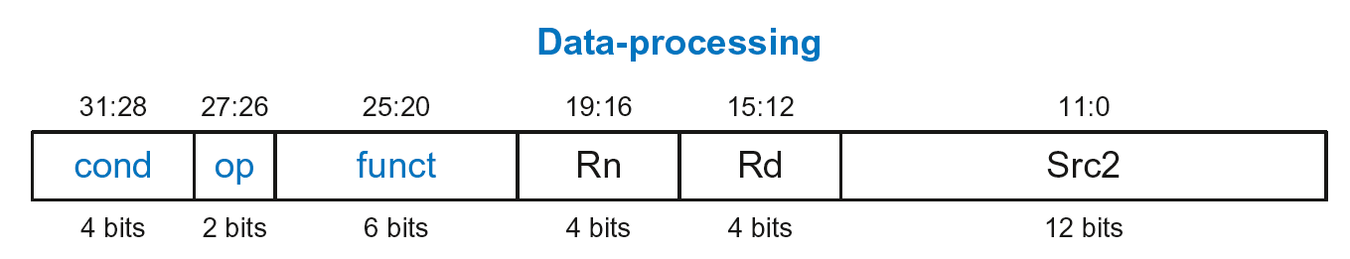
Data-processing Instruction Format
Operands:
Rn: first source register
Src2: second source – register or immediate
Rd: destination register
Control fields:
cond: specifies conditional execution
op: the operation code or opcode
funct: the function/operation to perform

Slide 152
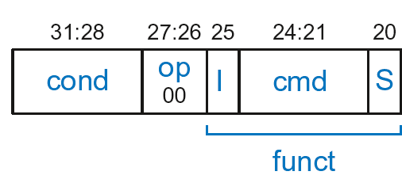
Data-processing Control Fields
op = 00₂ for data-processing (DP) instructions
funct is composed of cmd, I-bit, and S-bit

Slide 153
Data-processing Control Fields
op = 00₂ for data-processing (DP) instructions
funct is composed of cmd, I-bit, and S-bit
cmd: specifies the specific data-processing instruction. For example,
cmd = 0100₂ for ADD
cmd = 0010₂ for SUB
I-bit
I = 0: Src2 is a register
I = 1: Src2 is an immediate
S-bit: 1 if sets condition flags
S = 0: SUB R0, R5, R7
S = 1: ADDS R8, R2, R4 or CMP R3, #10

Slide 154
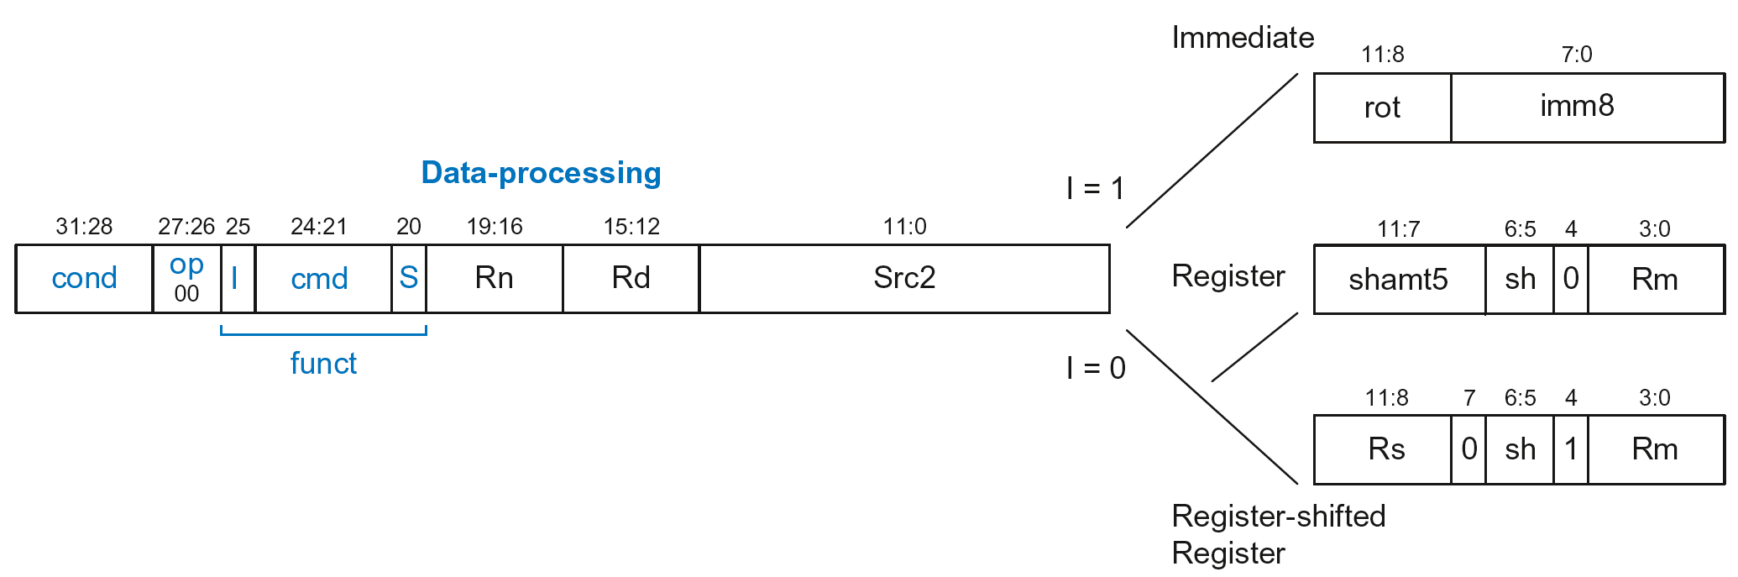
Data-processing Src2 Variations
Src2 can be:
Immediate
Register
Register-shifted register

Slide 155
Data-processing Src2 Variations
Src2 can be:
Immediate
Register
Register-shifted register

Slide 156
Immediate Src2
Immediate encoded as:
imm8: 8-bit unsigned immediate
rot: 4-bit rotation value
32-bit constant is: imm8 ROR (rot × 2)

Slide 157
Immediate Src2
Immediate encoded as:
imm8: 8-bit unsigned immediate
rot: 4-bit rotation value
32-bit constant is: imm8 ROR (rot × 2)
Example: imm8 = abcdefgh
rot | 32-bit constant
0000 | 0000 0000 0000 0000 0000 0000 abcd efgh
0001 | gh00 0000 0000 0000 0000 0000 00ab cdef
… | …
1111 | 0000 0000 0000 0000 0000 00ab cdef gh00

Slide 158
Immediate Src2
Immediate encoded as:
imm8: 8-bit unsigned immediate
rot: 4-bit rotation value
32-bit constant is: imm8 ROR (rot × 2)
Example: imm8 = abcdefgh
ROR by X = ROL by (32-X)
Ex: ROR by 30 = ROL by 2
rot | 32-bit constant
0000 | 0000 0000 0000 0000 0000 0000 abcd efgh
0001 | gh00 0000 0000 0000 0000 0000 00ab cdef
… | …
1111 | 0000 0000 0000 0000 0000 00ab cdef gh00

Slide 159
DP Instruction with Immediate Src2
ADD R0, R1, #42
cond = 1110₂ (14) for unconditional execution
op = 00₂ (0) for data-processing instructions
cmd = 0100₂ (4) for ADD
Src2 is an immediate so I = 1
Rd = 0, Rn = 1
imm8 = 42, rot = 0

Slide 160
DP Instruction with Immediate Src2
ADD R0, R1, #42
cond = 1110₂ (14) for unconditional execution
op = 00₂ (0) for data-processing instructions
cmd = 0100₂ (4) for ADD
Src2 is an immediate so I = 1
Rd = 0, Rn = 1
imm8 = 42, rot = 0

Slide 161
DP Instruction with Immediate Src2
ADD R0, R1, #42
cond = 1110₂ (14) for unconditional execution
op = 00₂ (0) for data-processing instructions
cmd = 0100₂ (4) for ADD
Src2 is an immediate so I = 1
Rd = 0, Rn = 1
imm8 = 42, rot = 0
0xE281002A

Slide 162
DP Instruction with Immediate Src2
SUB R2, R3, #0xFF0
cond = 1110₂ (14) for unconditional execution
op = 00₂ (0) for data-processing instructions
cmd = 0010₂ (2) for SUB
Src2 is an immediate so I=1
Rd = 2, Rn = 3
imm8 = 0xFF
imm8 must be rotated right by 28 to produce 0xFF0, so rot = 14

Slide 163
DP Instruction with Immediate Src2
SUB R2, R3, #0xFF0
cond = 1110₂ (14) for unconditional execution
op = 00₂ (0) for data-processing instructions
cmd = 0010₂ (2) for SUB
Src2 is an immediate so I=1
Rd = 2, Rn = 3
imm8 = 0xFF
imm8 must be rotated right by 28 to produce 0xFF0, so rot = 14
ROR by 28 =
ROL by (32-28) = 4

Slide 164
DP Instruction with Immediate Src2
SUB R2, R3, #0xFF0
cond = 1110₂ (14) for unconditional execution
op = 00₂ (0) for data-processing instructions
cmd = 0010₂ (2) for SUB
Src2 is an immediate so I=1
Rd = 2, Rn = 3
imm8 = 0xFF
imm8 must be rotated right by 28 to produce 0xFF0, so rot = 14
ROR by 28 =
ROL by (32-28) = 4

Slide 165
DP Instruction with Immediate Src2
SUB R2, R3, #0xFF0
cond = 1110₂ (14) for unconditional execution
op = 00₂ (0) for data-processing instructions
cmd = 0010₂ (2) for SUB
Src2 is an immediate so I=1
Rd = 2, Rn = 3
imm8 = 0xFF
imm8 must be rotated right by 28 to produce 0xFF0, so rot = 14
ROR by 28 =
ROL by (32-28) = 4
0xE2432EFF

Slide 166
DP Instruction with Register Src2
Src2 can be:
Immediate
Register
Register-shifted register

Slide 167
DP Instruction with Register Src2
Rm: the second source operand
shamt5: the amount Rm is shifted
sh: the type of shift (i.e., >>, <<, >>>, ROR)

Slide 168
DP Instruction with Register Src2
Rm: the second source operand
shamt5: the amount rm is shifted
sh: the type of shift (i.e., >>, <<, >>>, ROR)
First, consider unshifted versions of Rm (shamt5=0, sh=0)

Slide 169
DP Instruction with Register Src2
ADD R5, R6, R7
cond = 1110₂ (14) for unconditional execution
op = 00₂ (0) for data-processing instructions
cmd = 0100₂ (4) for ADD
Src2 is a register so I=0
Rd = 5, Rn = 6, Rm = 7
shamt = 0, sh = 0

Slide 170
DP Instruction with Register Src2
ADD R5, R6, R7
cond = 1110₂ (14) for unconditional execution
op = 00₂ (0) for data-processing instructions
cmd = 0100₂ (4) for ADD
Src2 is a register so I=0
Rd = 5, Rn = 6, Rm = 7
shamt = 0, sh = 0

Slide 171
DP Instruction with Register Src2
ADD R5, R6, R7
cond = 1110₂ (14) for unconditional execution
op = 00₂ (0) for data-processing instructions
cmd = 0100₂ (4) for ADD
Src2 is a register so I=0
Rd = 5, Rn = 6, Rm = 7
shamt = 0, sh = 0
0xE0865007

Slide 172
DP Instruction with Register Src2
Rm: the second source operand
shamt5: the amount Rm is shifted
sh: the type of shift
Shift Type | sh
LSL | 00₂
LSR | 01₂
ASR | 10₂
ROR | 11₂
Now, consider shifted versions.

Slide 173
DP Instruction with Register Src2
ORR R9, R5, R3, LSR #2
Operation: R9 = R5 OR (R3 >> 2)
cond = 1110₂ (14) for unconditional execution
op = 00₂ (0) for data-processing instructions
cmd = 1100₂ (12) for ORR
Src2 is a register so I=0
Rd = 9, Rn = 5, Rm = 3
shamt5 = 2, sh = 01₂ (LSR)
1110 00 0 1100 0 0101 1001 00010 01 0 0011
0xE1859123

Slide 174
DP with Register-shifted Reg. Src2
Src2 can be:
Immediate
Register
Register-shifted register

Slide 175
DP with Register-shifted Reg. Src2
EOR R8, R9, R10, ROR R12
Operation: R8 = R9 XOR (R10 ROR R12)
cond = 1110₂ (14) for unconditional execution
op = 00₂ (0) for data-processing instructions
cmd = 0001₂ (1) for EOR
Src2 is a register so I=0
Rd = 8, Rn = 9, Rm = 10, Rs = 12
sh = 11₂ (ROR)
1110 00 0 0001 0 1001 1000 1100 0 11 1 1010
0xE0298C7A

Slide 176
Shift Instructions Encoding
Shift Type | sh
LSL | 00₂
LSR | 01₂
ASR | 10₂
ROR | 11₂

Slide 177
Shift Instructions: Immediate shamt
ROR R1, R2, #23
Operation: R1 = R2 ROR 23
cond = 1110₂ (14) for unconditional execution
op = 00₂ (0) for data-processing instructions
cmd = 1101₂ (13) for all shifts (LSL, LSR, ASR, and ROR)
Src2 is an immediate-shifted register so I=0
Rd = 1, Rn = 0, Rm = 2
shamt5 = 23, sh = 11₂ (ROR)
1110 00 0 1101 0 0000 0001 10111 11 0 0010
0xE1A01BE2

Slide 178
Shift Instructions: Immediate shamt
ROR R1, R2, #23
Operation: R1 = R2 ROR 23
cond = 1110₂ (14) for unconditional execution
op = 00₂ (0) for data-processing instructions
cmd = 1101₂ (13) for all shifts (LSL, LSR, ASR, and ROR)
Src2 is an immediate-shifted register so I=0
Rd = 1, Rn = 0, Rm = 2
shamt5 = 23, sh = 11₂ (ROR)
Uses (immediate-shifted) register Src2 encoding
1110 00 0 1101 0 0000 0001 10111 11 0 0010
0xE1A01BE2

Slide 179
Shift Instructions: Register shamt
ASR R5, R6, R10
Operation: R5 = R6 >>> R10_{7:0}
cond = 1110₂ (14) for unconditional execution
op = 00₂ (0) for data-processing instructions
cmd = 1101₂ (13) for all shifts (LSL, LSR, ASR, and ROR)
Src2 is a register so I=0
Rd = 5, Rn = 0, Rm = 6, Rs = 10
sh = 10₂ (ASR)
1110 00 0 1101 0 0000 0101 1010 0 10 1 0110
0xE1A05A56

Slide 180
Shift Instructions: Register shamt
ASR R5, R6, R10
Operation: R5 = R6 >>> R10_{7:0}
cond = 1110₂ (14) for unconditional execution
op = 00₂ (0) for data-processing instructions
cmd = 1101₂ (13) for all shifts (LSL, LSR, ASR, and ROR)
Src2 is a register so I=0
Rd = 5, Rn = 0, Rm = 6, Rs = 10
sh = 10₂ (ASR)
Uses register-shifted register Src2 encoding
1110 00 0 1101 0 0000 0101 1010 0 10 1 0110
0xE1A05A56

Slide 181
Review: Data-processing Format
Src2 can be:
Immediate
Register
Register-shifted register

Slide 182
Instruction Formats
Data-processing
Memory
Branch

Slide 183
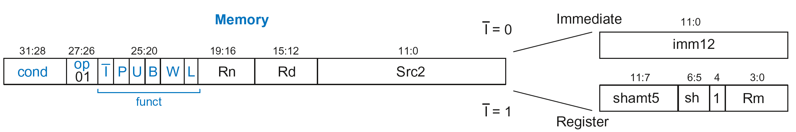
Memory Instruction Format
Encodes: LDR, STR, LDRB, STRB
op = 01₂
Rn = base register
Rd = destination (load), source (store)
Src2 = offset
funct = 6 control bits

Slide 184
Offset Options
Recall: Address = Base Address + Offset
Example: LDR R1, [R2, #4]
Base Address = R2, Offset = 4
Address = (R2 + 4)
Base address always in a register
The offset can be:
an immediate
a register
or a scaled (shifted) register

Slide 185
Offset Examples
ARM Assembly | Memory Address
LDR R0, [R3, #4] | R3 + 4
LDR R0, [R5, #-16] | R5 – 16
LDR R1, [R6, R7] | R6 + R7
LDR R2, [R8, -R9] | R8 – R9
LDR R3, [R10, R11, LSL #2] | R10 + (R11 << 2)
LDR R4, [R1, -R12, ASR #4] | R1 – (R12 >>> 4)
LDR R0, [R9] | R9

Slide 186
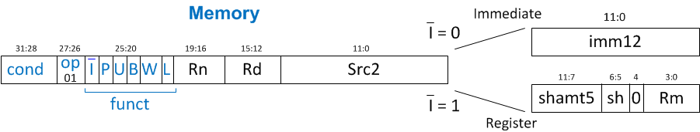
Memory Instruction Format
Encodes: LDR, STR, LDRB, STRB
op = 01₂
Rn = base register
Rd = destination (load), source (store)
Src2 = offset: register (optionally shifted) or immediate
funct = 6 control bits

Slide 187
Indexing Modes
Mode | Address | Base Reg. Update
Offset | Base register ± Offset | No change
Preindex | Base register ± Offset | Base register ± Offset
Postindex | Base register | Base register ± Offset
Examples
Offset: LDR R1, [R2, #4] ; R1 = mem[R2+4]
Preindex: LDR R3, [R5, #16]! ; R3 = mem[R5+16]
; R5 = R5 + 16
Postindex: LDR R8, [R1], #8 ; R8 = mem[R1]
; R1 = R1 + 8

Slide 188
Memory Instruction Format
funct:
I: Immediate bar
P: Preindex
U: Add
B: Byte
W: Writeback
L: Load

Slide 189
Memory Format funct Encodings
Type of Operation
L | B | Instruction
0 | 0 | STR
0 | 1 | STRB
1 | 0 | LDR
1 | 1 | LDRB

Slide 190
Memory Format funct Encodings
Type of Operation
Indexing Mode
L | B | Instruction
0 | 0 | STR
0 | 1 | STRB
1 | 0 | LDR
1 | 1 | LDRB
P | W | Indexing Mode
0 | 1 | Not supported
0 | 0 | Postindex
1 | 0 | Offset
1 | 1 | Preindex

Slide 191
Memory Format funct Encodings
Type of Operation
Indexing Mode
L | B | Instruction
0 | 0 | STR
0 | 1 | STRB
1 | 0 | LDR
1 | 1 | LDRB
P | W | Indexing Mode
0 | 1 | Not supported
0 | 0 | Postindex
1 | 0 | Offset
1 | 1 | Preindex
Add/Subtract Immediate/Register Offset
Value | I | U
0 | Immediate offset in Src2 | Subtract offset from base
1 | Register offset in Src2 | Add offset to base

Slide 192
Memory Instruction Format
Encodes: LDR, STR, LDRB, STRB
op = 01₂
Rn = base register
Rd = destination (load), source (store)
Src2 = offset: immediate or register (optionally shifted)
funct = I (immediate bar), P (preindex), U (add),
B (byte), W (writeback), L (load)

Slide 193
Memory Instr. with Immediate Src2
STR R11, [R5], #-26
Operation: mem[R5] <= R11; R5 = R5 - 26
cond = 1110₂ (14) for unconditional execution
op = 01₂ (1) for memory instruction
funct = 0000000₂ (0)
I = 0 (immediate offset), P = 0 (postindex),
U = 0 (subtract), B = 0 (store word), W = 0 (postindex),
L = 0 (store)
Rd = 11, Rn = 5, imm12 = 26

Slide 194
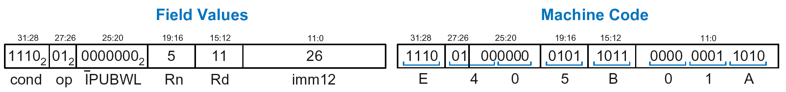
Memory Instr. with Immediate Src2
STR R11, [R5], #-26
Operation: mem[R5] <= R11; R5 = R5 - 26
cond = 1110₂ (14) for unconditional execution
op = 01₂ (1) for memory instruction
funct = 0000000₂ (0)
I = 0 (immediate offset), P = 0 (postindex),
U = 0 (subtract), B = 0 (store word), W = 0 (postindex),
L = 0 (store)
Rd = 11, Rn = 5, imm12 = 26

Slide 195
Memory Instr. with Register Src2
LDR R3, [R4, R5]
Operation: R3 <= mem[R4 + R5]
cond = 1110₂ (14) for unconditional execution
op = 01₂ (1) for memory instruction
funct = 111001₂ (57)
I = 1 (register offset), P = 1 (offset indexing),
U = 1 (add), B = 0 (load word), W = 0 (offset indexing),
L = 1 (load)
Rd = 3, Rn = 4, Rm = 5 (shamt5 = 0, sh = 0)
1110 01 111001 0100 0011 00000 00 0 0101 = 0xE7943005

Slide 196
Memory Instr. with Scaled Reg. Src2
STR R9, [R1, R3, LSL #2]
Operation: mem[R1 + (R3 << 2)] <= R9
cond = 1110₂ (14) for unconditional execution
op = 01₂ (1) for memory instruction
funct = 111000₂ (0)
I = 1 (register offset), P = 1 (offset indexing),
U = 1 (add), B = 0 (store word), W = 0 (offset indexing),
L = 0 (store)
Rd = 9, Rn = 1, Rm = 3, shamt = 2, sh = 00₂ (LSL)
1110 01 111000 0001 1001 00010 00 0 0011 = 0xE7819103

Slide 197
Review: Memory Instruction Format
Encodes: LDR, STR, LDRB, STRB
op = 01₂
Rn = base register
Rd = destination (load), source (store)
Src2 = offset: register (optionally shifted) or immediate
funct = I (immediate bar), P (preindex), U (add),
B (byte), W (writeback), L (load)

Slide 198
Instruction Formats
Data-processing
Memory
Branch

Slide 199
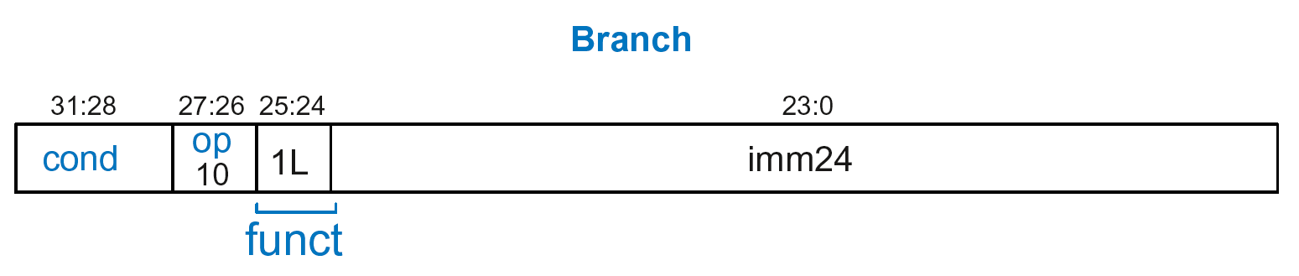
Branch Instruction Format
Encodes B and BL
op = 10₂
imm24: 24-bit immediate
funct = 1L₂: L = 1 for BL, L = 0 for B

Slide 200
Encoding Branch Target Address
Branch Target Address (BTA): Next PC when branch taken
BTA is relative to current PC + 8
imm24 encodes BTA
imm24 = # of words BTA is away from PC+8

Slide 201
Branch Instruction: Example 1
ARM assembly code
0xA0 BLT THERE
0xA4 ADD R0, R1, R2
0xA8 SUB R0, R0, R9
0xAC ADD SP, SP, #8
0xB0 MOV PC, LR
0xB4 THERE SUB R0, R0, #1
0xB8 BL TEST
PC
PC = 0xA0
PC + 8 = 0xA8
THERE label is 3 instructions past PC+8
So, imm24 = 3
PC+8
BTA

Slide 202
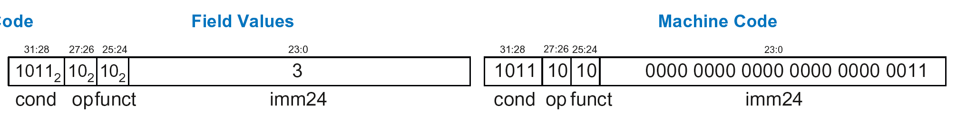
Branch Instruction: Example 1
ARM assembly code
0xA0 BLT THERE
0xA4 ADD R0, R1, R2
0xA8 SUB R0, R0, R9
0xAC ADD SP, SP, #8
0xB0 MOV PC, LR
0xB4 THERE SUB R0, R0, #1
0xB8 BL TEST
PC
PC = 0xA0
PC + 8 = 0xA8
THERE label is 3 instructions past PC+8
So, imm24 = 3
PC+8
BTA

Slide 203
Branch Instruction: Example 1
ARM assembly code
0xA0 BLT THERE
0xA4 ADD R0, R1, R2
0xA8 SUB R0, R0, R9
0xAC ADD SP, SP, #8
0xB0 MOV PC, LR
0xB4 THERE SUB R0, R0, #1
0xB8 BL TEST
PC
PC = 0xA0
PC + 8 = 0xA8
THERE label is 3 instructions past PC+8
So, imm24 = 3
PC+8
BTA
0xBA000003

Slide 204
Branch Instruction: Example 2
ARM assembly code
0x8040 TEST LDRB R5, [R0, R3]
0x8044 STRB R5, [R1, R3]
0x8048 ADD R3, R3, #1
0x8044 MOV PC, LR
0x8050 BL TEST
0x8054 LDR R3, [R1], #4
0x8058 SUB R4, R3, #9
BTA
PC = 0x8050
PC + 8 = 0x8058
TEST label is 6 instructions before PC+8
So, imm24 = -6
PC
PC+8

Slide 205
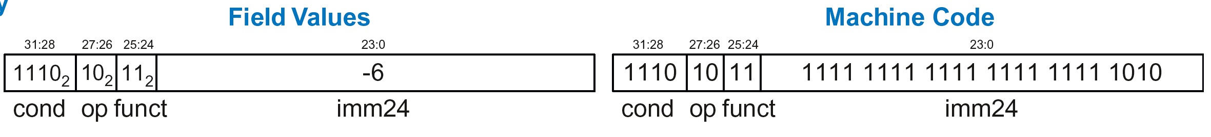
Branch Instruction: Example 2
ARM assembly code
0x8040 TEST LDRB R5, [R0, R3]
0x8044 STRB R5, [R1, R3]
0x8048 ADD R3, R3, #1
0x8044 MOV PC, LR
0x8050 BL TEST
0x8054 LDR R3, [R1], #4
0x8058 SUB R4, R3, #9
BTA
PC = 0x8050
PC + 8 = 0x8058
TEST label is 6 instructions before PC+8
So, imm24 = -6
PC
PC+8

Slide 206
Branch Instruction: Example 2
ARM assembly code
0x8040 TEST LDRB R5, [R0, R3]
0x8044 STRB R5, [R1, R3]
0x8048 ADD R3, R3, #1
0x8044 MOV PC, LR
0x8050 BL TEST
0x8054 LDR R3, [R1], #4
0x8058 SUB R4, R3, #9
BTA
PC = 0x8050
PC + 8 = 0x8058
TEST label is 6 instructions before PC+8
So, imm24 = -6
PC
PC+8
0xEBFFFFFA

Slide 207
Review: Instruction Formats

Slide 208
Conditional Execution
Encode in cond bits of machine instruction
For example,
ANDEQ R1, R2, R3 (cond = 0000)
ORRMI R4, R5, #0xF (cond = 0100)
SUBLT R9, R3, R8 (cond = 1011)

Slide 209
Review: Condition Mnemonics
cond | Mnemonic | Name | CondEx
0000 | EQ | Equal | $$Z$$
0001 | NE | Not equal | $$\overline{Z}$$
0010 | CS / HS | Carry set / Unsigned higher or same | $$C$$
0011 | CC / LO | Carry clear / Unsigned lower | $$\overline{C}$$
0100 | MI | Minus / Negative | $$N$$
0101 | PL | Plus / Positive of zero | $$\overline{N}$$
0110 | VS | Overflow / Overflow set | $$V$$
0111 | VC | No overflow / Overflow clear | $$\overline{V}$$
1000 | HI | Unsigned higher | $$\overline{Z}C$$
1001 | LS | Unsigned lower or same | $$Z OR \overline{C}$$
1010 | GE | Signed greater than or equal | $$\overline{N⊕V}$$
1011 | LT | Signed less than | $$N⊕V$$
1100 | GT | Signed greater than | $$\overline{Z}(\overline{N⊕V})$$
1101 | LE | Signed less than or equal | $$Z OR (N⊕V)$$
1110 | AL (or none) | Always / unconditional | ignored

Slide 210
Conditional Execution: Machine Code

Slide 211
Interpreting Machine Code
Start with op: tells how to parse rest
op = 00 (Data-processing)
op = 01 (Memory)
op = 10 (Branch)
I-bit: tells how to parse Src2
Data-processing instructions:
If I-bit is 0, bit 4 determines if Src2 is a register (bit 4 = 0) or a register-shifted register (bit 4 = 1)
Memory instructions:
Examine funct bits for indexing mode, instruction, and add or subtract offset

Slide 212
Interpreting Machine Code: Example 1
0xE0475001

Slide 213
Interpreting Machine Code: Example 1
0xE0475001
Start with op: 00₂, so data-processing instruction

Slide 214
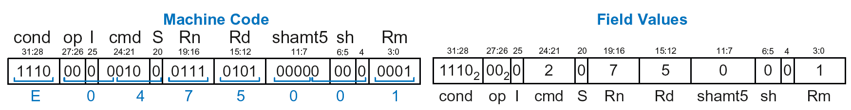
Interpreting Machine Code: Example 1
0xE0475001
Start with op: 00₂, so data-processing instruction
I-bit: 0, so Src2 is a register
bit 4: 0, so Src2 is a register (optionally shifted by shamt5)

Slide 215
Interpreting Machine Code: Example 1
0xE0475001
Start with op: 00₂, so data-processing instruction
I-bit: 0, so Src2 is a register
bit 4: 0, so Src2 is a register (optionally shifted by shamt5)
cmd: 0010₂ (2), so SUB
Rn=7, Rd=5, Rm=1, shamt5 = 0, sh = 0
So, instruction is: SUB R5,R7,R1

Slide 216
Interpreting Machine Code: Example 2
0xE5949010

Slide 217
Interpreting Machine Code: Example 2
0xE5949010
Start with op: 01₂, so memory instruction
funct: B=0, L=1, so LDR; P=1, W=0, so offset indexing;
I=0, so immediate offset, U=1, so add offset
Rn=4, Rd=9, imm12 = 16
So, instruction is: LDR R9,[R4,#16]

Slide 218
Addressing Modes
How do we address operands?
Register
Immediate
Base
PC-Relative

Slide 219
Addressing Modes
How do we address operands?
Register Only
Immediate
Base
PC-Relative

Slide 220
Register Addressing
Source and destination operands found in registers
Used by data-processing instructions
Three submodes:
Register-only
Immediate-shifted register
Register-shifted register

Slide 221
Register Addressing Examples
Register-only
Example: ADD R0, R2, R7
Immediate-shifted register
Example: ORR R5, R1, R3, LSL #1
Register-shifted register
Example: SUB R12, R9, R0, ASR R1

Slide 222
Addressing Modes
How do we address operands?
Register Only
Immediate
Base
PC-Relative

Slide 223
Immediate Addressing
Operands found in registers and immediates
Example: ADD R9, R1, #14
Uses data-processing format with I=1
Immediate is encoded as
8-bit immediate (imm8)
4-bit rotation (rot)
32-bit immediate = imm8 ROR (rot x 2)

Slide 224
Addressing Modes
How do we address operands?
Register Only
Immediate
Base
PC-Relative

Slide 225
Base Addressing
Address of operand is:
base register + offset
Offset can be a:
12-bit Immediate
Register
Immediate-shifted Register

Slide 226
Base Addressing Examples
Immediate offset
Example: LDR R0, [R8, #-11]
(R0 = mem[R8 - 11] )
Register offset
Example: LDR R1, [R7, R9]
(R1 = mem[R7 + R9] )
Immediate-shifted register offset
Example: STR R5, [R3, R2, LSL #4]
(R5 = mem[R3 + (R2 << 4)] )

Slide 227
Addressing Modes
How do we address operands?
Register Only
Immediate
Base
PC-Relative

Slide 228
PC-Relative Addressing
Used for branches
Branch instruction format:
Operands are PC and a signed 24-bit immediate (imm24)
Changes the PC
New PC is relative to the old PC
imm24 indicates the number of words away from PC+8
PC = (PC+8) + (SignExtended(imm24) x 4)

Slide 229
Power of the Stored Program
32-bit instructions & data stored in memory
Sequence of instructions: only difference between two applications
To run a new program:
No rewiring required
Simply store new program in memory
Program Execution:
Processor fetches (reads) instructions from memory in sequence
Processor performs the specified operation

Slide 230
The Stored Program
Program Counter (PC): keeps track of current instruction

Slide 231
Up Next
How to implement the ARM Instruction Set
Architecture in Hardware
Microarchitecture

