Slide 1

Matrix Algebra
SUBSPACES OF $ℝ^{n}$

Slide 2

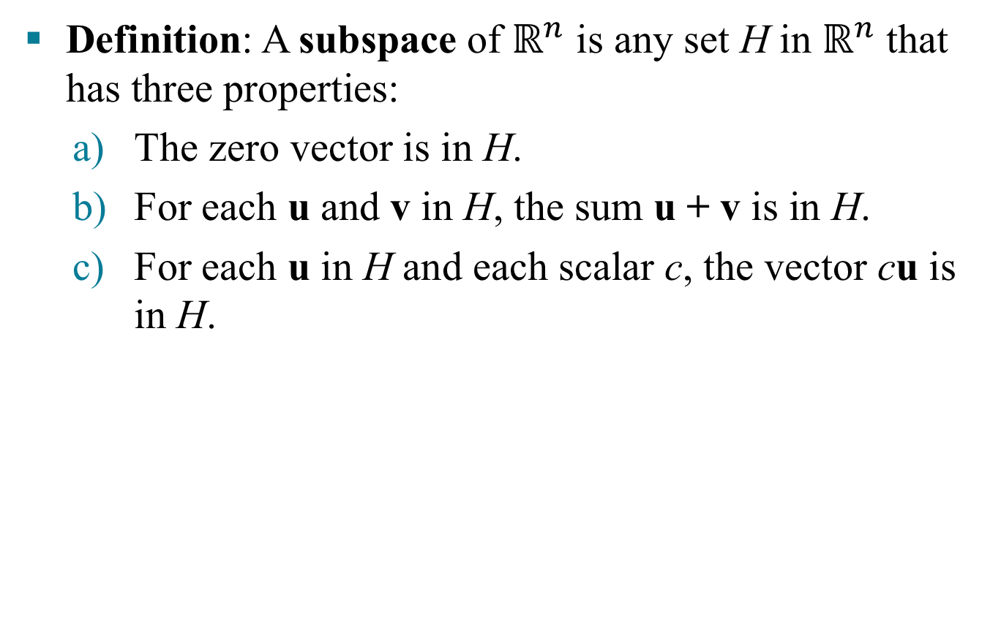
SUBSPACES OF $ℝ^{n}$
Definition: A subspace of $ℝ^{n}$ is any set H in $ℝ^{n}$ that has three properties:
The zero vector is in H.
For each u and v in H, the sum u + v is in H.
For each u in H and each scalar c, the vector cu is in H.

Slide 3
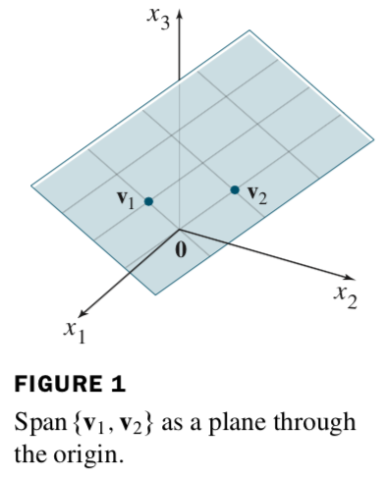
SUBSPACES OF $ℝ^{n}$
A plane through the origin is the standard way to visualize the subspace.

Slide 4
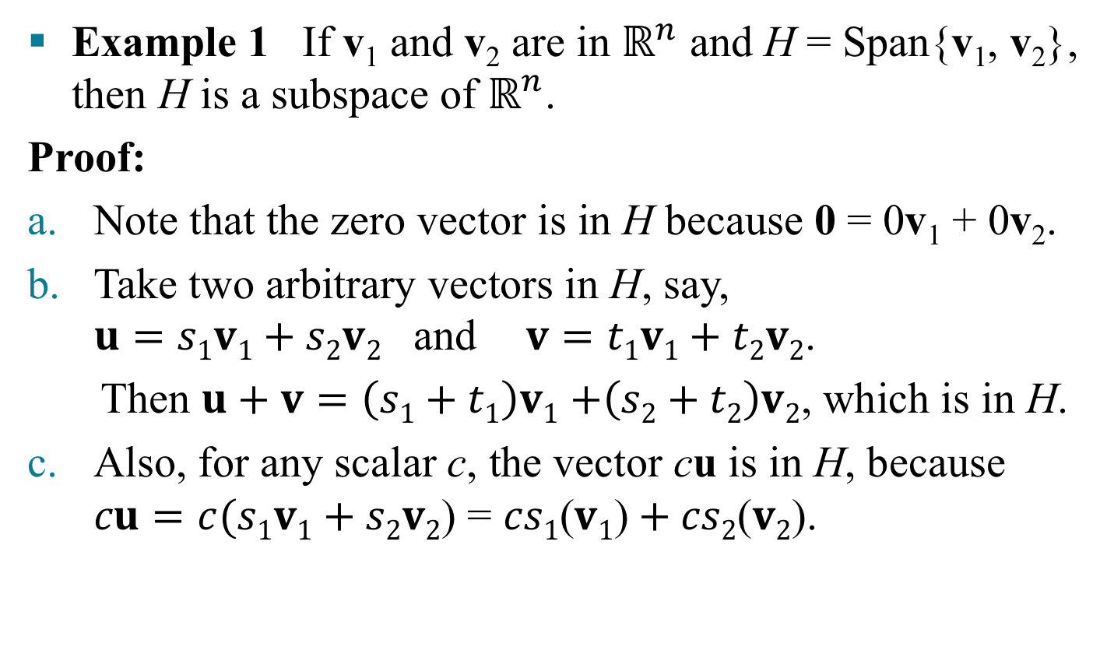
SUBSPACES OF $ℝ^{n}$
Example 1 If v₁ and v₂ are in $ℝ^{n}$ and H = Span{v₁, v₂}, then H is a subspace of $ℝ^{n}$.
Proof:
Note that the zero vector is in H because 0 = 0v₁ + 0v₂.
Take two arbitrary vectors in H, say, $u=s1v1+s2v2$ and$v=t1v1+t2v2$.
Then $u+v=\left(s1+t1\right)v1$ $+\left(s2+t2\right)v2$, which is in H.
Also, for any scalar c, the vector cu is in H, because $cu=c(s1v1+s2v2$) = $cs1\text{(}v1\text{)}+cs2\text{(}v2\text{)}$.

Slide 5
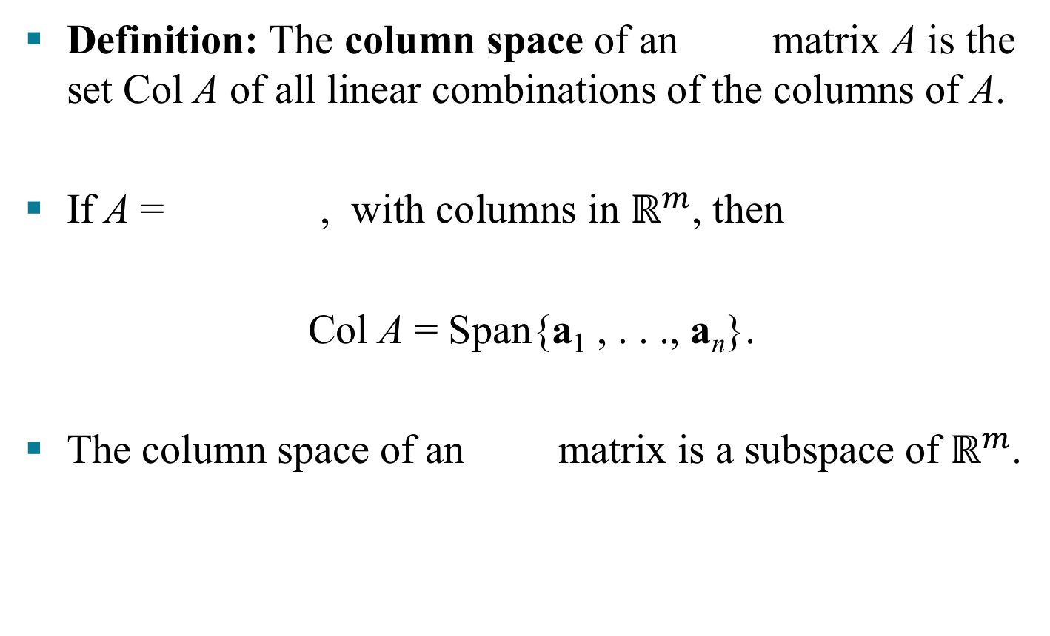
COLUMN SPACE AND NULL SPACE OF A MATRIX
Definition: The column space of an matrix A is the set Col A of all linear combinations of the columns of A.
If A = , with columns in $ℝ^{m}$, then
Col A = Span{a₁ , . . ., a_{n}}.
The column space of an matrix is a subspace of $ℝ^{m}$.

Slide 6
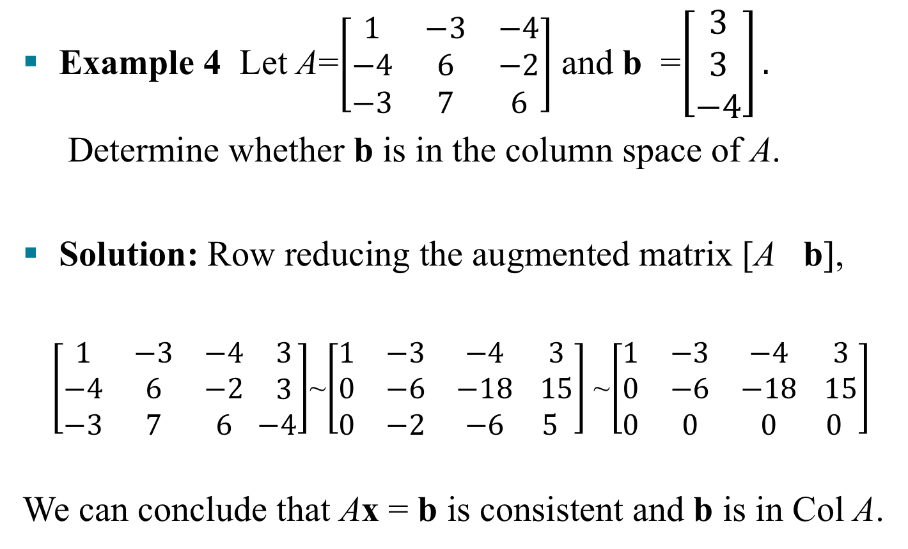
COLUMN SPACE AND NULL SPACE OF A MATRIX
Example 4 Let A=$\left[\begin{matrix}1 & −3 & −4 \\ −4 & 6 & −2 \\ −3 & 7 & 6\end{matrix}\right]$ and b =$\left[\begin{matrix}3 \\ 3 \\ −4\end{matrix}\right].$
Determine whether b is in the column space of A.
Solution: Row reducing the augmented matrix [A b],
$\left[\begin{matrix}1 & −3 & −4 \\ −4 & 6 & −2 \\ −3 & 7 & 6\end{matrix} \begin{matrix} 3 \\ 3 \\ −4\end{matrix}\right]$~$\left[\begin{matrix}1 & −3 & −4 \\ 0 & −6 & −18 \\ 0 & −2 & −6\end{matrix} \begin{matrix} 3 \\ 15 \\ 5\end{matrix}\right]$ ~$\left[\begin{matrix}1 & −3 & −4 \\ 0 & −6 & −18 \\ 0 & 0 & 0\end{matrix} \begin{matrix} 3 \\ 15 \\ 0\end{matrix}\right]$
We can conclude that Ax = b is consistent and b is in Col A.

Slide 7
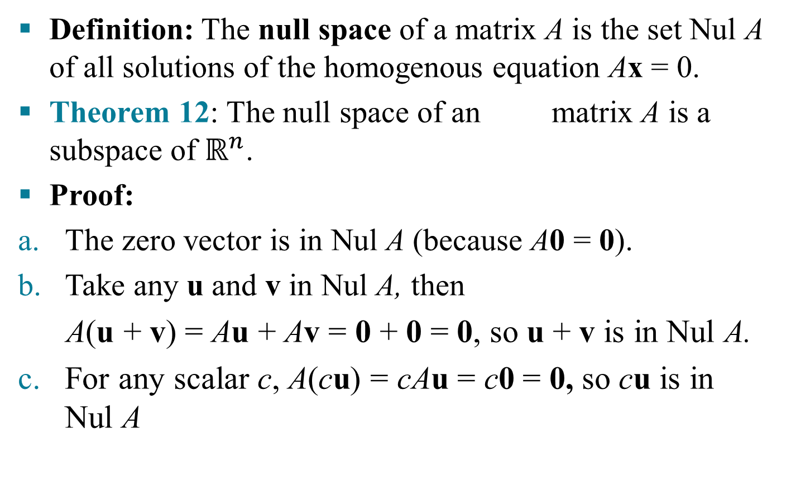
COLUMN SPACE AND NULL SPACE OF A MATRIX
Definition: The null space of a matrix A is the set Nul A of all solutions of the homogenous equation Ax = 0.
Theorem 12: The null space of an matrix A is a subspace of $ℝ^{n}$.
Proof:
The zero vector is in Nul A (because A0 = 0).
Take any u and v in Nul A, then
A(u + v) = Au + Av = 0 + 0 = 0, so u + v is in Nul A.
For any scalar c, A(cu) = cAu = c0 = 0, so cu is in Nul A

Slide 8
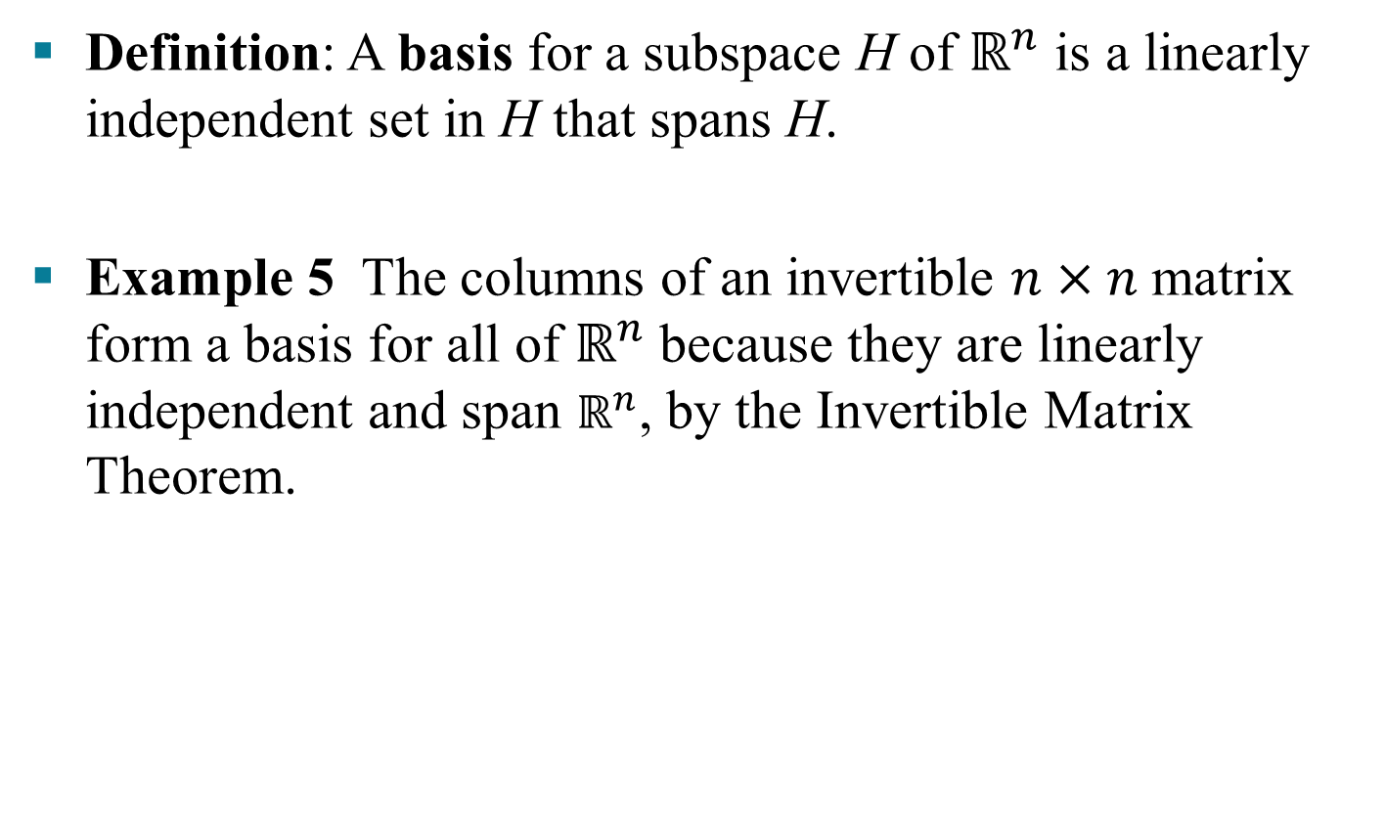
BASIS FOR A SUBSPACE
Definition: A basis for a subspace H of $ℝ^{n}$ is a linearly independent set in H that spans H.
Example 5 The columns of an invertible $n×n$matrix form a basis for all of $ℝ^{n}$because they are linearly independent and span $ℝ^{n}$, by the Invertible Matrix Theorem.

Slide 9
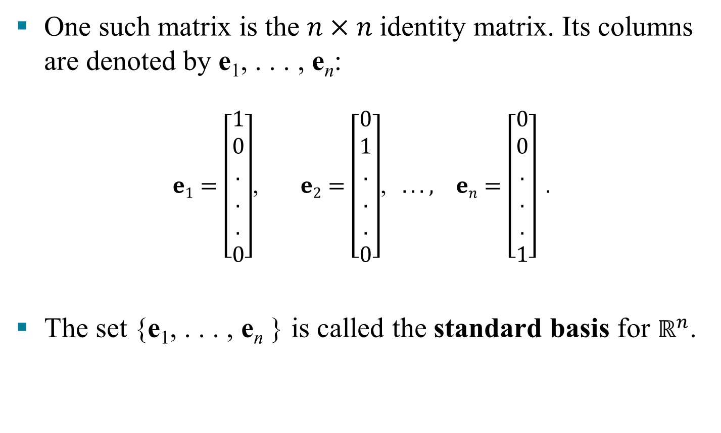
BASIS FOR A SUBSPACE
One such matrix is the $n×n$identity matrix. Its columns are denoted by e₁, . . . , e_{n}:
$e1=\left[\begin{aligned}1 \\ 0 \\ . \\ . \\ . \\ 0\end{aligned}\right]$, $e2=\left[\begin{aligned}0 \\ 1 \\ . \\ . \\ . \\ 0\end{aligned}\right]$, $. . . , en=\left[\begin{aligned}0 \\ 0 \\ . \\ . \\ . \\ 1\end{aligned}\right] .$
The set {e₁, . . . , e_{n} } is called the standard basis for $ℝ^{n}$.

Slide 10
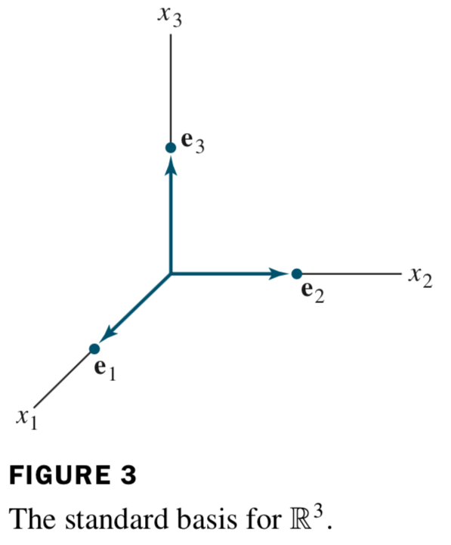
BASIS FOR A SUBSPACE

Slide 11
BASIS FOR A SUBSPACE
Theorem 13: The pivot columns of a matrix A form a basis for the column space of A.
Example
Basis for Col A = .
Basis for Nul A =

