Slide 1
MVP architectural pattern
MVC(Model View Controller)
M – Model
V – View
P – Presenter

Slide 2
Q
Do you need MVP in Android?
High cohesion low coupling
Easy test
Easy to expand
Increased code size

Slide 3
Using MVP
View to call the Presenter
Presenter use IView to control display

Slide 4
MVP invoke relationship
Decoupling is needed
Observer Pattern

Slide 5
Observer Pattern

Slide 6
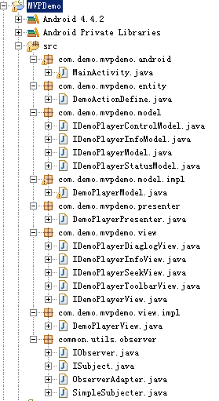
Practice

Slide 7
Model

Slide 8
View

Slide 9
MVP

