Slide 1
Forward LSTM cell
Deep RNN
Backward LSTM cell
Dense layer
Input

Slide 2
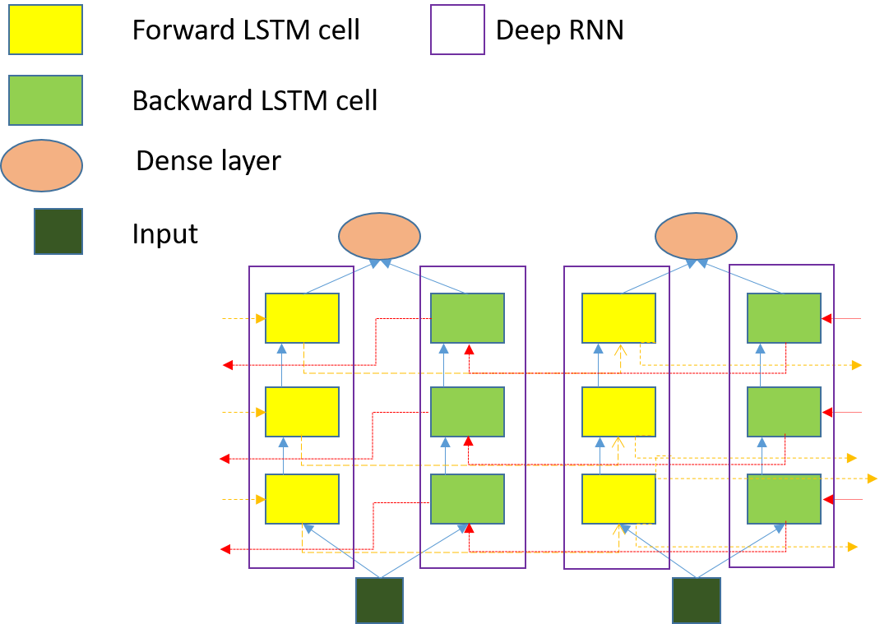

Slide 3
