Slide 1
Tutorial of libsvm
Yi-fan Liou
6/20/2021

Slide 2
Agenda
The basic concepts of machine learning
The basic of machine learning
Support vector machine
How to use libsvm
The diabetes
One-class SVM
implemetation

Slide 3
The pre-require
The basic concept for programing
Python would be good
The basic skill to manipulate computer
Not only use the GUI
If you hate GUI and love the command line would be good

Slide 4
About the speaker
Yi-Fan Liou
You can call me Mark as well
I am not a teacher… I don’t think I am qualified …
Ex-cofounders of many start-up team
Confounder of the Taipei Bioinformatics Omnibus (Facebook 社團，歡迎有興趣的人加入)
Specialist
Bioinformatics and Proteomics
I know you are not interested in …
But … if we only focus on machine learning and GPU using experience
Machine learning since 2009
CUDA programing since 2011
Finally
This is a casual course, please feel free to ask any questions. (我目前單身，先回答各位)
I am not always right. Tell me anything if I am wrong.
很重要所以打中文: 如果我詢問各位問題希望各位舉手時，我只是想了解目前各位的狀況，不會強迫各位發言(如果有人迫切想發言當然也不會阻止)

Slide 5
The Basic

Slide 6
Linear regression
Can you please google this?
Just kidding
y = Ax + b
0

Slide 7
Logistic regression – from statistic
Set: All the dependent variables are linear
continuous : least square errors
categorical : continuous with some errors
Y = a1x1 + a2x2 + …. + anxn + b
Ideally
Y = a1x1 + a2x2 + …. + anxn + b
Never forget : the least square assume the normal distribution
This concept make a straight line
prefer
Normal distribution
Extreme error would not
often happen
Not prefer
error

Slide 8
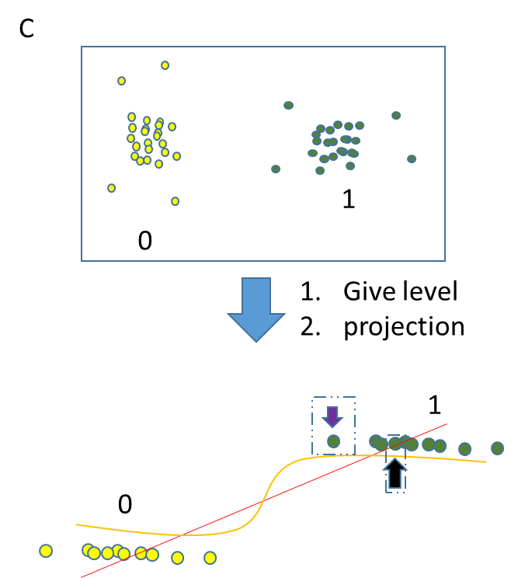
Logistic regression – from statistic
Set: All the dependent variables are linear
continuous : least square errors
categorical : continuous with some errors
Y = a1x1 + a2x2 + …. + anxn + b
Classification case
Y = a1x1 + a2x2 + …. + anxn + b
If you want to fit this line ….
This concept also make a straight line
It will be like this ….
NOT
Normal distribution
It is obviously : the errors between the line and data
won’t be normal distribution
1 or 0
error
That’s why the classification problem never use MSE as loss
( you can use MSE, but it will make a tragedy )
feature

Slide 9
Bias in categories
A
C
1
0
Give level
projection
B
1
0

Slide 10
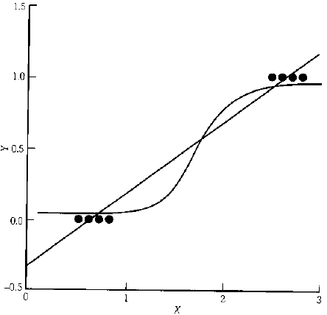
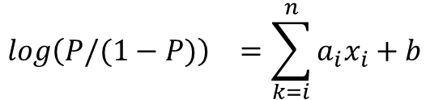
Logistic regression – from statistic
Regularly, the upper bond and lower bond is from 0~1
Why not use “ratio”?
$${log\left(P/(1−P)\right)}^{}=\sum_{k=i}^{n}{a_{i}x_{i}+b}$$
case
Control
(total samples except the cases)
Odds ratio
According to “maximum likelihood”, using the optimization method can get the odds ratio
http://janda.org/workshop/Discriminant%20analysis/Talk/talk01.htm
Newton
Gradient decent

Slide 11
Basic Terms of machine learning

Slide 12
Loss
The basic concept of machine learning is to estimate the probability of the dataset.
We use the probability to predict the unknown ones.
This term, loss, give the information of how far between the estimated probability and real probability
estimated
real
In category classification task, we usually use “cross entropy” to estimate the difference between the distributions.
loss

Slide 13
Estimating the training
The training strategies are simply discussed with two domain
For “weights” – calculate the loss for directly updating model
Batch
Epoch
For “hyerparamters” – calculating the loss for estimating the performance
Validation
Corss validation
N-fold
Leave one out
Holeout validation

Slide 14
Updating the weights – whole dataset
Dataset
Model
feed
loss
This is most intuiting method for updating the weights
feedback

Slide 15
Updating the weights – original stochastic method
Updating the model using whole dataset cause the “overfitting” issue
Dataset
Feed only one data
Model
loss
Updating the model using one-by-one data prevent the overfitting
feedback

Slide 16
Updating the weights – stochastic mini-batch method
Updating the model using stochastic method would be influence by the noise.
Dataset
Feed several data
Model
loss
This method can slightly prevent overfitting and efficiently use the memory
This method becomes a “classical” in training model
feedback

Slide 17
Batch? Epoch?
The dataset will feed into the model.
The model will be train again and again
Dataset
Mini
batch
Feed several data
Model
loss
If you train the model using the mini-batch method and the dataset is limited, one day you will train the model with whole dataset. Then, you reuse the dataset to train again.
One cycle mean one epoch
feedback

Slide 18
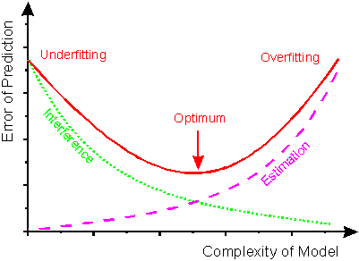
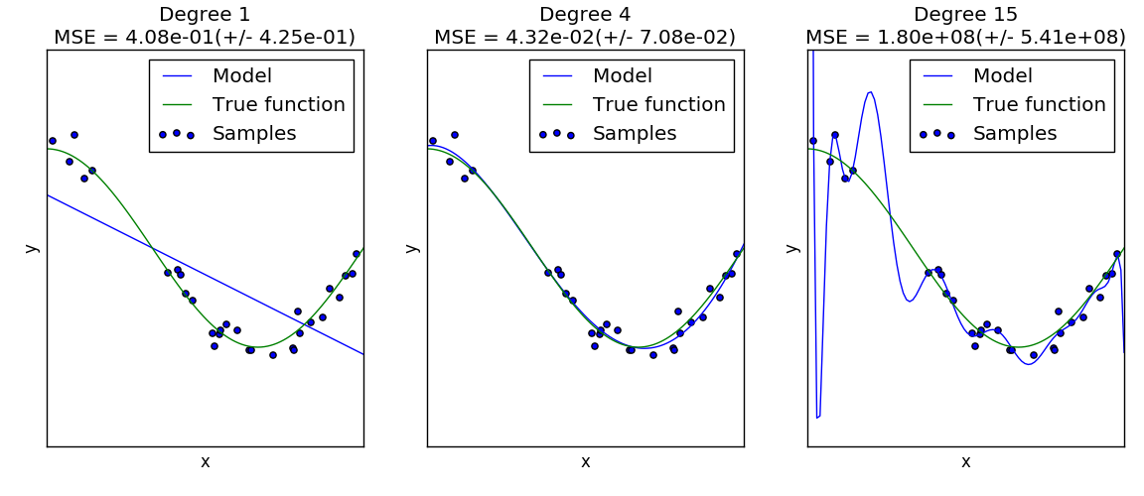
The classic overfitting issue
http://lijiancheng0614.github.io/scikit-learn/auto_examples/model_selection/plot_underfitting_overfitting.html
http://www.frank-dieterle.de/phd/images/image024.gif

Slide 19
Training, Test, Validation
Training
Test
Validation
Why validation?
Test dataset
Depending on the dataset resources
????
Train Dataset
Validation

Slide 20
More about validations
holdout validation
Most use in modern model, especially with “early-stopping”
Cross-validation
Leave-one-out cross validation
K-fold cross validation
Train Dataset
Validation

Slide 21
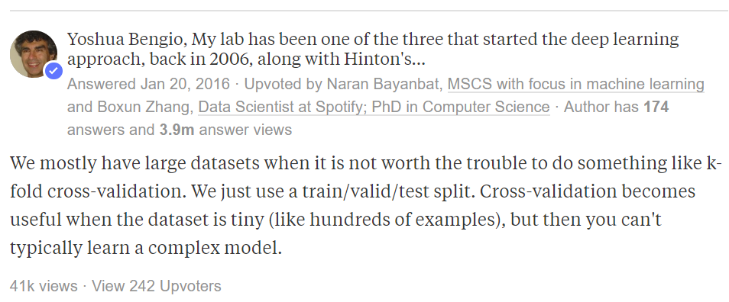
Cross validation in deep learning ?
https://www.quora.com/Is-cross-validation-heavily-used-in-deep-learning-or-is-it-too-expensive-to-be-used

Slide 22

Support vector machine (SVM)
The concept of SVM
To classify a data, the only thing we need to do is “define a decision boundary”
在機器學習領域中，最困難的問題就是定義”決策邊界”(decision boundary)
Support Vector Machine (SVM) 有個簡單假設:
不同群體的資料應可透過維度轉換找到同類別為群聚的角度
不同群體間資料可以透過一個平面將其區分開
DEMO time
Decision boundary
如果要定義出decision boundary，只需要找出位在邊界的幾個點。這些點稱呼為支援向量(support vectors)。

Slide 23
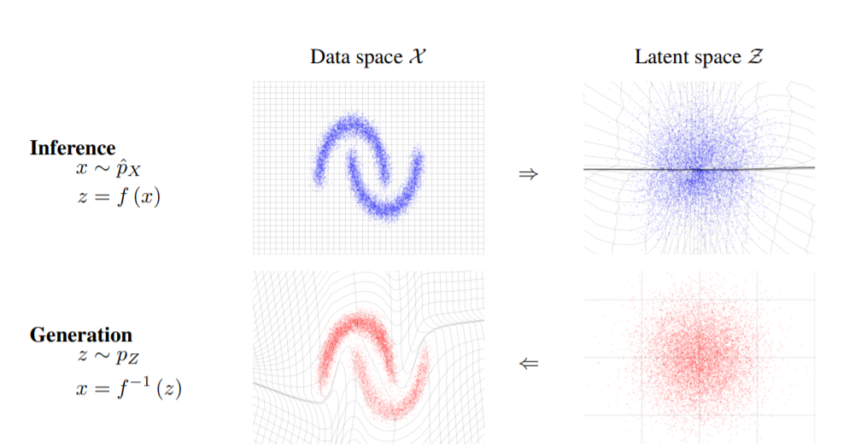
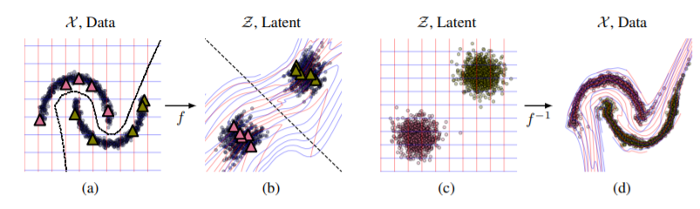
Why kernel trick?
https://arxiv.org/pdf/1605.08803.pdf
如果今天透過”線性模型“只能描述”直線”，那透過扭曲空間(也就是把資料點投射到特殊空間中)再用”一條線”來分割，這條線經過還原後就變成一條扭曲的線
類神經網路尤其是深度學習可以視為就是製作出這類型的扭曲線。
https://arxiv.org/pdf/1912.13025.pdf

Slide 24
The essential tuning hyperparameters
SVM主要可分為兩大分支
SVC – support vector classifier
SVR – support vector regression
本次主要以SVC為主要講解對象
以RBF kernel SVC來看(RBF也是最常用的kernel)，有兩個可以調整的數值，分別為C與Gamma。
調整這兩個數值就同等于調整decision boundary的軟硬
可以當成要調整一台腳踏車合適的齒輪比時，例如我想把車子調整為合適公路賽這種高速車，就可以把前齒輪調大或是把後齒輪調小。兩邊同時調整就能有機會調整出更合適在目前題目的樣子。

Slide 25
The standard flowchart of SVM
svm-train
Training dataset
Cross validation for hyperparameter tuning
Training dataset
dataset
normalization
grid.py
Normalization recorders
model
Test dataset
Test dataset
svm-predict
normalization
prediction
svm-scale
Libsvm source code :
https://github.com/cjlin1/libsvm

