Slide 1

Applied Stats II Replication Unconditional Support for Trump’s Resistance Prior to Election Day. Alexandra Haver, New York University School of Law, USA. Brendan Hartnett, Tufts University, USA. https://doi.org/10.7910/DVN/YNUE8B, Harvard Dataverse, V1
Mark Likeman

Slide 2
Background and Data:
Amid the uncertainty preceding the election, the authors conducted a survey experiment in October 2020 to examine the extent to which Trump’s voters would support him if he lost the election but refused to concede.
The authors explored the question: Would a higher popular vote margin of victory for Biden increase the acceptance of his Electoral College victory among Trump voters?
If support for resistance was unrelated to the popular vote margins, this could indicate that the legitimacy of the election and its victor were determined before the vote itself.
Methods and Data
The authors of this study explored their research questions in an online survey to 1,028 American adult respondents between October 24 and October 25, 2020.
Post-stratification weights were applied to make the survey nationally representative of American adults.
Respondents were asked if they intended to vote in the 2020 election. Those who had voted for Trump, planned to vote or leaned towards voting for Trump were categorized as Trump voters (n=510).
The survey examined the rationale guiding those who would support Trump’s resistance of the results, and respondents were asked to explain their motivations.

Slide 3
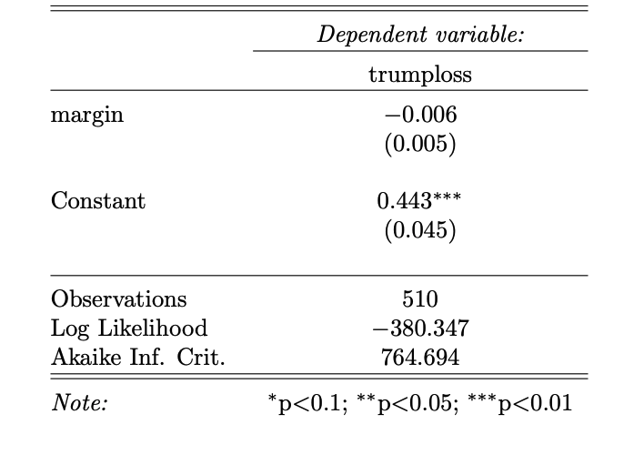

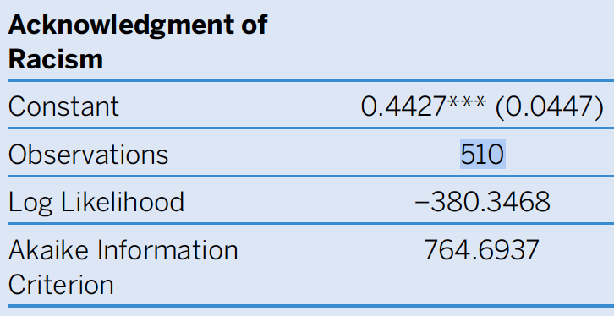
Dependent Variable:
‘trumploss’
# concede defeat
dat$trumploss[dat$trumplose==2] <- 0
# resist results of the election
dat$trumploss[dat$trumplose==1] <- 1
This model tested whether the randomly assigned popular-vote margin treatment affected likely Trump voter’s support for this resistance. The ‘margin’ -0.006 is the regression coefficient. Negative coefficient showing there is a negative relationship between ‘margin’ and ‘trumploss’ the variable that is being predicted. It provides the expected change in the dependent variable ‘trumploss’ for a one-unit decrease in the independent variable ‘margin’.
‘trumploss’ is the main one being looked at, and the others were potential confounders. ‘Acknowledgement of racism’ is a possible confounder, as it could influence both the dependent and independent variables.

Slide 4
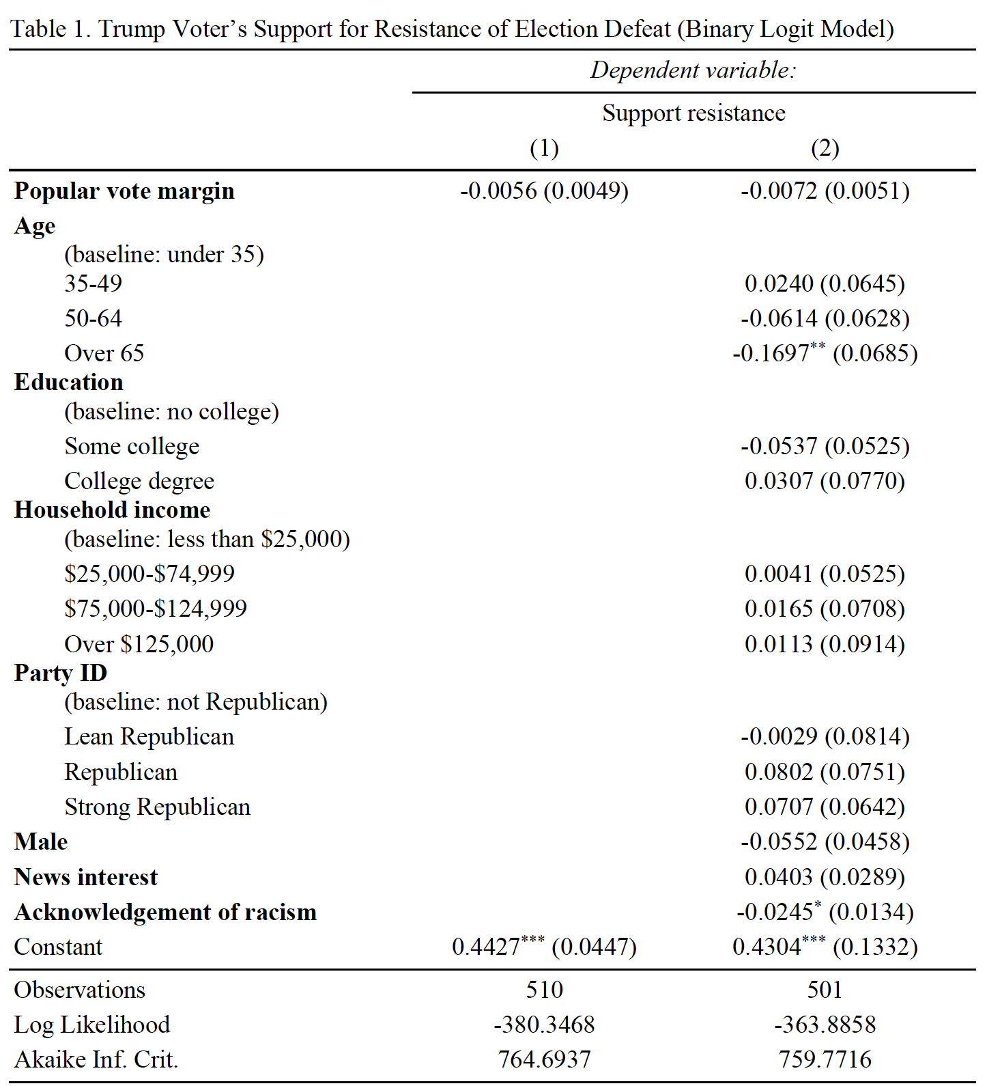
Dependent Variables:
‘Support resistance’ as shown in Table 1. is the main dependent variable.
This was recoded in the R file as:
dat$trumploss[dat$trumplose==2] <- 0 # concede defeat
dat$trumploss[dat$trumplose==1] <- 1 # resists result of the election
table(dat$trumploss)
Conceding defeat was related to ‘Biden’s popular vote margin’ variable.
Resisting the results of the election were related to the continuous variables; age, education, household income, party ID, and included news interest and racism.

Slide 5
Model 1
The code model1 <- glm(trumploss ~ margin, data=dat, weights=nationalweight) in R is fitting a generalized linear model with a binary outcome variable trumploss and a continuous predictor variable margin. The weight variable nationalweight is included to account for the sampling design and to adjust for any potential biases in the estimates.
The estimated slope is -0.0426, which represents the change in the expected value of ‘trumploss’ for each unit increase in margin.
Overall, the output suggests that there is a significant negative linear relationship between ‘margin’ and ‘trumploss’. This means that as the margin between Biden and Trump increases, the probability that a Trump voter believes that he should resist the election results decreases. The p-value for the slope coefficient is less than 0.001, indicating strong evidence against the null hypothesis of no relationship between margin and trumploss
# Model 1: Test for Trump margin significance using logit model
model1 <- glm(trumploss~margin, data=dat, weights=nationalweight)
Coefficients:
Estimate Std. Error t value Pr(>|t|)
(Intercept) 0.442669 0.044679 9.908 <2e-16 ***
margin -0.005614 0.004942 -1.136 0.256
‘weight’ could have been coded another way
weights <- dat$nationalweight
model <- glm(trumploss ~ margin, data = dat, weights = weights)
MY INERACTION
mylogit <- glm(trumploss ~ margin, data = dat, family = "binomial")
Coefficients:
Estimate Std. Error z value Pr(>|z|)
(Intercept) -0.26801 0.18285 -1.466 0.143
margin -0.01761 0.02045 -0.861 0.389

Slide 6
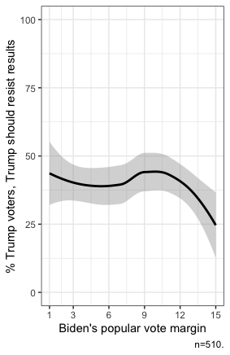
Independent Variable:
This plot has a smoothed line that shows the relationship between two variables: margin, which represents Biden's popular vote margin, and trumploss, which is a binary variable indicating whether Trump should resist the election results. The plot also includes a weight variable nationalweight which adjusts for sampling bias. The black line in the plot is a smoothed line that represents the estimated relationship between margin and trumploss.
The plot shows that as the margin between Biden and Trump increases, the percentage of Trump voters who believe that Trump should resist the election results decreases. At a margin of 1, almost all Trump voters believe that he should resist the results, while at a margin of 15, the percentage drops to almost 0%.
Overall, the plot suggests that there is a strong negative relationship between margin and trumploss, indicating that the wider Biden's margin of victory, the less likely Trump supporters are to believe that he should resist the election results.
Plot shows Trump resist vs Pop Vote Margin.
Loess graph using x ~ y formula. Independent/Explanatory variable (x) and Dependent/Response variable (y).

Slide 7
Model 2
This is Generalized Linear Model (GLM) in R, with the dependent variable 'trumploss' and several predictor variables.
The 'weights=nationalweight' argument specifies that the model should take into account the sample weights provided in the 'nationalweight' variable when fitting the model. These weights adjust for the fact that the sample may not be representative of the population.
The model attempts to predict whether Trump lost or won in a given location based on the values of the predictor variables. The coefficients of the model indicate how strongly each variable predicts a Trump loss, holding the other variables constant. The 'factor()' function indicates that categorical variables have been treated as factors, and the GLM uses dummy variable coding to represent these categories in the model.
In summary, the code fits a binomial GLM in R to predict the outcome of the 2020 presidential election for different locations, based on various demographic and political factors.
### Model 2: Test for Trump margin significance using logit model and demographics ####
model2 <- glm(trumploss ~ margin + factor(agecat) + factor(education3) + factor(hhinc)
+ factor(partyid) + factor(gen) + newsinterest + ackracism,
data=dat, weights=nationalweight)
model2
summary(model2)
Deviance Residuals:
Min 1Q Median 3Q Max
-0.7659 -0.3785 -0.2551 0.4799 1.0526
Coefficients:
Estimate Std. Error t value Pr(>|t|)
(Intercept) 0.430395 0.133155 3.232 0.00131 **
margin -0.007243 0.005087 -1.424 0.15510
factor(agecat)35-49 0.023986 0.064523 0.372 0.71025
factor(agecat)50-64 -0.061435 0.062815 -0.978 0.32854
factor(agecat)65 and over -0.169745 0.068533 -2.477 0.01360 *
factor(education3)Some college -0.053741 0.052515 -1.023 0.30665
factor(education3)College degree 0.030719 0.076981 0.399 0.69003
factor(hhinc)$25,000-$74,999 0.004097 0.052543 0.078 0.93789
factor(hhinc)$75,000-$124,999 0.016490 0.070797 0.233 0.81593
factor(hhinc)Over $125,000 0.011344 0.091440 0.124 0.90132
factor(partyid)Lean Republican -0.002943 0.081371 -0.036 0.97116
factor(partyid)Republican 0.080158 0.075104 1.067 0.28637
factor(partyid)Strong Republican 0.070735 0.064211 1.102 0.27118
factor(gen)Male -0.055235 0.045804 -1.206 0.22845
newsinterest 0.040299 0.028936 1.393 0.16435
ackracism -0.024516 0.013396 -1.830 0.06784 .

Slide 8
Hypothesis:
H1 – Misinformation about voter fraud
H2 – Illiberal political motivations to overturn the elections results.
My focus is on H2. Related to Model 2.
Models used in the study:
Model 1 – this tested whether the randomly assigned popular-vote margin treatment affected likely Trump voters’ support for his resistance.
Understanding Resistance
The authors of the study hypothesized that there would be two motivations for Trump voters to support him if he attempted to undermine the legitimacy of the 2020 presidential election:
- Misinformation about voter fraud.
- Illiberal political motivations to overturn the election results.
The authors conducted two logit regression analysis using generalized linear models.
Their model also also used partisanship (adherence to a political party) as a measure of alignment with Trump’s policy.

Slide 9
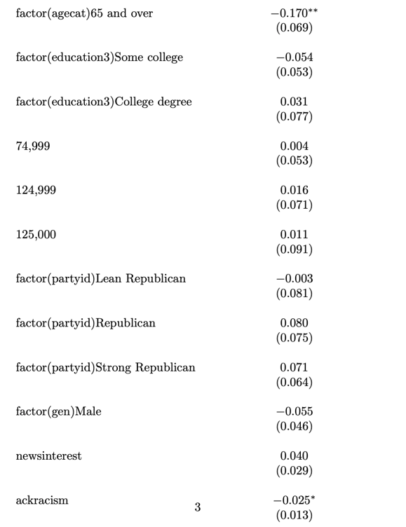
H2 – Illiberal political motivations to overturn the elections results.
Model 2 – Analysed how the demographics of respondents were associated with their support for Trump’s resistance. The model also tested the extent to which news interest and acknowledgement of racism impacted their support for resistance.
The ‘Over 65’ is a negative coefficient -0.1697 and not significant. ‘News Interest’ is positive coefficient 0.0403 which is favorable because it indicates a positive relationship between the variables involved.
My Model binomial GLM with a logit link as follows
Then I used a Confidence Interval with confint() function. The confidence for both the intercept and ‘newsinterest2’ contain zero, which means we cannot reject the null hypothesis that these parameters are equal to zero. Therefore, cannot say with confidence that either of them is statistically significant at the 95% level of confidence.
### Model 2: Test for Trump margin significance using logit model and demographics ####
model2 <- glm(trumploss ~ margin + factor(agecat) + factor(education3) + factor(hhinc)
+ factor(partyid) + factor(gen) + newsinterest + ackracism,
data=dat, weights=nationalweight)
> summary(mylogit)
Call:
glm(formula = trumploss ~ newsinterest, family = binomial(link = "logit"),
data = dat)
Deviance Residuals:
Min 1Q Median 3Q Max
-1.0652 -1.0652 -0.9673 1.2939 1.4671
Coefficients:
Estimate Std. Error z value Pr(>|z|)
(Intercept) -0.62861 0.43780 -1.436 0.151
newsinterest2 -0.03064 0.54112 -0.057 0.955
newsinterest3 0.11192 0.46384 0.241 0.809
newsinterest4 0.35878 0.45527 0.788 0.431
dat$newsinterest <- factor(dat$newsinterest)
mylogit <- glm(trumploss ~ newsinterest, data = dat, family = binomial(link="logit"))
> confint(mylogit)
Waiting for profiling to be done...
2.5 % 97.5 %
(Intercept) -1.5383792 0.2050683
newsinterest2 -1.0828917 1.0579522
newsinterest3 -0.7753891 1.0666294
newsinterest4 -0.5107110 1.2987556

Slide 10
H2 – Illiberal political motivations to overturn the elections results (cont.).
The findings from the survey stated that:
No significant relationship was discovered between respondents’ interest in news and current events, nor their acknowledgement of racism, on supporting Trump’s resistance.
The output of the code I have provided is from the summary of a logistic regression model ‘mylogit’ that relates the binary response variable ‘trumploss’ to the predictor variable ‘newsinterest’ at different levels. The Coefficients section shows the estimated regression coefficients for the intercept and each level of newsinterest. The Estimate column shows the estimated coefficient for each variable. For example, the estimated coefficient for ‘newsinterest2’ is -0.03064, which means that increasing the level of newsinterest from 1 to 2 is associated with a decrease in the log-odds of trumploss by 0.03064.
My Model binomial GLM with a logit link:
dat$newsinterest <- factor(dat$newsinterest)
mylogit <- glm(trumploss ~ newsinterest, data = dat, family = binomial(link="logit"))
glm(formula = trumploss ~ newsinterest, family = binomial(link = "logit"), data = dat)
Deviance Residuals:
Min 1Q Median 3Q Max
-1.0652 -1.0652 -0.9673 1.2939 1.4671
Coefficients:
Estimate Std. Error z value Pr(>|z|)
(Intercept) -0.62861 0.43780 -1.436 0.151
newsinterest2 -0.03064 0.54112 -0.057 0.955
newsinterest3 0.11192 0.46384 0.241 0.809
newsinterest4 0.35878 0.45527 0.788 0.431
In this example, the coefficients for all levels of newsinterest are not statistically significant at the 5% level since their p-values are greater than 0.05, which means we cannot reject the null hypothesis that these coefficients are equal to zero. Therefore, we cannot say with confidence that any level of newsinterest is associated with a significant change in the odds of trumploss.

Slide 11
H2 – Illiberal political motivations to overturn the elections results.
The results in this study indicated that the insurrection on January 6, 2021, was not a surprise, but a manifestation of an illiberal and contentious culture surrounding the 2020 Presidential Election fostered by Trump’s divisive rhetoric and misinformation campaign.
My Interaction:
Interpretation of the model: That ‘newsinterest2’ and ‘newsinterest3’ are statistically significant and significant predictors to ‘trumploss’ or that “Trump should resist the results of the election through measures such as discrediting the results as invalid..” (p=0.937,p=0.828)
dat$newsinterest <- factor(dat$newsinterest)
mylogit <- glm(trumploss ~ margin + newsinterest, data = dat, family = "binomial")
> summary(mylogit)
Call:
glm(formula = trumploss ~ margin + newsinterest, family = "binomial",
data = dat)
Deviance Residuals:
Min 1Q Median 3Q Max
-1.1066 -1.0294 -0.9342 1.3108 1.5090
Coefficients:
Estimate Std. Error z value Pr(>|z|)
(Intercept) -0.49254 0.47344 -1.040 0.298
margin -0.01550 0.02057 -0.753 0.451
newsinterest2 -0.04280 0.54167 -0.079 0.937
newsinterest3 0.10067 0.46433 0.217 0.828
newsinterest4 0.33929 0.45623 0.744 0.457
#Recode News interest
#so that higher values indicate more interest in the news
dat$newsinterest <- NA
dat$newsinterest[dat$newsint==1] <- 4
dat$newsinterest[dat$newsint==2] <- 3
dat$newsinterest[dat$newsint==3] <- 2
dat$newsinterest[dat$newsint==4] <- 1
#Descriptive table of news interest
table(dat$newsinterest)

Slide 12
Interpretation of ANOVA
This shows the results of an analysis of variance (ANOVA) table for the model with 'trumploss' as the dependent variable and 'margin' as the only predictor. The table provides information on the sum of squares, mean squares, F-value, and p-value for each variable in the model.
The 'F value' column shows the F-statistic, which is a ratio of the variance explained by the model (the mean square for the predictor variable) to the residual variance (the mean square for the residuals). In this case, the F-value is 0.74, indicating that the predictor variable ('margin') is not a significant predictor of 'trumploss', as the F-value is less than 1.
The 'Pr(>F)' column shows the p-value associated with the F-value. In this case, the p-value is 0.39, which is greater than the conventional threshold of 0.05. This suggests that there is no significant relationship between 'margin' and 'trumploss', as the p-value is not less than the threshold.
Overall, this ANOVA table suggests that 'margin' does not have a significant impact on 'trumploss'.
Added an ANOVA test for an interaction
# Interpetation of Anova
# the margin variable has a low sum of squares and a high P-Val which means there is not much variation that can
# be explained by the interaction between trumploss and margin.
interaction <- aov(trumploss ~ margin, data = dat)
Df Sum Sq Mean Sq F value Pr(>F)
margin 1 0.18 0.1781 0.74 0.39
Residuals 508 122.22 0.2406

Slide 13
Final Thoughts:
40% of Trump voters in this study stated that Trump should resist the election results even in a scenario in which Biden won by a large popular-vote margin, the precedent of a peaceful transfer of power in American elections was shaken even before the election.
It appears that not even misinformation pertaining to voter fraud and the use of mail-in ballots cannot explain away all support for Trump’s resistance, and that partisanship and negative partisanship also prompted voters to disregard the democratic electoral process entirely to support their preferred candidate in his quest for office by any means possible.
The authors of the study undertook an experiment with randomized hypothetical popular vote margins to test if support for resistance is contingent upon the results of the election itself. It seemed that Trump voters simply did not care for the election itself but wanted Trump in power no matter what. Misinformation in the 2020 election campaign was in full force, with Trump telling his followers that the only way he could lose would be through voter fraud.
However, it was Biden who won the popular vote and the Electoral College. Biden accepted the result, without any illiberal political motivations or partisan motivations.
Illiberal political motivations to overturn the elections results.
The term "illiberal" is often used to describe political movements or leaders that are perceived as anti-democratic, intolerant, and/or authoritarian in their approach to governance and policy.
This is arguably the main reason that not only explains Trump’s refusal to accept defeat or his resistance to election results but his continuance to espouse “the Big Lie”. According to the authors of this study, Trump voters bought into this, and was ultimately credited with inspiring the January 6th Capitol insurrection.

