Slide 1
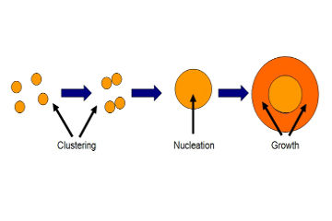
Visualization of Nucleation
A simple simulation of the Nucleation process for the purpose of visualizing how it works

Slide 2


Introduction
Mark Watson
PhD Candidate at UCCS
Lead Software Developer at Polaris Alpha

Slide 3
Visualization of Nucleation Simulation
What happens when a gaseous material begins to deposit on a substrate?
How do pressure and temperature affect the process?
What does it Look like?
https://github.com/marklwatson/nucleation

Slide 4
What it Is
A simple simulation written in 2D visualization software
Meant to provide a sense of what the surface of a substrate might look like while nucleation is occurring
Something you might see on a “Physics is Cool!” website

Slide 5
What it isn’t
Not a publishable study
Not meant to provide accurate simulation data to be tested against experimental data
Does not demonstrate differences between choices of substrates of film material. Typical values were used to determine calculations.

Slide 6
Tech
Written in HTML, Javascript and Paper.js
Paper.js is a javascript library using vector graphics for rendering 2D graphics on the web through a browser
Paper.js is completely open source and used for a variety of different purposes
http://paperjs.org/

Slide 7
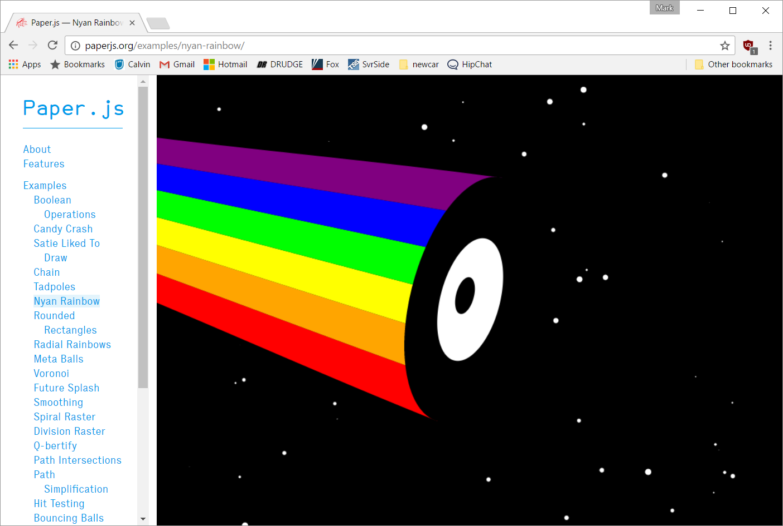

Slide 8
Limitations
Spatial Resolution—The smallest achievable spatial resolution is 1 pixel
Temporal Resolution—The smallest increment of time is 1/60th of a second, but it is not guaranteed.
Coordinates—The pixels are arranged in rows and columns, so radial coordinates are more difficult

Slide 9
Inputs
Temperature
Pressure
Critical Size of the Cluster

Slide 10
Software Design: Objects
Molecule/Atom
Cluster
r
2 pixels
R
Substrate

Slide 11
Software Design: Flow
Critical Size?
Desorb
Deposit
Move
Combine on Collisions
Yes
Start
End
No

Slide 12
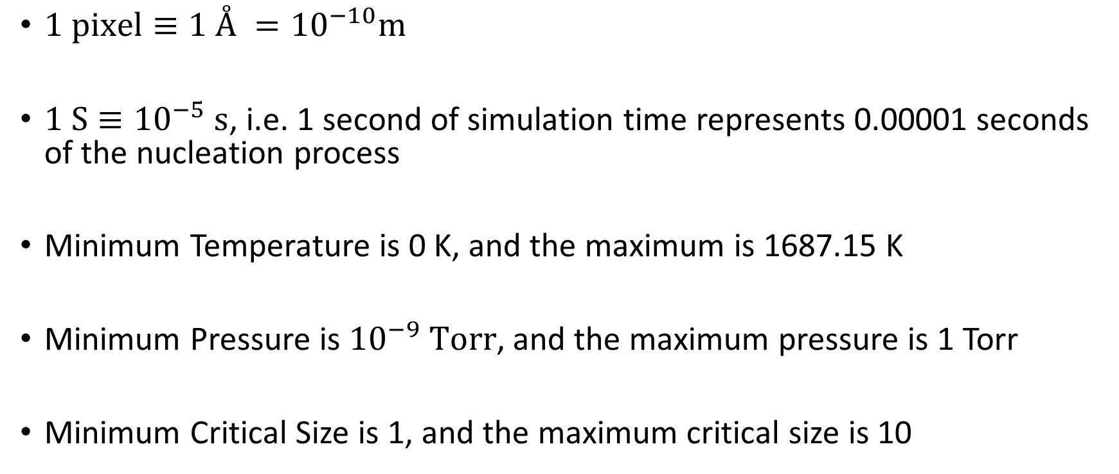
Metrics
$1 pixel≡1 Å ={10}^{−10}m$
$1 S≡{10}^{−5} s$, i.e. 1 second of simulation time represents 0.00001 seconds of the nucleation process
Minimum Temperature is 0 K, and the maximum is 1687.15 K
Minimum Pressure is ${10}^{−9} Torr$, and the maximum pressure is 1 Torr
Minimum Critical Size is 1, and the maximum critical size is 10

Slide 13

Radius of Clusters
When 2 clusters collide, they form a new cluster
The radius of the new cluster is based on the radius of the colliding clusters
$$A_{tot}=A_{1}+A_{2}$$
$$πr_{tot}^{2}=πr_{1}^{2}+πr_{2}^{2}$$
$$⇒ r_{tot}=\sqrt{r_{1}^{2}+r_{2}^{2}}$$

Slide 14

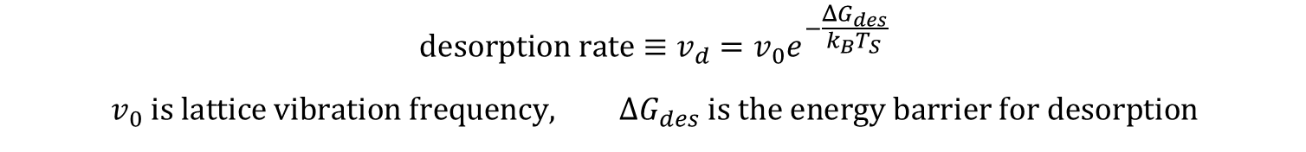
Desorption Rate
$$desorption rate≡v_{d}=v_{0}e^{−\frac{ΔG_{des}}{k_{B}T_{S}}}$$
$$v_{0} is lattice vibration frequency, ΔG_{des} is the energy barrier for desorption$$
Specific substrate and film materials are not specified in this simulation.
So those values cannot be determined, and that formula is not used.
Instead, the system uses the typical residence time of 10⁻⁶ seconds.
To be able to visualize the nucleation process, we want the molecule to stay resident
on the substrate for at least 10 seconds in real time while the simulation executes.
That is the basis of setting the time scaling of the simulation
$$10 S≡{10}^{−6}s ⇒ 1 S≡{10}^{−5} s$$

Slide 15
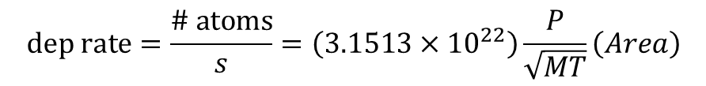
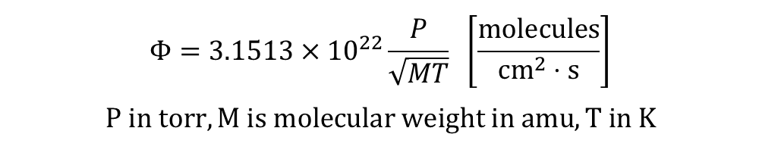
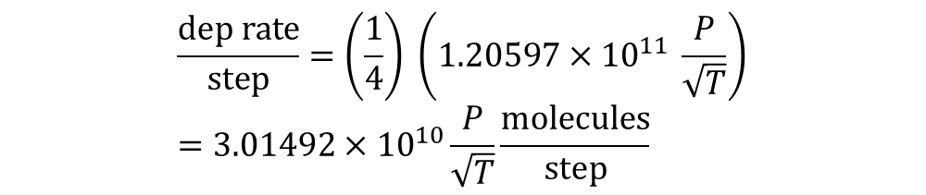
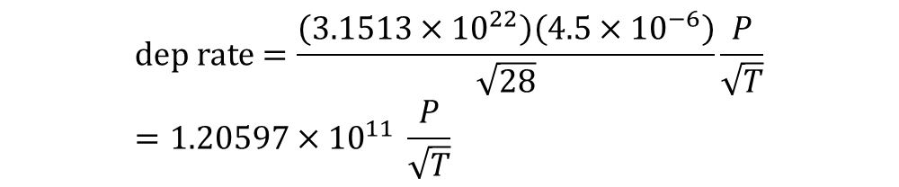
Deposition Rate
$$Φ=3.1513×{10}^{22}\frac{P}{\sqrt{MT}} \left[\frac{molecules}{cm^{2}⋅s}\right]$$
$$P in torr, M is molecular weight in amu, T in K$$
Starting with the Flux
Multiply by the area
To get the deposition rate
$$dep rate=\frac{\# atoms}{s}=\left(3.1513×{10}^{22}\right)\frac{P}{\sqrt{MT}}\left(Area\right)$$
$$dep rate=\frac{\left(3.1513×{10}^{22}\right)\left(4.5×{10}^{−6}\right)}{\sqrt{28}}\frac{P}{\sqrt{T}}=1.20597×{10}^{11} \frac{P}{\sqrt{T}}$$
Use Si as a typical substrate
The molecular weight of Si is 28 amu
There are 4 steps per second.
Therefore
$$\frac{dep rate}{step}=\left(\frac{1}{4}\right) \left(1.20597×{10}^{11} \frac{P}{\sqrt{T}}\right)=3.01492×{10}^{10}\frac{P}{\sqrt{T}}\frac{molecules}{step}$$

Slide 16
Surface Diffusion
We assume no holes or steps, etc.
Diffusion across the surface is equally likely in all directions
To simulate this, each molecule or cluster can move across the surface 0 to 4 pixels (at random), based on temperature.
0 K – 400 K : 1 pixel max
401 K – 800 K : 2 pixels max
801 K – 1200 K : 3 pixels max
1201 K – 1687.15 K : 4 pixels m

Slide 17
Termination Condition
The simulation terminates when 1 cluster covers 75% of the substrate area

Slide 18
Demonstration

Slide 19
Improvements
Materials for the substrate and the film material could be specified.
Using this, precise calculations could be made for deposition rate, desorption rate, surface diffusion, and critical cluster size
Common material configurations can be provided and chosen by the user to provide the values for the above calculations.
Different lattice configurations of the substrate can be taken into account.
Different colors for the substrate and the film material could be picked

Slide 20
Questions?

