Slide 1
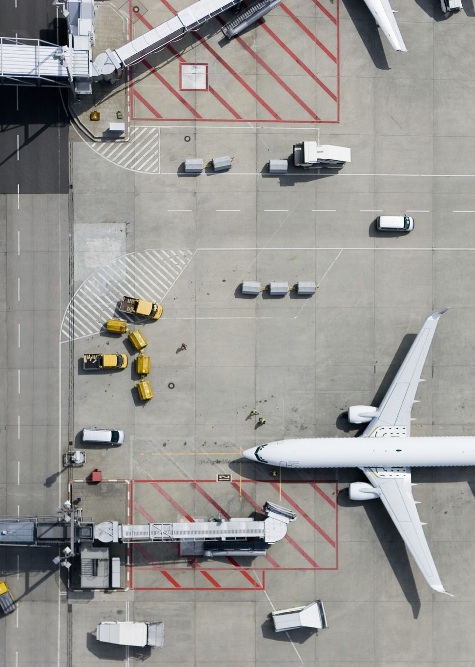
Airline Safety Concern
Real or False Narrative?

Slide 2
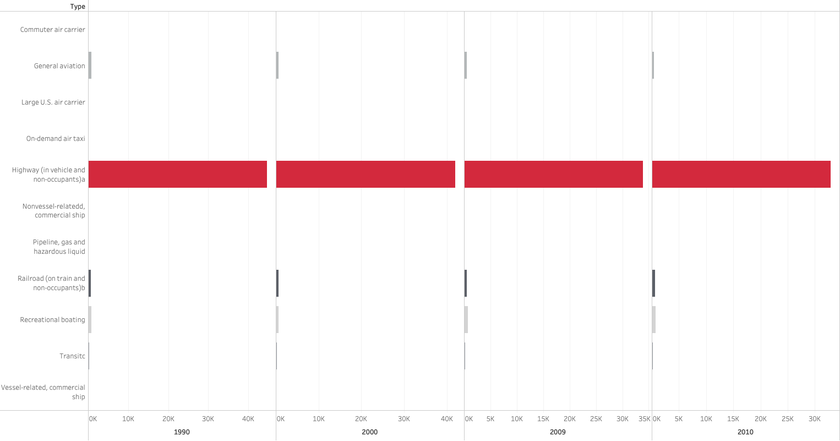
Transportation Fatalities by Mode: Select Years 1990-2010

Slide 3
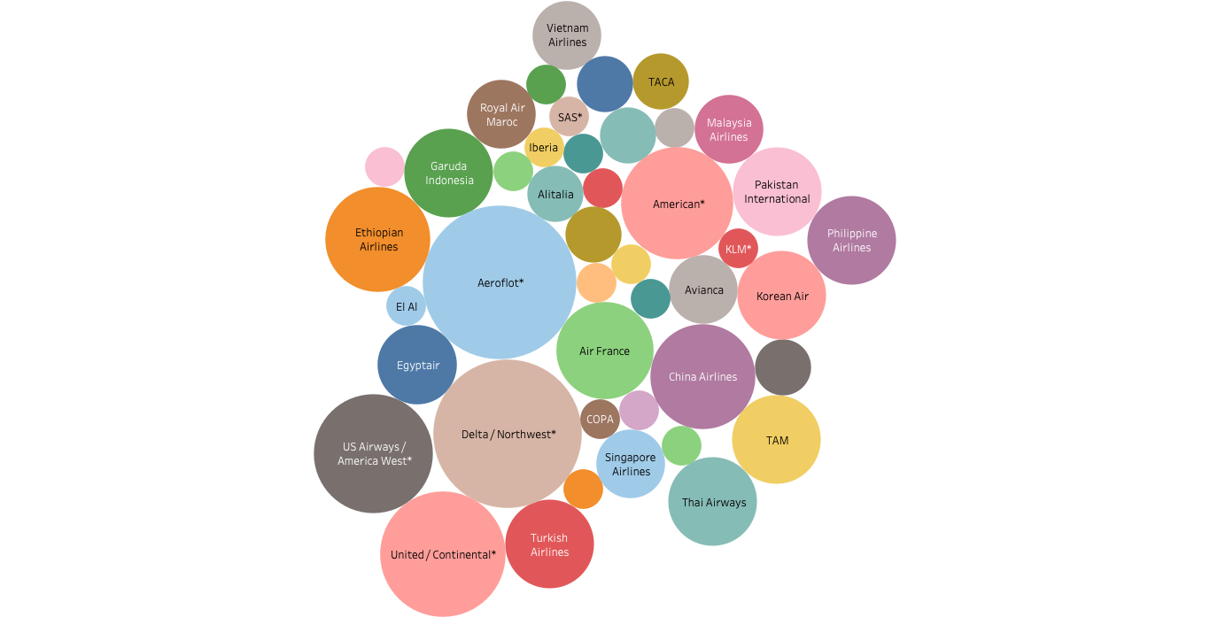
Airline Incidents *Size is indicative of the number of incidents from 1985-2014.

Slide 4
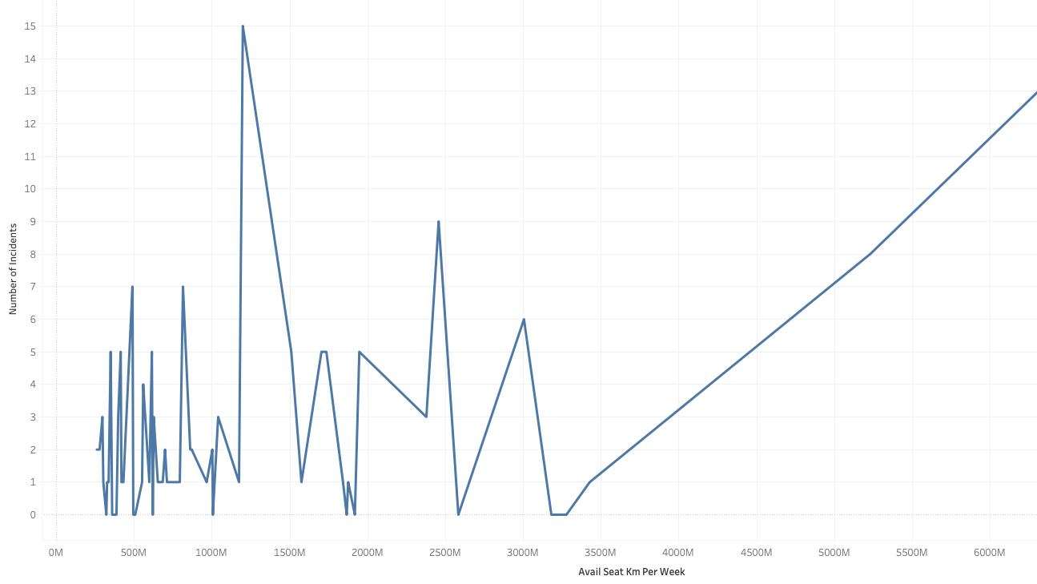
Airline Incidents per Available Seat (km per Week) Data from 1985-2014

Slide 5
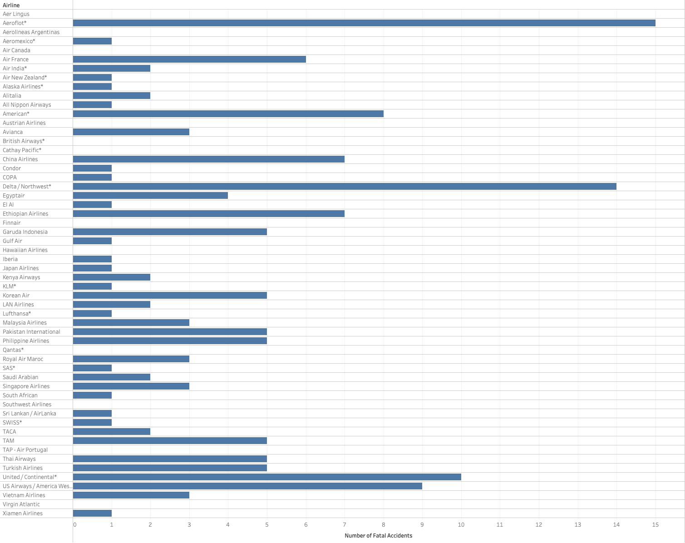
Worldwide Airline Fatal Accidents Data from 1985-2014

Slide 6
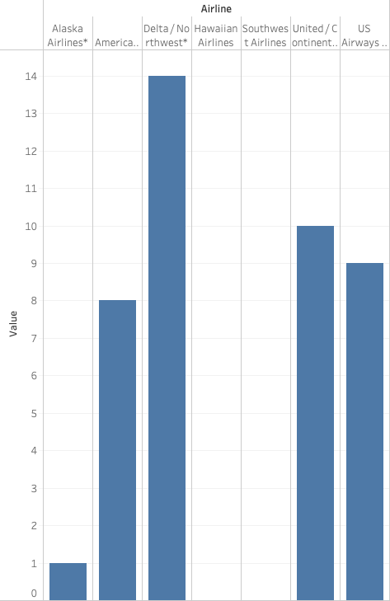
US Airline Fatalities Data from 1985-2014

Slide 7
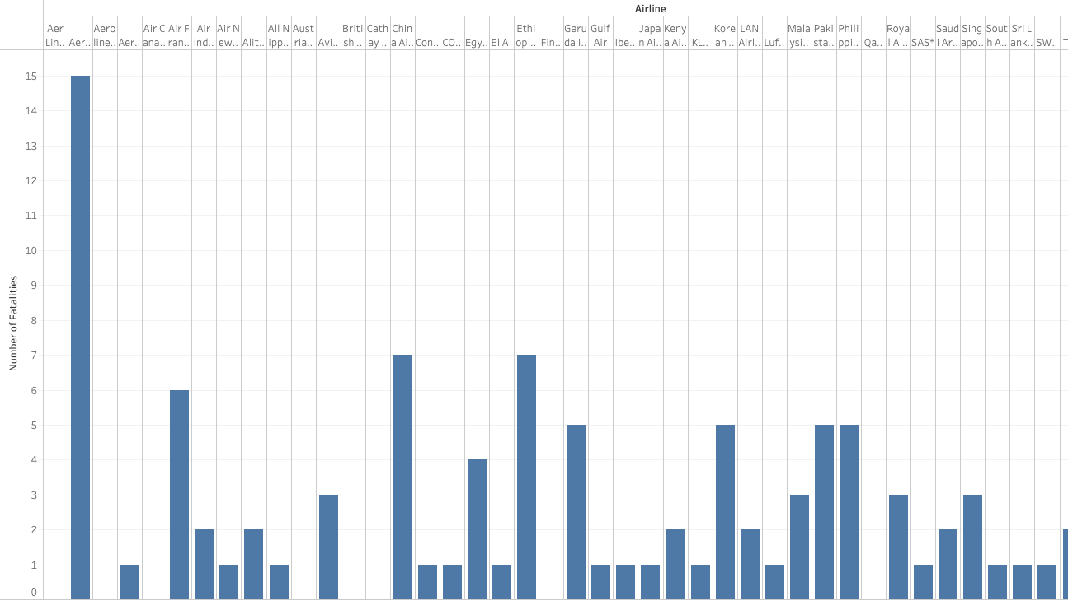
Non-US Airline Fatalities Data from 1985-2014

Slide 8

Conclusion/Results:
Air Transport is still (by far) the safest mode of transportation
Airline Incidents, Fatal Accidents and Fatalities are very low considering the data from 1985-2014
Both US and Non-US Airlines are very safe way for people to travel

