Slide 1
Twitter Followers
Final project for Advanced Algorithms course

Slide 2
Under the supervision of
Arsanios Isaac Helmy
Mark Magdy Amin
Mina Nagy Latif
Youssef Nazeer Tawfik
Clara Raef Nasry
Dr. Abdallah Saad

Slide 3



Project deliverables
01
02
03
Top-influencer
Complexity analysis
People you may know
with the highest number of followers
for the program’s algorithm
the closest group of twitter users to a certain user based on mutual followings

Slide 4

The stars of our algorithm
Star 01
Set is a C++ container used to store the UNIQUE elements in a sorted manner.
Sets are implemented as binary search trees.
Set
Filtering the original CSV file from duplicate rows

Slide 5
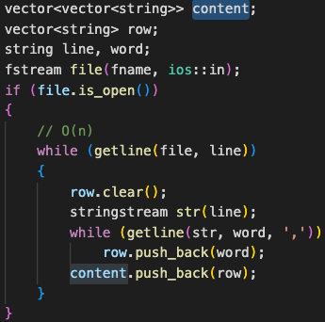
The stars of our algorithm
Star 02
Vectors are dynamic arrays with the ability to resize itself automatically when an element is inserted or deleted.
Vectors
where the ID rows were stored

Slide 6
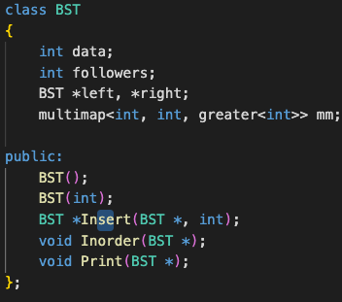
The stars of our algorithm
Star 03
Multimap
Multimap is a map where multiple elements can have the same keys (doesn’t have to be unique).
Keeps all the keys in sorted order always.
to be able to store duplicate following IDs

Slide 7
The stars of our algorithm
Star 04
The left subtree of a node contains only nodes with keys lesser than the node’s key.
The right subtree of a node contains only nodes with keys greater than the node’s key.
Binary Search Tree
where the 2nd column IDs are stored

Slide 8
Complexity Analysis

Slide 9
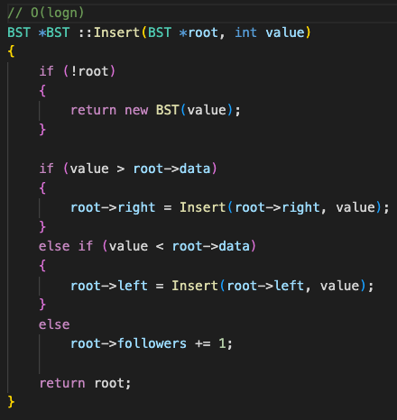
Insertion into BST
O(log n)

Slide 10
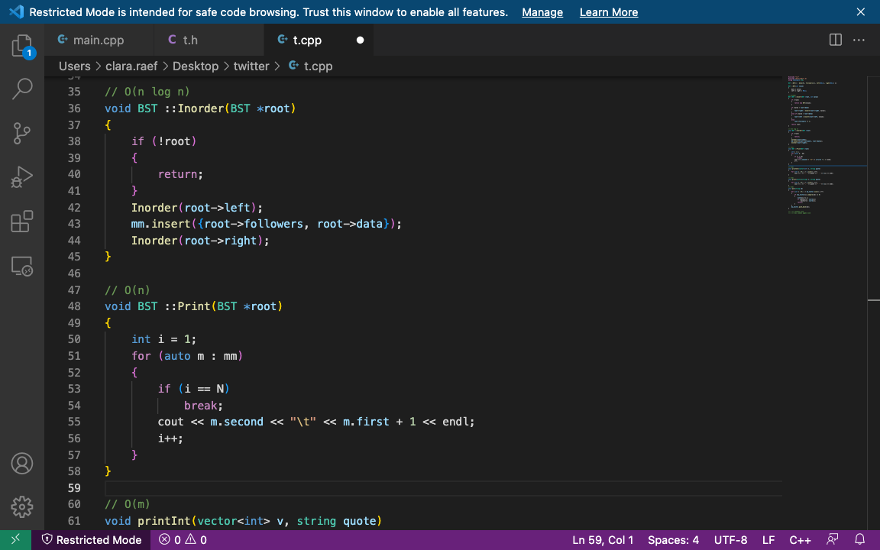
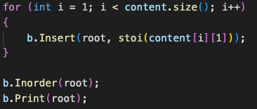
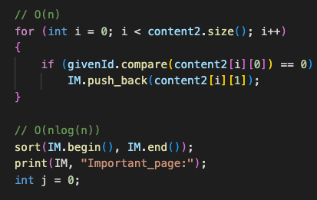
O(n log n)

Slide 11
O(n)

Slide 12
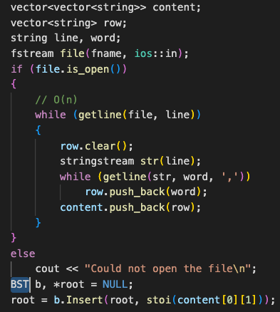
O(n)

Slide 13
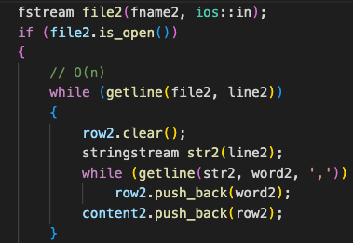
O(n)

Slide 14
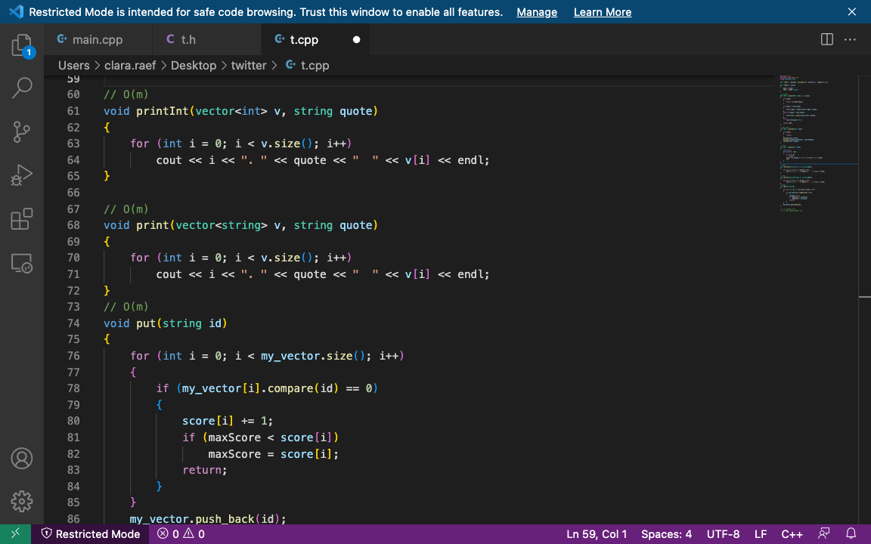
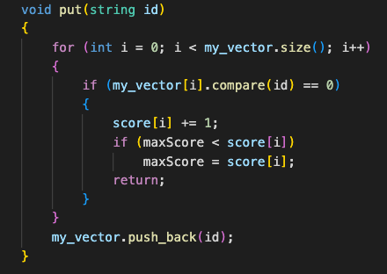
O(m)

Slide 15
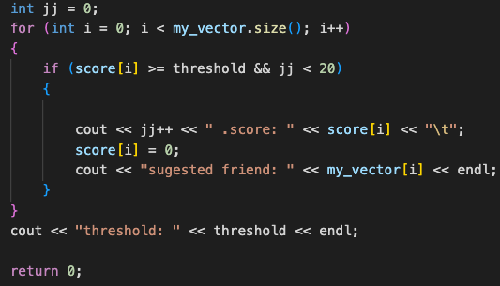
O(m)

Slide 16
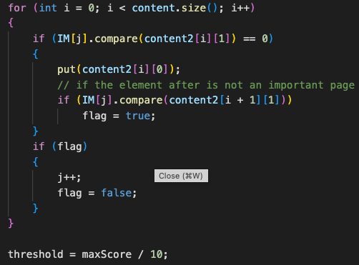
O(m*n)

Slide 17
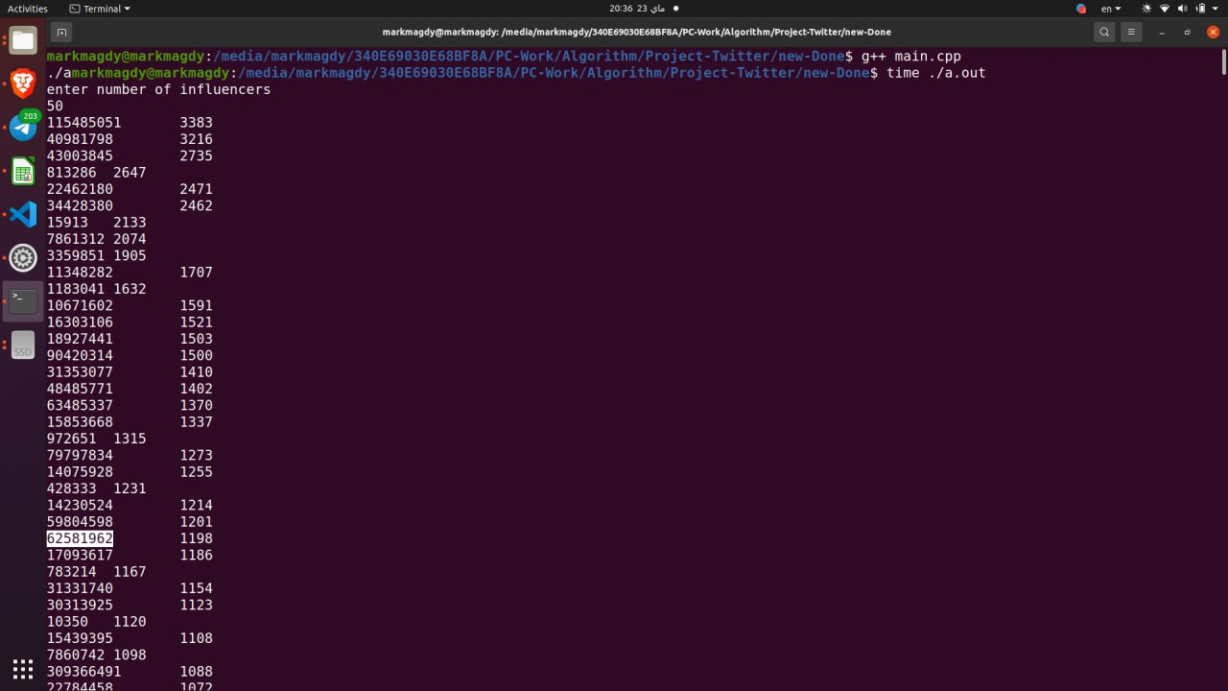
Output Screenshots

Slide 18
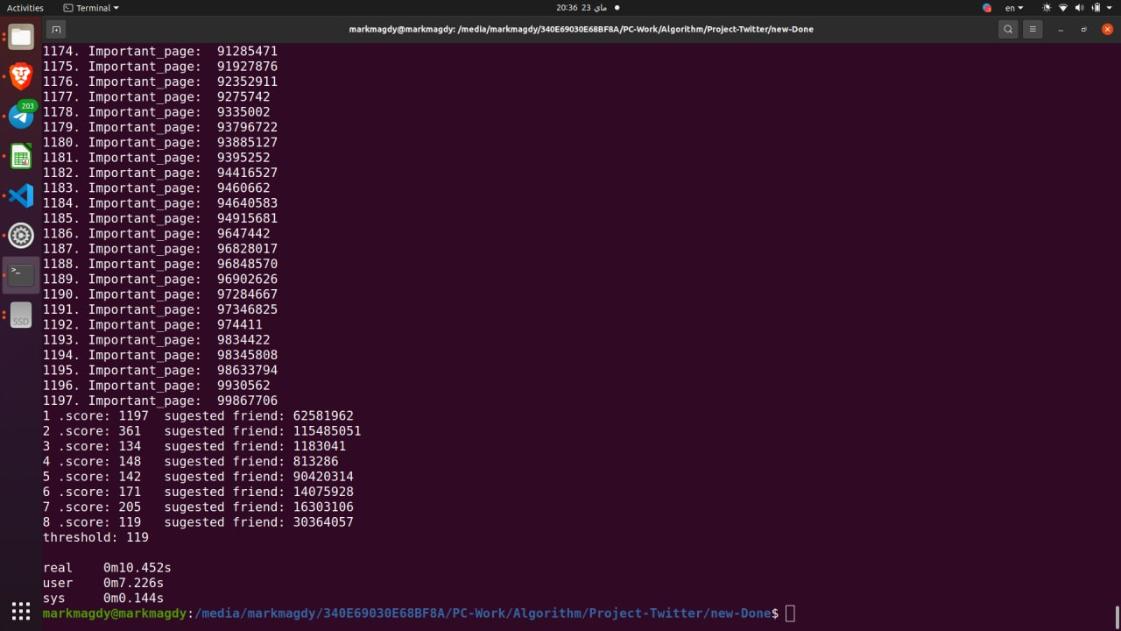
Output Screenshots

Slide 19
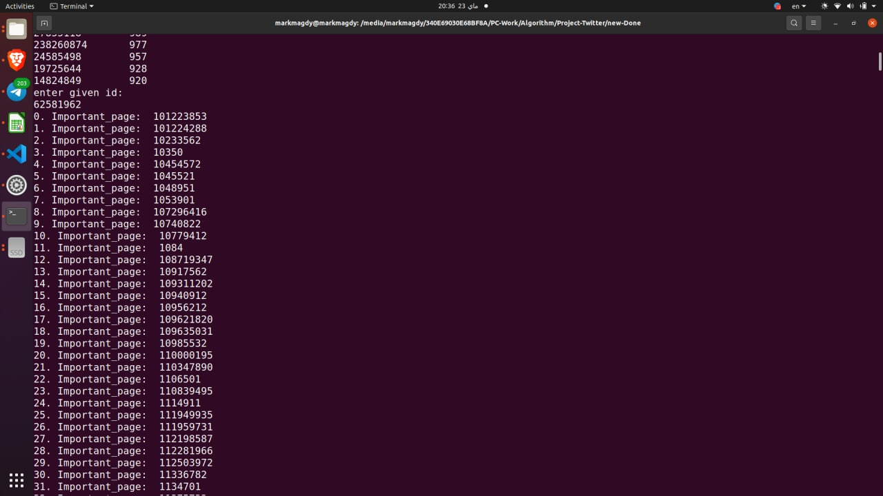
Output Screenshots

