Slide 1
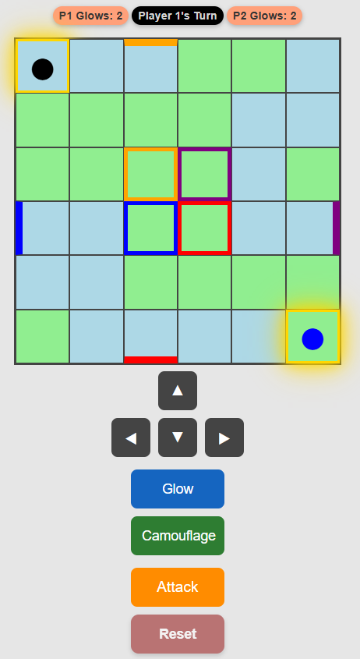
REACH THE OPPOSITE CORNER,
OR SUCCESSFULLY ATTACK

