Slide 1
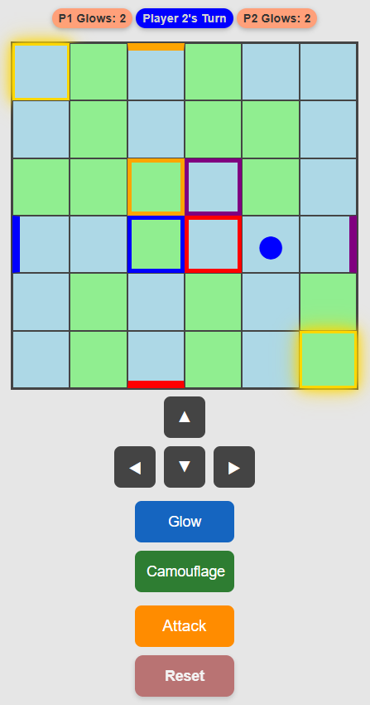
USE CAMOUFLAGE: MATCH TILE COLOR TO HIDE

