Slide 1
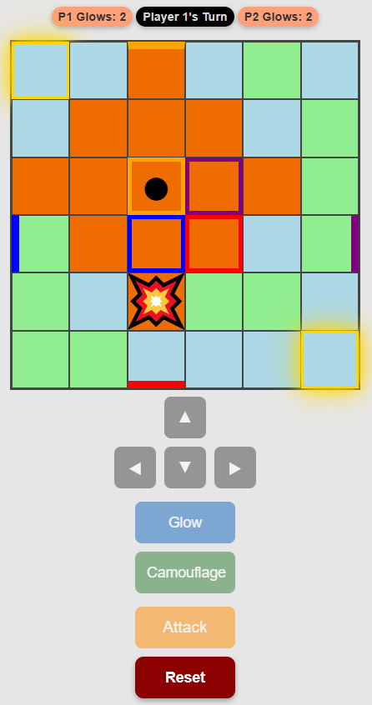
ATTACK: 1 SHOT. NO 2ND CHANCES. RANGE: 2 MANHATTEN STEPS

