Slide 1
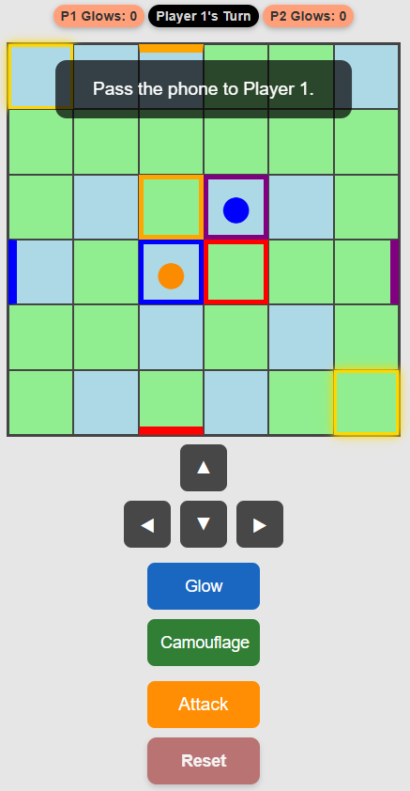
GLOW: REVEAL OPPONENT.
TWO GLOWS FOR EACH PLAYER

