Slide 1
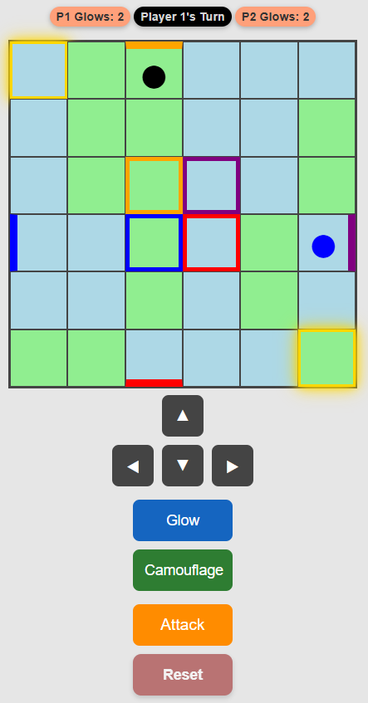
WARP DOORS AT EDGES TELEPORT PLAYERS TO CENTER OF GRID

