Slide 1
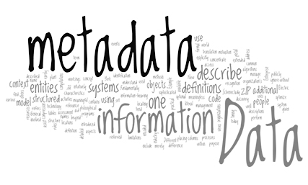
metamorphichq.com

Slide 2

Metadata is data about data.
It describes
what data you Own
its Contents
its Structure and Format
who should be Allowed Access
expectations about Quality
in fact anything required to convert data into Value
metamorphichq.com

Slide 3

Metadata takes multiple forms and has many uses.
Descriptive content about documents and records
Schemas for document exchange
Database schemas
Results of data profiling
Data lineage and ETL documentation
Notes and comments
metamorphichq.com

Slide 4
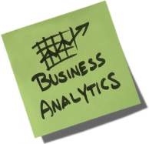
Metamorphic is focused on
Metadata to enable business analytics
and business intelligence
metamorphichq.com

Slide 5
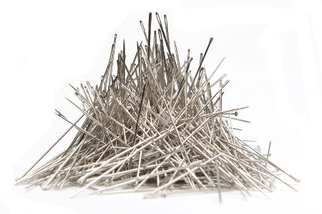
In the context of big data
Metadata is becoming as voluminous as the data itself
And data will become increasingly unwieldy as analysts become lost in
myriad versions
naming conventions
spread and file-marts
Getting control of metadata is the key to unlocking value with agility, confidence, and security
metamorphichq.com

Slide 6
Metamorphic is a Metadata Management System.
It enables:
Trust in the numbers
Time spent on analysis, taking away pain in preparation
Security Classification and Data Governance
A Search Engine for Data
A Data Quality Firewall
Control over Enterprise Information Assets
metamorphichq.com

Slide 7
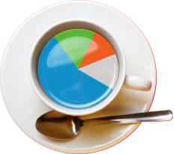
For more information, please contact
Mark Moloney
markmo@metamorphichq.com
metamorphichq.com

