Slide 1
Mirror Symmetry Concepts
u - vector input response
φ
θ’
θ
v - vector mirror symmetric to u

Slide 2
Mirror Symmetry Concepts
S - reflection matrix
u - vector input response
φ
θ’
θ
stencil
v - vector mirror symmetric to u if
2015 L1.2

Slide 3
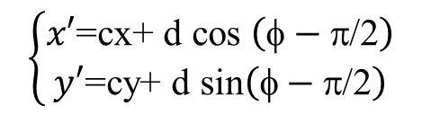
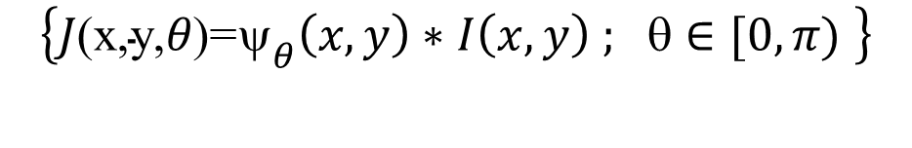
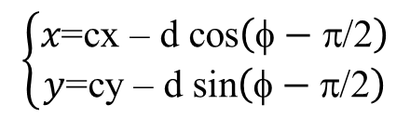


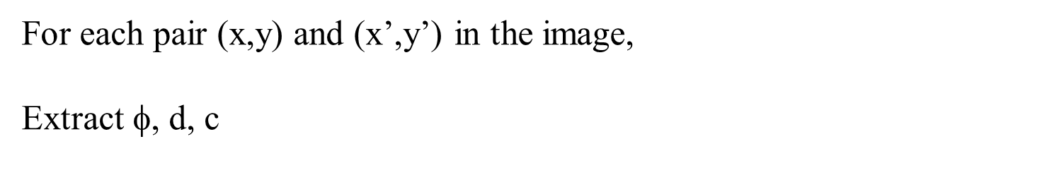
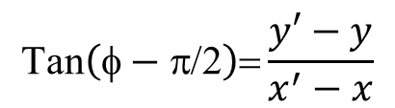
Image-Measure of Mirror Symmetry
Given image coordinates (x,y) with wavelet convolution responses
$$\left\{J\text{(}\text{x}\text{,}\text{y}\text{,}θ\text{)=}{\text{y}}_{θ}\left(x,y\right)∗I\left(x,y\right) \text{;} \text{q}∈[0,π) \right\}$$
For each pair (x,y) and (x’,y’) in the image,
Extract $\text{f}$, d, c
d
φ
(x’,y’)
d
θ
c=(cx,cy)
(x,y)
d = $\frac{1}{2}\sqrt{{\left(x′−x\right)}^{2}+{\left(y′−y\right)}^{2}}$
$$\text{Tan}\left(\text{f}−\text{p}\text{/2}\right)\text{=}\frac{y′−y}{x^{′}−x}$$
$$\left\{\begin{aligned}x\text{=}\text{cx}\text{ – }\text{d} \text{cos}\left(\text{f}−\text{p}\text{/2}\right) \\ y\text{=}\text{cy}\text{ – }\text{d} \text{sin}\left(\text{f}−\text{p}\text{/2}\right)\end{aligned}\right.$$
We can recover
the coordinates
c=(cx,cy)=$\frac{1}{2}\left(x^{′}+x\text{,}{ y}^{′}+y\right)$
$$\left\{\begin{aligned}x\text{′}\text{=}\text{cx}\text{+} \text{d} \text{cos} \left(\text{f}−\text{p}\text{/2}\right) \\ y′\text{=}\text{cy}\text{+} \text{d} \text{sin}\left(\text{f}−\text{p}\text{/2}\right)\end{aligned}\right.$$

Slide 4
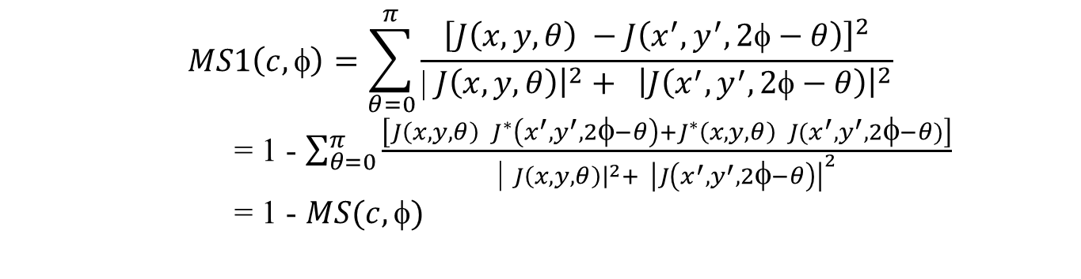
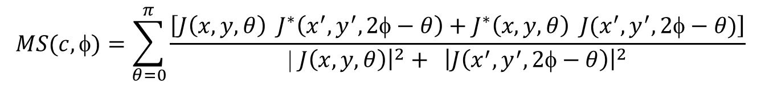


Image-Measure of Mirror Symmetry (cont.)
MS1 (the smaller the more symmetric)
$$MS1\left(c, \text{f}\right)=\sum_{θ=0}^{π}{\frac{{\left[J\left(x,y,θ\right) −J\left(x^{′},y^{′},2\text{f}−θ\right)\right]}^{2}}{\text{| }J\left(x,y,θ\right){\left.​\right|}^{2}+ {\left|J\left(x^{′},y^{′},2\text{f}−θ\right)\right|}^{2}}}$$
= 1 - $\sum_{θ=0}^{π}{\frac{\left[J\left(x,y,θ\right) J^{∗}\left(x^{′},y^{′},2\text{f}−θ\right)+J^{∗}\left(x,y,θ\right) J(x^{′},y^{′},2\text{f}−θ)\right]}{\text{| }J\left(x,y,θ\right){\left.​\right|}^{2}+ {\left|J\left(x^{′},y^{′},2\text{f}−θ\right)\right|}^{2}}}$
= 1 - $MS(c,\text{f})$
We work with a MS (the larger the more symmetric)
$$MS(c, \text{f})=\sum_{θ=0}^{π}{\frac{\left[J\left(x,y,θ\right) J^{∗}\left(x^{′},y^{′},2\text{f}−θ\right)+J^{∗}\left(x,y,θ\right) J(x^{′},y^{′},2\text{f}−θ)\right]}{\text{| }J\left(x,y,θ\right){\left.​\right|}^{2}+ {\left|J\left(x^{′},y^{′},2\text{f}−θ\right)\right|}^{2}}}$$
Invariant by scaling:
$$J\left(x,y,θ\right) →γ J\left(x,y,θ\right)$$
does not change
$$MS(c, \text{f})$$

Slide 5

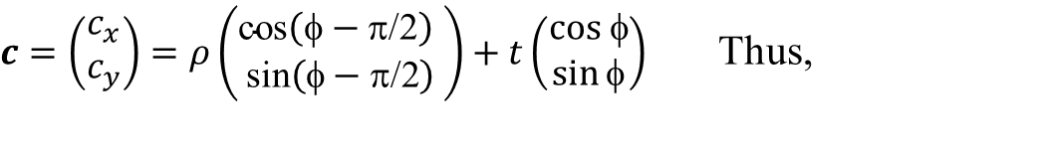




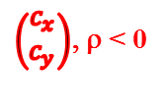
Hough Space for Lines and Symmetry Accumulator
y
$c=\left(\begin{aligned}c_{x} \\ c_{y}\end{aligned}\right)=ρ\left(\begin{aligned}\text{cos}\left(\text{f}−\text{p}\text{/2}\right) \\ \text{sin}\left(\text{f}−\text{p}\text{/2}\right)\end{aligned}\right)+t\left(\begin{aligned}cos \text{f} \\ \sin{\text{f}}\end{aligned}\right)$ Thus,
$$c$$
t
$\left(\text{cos}\left(\text{f}−\text{p}\text{/2}\right)\text{, }\text{sin}\left(\text{f}−\text{p}\text{/2}\right)\right) \left(\begin{aligned}c_{x} \\ c_{y}\end{aligned}\right)$ $= ρ$
ρ
φ
$$Sym(ρ,\text{f})=MS(c, \text{f})$$
φ−π/2
x
y
The parameter ρ can take positive and negative values
φ−π/2
φ
$\left(\begin{aligned}c_{x} \\ c_{y}\end{aligned}\right)$, ρ < 0
ρ < 0
φ+π/2
x
φ
$\left(\begin{aligned}c_{x} \\ c_{y}\end{aligned}\right)$, ρ > 0
ρ > 0
$$\left(cos\text{(}\text{f}\text{−}\text{p}\text{/2)}\sin{\text{(}\text{f}\text{−}\text{p}\text{/2)}}\right)$$

Slide 6
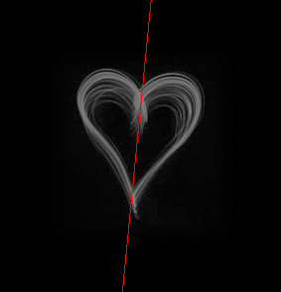

Visualization of Symmetry Accumulator
ρ
Sym (ρ, φ)
φ
y
φ
ρ
x
ρ

Slide 7

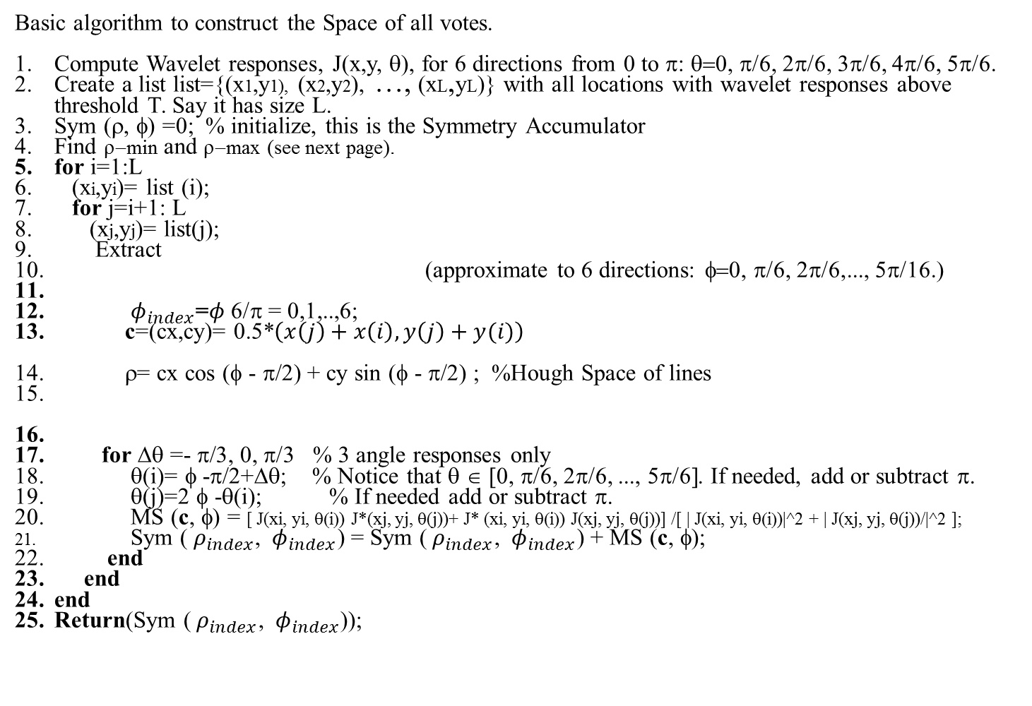
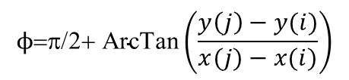
Symmetry computation
φ
d
d
(x’,y’)
θ
c=(cx,cy)
Basic algorithm to construct the Space of all votes.
Compute Wavelet responses, J(x,y, θ), for 6 directions from 0 to π: θ=0, π/6, 2π/6, 3π/6, 4π/6, 5π/6.
Create a list list={(x1,y1), (x2,y2), …, (xL,yL)} with all locations with wavelet responses above threshold T. Say it has size L.
Sym (ρ, φ) =0; % initialize, this is the Symmetry Accumulator
Find ρ−min and ρ−max (see next page).
for i=1:L
(xi,yi)= list (i);
for j=i+1: L
(xj,yj)= list(j);
Extract
(approximate to 6 directions: φ=0, π/6, 2π/6,..., 5π/16.)
${ φ}_{index}$=$φ$6/π = 0,1,..,6;
c=(cx,cy)= 0.5*$\left(x\left(j\right)+x\left(i\right),y\left(j\right)+y(i)\right)$
ρ= cx cos (φ - π/2) + cy sin (φ - π/2) ; %Hough Space of lines
for Δθ =- π/3, 0, π/3 % 3 angle responses only
θ(i)= φ -π/2+Δθ; % Notice that θ ∈ [0, π/6, 2π/6, ..., 5π/6]. Ιf needed, add or subtract π.
θ(j)=2 φ -θ(i); % If needed add or subtract π.
MS (c, φ) = [ J(xi, yi, θ(i)) J*(xj, yj, θ(j))+ J* (xi, yi, θ(i)) J(xj, yj, θ(j))] /[ | J(xi, yi, θ(i))|^2 + | J(xj, yj, θ(j))/|^2 ];
Sym (${ ρ}_{index}$, ${ φ}_{index}$) = Sym (${ ρ}_{index}$, ${ φ}_{index}$) + MS (c, φ);
end
end
end
Return(Sym (${ ρ}_{index}$, ${ φ}_{index}$));
(x,y)
$$ϕ\text{=}\text{p}\text{/2+ }\text{ArcT}\text{an}\left(\frac{y\left(j\right)−y(i)}{x(j)−x(i)}\right)$$
$${ ρ}_{index}\text{=}\text{floor}\left(\frac{\text{r}−ρ_{min}}{ρ_{max}−ρ_{min}}\text{x}\text{ 99}\right)→{ ρ}_{index}=0,1,2,…,99$$
Computer Vision
September 2015 L1.7

Slide 8
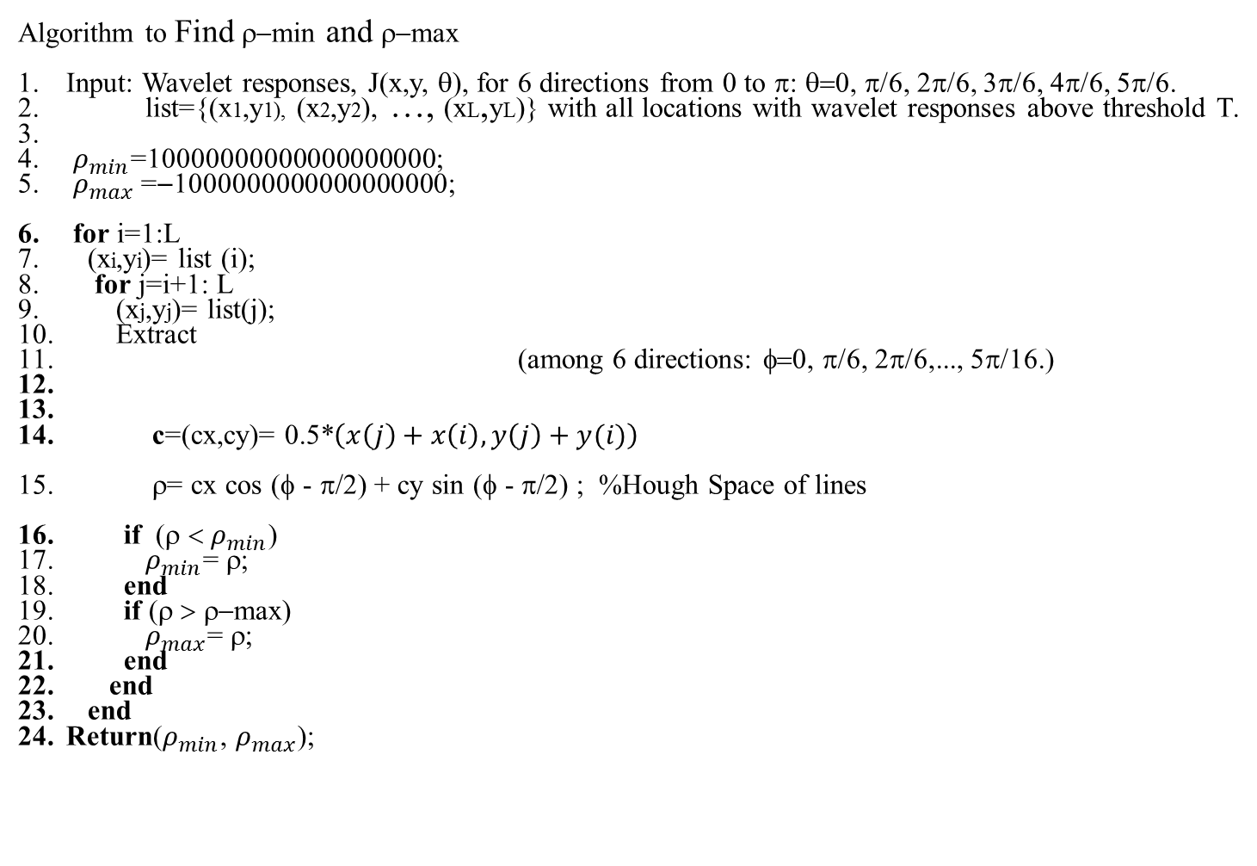
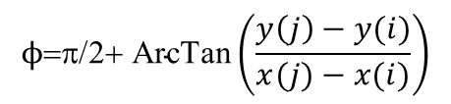
Symmetry computation
d
φ
(x’,y’)
d
(x,y)
θ
c=(cx,cy)
Algorithm to Find ρ−min and ρ−max
Input: Wavelet responses, J(x,y, θ), for 6 directions from 0 to π: θ=0, π/6, 2π/6, 3π/6, 4π/6, 5π/6.
list={(x1,y1), (x2,y2), …, (xL,yL)} with all locations with wavelet responses above threshold T.
$ρ_{min}$=10000000000000000000;
$ρ_{max}$=−1000000000000000000;
for i=1:L
(xi,yi)= list (i);
for j=i+1: L
(xj,yj)= list(j);
Extract
(among 6 directions: φ=0, π/6, 2π/6,..., 5π/16.)
c=(cx,cy)= 0.5*$\left(x\left(j\right)+x\left(i\right),y\left(j\right)+y(i)\right)$
ρ= cx cos (φ - π/2) + cy sin (φ - π/2) ; %Hough Space of lines
if (ρ < $ρ_{min}$)
$ρ_{min}$= ρ;
end
if (ρ > ρ−max)
$ρ_{max}$= ρ;
end
end
end
Return($ρ_{min}$, $ρ_{max}$);
$$ϕ\text{=}\text{p}\text{/2+ }\text{ArcT}\text{an}\left(\frac{y\left(j\right)−y(i)}{x(j)−x(i)}\right)$$

