Slide 1

PROJECT PLAN
Mod 2:
Feat_func
python
Mod 1:
Data_imp.

Slide 2
PROJECT PLAN
Mod 3:
Feat_func
Python 2
Mod 2:
Feat_func
python
Mod 1:
Data_imp.

Slide 3
PROJECT PLAN
Mod 4:
Feat_func
& y_gene
TS
Mod 3:
Feat_func
Python 2
Mod 2:
Feat_func
python
Mod 1:
Data_imp.

Slide 4
csv input
PROJECT PLAN
Mod 4:
Feat_func
& y_gene
TS
Module 5:
RF for squeeze
Module 6:
RF for Ema’s
Mod 3:
Feat_func
Python 2
Mod 2:
Feat_func
python
Mod 1:
Data_imp.

Slide 5
csv input
PROJECT PLAN
Mod 4:
Feat_func
& y_gene
TS
Module 5:
RF for squeeze
Module 6:
RF for Ema’s
Mod 3:
Feat_func
Python 2
Selective Function
Module 7
LSTM binary
Mod 2:
Feat_func
python
Mod 1:
Data_imp.

Slide 6
csv input
PROJECT PLAN
Mod 4:
Feat_func
& y_gene
TS
Module 5:
RF for squeeze
Module 6:
RF for Ema’s
Mod 3:
Feat_func
Python 2
Selective Function
Module 7
LSTM binary
Mod 2:
Feat_func
python
Module 8
LSTM price e.
Mod 1:
Data_imp.
Module 9
LSTM price t.

Slide 7
csv input
PROJECT PLAN
Mod 4:
Feat_func
& y_gene
TS
Module 5:
RF for squeeze
Module 6:
RF for Ema’s
Mod 3:
Feat_func
Python 2
Selective Function
Module 7
LSTM binary
Mod 2:
Feat_func
python
Module 8
LSTM price e.
Module 10:
Automation
And ML integration
Mod 1:
Data_imp.
Module 9
LSTM price t.

Slide 8
csv input
PROJECT FINAL
Mod 4:
Feat_func
& y_gene
TS
Module 5:
RF for squeeze
Module 6:
RF for Ema’s
RF’s trained & tested
Mod 3:
Feat_func
Python 2
Module 10:
* Automation / ML integration (future developments)
* Develop a .py script using Select Function
* Develop Function that feeds prices from module 8 & 9.
* Discard LSTM binary
Selective Function
Mod 2:
Feat_func
python
Module 8
LSTM price e.
Mod 1:
Data_imp.
Module 9
LSTM price t.

Slide 9
csv input
PROJECT FINAL
Mod 4:
Feat_func
& y_gene
TS
Module 5:
RF for squeeze
Module 6:
RF for Ema’s
RF’s trained & tested
Mod 3:
Feat_func
Python 2
Module 10:
* Automation / ML integration (future developments)
* Develop a .py script using Select Function
* Develop Function that feeds prices from module 8 & 9.
* Discard LSTM binary
Selective Function
Mod 2:
Feat_func
python
Module 8
LSTM price e.
EP/TP function
Mod 1:
Data_imp.
Module 9
LSTM price t.

Slide 10
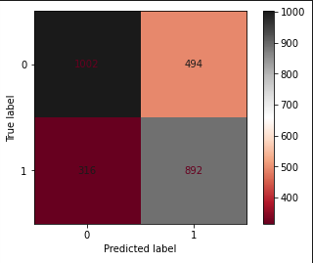
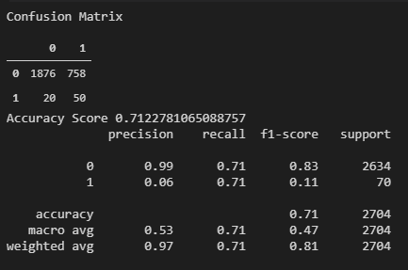
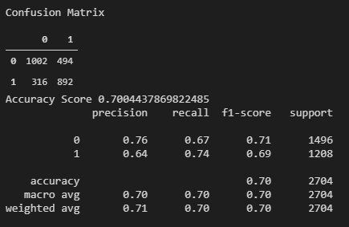
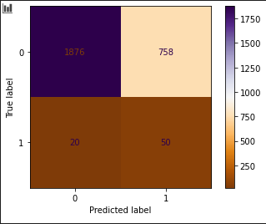
Random Forest Metrics
Module 5: Squeeze RF
Module 6: Xmas RF
Confusion Matrix
Confusion Matrix

Slide 11
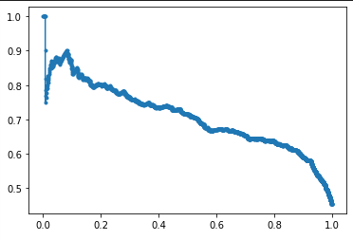
Random Forest Metrics
Module 5: Squeeze RF
Module 6: Xmas RF
Precision Recall Curve

Slide 12
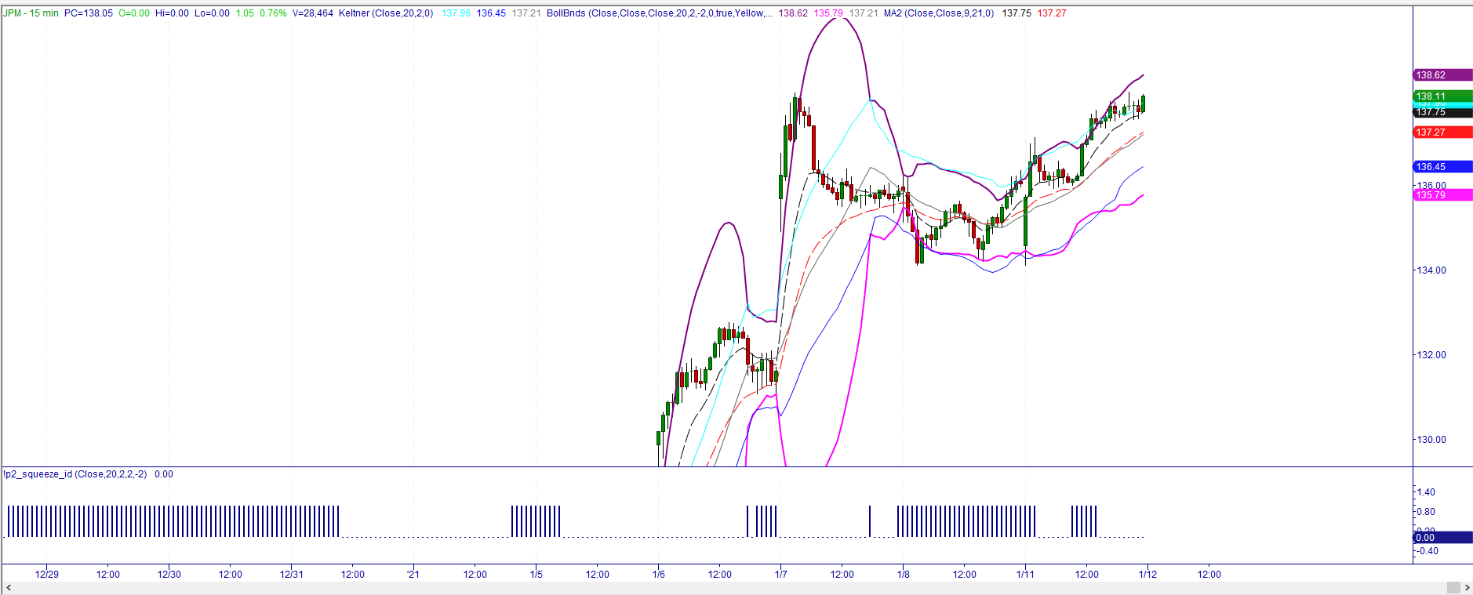
algo-owls
Module 8:
dashboard

