Slide 1
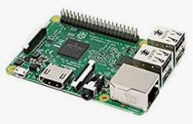

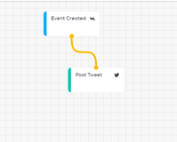


Door Bell
Let’s make sure to use the current, live copy for the header in all visuals moving forward. I have dropped that copy in above.

Slide 2
Door Bell Information flow
Connect a Button, Camera and Speaker to a RaspberryPi
Create a python program that on clicking the button triggers a picture being taken and the Doorbell sound being played
The picture being taken triggers an event in Wia where a picture and message are displayed in widgets.
The event then triggers a twitter message indicating that the doorbell has been pressed.
The widgets in Wia that contain the picture and message are iframed into a webpage so the picture and message can viewed by the homeowner
Let’s make sure to use the current, live copy for the header in all visuals moving forward. I have dropped that copy in above.

