Slide 1


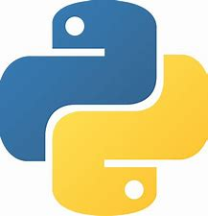
L1
Python Installation
Checking if the python installation directory is on the system path environment variable
Confirm installation on cmd
Check pip version
Install virtutalenv
Install django
Pycharm Installation
Registration
Configuration of VM options
Where to place the .jar file
Configuration of license server
creating django app
Basic commands on Django
Creating an web application
Adding important directories and files to the newly added webapp
Setting.py configuration
Main urls.py configuration
views.py configuration
urls.py configuration on webapp
Editing html page created

