Slide 1



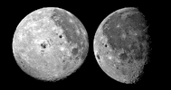
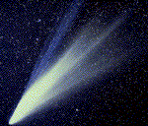
OUR SOLAR SYSTEM
The Sun
Nine Planets
~140 satellites of the planets
Many Comets and asteroids

Slide 2
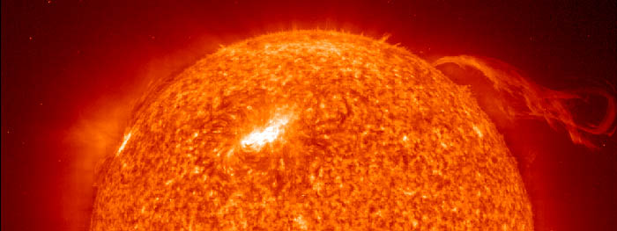
SUN
75% hydrogen and 25% helium by mass
Sun converts hydrogen to helium in its core
Differential rotation
  equator the surface rotates once every 25.4 days
  near the poles it's as much as 36 days
Core conditions
  temperature is 15.6 million Kelvin (surface 5800 K)
  pressure is 250 billion atmospheres

Slide 3
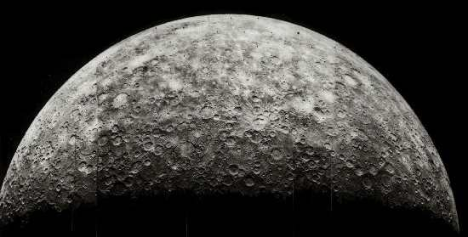
MERCURY
Orbit
  highly eccentric
  perihelion 46 million km
  aphelion it is 70 million km
Closest to sun
Appears to travel fastest
8th largest

Slide 4
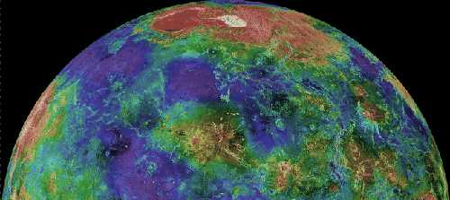
VENUS
2nd from Sun
6th largest
brightest
inferior planet
  shows phases when viewed from Earth
  Galileo's observed phases
  Copernicus used data to develop heliocentric theory.

Slide 5
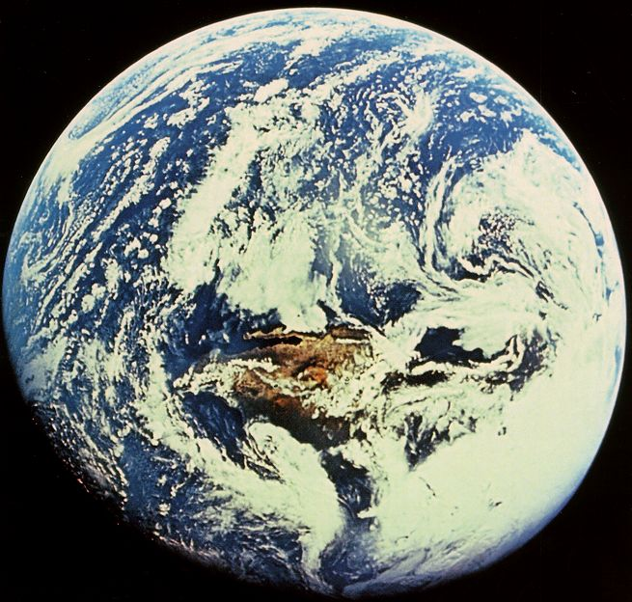
EARTH
3rd from the Sun
Moon is 1/6 mass of earth
period of rotation: 24 hours
period of orbit 365.25 days

Slide 6
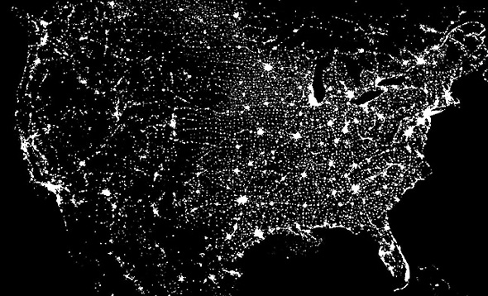
Where are you?

Slide 7
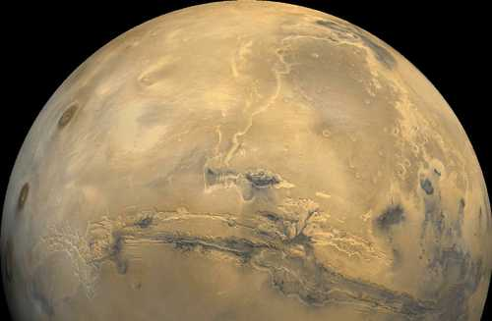
MARS
Mars is the 4th Planet from the Sun
Solid carbon dioxide is found at the poles
Mars is known as the Red Planet

Slide 8
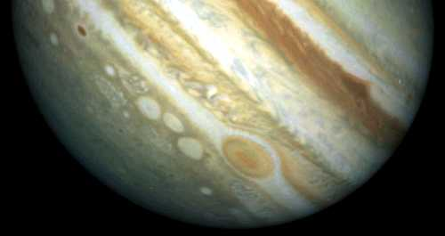
JUPITER
Jupiter contains over 70% of the mass in the solar system outside the Sun.
It is about 11 times the radius and 330 times the mass of the earth.
It is the first representative of the outer solar system.
Unlike the inner planets, Jupiter is not a solid body, but instead is a ball of gas and liquid (mostly hydrogen and helium).
  From the earth, there are two obvious clues to this:
  1. Jupiter, which rotates extremely rapidly (a period of about 10 hours), has a significant bulge at the equator. We call this oblateness, and
  Jupiter has an oblateness of about 6%, which means that the equatorial diameter is 6% greater than the polar diameter.
  2. In addition, Jupiter rotates differentially, just as the Sun does. The period of rotation at the poles is about 10 minutes less than that of the equator, while the interior rotates at an intermediate speed.

Slide 9
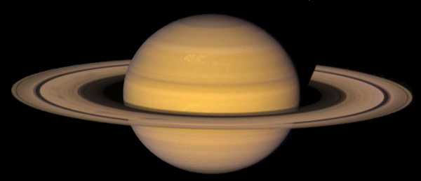
SATURN
Saturn:
  Saturn is a gas giant.
  It has strong surface winds (500 m/sec).
  Saturn is less dense than water.
  Saturn’s magnetic field is 20x less than Jupiter's, but its core rotation period (10.5 hours) is similar.
Saturn’s Moons:
  Titan is the big one, and is larger than planet Mercury!
  Mimas has a huge crater.
  Epimetheus and Janus, just inside the orbit of Mimas, are continually exchanging orbits with one another in a "waltz" -- they are called the coorbital satellites.

Slide 10
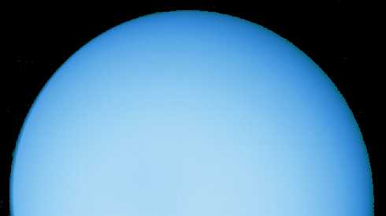
URANUS
Uranus has more moons (27) than any other planet except Jupiter (63) and Saturn (33)!
Notes:
I. Uranus (This data is from: http://www.geocities.com/ResearchTriangle/2389/ch_19_26_stdy_gd.html)
A. Discovery and Orbit
Uranus was discovered in 1781 by Herschel. This caused a sensation, because everyone had assumed they knew all the planets that there were. Its orbit is very slightly elliptical, its year is 84 Earth years long (because -- remember P2=a3 -- it's at an average distance "a" of 19.18 A.U.). Its weirdest feature is that it's turned on its side: its axial tilt is 97deg to the plane of its orbit around the Sun (the ecliptic). Like the other planets, its own equator dominates the dynamics of its ring-and-moons system (not the plane of its orbit around the Sun), so the moons' orbits are really easy to measure right now, as the planet's south pole is pointing toward the inner solar system.

Slide 11
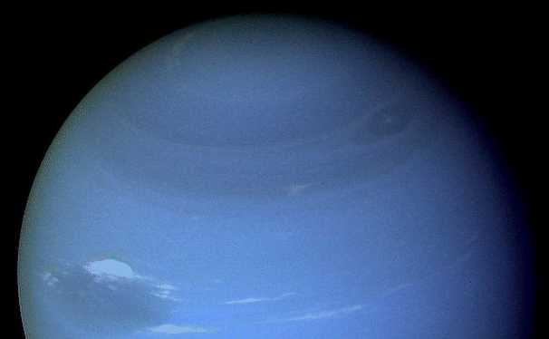
NEPTUNE (13 moons)
The blue coloration of Neptune is probably due to the presence of methane
Note the apparent storms

Slide 12
PLUTO
Pluto is very small as planets go, only 0.002 Earth masses.
Pluto’s orbit is elliptical : it varies from 29 to 49 A.U. from the Sun, crossing inside of Neptune's orbit.
Pluto's orbit is inclined 17deg to the ecliptic, so it goes farther above and below the plane in which the other planets formed than any other planet.

Slide 13
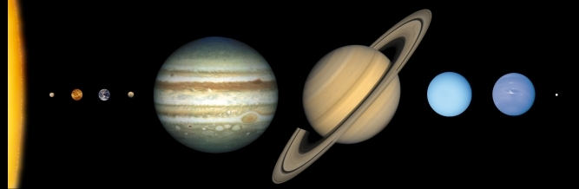
Sizes of the Sun and Planets
Relative size: planets – ordered by distance from the Sun

Slide 14
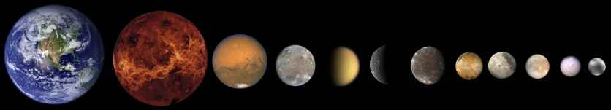
Sizes of the Sun and Planets
Relative size: small planets and larger moons – ordered by size

Slide 15
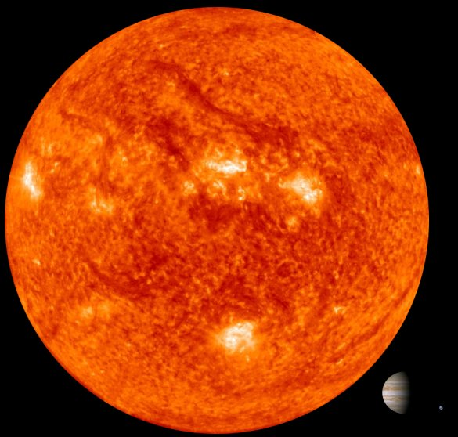
Relative size: The Sun, Jupiter, and Earth

Slide 16
Sample Quiz Questions
Question: Which of the planets are rocky?
Answer: The inner planets: Mercury, Venus, Earth and Mars

Slide 17
Sample Question 2
Which of the planets has the most satellites?
Jupiter!

Slide 18
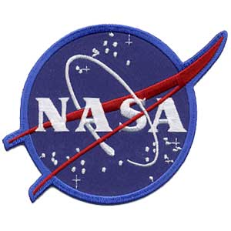
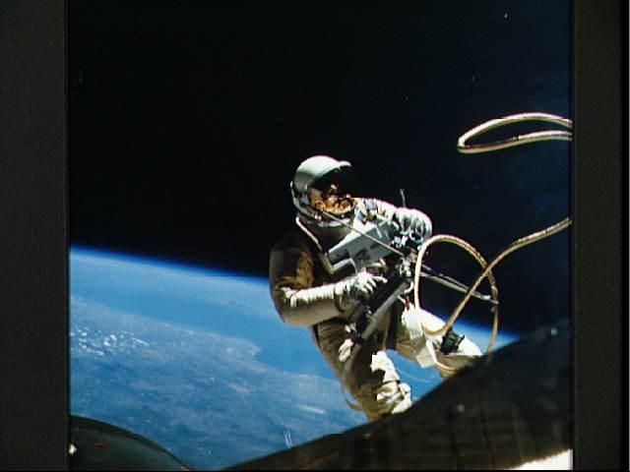
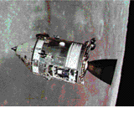
Credits
Photographs are provided by NASA

