Slide 1
Introduction to Astronomy

Slide 2
Beginnings
Learning the Sky
Observing Tools
What you will see
Advanced observing

Slide 3
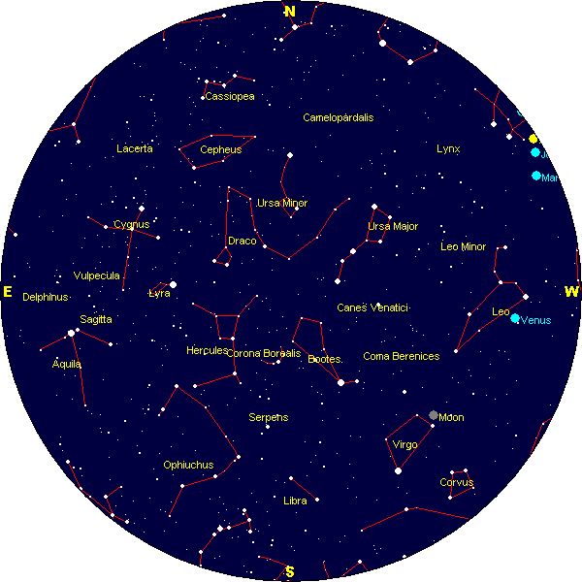
Learn the Sky
88 Constellations
  Only about half visible in the Northern Hemisphere
Bright stars
  About 25-30 Stars

Slide 4
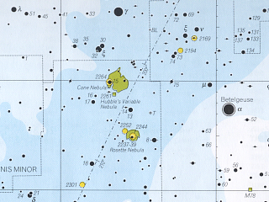
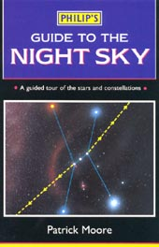
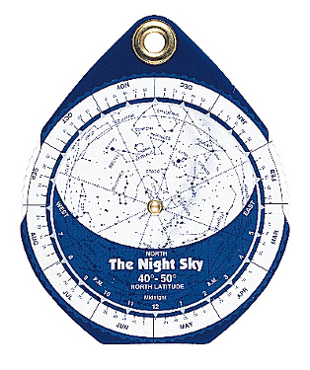
How can you learn the sky?
Astronomy Clubs
  www.hvaastronomy.com
Books
Star charts
  Planispheres
Software

Slide 5
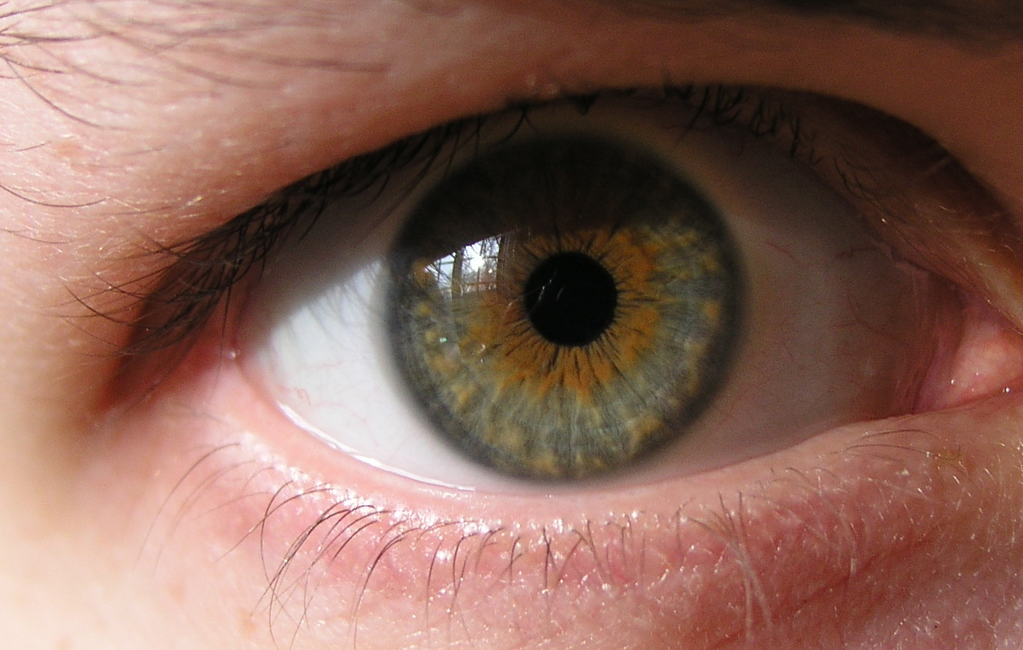
Observing Tools - 1
Eyes
  Young eyes
    ~0.3”-0.4” telescopes
  Older Eyes
    ~0.25”-0.3”
What if you wear glasses?

Slide 6
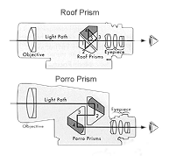
Observing Tools - 2
Binoculars
  What to know about
    Roof Prisms
    Porro Prisms
    Coated/Uncoated
    BAK4, BAK7
    Magnification

Slide 7
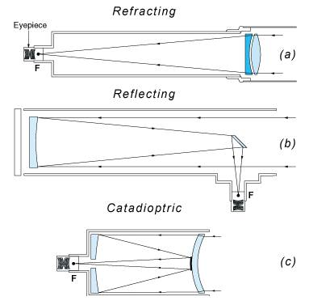
Observing Tools - 3
Telescopes
  Refracting
  Reflecting
  Catadioptric

Slide 8
What will you see?
Eyes - ~0.25” Telescopes
  Stars to about magnitude 6-7
  A few none stellar objects
    Andromeda Galaxy
    Planets and the Moon
    A few star clusters and nebula
But you want more!

Slide 9
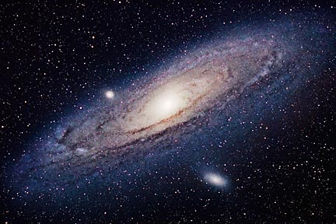
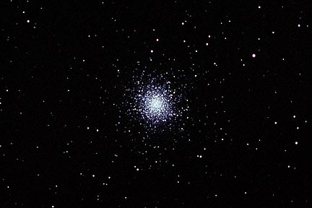
What will you see - 2
Binoculars - ~2”-4” Telescopes
  Same stuff as with naked eyes, but…..
  You’ll be able to see objects 16-32 times more faint!
  Galaxys, Globluar clusters, nebula, etc.

Slide 10
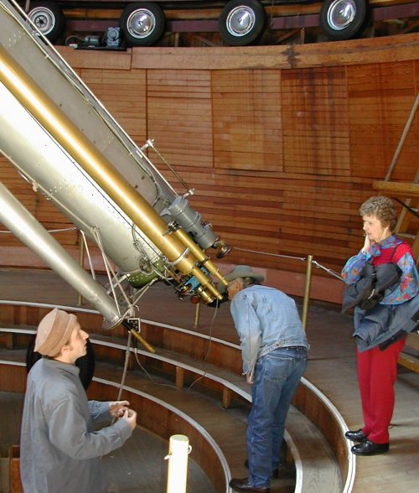
What will you see - 3
Telescopes - ~4”-20+”
  Same stuff as with eyes and Binoculars, but….
  Now you will be able to see objects up to 100’s of times more faint
  Ability to see fine detail (resolution)

Slide 11
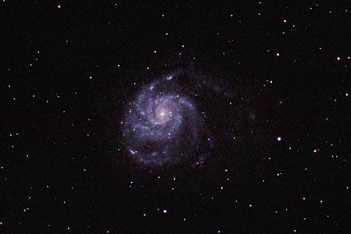
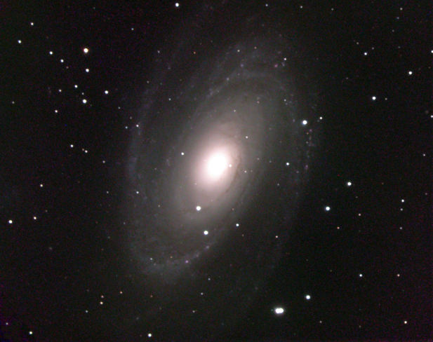
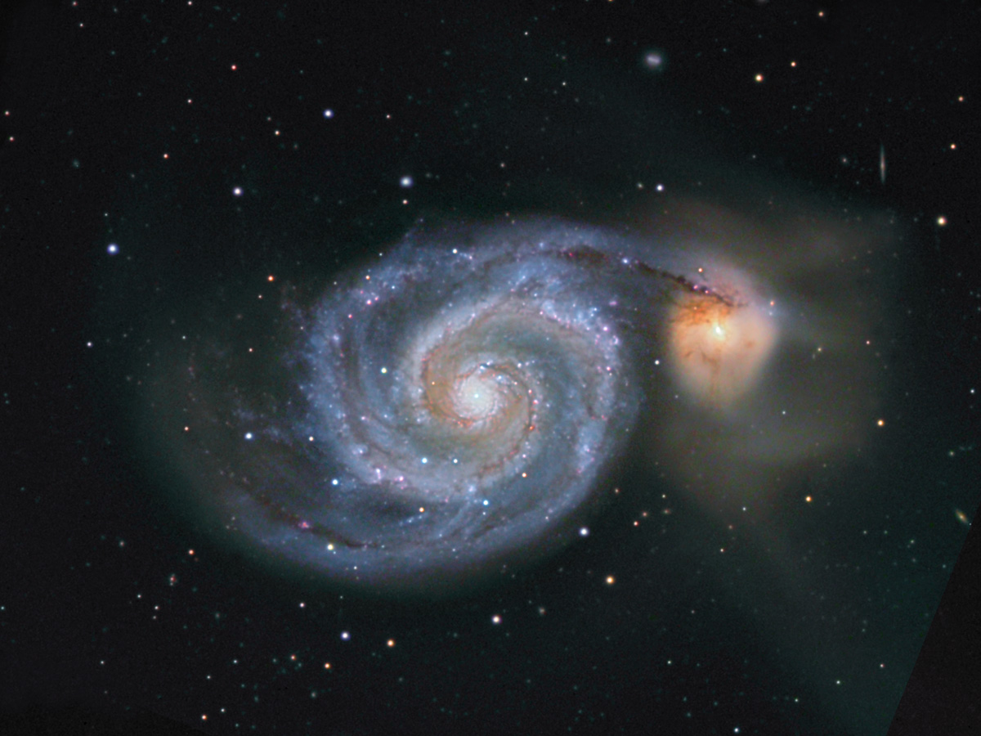
Galaxies

Slide 12
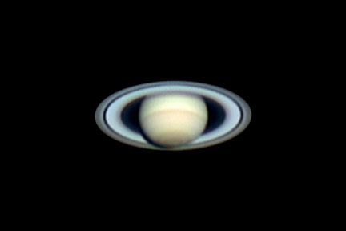
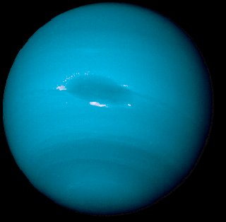
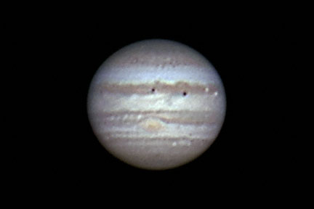
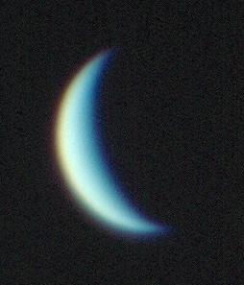
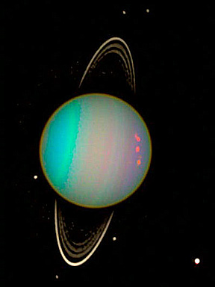
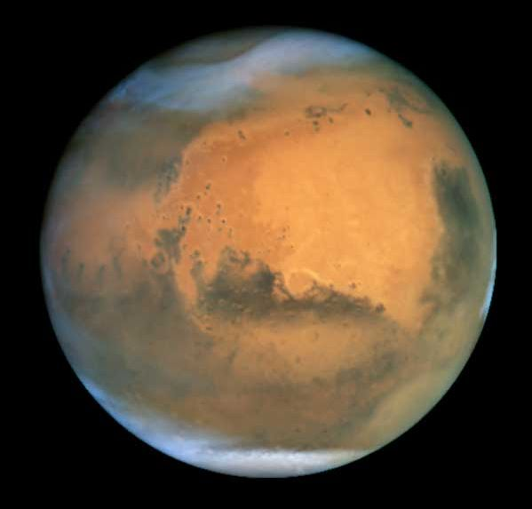
Planets

Slide 13
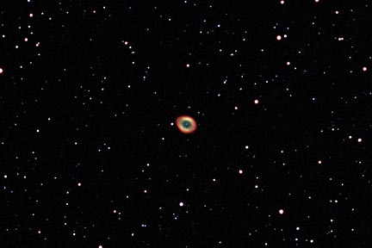
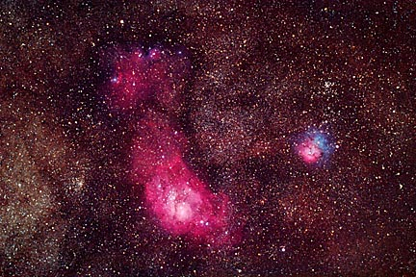
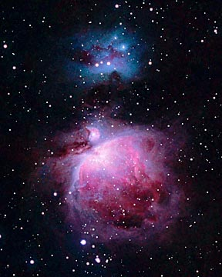
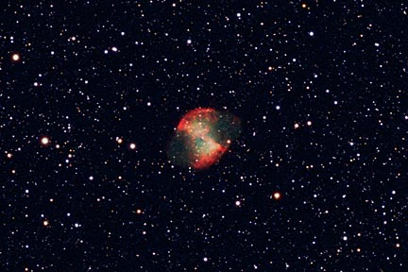
Nebula

Slide 14
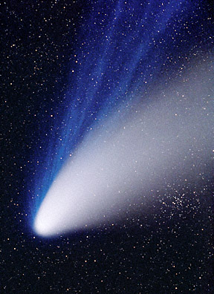
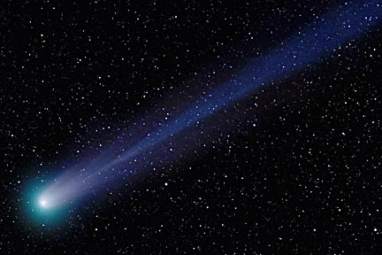
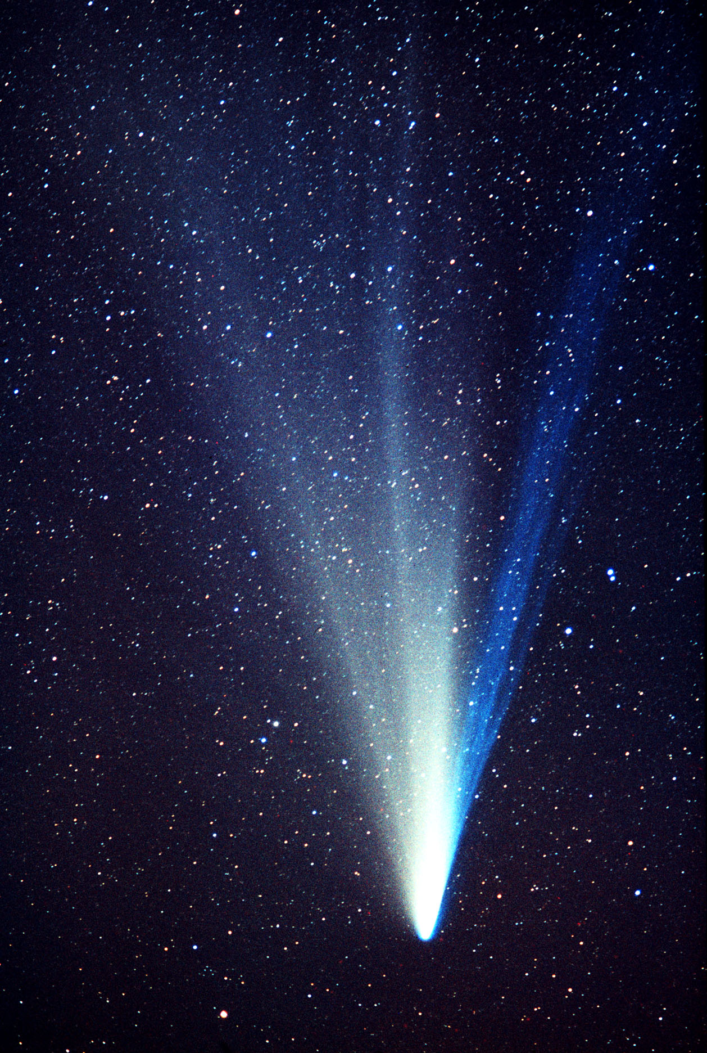
Comets

Slide 15
Free Software
Virtual Moon
    http://www.astrosurf.com/avl/UK_index.html
Planetarium
  WinStars
    http://site.voila.fr/winstars/english/index2.html
  Cartes du Ciel (Sky Charts)
    http://www.stargazing.net/astropc/index.html

Slide 16
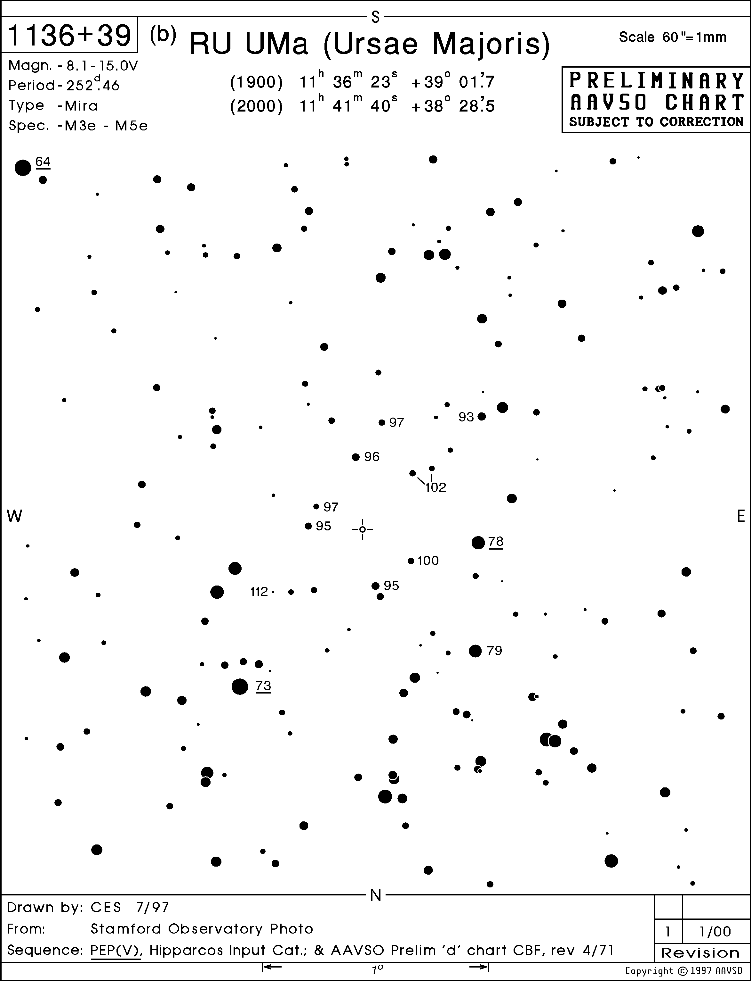
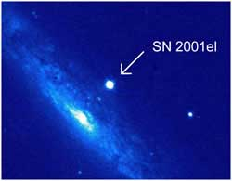
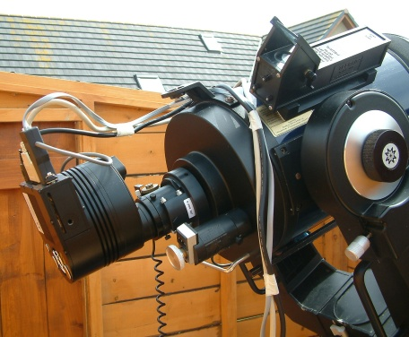
Advanced Observing
Cameras
Variable Stars
Meteors
Asteroids
Supernova
Spectroscopy

Slide 17
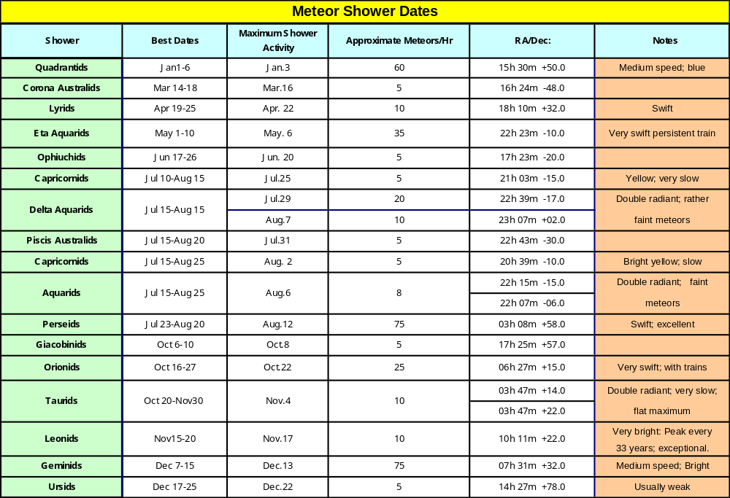
Meteor Showers

Slide 18
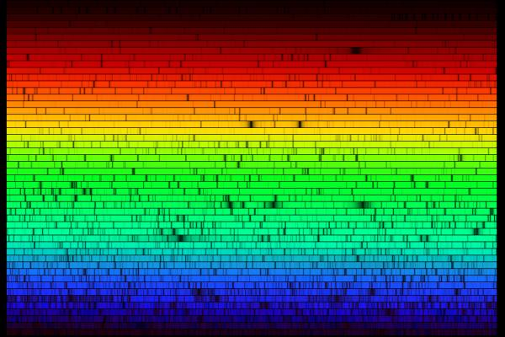
Solar (Our Sun) Spectrum

Slide 19
Questions?
Milky Way Galaxy
  Mass: 10¹² solar masses
  Center: Direction: α = 17.8h, δ = -29° (Sagittarius)
  Distance: 29,000 lt. yrs.
  Diameter: 326,000 lt. yrs.
  Velocity: 370 miles/sec relative to 3°K background radiation
  toward α = 10h, δ = -20° (southeast Hydra)
Some Close Galaxies of the Local Group
  Large Magellanic Cloud 163,000 lt. yrs.
  Small Magellanic Cloud 196,000 lt. yrs.
  Leo I 750,000 lt. yrs.
  Leo II 750,000 lt. yrs.
  M31, M32 2.3 million lt. yrs.
  M33 2.4 million lt. yrs.
Most Distant Object Readily Visible in an Amateur Telescope
  3C275 2 - 3 billion lt. yrs.
  (quasar) (typically requires 10-in. or larger telescope)

