Slide 1
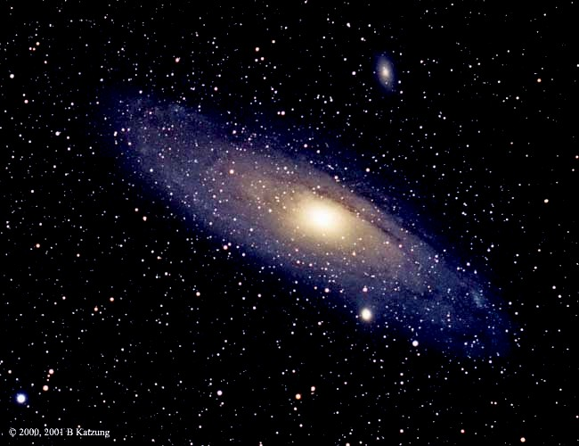
Nova & SuperNova
Heart of the Valley Astronomers,
Corvallis, OR
2007

Slide 2
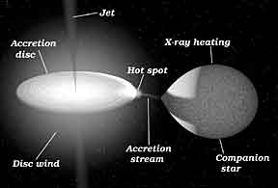
Types of Nova
Type 1a
  The most commonly accepted theory of this type of supernovae is that they are the result of a carbon-oxygen white dwarf accreting matter from a nearby companion star, typically a red giant.

Slide 3
Types of Nova
Type 1b and 1c
  Types Ib and Ic have lost most of their outer envelopes due to strong stellar winds or else from interaction with a companion.
  Type Ib supernovae are thought to be the result of the collapse of a massive Wolf-Rayet star.
  There is some evidence that a few percent of the Type Ic supernovae may be the progenitors of gamma ray bursts (GRB),
    though it is also believed that any Hydrogen-stripped core-collapse supernova (Type Ib, Ic) could be a GRB.

Slide 4
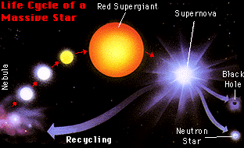
Types of Nova
Type II
  Type II is associated with individual massive stars and has hydrogen lines due to the overlying stellar atmosphere.

Slide 5
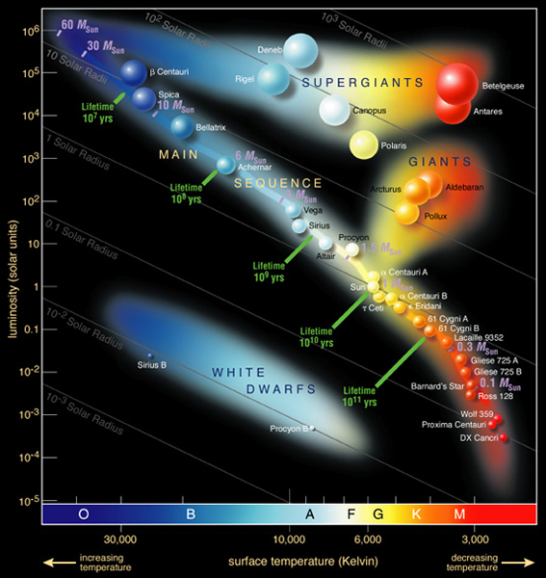
HR Review
Things to Note
  White Dwarfs
  Red Giants

Slide 6
Nova Type Summary
Type I is associated with binary star systems and has no hydrogen lines.
Type Ia has strong silicon lines at maximum light.
Type Ib has no silicon lines at maximum light and is about 1 - 2 magnitudes fainter than Ia's. helium lines are present and probably due to helium detonation on a carbon-oxygen core.
Type Ic have no helium lines and also no silicon lines at maximum light.
Type II is associated with individual massive stars and has hydrogen lines due to the overlying stellar atmosphere.

Slide 7
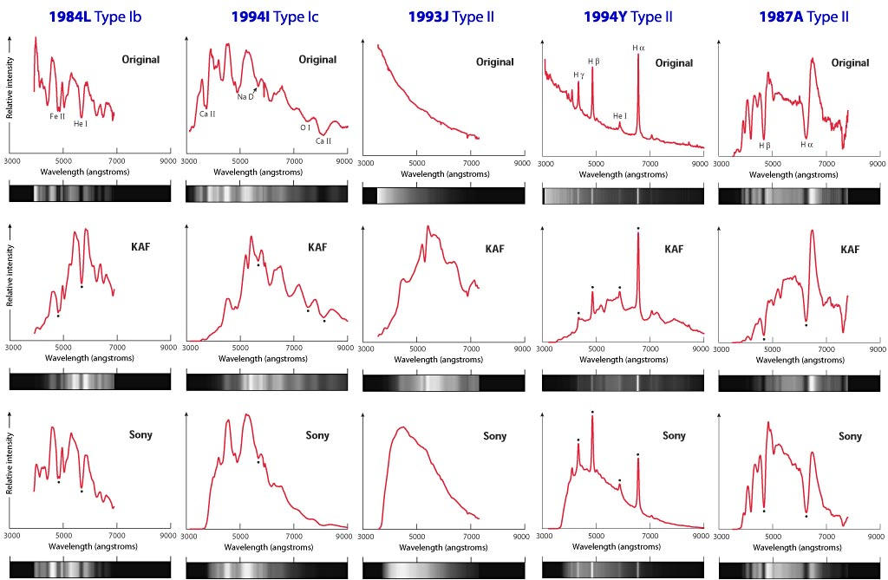
Nova/Supernova Spectra

Slide 8
What makes a Nova
Type 1a
  If the accretion continues long enough, the white dwarf will eventually approach the Chandrasekhar limit of 1.44 solar masses;
    the maximum mass that can be supported by electron degeneracy pressure.
    Beyond this limit the white dwarf would collapse to form a neutron star.

Slide 9
Type 1b, 1c, II
Type 1b and 1c, like supernovae of Type II, are probably massive stars running out of fuel at their centers
Type II are massive stars (<~8 Solar masses) that have exhausted their Hydrogen causing He to fuse, then He→C (triple α process)→Progressively heavier elements until Fe is reached.
  Fe is the last fusion process where excess energy is produced!

Slide 10
Core Collapse
Once Energy Production by Fusion is over
  Outer layers begin to fall toward star center since pressure drops.
    Outer layers can reach 70,000km/sec (0.23c)
  Compression causes heat
    Think of what happens when you compress a gas
    Protons and Electron combine via inverse β decay releasing neutrinos by the bucketload and these carry away even more energy
    Some of the neutrinos are absorbed by the outer layers, the explosion begins

Slide 11
Core Collapse - part deux
The electron-proton combination forms neutrons
  The inward collapse is temporarily halted by neutron degeneracy (more about these degenerates later)
    Outer layers hit this degenerate neutron mass (about the density of an atomic nucleus, ~10¹⁸kg/m³) and rebounds producing a shock wave propagating outward.
  The gravitational energy in this collapse gets converted to about a 10sec neutrino burst
    About 10⁴⁶ Joules of energy

Slide 12
Quick Energy Guide
The Joule
  1 Joule is the energy to lift 1kg about 10cm on the surface of the earth.
  10⁴³ J = energy to lift 10⁴³ kg about 10cm
  Mass of the Earth is ~ 5.9742 × 10²⁴ kg
The energy released in a supernova explosion could lift about 10¹⁹ earth masses 10 cm.
10,000,000,000,000,000,000 earth masses!

Slide 13
Electron Degeneracy
Electron degeneracy is a stellar application of the Pauli Exclusion Principle, as is neutron degeneracy.
No two electrons can occupy identical states, even under the pressure of a collapsing star of several solar masses.
For stellar masses less than about 1.44 solar masses, the energy from the gravitational collapse is not sufficient to produce the neutrons of a neutron star, so the collapse is halted by electron degeneracy to form white dwarfs. This maximum mass for a white dwarf is called the Chandrasekhar limit.
As the star contracts, all the lowest electron energy levels are filled and the electrons are forced into higher and higher energy levels, filling the lowest unoccupied energy levels. This creates an effective pressure which prevents further gravitational collapse.

Slide 14
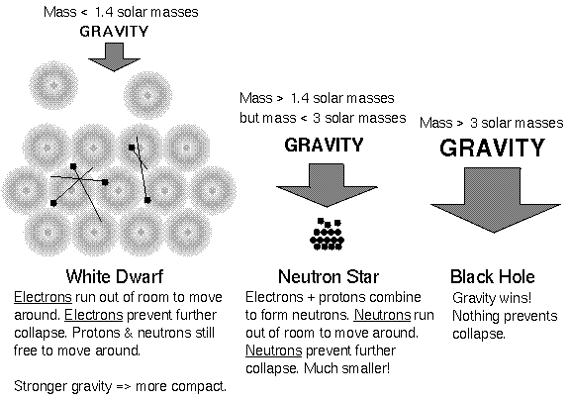
Electron Energy Levels

Slide 15
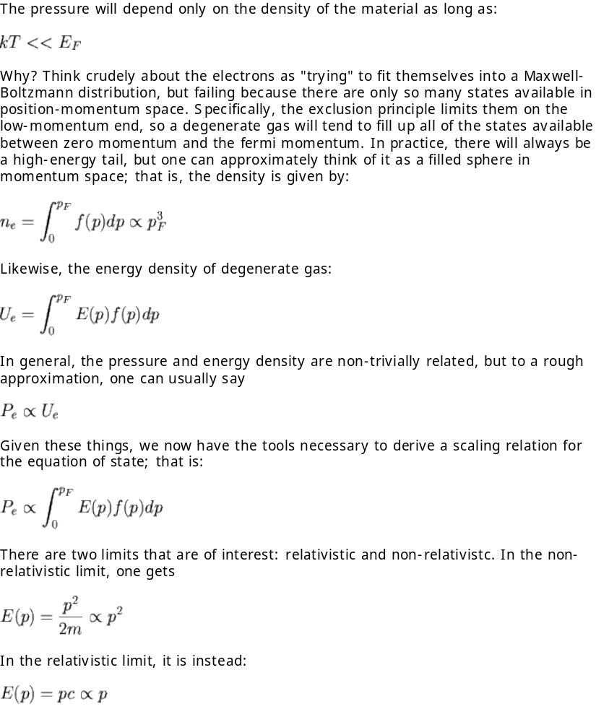
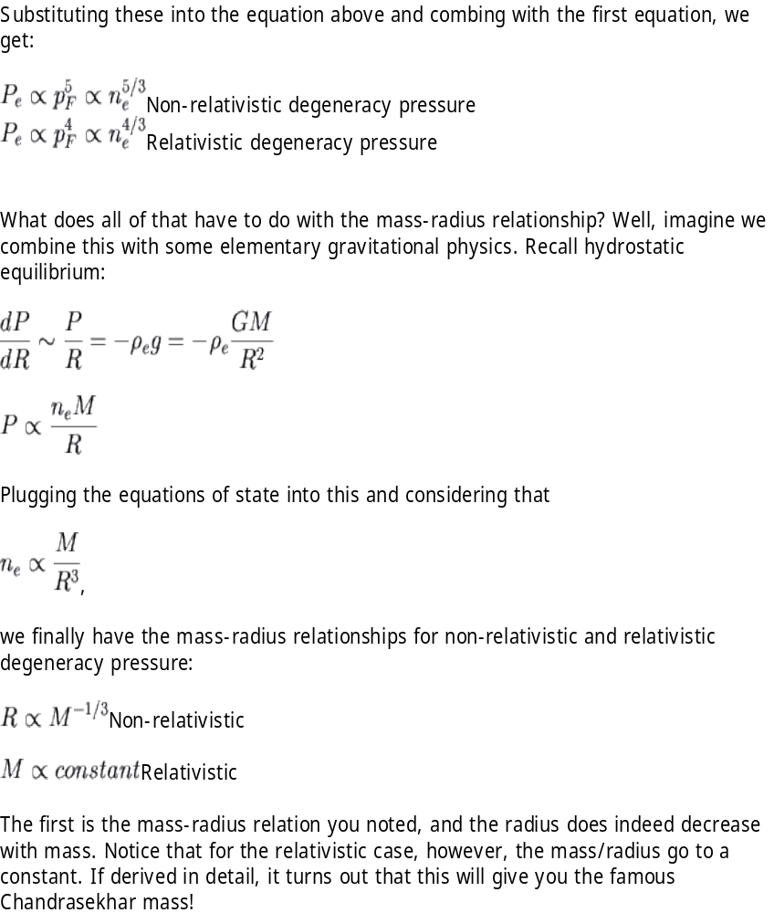
Details – For anyone interested

Slide 16
Interesting Facts
White Dwarf
  Average Mass= 0.4-0.6 solar masses
  Volume ~ 1,000,000 less than the sun
  Average Density ~10⁷ g/cm³
    1g of water would weigh over 20,000lbs
    Earth averages 5.5g/cm³, 1g of water=1cm³ on earth
Neutron Star
  Average Mass <1.4 solar masses
  Radius ~10km
  Average Density ~10¹⁴ g/cm³
    1 g of water would weigh over 200 billion lbs

Slide 17
We are all Star Dust
Extremely important for distributing various elements through the interstellar medium.
The Big Bang produced very little material besides hydrogen and helium, yet we know that most of our planet is composed of other elements.
These other elements were produced inside stars and during supernova explosions, and were disbursed into the interstellar medium by supernova remnants.
Eventually, the remnants cool and collapse to form interstellar clouds from which new stars and planets can be formed.

Slide 18
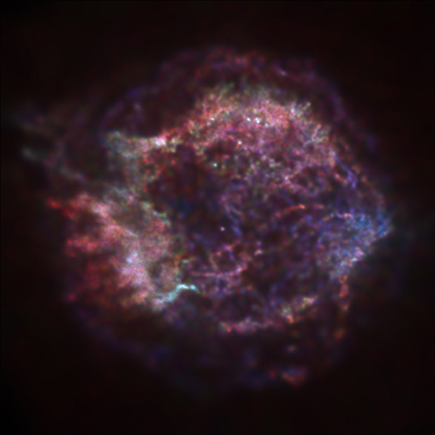
Views from Above
Cassiopeia A
  Oxygen-rich Galactic supernova remnant

Slide 19
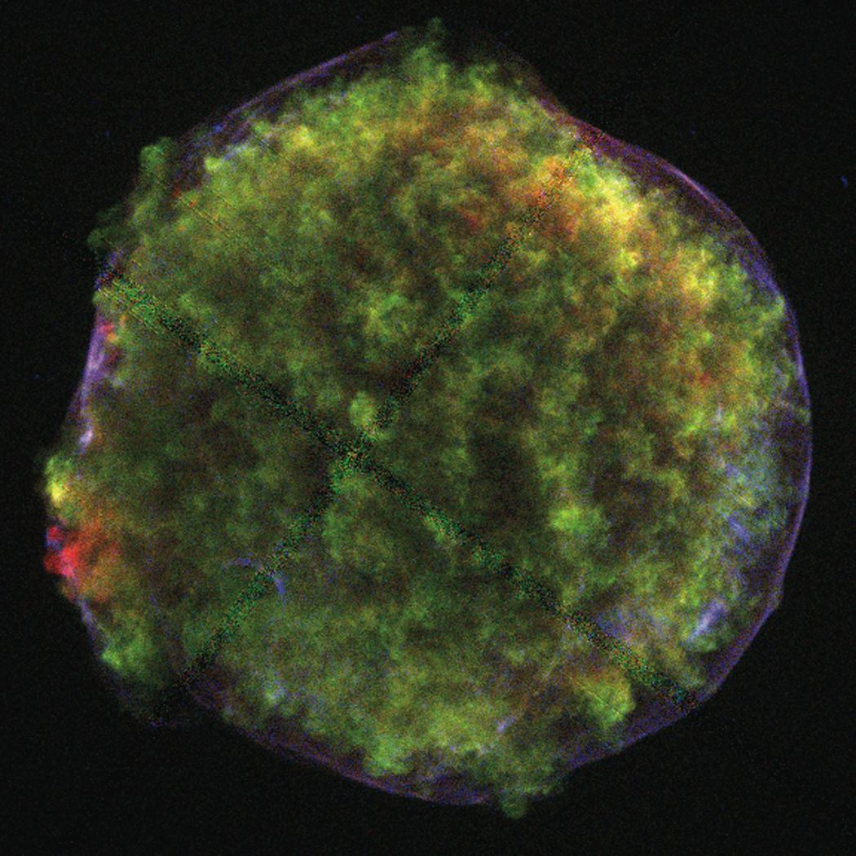
Chandra X-ray image of the Tycho supernova remnant showing iron-rich ejecta (red features), silicon rich ejecta (green features), and featureless spectra from the forward shock (blue rims).

Slide 20
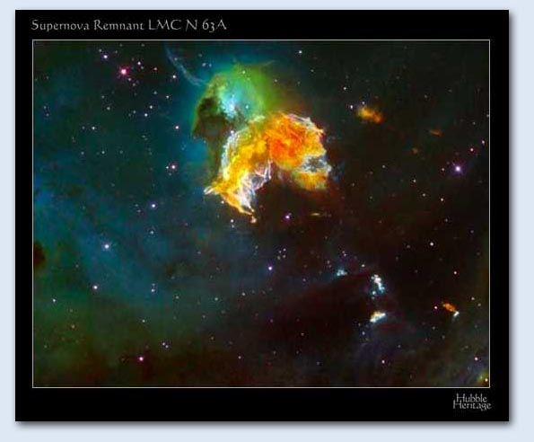

Slide 21
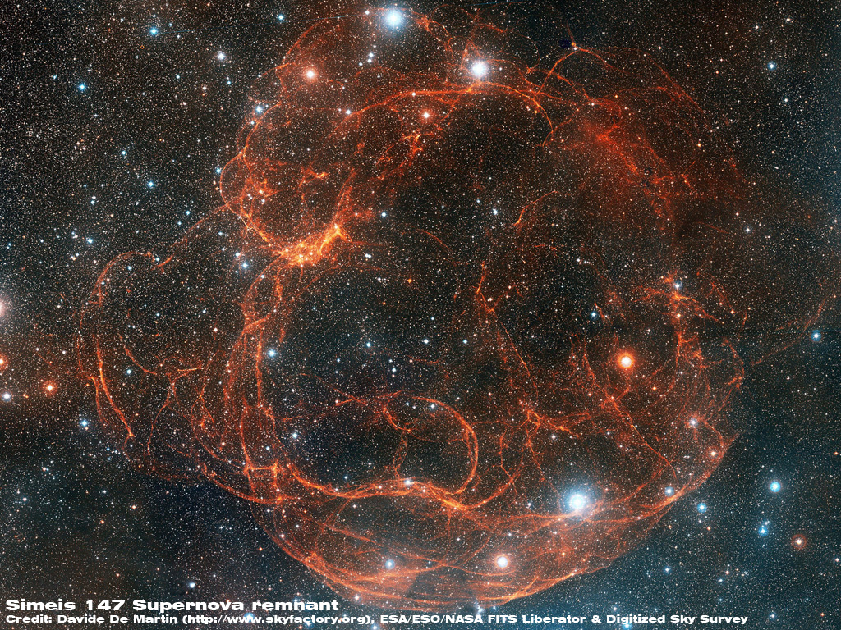

Slide 22
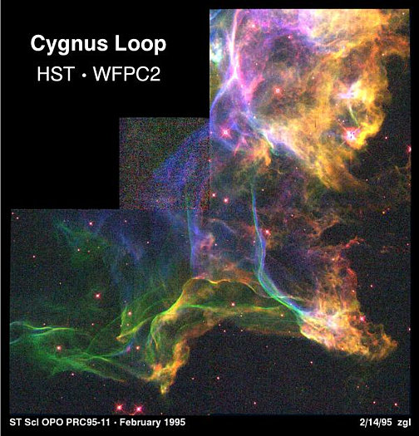

Slide 23
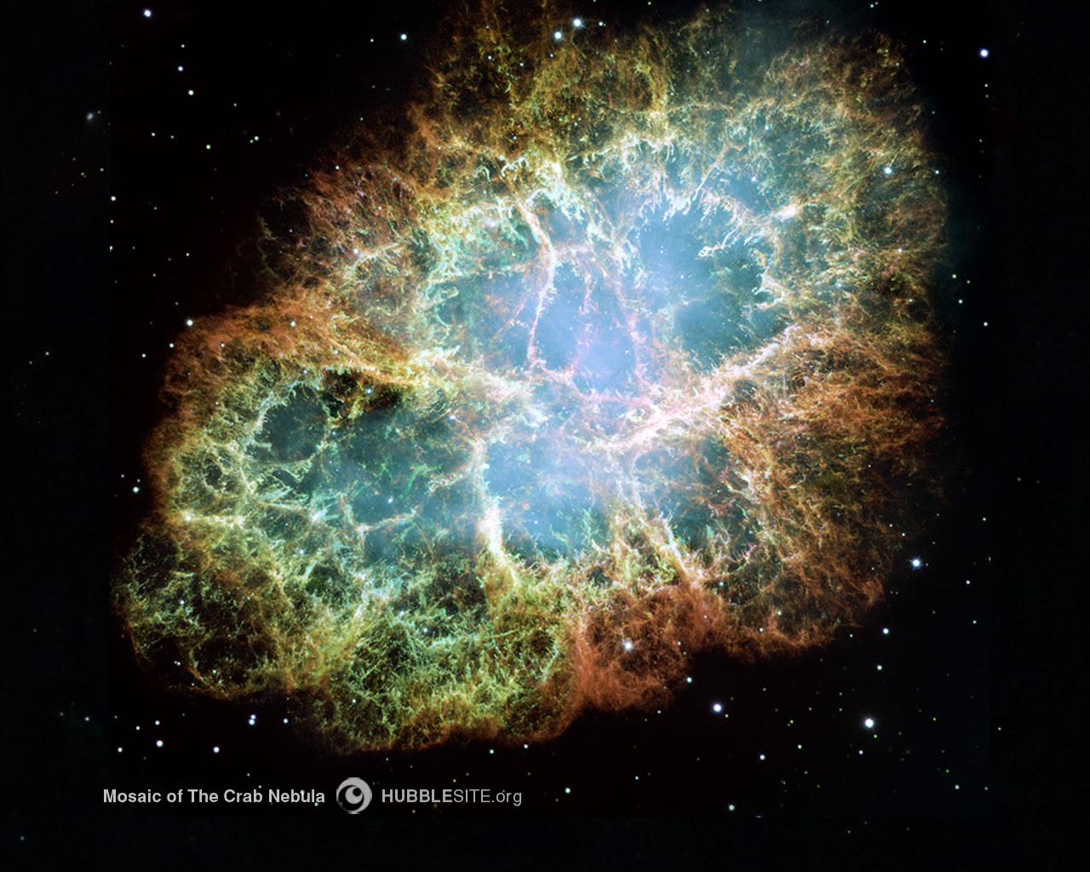

Slide 24
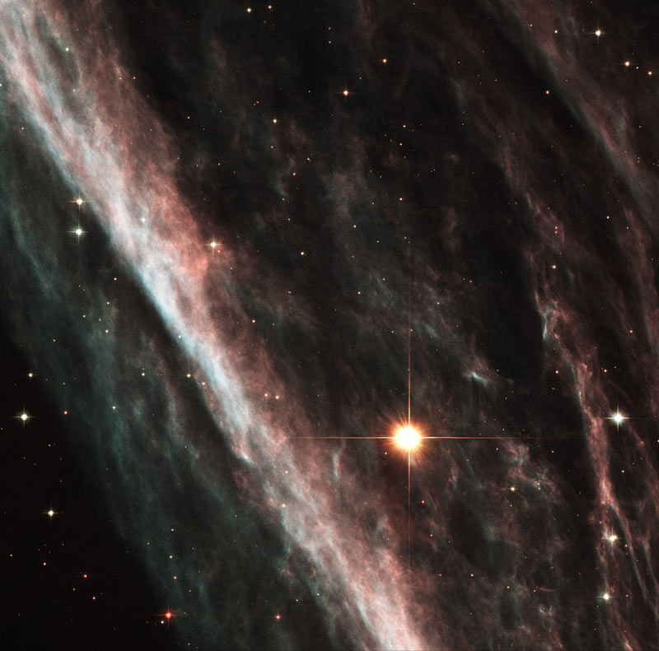
The Pencil Nebula is part of the huge Vela supernova remnant, located in the southern constellation Vela

Slide 25
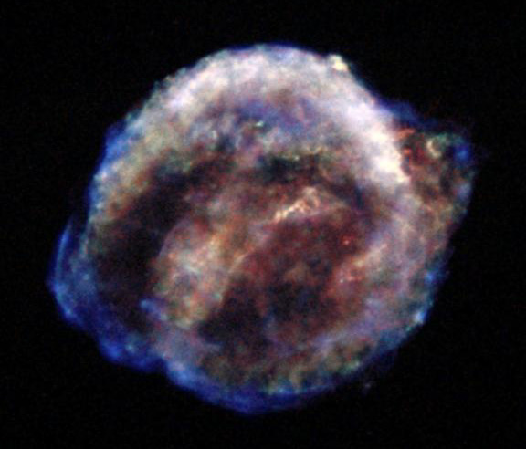
Kepler’s SN1604
Ophiuchus
  Right Ascension17 : 30.6 (h:m)
  Declination-21 : 29 (deg:m)
  Distance < 20,000 (ly)
  Visual brightness -2.5 (mag)

