Slide 1
Saturn 2007
Heart of the Valley Astronomers

Slide 2
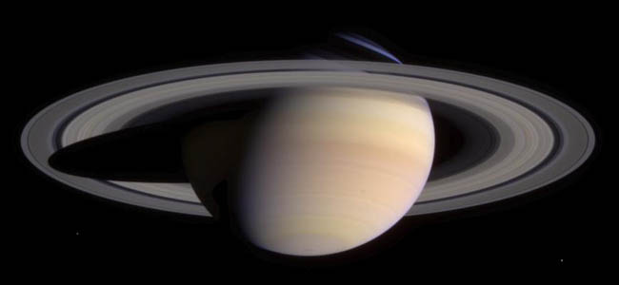
Saturn
6th from Sun; 9.5 A.U. from Sun
This gas-giant is known for its low density.
Rings are easily seen in small telescopes.

Slide 3
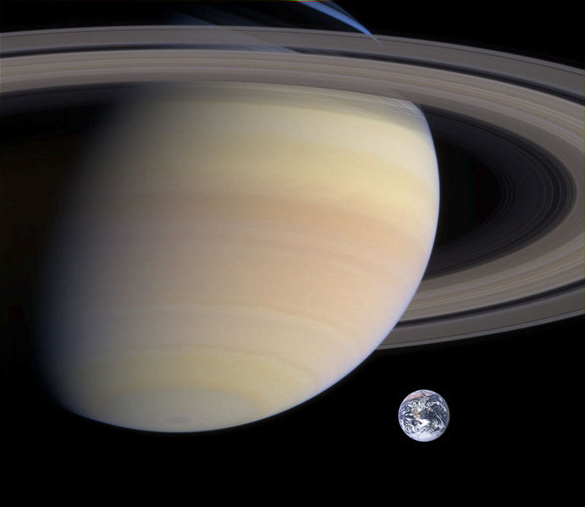
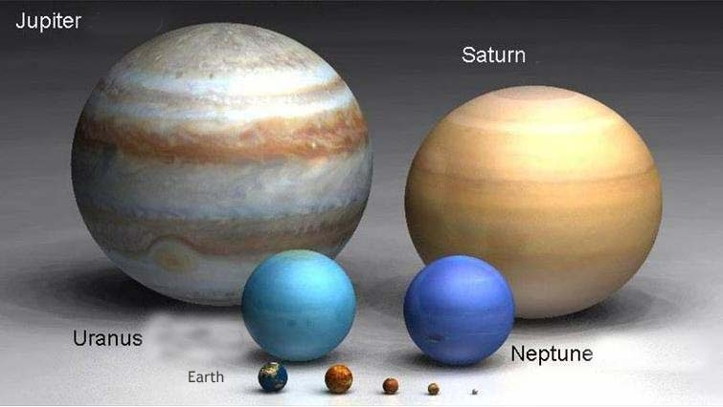
Saturn in the Solar System’s context

Slide 4
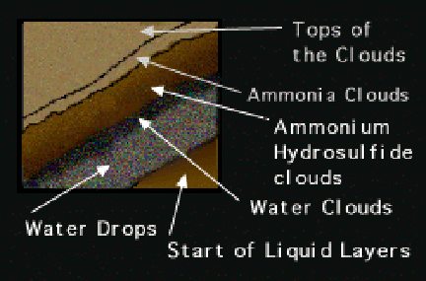
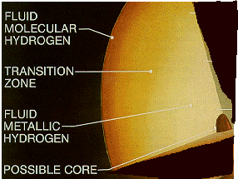
Saturn’s Introduction
Rotational period differs from equatorial & polar areas
75% hydrogen and 25% helium
  Traces of water, methane, ammonia and silica rock
12,000+K @ core – where does this originate?
  Heat generated from gravitational compression
  Possibly more from helium “rain” through lighter H_{²}

Slide 5
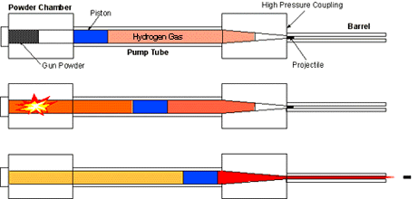
How can we generate metallic hydrogen?
Light gas gun
Reproduced LMH in laboratory conditions (1996)
Temperature at 3,000+ Kelvin
Pressures of over a million atmospheres
LMH only lasted for a microsecond

Slide 6
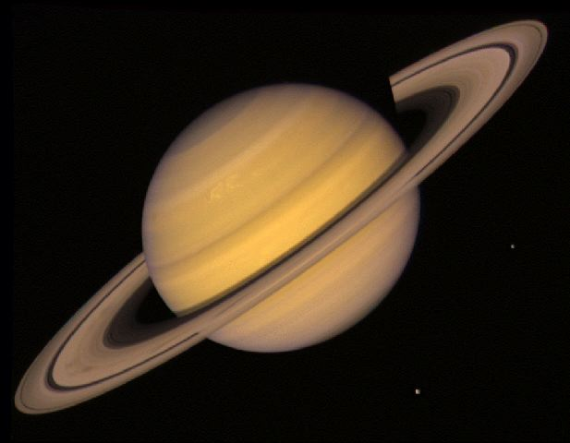
Equatorial & polar diameters vary by >10%
(75,335 miles vs. 67,955 miles)

Slide 7
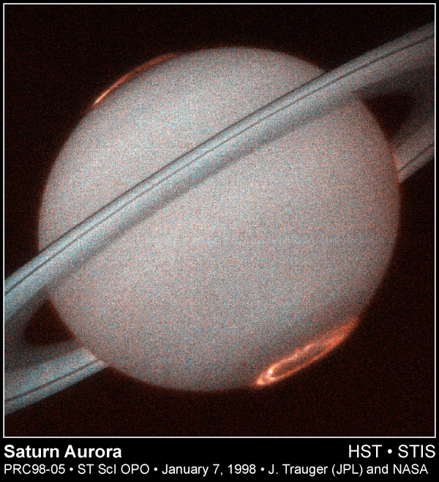
In addition to weather systems with several-hundred mph winds, Saturn possesses a large magnetic field, resulting in auroras.

Slide 8
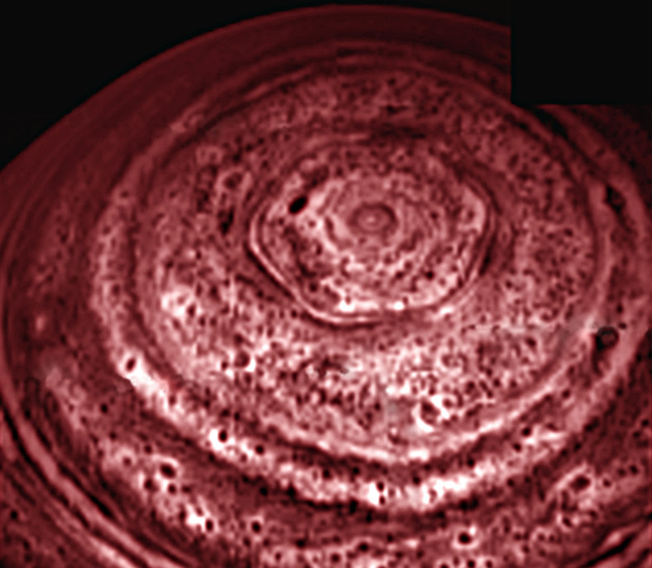

Slide 9
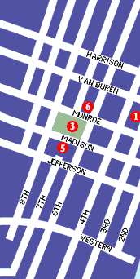
Ring Dimensions:
Over 150,000 miles in diameter, but…
Width is about 1 km, tops

Slide 10
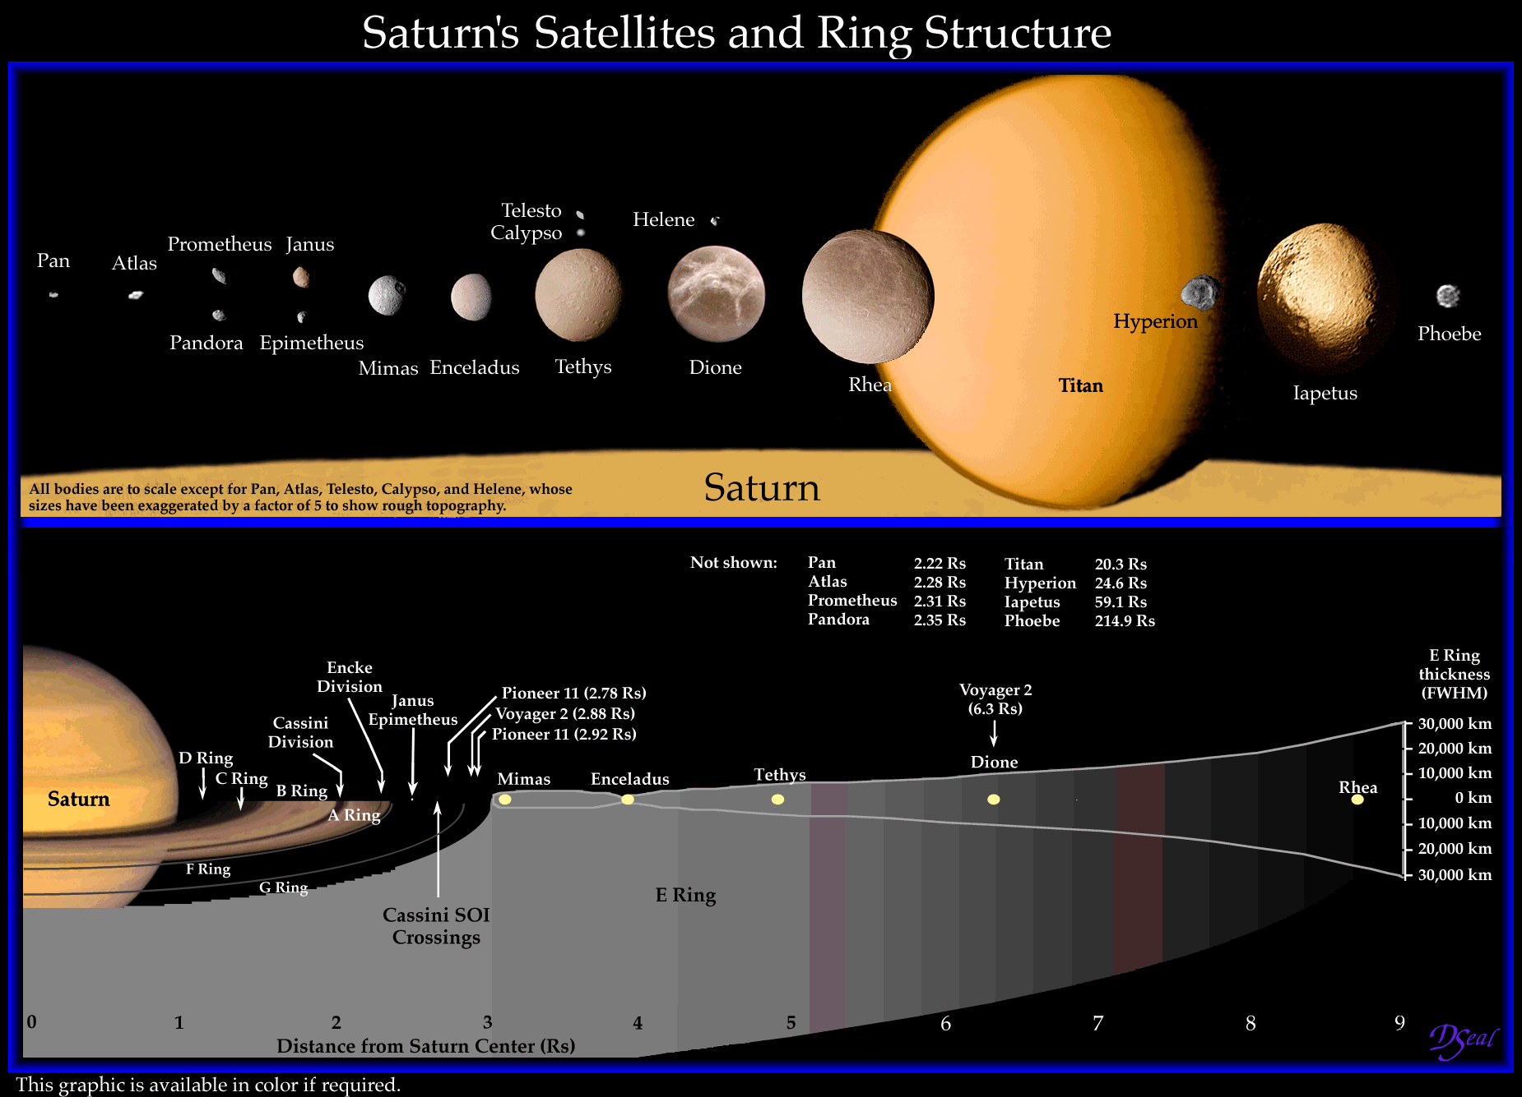

Slide 11
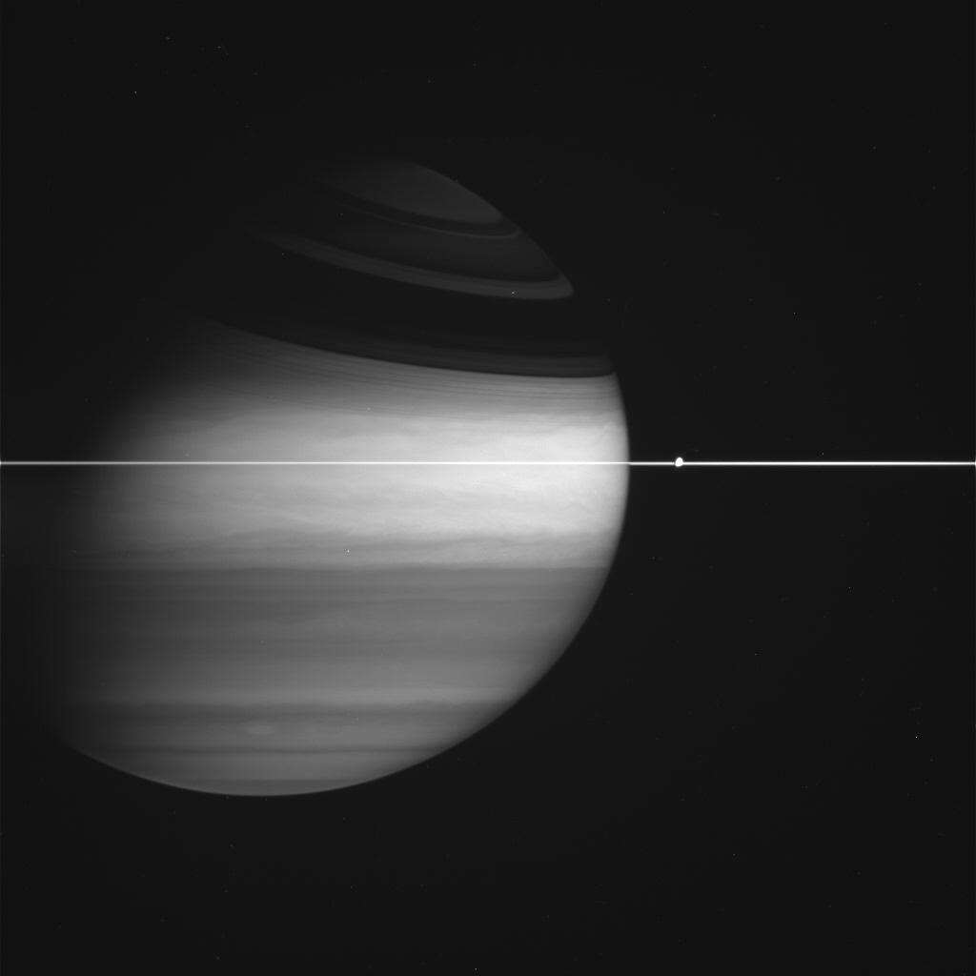
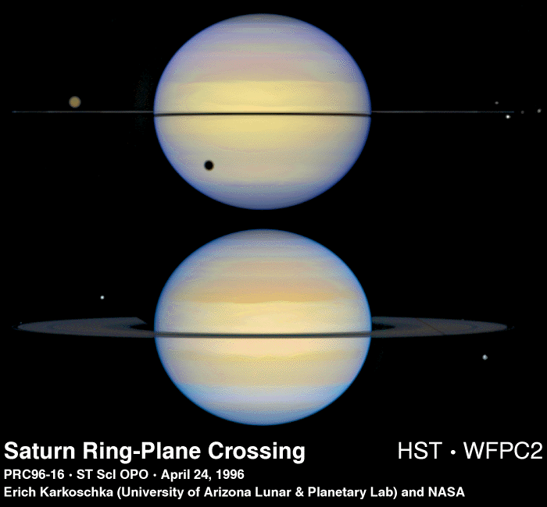
Moon/Ring interactions

Slide 12
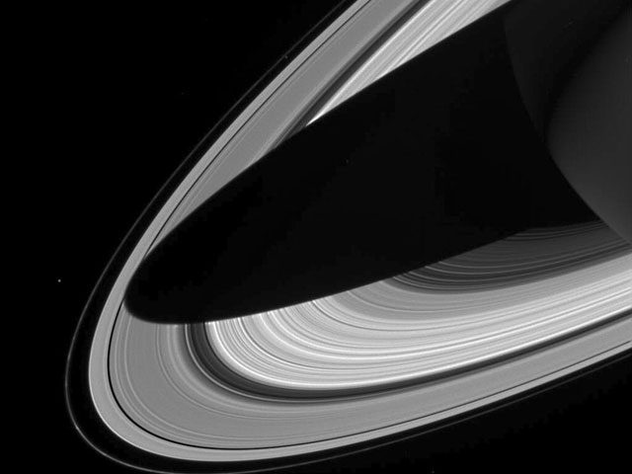

Slide 13
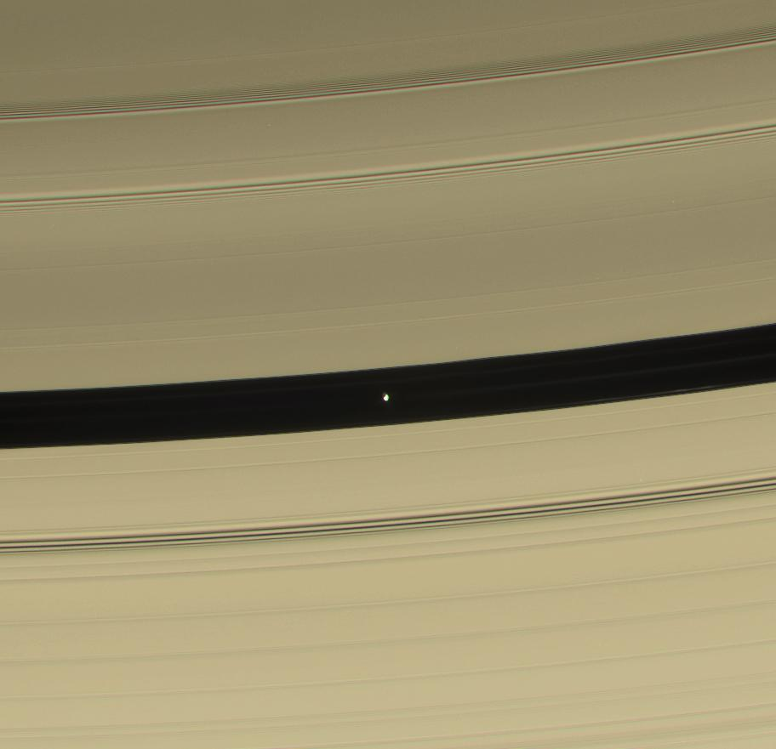
Pan in the Encke Division

Slide 14
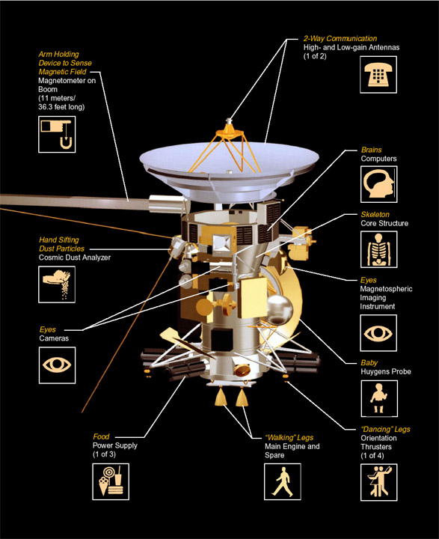
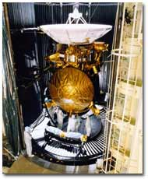
Explorations
Saturn orbiter/Titan atmospheric probe.
Launched 1997, arrived at Saturn 2004.

Slide 15
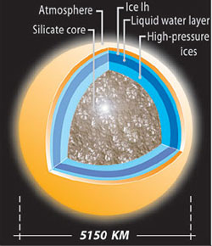
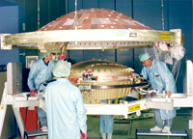
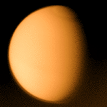
Titan
Saturn’s largest moon, with thick nitrogen atmosphere.
Heavy clouds prevail.
Recently visited by Huygens probe.

Slide 16
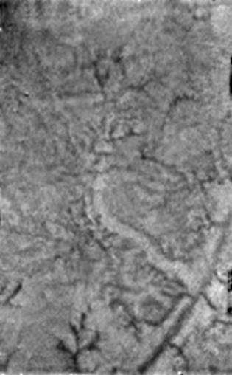
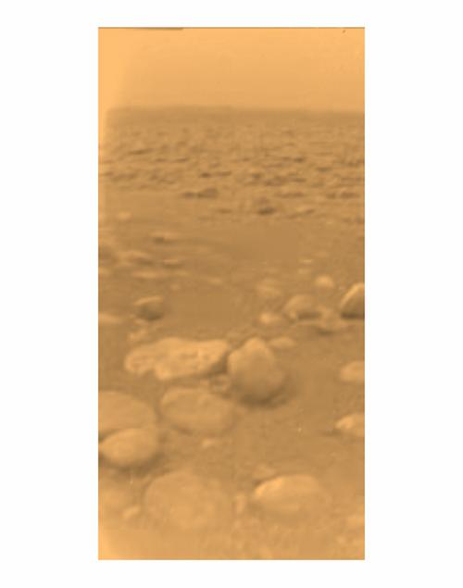
Huygens at Titan

Slide 17
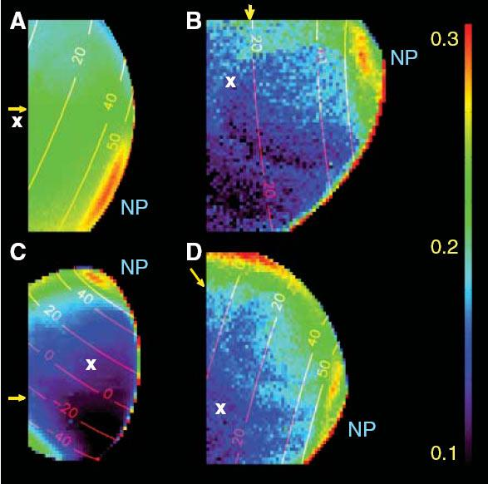
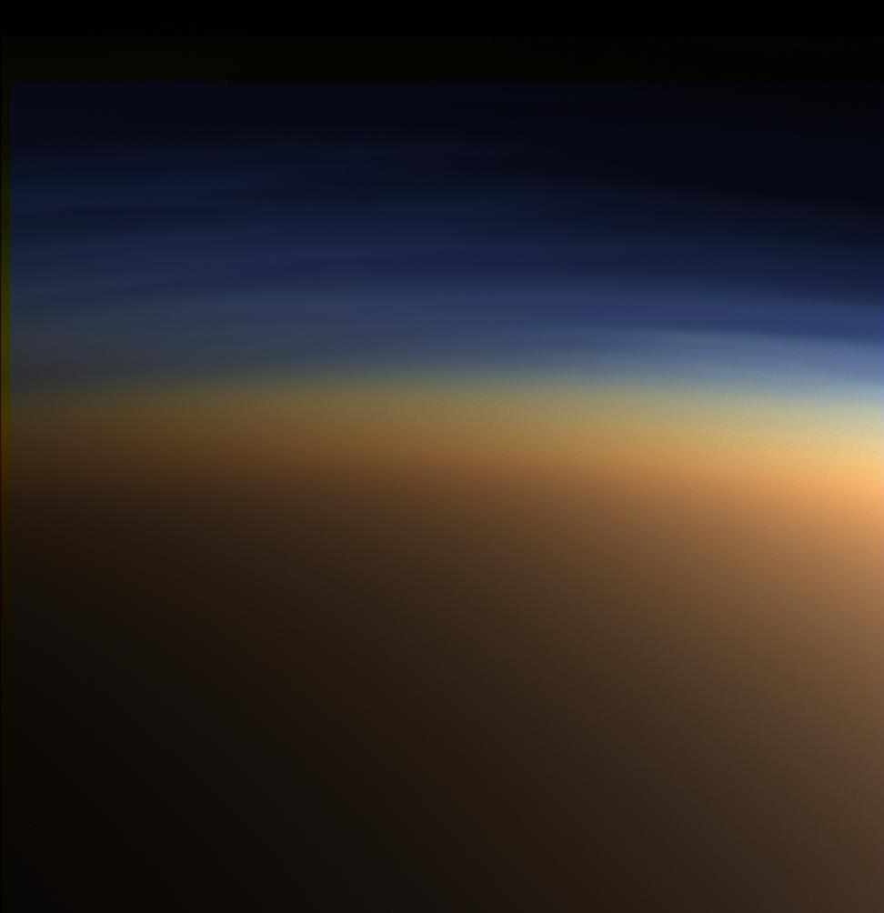
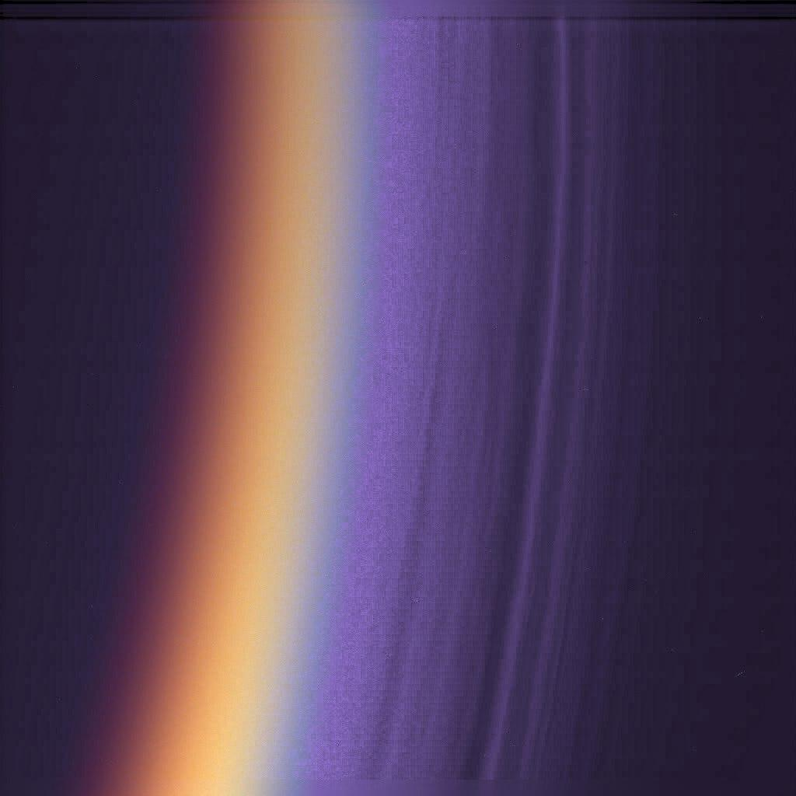
Titan’s Atmosphere
98.4% N², 1.6% NH³, & traces of hydrocarbons, Ar, CO², CO, HCN, & He.
Hydrocarbons are thought to form in Titan's upper atmosphere in reactions resulting from the breakup of methane by the Sun's ultraviolet light.

Slide 18
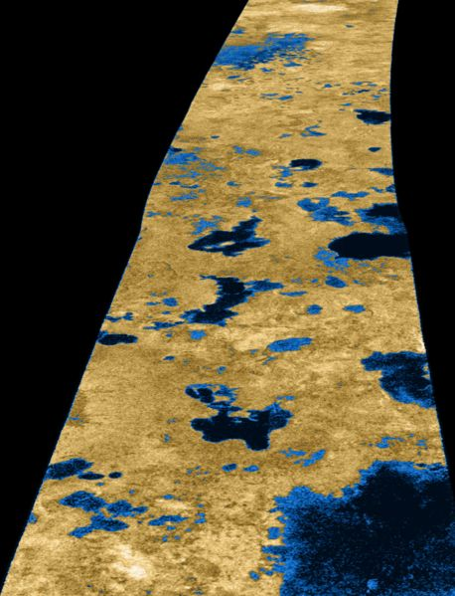
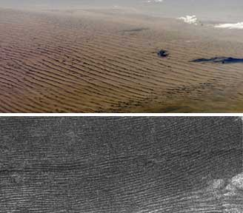
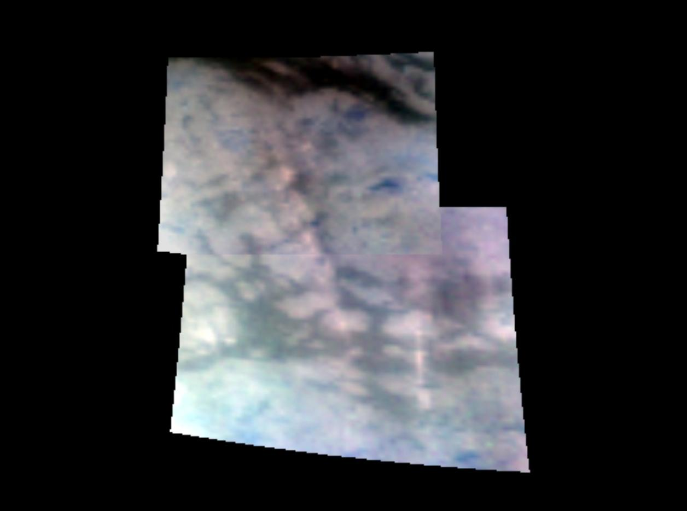
Titan Landforms
Surfing, 4-wheeling, or skiing sites?

Slide 19
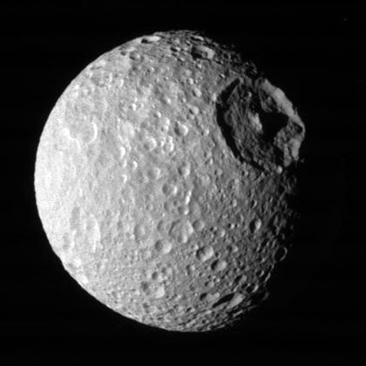
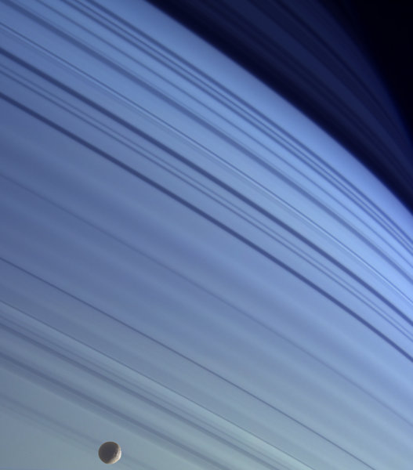

Slide 20
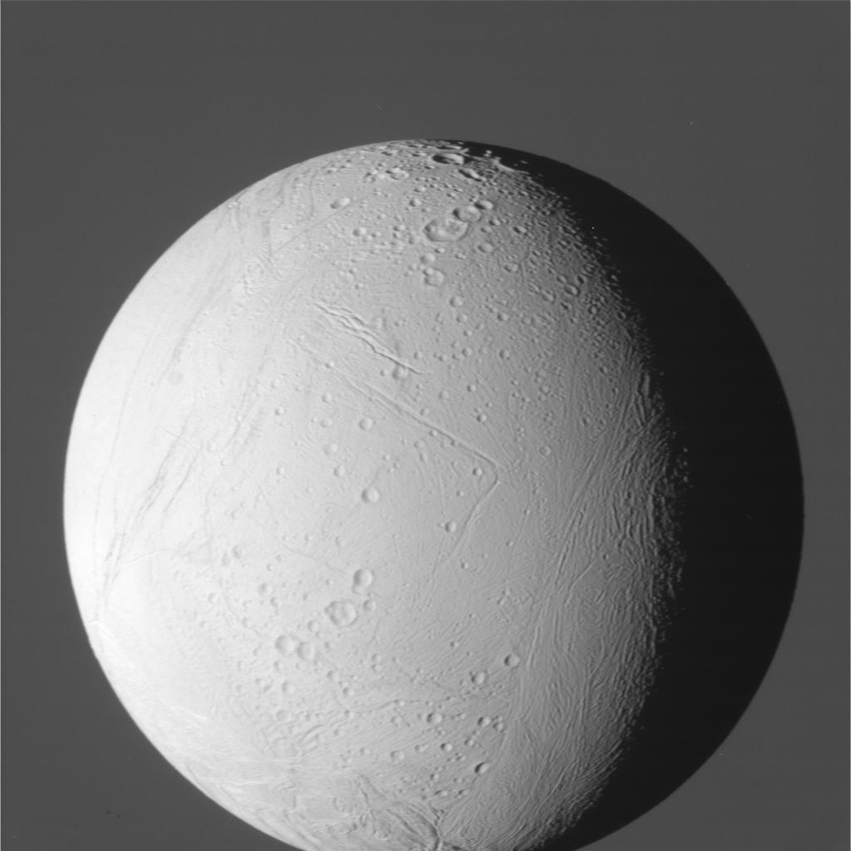
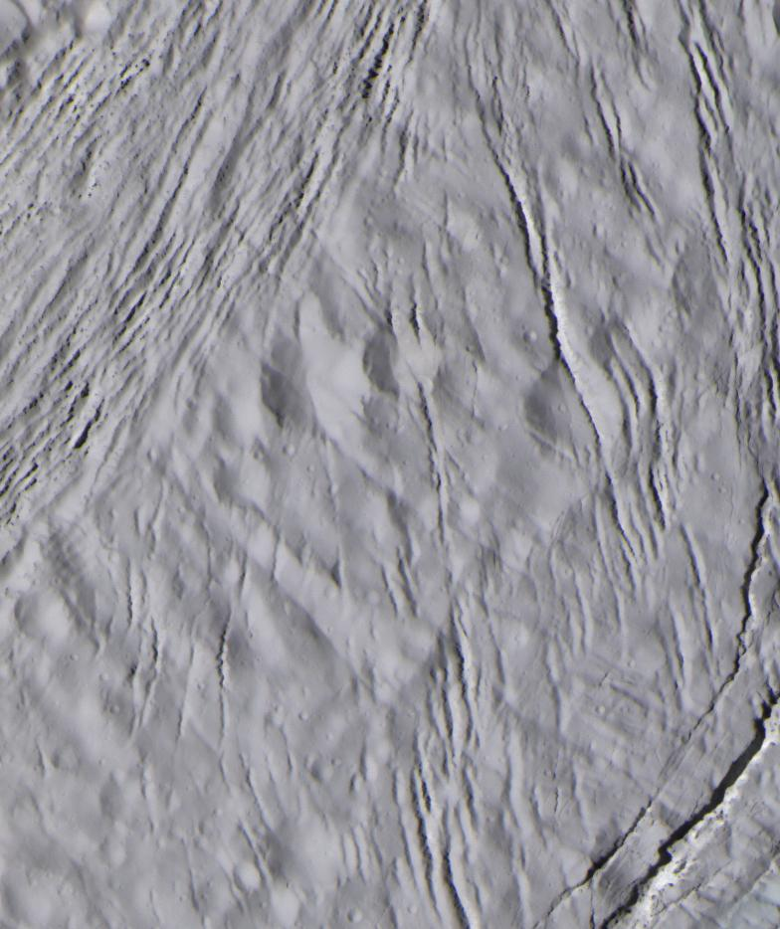
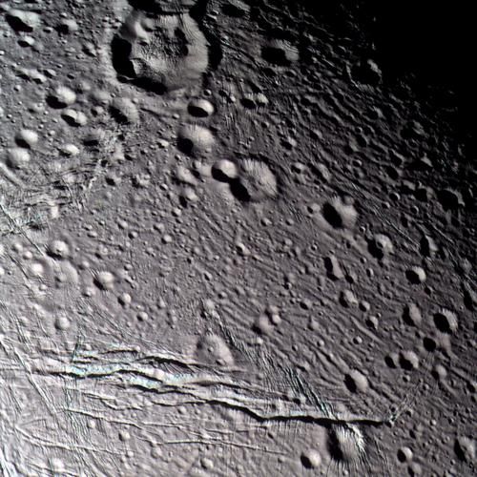
Cassini visits Enceladus

Slide 21
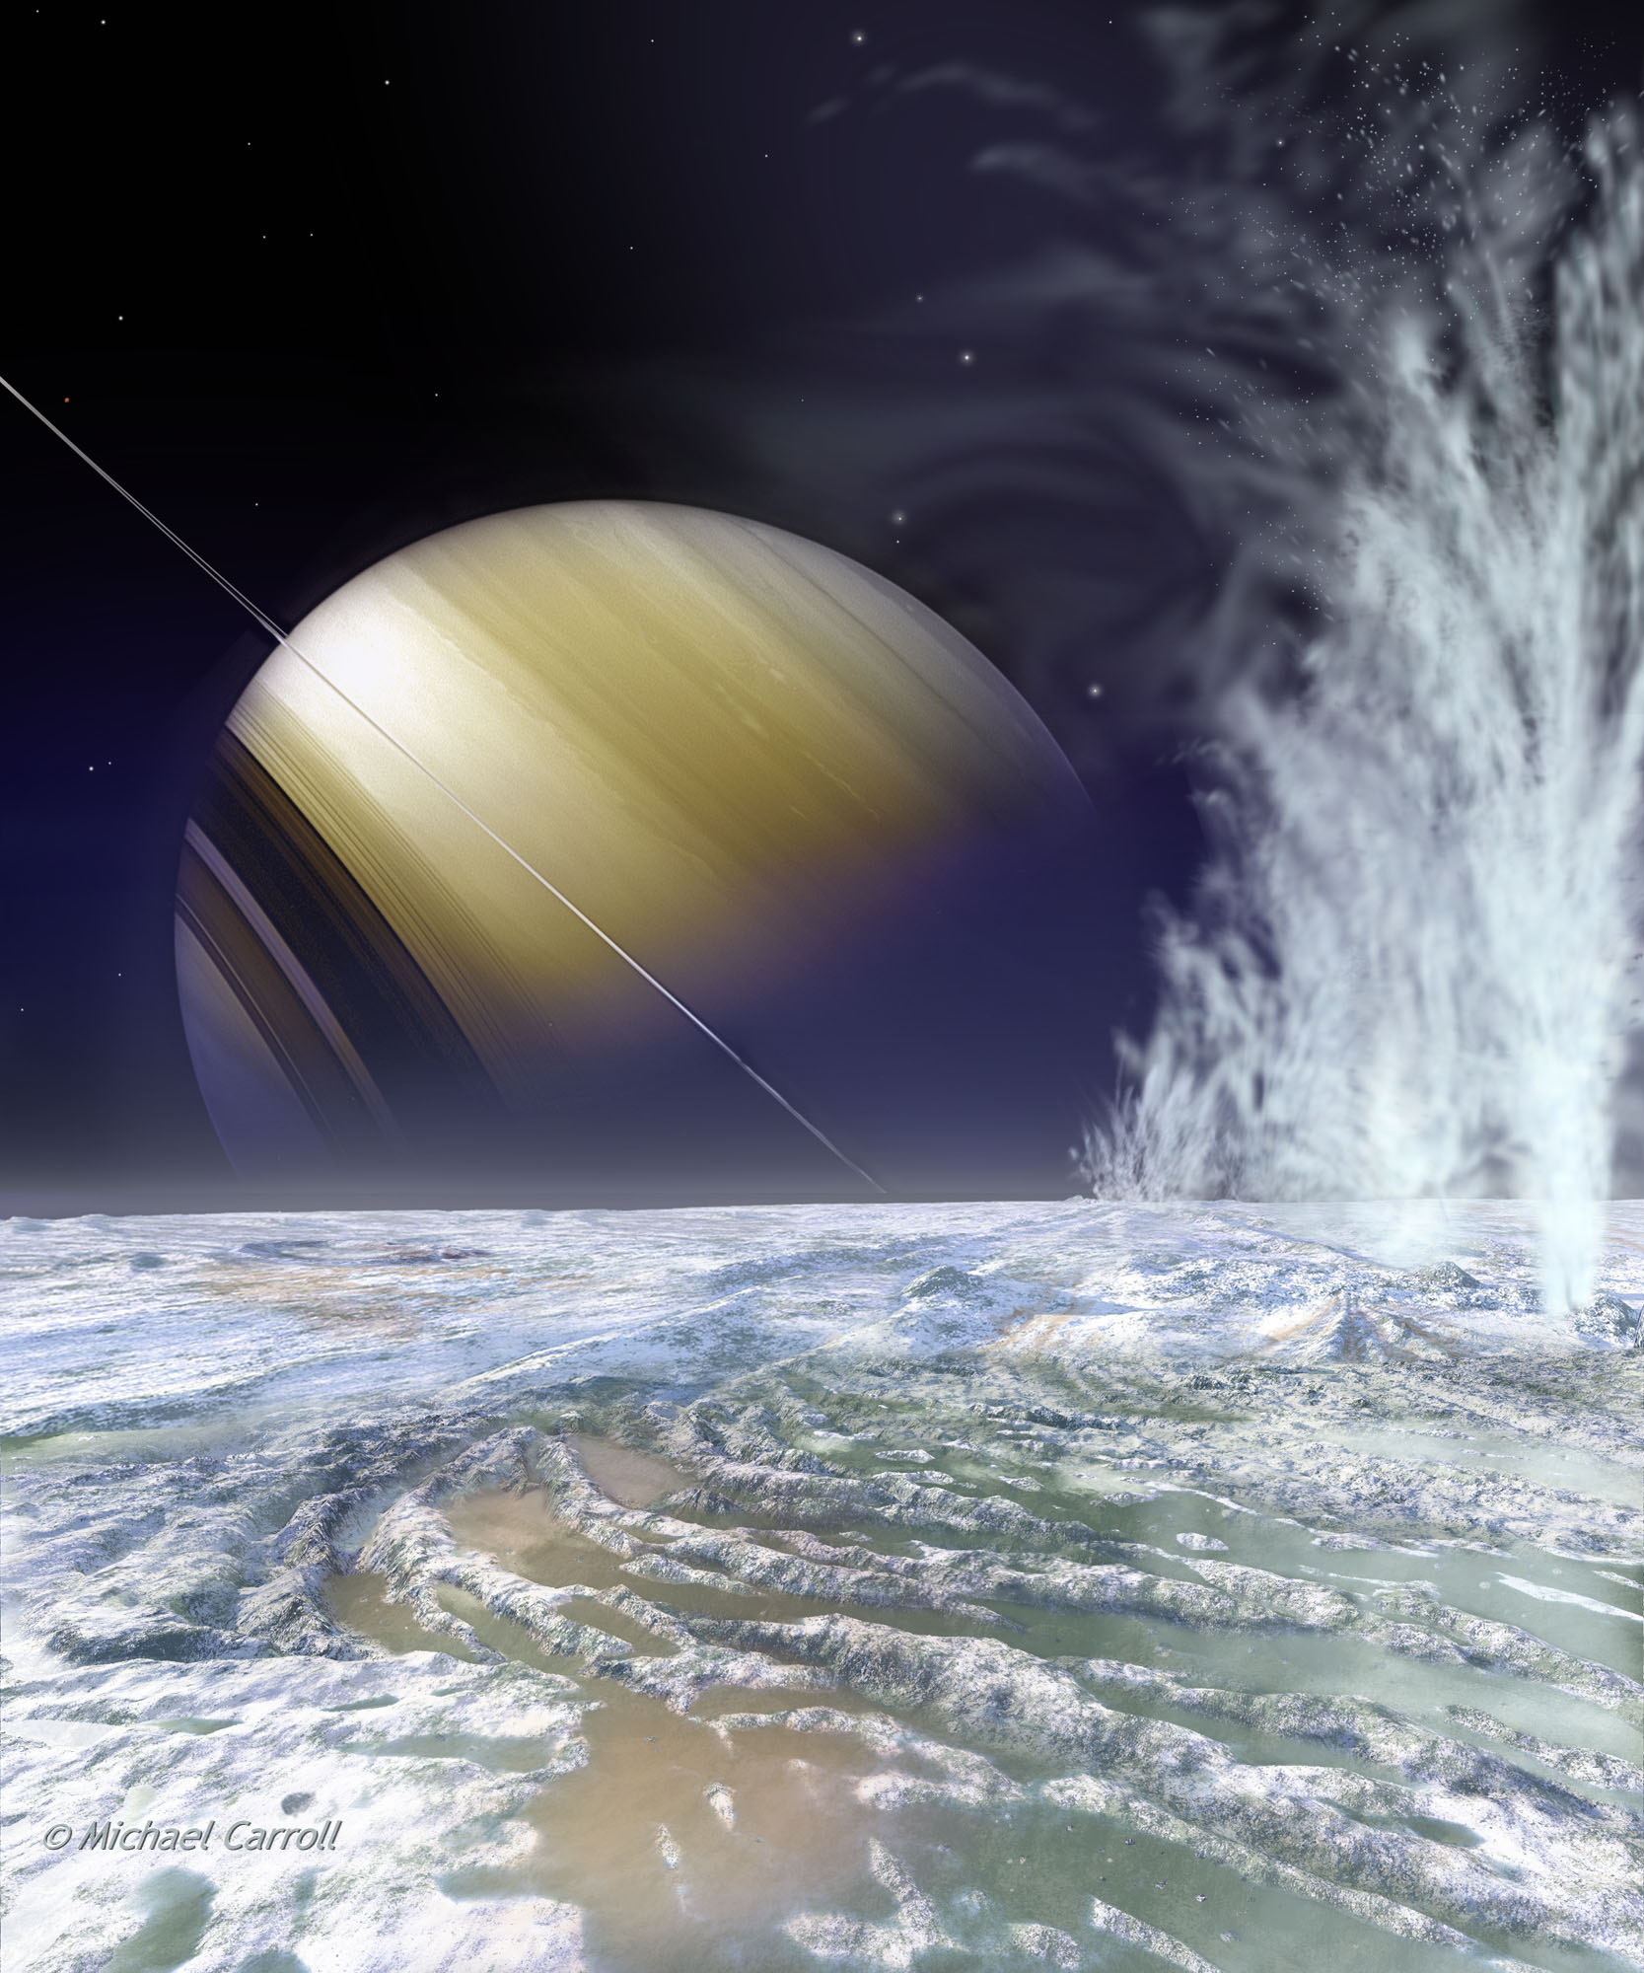
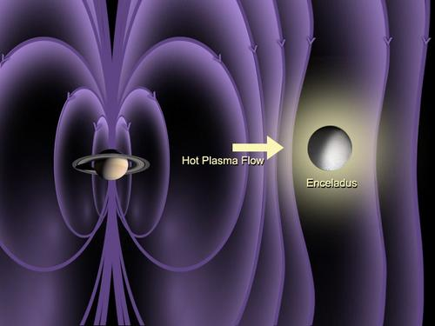
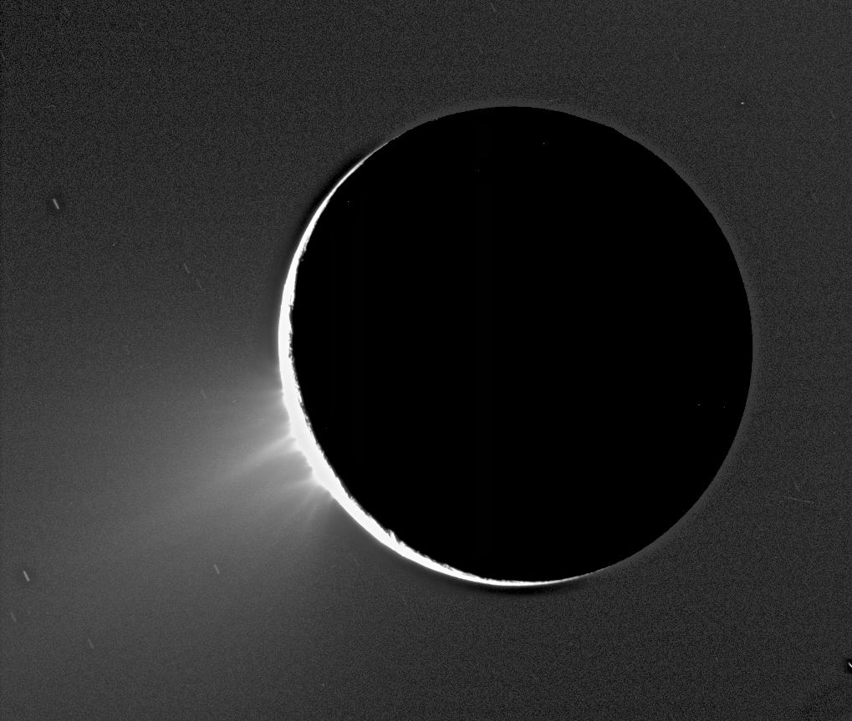
Enceladus & geysers

Slide 22
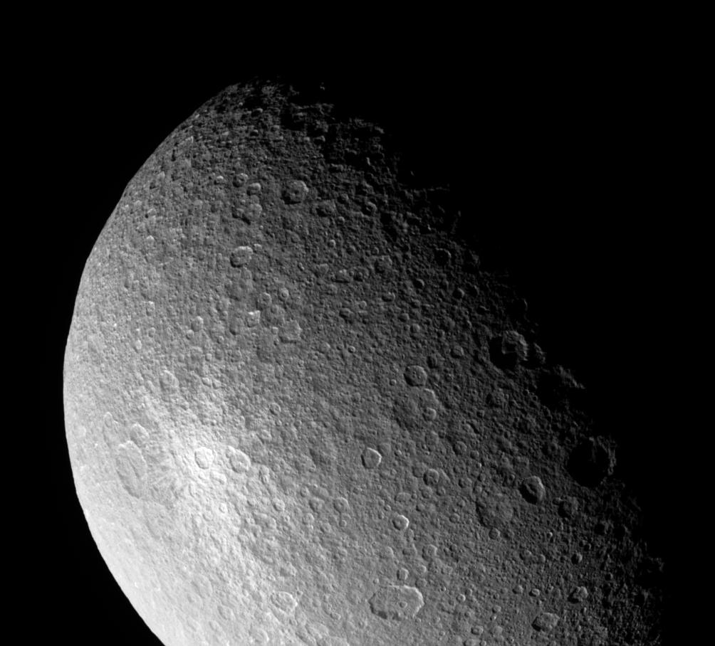
Rhea & Ice impact

Slide 23
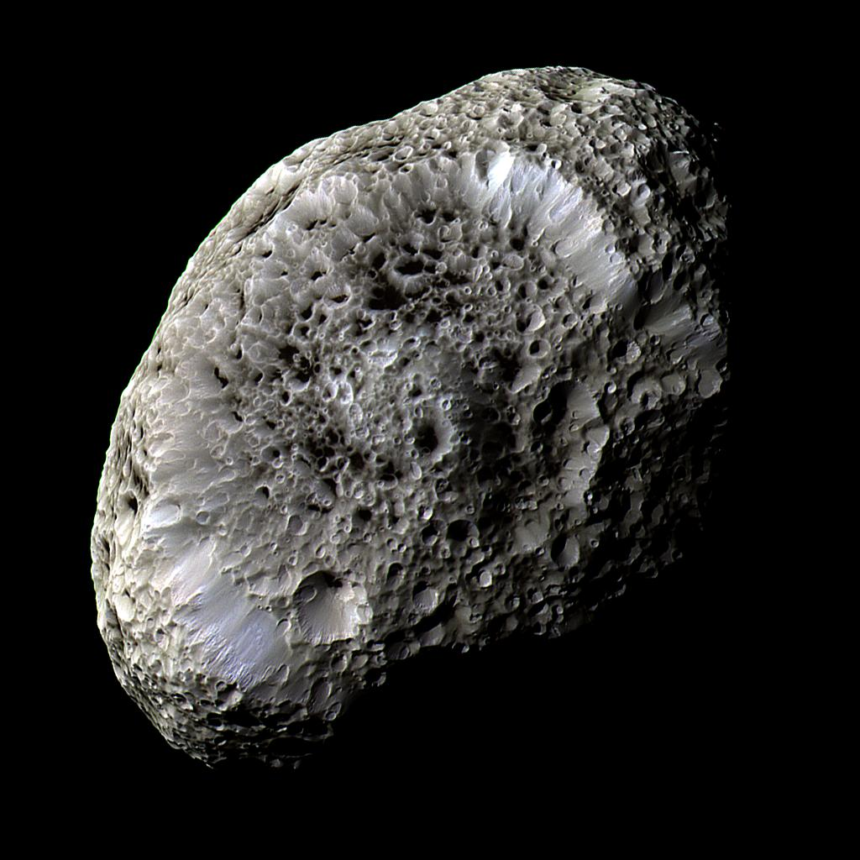
Hyperion (!)
Chaotic rotation is a distinguishing feature.
So is cratered appearance – dark material appears to line bottoms.

Slide 24
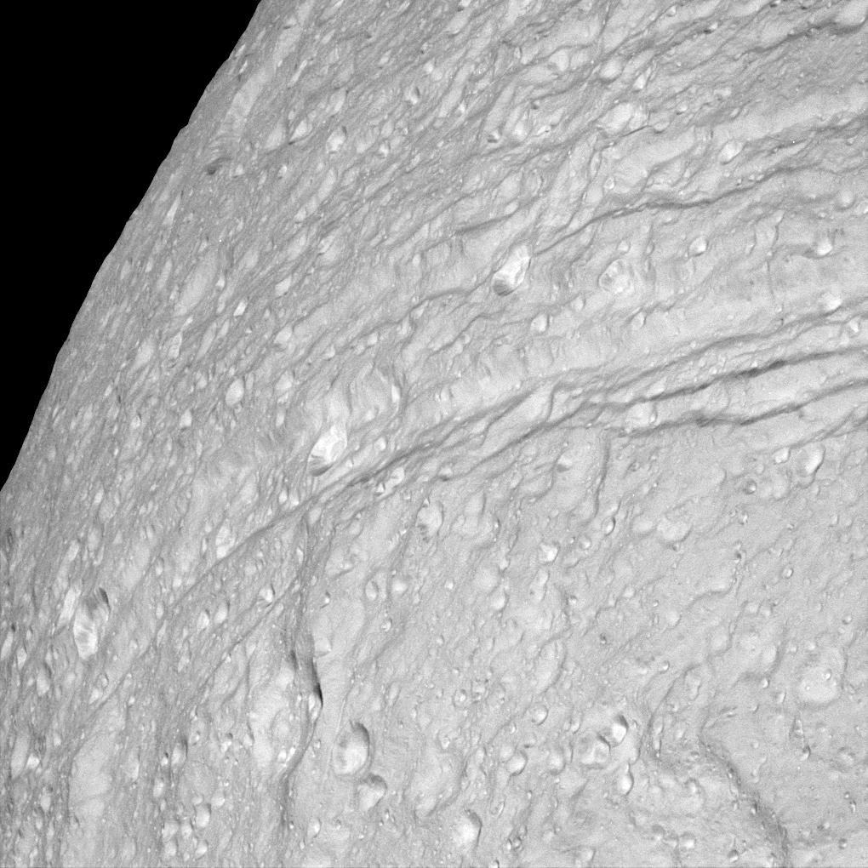
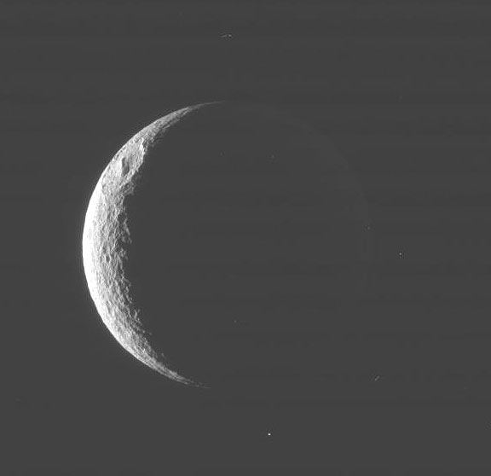
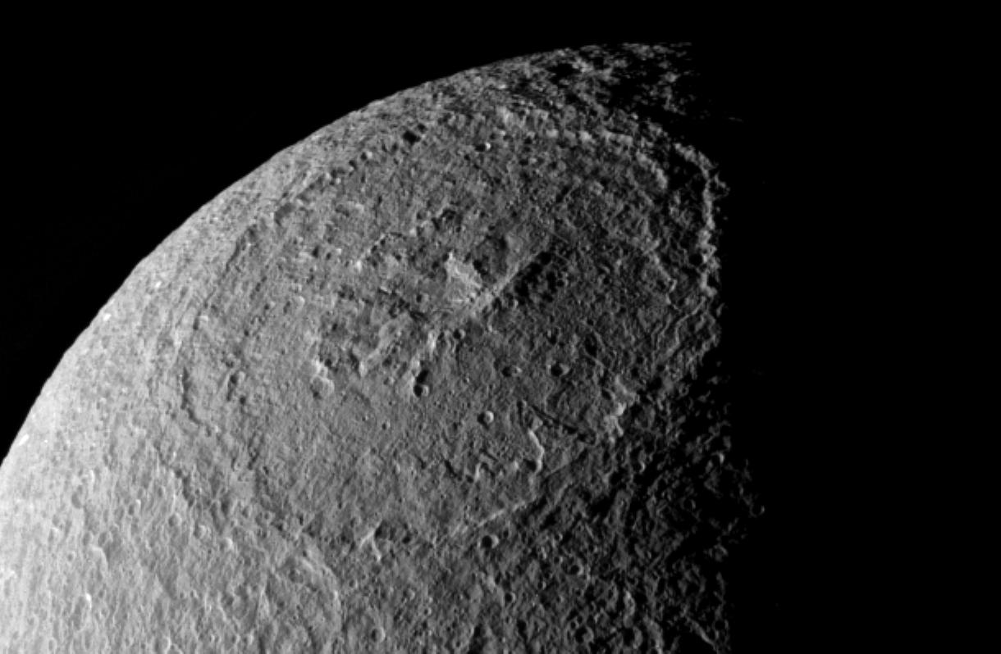
Tethys & basin
Crater Odysseus is about 250mi in diameter
Ithaca Chasma – 63mi wide, 2+mi deep, & running over 1,200miles.

Slide 25
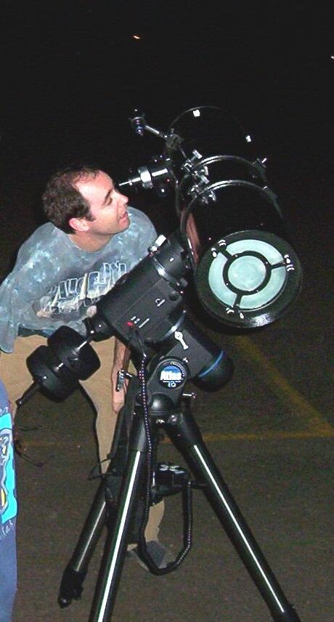
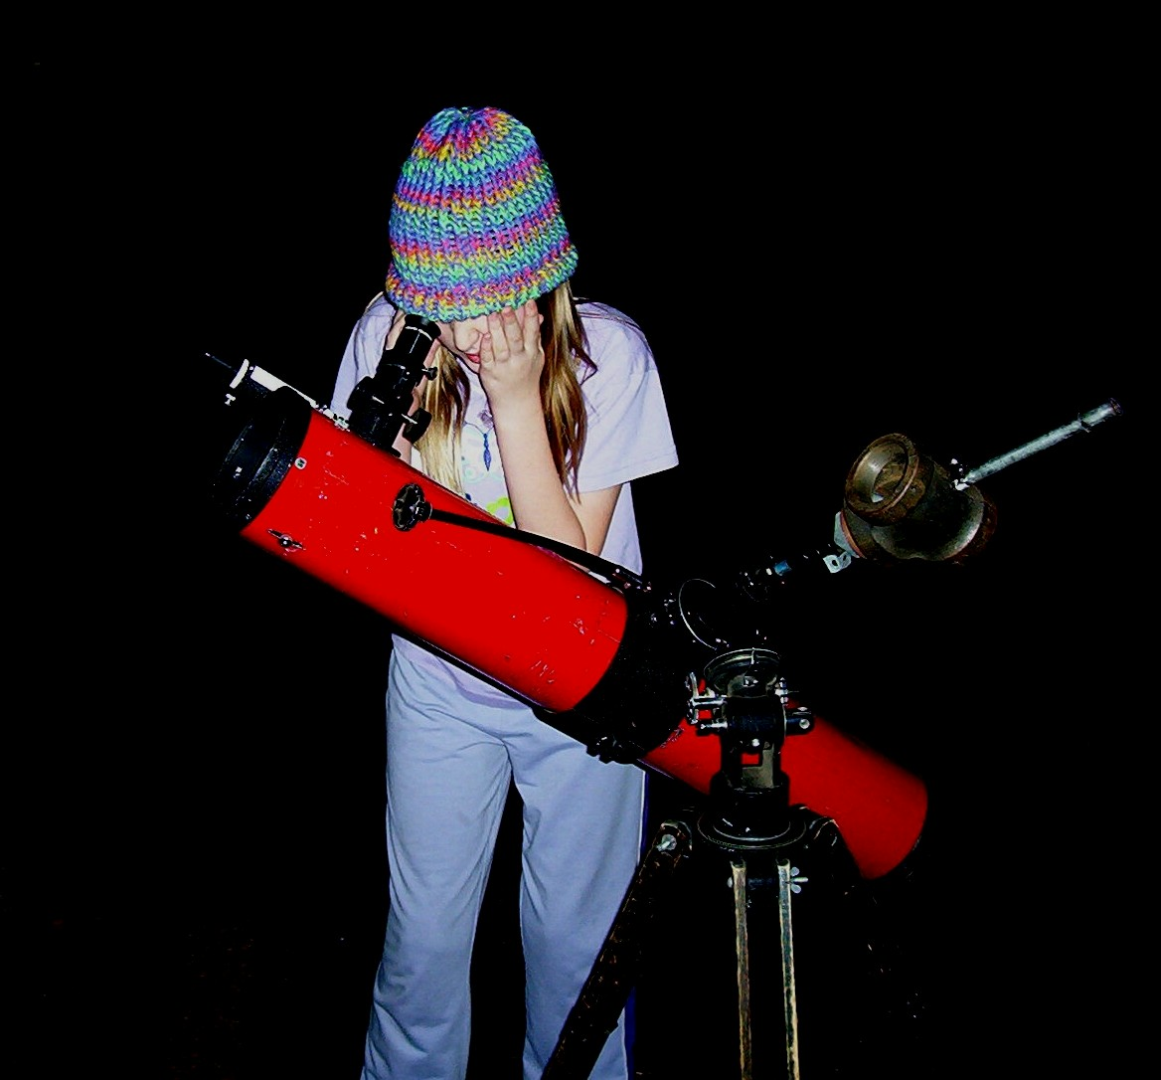
Personal contemplating

Slide 26
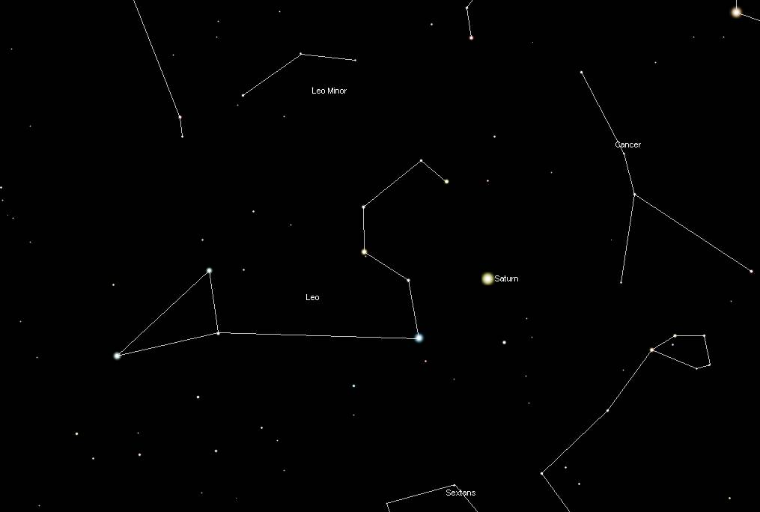

Slide 27
Viewing Saturn remember, it doesn’t take much aperture
View well away from Sun
Cloud bands are subtle – try locating only when high in sky. Colored filters can help (Wratten 80a, 47, 25)
Colors are subtle but fun to discern
Dress appropriately, sit if you can
Moon locations – Sky & Telescope magazine or download http://www.mew3.com/palm/saturn/doc/
American Association of Lunar & Planetary Observers - http://www.lpl.arizona.edu/alpo/

Slide 28
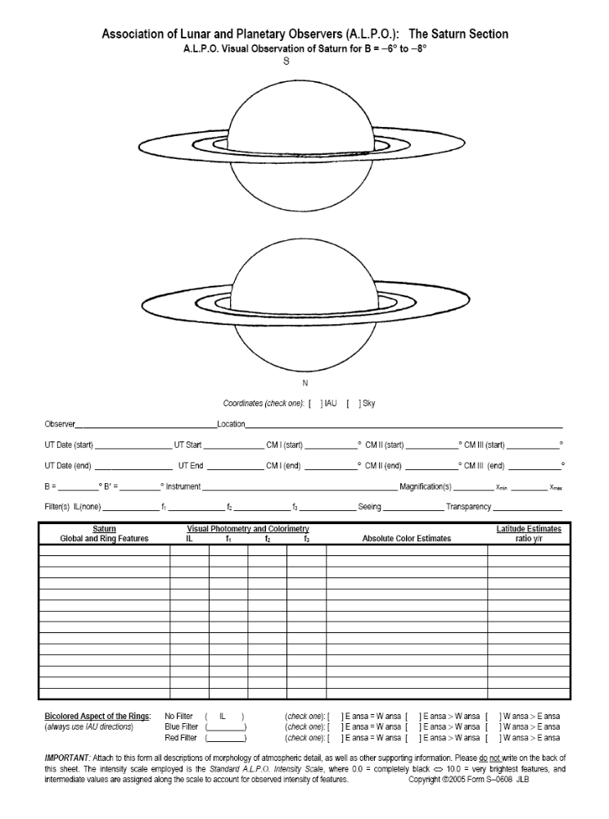

Slide 29
Your Thoughts?

