Slide 1
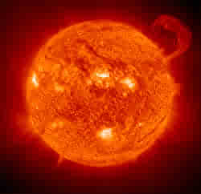
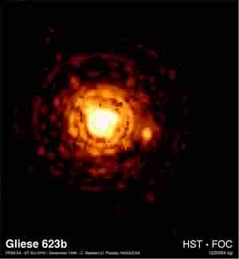
The life of stars
The life of stars
Notes:
Introduce myself
Tell them about my interest in astronomy and physics
Ask them to tell me about them – why are they here?

Slide 2
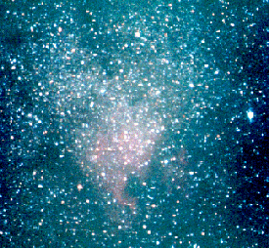
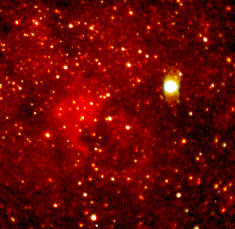
The Interstellar Medium
Notes:
Huge clouds of gas and dust are the starting points for stars to be born.
Most of the universe is composed of hydrogen and helium so the interstellar clouds are composed of these elements (with very small amounts of impurities if other stars existed previously or injected material into the cloud from a supernova.
Something shocks the cloud and things begin to happen. The gas starts to condense

Slide 3
What is a light year?
How many miles in a light year?
Why is it called a light year?
Just how fast is light?
Notes:
186000 miles per second
300000 kilometers per second
One Kilometer is about equal to .62 miles.

Slide 4
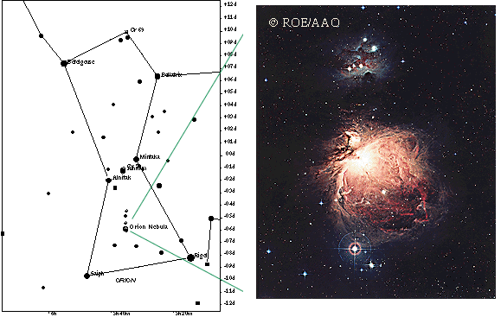
Constellation of
Orion
M42 – The Great Orion
Nebula
Notes:
M42 – Messier 42 is a vast star forming region about 1600 light years distant from earth

Slide 5
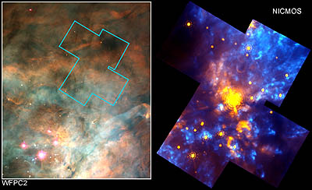
Notes:
Hubble telescope close up of a section of the Orion nebula near the trapezium.

Slide 6
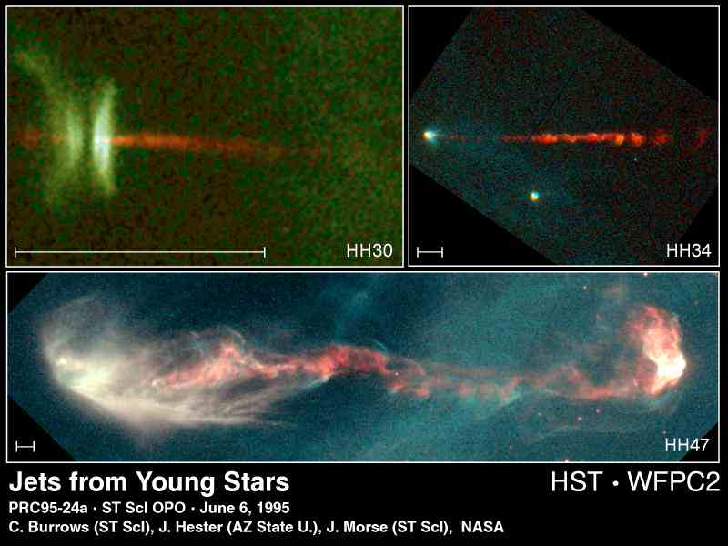
Notes:
As stars form they often release jets of gas and dust.

Slide 7
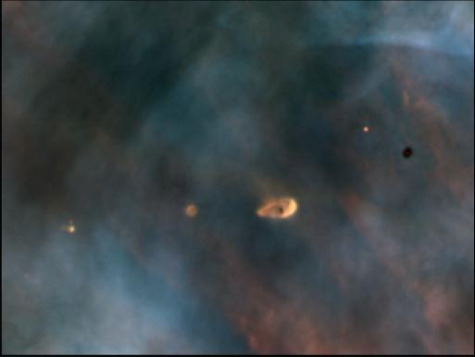
Notes:
These are proto planetary disks (Proplyds). They are thought to be planetary systems in the making.

Slide 8
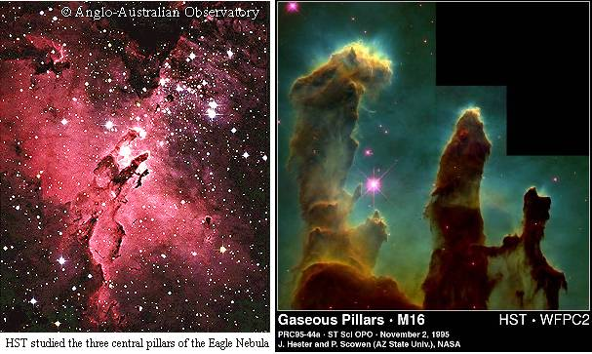

Slide 9
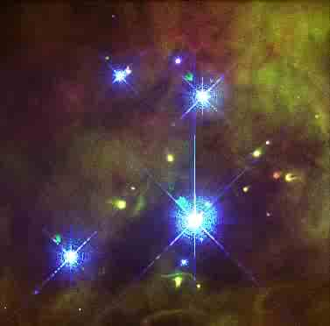

Slide 10
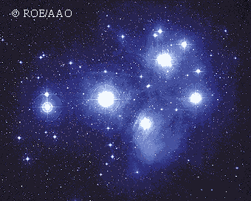

Slide 11
Mass and weight
What is weight?
What is mass?
Notes:
The weight of a body is the gravitational force exerted on it - from earth for instance. Weight comes from a bodies mass and the local gravity
The mass of a body is it’s resistance to acceleration when acted on by some force. Mass is independent of gravity. An object has mass even when it is weightless.

Slide 12
The measure of a star’s temperature
What is Kelvin?
Notes:
Named after Lord Kelvin – Sir William Thomson – The Kelvin temp scale is the “absolute temperature scale”
To calculate Celsius subtract 273.15 from the K temp
To calculate Fahrenheit multiply the Celsius temp by 9/5 and add 32.

Slide 13
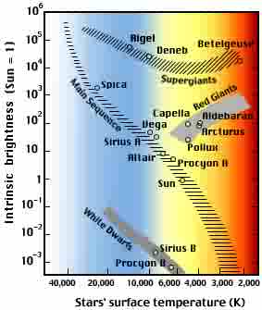

Slide 14
What is fusion?

Slide 15
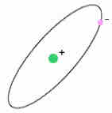
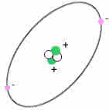
Hydrogen atom
1 Proton
2 Protons &
2 Neutrons
Helium atom
Notes:
The first step is Two protons form deuterium – this takes 14 billion years on average.
In six seconds deuterium and an H atom form Helium 3 – the process releases a gamma ray
Two He3 nuclei fuse to form a nucleus of normal helium (He4), this reaction gives up two protons and a gamma ray – this takes about a million years on average.
The sun converts 5 million tons of mass per second into energy – 600 times the weight of the water flowing over Niagara falls
Since it was born the sun has converted 5.5 x 10^23 tons into radiation – this is 1/4000 of it’s mass.

Slide 16
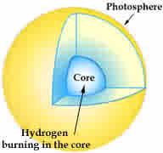
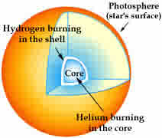

Slide 17
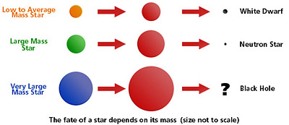
All stars will swell dramatically as they run out of fuel for nuclear fusion.
This pulsation often sheds gases from the star.

Slide 18
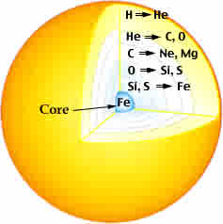
The structure of a highly evolved star of 20 solar masses.
The letters H, He, C, O, Ne, Mg, Si, S, and Fe are the chemical symbols for hydrogen, helium, carbon, oxygen, neon, magnesium, silicon, sulfur, and iron.
(The star's core and shells are not drawn to scale.)

Slide 19
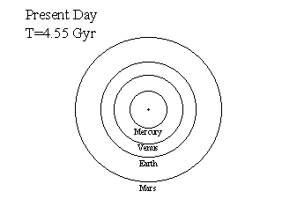
Notes:
Properties:
Age = 4.55 Gyr
Mass = 1 M_{sun} = 1.99x10³³ g
Radius = 1 R_{sun} = 700,000 km
Luminosity = 1 L_{sun} = 3.83x10²⁶ Watts
Temperature = 5779 K
~50% of the core H has been burned
The Sun took ~ 50 Myr to form.
Reached the Main Sequence ~4.50 Gyr ago
Little Fainter: 0.70 L_{sun}
Little Smaller Radius: 0.897 R_{sun}
Little Cooler: 5586 K
Continues to burn H to He in its core, slowly getting slightly hotter & brighter.
Mid-Life Crisis for the Earth 5.6 Gyr (1.1 Gyr from today):
Sun 10% brighter: ~1.1 L_{sun}
Cause a moist greenhouse effect on Earth, driving away most of the water in the air.
9 Gyr (3.5 Gyr from today):
Sun 40% brighter: ~1.4 L_{sun}
Oceans totally evaporate in a runaway greenhouse effect: Earth like Venus today.

Slide 20
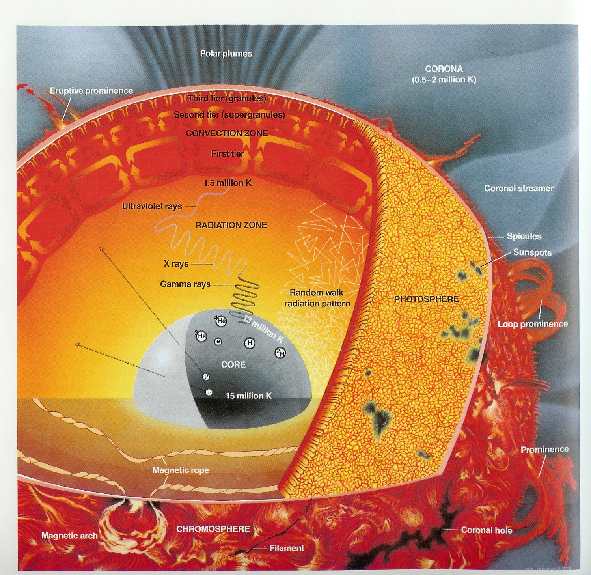
Notes:
15 million Kelvin is about 27 million degrees farhenheit.

Slide 21
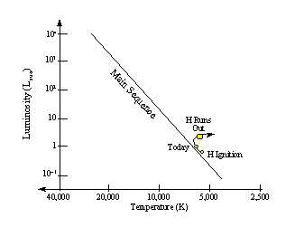
Notes:
End of the Main-Sequence Life 11 Gyr: H exhausted in the core
Inert He core starts to collapse
H burning moves into a shell
T = 5517 K
R = 1.575 R_{sun}
L = 2.21 L_{sun}
Sun leaves the Main-Sequence.

Slide 22
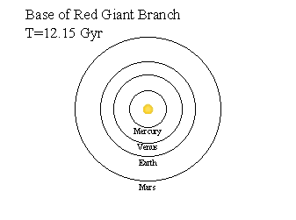
Notes:
"Lively Old Age" Next 0.7 Gyr:
Sun expands an near-constant L ~2.2 L_{sun} towards the base of the Red Giant Branch.
Sun swells in size from 1.58 R_{sun} to 2.3 R_{sun}
Cools from 5517 K to 4902 K
Start of slow mass loss in a stellar wind:
Wind picks up as the Sun approaches the base of the Red Giant Branch

Slide 23
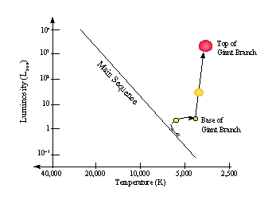
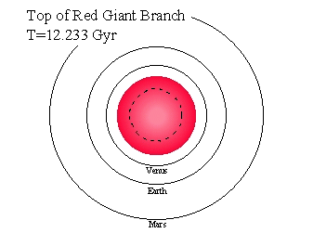
Notes:
Climbing the Red Giant Branch
Takes ~0.6 Gyr to make the climb.
Loses 28% of its mass in a strong wind
Causes the planets to move out some:
Venus ~1 AU, Earth ~1.4 AU
At the Top, just before the Helium Flash:
T = 3107 K (M0 III Star)
L = 2350 L_{sun}
R = 166 R_{sun} (0.775 AU) engulfing Mercury.

Slide 24
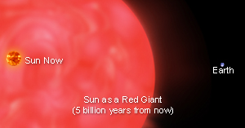

Slide 25
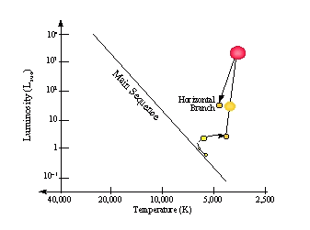
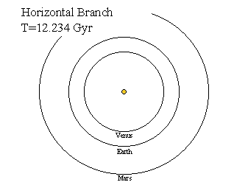

Slide 26
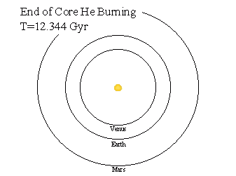
Notes:
Horizontal Branch Burns He to C&O in core for ~100 Myr:
He core starts to run out
C-O Core contracts & heats up
Star swells up a little & gets brighter:
R = 18 R_{sun}
T = 4450 K
L = 110 L_{sun}

Slide 27
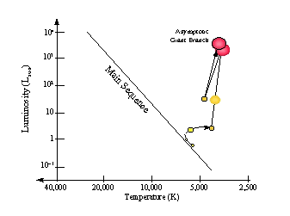
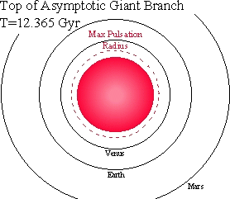
Notes:
Ascent of the Asymptotic Giant Branch Climbs the Asymptotic GB in ~20 Myr:
Collapsing C-O core.
He burning shell + H burning shell
Star swells, gets cooler & brighter:
R = 180 R_{sun} (0.84 AU)
T = 3160 K
L = 3000 L_{sun}
AGB Phase Mass Loss AGB ascent is accompanied by mass loss in the form of a stellar wind:
The Sun's mass gets reduced to ~0.6 M_{sun}
Remaining planets move further outward:
Venus at 1.22 AU
Earth at 1.69 AU
Near the top: thermal pulsations start.

Slide 28
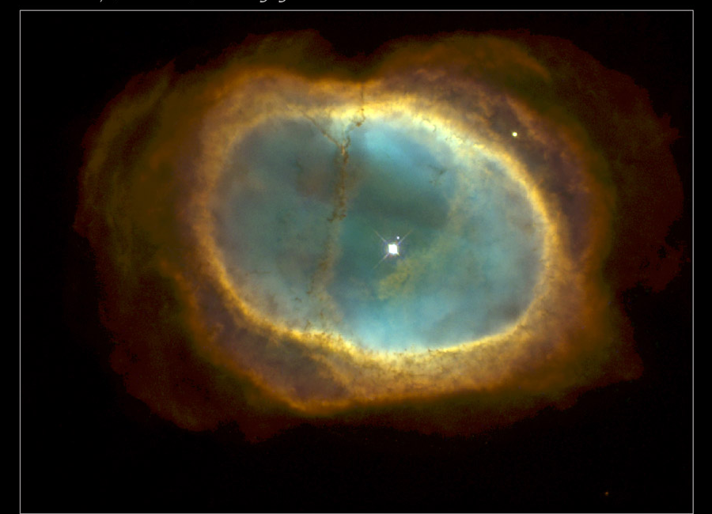

Slide 29
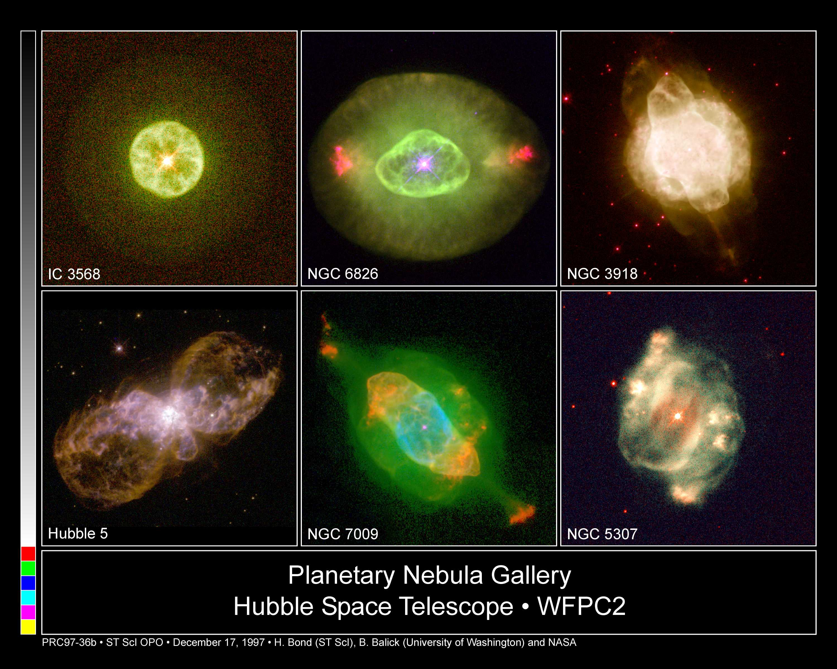
Planetary nebulae

Slide 30
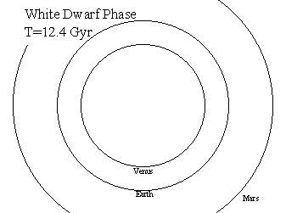
Notes:
The Final Configuration Core, now ~0.54 M_{sun}, evolves into a slowly cooling White Dwarf with R~R_{earth}.
Mass loss is now ended, and the remaining planets settle into their orbits:
Venus at 1.34 AU
Earth at 1.85 AU
Mars at 2.8 AU

Slide 31
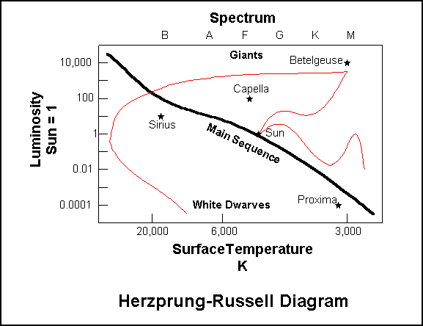

Slide 32
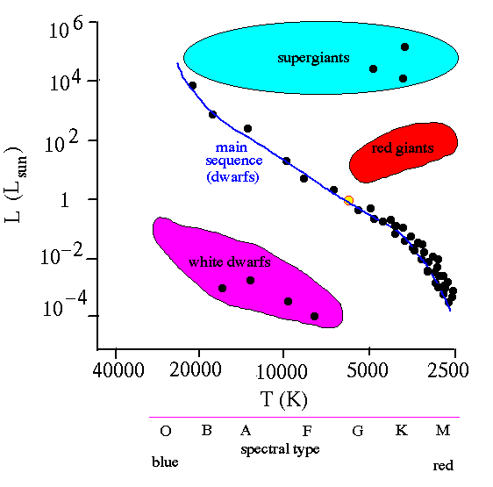

Slide 33
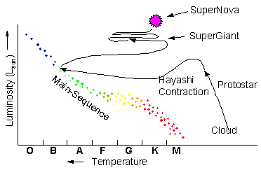
Notes:
The more massive the star the higher it comes in on the main sequence and the shorter it’s life before something happens.

Slide 34
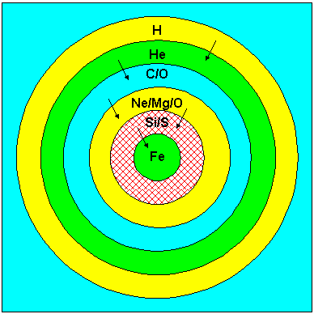

Slide 35
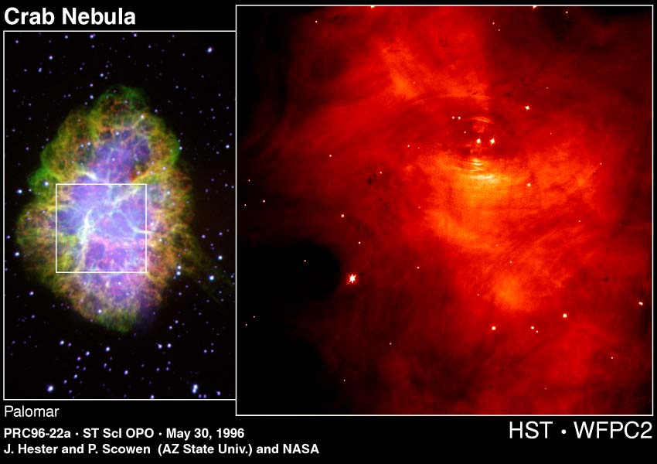
TThe Crab Nebula was formed during the year 1054 supernova.
IIt has a pulsar in its core
Notes:
Distance
6.3 (kly)
Visual Brightness
8.4 (mag)
Apparent Dimension
6x4 (arc min)
Discovered 1731 by British amateur astronomer John Bevis.
The Crab Nebula is the most famous and conspicuous known supernova remnant, an cloud of gas created in the explosion of a star as supernova.
The supernova was noted on July 4, 1054 A.D. by Chinese astronomers, and was about four times brighter than Venus, or about mag -6. According to the records, it was visible in daylight for 23 days, and 653 days to the naked eye in the night sky. It was probably also recorded by Anasazi Indian artists (in present-day Arizona and New Mexico), as findings in Navaho Canyon and White Mesa (both AZ) as well as in the Chaco Canyon National Park (NM) indicate; there's a review of the research on the Chaco Canyon Anasazi art online. In addition, Ralph R. Robbins of the University of Texas has found Mimbres Indian art from New Mexico, possibly depicting the supernova.
The Supernova 1054 was also assigned the variable star designation CM Tauri. It is one of few historically observed supernovae in our Milky Way Galaxy.

Slide 36
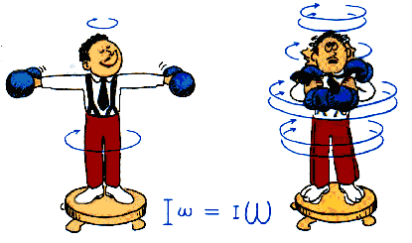
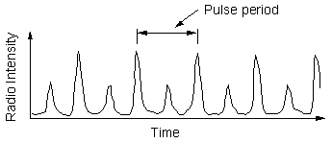

Slide 37
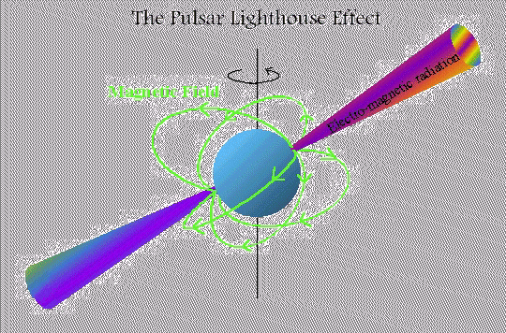
Rotating Neutron star

Slide 38
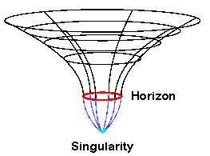
Black hole – effect on space

Slide 39

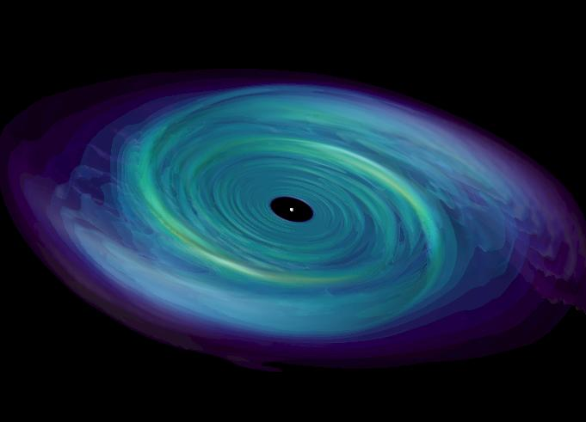
Black holes with infalling matter
Jet

Slide 40
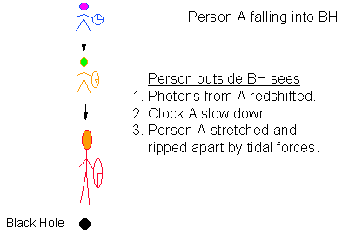

Slide 41
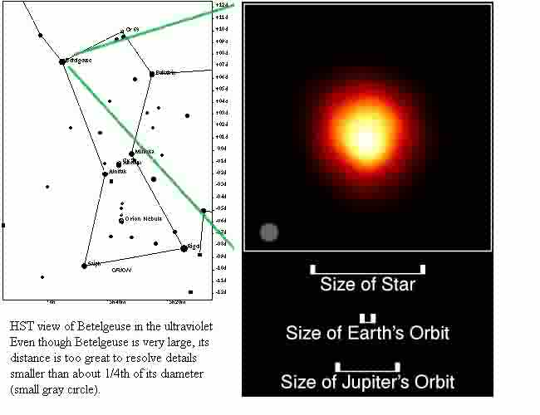
Notes:
BETELGEUSE (Alpha Orionis). The great star Betelgeuse is one of the two that dominate mighty Orion of winter, the other Rigel, the pair respectively called Alpha and Beta Orionis. The name Betelgeuse is a corruption of the Arabic "yad al jauza," which means the "hand of al-jauza," al-jauza the ancient Arabs' "Central One," a mysterious woman. For us, it marks the upper left hand corner of the figure of the Greek's ancient hunter (and since he is facing you, his right shoulder). One of the sky's two first magnitude supergiants (the other Antares of summer), Betelgeuse is one of the larger stars that can be seen, indeed one of the larger stars to be found anywhere. At its most likely distance of 425 light years, its measured angular diameter yields a radius 630 times that of the Sun, 2.9 astronomical units. If placed at the Sun, the star would go 55% of the way to the orbit of the planet Jupiter. The star is so large that it is the first ever actually directly imaged as a disk from Earth (by the Hubble Space Telescope). From its size and temperature, allowing for its infrared radiation, Betelgeuse shines an amazing 60,000 times brighter than our Sun. The distance, however, is so great to be subject to some uncertainty, the possible radius ranging from 45% to 70% of Jupiter's orbit, the luminosity from 40,000 solar to 100,000 solar. Whatever the actual numbers, Betelgeuse is clearly a highly evolved star, one whose central hydrogen fuel supply has run out. As a result, the core contracted into a hot dense state, and the outer portions swelled outward. We do not really know the star's condition at the moment, but the odds are that it is now in the process of fusing helium into carbon and oxygen in its core. Betelgeuse is variable over long time periods, is ejecting part of itself through a strong wind, and is surrounded by a huge shell of dust of its own making. The wind and variability are perhaps related to huge hot spots on the star's surface, one of which was seen by Hubble. Betelgeuse is also surrounded by some controversy. From theory, its initial mass should have fallen somewhere between 12 and about 17 times that of the Sun. If at the high end, the core will fuse elements through neon, magnesium, sodium, and silicon all the way to iron. It will then collapse, and Betelgeuse will blow up as a "supernova", most likely leaving a compact neutron star about the size of a small town behind. If it were to explode today, it would become as bright as a crescent Moon, would cast strong shadows on the ground, and would be seen easily in full daylight. If the star is near or under the lower end of the range, then Betelgeuse may eventually become a shrunken and dense white dwarf about the size of Earth. Even then, however, it will be different. Most white dwarfs are made of carbon and oxygen, whereas Betelgeuse has enough mass to become one of the exceedingly rare neon-oxygen white dwarfs. The only way we will really know is to wait a few million years.

Slide 42
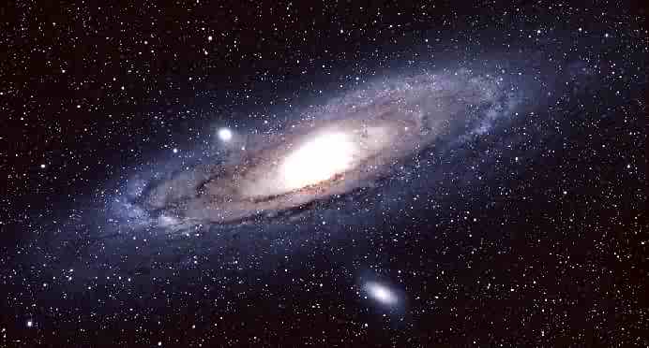

Slide 43
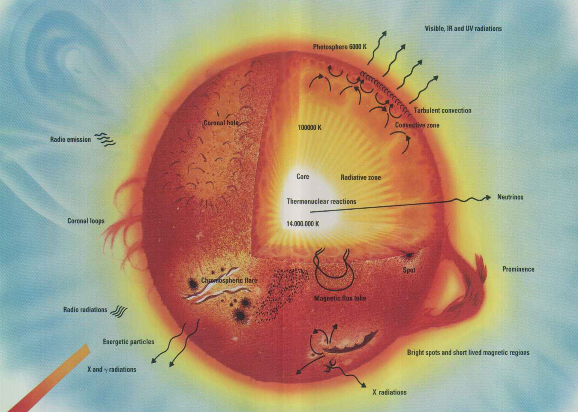

Slide 44
Websites for more information
http://www.milky-way.com/gb/sevol.htm
http://sunshine.chpc.utah.edu/labs/star_life/starlife_main.html
http://www.astro.keele.ac.uk/workx/starlife/StarpageS_26M.html
http://cassfos02.ucsd.edu/public/tutorial/StevI.html

