Slide 1
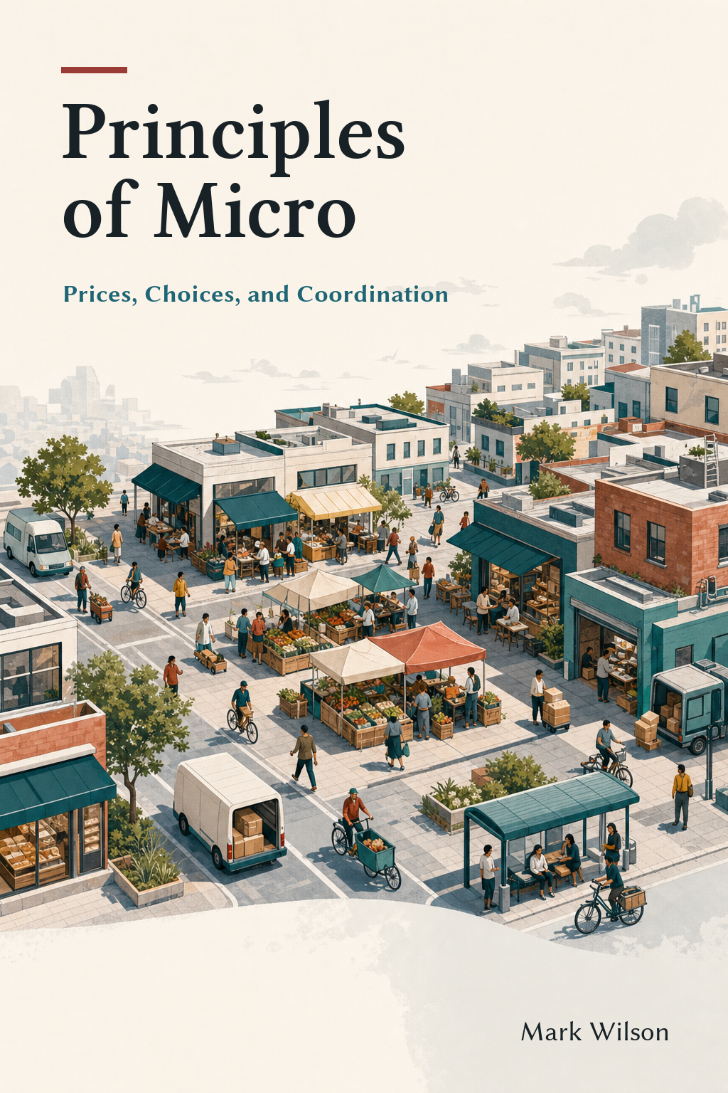
Thinking Like
an Economist
Chapter 1
Principles of Micro
Choices • Incentives • Coordination
Mark Wilson
Notes:
Open with the parking puzzle rather than a definition. Tell students that the chapter is about a way of asking questions they will reuse throughout the course.
[Sources]
- Principles of Micro, Chapter 1: Thinking Like an Economist (current project draft).
- Cover artwork: design/book-cover/principles-of-micro-cover.png (project-generated asset).
[/Sources]

Slide 2
CHAPTER 1
Economics begins with limited means and competing uses
oikonomia
Modern economics asks two connected questions:
Managing a household
•
How do people use scarce resources?
•
How do millions of separate plans fit together?
It is about choice and interaction—not just money.
PRINCIPLES OF MICRO
2
Notes:
Keep the etymology brief. Ancient household management was not modern economics in miniature. Use it only to motivate the enduring problem of allocating scarce means, then widen the lens to decentralized coordination.
[Sources]
- Principles of Micro, Chapter 1: Thinking Like an Economist (current project draft).
- Dotan Leshem, ‘What Did the Ancient Greeks Mean by Oikonomia?’ Journal of Economic Perspectives 30(1), 2016, 225–238. https://doi.org/10.1257/jep.30.1.225
[/Sources]

Slide 3
CHAPTER 1
A money price of zero does not eliminate scarcity
$0
•
Arrive earlier
•
Circle and search
•
Walk farther
Free campus parking
•
Risk finding no space
If money does not ration the spaces, something else will.
PRINCIPLES OF MICRO
3
Notes:
Ask students what they would do on Monday morning. Let them generate the nonmoney costs before revealing the list. Stress that a zero posted price changes the rationing method; it does not create more convenient spaces.
[Sources]
- Principles of Micro, Chapter 1: Thinking Like an Economist (current project draft).
[/Sources]

Slide 4
CHAPTER 1
Scarcity means not every desired use can occur
Scarcity
LIMITED RESOURCES
•
Time
A resource is limited relative to the uses people have for it.
•
Land
•
Attention
•
Skilled labor
•
Machine capacity
More of one use generally means less of another.
PRINCIPLES OF MICRO
4
Notes:
Correct the common misconception that scarcity means poverty or a temporary shortage. Wealth changes the constraint but does not remove time, attention, land, or alternative uses.
[Sources]
- Principles of Micro, Chapter 1: Thinking Like an Economist (current project draft).
[/Sources]

Slide 5
CHAPTER 1
What is the cost of attending college?
$ ?
Take one minute.
List every cost you can think of.
Do not look only for items that appear on a bill.
We will build the answer together.
PRINCIPLES OF MICRO
5
Notes:
Pause here and collect answers before advancing. Students will usually name tuition, fees, books, housing, and food. Let the list develop before asking what they give up by attending college. Do not resolve the room-and-board issue yet.
[Sources]
- Principles of Micro, Chapter 1: Thinking Like an Economist (current project draft).
[/Sources]

Slide 6
CHAPTER 1
Some college costs appear on a bill
DIRECT COSTS
•
Tuition and required fees
Room and board?
•
Books and supplies
Everyone must eat and live somewhere. Count only the amount that attending college adds above the next-best alternative.
•
Extra travel or living costs caused by attending
Count the costs caused by attending college, not every dollar spent while enrolled.
PRINCIPLES OF MICRO
6
Notes:
Use room and board to teach the comparison correctly. A student who would otherwise live with family may incur substantial additional housing and food costs. A student who would rent and buy food anyway should count only the extra amount caused by college.
[Sources]
- Principles of Micro, Chapter 1: Thinking Like an Economist (current project draft).
[/Sources]

Slide 7
CHAPTER 1
College also costs the earnings a student gives up
CHOSEN PATH
BEST ALTERNATIVE
Attend college
Work now
instead of
Forgone wages
If working is the best alternative, the wages and experience given up are part of the opportunity cost.
PRINCIPLES OF MICRO
7
Notes:
Students often omit foregone earnings because no bill arrives for them. Stress that opportunity cost is the value of the best alternative forgone. For many full-time students, that alternative includes a job, earnings, and work experience. Do not claim that foregone wages are identical for every student.
[Sources]
- Principles of Micro, Chapter 1: Thinking Like an Economist (current project draft).
[/Sources]

Slide 8
CHAPTER 1
Public choices involve trade-offs too
Environmental quality
Efficiency and equality
Cleaner production may require resources that could have produced other goods and services.
Efficiency concerns the size of the pie. Equality concerns how evenly it is divided.
Economics can trace the consequences. It cannot decide how society should value competing goals.
PRINCIPLES OF MICRO
8
Notes:
Keep the claims conditional. Taxes and redistribution may change incentives and the size of the pie, but the response depends on the policy. Separate the positive question about consequences from the value judgment about priorities.
[Sources]
- Principles of Micro, Chapter 1: Thinking Like an Economist (current project draft).
[/Sources]

Slide 9
CHAPTER 1
Past costs do not change the next choice
Already paid
+
Cannot recover
= sunk cost
The relevant question is what can still be gained or avoided now.
PRINCIPLES OF MICRO
9
Notes:
Use a nonrefundable concert ticket or prepaid gym membership. Accountants are not wrong to record the payment. The economic point is that an unrecoverable payment does not affect the benefit or cost of tonight’s choice.
[Sources]
- Principles of Micro, Chapter 1: Thinking Like an Economist (current project draft).
[/Sources]

Slide 10
CHAPTER 1
Rationality means purposeful choice, not perfection
People generally try to make themselves as well off as they can—given what they value, know, and can choose.
•
People can have incomplete or mistaken information.
•
People can make errors and later regret them.
•
People can care about family, fairness, charity, or learning—not only money.
PRINCIPLES OF MICRO
10
Notes:
Introduce this before marginal analysis. Rationality is not praise and does not require perfect calculation. The useful prediction is that choices tend to change when perceived benefits, perceived costs, information, or available options change.
[Sources]
- Principles of Micro, Chapter 1: Thinking Like an Economist (current project draft).
[/Sources]

Slide 11
CHAPTER 1
The useful question is: Is one more hour worth it?
One more hour of study
ADDED BENEFIT
ADDED COST
Better understanding
Higher expected grade
Less sleep or leisure
Less time for other work
versus
Marginal means additional.
PRINCIPLES OF MICRO
11
Notes:
Begin with ordinary language. Students understand whether the next hour is worth it before they meet MB and MC. Only after the comparison is clear should you attach the terms marginal benefit and marginal cost.
[Sources]
- Principles of Micro, Chapter 1: Thinking Like an Economist (current project draft).
[/Sources]

Slide 12
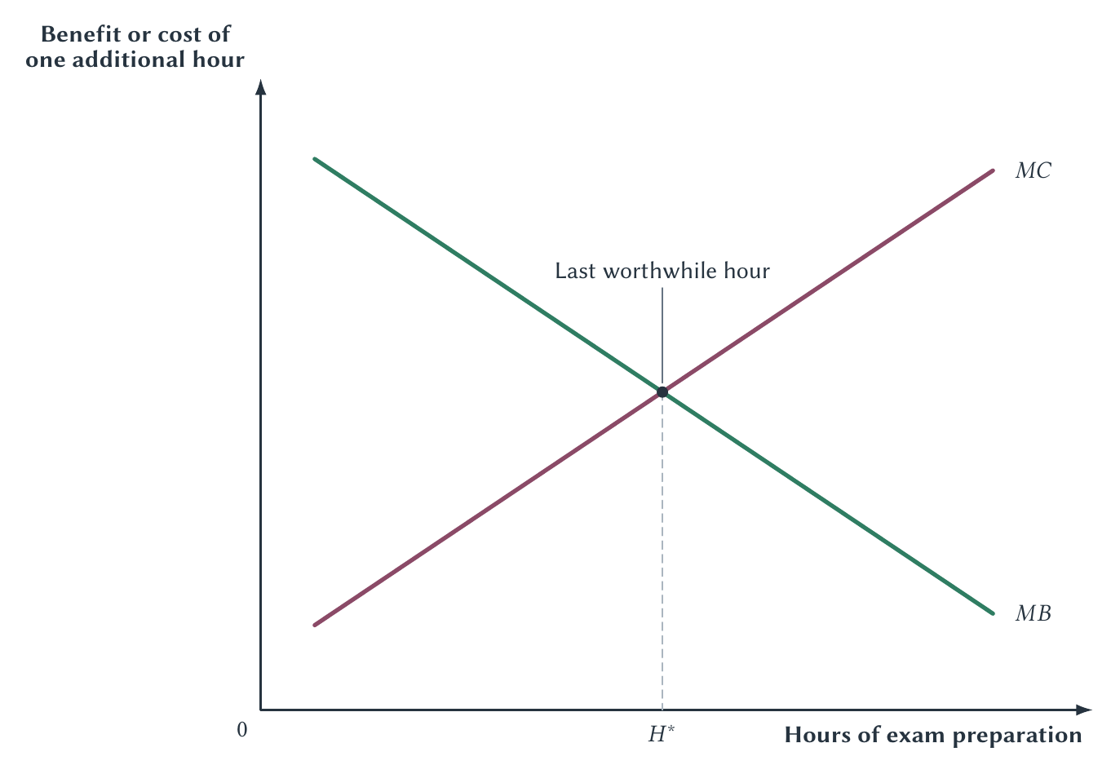
CHAPTER 1
Before H*, another hour adds more benefit than cost
PRINCIPLES OF MICRO
12
Notes:
Walk from left to right. Before H*, MB exceeds MC, so another hour increases total net benefit. Beyond H*, MC exceeds MB, so the student would be better off cutting back. Emphasize that the vertical axis shows the benefit or cost of the next hour, not the total grade or total effort.
[Sources]
- Principles of Micro, Chapter 1: Thinking Like an Economist (current project draft).
- Figure: figures/ch01_thinking_like_an_economist/ch01_marginal_benefit_cost.pdf (project-reviewed figure, rasterized for PowerPoint compatibility).
[/Sources]

Slide 13
CHAPTER 1
At H*, total net benefit is greatest
MB = MC
•
Before the crossing: keep going.
•
After the crossing: cut back.
•
At the crossing: no small feasible change makes the choice better.
Equal margins are a decision rule—not a calculus requirement.
PRINCIPLES OF MICRO
13
Notes:
Clarify that MB = MC does not mean total benefit equals total cost. It compares the last unit. With whole units, choose the last unit whose benefit covers its cost and reject the next unit when cost exceeds benefit.
[Sources]
- Principles of Micro, Chapter 1: Thinking Like an Economist (current project draft).
[/Sources]

Slide 14
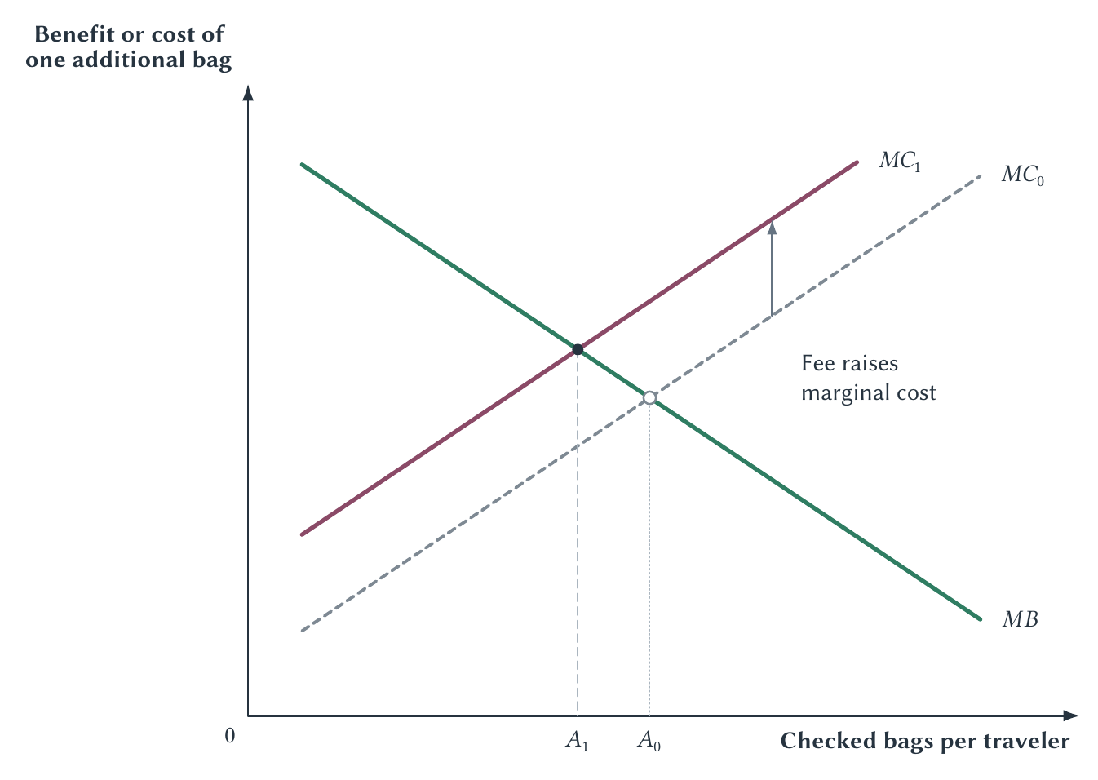
CHAPTER 1
A per-bag fee raises the cost of checking another bag
Before fee
A₀
After fee
A₁ < A₀
PRINCIPLES OF MICRO
14
Notes:
The fee is fixed per bag, but it is a per-unit fee: each additional checked bag now costs more. The model predicts direction, not the response size or whether the fee is desirable.
[Sources]
- Principles of Micro, Chapter 1: Thinking Like an Economist (current project draft).
- Figure: figures/ch01_thinking_like_an_economist/ch01_incentive_change_behavior.pdf (project-reviewed figure, rasterized for PowerPoint compatibility).
[/Sources]

Slide 15
CHAPTER 1
Raise one cost and adjustment often moves somewhere else
Fewer checked bags
•
Use a larger carry-on
•
Pack less
is only the first response
•
Ship items separately
•
Choose a different ticket or airline
•
Change boarding rules or enforcement
Follow the chain of responses, not only the first visible effect.
PRINCIPLES OF MICRO
15
Notes:
Ask students to generate alternatives before revealing them. This is the transferable lesson: people adjust on several margins, and changing one response can create secondary effects elsewhere.
[Sources]
- Principles of Micro, Chapter 1: Thinking Like an Economist (current project draft).
[/Sources]

Slide 16
CHAPTER 1
Models leave out details so one idea is easier to see
A road map does not show every tree, room, or chair.
The right question is whether the missing details matter for the problem.
•
What does the model leave out?
•
What should happen if its main idea is right?
•
What facts would support or weaken that explanation?
PRINCIPLES OF MICRO
16
Notes:
Use ordinary language. Avoid asking whether every assumption is literally true. The teaching point is that simplification is useful when it isolates an idea and produces a prediction that evidence can check.
[Sources]
- Principles of Micro, Chapter 1: Thinking Like an Economist (current project draft).
[/Sources]

Slide 17
CHAPTER 1
Does studying economics pay?
A RECENT DESCRIPTIVE ESTIMATE
WHAT ELSE COULD EXPLAIN IT?
$6.90M
•
Who chooses economics
•
Schools without a business major
Estimated work-life earnings for economics majors
•
Career plans and full-time work
Full-time workers ages 25-64 • ACS 2020-2024
Stronger evidence: in one grade-cutoff study, access to the economics major raised annual early-career wages by about $22,000.
A striking pattern is the start of the analysis, not the end.
PRINCIPLES OF MICRO
17
Notes:
Begin with the headline, then ask students why the ranking does not by itself prove that choosing economics caused the earnings difference. Mention that several highly selective schools lack an undergraduate business major, so business-oriented students may sort into economics. Then explain why the grade-cutoff comparison is stronger evidence while remaining cautious about generalizing from one university.
[Sources]
- Principles of Micro, Chapter 1: Thinking Like an Economist (current project draft).
- David Waldron, ‘The Highest- and Lowest-Paid College Majors,’ based on IPUMS-USA ACS 2020-2024, circulated by Crémieux on August 3, 2026. https://x.com/cremieuxrecueil/status/2084314749651599433
- Zachary Bleemer and Aashish Mehta, ‘Will Studying Economics Make You Rich?’ American Economic Journal: Applied Economics 14(2), 2022, 1-22. https://doi.org/10.1257/app.20200447
[/Sources]

Slide 18
CHAPTER 1
A before-and-after change is not enough
Parking search falls
But what else changed?
after a university begins charging
•
Enrollment
•
A new parking lot
•
Online classes
•
Construction or fuel prices
A comparison group helps separate the policy from other changes over time.
PRINCIPLES OF MICRO
18
Notes:
Do not teach an estimator. The sole purpose is to show why one observation before and one after can mix the policy with many other changes. A similar untreated location can strengthen the comparison.
[Sources]
- Principles of Micro, Chapter 1: Thinking Like an Economist (current project draft).
[/Sources]

Slide 19
CHAPTER 1
A comparison group makes the evidence stronger
SFPARK PROGRAM AREAS
COMPARISON AREAS
Prices, payment technology, time limits, information, and signs changed together.
Researchers compared search behavior before and after in areas outside the program.
about 15%
about 12%
The evidence supports the bundled program—not price alone.
less search time
less search distance
PRINCIPLES OF MICRO
19
Notes:
Focus on research design, not the percentages. The program areas changed more than price, so the study does not isolate a pure price effect. It does show that search declined more in the program areas than in comparison areas.
[Sources]
- Principles of Micro, Chapter 1: Thinking Like an Economist (current project draft).
- San Francisco Municipal Transportation Agency, SFpark Pilot Project Evaluation (2014). https://www.sfmta.com/sites/default/files/reports-and-documents/2018/08/sfpark_pilot_project_evaluation.pdf
- Farzad Alemi, Caroline J. Rodier, and Christiana Drake, ‘Cruising and On-Street Parking Pricing,’ Transportation Research Part A 111 (2018): 187–198. https://doi.org/10.1016/j.tra.2018.03.007
[/Sources]

Slide 20
CHAPTER 1
Facts and values answer different questions
Positive
Normative
What happened?
Why?
What is likely to happen?
What should be done?
Which goals matter most?
Requires evidence
Requires evidence and values
Evidence can inform a judgment. It cannot make the judgment for us.
PRINCIPLES OF MICRO
20
Notes:
Use parking: ‘Charging will reduce some parking demand’ is positive. ‘The university should charge’ is normative. Students may agree about effects and disagree about goals, or disagree about the size of the effect itself.
[Sources]
- Principles of Micro, Chapter 1: Thinking Like an Economist (current project draft).
[/Sources]

Slide 21
CHAPTER 1
The first visible effect is rarely the whole effect
SEEN
UNSEEN
The student pays no parking fee.
The glazier is paid to replace a broken window.
Time spent searching.
The displaced purchase.
Later responses to changed incentives.
Good intentions explain a policy’s purpose—not its full consequences.
PRINCIPLES OF MICRO
21
Notes:
Use Bastiat to reinforce opportunity cost and secondary consequences, not as a detached biography. Looking for the unseen does not dictate a policy conclusion; it prevents us from counting only the most visible benefit or cost.
[Sources]
- Principles of Micro, Chapter 1: Thinking Like an Economist (current project draft).
- Frédéric Bastiat, ‘What Is Seen and What Is Not Seen’ (1850), in Selected Essays on Political Economy, trans. Seymour Cain. https://oll.libertyfund.org/titles/bastiat-selected-essays-on-political-economy
[/Sources]

Slide 22
CHAPTER 1
Economics is a method for following choices and consequences
Economics is a method for following choices and consequences
•
Find the constraint
•
Identify the best forgone alternative
•
Compare the next unit
•
Trace the incentive
•
Follow the adjustments
•
Check the explanation against evidence
Next: how specialization and trade turn separate choices into cooperation.
22
PRINCIPLES OF MICRO
22
PRINCIPLES OF MICRO
Notes:
Close by returning to the parking puzzle. Students should now be able to identify what is scarce, the full cost, the available responses, the rule shaping those responses, and the evidence needed to test the explanation. Preview Chapter 2 as the move from individual choice to cooperation through specialization and exchange.
[Sources]
- Principles of Micro, Chapter 1: Thinking Like an Economist (current project draft).
[/Sources]

