Slide 1

Opportunity Cost,
Trade, and Coordination
Chapter 2
Principles of Micro
Trade turns different abilities into cooperation
Mark Wilson
Notes:
Open with the independent-fundraiser puzzle. Two students each need cookies and flyers. Ask whether working separately is necessarily their best option.
[Sources]
- Principles of Micro, Chapter 2: Opportunity Cost, Trade, and Coordination (current project draft).
- Cover artwork: design/book-cover/principles-of-micro-cover.png (project-generated asset).
[/Sources]

Slide 2
CHAPTER 2
Can two separate producers both gain by trading?
AVA
BEN
Preparing one
club fundraiser
Preparing another
club fundraiser
Cookies + flyers
Cookies + flyers
They do not begin as teammates. They discover a reason to cooperate.
PRINCIPLES OF MICRO
2
Notes:
Do not solve the problem yet. The chapter first needs a way to describe production choices and opportunity cost.
[Sources]
- Principles of Micro, Chapter 2: Opportunity Cost, Trade, and Coordination (current project draft).
[/Sources]

Slide 3
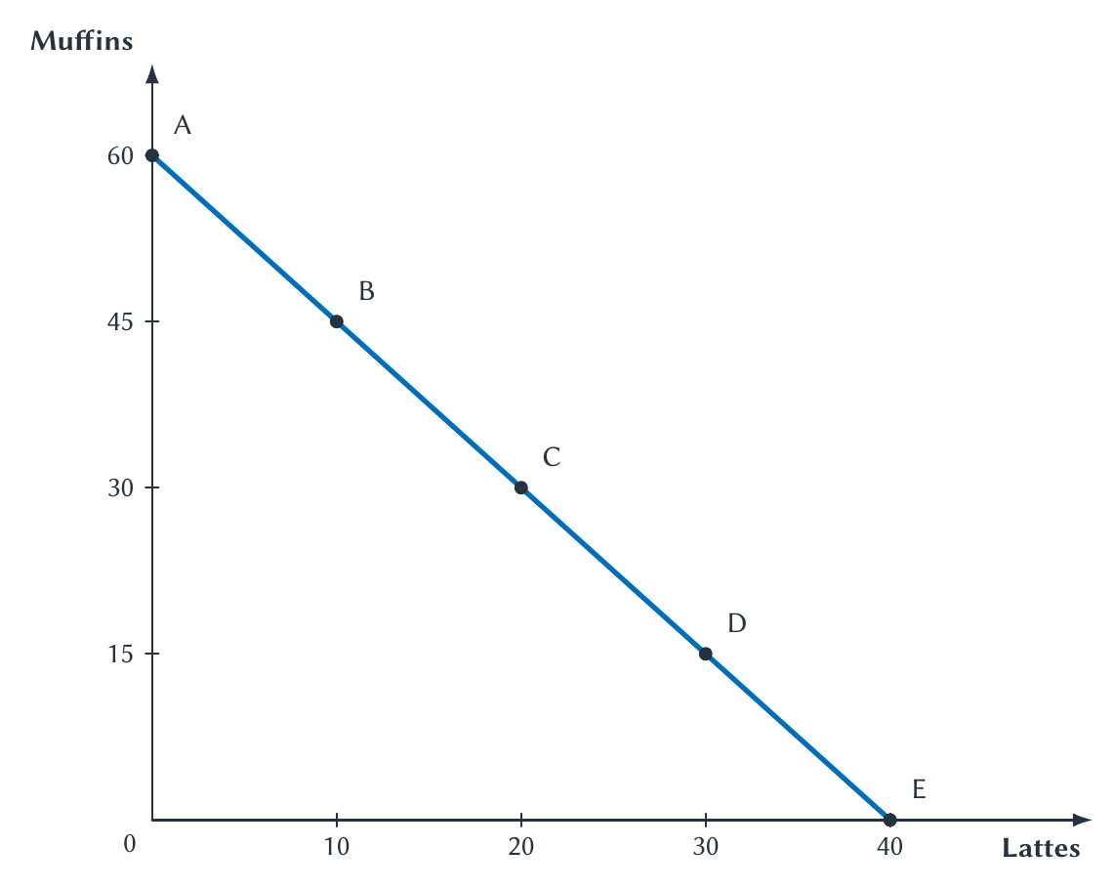
CHAPTER 2
A PPF shows the production choices that are possible
Production possibilities frontier
The combinations of two goods that can be produced with current resources and technology.
Moving along the frontier means producing more of one good and less of the other.
PRINCIPLES OF MICRO
3
Notes:
Read the endpoints first. The coffee shop can devote all resources to muffins, all to lattes, or choose a combination between them.
[Sources]
- Principles of Micro, Chapter 2: Opportunity Cost, Trade, and Coordination (current project draft).
- Project-reviewed Chapter 2 figure from figures/ch02_opportunity_cost_trade_and_coordination/.
[/Sources]

Slide 4
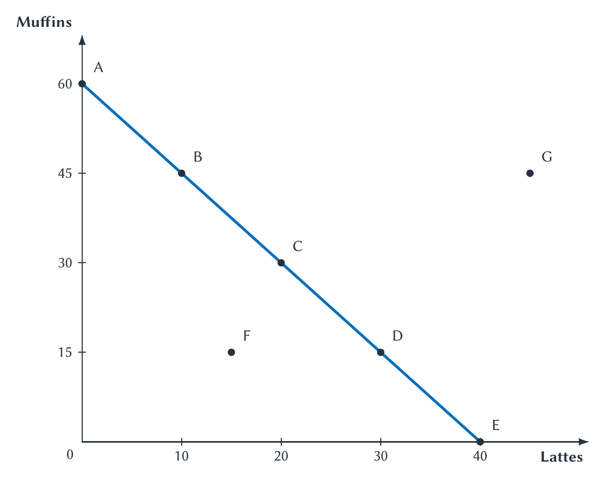
CHAPTER 2
Not every point means the same thing
ON THE FRONTIER
Resources are fully used.
INSIDE
Possible, but some resources are idle or used poorly.
OUTSIDE
Not possible with current resources and technology.
PRINCIPLES OF MICRO
4
Notes:
Ask students to classify F and G before revealing the labels. 'Efficient' here means producing on the current frontier, not that the point is morally best.
[Sources]
- Principles of Micro, Chapter 2: Opportunity Cost, Trade, and Coordination (current project draft).
- Project-reviewed Chapter 2 figure from figures/ch02_opportunity_cost_trade_and_coordination/.
[/Sources]

Slide 5
CHAPTER 2
Moving from B to C reveals an opportunity cost
Point
Lattes
Muffins
+10 lattes
B
10
45
requires giving up
C
20
30
15 muffins
Opportunity cost of 1 latte = 1.5 muffins
PRINCIPLES OF MICRO
5
Notes:
Work the arithmetic on the board: 15 muffins divided by 10 lattes equals 1.5 muffins per latte. Stress the units.
[Sources]
- Principles of Micro, Chapter 2: Opportunity Cost, Trade, and Coordination (current project draft).
[/Sources]

Slide 6
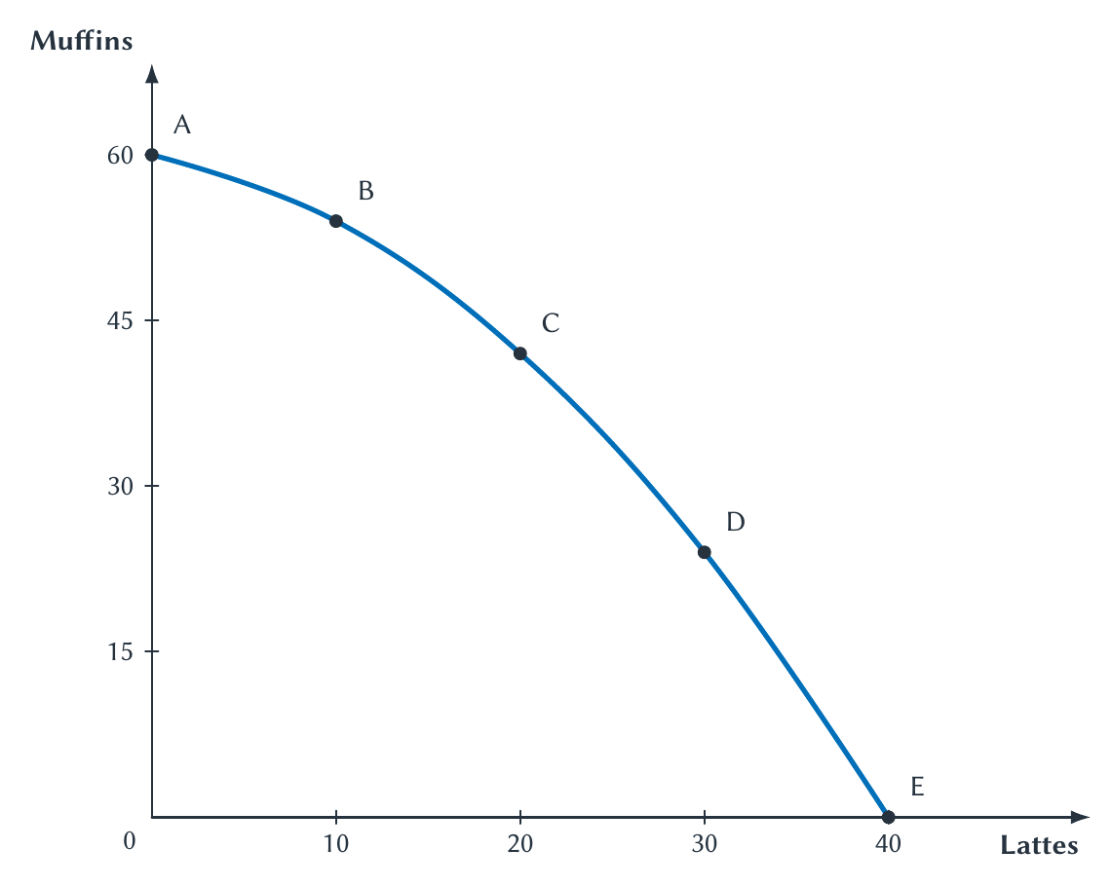
CHAPTER 2
Opportunity cost often rises as production shifts
Why bowed out?
Workers and equipment differ. As the shop makes more lattes, it eventually pulls resources away from tasks they perform especially well.
Specialization makes trade-offs change along the frontier.
PRINCIPLES OF MICRO
6
Notes:
Do not make students memorize the exact opportunity costs at each segment. The point is that resources are not equally suited to every task.
[Sources]
- Principles of Micro, Chapter 2: Opportunity Cost, Trade, and Coordination (current project draft).
- Project-reviewed Chapter 2 figure from figures/ch02_opportunity_cost_trade_and_coordination/.
[/Sources]

Slide 7
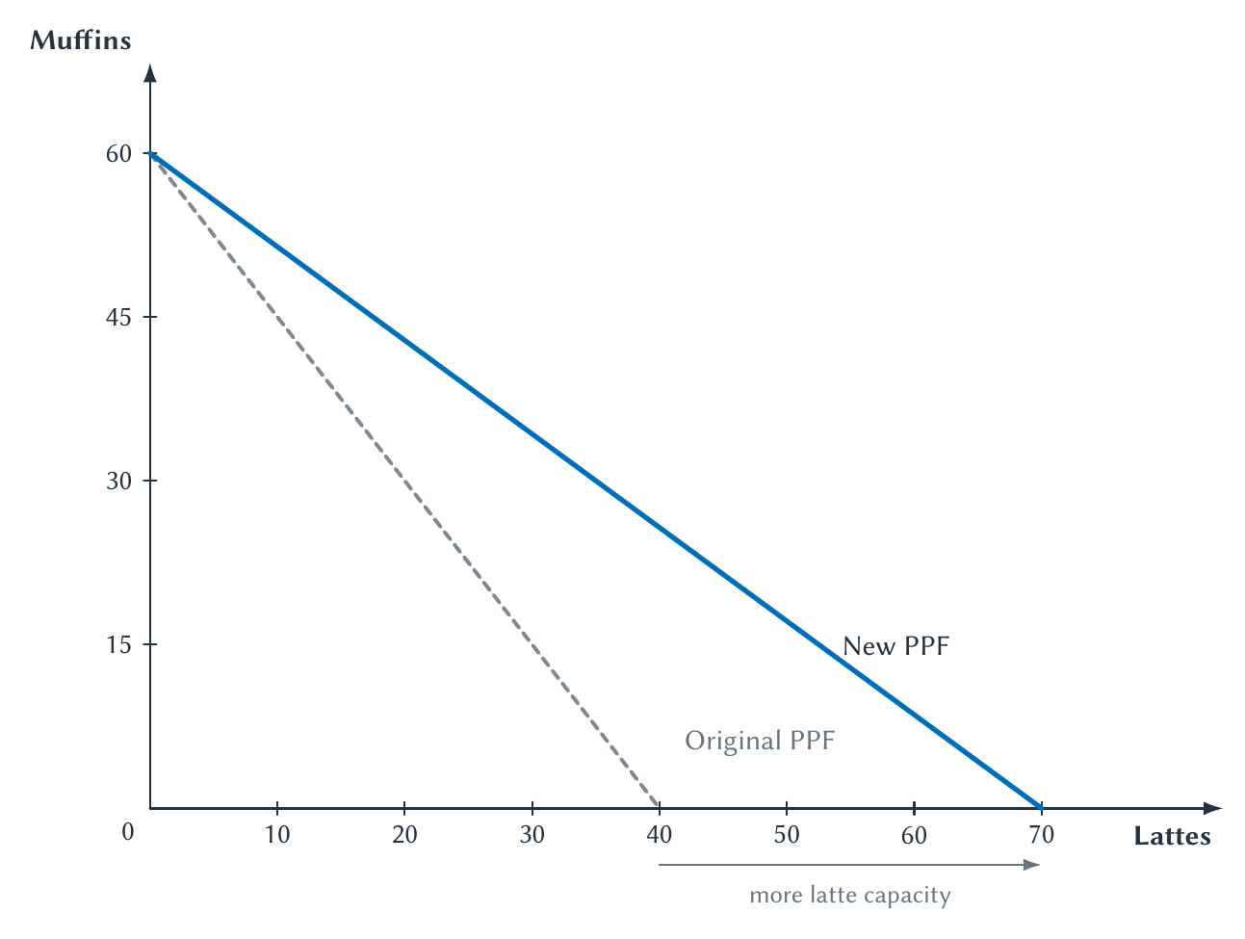
CHAPTER 2
Technology can move the production boundary
Better espresso equipment
The shop can produce more lattes with the same resources. Its muffin capacity need not change.
The PPF is a current constraint, not a permanent law of nature.
PRINCIPLES OF MICRO
7
Notes:
Ask which intercept should move. The example is sector-specific: latte technology improves while muffin technology stays unchanged.
[Sources]
- Principles of Micro, Chapter 2: Opportunity Cost, Trade, and Coordination (current project draft).
- Project-reviewed Chapter 2 figure from figures/ch02_opportunity_cost_trade_and_coordination/.
[/Sources]

Slide 8
CHAPTER 2
Who should mow Patrick Mahomes's lawn?
Suppose Mahomes can mow faster than the best lawn service.
Should he do it himself?
Being better at a task does not tell us who should perform it.
PRINCIPLES OF MICRO
8
Notes:
Treat the example as hypothetical. Students will often answer that Mahomes should mow because he is faster. Ask what he gives up during that hour. The example separates absolute advantage from comparative advantage.
[Sources]
- Principles of Micro, Chapter 2: Opportunity Cost, Trade, and Coordination (current project draft).
[/Sources]

Slide 9
CHAPTER 2
Two different ideas of advantage
Absolute advantage
Comparative advantage
Produces more with the same time and resources
Produces at a lower opportunity cost
A productivity comparison
A trade-off comparison
Trade follows comparative advantage.
PRINCIPLES OF MICRO
9
Notes:
Make students state both definitions aloud. Do not let them assign comparative advantage by looking only at who can produce more.
[Sources]
- Principles of Micro, Chapter 2: Opportunity Cost, Trade, and Coordination (current project draft).
[/Sources]

Slide 10
CHAPTER 2
Ava and Ben each have eight hours
BOTH NEED
•
They begin independently.
Cookies
•
Each plans to make both goods.
and
•
They differ in how quickly they work.
Flyers
•
They discover that exchange may help both.
First compare their production possibilities.
PRINCIPLES OF MICRO
10
Notes:
Keep the setup concrete. Each student is preparing a different club fundraiser, so there is no shared manager assigning tasks.
[Sources]
- Principles of Micro, Chapter 2: Opportunity Cost, Trade, and Coordination (current project draft).
[/Sources]

Slide 11
CHAPTER 2
How long does each student need for one unit?
Student
1 cookie
1 flyer
Ava
10 minutes
20 minutes
Ben
40 minutes
40 minutes
Who has the absolute advantage in cookies? In flyers?
PRINCIPLES OF MICRO
11
Notes:
Pause before answering. Students can already see that Ava uses less time per unit for both goods, but the next slide translates the data into a common eight-hour output.
[Sources]
- Principles of Micro, Chapter 2: Opportunity Cost, Trade, and Coordination (current project draft).
[/Sources]

Slide 12
CHAPTER 2
Ava can produce more of both goods
Student
Cookies in 8 hours
Flyers in 8 hours
Ava
48
24
Ben
12
12
Absolute advantage
Ava in cookies and flyers
PRINCIPLES OF MICRO
12
Notes:
This is where students often stop and assign every task to Ava. Remind them that absolute advantage is not the rule for specialization. Now calculate opportunity cost.
[Sources]
- Principles of Micro, Chapter 2: Opportunity Cost, Trade, and Coordination (current project draft).
[/Sources]

Slide 13
CHAPTER 2
Comparative advantage requires opportunity cost
Opportunity cost of one unit
amount of the other good given up
amount of the chosen good gained
Always include the units.
Cookies cost flyers. Flyers cost cookies.
PRINCIPLES OF MICRO
13
Notes:
Work from the output table. The opportunity cost of a cookie is flyers divided by cookies. The opportunity cost of a flyer is cookies divided by flyers.
[Sources]
- Principles of Micro, Chapter 2: Opportunity Cost, Trade, and Coordination (current project draft).
[/Sources]

Slide 14
CHAPTER 2
What is the opportunity cost of one cookie?
AVA
BEN
24 flyers / 48 cookies
12 flyers / 12 cookies
Calculate both before assigning comparative advantage.
PRINCIPLES OF MICRO
14
Notes:
Stop here. Have students calculate the two ratios. Do not reveal comparative advantage until both opportunity costs are stated with units.
[Sources]
- Principles of Micro, Chapter 2: Opportunity Cost, Trade, and Coordination (current project draft).
[/Sources]

Slide 15
CHAPTER 2
Ava gives up fewer flyers to make a cookie
Ava
Ben
1 cookie
1 cookie
costs
costs
1/2 flyer
1 flyer
Ava has the comparative advantage in cookies.
PRINCIPLES OF MICRO
15
Notes:
Ava's opportunity cost is lower: one-half flyer is less than one flyer. This conclusion comes from trade-offs, not from Ava's larger output alone.
[Sources]
- Principles of Micro, Chapter 2: Opportunity Cost, Trade, and Coordination (current project draft).
[/Sources]

Slide 16
CHAPTER 2
Ben gives up fewer cookies to make a flyer
Student
Cost of 1 cookie
Cost of 1 flyer
Ava
1/2 flyer
2 cookies
Ben
1 flyer
1 cookie
Comparative advantage
Ava: cookies Ben: flyers
PRINCIPLES OF MICRO
16
Notes:
Ava's cost of one flyer is two cookies. Ben's is one cookie, so Ben has the comparative advantage in flyers. Each good has one lower-cost producer.
[Sources]
- Principles of Micro, Chapter 2: Opportunity Cost, Trade, and Coordination (current project draft).
[/Sources]

Slide 17
CHAPTER 2
Before specialization
6 hours on cookies + 2 hours on flyers
Student
Cookies
Flyers
Ava
36
6
Ben
9
3
Total
45
9
No trade. No shared plan.
PRINCIPLES OF MICRO
17
Notes:
This is a simple benchmark, not the only no-trade allocation. Its purpose is to compare the same two students before and after specialization and exchange.
[Sources]
- Principles of Micro, Chapter 2: Opportunity Cost, Trade, and Coordination (current project draft).
[/Sources]

Slide 18
CHAPTER 2
Specialize according to comparative advantage
Student
Cookies
Flyers
Ava
48
0
Ben
0
12
Total
48
12
Ava specializes in cookies. Ben specializes in flyers.
PRINCIPLES OF MICRO
18
Notes:
Link the assignment directly to the opportunity-cost table. Ava did not receive cookies because she has absolute advantage in both. Ben still specializes because his opportunity cost of flyers is lower.
[Sources]
- Principles of Micro, Chapter 2: Opportunity Cost, Trade, and Coordination (current project draft).
[/Sources]

Slide 19
CHAPTER 2
Total output rises
BEFORE
AFTER SPECIALIZATION
45 cookies
48 cookies
becomes
9 flyers
12 flyers
+3 cookies and +3 flyers
PRINCIPLES OF MICRO
19
Notes:
The larger total is the source of the possible gain. Specialization alone does not guarantee that both people benefit; they still need a mutually acceptable trade.
[Sources]
- Principles of Micro, Chapter 2: Opportunity Cost, Trade, and Coordination (current project draft).
[/Sources]

Slide 20
CHAPTER 2
A trade must improve on both opportunity costs
Ava's cost
Ben's cost
Trade price of
1 cookie
0.5 flyer
<
<
1 flyer
Example: 10 cookies for 8 flyers
That is 1 cookie for 0.8 flyer.
PRINCIPLES OF MICRO
20
Notes:
Ava will not accept fewer than 0.5 flyer per cookie because she can make flyers herself at that cost. Ben will not pay more than 1 flyer per cookie because he can make cookies himself at that cost.
[Sources]
- Principles of Micro, Chapter 2: Opportunity Cost, Trade, and Coordination (current project draft).
[/Sources]

Slide 21
CHAPTER 2
After trade, both students gain
Student
After trade
Compared with no trade
Ava
38 cookies, 8 flyers
+2 cookies, +2 flyers
Ben
10 cookies, 4 flyers
+1 cookie, +1 flyer
Voluntary exchange turns the larger total into gains for each person.
PRINCIPLES OF MICRO
21
Notes:
Show the arithmetic. Ava produced 48 cookies, gives Ben 10, and receives 8 flyers. Ben produced 12 flyers, gives Ava 8, and receives 10 cookies.
[Sources]
- Principles of Micro, Chapter 2: Opportunity Cost, Trade, and Coordination (current project draft).
[/Sources]

Slide 22
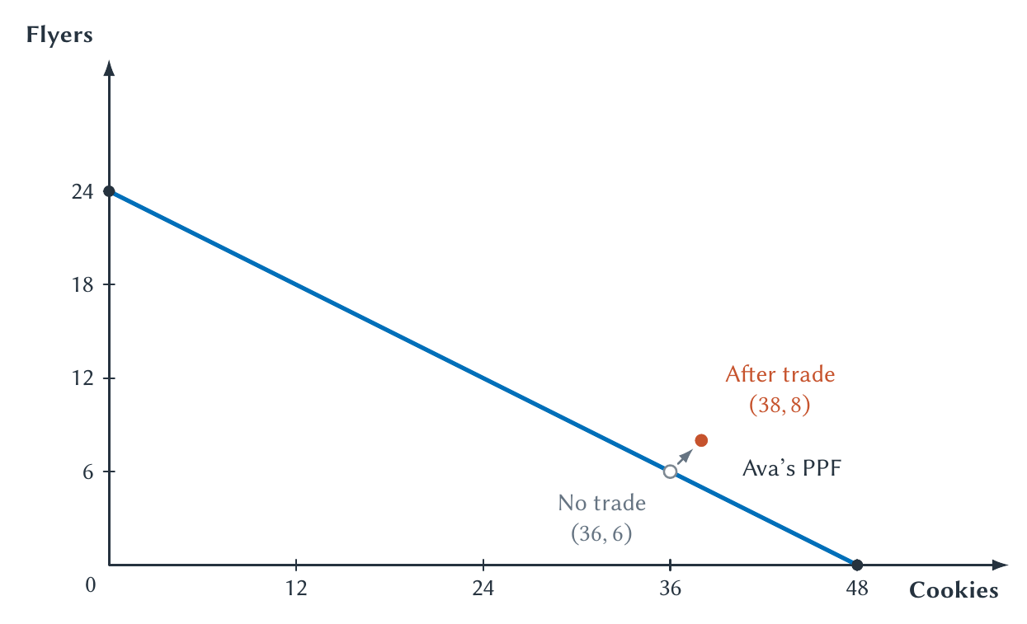
CHAPTER 2
Ava consumes beyond her PPF
PRINCIPLES OF MICRO
22
Notes:
Read the two labeled points. Ava's production ability did not change. She consumes a combination beyond her PPF because Ben produced the flyers she receives in trade.
[Sources]
- Principles of Micro, Chapter 2: Opportunity Cost, Trade, and Coordination (current project draft).
- Project-reviewed Chapter 2 figure from figures/ch02_opportunity_cost_trade_and_coordination/.
[/Sources]

Slide 23
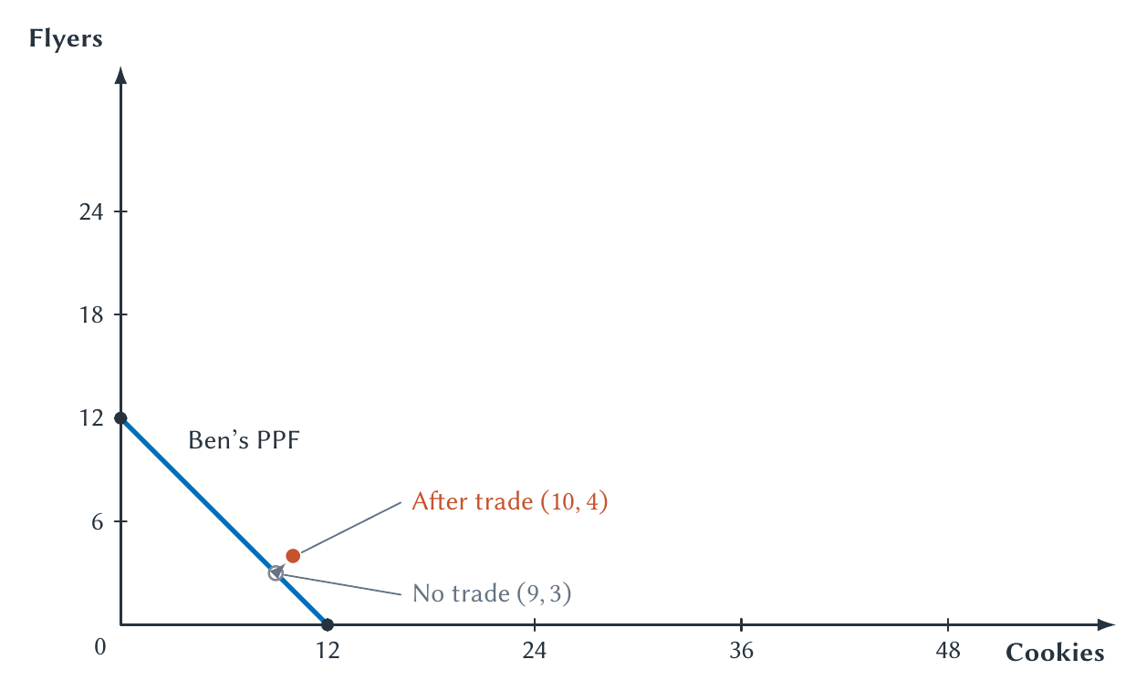
CHAPTER 2
Ben consumes beyond his PPF
PRINCIPLES OF MICRO
23
Notes:
Ben is less productive in both goods, yet gains from trade. This is the central comparative-advantage result: absolute advantage is not required for a person to gain from exchange.
[Sources]
- Principles of Micro, Chapter 2: Opportunity Cost, Trade, and Coordination (current project draft).
- Project-reviewed Chapter 2 figure from figures/ch02_opportunity_cost_trade_and_coordination/.
[/Sources]

Slide 24
CHAPTER 2
Trade expands consumption choices, not production ability
Production
Consumption
Trade lets each person consume some goods produced by someone else.
Each person's PPF stays where it was.
The gain comes from specialization and exchange.
PRINCIPLES OF MICRO
24
Notes:
Correct the common mistake that trade shifts the PPF. Technology or additional resources can shift production possibilities. Trade changes what can be consumed from a given set of production possibilities.
[Sources]
- Principles of Micro, Chapter 2: Opportunity Cost, Trade, and Coordination (current project draft).
[/Sources]

Slide 25
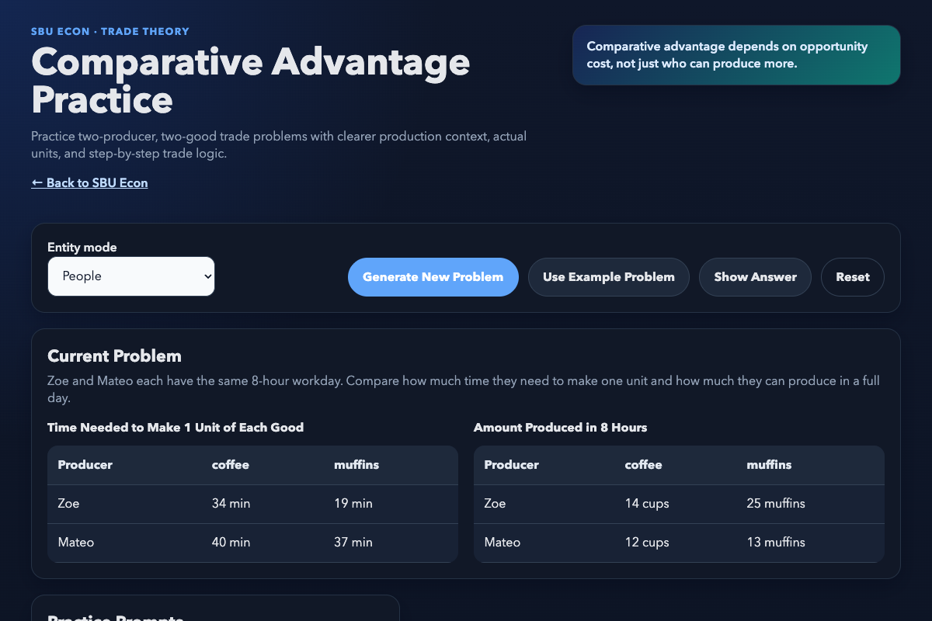
CHAPTER 2
Practice with new comparative-advantage problems
1
Work one problem on the board.
2
Check the answer in the app.
3
Generate more examples for practice.
sbu-econ.org/comparative-advantage/
PRINCIPLES OF MICRO
25
Notes:
Open the app from the linked address. Work a fresh problem on the board before clicking Show Answer. Then demonstrate Generate New Problem so students know where to get additional practice.
[Sources]
- Principles of Micro, Chapter 2: Opportunity Cost, Trade, and Coordination (current project draft).
- Comparative Advantage Practice app: https://sbu-econ.org/comparative-advantage/
- Screenshot: slides/assets/ch02_comparative_advantage_app.png (companion-app asset).
[/Sources]

Slide 26
CHAPTER 2
Most cooperation occurs among people who never meet
What in this room could you make entirely by yourself?
A laptop is obviously out of reach. So is something as simple as a pencil.
Adam Smith's insight
Specialization expands as the market expands.
PRINCIPLES OF MICRO
26
Notes:
Connect Smith's division of labor to the butcher, brewer, and baker: exchange does not require shared motives or a common production order. Use the pencil as a brief reminder that ordinary objects embody cooperation among strangers.
[Sources]
- Principles of Micro, Chapter 2: Opportunity Cost, Trade, and Coordination (current project draft).
- Adam Smith, An Inquiry into the Nature and Causes of the Wealth of Nations, Book I, Chapters I-III (1776). https://www.gutenberg.org/ebooks/3300
- Leonard E. Read, 'I, Pencil' (1958). Use only a brief paraphrase. https://fee.org/resources/i-pencil/
[/Sources]

Slide 27
CHAPTER 2
Gains from trade require workable exchange
MONEY
RULES AND TRUST
PRICES
Lets selling and buying occur at different times and with different people.
Make payment, delivery, quality, and promises more dependable.
Help separate buyers and sellers adjust their plans without one common manager.
Potential gains are not enough. People must be able to find one another and carry out the trade.
PRINCIPLES OF MICRO
27
Notes:
Keep this compressed. A used-laptop sale can fail because of search, trust, payment, delivery, or enforcement problems. Preview Chapters 3 and 4: they explain where prices come from and how prices coordinate plans.
[Sources]
- Principles of Micro, Chapter 2: Opportunity Cost, Trade, and Coordination (current project draft).
[/Sources]

Slide 28
CHAPTER 2
Trade lets different people turn lower opportunity costs into mutual gains
Trade lets different people turn lower opportunity costs into mutual gains
•
A PPF makes production trade-offs visible.
•
Comparative advantage depends on opportunity cost.
•
Specialization can increase total output.
•
Mutually acceptable terms of trade can make both sides better off.
•
Money, prices, rules, and trust help the exchange happen.
Next: where demand and supply come from.
28
PRINCIPLES OF MICRO
28
PRINCIPLES OF MICRO
Notes:
Return to Ava and Ben. They did not need a manager to assign tasks. Once they discovered their different opportunity costs and could trade on acceptable terms, cooperation emerged from separate choices.
[Sources]
- Principles of Micro, Chapter 2: Opportunity Cost, Trade, and Coordination (current project draft).
[/Sources]

