Slide 1

Demand and Supply
Chapter 3
Principles of Micro
Curves summarize how buyers and sellers respond
Mark Wilson
Notes:
Open with Maya's iced-coffee purchase. The chapter begins with a puzzle: one price is observed today, but a demand curve contains choices at many possible prices.
[Sources]
- Principles of Micro, Chapter 3: Demand and Supply (current project draft).
- Cover artwork: design/book-cover/principles-of-micro-cover.png (project-generated asset).
[/Sources]

Slide 2
CHAPTER 3
One purchase does not reveal a demand curve
Today
Where do the other points come from?
$5 per cup
$2 $3 $4 $6 $7 $8
Maya buys 4 cups
Economists ask what Maya would choose at each possible price.
PRINCIPLES OF MICRO
2
Notes:
Let students answer before defining a schedule. The points come from controlled what-if questions, not seven observed weeks.
[Sources]
- Principles of Micro, Chapter 3: Demand and Supply (current project draft).
[/Sources]

Slide 3
CHAPTER 3
A demand schedule records the what-if answers
Point
Price per cup
Cups demanded per week
A
$8
1
B
$7
2
C
$6
3
D
$5
4
E
$4
5
F
$3
6
G
$2
7
Each row is an alternative choice, not a different week.
PRINCIPLES OF MICRO
3
Notes:
Read several rows aloud as what-if questions. Hold Maya's income, preferences, schedule, and other choices fixed while changing only the price of iced coffee.
[Sources]
- Principles of Micro, Chapter 3: Demand and Supply (current project draft).
[/Sources]

Slide 4
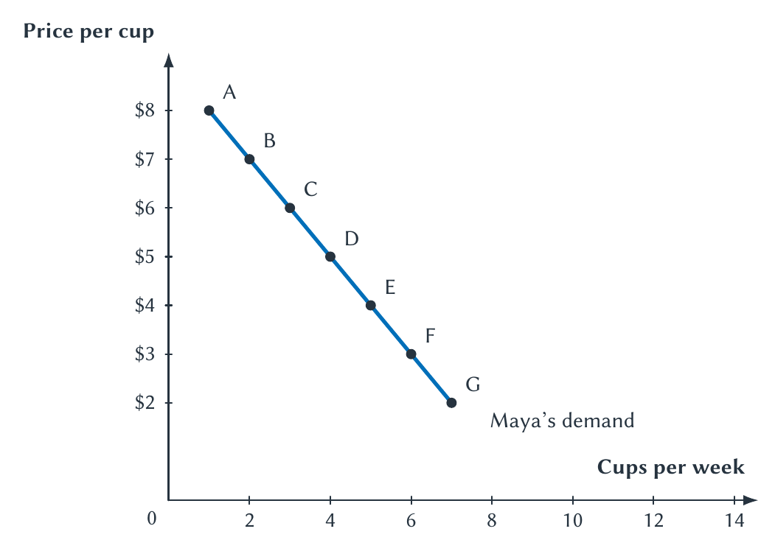
CHAPTER 3
The curve turns Maya's schedule into a picture
PRINCIPLES OF MICRO
4
Notes:
Choose one point and translate it into a sentence: at a price of $5, Maya's quantity demanded is four cups per week. Then emphasize that all seven points hold the same other conditions fixed.
[Sources]
- Principles of Micro, Chapter 3: Demand and Supply (current project draft).
- Project-reviewed Chapter 3 figure from figures/ch03_demand_and_supply/.
[/Sources]

Slide 5
CHAPTER 3
A curve changes one thing at a time
Ceteris paribus
Other things equal
Change the price of iced coffee.
Keep income, preferences, and other conditions unchanged.
The curve is a set of what-if choices, not a timeline.
PRINCIPLES OF MICRO
5
Notes:
The Latin term improves students' economics vocabulary, but the plain-English rule is the teaching point. A curve isolates one relationship so we can understand it.
[Sources]
- Principles of Micro, Chapter 3: Demand and Supply (current project draft).
[/Sources]

Slide 6
CHAPTER 3
Demand and quantity demanded are not the same
DEMAND
QUANTITY DEMANDED
The whole relationship
One amount at one price
All the quantities a buyer is willing and able to purchase at the possible prices.
The amount a buyer chooses at one particular price.
A price change moves Maya along the same demand curve.
PRINCIPLES OF MICRO
6
Notes:
Model the wording carefully: if price falls from $7 to $5, quantity demanded rises from two cups to four. Demand itself has not increased.
[Sources]
- Principles of Micro, Chapter 3: Demand and Supply (current project draft).
[/Sources]

Slide 7
CHAPTER 3
The law of demand
Price rises
Quantity demanded falls
Price falls
Quantity demanded rises
Why? A price change alters the choices buyers must compare and how far their limited income goes.
At a lower price, more units are worth buying.
PRINCIPLES OF MICRO
7
Notes:
Connect to marginal reasoning. A buyer purchases another cup when its perceived benefit is at least as large as its price. A lower price makes additional cups worth buying.
[Sources]
- Principles of Micro, Chapter 3: Demand and Supply (current project draft).
[/Sources]

Slide 8
CHAPTER 3
Build market demand one price at a time
At $5 per cup
Maya
Jordan
Market
4
+
3
=
7 cups
Hold price fixed. Add quantities, not prices.
PRINCIPLES OF MICRO
8
Notes:
Do this arithmetic before using the phrase horizontal summation. At a common price, add the quantities chosen by every buyer in the market.
[Sources]
- Principles of Micro, Chapter 3: Demand and Supply (current project draft).
[/Sources]

Slide 9
CHAPTER 3
Repeat the addition at every possible price
Price
Maya
Jordan
Market quantity demanded
$8
1
0
1
$5
4
3
7
$2
7
6
13
Market demand is a sum, not an average.
PRINCIPLES OF MICRO
9
Notes:
The full chapter table includes every price. Three rows are enough on the slide to show the rule and prevent the common mistake of averaging the individual quantities.
[Sources]
- Principles of Micro, Chapter 3: Demand and Supply (current project draft).
[/Sources]

Slide 10
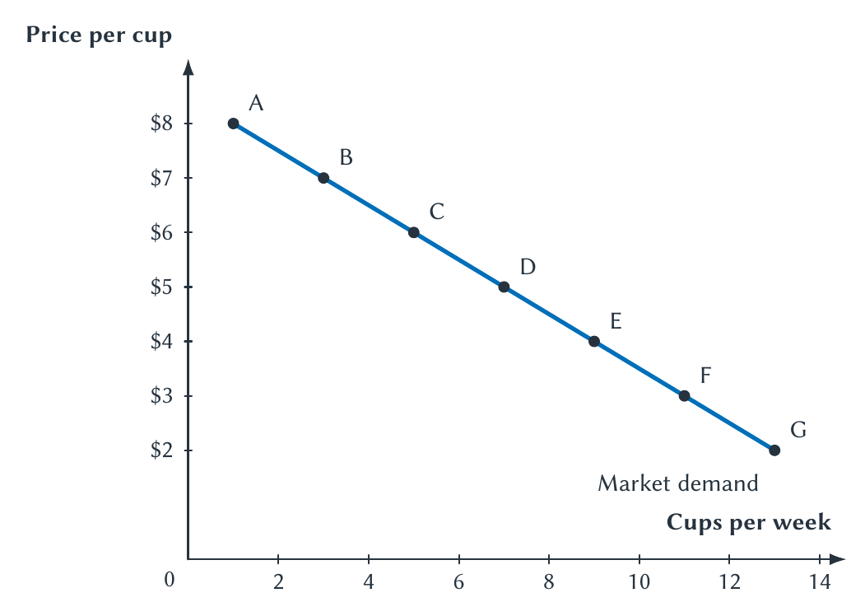
CHAPTER 3
Market demand combines separate buyers
PRINCIPLES OF MICRO
10
Notes:
At $5, locate the market quantity of seven cups. No buyer chooses the market curve. It emerges when their separate quantities are added at each common price.
[Sources]
- Principles of Micro, Chapter 3: Demand and Supply (current project draft).
- Project-reviewed Chapter 3 figure from figures/ch03_demand_and_supply/.
[/Sources]

Slide 11
CHAPTER 3
Economists estimate demand from evidence
Econometrics
THE UBER EXAMPLE
Researchers used nearly 50 million transactions and small price differences created near surge-pricing thresholds.
Statistical methods used to measure economic relationships and test economic ideas with data.
Similar riders facing slightly different prices revealed how ride choices responded to price.
One observed price and quantity are a market outcome, not a demand curve.
PRINCIPLES OF MICRO
11
Notes:
Keep this to one minute. Economists cannot normally observe an entire demand curve at one moment. The Uber study illustrates how unusually detailed data and small price changes can reveal otherwise hidden responses.
[Sources]
- Principles of Micro, Chapter 3: Demand and Supply (current project draft).
- Peter Cohen, Robert Hahn, Jonathan Hall, Steven Levitt, and Robert Metcalfe, 'Using Big Data to Estimate Consumer Surplus: The Case of Uber,' NBER Working Paper 22627 (2016). https://www.nber.org/papers/w22627
[/Sources]

Slide 12
CHAPTER 3
First ask whether iced coffee's own price changed
OWN PRICE CHANGED
ANOTHER CONDITION CHANGED
Move along demand
Shift demand
The demand curve already shows how quantity demanded responds to the price of iced coffee.
Income, alternatives, information, expectations, or the number of buyers changes the whole relationship.
Do not count the same price change twice.
PRINCIPLES OF MICRO
12
Notes:
This is the chapter's main demand-side memory anchor. A lower price increases quantity demanded; it does not increase demand.
[Sources]
- Principles of Micro, Chapter 3: Demand and Supply (current project draft).
[/Sources]

Slide 13
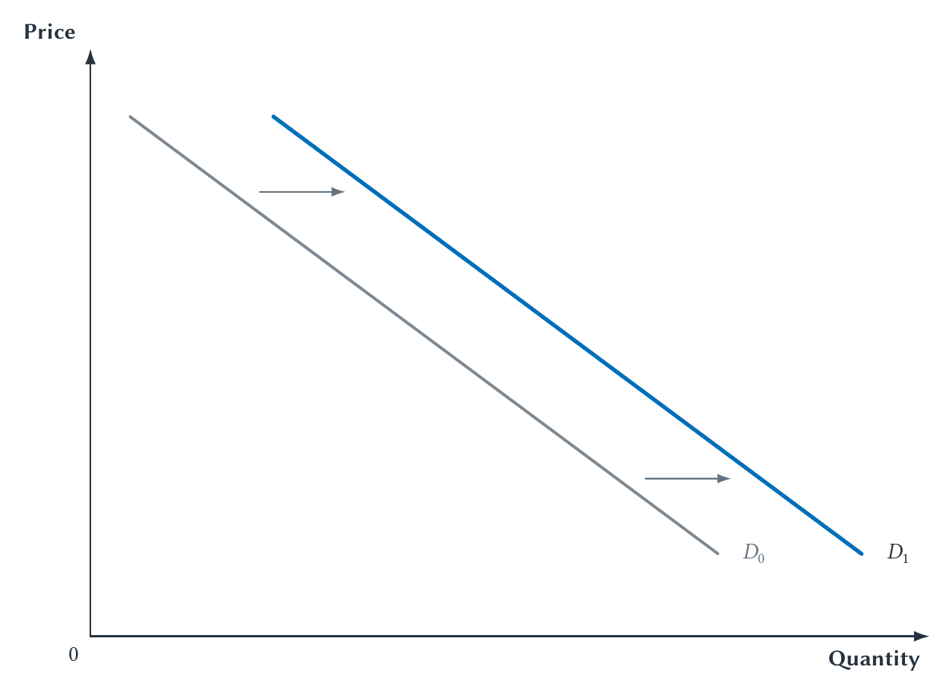
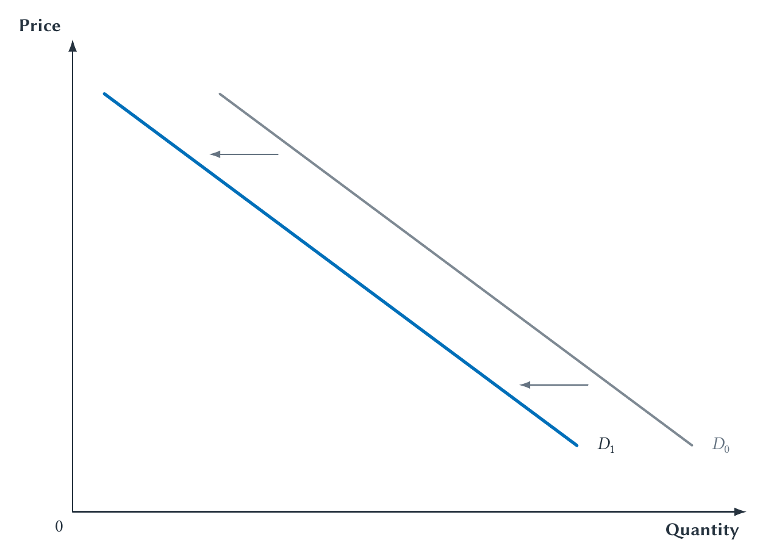
CHAPTER 3
A demand shift changes choices at every possible price
INCREASE IN DEMAND
DECREASE IN DEMAND
More at every price
Less at every price
PRINCIPLES OF MICRO
13
Notes:
A shift describes a new set of what-if answers. It does not by itself determine the price or quantity actually sold; Chapter 4 adds supply and market adjustment.
[Sources]
- Principles of Micro, Chapter 3: Demand and Supply (current project draft).
- Project-reviewed Chapter 3 figure from figures/ch03_demand_and_supply/.
[/Sources]

Slide 14
CHAPTER 3
Demand shifts when buyers' circumstances change
Price of the good itself: movement along demand
•
Income
•
Prices of substitutes or complements
•
Information, tastes, or preferences
•
Expectations about the future
•
Number of buyers
Naming the shifter is not enough. Explain why buyers choose more or less.
PRINCIPLES OF MICRO
14
Notes:
Teach the mechanism first: resources, alternatives, information or preferences, expectations, and participation. Then attach the standard names.
[Sources]
- Principles of Micro, Chapter 3: Demand and Supply (current project draft).
[/Sources]

Slide 15
CHAPTER 3
Income can shift demand in either direction
NORMAL GOOD
INFERIOR GOOD
Income rises: demand rises
Income rises: demand falls
Buyers purchase more when their income increases, with other conditions unchanged.
Buyers switch toward alternatives they prefer when they can afford them.
Inferior describes an income response, not quality.
PRINCIPLES OF MICRO
15
Notes:
Use instant noodles only as a possible example for some students, not as a universal classification. The definition depends on observed behavior when income changes.
[Sources]
- Principles of Micro, Chapter 3: Demand and Supply (current project draft).
[/Sources]

Slide 16
CHAPTER 3
Related goods change the alternatives buyers face
SUBSTITUTES
COMPLEMENTS
One can replace the other
The goods are used together
If tea becomes more expensive, demand for coffee may increase.
If game consoles become more expensive, demand for console-only games may decrease.
Always name the other good and trace the buyer's response.
PRINCIPLES OF MICRO
16
Notes:
Students often memorize the labels but reverse the direction. Ask what buyers do after the related good's price changes.
[Sources]
- Principles of Micro, Chapter 3: Demand and Supply (current project draft).
[/Sources]

Slide 17
CHAPTER 3
Supply begins with sellers' what-if choices
Point
Price per cup
Cups supplied per week
A
$2
0
B
$3
1
C
$4
2
D
$5
3
E
$6
4
F
$7
5
G
$8
6
Each row asks how much Riley would offer at a possible price.
PRINCIPLES OF MICRO
17
Notes:
Return to the same what-if structure used for demand. Hold Riley's input costs, equipment, and other opportunities fixed while changing the price received for iced coffee.
[Sources]
- Principles of Micro, Chapter 3: Demand and Supply (current project draft).
[/Sources]

Slide 18
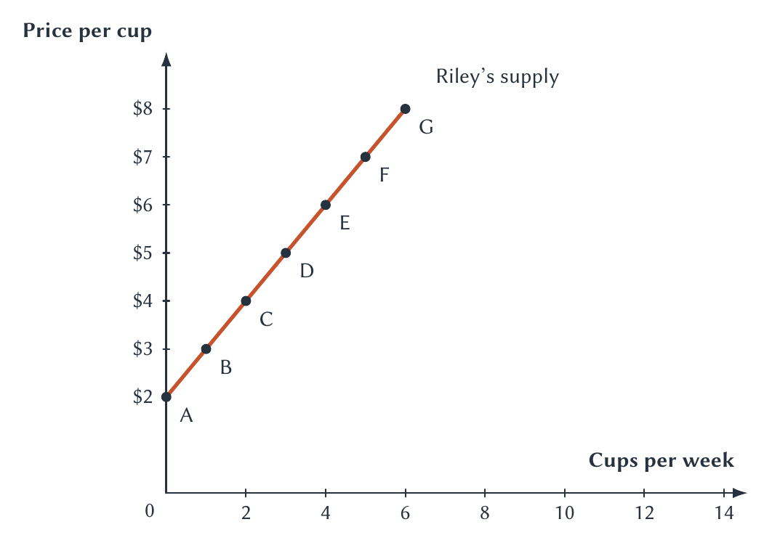
CHAPTER 3
Riley offers more cups when the reward is higher
PRINCIPLES OF MICRO
18
Notes:
Translate point D: at $5, Riley supplies three cups per week. A higher own price moves Riley up the same supply curve.
[Sources]
- Principles of Micro, Chapter 3: Demand and Supply (current project draft).
- Project-reviewed Chapter 3 figure from figures/ch03_demand_and_supply/.
[/Sources]

Slide 19
CHAPTER 3
The law of supply follows the seller's incentive
Price rises
Quantity supplied rises
A higher price makes this good a more attractive use of scarce time and resources.
More units become worth producing and selling.
PRINCIPLES OF MICRO
19
Notes:
Do not describe sellers as becoming greedier. The additional price makes it worthwhile to use time and resources that were previously more valuable elsewhere or too costly to employ.
[Sources]
- Principles of Micro, Chapter 3: Demand and Supply (current project draft).
[/Sources]

Slide 20
CHAPTER 3
Build market supply at one price
At $5 per cup
Riley
Sam
Market
3
+
4
=
7 cups
At a common price, add every seller's quantity supplied.
PRINCIPLES OF MICRO
20
Notes:
The market-supply calculation mirrors market demand. At $5, Riley offers three cups and Sam offers four, so market quantity supplied is seven.
[Sources]
- Principles of Micro, Chapter 3: Demand and Supply (current project draft).
[/Sources]

Slide 21
CHAPTER 3
Market supply also adds quantities at each price
Price
Riley
Sam
Market quantity supplied
$2
0
1
1
$5
3
4
7
$8
6
7
13
No single seller chooses market supply.
PRINCIPLES OF MICRO
21
Notes:
Use the $5 row to reconnect the table to the previous slide. A real market may add quantities across many firms, farms, workers, landlords, or other sellers.
[Sources]
- Principles of Micro, Chapter 3: Demand and Supply (current project draft).
[/Sources]

Slide 22
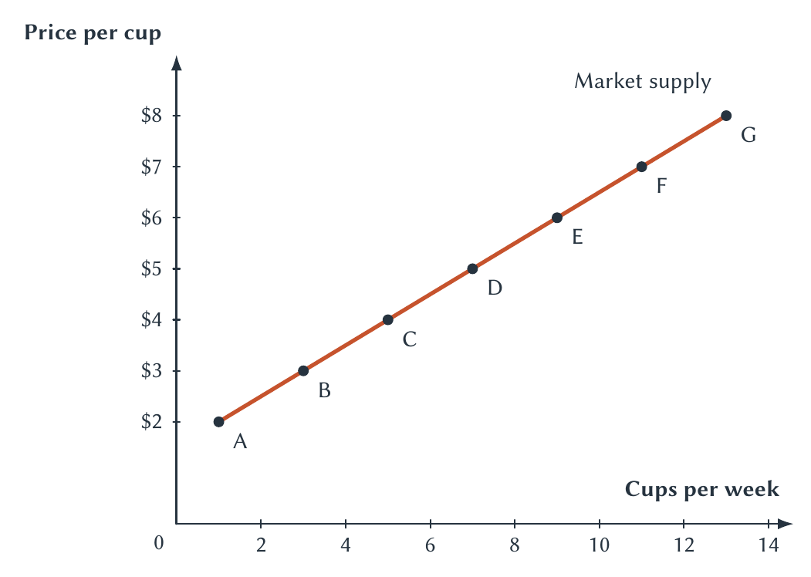
CHAPTER 3
Market supply combines separate sellers
PRINCIPLES OF MICRO
22
Notes:
At $5, locate market quantity supplied of seven cups. The curve slopes upward because higher prices make additional production worthwhile for existing sellers.
[Sources]
- Principles of Micro, Chapter 3: Demand and Supply (current project draft).
- Project-reviewed Chapter 3 figure from figures/ch03_demand_and_supply/.
[/Sources]

Slide 23
CHAPTER 3
The own-price rule applies to supply too
OWN PRICE CHANGED
ANOTHER CONDITION CHANGED
Move along supply
Shift supply
Existing sellers change quantity supplied as the price of iced coffee changes.
Costs, technology, expectations, production conditions, rules, or the number of sellers changes the whole relationship.
A lasting high price may later attract new sellers, but entry is a separate supply shift.
PRINCIPLES OF MICRO
23
Notes:
Keep immediate movement along supply distinct from a later change in the number of sellers. This prevents entry from blurring the own-price rule.
[Sources]
- Principles of Micro, Chapter 3: Demand and Supply (current project draft).
[/Sources]

Slide 24
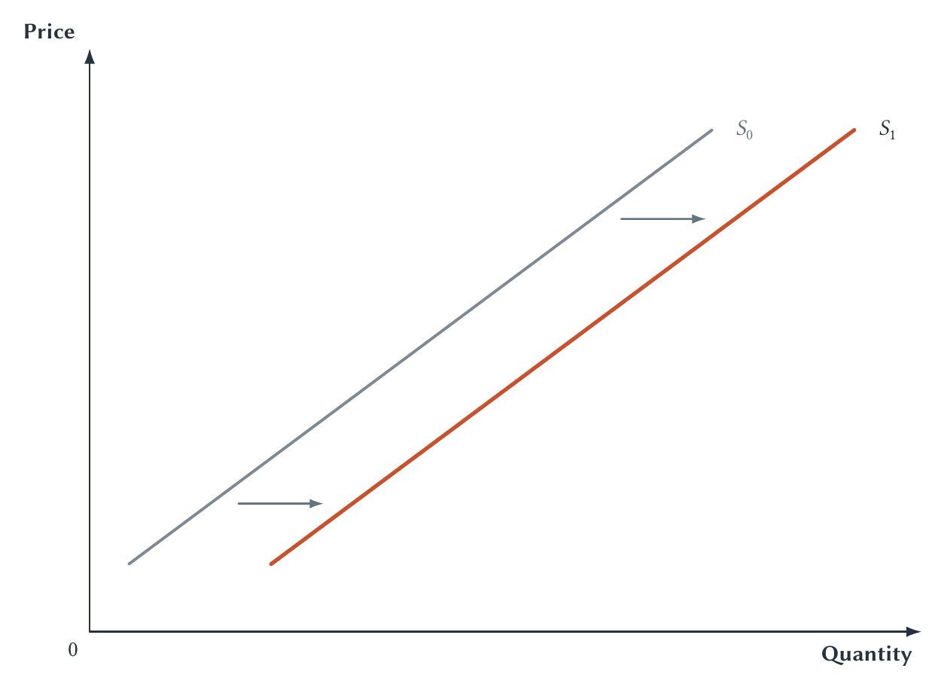
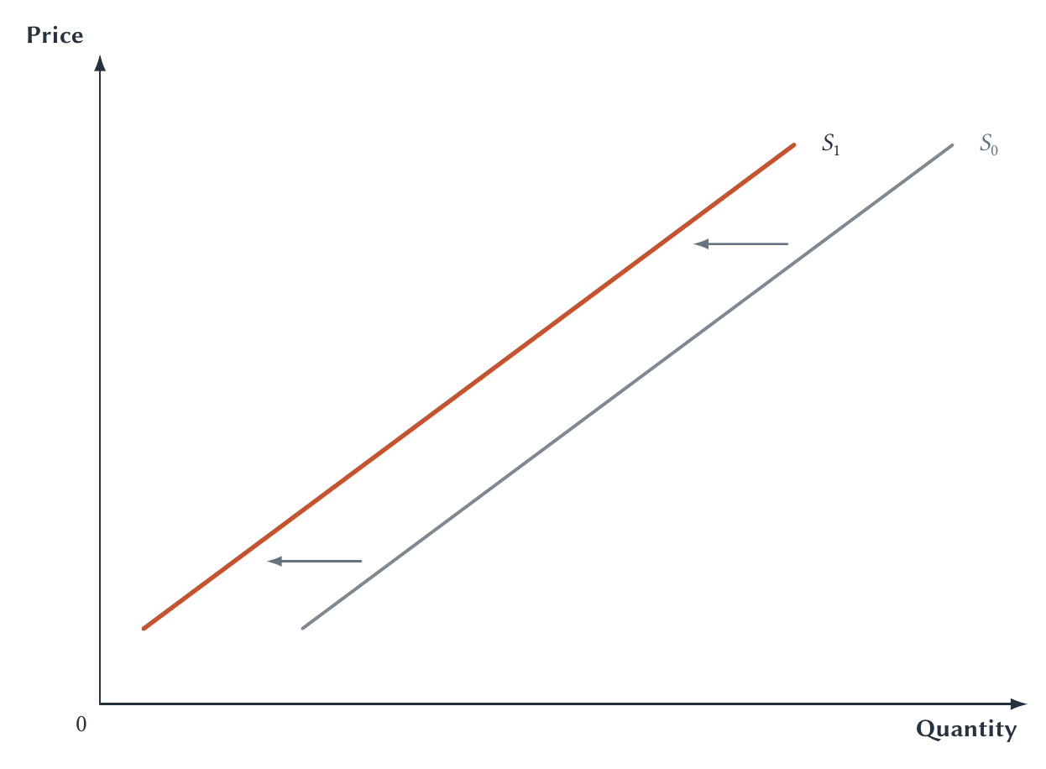
CHAPTER 3
A supply shift changes choices at every possible price
INCREASE IN SUPPLY
DECREASE IN SUPPLY
More at every price
Less at every price
PRINCIPLES OF MICRO
24
Notes:
A rightward shift means sellers offer more at each possible price. A leftward shift means they offer less. Do not infer the market outcome until demand is added in Chapter 4.
[Sources]
- Principles of Micro, Chapter 3: Demand and Supply (current project draft).
- Project-reviewed Chapter 3 figure from figures/ch03_demand_and_supply/.
[/Sources]

Slide 25
CHAPTER 3
Supply shifts when production conditions change
Price of the good itself: movement along supply
•
Input prices
•
Technology or productivity
•
Expectations about the future
•
Number of sellers
•
Weather or another production shock
•
Taxes, subsidies, or rules that change production costs
PRINCIPLES OF MICRO
25
Notes:
Ask what changed for sellers: cost, productive ability, plans, production conditions or rules, or participation. Then determine the direction.
[Sources]
- Principles of Micro, Chapter 3: Demand and Supply (current project draft).
[/Sources]

Slide 26
CHAPTER 3
The most important rule in this chapter
The most important rule in this chapter
The price of the good itself
causes movement along the curve
It does not shift demand or supply.
Use quantity demanded or quantity supplied when describing the response.
26
PRINCIPLES OF MICRO
26
PRINCIPLES OF MICRO
Notes:
Pause here. This rule should become automatic before Chapter 4. Ask students to correct the sentence 'a lower price increases demand.'
[Sources]
- Principles of Micro, Chapter 3: Demand and Supply (current project draft).
[/Sources]

Slide 27
CHAPTER 3
Diagnose the event before drawing the graph
1
What happened?
2
Does it affect buyers or sellers?
3
Did the good's own price change?
4
Which curve is involved?
5
If it shifts, does it move left or right?
PRINCIPLES OF MICRO
27
Notes:
Require this sequence whenever students shift the wrong curve. Step 3 catches the most common error before they draw anything.
[Sources]
- Principles of Micro, Chapter 3: Demand and Supply (current project draft).
[/Sources]

Slide 28
CHAPTER 3
Which curve changes, and in which direction?
A
Student income rises, and iced coffee is a normal good.
B
The price of coffee beans rises.
C
The price of iced coffee falls.
D
A new coffee stand opens near campus.
Use the five questions. Do not predict equilibrium yet.
PRINCIPLES OF MICRO
28
Notes:
Answers: A demand shifts right. B supply shifts left. C buyers move down along demand and sellers move down along supply; do not say either curve shifted. D market supply shifts right because the number of sellers increased.
[Sources]
- Principles of Micro, Chapter 3: Demand and Supply (current project draft).
[/Sources]

Slide 29
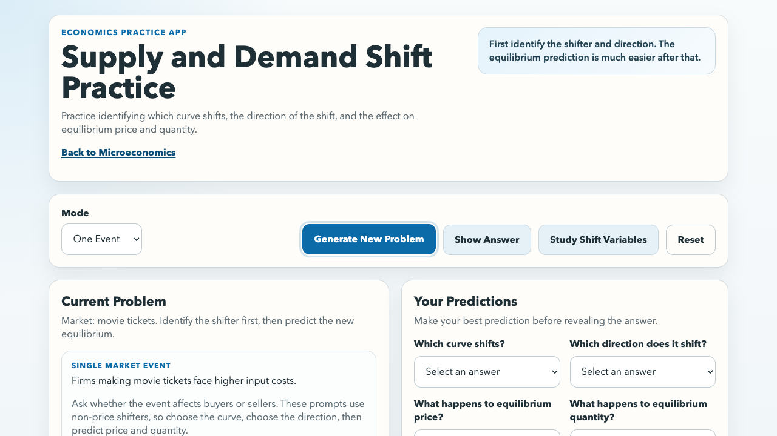
CHAPTER 3
Practice identifying the shifter before predicting outcomes
USE NOW
Choose demand or supply.
Choose left or right.
AFTER CHAPTER 4
Then predict equilibrium price and quantity.
sbu-econ.org/supply-demand-shift-practice/
PRINCIPLES OF MICRO
29
Notes:
Open the linked app. In Chapter 3, use only the curve and direction questions. The equilibrium questions become useful after Chapter 4 puts demand and supply together.
[Sources]
- Principles of Micro, Chapter 3: Demand and Supply (current project draft).
- Supply and Demand Shift Practice app: https://sbu-econ.org/supply-demand-shift-practice/
- Screenshot: slides/assets/ch03_shift_practice.png (companion-app asset captured 2026-07-30).
[/Sources]

Slide 30
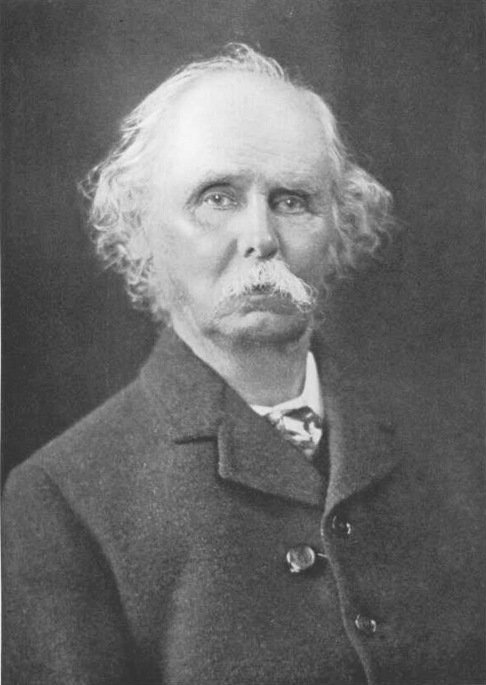
CHAPTER 3
Marshall made the controlled what-if central to economics
Alfred Marshall
1842-1924
Demand and supply schedules isolate one price-and-quantity relationship while other important conditions are held fixed.
Simplify one part of a complicated market long enough to understand it.
PRINCIPLES OF MICRO
30
Notes:
Keep the profile concept-first. Marshall's demand-schedule discussion reinforces alternative quantities at possible prices, other things held equal, and market demand built from individual demands.
[Sources]
- Principles of Micro, Chapter 3: Demand and Supply (current project draft).
- Alfred Marshall, Principles of Economics, 8th ed. (1920), Book III, Chapter III and Book V. https://www.econlib.org/library/Marshall/marP.html
- Emery Walker, Alfred Marshall, 1921 photograph, public domain. https://commons.wikimedia.org/wiki/File:Alfred_Marshall.jpg
[/Sources]

Slide 31
CHAPTER 3
Direction is not size
Demand
Supply
A higher price leads buyers to purchase less.
A higher price leads sellers to offer more.
But how much do buyers and sellers respond?
Chapter 5 introduces elasticity to measure responsiveness.
PRINCIPLES OF MICRO
31
Notes:
This bridge prevents students from reading steepness or the laws themselves as a complete measure of responsiveness. Do not calculate elasticity here.
[Sources]
- Principles of Micro, Chapter 3: Demand and Supply (current project draft).
[/Sources]

Slide 32
CHAPTER 3
Demand and supply are maps of decentralized choice
Demand and supply are maps of decentralized choice
•
Each curve is a set of controlled what-if choices.
•
Market curves add individual quantities at a common price.
•
The good's own price causes movement along a curve.
•
Other conditions can shift demand or supply.
•
Diagnose the side, cause, and direction before drawing.
Next: how market prices bring the two sides together.
32
PRINCIPLES OF MICRO
32
PRINCIPLES OF MICRO
Notes:
Close by returning to the opening puzzle. A curve makes unseen possible choices visible. Chapter 4 asks how separate buyer and seller plans fit together at a market-clearing price.
[Sources]
- Principles of Micro, Chapter 3: Demand and Supply (current project draft).
[/Sources]

