Slide 1

Market Equilibrium and Market Adjustment
Chapter 4
Principles of Micro
How prices bring separate plans together
Mark Wilson
Notes:
Open with the forecast blizzard. Demand changes before the posted price changes, so buyer and seller plans no longer fit at yesterday's price.
[Sources]
- Principles of Micro, Chapter 4: Market Equilibrium and Market Adjustment (current project draft).
- Cover artwork: design/book-cover/principles-of-micro-cover.png (project-generated asset).
[/Sources]

Slide 2
CHAPTER 4
A storm forecast changes demand first
The shelves are not empty yet. What changed first?
•
More buyers want snow shovels at yesterday's price.
•
Stores still have yesterday's inventory and posted price.
•
Buyer and seller plans no longer fit together.
PRINCIPLES OF MICRO
2
Notes:
Ask before revealing the bullets. The direct event is a demand increase. The old price now creates a shortage, which gives the chapter its adjustment story.
[Sources]
- Principles of Micro, Chapter 4: Market Equilibrium and Market Adjustment (current project draft).
[/Sources]

Slide 3
CHAPTER 4
Chapter 3 gave us two separate sets of plans
BUYERS
SELLERS
Demand
Supply
How much buyers plan to purchase at each possible price
How much sellers plan to offer at each possible price
At what price do the plans match?
PRINCIPLES OF MICRO
3
Notes:
Do not reteach the shifters. The lecture job now is to combine the two sides and explain how price coordinates their separate plans.
[Sources]
- Principles of Micro, Chapter 4: Market Equilibrium and Market Adjustment (current project draft).
[/Sources]

Slide 4
CHAPTER 4
Supply and demand work best as a competitive-market model
•
Many buyers and many sellers
•
No one participant controls the market price
•
Goods are reasonably comparable
•
Buyers and sellers can respond when price changes
The model is a starting point, not a claim that every market is identical.
PRINCIPLES OF MICRO
4
Notes:
Use wheat versus one patented drug as a quick contrast. Keep this brief; later chapters explain monopoly and product differentiation.
[Sources]
- Principles of Micro, Chapter 4: Market Equilibrium and Market Adjustment (current project draft).
[/Sources]

Slide 5
CHAPTER 4
X marks the spot, but what makes that spot special?
X
It is the only price where quantity demanded equals quantity supplied.
That price is the market-clearing price.
PRINCIPLES OF MICRO
5
Notes:
Use the instructor phrasing directly: students can guess the intersection, but they must explain why it matters. Every other price produces conflicting buyer and seller plans.
[Sources]
- Principles of Micro, Chapter 4: Market Equilibrium and Market Adjustment (current project draft).
[/Sources]

Slide 6
CHAPTER 4
Find the one price where the snow-shovel plans match
Price
Quantity demanded
Quantity supplied
$20
100
20
$25
80
40
$30
60
60
$35
40
80
$40
20
100
Equilibrium price: $30 | Equilibrium quantity: 60 shovels per day
PRINCIPLES OF MICRO
6
Notes:
Pause before revealing the bottom line. At $30, both planned quantities equal 60. At every other listed price, the plans conflict.
[Sources]
- Principles of Micro, Chapter 4: Market Equilibrium and Market Adjustment (current project draft).
[/Sources]

Slide 7
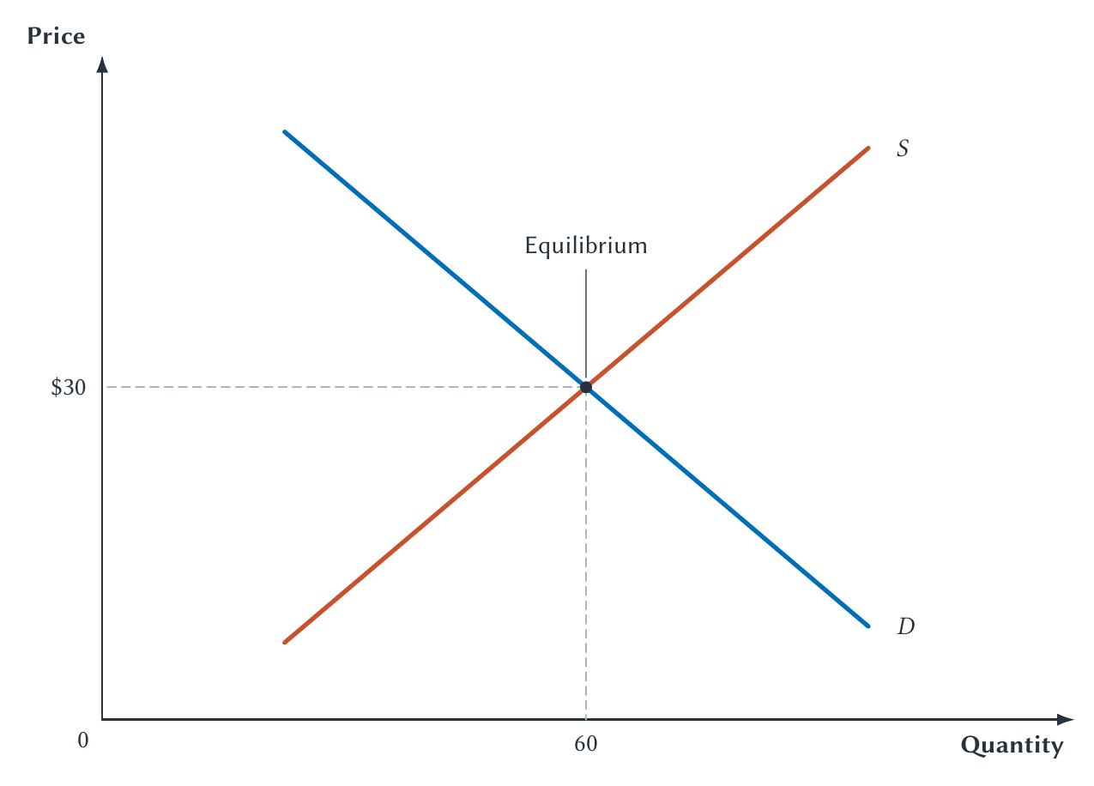
CHAPTER 4
The schedule and graph identify the same equilibrium
At $30, Qd = Qs = 60
PRINCIPLES OF MICRO
7
Notes:
Trace from the intersection to the two axes. The graph does not add a new answer; it shows the same matching plans found in the schedule.
[Sources]
- Principles of Micro, Chapter 4: Market Equilibrium and Market Adjustment (current project draft).
- Project-reviewed Chapter 4 figure from figures/ch04_market_equilibrium_and_market_adjustment/.
[/Sources]

Slide 8
CHAPTER 4
Equilibrium means the current plans fit together
Quantity demanded equals quantity supplied at the current price.
•
Buyers willing to pay that price can find willing sellers.
•
Sellers willing to accept that price can find willing buyers.
•
There is no shortage or surplus pushing the price up or down.
PRINCIPLES OF MICRO
8
Notes:
Market clearing does not mean everyone gets everything desired. It means planned purchases and planned sales match at the current price.
[Sources]
- Principles of Micro, Chapter 4: Market Equilibrium and Market Adjustment (current project draft).
[/Sources]

Slide 9
CHAPTER 4
Prices away from equilibrium create pressure
Current price
Market condition
Pressure on price
Below equilibrium
Qd is greater than Qs
Rises
At equilibrium
Qd equals Qs
No upward or downward pressure
Above equilibrium
Qs is greater than Qd
Falls
The current price determines whether plans match.
PRINCIPLES OF MICRO
9
Notes:
The words low and high only make sense relative to equilibrium. A low price creates a shortage only when it is below the market-clearing price.
[Sources]
- Principles of Micro, Chapter 4: Market Equilibrium and Market Adjustment (current project draft).
[/Sources]

Slide 10
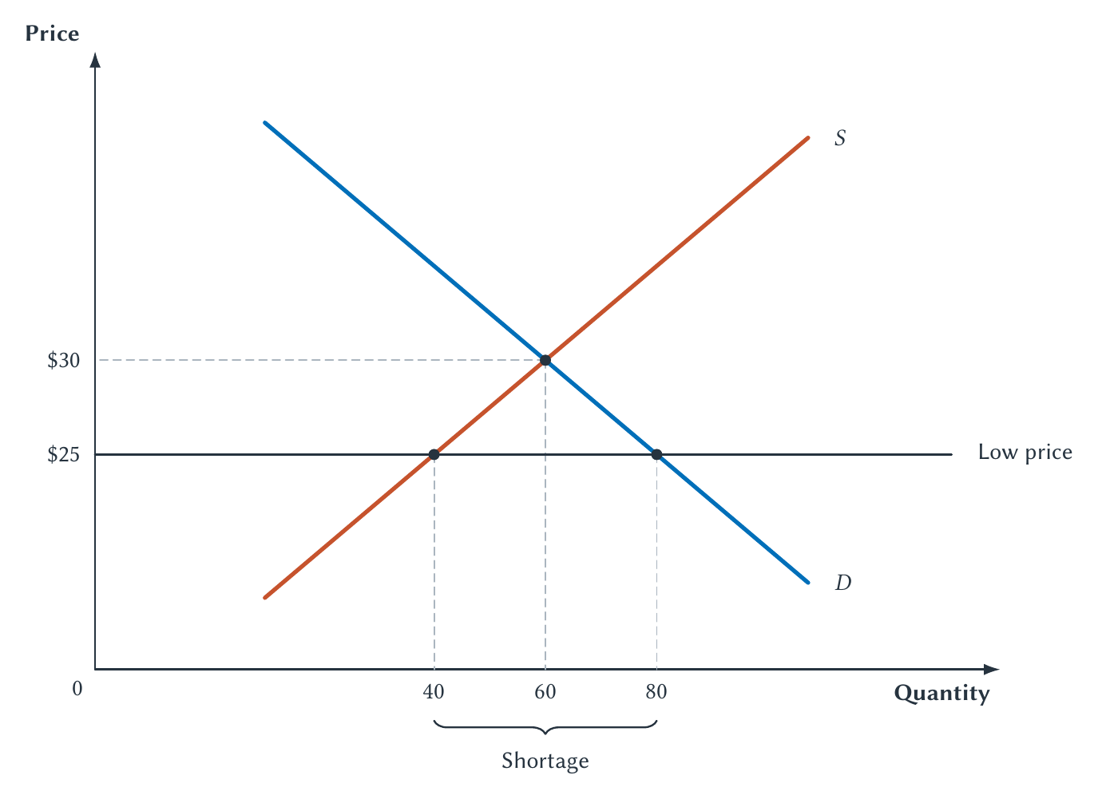
CHAPTER 4
$25 creates a shortage of 40 shovels
Shortage = Qd - Qs = 40
PRINCIPLES OF MICRO
10
Notes:
Ask students to locate Qs and Qd before naming the gap. The shortage is 80 minus 40, not the entire quantity demanded.
[Sources]
- Principles of Micro, Chapter 4: Market Equilibrium and Market Adjustment (current project draft).
- Project-reviewed Chapter 4 figure from figures/ch04_market_equilibrium_and_market_adjustment/.
[/Sources]

Slide 11
CHAPTER 4
A shortage is not the same thing as scarcity
SCARCITY
SHORTAGE
Resources are limited compared with human wants.
Quantity demanded exceeds quantity supplied at the current price.
This is always present.
This depends on price.
A good can be scarce without being in shortage.
PRINCIPLES OF MICRO
11
Notes:
Use a fully stocked grocery store as the contrast. The goods remain scarce even when the posted prices prevent shortages.
[Sources]
- Principles of Micro, Chapter 4: Market Equilibrium and Market Adjustment (current project draft).
[/Sources]

Slide 12
CHAPTER 4
A shortage creates upward pressure on price
Price is below equilibrium
Qd is greater than Qs
Buyers compete for available goods
Price tends to rise
>
>
>
As price rises, buyers purchase less and sellers offer more.
If the posted price cannot rise, competition moves into waiting, search, travel, connections, or luck.
PRINCIPLES OF MICRO
12
Notes:
This is the adjustment mechanism behind the graph. A price ceiling later prevents the money price from doing this job but does not make the scarce units less contested.
[Sources]
- Principles of Micro, Chapter 4: Market Equilibrium and Market Adjustment (current project draft).
[/Sources]

Slide 13
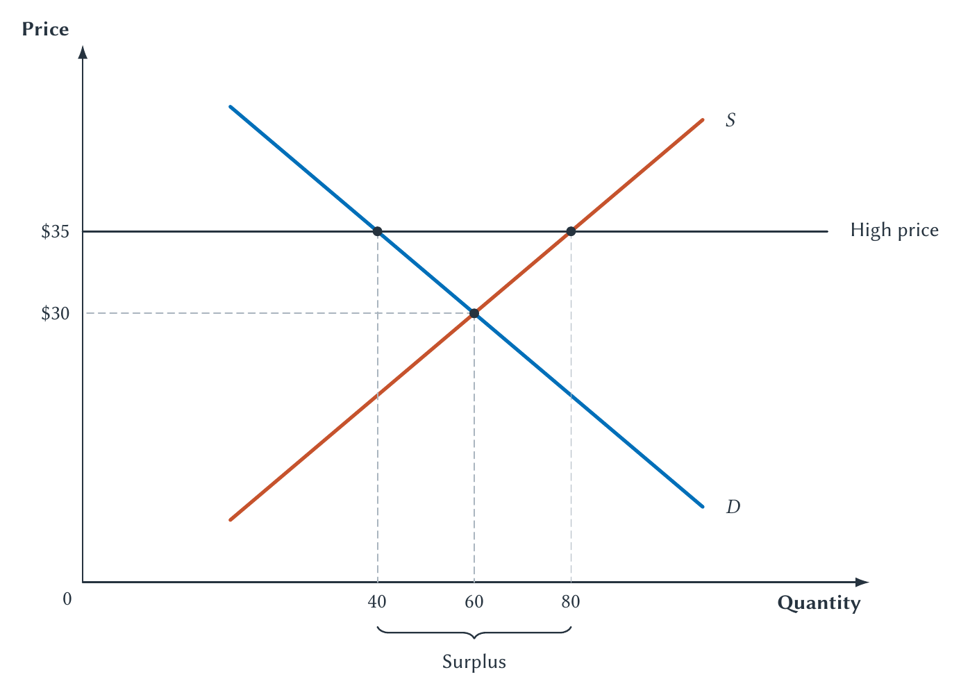
CHAPTER 4
At $35, sellers offer 40 more shovels than buyers want
Surplus = Qs - Qd = 40
PRINCIPLES OF MICRO
13
Notes:
Ask students to locate Qd and Qs before naming the gap. Unsold planned output gives sellers a reason to adjust.
[Sources]
- Principles of Micro, Chapter 4: Market Equilibrium and Market Adjustment (current project draft).
- Project-reviewed Chapter 4 figure from figures/ch04_market_equilibrium_and_market_adjustment/.
[/Sources]

Slide 14
CHAPTER 4
A surplus creates downward pressure on price
Price is above equilibrium
Qs is greater than Qd
Sellers have unsold goods
Price tends to fall
>
>
>
As price falls, buyers purchase more and sellers offer less.
Sales, bargaining, smaller future orders, storage, and exit are all possible adjustments.
PRINCIPLES OF MICRO
14
Notes:
Connect the diagram to observable seller behavior. The point is not that every seller makes the same adjustment, but that unsold output creates pressure to respond.
[Sources]
- Principles of Micro, Chapter 4: Market Equilibrium and Market Adjustment (current project draft).
[/Sources]

Slide 15
CHAPTER 4
The law of supply and demand describes the adjustment
When a competitive market is out of equilibrium, price tends to move in the direction that brings quantity demanded and quantity supplied together.
A changing price is both a signal and an incentive.
PRINCIPLES OF MICRO
15
Notes:
Keep the qualification brief. Contracts, inventory limits, and slow production can delay adjustment, but the model still identifies the direction of pressure.
[Sources]
- Principles of Micro, Chapter 4: Market Equilibrium and Market Adjustment (current project draft).
[/Sources]

Slide 16
CHAPTER 4
Analyze a market change in four steps
1. Identify the event
2. Choose the curve
3. Shift left or right
4. Compare equilibria
>
>
>
Begin with the event, not with a memorized arrow.
Economists sometimes call this before-and-after reasoning comparative statics.
PRINCIPLES OF MICRO
16
Notes:
The technical term is optional. Require the four questions and a verbal explanation of the adjustment.
[Sources]
- Principles of Micro, Chapter 4: Market Equilibrium and Market Adjustment (current project draft).
[/Sources]

Slide 17
CHAPTER 4
One curve shifts; price moves us along the other
THE CAUSE
THE RESPONSE
An outside event changes demand or supply.
The new shortage or surplus changes price.
That curve shifts.
The market moves along the other curve.
Do not shift both curves after one event.
PRINCIPLES OF MICRO
17
Notes:
This is the chapter's central link back to Chapter 3. Sellers supplying more after a demand increase is movement along supply, not a supply shift.
[Sources]
- Principles of Micro, Chapter 4: Market Equilibrium and Market Adjustment (current project draft).
[/Sources]

Slide 18
CHAPTER 4
A blizzard forecast increases snow-shovel demand
•
Event: A major snowstorm is forecast.
•
Curve: Buyers want more shovels at every possible price.
•
Shift: Demand moves right from D0 to D1.
•
Prediction: Equilibrium price and quantity both rise.
At the old price, the demand increase first creates a shortage.
PRINCIPLES OF MICRO
18
Notes:
Have students identify demand before showing the final prediction. The old-price shortage is what connects the shifted curve to the new equilibrium.
[Sources]
- Principles of Micro, Chapter 4: Market Equilibrium and Market Adjustment (current project draft).
[/Sources]

Slide 19
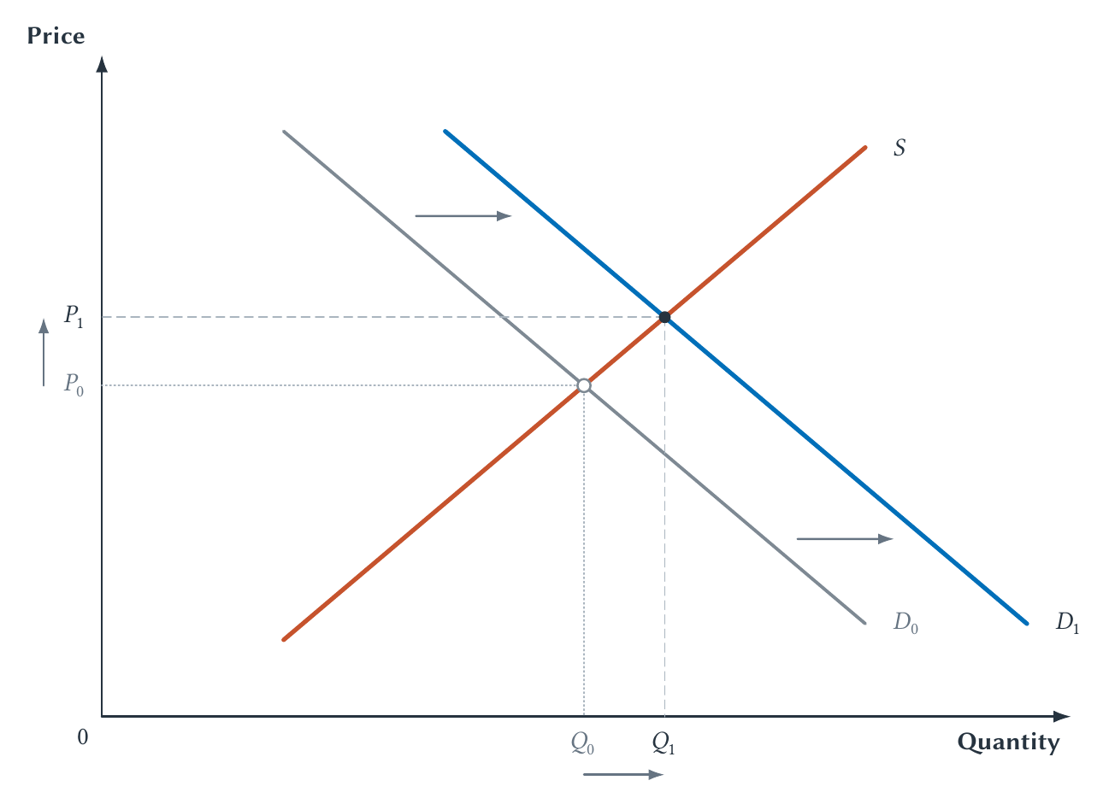
CHAPTER 4
A demand increase raises equilibrium price and quantity
Demand right: P rises, Q rises
PRINCIPLES OF MICRO
19
Notes:
At P0, the new demand curve creates a shortage. Rising price moves sellers upward along the unchanged supply curve until the new equilibrium is reached.
[Sources]
- Principles of Micro, Chapter 4: Market Equilibrium and Market Adjustment (current project draft).
- Project-reviewed Chapter 4 figure from figures/ch04_market_equilibrium_and_market_adjustment/.
[/Sources]

Slide 20
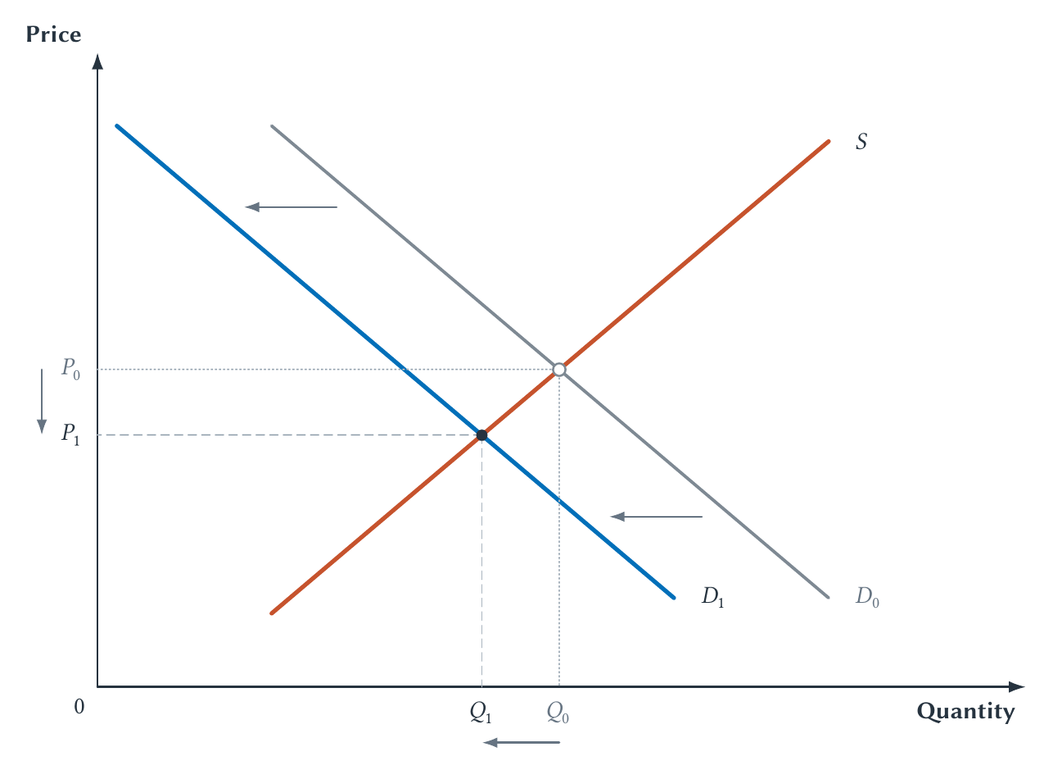
CHAPTER 4
A demand decrease lowers equilibrium price and quantity
Demand left: P falls, Q falls
PRINCIPLES OF MICRO
20
Notes:
Use better late-night train service reducing rideshare demand as the event. At the old price, the demand decrease creates a surplus and downward price pressure.
[Sources]
- Principles of Micro, Chapter 4: Market Equilibrium and Market Adjustment (current project draft).
- Project-reviewed Chapter 4 figure from figures/ch04_market_equilibrium_and_market_adjustment/.
[/Sources]

Slide 21
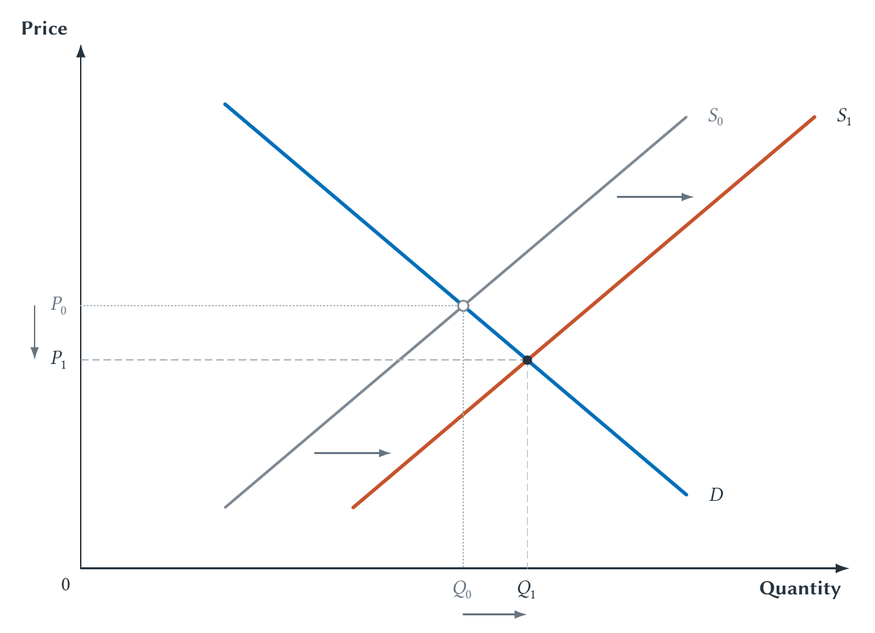
CHAPTER 4
A supply increase lowers price and raises quantity
Supply right: P falls, Q rises
PRINCIPLES OF MICRO
21
Notes:
Use a cost-saving technology as the event. At the old price, the supply increase creates a surplus. Falling price moves buyers down along the unchanged demand curve.
[Sources]
- Principles of Micro, Chapter 4: Market Equilibrium and Market Adjustment (current project draft).
- Project-reviewed Chapter 4 figure from figures/ch04_market_equilibrium_and_market_adjustment/.
[/Sources]

Slide 22
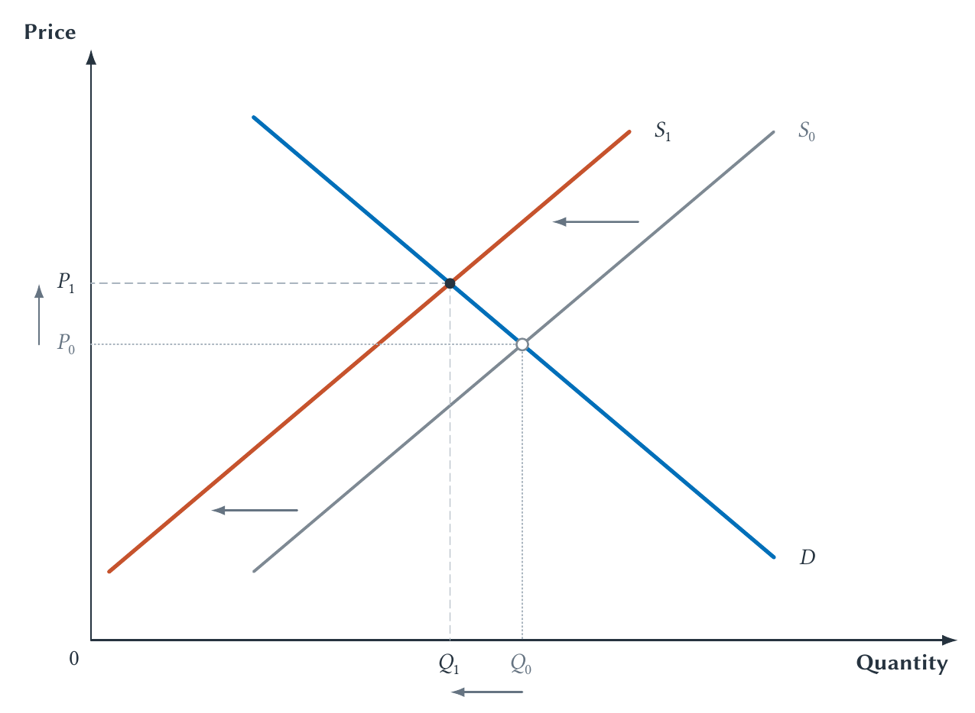
CHAPTER 4
A supply decrease raises price and lowers quantity
Supply left: P rises, Q falls
PRINCIPLES OF MICRO
22
Notes:
Use a crop freeze as the event. At the old price, the supply decrease creates a shortage. Rising price moves buyers up along the unchanged demand curve.
[Sources]
- Principles of Micro, Chapter 4: Market Equilibrium and Market Adjustment (current project draft).
- Project-reviewed Chapter 4 figure from figures/ch04_market_equilibrium_and_market_adjustment/.
[/Sources]

Slide 23
CHAPTER 4
Use the four outcomes to check your reasoning
Market change
Equilibrium price
Equilibrium quantity
Demand increases
Rises
Rises
Demand decreases
Falls
Falls
Supply increases
Falls
Rises
Supply decreases
Rises
Falls
Always be able to explain the shortage or surplus at the old price.
PRINCIPLES OF MICRO
23
Notes:
Use the table after the mechanisms have been taught. A student who knows only the arrow pattern is not yet ready for policy applications.
[Sources]
- Principles of Micro, Chapter 4: Market Equilibrium and Market Adjustment (current project draft).
[/Sources]

Slide 24
CHAPTER 4
When both curves shift, analyze each shift separately
Analyze the demand shift
Analyze the supply shift
Compare the price arrows
Compare the quantity arrows
>
>
>
Same direction: definite
Opposite directions: ambiguous
A combined graph cannot create information about which shift is larger.
PRINCIPLES OF MICRO
24
Notes:
Do not draw one combined graph unless relative shift sizes are given. Separate directional reasoning prevents the picture from hiding an unsupported assumption.
[Sources]
- Principles of Micro, Chapter 4: Market Equilibrium and Market Adjustment (current project draft).
[/Sources]

Slide 25
CHAPTER 4
A major event arrives while hotels close for repairs
DEMAND
SUPPLY
More visitors want hotel rooms.
Repair closures reduce available rooms.
By itself: P rises, Q rises
By itself: P rises, Q falls
Price rises for sure. Quantity is ambiguous.
PRINCIPLES OF MICRO
25
Notes:
Have students say both separate predictions before combining them. Both shifts raise price, while their quantity effects oppose one another.
[Sources]
- Principles of Micro, Chapter 4: Market Equilibrium and Market Adjustment (current project draft).
[/Sources]

Slide 26
CHAPTER 4
Simultaneous shifts either reinforce or offset
Demand and supply change
Price
Quantity
Demand rises; supply rises
Ambiguous
Rises
Demand falls; supply falls
Ambiguous
Falls
Demand rises; supply falls
Rises
Ambiguous
Demand falls; supply rises
Falls
Ambiguous
Ambiguous means we need more information about the relative shift sizes.
PRINCIPLES OF MICRO
26
Notes:
Treat ambiguity as a correct model result, not a failure. The model identifies exactly what additional information is missing.
[Sources]
- Principles of Micro, Chapter 4: Market Equilibrium and Market Adjustment (current project draft).
[/Sources]

Slide 27
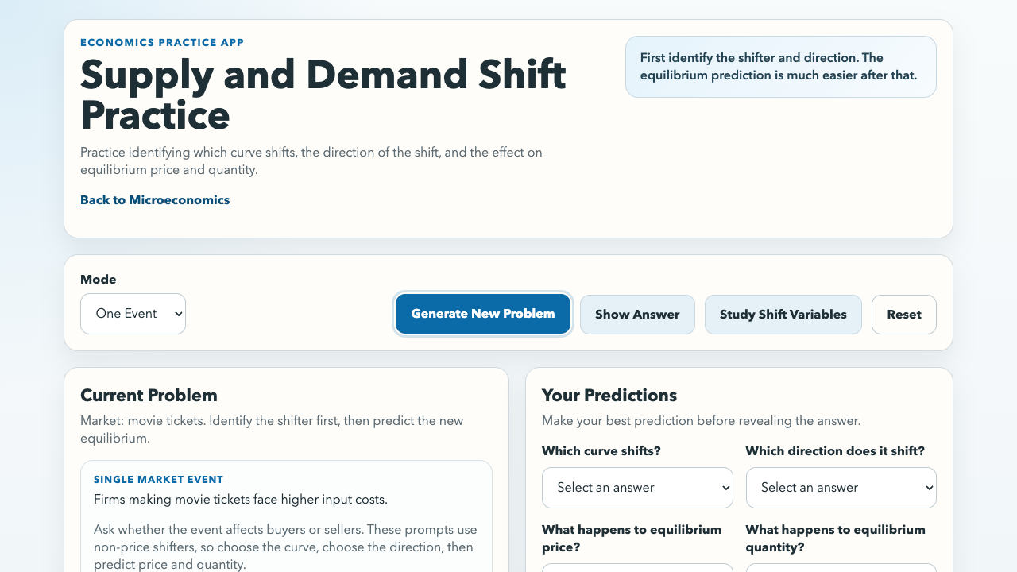
CHAPTER 4
Practice the full market-change sequence
FOR EACH EVENT
1. Choose demand or supply.
2. Choose left or right.
3. Predict price and quantity.
4. Explain the result.
sbu-econ.org/supply-demand-shift-practice/
PRINCIPLES OF MICRO
27
Notes:
Open the linked app after students can explain the four single shifts. Then use simultaneous-shift cases to practice reinforce, offset, and ambiguity.
[Sources]
- Principles of Micro, Chapter 4: Market Equilibrium and Market Adjustment (current project draft).
- Supply and Demand Shift Practice app: https://sbu-econ.org/supply-demand-shift-practice/
- Screenshot: slides/assets/ch03_shift_practice.png (companion-app asset captured 2026-07-30).
[/Sources]

Slide 28
CHAPTER 4
No one person knows the entire snow-shovel market
•
Buyers know their own needs, budgets, and alternatives.
•
Stores know local inventory, customers, and suppliers.
•
Producers know capacity, input costs, and delivery limits.
A changing price lets each person respond using knowledge others do not possess.
PRINCIPLES OF MICRO
28
Notes:
Set up the knowledge problem without making this a full Hayek lecture. The key is that information is spread across many participants.
[Sources]
- Principles of Micro, Chapter 4: Market Equilibrium and Market Adjustment (current project draft).
- F. A. Hayek, The Use of Knowledge in Society, American Economic Review 35(4), 1945. https://www.aeaweb.org/aer/top20/35.4.519-530.pdf
[/Sources]

Slide 29
CHAPTER 4
Prices coordinate people who never meet
Shortage raises price
Buyers conserve or substitute
Sellers release or order inventory
Plans move toward agreement
>
>
>
The price does not explain every cause. It tells people that adjustment is worthwhile.
PRINCIPLES OF MICRO
29
Notes:
Preview Hayek: prices are compact signals that help decentralized people adjust without first learning the entire story behind the market change.
[Sources]
- Principles of Micro, Chapter 4: Market Equilibrium and Market Adjustment (current project draft).
- F. A. Hayek, The Use of Knowledge in Society, American Economic Review 35(4), 1945. https://www.aeaweb.org/aer/top20/35.4.519-530.pdf
[/Sources]

Slide 30
CHAPTER 4
Markets need rules before prices can coordinate exchange
Property rights
Contracts
Trust
Who may use, transfer, or exclude others from an asset?
Will payment and delivery promises be honored?
Can people trade without fearing fraud or arbitrary loss?
A reliable record helps, but someone must still resolve disputes and enforce recognized rights.
PRINCIPLES OF MICRO
30
Notes:
Use the digital-land example only if time permits: mapping and recording a claim are useful, but they do not decide which competing claim is legitimate or make others honor it.
[Sources]
- Principles of Micro, Chapter 4: Market Equilibrium and Market Adjustment (current project draft).
- Douglass C. North, Institutions, Journal of Economic Perspectives 5(1), 1991. https://www.aeaweb.org/articles?id=10.1257/jep.5.1.97
[/Sources]

Slide 31
CHAPTER 4
Equilibrium is a story about plans and adjustment
•
Equilibrium is the price where Qd equals Qs.
•
Shortages push price upward; surpluses push it downward.
•
A shifted curve creates movement along the other curve.
•
Separate simultaneous shifts before combining predictions.
•
Prices coordinate decentralized choices when supporting rules exist.
Next: direction is not enough. Elasticity measures how much people respond.
PRINCIPLES OF MICRO
31
Notes:
Close by returning to the storm forecast. The equilibrium framework explains how a shock becomes a shortage, a price change, movement along the unchanged curve, and a new set of coordinated plans.
[Sources]
- Principles of Micro, Chapter 4: Market Equilibrium and Market Adjustment (current project draft).
[/Sources]

