Slide 1

Elasticity and Market Responsiveness
Chapter 5
Principles of Micro
Direction tells us which way. Elasticity tells us how much.
Mark Wilson
Notes:
Open with the gasoline question on the next slide. Chapters 3 and 4 already supplied the direction of change; this chapter adds magnitude.
[Sources]
- Principles of Micro, Chapter 5: Elasticity and Market Responsiveness (current project draft).
- Cover artwork: design/book-cover/principles-of-micro-cover.png (project-generated asset).
[/Sources]

Slide 2
CHAPTER 5
Gasoline rises from $3 to $4 per gallon
$3 -> $4
The law of demand says purchases will fall.
How much?
PRINCIPLES OF MICRO
2
Notes:
Ask students for possible short-run adjustments and then longer-run adjustments. Do not calculate yet. The purpose is to show why direction alone is incomplete.
[Sources]
- Principles of Micro, Chapter 5: Elasticity and Market Responsiveness (current project draft).
[/Sources]

Slide 3
CHAPTER 5
The same price change can produce very different responses
HARD TO ADJUST
EASIER TO ADJUST
Emergency care
Restaurant meals
Urgency and few alternatives make the response small.
Cook at home, choose another restaurant, or eat out less.
SHORT RUN
LONGER RUN
Gasoline this week
Gasoline over years
Most households still own the same car and make the same commute.
Vehicles, travel, work, and location can all change.
PRINCIPLES OF MICRO
3
Notes:
All four examples obey the law of demand. What differs is the number of practical ways to respond.
[Sources]
- Principles of Micro, Chapter 5: Elasticity and Market Responsiveness (current project draft).
[/Sources]

Slide 4
CHAPTER 5
Elasticity is a ratio of two percentage changes
elasticity = percentage response / percentage change that caused it
Elasticity compares the size of a response with the size of the change that produced it.
An elasticity of 2 means the response is about twice the percentage change in the driver.
PRINCIPLES OF MICRO
4
Notes:
Stress that elasticity is unit-free. It does not mean two units or two percent. It compares two percentage changes.
[Sources]
- Principles of Micro, Chapter 5: Elasticity and Market Responsiveness (current project draft).
[/Sources]

Slide 5
CHAPTER 5
Price elasticity of demand measures buyer responsiveness
εd = % change in Qd / % change in P
The top is the buyer's response. The bottom is the good's own price change.
Example: price rises 10%; quantity demanded falls 20%
εd = -20% / 10% = -2
PRINCIPLES OF MICRO
5
Notes:
Read the formula in words before using the symbols. The chapter supplies percentage changes; students do not need to calculate percentage changes by hand here.
[Sources]
- Principles of Micro, Chapter 5: Elasticity and Market Responsiveness (current project draft).
[/Sources]

Slide 6
CHAPTER 5
Demand elasticity is negative; classification uses its size
SIGNED VALUE
ABSOLUTE VALUE
εd = -2
|εd| = 2
The minus sign records the law of demand: price and quantity demanded move in opposite directions.
Dropping the sign makes it easy to classify the response as elastic, unit elastic, or inelastic.
Keep the sign while solving. Use absolute value when classifying.
PRINCIPLES OF MICRO
6
Notes:
Both statements describe the same response. Do not drop the sign for income or cross-price elasticity later; there the sign carries the classification.
[Sources]
- Principles of Micro, Chapter 5: Elasticity and Market Responsiveness (current project draft).
[/Sources]

Slide 7
CHAPTER 5
Three categories compare the two percentage changes
LESS THAN 1
EQUALS 1
GREATER THAN 1
Inelastic
Unit elastic
Elastic
Quantity changes by a smaller percentage than price.
Quantity and price change by the same percentage.
Quantity changes by a larger percentage than price.
Inelastic does not mean no response. Only perfectly inelastic demand has no quantity response.
PRINCIPLES OF MICRO
7
Notes:
Have students say the comparison in words. The threshold is about proportional response, not whether quantity is large or small.
[Sources]
- Principles of Micro, Chapter 5: Elasticity and Market Responsiveness (current project draft).
[/Sources]

Slide 8
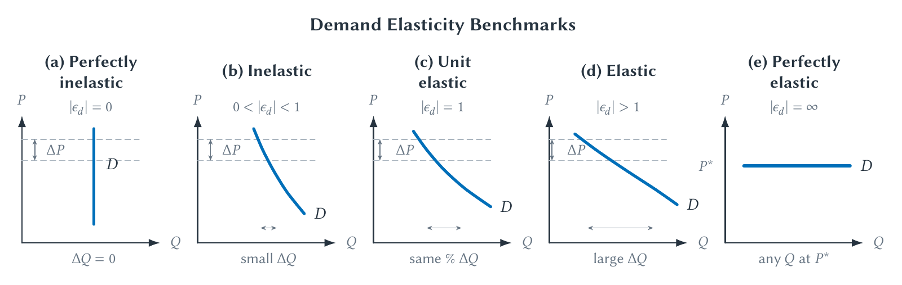
CHAPTER 5
Demand responses range from none to extremely large
Compare the horizontal quantity response to the common vertical price change.
PRINCIPLES OF MICRO
8
Notes:
Read the panels from left to right. The middle panels are teaching benchmarks near the shown price change, not claims that an entire straight curve has one elasticity.
[Sources]
- Principles of Micro, Chapter 5: Elasticity and Market Responsiveness (current project draft).
- Project-reviewed Chapter 5 figure from figures/ch05_elasticity_and_market_responsiveness/.
[/Sources]

Slide 9
CHAPTER 5
Know any two pieces and you can find the third
PRICE CHANGE
RESPONSE
RATIO
% change in P
% change in Qd
εd
The change that starts the calculation.
The buyer's quantity response.
The response divided by the price change.
The formula is a relationship among three numbers, not a new set of rules.
PRINCIPLES OF MICRO
9
Notes:
Students should be able to solve for elasticity, quantity response, or price change. Keep the arithmetic secondary to the interpretation.
[Sources]
- Principles of Micro, Chapter 5: Elasticity and Market Responsiveness (current project draft).
[/Sources]

Slide 10
CHAPTER 5
Worked example: find elasticity
Price rises 10%. Quantity demanded falls 5%.
εd = -5% / 10%
εd = -0.5
Because |εd| is less than 1, demand is inelastic.
PRINCIPLES OF MICRO
10
Notes:
Ask for the sign before displaying the setup. Then ask for the classification and its plain-English meaning: quantity responded by half the percentage change in price.
[Sources]
- Principles of Micro, Chapter 5: Elasticity and Market Responsiveness (current project draft).
[/Sources]

Slide 11
CHAPTER 5
Worked examples: find the missing percentage change
FIND QUANTITY RESPONSE
FIND PRICE CHANGE
εd = -2; price rises 4%
εd = -0.5; Qd falls 3%
% change in Qd = -2 x 4% = -8%
Quantity demanded falls 8%.
% change in P = -3% / -0.5 = 6%
Price rose 6%.
Check the signs against the law of demand.
PRINCIPLES OF MICRO
11
Notes:
Use these as board examples if preferred. The slide is a check after students attempt the arithmetic.
[Sources]
- Principles of Micro, Chapter 5: Elasticity and Market Responsiveness (current project draft).
[/Sources]

Slide 12

CHAPTER 5
Practice the ratio, sign, and interpretation
USE ANY TWO
1. Solve for the third value.
2. Keep the correct sign.
3. Classify the response.
4. Explain the result in words.
sbu-econ.org/elasticity-practice/
PRINCIPLES OF MICRO
12
Notes:
Demonstrate one price-elasticity problem now. Return to the app after supply, income, and cross-price elasticity are introduced.
[Sources]
- Principles of Micro, Chapter 5: Elasticity and Market Responsiveness (current project draft).
- Elasticity Practice app: https://sbu-econ.org/elasticity-practice/
- Screenshot: slides/assets/ch05_elasticity_practice.png (companion-app asset captured 2026-07-30).
[/Sources]

Slide 13
CHAPTER 5
What makes demand more responsive?
Factor
More elastic when...
Less elastic when...
Substitutes
Many close alternatives
Few close alternatives
Necessity
Purchase can be delayed
Purchase is urgent
Time
Buyers can change plans
Response must be immediate
Budget share
Large part of spending
Small part of spending
Market definition
Good is narrowly defined
Good is broadly defined
PRINCIPLES OF MICRO
13
Notes:
Do not ask students to memorize five unrelated facts. The next slide provides the organizing idea.
[Sources]
- Principles of Micro, Chapter 5: Elasticity and Market Responsiveness (current project draft).
[/Sources]

Slide 14
CHAPTER 5
Most demand determinants ask the same question
How easily can buyers switch, wait, reduce use, or meet the same need another way?
Substitutes, necessity, time, and market definition all change the available ways to adjust.
Budget share is the partial exception: it changes how much the price change matters.
PRINCIPLES OF MICRO
14
Notes:
Use the word substitutability only after giving the plain-English question. Elasticity is not a permanent trait of a product; it depends on buyers, alternatives, price range, market definition, and time.
[Sources]
- Principles of Micro, Chapter 5: Elasticity and Market Responsiveness (current project draft).
[/Sources]

Slide 15
CHAPTER 5
Elasticity is not the same as slope
SLOPE
ELASTICITY
Changes in units
Changes in percentages
Its number changes when the units on either axis change.
It compares responsiveness across goods and markets measured in different units.
A curve's appearance can be a clue, but the percentage changes decide the classification.
PRINCIPLES OF MICRO
15
Notes:
Keep this brief. Do not develop point elasticity or algebraic slope comparisons in a principles lecture.
[Sources]
- Principles of Micro, Chapter 5: Elasticity and Market Responsiveness (current project draft).
[/Sources]

Slide 16
CHAPTER 5
A higher price creates two effects on total revenue
Total revenue = Price x Quantity
A price increase makes the revenue rectangle taller, but the fall in quantity makes it narrower.
PRICE EFFECT
QUANTITY EFFECT
More per unit
Fewer units sold
Pushes revenue up.
Pushes revenue down.
PRINCIPLES OF MICRO
16
Notes:
A seller can post a higher price but cannot choose how many buyers remain. Elasticity tells us which of the two revenue effects is larger.
[Sources]
- Principles of Micro, Chapter 5: Elasticity and Market Responsiveness (current project draft).
[/Sources]

Slide 17
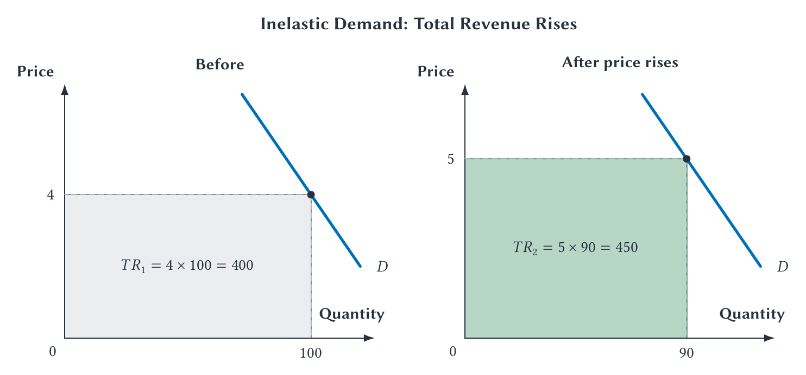
CHAPTER 5
With inelastic demand, the price effect is larger
Price rises 25%; quantity falls 10%; total revenue rises from 400 to 450.
PRINCIPLES OF MICRO
17
Notes:
Begin at the same initial rectangle used on the next slide. The smaller percentage quantity response means the taller price outweighs the narrower quantity.
[Sources]
- Principles of Micro, Chapter 5: Elasticity and Market Responsiveness (current project draft).
- Project-reviewed Chapter 5 figure from figures/ch05_elasticity_and_market_responsiveness/.
[/Sources]

Slide 18
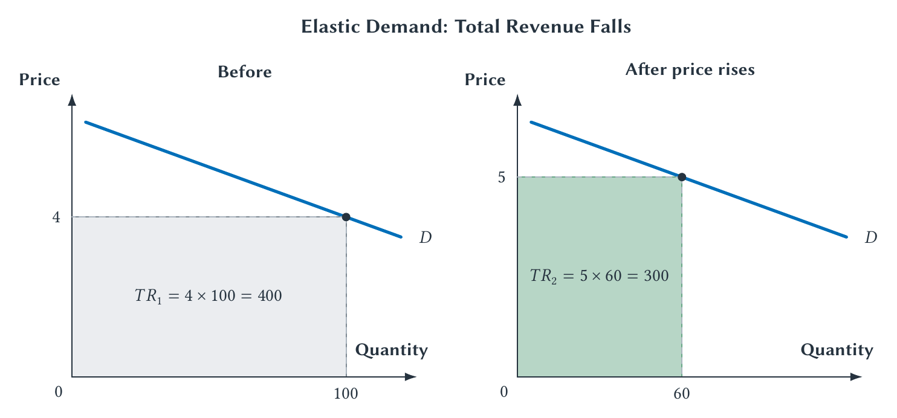
CHAPTER 5
With elastic demand, the quantity effect is larger
Price rises 25%; quantity falls 40%; total revenue falls from 400 to 300.
PRINCIPLES OF MICRO
18
Notes:
Only the quantity response changed from the preceding example. The larger percentage quantity loss makes the new revenue rectangle smaller.
[Sources]
- Principles of Micro, Chapter 5: Elasticity and Market Responsiveness (current project draft).
- Project-reviewed Chapter 5 figure from figures/ch05_elasticity_and_market_responsiveness/.
[/Sources]

Slide 19
CHAPTER 5
The total-revenue test follows from the two effects
Demand
If price rises
If price falls
Elastic
Total revenue falls
Total revenue rises
Unit elastic
Revenue is roughly unchanged
Revenue is roughly unchanged
Inelastic
Total revenue rises
Total revenue falls
This rule describes movement along an unchanged demand curve.
PRINCIPLES OF MICRO
19
Notes:
Ask students to reconstruct the rule instead of memorizing six cells. If demand shifts, price and quantity may change for other reasons.
[Sources]
- Principles of Micro, Chapter 5: Elasticity and Market Responsiveness (current project draft).
[/Sources]

Slide 20
CHAPTER 5
Revenue is not profit
Elasticity tells a seller what happens to sales revenue.
Profit also depends on costs.
A price change that raises total revenue does not automatically raise profit.
PRINCIPLES OF MICRO
20
Notes:
This prevents students from carrying the total-revenue test too far. Cost analysis begins in Chapter 13.
[Sources]
- Principles of Micro, Chapter 5: Elasticity and Market Responsiveness (current project draft).
[/Sources]

Slide 21
CHAPTER 5
Income elasticity shows how demand responds to income
εI = % change in Qd / % change in income
Here the sign classifies the good, so do not discard it.
POSITIVE SIGN
NEGATIVE SIGN
Normal good
Inferior good
Demand rises when income rises.
Demand falls when income rises.
PRINCIPLES OF MICRO
21
Notes:
Inferior is a demand classification, not a judgment about quality. A good can be inferior for one group or income range and normal for another.
[Sources]
- Principles of Micro, Chapter 5: Elasticity and Market Responsiveness (current project draft).
[/Sources]

Slide 22
CHAPTER 5
Cross-price elasticity measures relationships between goods
εxy = % change in Qx / % change in Py
Good x responds. The price of good y changes.
POSITIVE SIGN
NEGATIVE SIGN
Substitutes
Complements
A higher price for y raises demand for x.
A higher price for y lowers demand for x.
PRINCIPLES OF MICRO
22
Notes:
Substitutes and complements describe relationships among people's choices. They are not permanent labels attached to products.
[Sources]
- Principles of Micro, Chapter 5: Elasticity and Market Responsiveness (current project draft).
[/Sources]

Slide 23
CHAPTER 5
Tobacco and marijuana: logic does not settle the sign
Substitution story
Complement story
A higher cigarette price may lead some users to switch toward marijuana.
If the goods are often used together, less cigarette use may also reduce marijuana use.
Studies using different people, periods, laws, and methods have found different relationships.
A negative cross-price elasticity describes complementarity; it does not prove a gateway-drug claim.
PRINCIPLES OF MICRO
23
Notes:
Use this case to show why cross-price elasticity is measured rather than inferred from intuition. Keep the gateway distinction brief and causal: complementarity alone does not show that one drug causes initiation of the other.
[Sources]
- Principles of Micro, Chapter 5: Elasticity and Market Responsiveness (current project draft).
- Chaloupka et al. (1999), Farrelly et al. (1999), and Cooper et al. (2023), studies of tobacco-marijuana demand relationships in different settings.
[/Sources]

Slide 24
CHAPTER 5
Real-world elasticities are estimates, not constants
Market and setting
Approximate estimate
Main lesson
Medical care, 1970s insurance experiment
-0.20
Small response to out-of-pocket price
U.S. cigarette sales per person
-0.70
Sales fall less than proportionally
Gasoline, pooled studies
-0.293 short run; -0.773 long run
More adjustment with time
Air travel, 2010-2019 data
-0.87 global; -1.27 Europe
Setting and market definition matter
Ask: Which buyers? Which market? Which time period? Which method?
PRINCIPLES OF MICRO
24
Notes:
Students should interpret the range, not memorize the numbers. Each estimate is bounded by its population, place, period, price range, and method.
[Sources]
- Principles of Micro, Chapter 5: Elasticity and Market Responsiveness (current project draft).
- Manning et al. (1987), Health Insurance and the Demand for Medical Care, American Economic Review 77(3): 251-277.
- U.S. Centers for Disease Control and Prevention, Economic Trends in Tobacco, updated September 17, 2024.
- Labandeira, Labeaga, and Lopez-Otero (2017), A Meta-Analysis on the Price Elasticity of Energy Demand, Energy Policy 102: 549-568.
- Oesingmann and Kolker (2026), Price Elasticities in Aviation, Transportation Research Procedia 94: 58-66.
[/Sources]

Slide 25
CHAPTER 5
Price elasticity of supply measures seller responsiveness
εs = % change in Qs / % change in P
The top is the seller's quantity response. The bottom is the good's own price change.
•
Supply elasticity is normally positive.
•
The same greater-than-one, equal-to-one, and less-than-one categories apply.
•
The key question is how easily sellers can change output.
PRINCIPLES OF MICRO
25
Notes:
Parallel the demand formula, then change the mechanism. Buyers look for alternatives; sellers look for ways to alter output.
[Sources]
- Principles of Micro, Chapter 5: Elasticity and Market Responsiveness (current project draft).
[/Sources]

Slide 26
CHAPTER 5
Supply is more elastic when sellers have ways to adjust
TIME
UNUSED CAPACITY
FLEXIBLE INPUTS
Plans can change
Output can rise now
Resources can move
Capacity, methods, and entry or exit can change in the longer run.
Existing workers or equipment may be able to produce more before new investment.
Inputs, production methods, and firms can be redirected toward the market.
Time creates more options, but existing spare capacity can still make short-run supply responsive.
PRINCIPLES OF MICRO
26
Notes:
Avoid treating time as a mechanical rule. The real question is which production limits can change. Spare capacity explains why some short-run supply is already responsive.
[Sources]
- Principles of Micro, Chapter 5: Elasticity and Market Responsiveness (current project draft).
[/Sources]

Slide 27
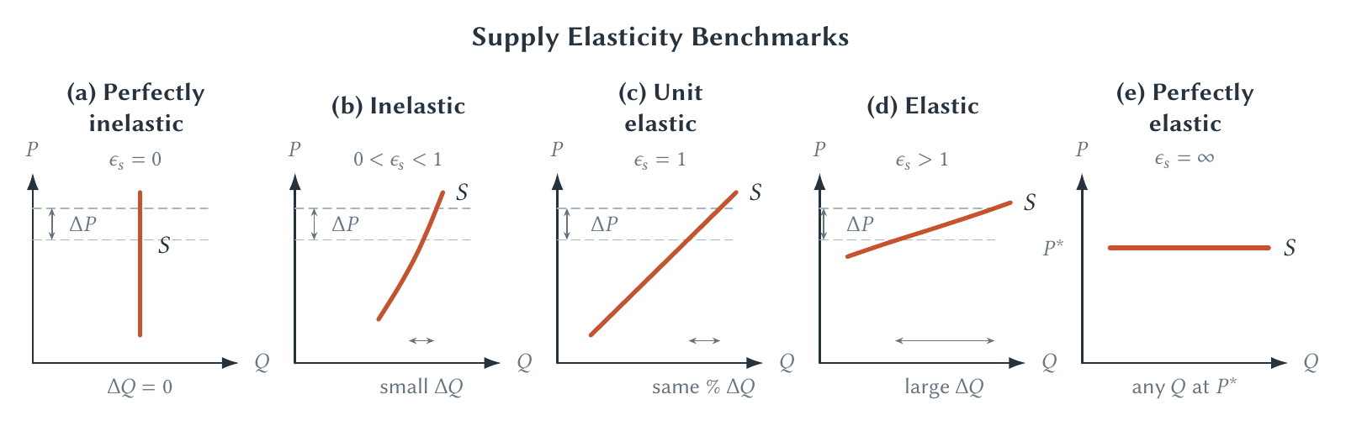
CHAPTER 5
Supply responses also range from none to extremely large
Unlike demand, vertical supply can describe a real short-run limit or a fixed resource such as land in one location.
PRINCIPLES OF MICRO
27
Notes:
Use tickets to a sold-out event or land in one location to make vertical supply concrete. Perfectly elastic supply remains a benchmark.
[Sources]
- Principles of Micro, Chapter 5: Elasticity and Market Responsiveness (current project draft).
- Project-reviewed Chapter 5 figure from figures/ch05_elasticity_and_market_responsiveness/.
[/Sources]

Slide 28
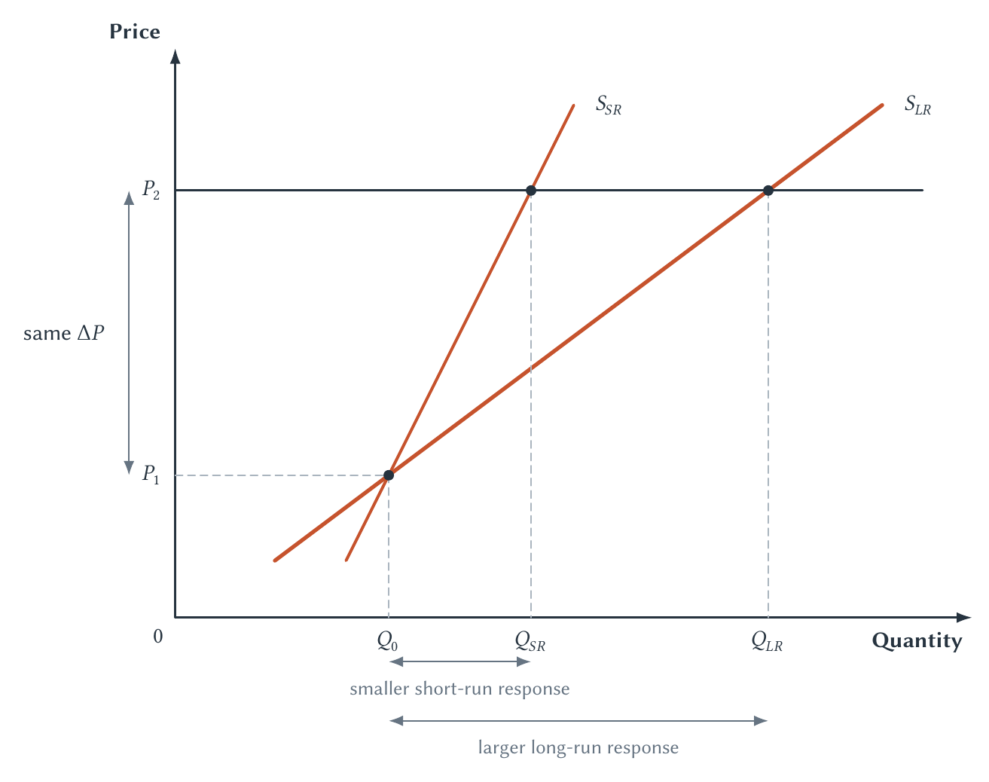
CHAPTER 5
More time often makes supply more elastic
The law of supply does not change. The available production choices do.
PRINCIPLES OF MICRO
28
Notes:
Name the short-run constraints before tracing the quantity changes. In the long run, firms can change capacity, methods, and market participation.
[Sources]
- Principles of Micro, Chapter 5: Elasticity and Market Responsiveness (current project draft).
- Project-reviewed Chapter 5 figure from figures/ch05_elasticity_and_market_responsiveness/.
[/Sources]

Slide 29
CHAPTER 5
Oil prices reveal adjustment unfolding over time
SOON AFTER A PRICE SHOCK
AFTER YEARS OF ADJUSTMENT
Few choices can change
More choices can change
Drivers still own the same vehicles. Producers still have existing wells, refineries, workers, and transport capacity.
Households change vehicles and location. Firms explore, invest, enter, exit, and redirect resources.
Short-run demand and supply are often less elastic than long-run demand and supply.
PRINCIPLES OF MICRO
29
Notes:
Return to the chapter opener. The initial price jump can be large because both sides have limited immediate adjustment. Later responses include technology, investment, location, entry, and exit.
[Sources]
- Principles of Micro, Chapter 5: Elasticity and Market Responsiveness (current project draft).
- Labandeira, Labeaga, and Lopez-Otero (2017), A Meta-Analysis on the Price Elasticity of Energy Demand, Energy Policy 102: 549-568.
[/Sources]

Slide 30
CHAPTER 5
Housing supply depends on what can actually change
A city cannot add thousands of apartments next week.
•
In the short run, the existing housing stock is largely fixed.
•
Over time, builders can add units and firms can enter.
•
Geography and land-use rules can still limit long-run construction.
The same increase in demand can therefore produce different price and quantity changes across cities.
PRINCIPLES OF MICRO
30
Notes:
Housing makes supply elasticity concrete. Do not attribute every difference to regulation alone; geography and other physical limits also matter.
[Sources]
- Principles of Micro, Chapter 5: Elasticity and Market Responsiveness (current project draft).
- Saiz (2010), The Geographic Determinants of Housing Supply, Quarterly Journal of Economics 125(3): 1253-1296.
[/Sources]

Slide 31
CHAPTER 5
Elasticity changes the effects of market policy
Later topic
Why responsiveness matters
Taxes
The less responsive side tends to bear more of the burden.
Deadweight loss
Larger quantity responses usually mean more lost trade.
Price controls
Elasticity affects the size of shortages or surpluses.
Market power
Demand elasticity helps firms predict revenue from price changes.
A law can name who sends a payment. It cannot dictate how buyers and sellers adjust.
PRINCIPLES OF MICRO
31
Notes:
Keep these as previews. Chapter 7 develops tax incidence and deadweight loss; Chapter 8 develops price controls; Chapters 15 and 16 return to demand elasticity and pricing.
[Sources]
- Principles of Micro, Chapter 5: Elasticity and Market Responsiveness (current project draft).
[/Sources]

Slide 32
CHAPTER 5
Elasticity asks one practical question
How much do people adjust?
•
Elasticity is a ratio of two percentage changes.
•
Demand responsiveness depends mostly on substitutes and ways to adjust.
•
Elasticity determines which total-revenue effect is larger.
•
Income and cross-price elasticity measure shifts in demand.
•
Supply responsiveness depends on capacity, inputs, entry, exit, and time.
Next: use value and cost to measure the gains created by market exchange.
PRINCIPLES OF MICRO
32
Notes:
End by asking students to explain one elastic and one inelastic choice without using the determinant list mechanically. Then preview consumer and producer surplus in Chapter 6.
[Sources]
- Principles of Micro, Chapter 5: Elasticity and Market Responsiveness (current project draft).
[/Sources]

