Slide 1

Consumer Surplus, Producer Surplus, and Market Efficiency
Chapter 6
Principles of Micro
Measure the gains created when buyer value exceeds seller cost
Mark Wilson
Notes:
Open with one transaction rather than a graph. Every shaded region in the chapter grows from the buyer-value-versus-seller-cost logic.
[Sources]
- Principles of Micro, Chapter 6: Consumer Surplus, Producer Surplus, and Market Efficiency (current project draft).
- Cover artwork: design/book-cover/principles-of-micro-cover.png (project-generated asset).
[/Sources]

Slide 2
CHAPTER 6
A trade both sides want
BUYER
AGREED PRICE
SELLER
Values item at $50
$40
Cost is $30
The highest price the buyer would pay is $50.
The exchange occurs because both sides prefer trading to walking away.
The seller can provide the item for $30.
Trade does not require agreement about value. Different values create the gain.
PRINCIPLES OF MICRO
2
Notes:
Define willingness to pay here: the highest amount the buyer would pay rather than go without. Ask why each side says yes at $40.
[Sources]
- Principles of Micro, Chapter 6: Consumer Surplus, Producer Surplus, and Market Efficiency (current project draft).
[/Sources]

Slide 3
CHAPTER 6
The $40 price leaves both sides better off
BUYER GAIN
SELLER GAIN
TOTAL GAIN
Consumer surplus = $10
Producer surplus = $10
Total surplus = $20
$50 willingness to pay minus the $40 price.
$40 price minus the seller's $30 cost.
$50 buyer value minus $30 seller cost.
Consumer and producer surplus are names for real gains, not merely areas on a graph.
PRINCIPLES OF MICRO
3
Notes:
Keep this concrete. The buyer receives something worth more than the money paid; the seller receives more than the cost of providing it.
[Sources]
- Principles of Micro, Chapter 6: Consumer Surplus, Producer Surplus, and Market Efficiency (current project draft).
[/Sources]

Slide 4
CHAPTER 6
Price divides the gain; it does not determine its total size
Price
Consumer surplus
Producer surplus
Total surplus
$35
$15
$5
$20
$40
$10
$10
$20
$45
$5
$15
$20
Buyer value stays $50. Seller cost stays $30. Total surplus stays $20.
PRINCIPLES OF MICRO
4
Notes:
Pause before revealing total surplus. A higher price transfers part of the gain from buyer to seller; a lower price does the reverse.
[Sources]
- Principles of Micro, Chapter 6: Consumer Surplus, Producer Surplus, and Market Efficiency (current project draft).
[/Sources]

Slide 5
CHAPTER 6
Three formulas organize the one-trade example
CONSUMER SURPLUS
PRODUCER SURPLUS
TOTAL SURPLUS
CS = WTP - price
PS = price - cost
TS = CS + PS
What the buyer was willing to pay minus what the buyer actually pays.
What the seller receives minus the cost of providing the unit.
The buyer's gain plus the seller's gain.
WTP means willingness to pay: the buyer's highest acceptable price.
PRINCIPLES OF MICRO
5
Notes:
The abbreviations come after the English definitions. Students should be able to explain each difference before calculating it.
[Sources]
- Principles of Micro, Chapter 6: Consumer Surplus, Producer Surplus, and Market Efficiency (current project draft).
[/Sources]

Slide 6
CHAPTER 6
For one trade, price cancels from total surplus
Total surplus = buyer value - seller cost
The buyer pays the price.
The seller receives the price.
Price transfers surplus between them. Value minus cost determines how much the trade creates.
PRINCIPLES OF MICRO
6
Notes:
This distinction becomes central in policy chapters. A transfer changes who receives surplus; deadweight loss means some surplus disappears.
[Sources]
- Principles of Micro, Chapter 6: Consumer Surplus, Producer Surplus, and Market Efficiency (current project draft).
[/Sources]

Slide 7
CHAPTER 6
Voluntary exchange is the starting point
A voluntary trade occurs because both sides expect to benefit.
•
Buyers and sellers know details about their own needs, alternatives, and costs.
•
Secure rights and trusted promises make exchange possible.
•
Prices help many separate choices produce a coordinated result.
Welfare economics measures the gains that result.
PRINCIPLES OF MICRO
7
Notes:
Paraphrase Milton and Rose Friedman rather than quoting. Welfare here means economic well-being, not a government assistance program.
[Sources]
- Principles of Micro, Chapter 6: Consumer Surplus, Producer Surplus, and Market Efficiency (current project draft).
- Milton Friedman and Rose Friedman, Free to Choose: A Personal Statement (1980), Chapter 1, The Power of the Market.
[/Sources]

Slide 8
CHAPTER 6
Demand becomes a measure of buyer value
WILLINGNESS TO PAY
MARGINAL UNIT
Highest acceptable price
The next unit
The most a buyer would pay for a unit rather than go without it.
The marginal value is the willingness to pay for one more unit at that quantity.
For welfare analysis, choose a quantity and read upward to the demand curve.
PRINCIPLES OF MICRO
8
Notes:
Use reservation price as an optional synonym, not another term to memorize. The important move is reading the curve vertically.
[Sources]
- Principles of Micro, Chapter 6: Consumer Surplus, Producer Surplus, and Market Efficiency (current project draft).
[/Sources]

Slide 9
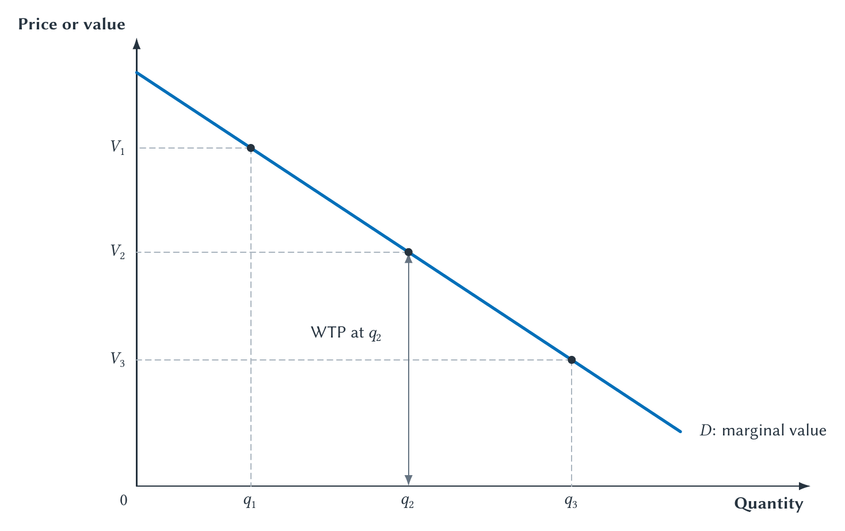
CHAPTER 6
Read demand vertically: its height is willingness to pay
At q2, willingness to pay is the height from the quantity axis to demand, not merely the dot.
PRINCIPLES OF MICRO
9
Notes:
Trace the vertical arrow at q2. As quantity expands, the market reaches units with lower willingness to pay.
[Sources]
- Principles of Micro, Chapter 6: Consumer Surplus, Producer Surplus, and Market Efficiency (current project draft).
- Project-reviewed Chapter 6 figure from figures/ch06_consumer_surplus_producer_surplus_and_market_efficiency/.
[/Sources]

Slide 10
CHAPTER 6
Consumer surplus measures a buyer's gain
Buyer willingness to pay
Market price
$50
$40
minus
Consumer surplus = $10
A buyer willing to pay exactly $40 receives no surplus but may still buy.
PRINCIPLES OF MICRO
10
Notes:
This is the one-unit version of the shaded area on the next slide.
[Sources]
- Principles of Micro, Chapter 6: Consumer Surplus, Producer Surplus, and Market Efficiency (current project draft).
[/Sources]

Slide 11
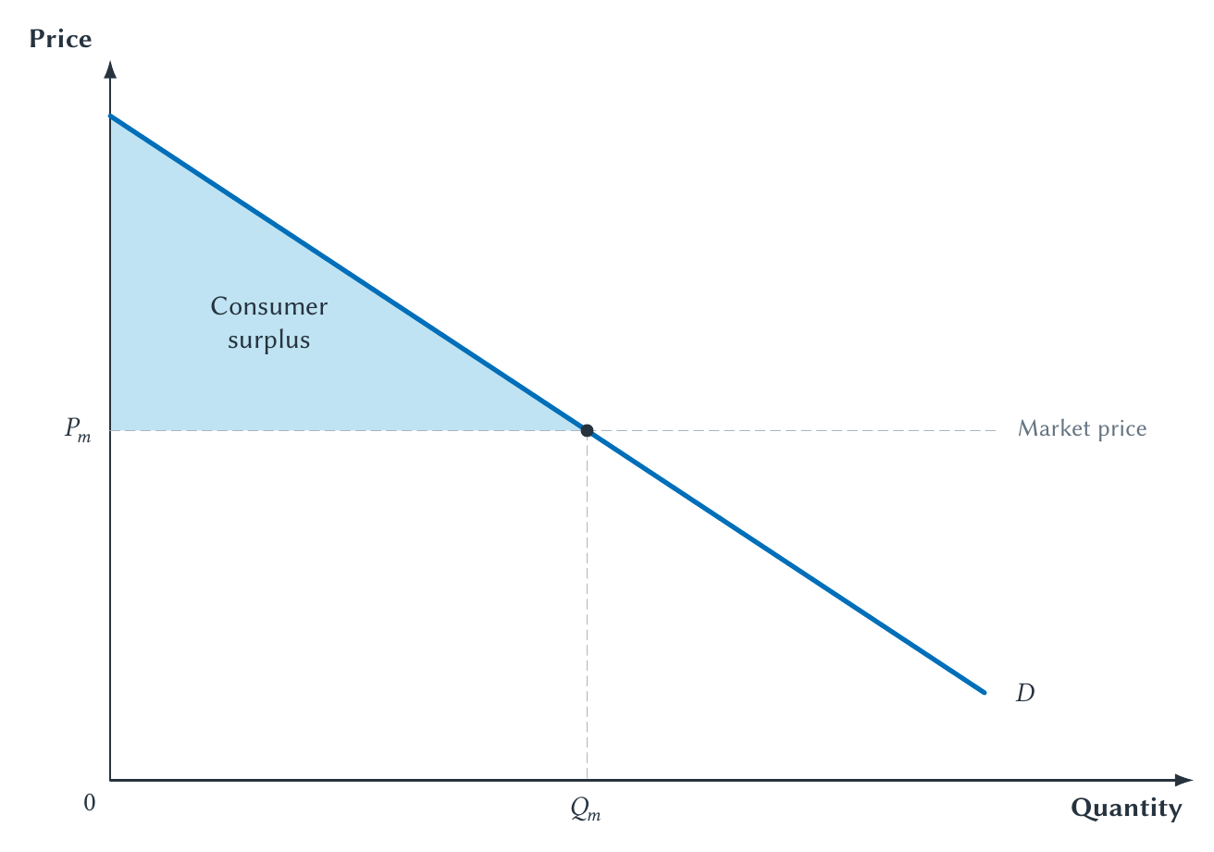
CHAPTER 6
Consumer surplus adds buyer gains across units
For every purchased unit, demand shows value and the price line shows what the buyer pays.
PRINCIPLES OF MICRO
11
Notes:
The area is below demand because demand shows willingness to pay, above price because that is what buyers give up, and ends at the quantity purchased.
[Sources]
- Principles of Micro, Chapter 6: Consumer Surplus, Producer Surplus, and Market Efficiency (current project draft).
- Project-reviewed Chapter 6 figure from figures/ch06_consumer_surplus_producer_surplus_and_market_efficiency/.
[/Sources]

Slide 12
CHAPTER 6
Consumer surplus is a gain, not just a triangle
Willingness to pay minus price, added across all units purchased
Triangle area = 1/2 x base x height
The formula calculates the shaded region. The economic meaning explains why the region matters.
PRINCIPLES OF MICRO
12
Notes:
Stress the units: consumer surplus is measured in dollars, not units of the good. For non-linear demand or discrete buyers, the geometry can differ while the gain interpretation remains.
[Sources]
- Principles of Micro, Chapter 6: Consumer Surplus, Producer Surplus, and Market Efficiency (current project draft).
[/Sources]

Slide 13
CHAPTER 6
Choices usually provide evidence about value
Revealed preference
If someone voluntarily buys at $40 when alternatives exist, the choice suggests the good is worth at least $40 to that person.
Economists start with people's choices because outsiders usually know less about their goals and alternatives.
Coercion, deception, or severe impairment can make a choice weaker evidence of well-being.
PRINCIPLES OF MICRO
13
Notes:
Keep the qualification narrow. This is not a behavioral-economics lecture and does not claim that ordinary choices are infallible.
[Sources]
- Principles of Micro, Chapter 6: Consumer Surplus, Producer Surplus, and Market Efficiency (current project draft).
- Paul A. Samuelson (1938), A Note on the Pure Theory of Consumer's Behaviour, Economica 5(17): 61-71.
[/Sources]

Slide 14
CHAPTER 6
Supply becomes a measure of seller cost
COST
WILLINGNESS TO ACCEPT
Opportunity cost included
Lowest acceptable price
Labor, materials, equipment, time, and what those resources could have produced elsewhere.
The minimum amount a seller would accept to provide or give up the unit.
Choose a quantity and read upward to the supply curve.
PRINCIPLES OF MICRO
14
Notes:
In the simple competitive model, willingness to accept reflects cost. As production expands, higher-cost units enter.
[Sources]
- Principles of Micro, Chapter 6: Consumer Surplus, Producer Surplus, and Market Efficiency (current project draft).
[/Sources]

Slide 15
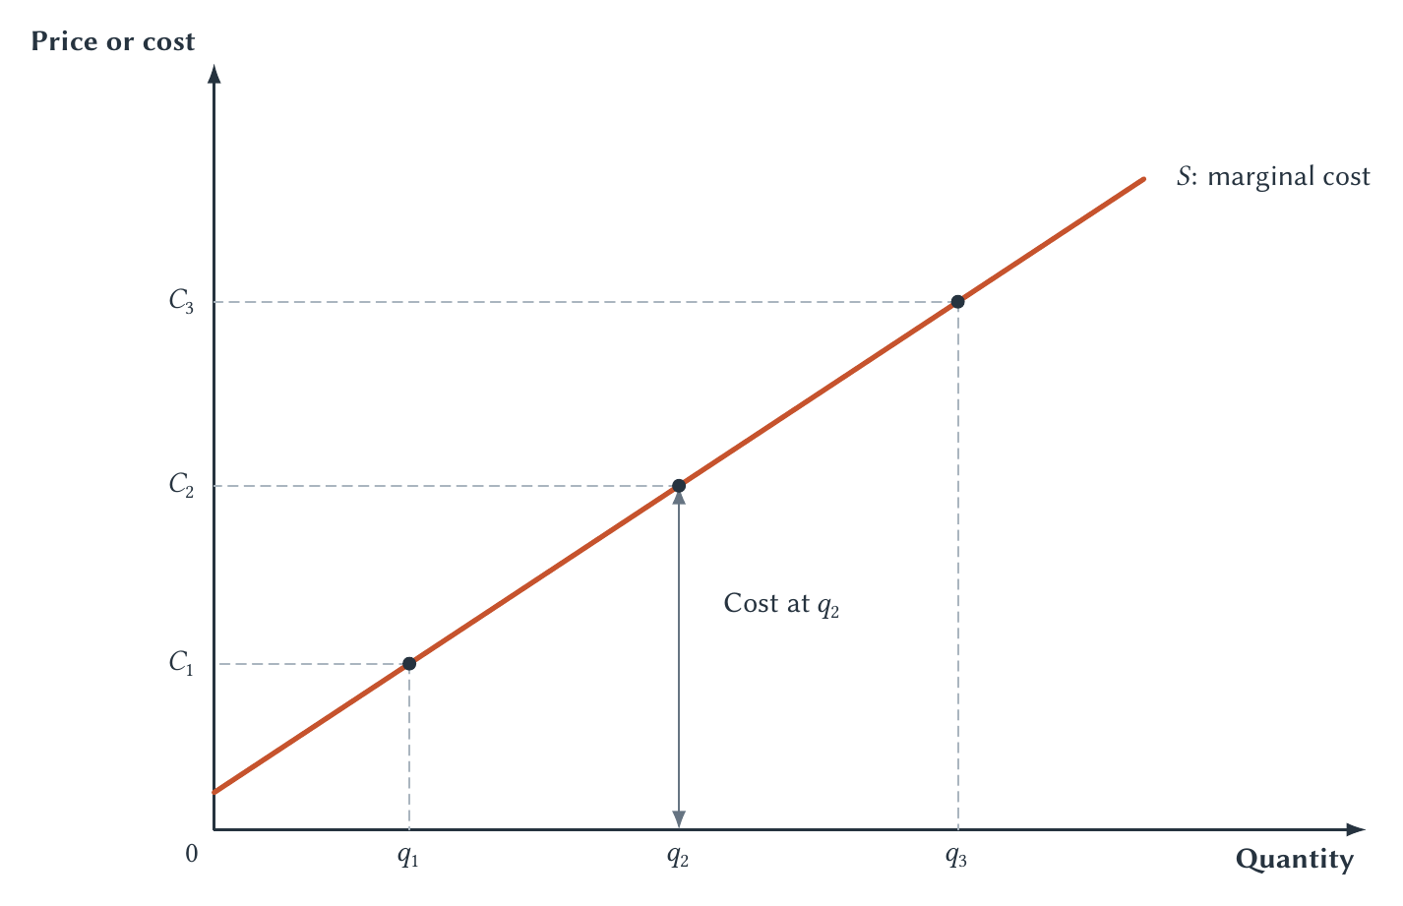
CHAPTER 6
Read supply vertically: its height is cost
At q2, cost is the height from the quantity axis to supply, not merely the dot.
PRINCIPLES OF MICRO
15
Notes:
Trace the vertical arrow at q2. Supply arranges possible units from lower cost to higher cost.
[Sources]
- Principles of Micro, Chapter 6: Consumer Surplus, Producer Surplus, and Market Efficiency (current project draft).
- Project-reviewed Chapter 6 figure from figures/ch06_consumer_surplus_producer_surplus_and_market_efficiency/.
[/Sources]

Slide 16
CHAPTER 6
Producer surplus measures a seller's gain
Market price
Seller cost
$40
$30
minus
Producer surplus = $10
Producer surplus is related to profit, but fixed costs may still need to be subtracted.
PRINCIPLES OF MICRO
16
Notes:
The fixed-cost qualification previews Chapter 13 without turning this chapter into cost accounting.
[Sources]
- Principles of Micro, Chapter 6: Consumer Surplus, Producer Surplus, and Market Efficiency (current project draft).
[/Sources]

Slide 17
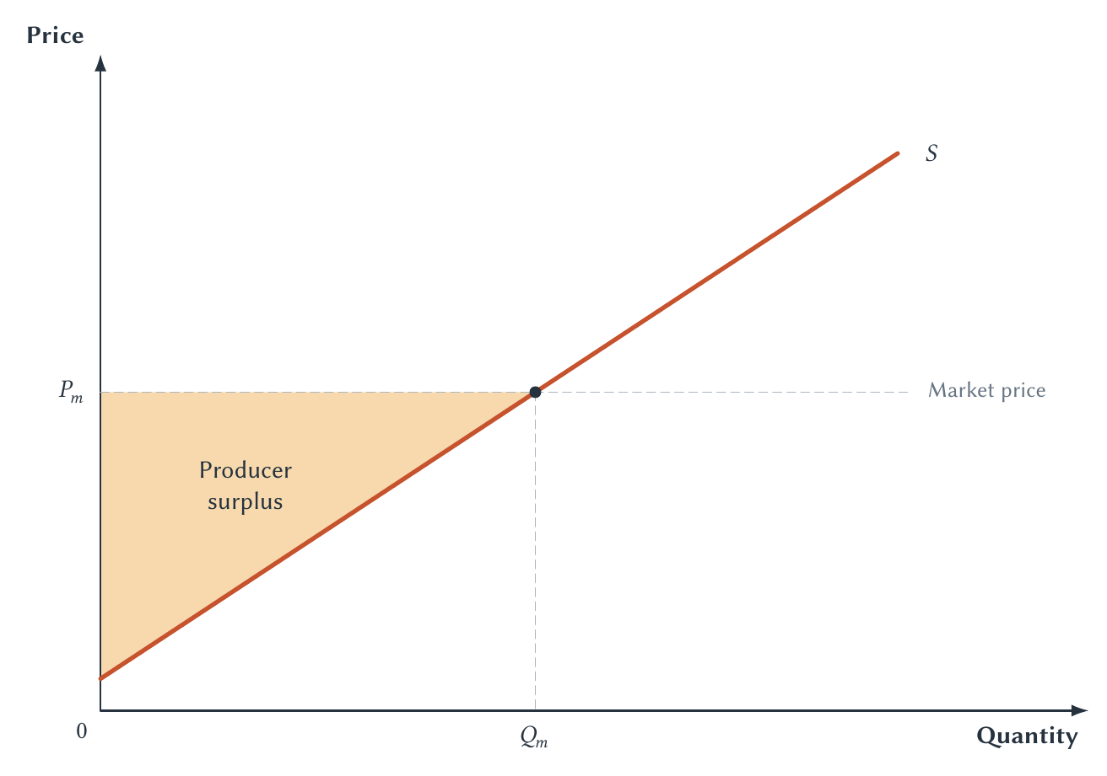
CHAPTER 6
Producer surplus adds seller gains across units
For every sold unit, the price line shows what sellers receive and supply shows their cost.
PRINCIPLES OF MICRO
17
Notes:
The area is above supply because supply shows cost, below price because that is what sellers receive, and ends at the quantity sold.
[Sources]
- Principles of Micro, Chapter 6: Consumer Surplus, Producer Surplus, and Market Efficiency (current project draft).
- Project-reviewed Chapter 6 figure from figures/ch06_consumer_surplus_producer_surplus_and_market_efficiency/.
[/Sources]

Slide 18
CHAPTER 6
Owning something can change the valuation question
A lifelong Bills fan wins a Super Bowl ticket.
BEFORE WINNING
AFTER WINNING
Willingness to pay
Willingness to accept
How much would the student give up to acquire the ticket?
How much compensation would make the student give up the ticket?
The two amounts need not be equal. Initial ownership can affect which question is appropriate.
PRINCIPLES OF MICRO
18
Notes:
Do not turn this into an endowment-effect lesson or claim the student is irrational. The narrow point is that acquiring a good and surrendering an established good or right are different questions.
[Sources]
- Principles of Micro, Chapter 6: Consumer Surplus, Producer Surplus, and Market Efficiency (current project draft).
- Horowitz and McConnell (2002), A Review of WTA/WTP Studies, Journal of Environmental Economics and Management 44(3): 426-447.
[/Sources]

Slide 19
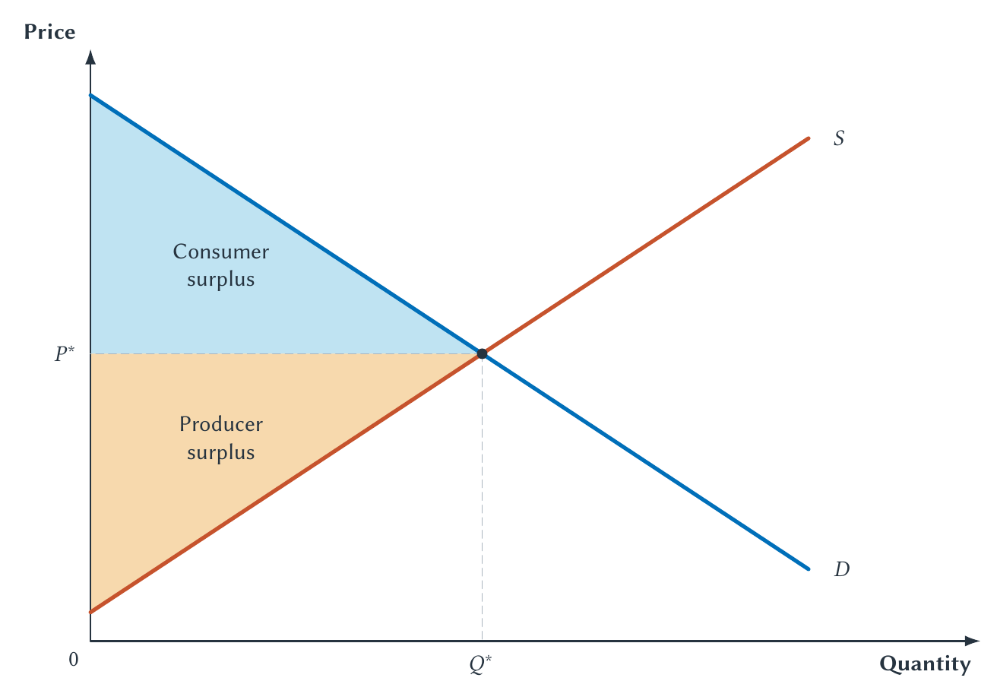
CHAPTER 6
Consumer and producer surplus combine at equilibrium
Together, the two regions fill the value-minus-cost gains from all trades through Q*.
PRINCIPLES OF MICRO
19
Notes:
This is the chapter's cumulative graph. Demand forms the upper boundary because it measures buyer value; supply forms the lower boundary because it measures seller cost.
[Sources]
- Principles of Micro, Chapter 6: Consumer Surplus, Producer Surplus, and Market Efficiency (current project draft).
- Project-reviewed Chapter 6 figure from figures/ch06_consumer_surplus_producer_surplus_and_market_efficiency/.
[/Sources]

Slide 20
CHAPTER 6
The graph is the many-unit version of the opening trade
For every unit traded: surplus = buyer value - seller cost
Consumer surplus measures the buyer side.
Producer surplus measures the seller side.
Total surplus adds value minus cost across all units traded.
PRINCIPLES OF MICRO
20
Notes:
Return explicitly to the $50 and $30 example. The colored areas should now have an economic meaning rather than being shapes to memorize.
[Sources]
- Principles of Micro, Chapter 6: Consumer Surplus, Producer Surplus, and Market Efficiency (current project draft).
[/Sources]

Slide 21
CHAPTER 6
Efficiency means realizing the available gains from trade
PRODUCE THE UNIT
DO NOT PRODUCE
Value exceeds cost
Cost exceeds value
Buyer value is greater than the resources used to provide it. The unit adds total surplus.
The resources are worth more in another use. The unit reduces total surplus.
Boundary: demand must include all relevant benefits and supply all relevant costs.
PRINCIPLES OF MICRO
21
Notes:
Define the efficient quantity as the quantity that maximizes total surplus. State the boundary now so later externality analysis has a clear entry point.
[Sources]
- Principles of Micro, Chapter 6: Consumer Surplus, Producer Surplus, and Market Efficiency (current project draft).
[/Sources]

Slide 22
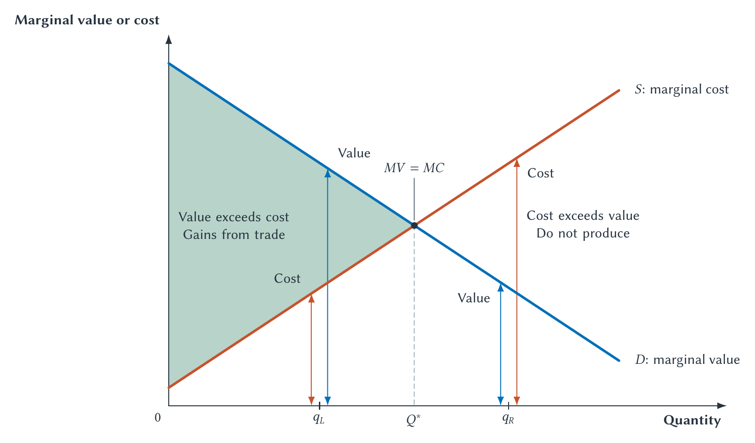
CHAPTER 6
The efficient quantity includes every value-above-cost unit
Compare the two curve heights: keep producing while value exceeds cost.
PRINCIPLES OF MICRO
22
Notes:
Use the paired arrows on both sides of Q*. At a left-side quantity, value is higher than cost; at a right-side quantity, cost is higher than value.
[Sources]
- Principles of Micro, Chapter 6: Consumer Surplus, Producer Surplus, and Market Efficiency (current project draft).
- Project-reviewed Chapter 6 figure from figures/ch06_consumer_surplus_producer_surplus_and_market_efficiency/.
[/Sources]

Slide 23
CHAPTER 6
This is the marginal rule from Chapter 1
Continue while the added benefit exceeds the added cost.
Before Q*
After Q*
One more unit increases total surplus.
One more unit reduces total surplus.
At Q*, the ordering reverses.
PRINCIPLES OF MICRO
23
Notes:
Tie the graph back to rational choice. The efficient quantity is not special because the curves make an X; it is where the value-cost comparison changes.
[Sources]
- Principles of Micro, Chapter 6: Consumer Surplus, Producer Surplus, and Market Efficiency (current project draft).
[/Sources]

Slide 24
CHAPTER 6
Could an ideal planner choose a better quantity?
With every buyer value and seller cost
A perfectly informed planner could reproduce Q*, but no other quantity could create more total surplus.
The harder real-world problem
Values and costs are dispersed across many buyers and sellers. Prices help coordinate that local knowledge.
PRINCIPLES OF MICRO
24
Notes:
This is a short decentralized-coordination callback, not a full central-planning section. The planner result depends on having the same complete information embodied in the curves.
[Sources]
- Principles of Micro, Chapter 6: Consumer Surplus, Producer Surplus, and Market Efficiency (current project draft).
[/Sources]

Slide 25
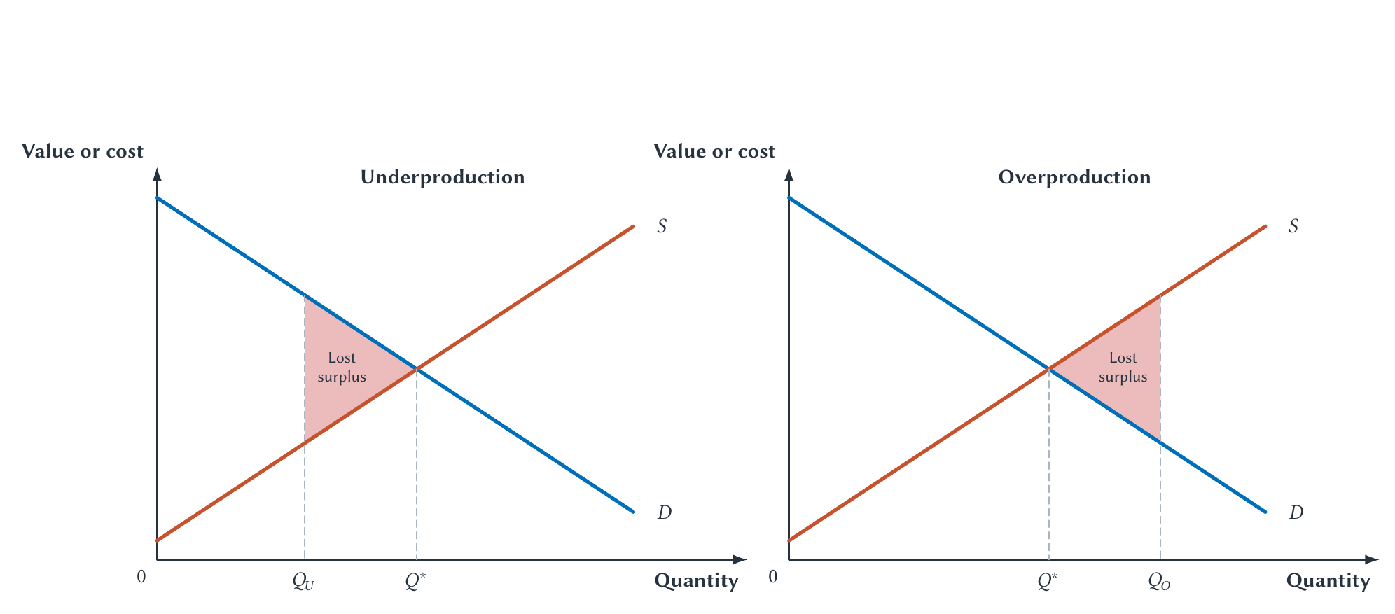
CHAPTER 6
Too little and too much both lose surplus
Underproduction blocks value-above-cost trades; overproduction creates cost-above-value units.
PRINCIPLES OF MICRO
25
Notes:
Use the same efficient quantity in both panels. The red triangle is the gap between actual total surplus and the maximum available total surplus.
[Sources]
- Principles of Micro, Chapter 6: Consumer Surplus, Producer Surplus, and Market Efficiency (current project draft).
- Project-reviewed Chapter 6 figure from figures/ch06_consumer_surplus_producer_surplus_and_market_efficiency/.
[/Sources]

Slide 26
CHAPTER 6
Lost surplus is deadweight loss
Some gains available at the efficient outcome have disappeared.
•
Underproduction: mutually beneficial trades do not occur.
•
Overproduction: resources create units whose cost exceeds their value.
•
The loss is not merely a transfer from one group to another.
PRINCIPLES OF MICRO
26
Notes:
Introduce the term because later chapters use it repeatedly. Keep the meaning in ordinary language: unrealized gains or wasteful units.
[Sources]
- Principles of Micro, Chapter 6: Consumer Surplus, Producer Surplus, and Market Efficiency (current project draft).
[/Sources]

Slide 27
CHAPTER 6
A high price is not itself a deadweight loss
TRANSFER
EFFICIENCY LOSS
Who receives the surplus?
How much surplus exists?
A different price may move surplus between buyers and sellers without changing total surplus.
A changed quantity or allocation can block valuable trades or use resources wastefully.
Always ask whether surplus moved or disappeared.
PRINCIPLES OF MICRO
27
Notes:
This distinction prepares students for taxes, price controls, tariffs, and monopoly. Price changes can have distributional effects without being the source of deadweight loss.
[Sources]
- Principles of Micro, Chapter 6: Consumer Surplus, Producer Surplus, and Market Efficiency (current project draft).
[/Sources]

Slide 28
CHAPTER 6
What competitive markets accomplish
WHO RECEIVES GOODS?
WHO PRODUCES?
HOW MUCH?
Higher-value buyers
Lower-cost sellers
Surplus-maximizing quantity
At a common price, buyers with greater willingness to pay are more likely to purchase.
At a common price, lower-cost producers can supply when higher-cost producers cannot.
The market includes value-above-cost units and excludes cost-above-value units.
Efficiency concerns allocation as well as the total quantity.
PRINCIPLES OF MICRO
28
Notes:
Students often remember only the right quantity. Stress that the same quantity can be inefficient if high-cost firms produce while low-cost firms are excluded, or if low-value users receive goods instead of high-value users.
[Sources]
- Principles of Micro, Chapter 6: Consumer Surplus, Producer Surplus, and Market Efficiency (current project draft).
[/Sources]

Slide 29
CHAPTER 6
Efficiency and equity ask different questions
EFFICIENCY
EQUITY
How large is the pie?
How is the pie divided?
Have the available gains from trade been created, or have valuable resources been wasted?
How are income, goods, opportunities, and gains distributed among people?
Gains that are never created cannot be divided. Changing the division can also change incentives and the pie's size.
PRINCIPLES OF MICRO
29
Notes:
Do not imply that efficiency settles fairness or that equity concerns are unimportant. Good analysis asks both questions and traces possible trade-offs.
[Sources]
- Principles of Micro, Chapter 6: Consumer Surplus, Producer Surplus, and Market Efficiency (current project draft).
- U.S. Environmental Protection Agency, Guidelines for Preparing Economic Analyses, 3rd ed., Chapters 7 and 9 and Appendix A.
[/Sources]

Slide 30
CHAPTER 6
When can the competitive benchmark fail?
Source
What is missing from the benchmark?
Market power
A seller or small group can restrict output or influence price.
Externalities
Some costs or benefits fall on people outside the market.
Public goods or weak rights
Ordinary exchange may not reward provision or conservation.
Information problems
Important facts may be missing or hidden from one side.
Later chapters relax these conditions one at a time.
PRINCIPLES OF MICRO
30
Notes:
This is a preview, not a survey course compressed onto one slide. Name each mechanism and point students to its later chapter.
[Sources]
- Principles of Micro, Chapter 6: Consumer Surplus, Producer Surplus, and Market Efficiency (current project draft).
[/Sources]

Slide 31
CHAPTER 6
A market-failure claim needs a mechanism
A high price, unpopular outcome, or unequal distribution is not by itself proof of market failure.
•
Identify the missing condition.
•
Explain how it blocks beneficial trades or encourages costly activity.
•
Trace the resulting loss of surplus.
•
Compare a proposed policy with realistic alternatives.
Finding a market failure does not prove that every proposed policy will improve the outcome.
PRINCIPLES OF MICRO
31
Notes:
This is the book's policy discipline. Diagnosis comes before remedy; policy also has information, incentive, and implementation costs.
[Sources]
- Principles of Micro, Chapter 6: Consumer Surplus, Producer Surplus, and Market Efficiency (current project draft).
[/Sources]

Slide 32
CHAPTER 6
Research discussion: Prohibition and gains from trade
National Prohibition blocked many voluntary alcohol transactions from 1920 to 1933.
•
Which gains from trade were prevented?
•
Did alcohol markets satisfy the competitive benchmark's assumptions?
•
What costs followed when production and exchange moved into illegal markets?
•
Why might regulated legal sale outperform both prohibition and an unregulated market?
The assignment has no required political conclusion. Compare institutions and evidence.
PRINCIPLES OF MICRO
32
Notes:
Use as an in-class discussion or short research brief. Be precise: the Eighteenth Amendment and Volstead Act prohibited manufacture, sale, and transportation, not alcohol consumption itself. Repeal did not create an institution-free market.
[Sources]
- Principles of Micro, Chapter 6: Consumer Surplus, Producer Surplus, and Market Efficiency (current project draft).
- U.S. Constitution, Amendments XVIII and XXI; National Archives Volstead Act materials; Miron and Zwiebel (1991), Alcohol Consumption During Prohibition.
[/Sources]

Slide 33
CHAPTER 6
Market efficiency begins with gains from trade
•
Consumer surplus is willingness to pay minus price.
•
Producer surplus is price minus seller cost.
•
Total surplus adds buyer value minus seller cost across trades.
•
The efficient quantity includes value-above-cost units and excludes cost-above-value units.
•
Efficiency, equity, and market failure are distinct questions.
Next: taxes create revenue, shift surplus, and can choke off mutually beneficial trades.
PRINCIPLES OF MICRO
33
Notes:
Close by asking students to explain one shaded area without using a formula. Then preview Chapter 7: taxes will be measured against this competitive surplus benchmark.
[Sources]
- Principles of Micro, Chapter 6: Consumer Surplus, Producer Surplus, and Market Efficiency (current project draft).
[/Sources]

