Slide 1

Taxes and Deadweight Loss
Chapter 7
Principles of Micro
Follow the wedge from legal rule to prices, behavior, revenue, and lost trade
Mark Wilson
Notes:
Open with a one-dollar tax on a cup of coffee. The law names a remitter; the market determines who ultimately bears the burden.
[Sources]
- Principles of Micro, Chapter 7: Taxes and Deadweight Loss (current project draft).
- Cover artwork: design/book-cover/principles-of-micro-cover.png (project-generated asset).
[/Sources]

Slide 2
CHAPTER 7
A $1 coffee tax starts a chain of responses
Who sends the dollar is only the first question.
•
Customers may pay more.
•
Coffee shops may receive less.
•
Fewer cups may be sold.
•
Workers, landlords, or suppliers may eventually be affected.
PRINCIPLES OF MICRO
2
Notes:
Ask students who pays a tax legally and then immediately separate that from who becomes worse off after prices and behavior adjust.
[Sources]
- Principles of Micro, Chapter 7: Taxes and Deadweight Loss (current project draft).
[/Sources]

Slide 3
CHAPTER 7
Lawmakers choose remittance; markets determine burden
LEGAL INCIDENCE
ECONOMIC INCIDENCE
Who sends the tax?
Who bears the cost?
The law names the buyer, seller, employer, corporation, or other remitter.
Prices and behavior adjust, changing purchasing power, income, profits, and opportunities.
Changing the name on the tax bill does not make the burden disappear.
PRINCIPLES OF MICRO
3
Notes:
Use legal incidence consistently. Avoid statutory incidence in visible copy.
[Sources]
- Principles of Micro, Chapter 7: Taxes and Deadweight Loss (current project draft).
[/Sources]

Slide 4
CHAPTER 7
Five terms organize the tax analysis
Term
Plain meaning
Per-unit tax
A fixed dollar amount on each unit sold.
Tax wedge
The gap between what buyers pay and sellers receive.
Tax base
The activity, income, property, or transaction being taxed.
Tax revenue
Tax per unit multiplied by the units still sold.
Deadweight loss
Gains from trade lost when transactions disappear.
A percentage tax changes with price or income, but the same incidence logic applies.
PRINCIPLES OF MICRO
4
Notes:
Do not ask students to memorize a vocabulary inventory. Define each term again when its diagram appears.
[Sources]
- Principles of Micro, Chapter 7: Taxes and Deadweight Loss (current project draft).
[/Sources]

Slide 5
CHAPTER 7
If buyers remit the tax, sellers receive less at every quantity
POSTED SELLER PRICE
FULL BUYER PRICE
$4
$5
The buyer must also send $1 to the government.
At every quantity, buyers can offer sellers $1 less than before.
The adjusted demand curve lies below demand by the amount of the tax.
PRINCIPLES OF MICRO
5
Notes:
Clarify that tastes and underlying willingness to pay have not changed. The lower curve shows how much remains available to the seller after the buyer pays the tax.
[Sources]
- Principles of Micro, Chapter 7: Taxes and Deadweight Loss (current project draft).
[/Sources]

Slide 6
CHAPTER 7
Seller remittance raises the buyer price at every quantity
AMOUNT SELLER NEEDS
REQUIRED BUYER PRICE
$4
$5
The seller must still cover the cost of making the cup.
The seller keeps $4 after sending $1 to the government.
The adjusted supply curve lies above supply by the amount of the tax.
PRINCIPLES OF MICRO
6
Notes:
Clarify that production cost has not changed. The upper curve shows the buyer price needed for sellers to cover cost and the tax.
[Sources]
- Principles of Micro, Chapter 7: Taxes and Deadweight Loss (current project draft).
[/Sources]

Slide 7
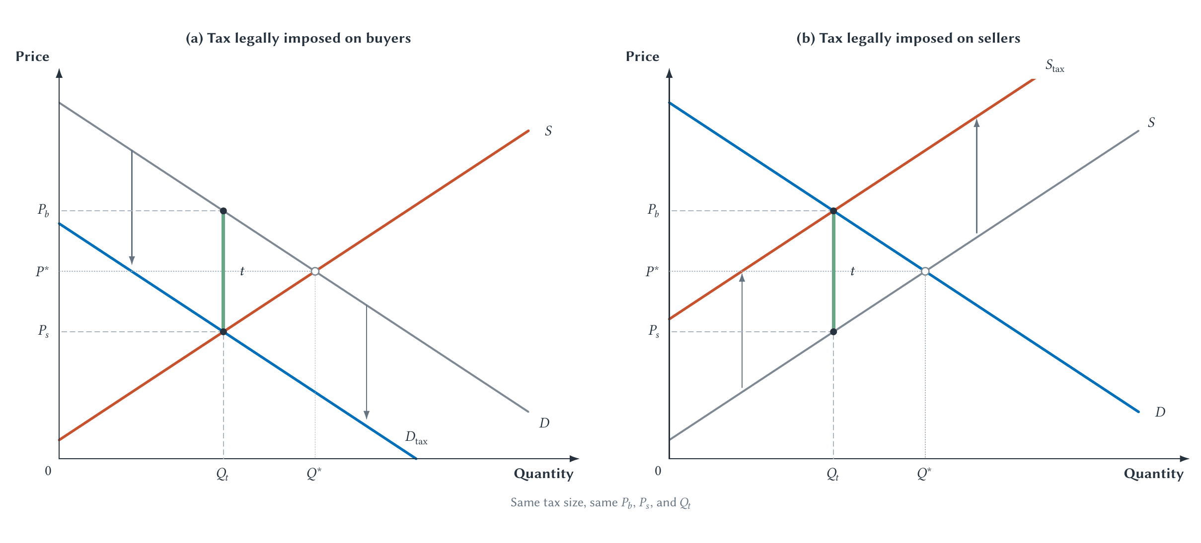
CHAPTER 7
Taxing buyers or sellers produces the same outcome
In both panels, buyers pay more, sellers receive less, and quantity falls.
PRINCIPLES OF MICRO
7
Notes:
Read the buyer panel first, then the seller panel. Only after students see the equivalence should the lecture switch to the wedge shortcut.
[Sources]
- Principles of Micro, Chapter 7: Taxes and Deadweight Loss (current project draft).
- Project-reviewed Chapter 7 figure from figures/ch07_taxes_and_deadweight_loss/.
[/Sources]

Slide 8
CHAPTER 7
Legal payment does not determine economic burden
The law can decide who sends the check. It cannot decide who ultimately bears the cost.
Administrative and compliance differences can matter. But merely changing the remitter does not move the entire burden to that side.
PRINCIPLES OF MICRO
8
Notes:
This is the chapter's first durable rule. Pause and ask students to restate it in their own words.
[Sources]
- Principles of Micro, Chapter 7: Taxes and Deadweight Loss (current project draft).
[/Sources]

Slide 9
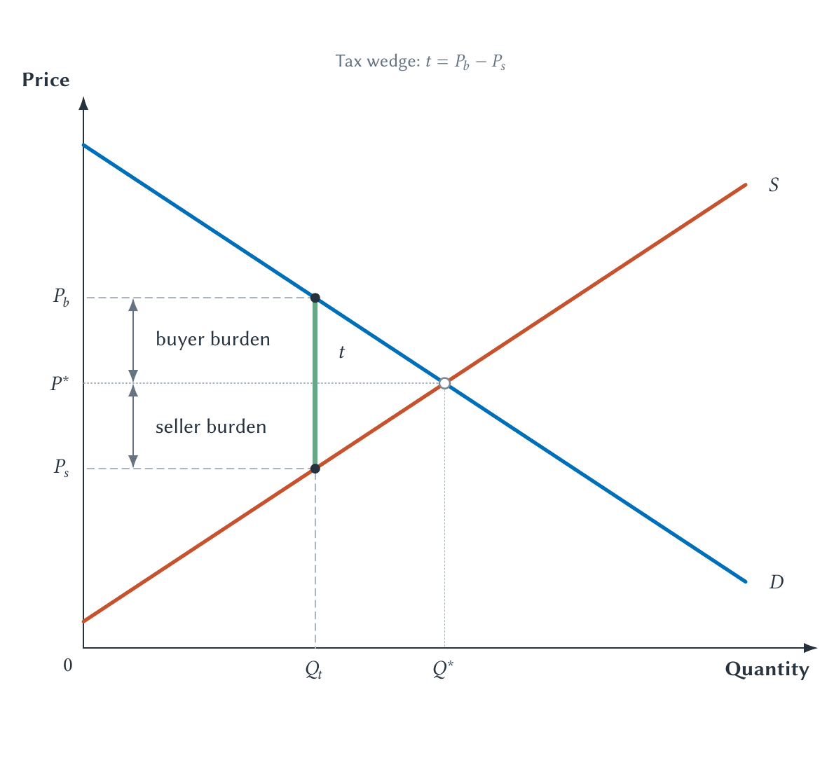
CHAPTER 7
The tax wedge replaces both shifted-curve diagrams
At the taxed quantity, demand gives the buyer price and supply gives the seller price.
PRINCIPLES OF MICRO
9
Notes:
The wedge is the standard diagram for the rest of the chapter. It summarizes the same outcome without repeating legal-remittance shifts.
[Sources]
- Principles of Micro, Chapter 7: Taxes and Deadweight Loss (current project draft).
- Project-reviewed Chapter 7 figure from figures/ch07_taxes_and_deadweight_loss/.
[/Sources]

Slide 10
CHAPTER 7
A $1 wedge need not split fifty-fifty
BEFORE TAX
BUYER PRICE
SELLER PRICE
$4.00
$4.60
$3.60
Buyers pay and sellers receive the same price.
Buyers bear 60 cents through the higher price.
Sellers bear 40 cents through the lower amount received.
60 cents + 40 cents = the $1 tax wedge
PRINCIPLES OF MICRO
10
Notes:
The numbers are illustrative. Nothing requires a 50-50 split, and legal remittance does not determine the split.
[Sources]
- Principles of Micro, Chapter 7: Taxes and Deadweight Loss (current project draft).
[/Sources]

Slide 11
CHAPTER 7
Tax incidence follows adjustment
Who can change behavior more easily?
•
Can buyers switch products, wait, or leave the market?
•
Can sellers redirect resources, relocate, or exit?
•
How much time does each side have to adjust?
The less-responsive side tends to bear more.
PRINCIPLES OF MICRO
11
Notes:
Preview the elasticity result without yet showing the comparison figure. Ask students to predict which side of a market has fewer alternatives.
[Sources]
- Principles of Micro, Chapter 7: Taxes and Deadweight Loss (current project draft).
[/Sources]

Slide 12
CHAPTER 7
Welfare analysis starts from the efficient no-tax outcome
Before the tax, every traded unit through Q* creates gains from trade.
BUYER VALUE
TAX WEDGE
Above seller cost
Separates the two sides
The unit adds to total surplus.
Some value-above-cost trades no longer occur.
PRINCIPLES OF MICRO
12
Notes:
Reconnect explicitly to Chapter 6. Do not introduce deadweight loss as merely a triangle; first recover the value-versus-cost meaning.
[Sources]
- Principles of Micro, Chapter 7: Taxes and Deadweight Loss (current project draft).
[/Sources]

Slide 13
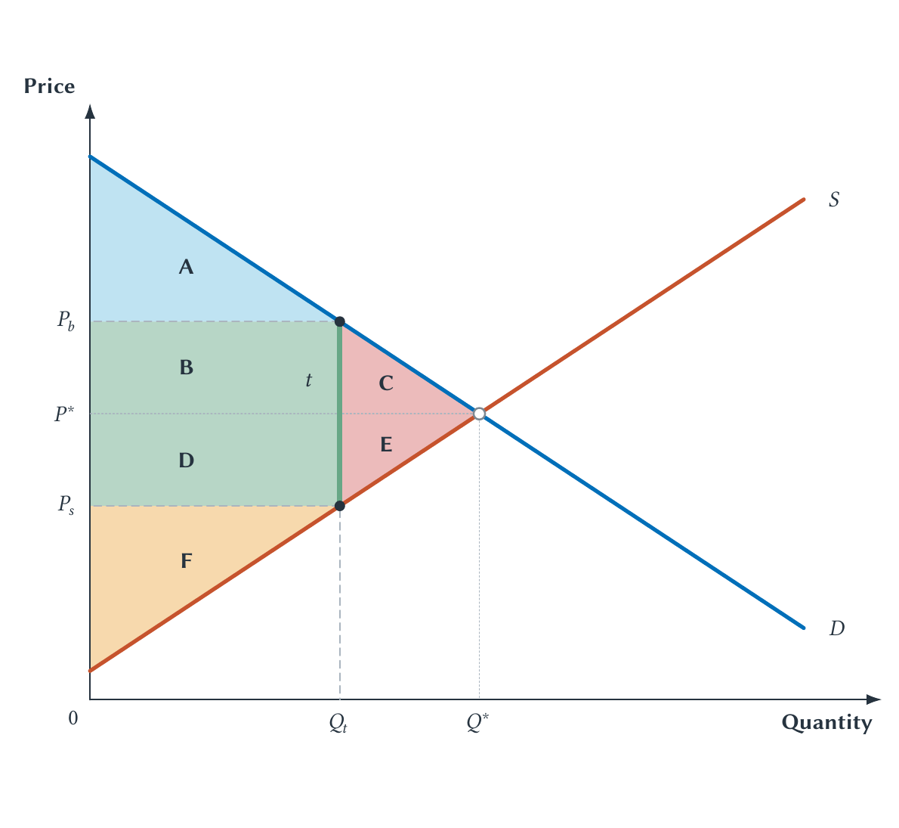
CHAPTER 7
A tax transfers some surplus and destroys some surplus
The letters let us separate what moves to government from what disappears.
PRINCIPLES OF MICRO
13
Notes:
Walk through before-tax welfare first, then after-tax welfare. The letters are intentionally reusable on exams.
[Sources]
- Principles of Micro, Chapter 7: Taxes and Deadweight Loss (current project draft).
- Project-reviewed Chapter 7 figure from figures/ch07_taxes_and_deadweight_loss/.
[/Sources]

Slide 14
CHAPTER 7
Read the lettered areas before naming the loss
Measure
Before tax
After tax
Consumer surplus
A + B + C
A
Producer surplus
D + E + F
F
Tax revenue
0
B + D
Deadweight loss
0
C + E
B + D moves to government. C + E is not received by anyone.
PRINCIPLES OF MICRO
14
Notes:
Students often call every loss of consumer or producer surplus deadweight loss. Separate the transfer to government from the surplus that vanishes.
[Sources]
- Principles of Micro, Chapter 7: Taxes and Deadweight Loss (current project draft).
[/Sources]

Slide 15
CHAPTER 7
Tax revenue is the wedge times the remaining tax base
Tax revenue = tax per unit × after-tax quantity
The rectangle's height is the tax. Its width is the number of units still sold.
Revenue may fund public goods, services, or transfers. It is not deadweight loss.
PRINCIPLES OF MICRO
15
Notes:
Counting tax revenue as a transfer does not assume that every use of government revenue is equally valuable. It only distinguishes transfer from disappearance.
[Sources]
- Principles of Micro, Chapter 7: Taxes and Deadweight Loss (current project draft).
[/Sources]

Slide 16
CHAPTER 7
A tax can block a trade both sides wanted
BUYER VALUE
SELLER COST
PER-UNIT TAX
$4.50
$4.00
$1.00
The buyer will not pay more than this amount.
Without a tax, any price between $4.00 and $4.50 can work.
The wedge is larger than the 50 cents of possible surplus.
The transaction disappears, so its 50 cents of potential surplus is never created.
PRINCIPLES OF MICRO
16
Notes:
Lead with this numerical transaction before returning to the triangle. The tax blocks the trade because no price can satisfy both sides after the wedge.
[Sources]
- Principles of Micro, Chapter 7: Taxes and Deadweight Loss (current project draft).
[/Sources]

Slide 17
CHAPTER 7
Deadweight loss means lost gains from trade
The efficiency loss comes from the fall in quantity.
•
A higher buyer price divides the burden.
•
A lower seller price divides the burden.
•
The missing transactions reduce total surplus.
A high price is not, by itself, deadweight loss.
PRINCIPLES OF MICRO
17
Notes:
The units from the taxed quantity to the no-tax quantity had buyer value above seller cost. Their disappearance is the loss.
[Sources]
- Principles of Micro, Chapter 7: Taxes and Deadweight Loss (current project draft).
[/Sources]

Slide 18
CHAPTER 7
Elasticity now answers two tax questions
INCIDENCE
EFFICIENCY
Who bears more?
How many trades disappear?
The less-responsive side has fewer ways to escape the tax.
A stronger quantity response produces a larger deadweight loss.
Responsiveness divides the wedge and determines how far quantity moves.
PRINCIPLES OF MICRO
18
Notes:
This is the explicit bridge to Chapter 5. Keep incidence and deadweight loss distinct even though both depend on elasticity.
[Sources]
- Principles of Micro, Chapter 7: Taxes and Deadweight Loss (current project draft).
[/Sources]

Slide 19
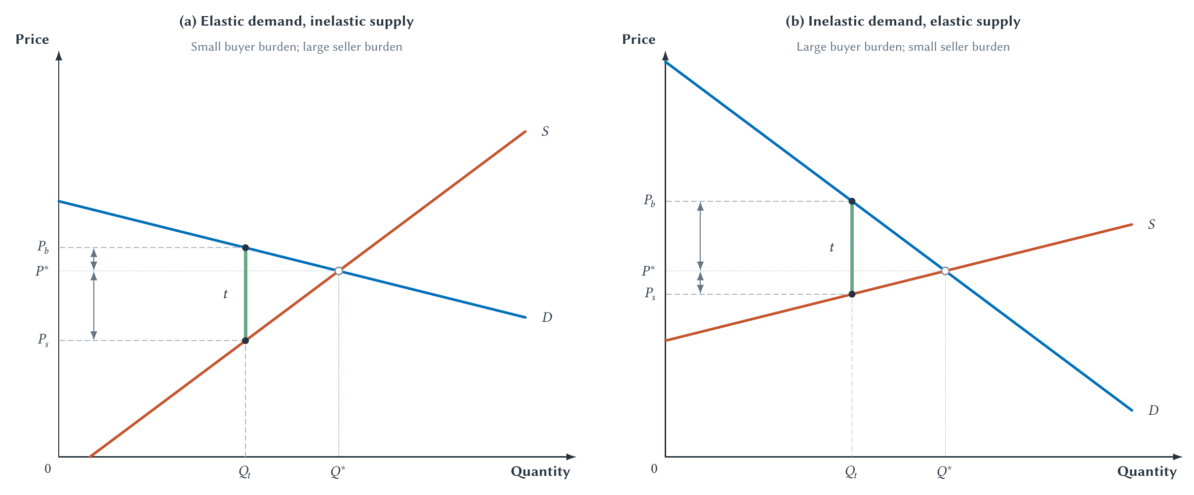
CHAPTER 7
The less-elastic side bears more of the tax
The side with fewer adjustment options experiences the larger price change from P*.
PRINCIPLES OF MICRO
19
Notes:
Ask students to identify the less-elastic side before reading the burden labels. The burden does not disappear when one side adjusts; it shifts to the other side.
[Sources]
- Principles of Micro, Chapter 7: Taxes and Deadweight Loss (current project draft).
- Project-reviewed Chapter 7 figure from figures/ch07_taxes_and_deadweight_loss/.
[/Sources]

Slide 20
CHAPTER 7
Fewer alternatives mean less room to escape
VISITORS
LOCAL HOTELS AND LAND
Can choose another city
Cannot move elsewhere
More elastic demand can limit how much of a hotel tax is passed to guests.
A fixed location can make local supply less elastic and increase the local burden.
Time matters: alternatives that are unavailable today may appear later.
PRINCIPLES OF MICRO
20
Notes:
Treat the hotel example as intuition, not a universal empirical result. Actual incidence depends on the relevant market and time horizon.
[Sources]
- Principles of Micro, Chapter 7: Taxes and Deadweight Loss (current project draft).
[/Sources]

Slide 21
CHAPTER 7
Elasticity also controls how much trade disappears
More response → larger quantity change → larger deadweight loss
A responsive side may bear less of the tax because it adjusts away, but that adjustment helps reduce the number of transactions.
PRINCIPLES OF MICRO
21
Notes:
This is the subtle point: elasticity can reduce a side's burden while increasing the market's quantity response. Incidence and efficiency are different questions.
[Sources]
- Principles of Micro, Chapter 7: Taxes and Deadweight Loss (current project draft).
[/Sources]

Slide 22
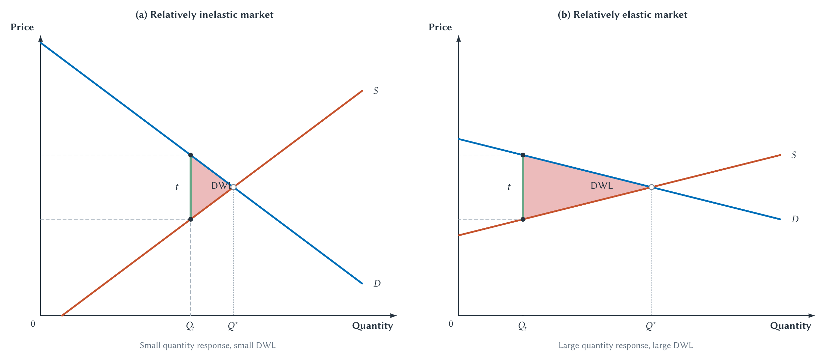
CHAPTER 7
A more responsive market loses more trades
The tax wedge is unchanged; the larger quantity response creates the larger lost-trade triangle.
PRINCIPLES OF MICRO
22
Notes:
Hold tax size fixed. Direct attention to the distance between the taxed and no-tax quantities, not merely to the visual steepness of a single curve.
[Sources]
- Principles of Micro, Chapter 7: Taxes and Deadweight Loss (current project draft).
- Project-reviewed Chapter 7 figure from figures/ch07_taxes_and_deadweight_loss/.
[/Sources]

Slide 23
CHAPTER 7
A larger tax pushes revenue in two directions
RATE EFFECT
BASE EFFECT
More tax per unit
Fewer units are taxed
Every unit still sold sends more revenue to the government.
The larger wedge causes buyers and sellers to cancel more transactions.
Revenue rises only when the first effect is larger than the second.
PRINCIPLES OF MICRO
23
Notes:
This is the bridge from a single-market wedge to tax-rate-and-tax-base reasoning.
[Sources]
- Principles of Micro, Chapter 7: Taxes and Deadweight Loss (current project draft).
[/Sources]

Slide 24
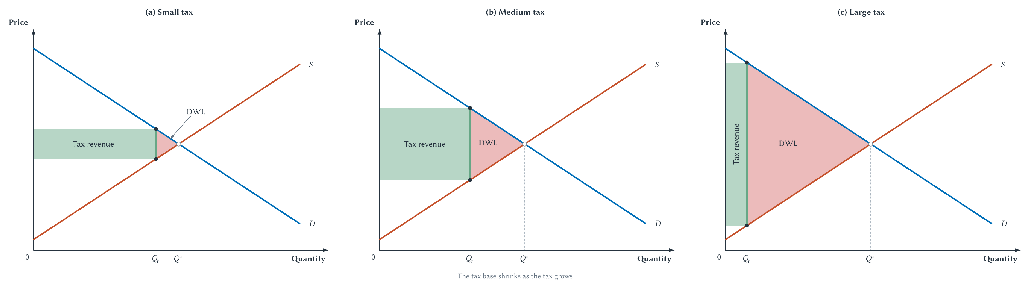
CHAPTER 7
Larger taxes shrink the base and raise deadweight loss
Revenue can eventually fall, while the lost-trade triangle keeps expanding.
PRINCIPLES OF MICRO
24
Notes:
Treat this as a pattern-recognition figure. It is schematic and does not claim that any particular real tax is already on the revenue-decreasing side.
[Sources]
- Principles of Micro, Chapter 7: Taxes and Deadweight Loss (current project draft).
- Project-reviewed Chapter 7 figure from figures/ch07_taxes_and_deadweight_loss/.
[/Sources]

Slide 25
CHAPTER 7
Deadweight loss grows faster than the tax wedge
DWL = 1/2 × tax wedge × reduction in quantity
A larger tax increases both the triangle's height and its width.
In the standard straight-line example, doubling the tax roughly quadruples deadweight loss.
PRINCIPLES OF MICRO
25
Notes:
Keep the arithmetic secondary. The economic reason is that a larger wedge blocks more trades and reaches units farther from the original equilibrium.
[Sources]
- Principles of Micro, Chapter 7: Taxes and Deadweight Loss (current project draft).
[/Sources]

Slide 26
CHAPTER 7
Government sets the rate, but behavior moves the base
Tax revenue = tax rate × tax base
•
People may change work, saving, buying, investment, or location.
•
They may also change timing, reporting, or legal form.
•
A higher rate does not guarantee proportionally higher revenue.
PRINCIPLES OF MICRO
26
Notes:
Put the point memorably: government can raise a rate by law, but it cannot command the tax base to stand still.
[Sources]
- Principles of Micro, Chapter 7: Taxes and Deadweight Loss (current project draft).
[/Sources]

Slide 27
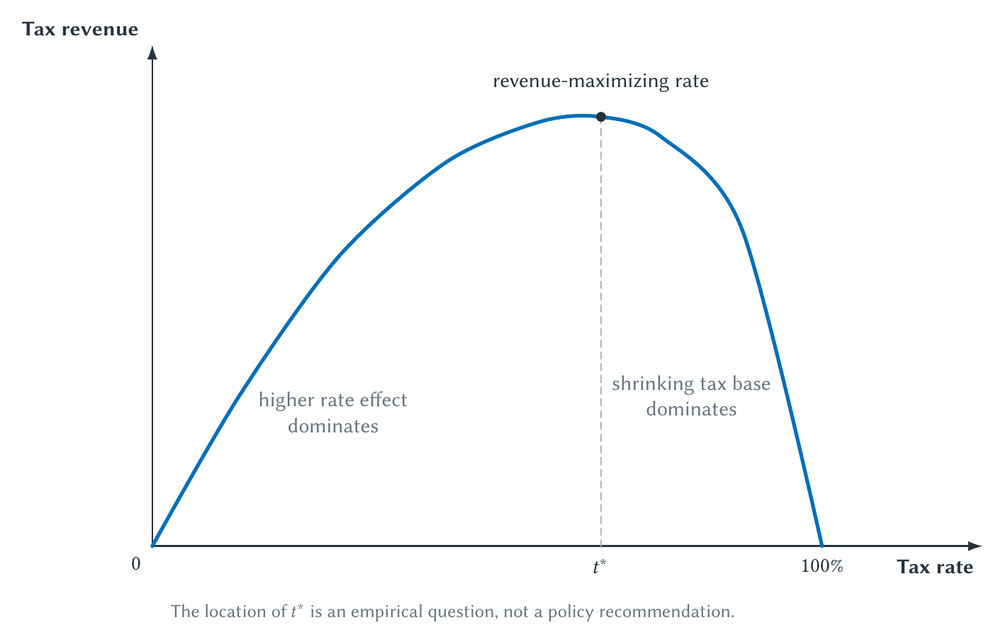
CHAPTER 7
The Laffer curve is a revenue relationship
The peak maximizes revenue only; the diagram does not identify the best tax rate.
PRINCIPLES OF MICRO
27
Notes:
The curve establishes a logical possibility, not the location of a real economy. A tax cut pays for itself only if the current rate is on the revenue-decreasing side.
[Sources]
- Principles of Micro, Chapter 7: Taxes and Deadweight Loss (current project draft).
- Project-reviewed Chapter 7 figure from figures/ch07_taxes_and_deadweight_loss/.
[/Sources]

Slide 28
CHAPTER 7
A Laffer curve cannot choose tax policy by itself
EMPIRICAL QUESTION
RECENT EVIDENCE
POLICY OBJECTIVE
Where are we on the curve?
The peak may be flat
Is revenue the only goal?
The answer depends on the tax base and how people adjust.
A range of rates may raise similar revenue once tax-base interactions are included.
Growth, distribution, administration, and public spending also matter.
Revenue maximization is not welfare maximization.
PRINCIPLES OF MICRO
28
Notes:
Use the modern flat-Laffer result qualitatively. Do not report a maximizing rate or turn the slide into a partisan claim.
[Sources]
- Principles of Micro, Chapter 7: Taxes and Deadweight Loss (current project draft).
- Rachel Moore, Brandon Pecoraro, and David Splinter, Laffer Curves Are Flat, working paper, February 2, 2026.
[/Sources]

Slide 29
CHAPTER 7
Taxes on firms and machines ultimately reach people
CORPORATE INCOME TAX
AI OR ROBOT TAX
Follow the human channels
The machine cannot bear it
Owners, workers, customers, and suppliers may be affected through profits, wages, prices, output, and investment.
The tax can change automation, jobs, prices, profits, complementary work, and future innovation.
Ask who can adjust, through which channel, and over what time horizon.
PRINCIPLES OF MICRO
29
Notes:
Do not announce a universal burden split. CBO emphasizes uncertainty; a German municipal study found a substantial wage channel in that setting. Robot-tax results depend on adjustment and the surrounding tax system.
[Sources]
- Principles of Micro, Chapter 7: Taxes and Deadweight Loss (current project draft).
- Jennifer C. Gravelle, Corporate Tax Incidence: A Review of Empirical Estimates and Analysis, CBO Working Paper 2011-01.
- Clemens Fuest, Andreas Peichl, and Sebastian Siegloch, Do Higher Corporate Taxes Reduce Wages? American Economic Review 108(2), 2018.
- Joao Guerreiro, Sergio Rebelo, and Pedro Teles, Should Robots Be Taxed? Review of Economic Studies 89(1), 2022.
[/Sources]

Slide 30
CHAPTER 7
A higher bracket applies only to the next dollars earned
FICTIONAL SCHEDULE
TWO RATE CONCEPTS
$60,000 of income
Marginal ≠ average
First $50,000 taxed at 10%; final $10,000 taxed at 20%.
The marginal rate is 20%. The average rate is lower because earlier dollars remain in the lower bracket.
Entering a higher bracket does not normally re-tax all earlier income at the new rate.
PRINCIPLES OF MICRO
30
Notes:
Lead with the numerical example. Define marginal as the rate on the next dollar and average as total tax divided by total income.
[Sources]
- Principles of Micro, Chapter 7: Taxes and Deadweight Loss (current project draft).
[/Sources]

Slide 31
CHAPTER 7
A real tax system is more than a headline rate
Design choice
Question to ask
Tax base
What income, property, activity, or transaction counts?
Rate structure
Is the burden proportional, progressive, or regressive?
Deductions and credits
Which activities or taxpayers receive different treatment?
Behavior
How do work, saving, timing, reporting, and business form change?
Administration
What do compliance, enforcement, avoidance, and evasion cost?
The wedge diagram captures the central price-and-quantity effect, not every real-world cost.
PRINCIPLES OF MICRO
31
Notes:
Keep this compact. The purpose is to show that rates, bases, rules, behavior, and administration work together, not to teach the U.S. tax code.
[Sources]
- Principles of Micro, Chapter 7: Taxes and Deadweight Loss (current project draft).
- Joel Slemrod and Christian Gillitzer, Tax Systems, MIT Press, 2013.
[/Sources]

Slide 32
CHAPTER 7
Research question: why target property taxes for relief?
Taxes on immovable property are often among the least damaging taxes, yet many states propose caps or elimination.
•
What exactly is taxed: land, buildings, or both?
•
Who bears the burden after property values and rents adjust?
•
What revenue or spending replaces the lost funds?
•
Which local services are affected?
Investigate a current proposal before reaching a conclusion.
PRINCIPLES OF MICRO
32
Notes:
Use as an optional in-class discussion or research brief. Students must distinguish land from improvements and identify replacement revenue or spending reductions.
[Sources]
- Principles of Micro, Chapter 7: Taxes and Deadweight Loss (current project draft).
- OECD, Housing Taxation in OECD Countries, 2022, recurrent taxes on immovable property.
[/Sources]

Slide 33
CHAPTER 7
Good tax analysis traces the response
•
Separate legal remittance from economic burden.
•
Use elasticity to explain who bears more and how quantity changes.
•
Separate tax revenue from deadweight loss.
•
Follow the tax base when rates change.
•
Compare the cost of raising revenue with what the revenue finances.
Next: price controls alter market outcomes without raising revenue.
PRINCIPLES OF MICRO
33
Notes:
Close by returning to the coffee tax. Ask students to explain the full chain from the legal rule to prices, quantity, revenue, deadweight loss, and incidence.
[Sources]
- Principles of Micro, Chapter 7: Taxes and Deadweight Loss (current project draft).
[/Sources]

