Slide 1

Price Controls and Regulation
Chapter 8
Principles of Micro
A legal price cannot repeal scarcity
Mark Wilson
Notes:
Open by contrasting a tax with a price control. A tax can finance public services; a binding price control creates a shortage or surplus without creating the missing good.
[Sources]
- Principles of Micro, Chapter 8: Price Controls and Regulation (current project draft).
- Cover artwork: design/book-cover/principles-of-micro-cover.png (project-generated asset).
[/Sources]

Slide 2
CHAPTER 8
Taxes distort markets; price controls stop prices from clearing them
A government can set a legal price. It cannot choose away demand and supply.
•
A tax creates a wedge and raises revenue.
•
A binding price control creates a shortage or surplus.
•
Scarcity remains, so another rationing system takes over.
PRINCIPLES OF MICRO
2
Notes:
Use this as the bridge from Chapter 7. Taxes may be a costly way to finance valued public goods; price controls are often an unforced error because they block price adjustment without producing more output.
[Sources]
- Principles of Micro, Chapter 8: Price Controls and Regulation (current project draft).
[/Sources]

Slide 3
CHAPTER 8
A legal price matters only when it blocks equilibrium
MARKET-CLEARING PRICE
CONTROLLED PRICE
Quantity demanded = quantity supplied
The law limits adjustment
At this price, buyers and sellers can carry out the trades they want.
If the rule blocks the market-clearing price, quantity demanded and quantity supplied differ.
First ask whether the control is binding.
PRINCIPLES OF MICRO
3
Notes:
Students often assume every announced price ceiling lowers price or every floor raises it. Make binding versus nonbinding the first diagnostic question.
[Sources]
- Principles of Micro, Chapter 8: Price Controls and Regulation (current project draft).
[/Sources]

Slide 4
CHAPTER 8
Six terms organize price-control analysis
Term
Plain meaning
Price ceiling
A legal maximum price.
Price floor
A legal minimum price.
Binding
The rule prevents the market from reaching equilibrium.
Nonbinding
The rule does not change the equilibrium outcome.
Shortage
Quantity demanded exceeds quantity supplied.
Surplus
Quantity supplied exceeds quantity demanded.
The diagram, not the vocabulary list, does the real work.
PRINCIPLES OF MICRO
4
Notes:
Define each term again when its graph appears. This slide is a compact reference, not a memorization exercise.
[Sources]
- Principles of Micro, Chapter 8: Price Controls and Regulation (current project draft).
[/Sources]

Slide 5
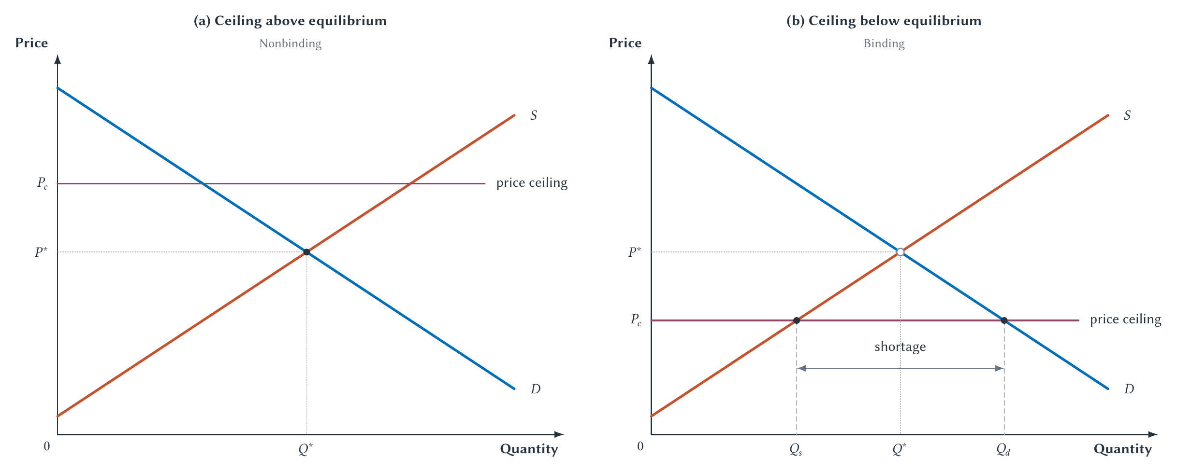
CHAPTER 8
A ceiling below equilibrium creates a shortage
At the lower legal price, buyers want more and sellers offer less.
PRINCIPLES OF MICRO
5
Notes:
Read the nonbinding panel first. In the binding panel, point separately to quantity supplied and quantity demanded before naming the shortage.
[Sources]
- Principles of Micro, Chapter 8: Price Controls and Regulation (current project draft).
- Project-reviewed Chapter 8 figures from figures/ch08_price_controls_and_regulation/.
[/Sources]

Slide 6
CHAPTER 8
A binding ceiling changes more than the posted price
STEP 1
STEP 2
STEP 3
STEP 4
Price is held down
Shortage appears
Other margins adjust
Quantity falls
→
→
→
The legal maximum blocks upward adjustment.
Buyers want more than sellers offer.
Waiting, search, rules, quality, and connections ration access.
Some mutually beneficial trades disappear.
If price cannot adjust, something else adjusts.
PRINCIPLES OF MICRO
6
Notes:
Keep returning to this chain throughout the chapter. The shortage is not the end of the analysis; it changes how scarce units are allocated.
[Sources]
- Principles of Micro, Chapter 8: Price Controls and Regulation (current project draft).
[/Sources]

Slide 7
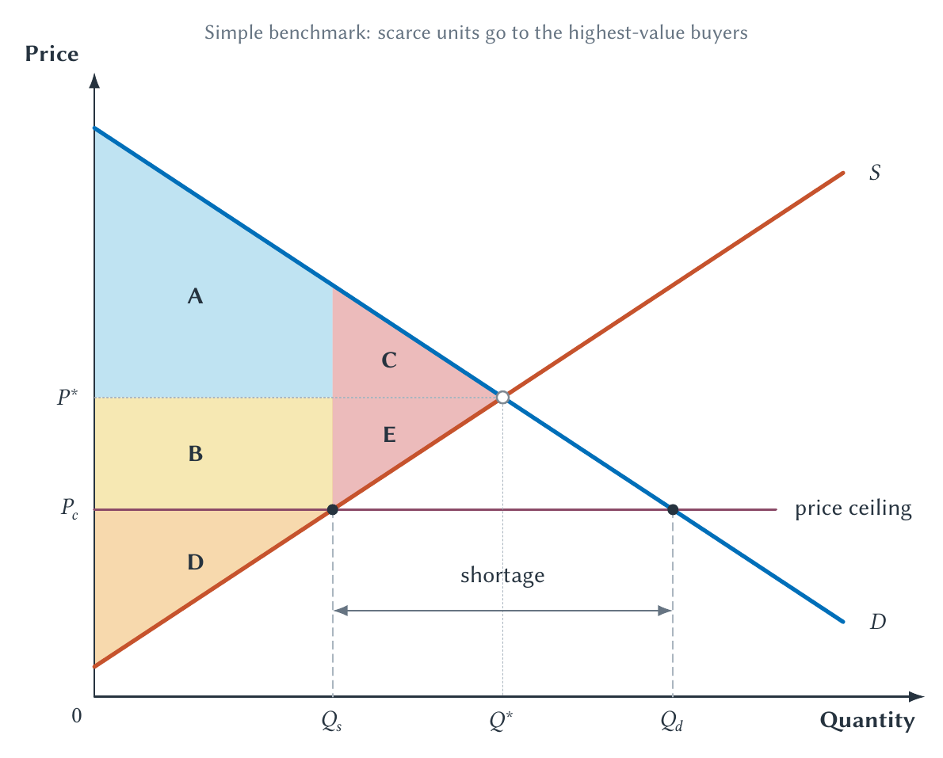
CHAPTER 8
The simple welfare diagram isolates lost trades
Some buyers gain from the lower price, sellers lose, and trades between Qs and Q* disappear.
PRINCIPLES OF MICRO
7
Notes:
Use this as the only required area-accounting figure. State the clean assumptions: the available units reach the highest-value buyers and obtaining them involves no waiting or search cost.
[Sources]
- Principles of Micro, Chapter 8: Price Controls and Regulation (current project draft).
- Project-reviewed Chapter 8 figures from figures/ch08_price_controls_and_regulation/.
[/Sources]

Slide 8
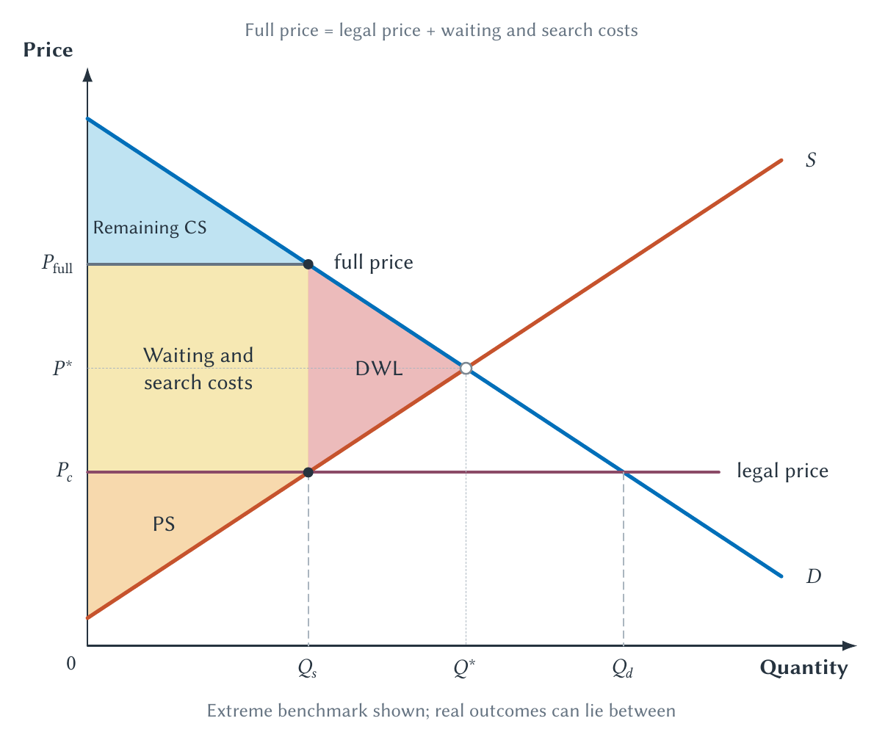
CHAPTER 8
The posted price can understate what buyers really pay
A lower money price can be offset by time, effort, uncertainty, and inconvenience.
PRINCIPLES OF MICRO
8
Notes:
Treat this as an extreme benchmark, not a second area exercise or an estimate of every controlled market. Real outcomes can fall outside the clean diagram because allocation and quality also change.
[Sources]
- Principles of Micro, Chapter 8: Price Controls and Regulation (current project draft).
- Project-reviewed Chapter 8 figures from figures/ch08_price_controls_and_regulation/.
[/Sources]

Slide 9
CHAPTER 8
Many people want to live in Manhattan; there are not enough apartments
Rent control can lower rent for a selected tenant. It cannot create an apartment for every person who wants one at that rent.
The shortage must be rationed somehow.
PRINCIPLES OF MICRO
9
Notes:
Use Manhattan as the intuitive opening to rent control. Separate the benefit to an incumbent tenant from the broader question of housing supply and access.
[Sources]
- Principles of Micro, Chapter 8: Price Controls and Regulation (current project draft).
[/Sources]

Slide 10
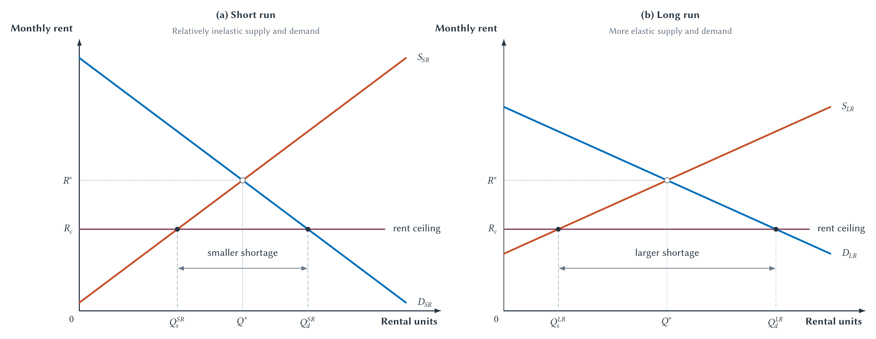
CHAPTER 8
Rent-control shortages tend to grow over time
Construction, conversion, maintenance, household size, and location adjust more in the long run.
PRINCIPLES OF MICRO
10
Notes:
Reconnect the figure to Chapter 5. Greater long-run responsiveness makes quantity supplied lower and quantity demanded higher at the controlled rent.
[Sources]
- Principles of Micro, Chapter 8: Price Controls and Regulation (current project draft).
- Project-reviewed Chapter 8 figures from figures/ch08_price_controls_and_regulation/.
[/Sources]

Slide 11
CHAPTER 8
San Francisco shows the benefit and the cost
•
Covered tenants became more likely to remain in their homes.
•
Landlords reduced the supply of rental housing covered by the policy.
•
The benefit went mainly to selected incumbent tenants.
•
Future renters faced a smaller market and higher citywide rents.
Protecting current tenants is not the same as making housing broadly affordable.
PRINCIPLES OF MICRO
11
Notes:
Present the measured tenant-stability benefit honestly, then trace supply, mobility, and access. Do not turn the benefit into an offsetting verdict on the policy.
[Sources]
- Principles of Micro, Chapter 8: Price Controls and Regulation (current project draft).
- Rebecca Diamond, Tim McQuade, and Franklin Qian, The Effects of Rent Control Expansion on Tenants, Landlords, and Inequality, American Economic Review 109(9), 2019.
[/Sources]

Slide 12

CHAPTER 8
Gasoline was rationed partly by waiting
The controlled money price did not include hours in line, uncertainty about supply, or the risk of reaching an empty pump.
Time became part of the price.
PRINCIPLES OF MICRO
12
Notes:
Use the visible line and the sign on the final car to make full price concrete. Waiting allocated gasoline when the posted price could not clear the market.
[Sources]
- Principles of Micro, Chapter 8: Price Controls and Regulation (current project draft).
- David Falconer, Portland gasoline line, December 1973, U.S. National Archives Identifier 555459; public domain.
- Robert T. Deacon and Jon Sonstelie, Rationing by Waiting and the Value of Time, Journal of Political Economy 93(4), 1985.
[/Sources]

Slide 13
CHAPTER 8
A price floor reverses the direction of the imbalance
A binding floor holds price above equilibrium: sellers offer more while buyers want less.
The result is a surplus.
PRINCIPLES OF MICRO
13
Notes:
Mirror the ceiling logic. The same first question applies: is the floor above equilibrium and therefore binding?
[Sources]
- Principles of Micro, Chapter 8: Price Controls and Regulation (current project draft).
[/Sources]

Slide 14
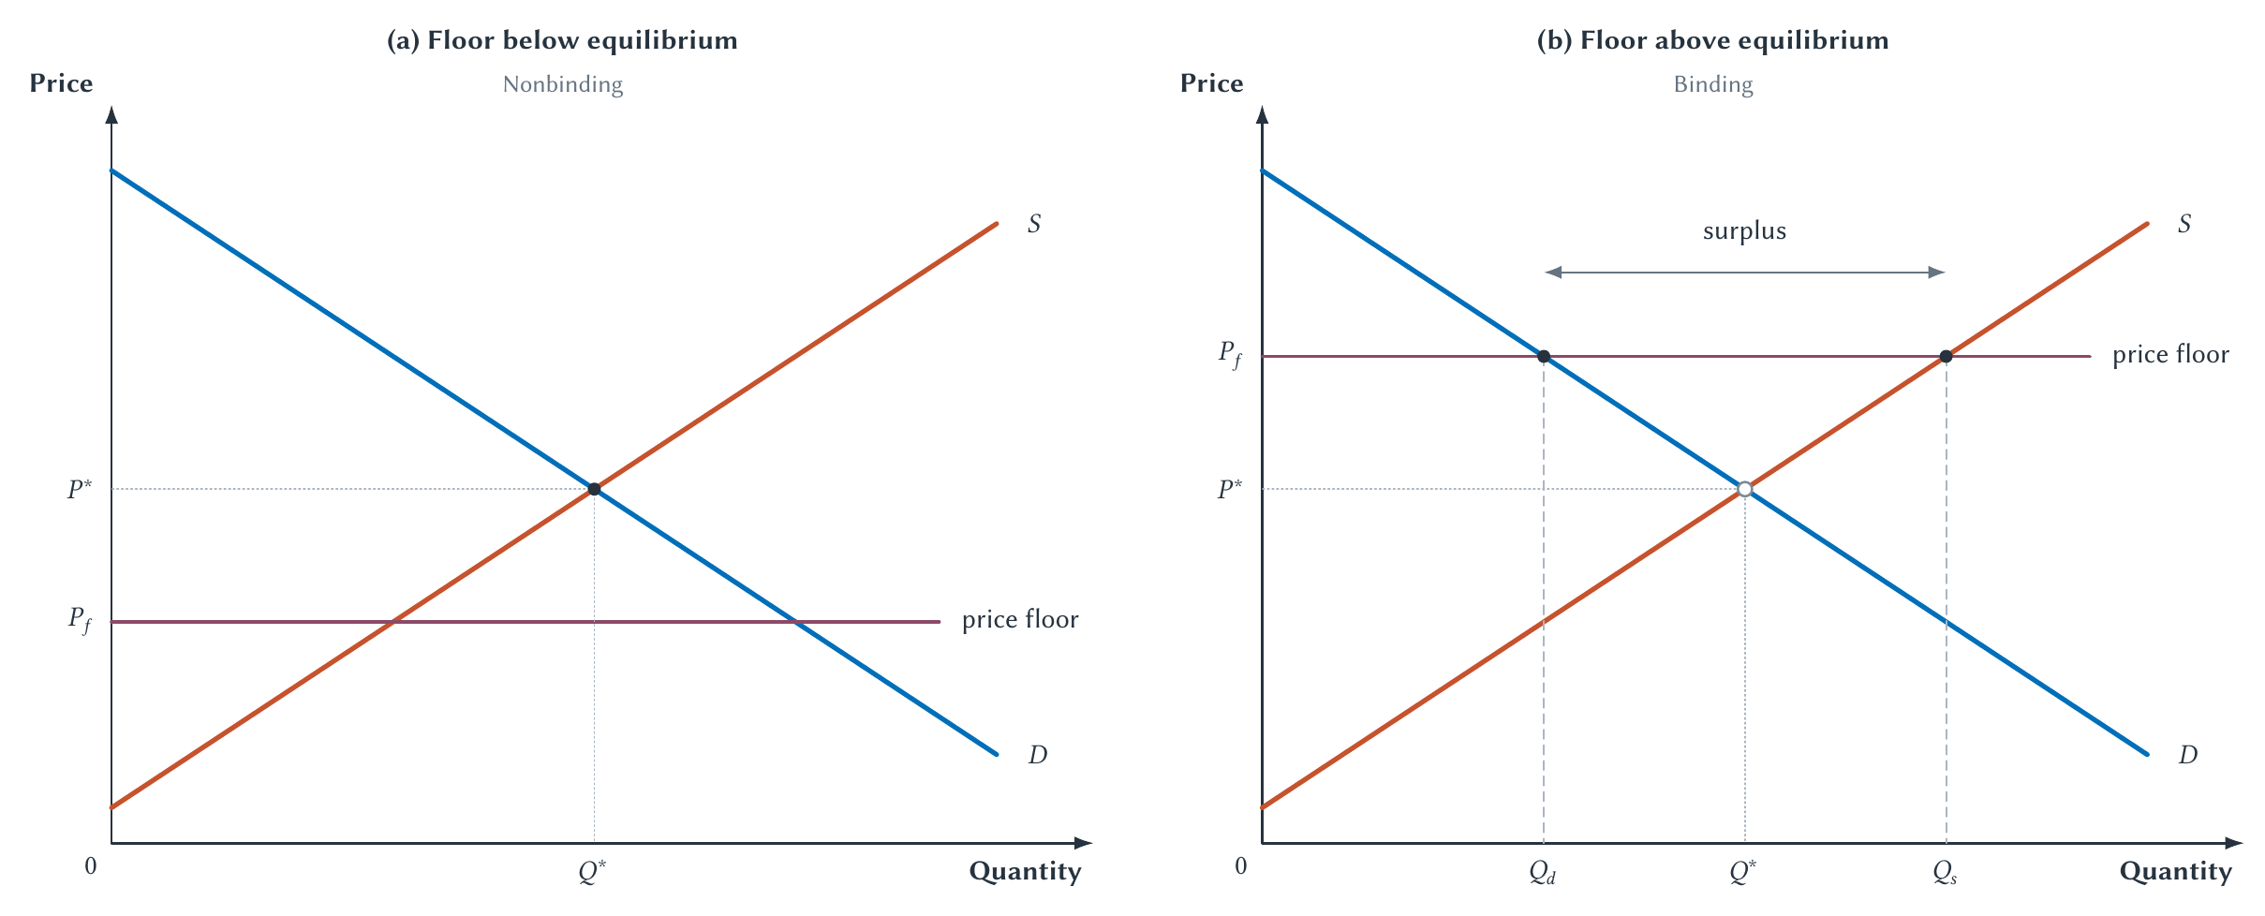
CHAPTER 8
A floor above equilibrium creates a surplus
At the higher legal price, sellers offer more and buyers purchase less.
PRINCIPLES OF MICRO
14
Notes:
Have students locate quantity demanded and quantity supplied before measuring the surplus.
[Sources]
- Principles of Micro, Chapter 8: Price Controls and Regulation (current project draft).
- Project-reviewed Chapter 8 figures from figures/ch08_price_controls_and_regulation/.
[/Sources]

Slide 15
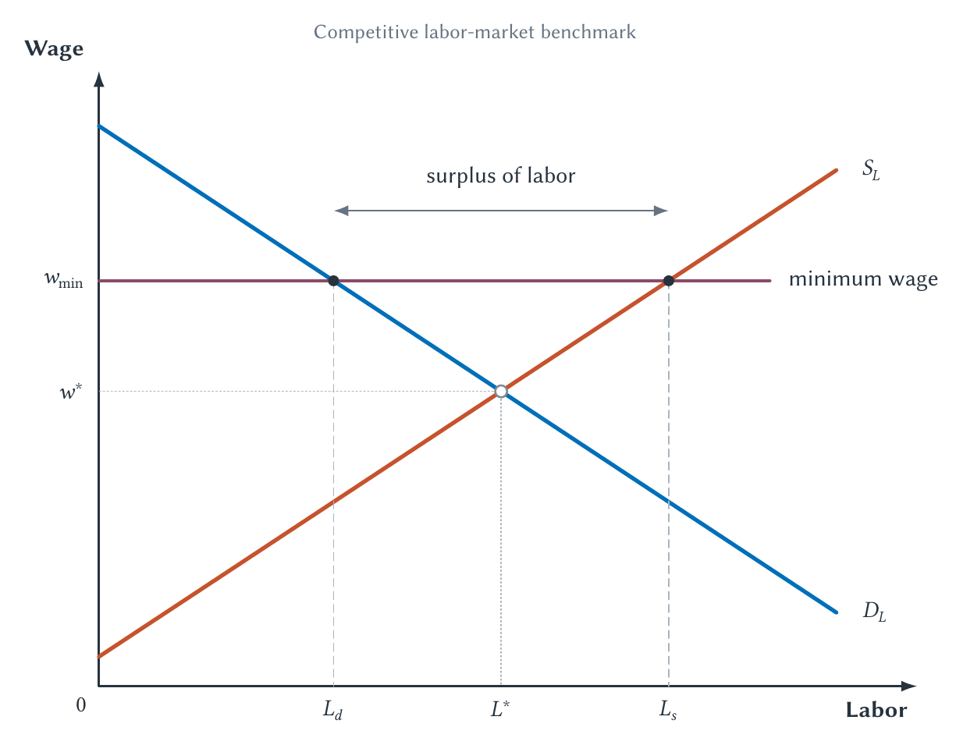
CHAPTER 8
A minimum wage is a price floor in a labor market
The law can require a higher wage for a job that exists; it cannot require the job to exist.
PRINCIPLES OF MICRO
15
Notes:
Teach the competitive benchmark directly: employment falls, labor supplied rises, and a labor surplus appears. Defer employer market power and empirical complications to Chapter 18.
[Sources]
- Principles of Micro, Chapter 8: Price Controls and Regulation (current project draft).
- Project-reviewed Chapter 8 figures from figures/ch08_price_controls_and_regulation/.
[/Sources]

Slide 16
CHAPTER 8
Firms can adjust on more margins than head count
•
Employ fewer workers or offer fewer hours.
•
Raise job requirements or reduce benefits.
•
Raise prices or change the product mix.
•
Substitute equipment, software, or self-service for some tasks.
A rule aimed at wages can change many parts of the job.
PRINCIPLES OF MICRO
16
Notes:
The labor-demand result is the starting point. These additional margins explain why measuring only employment may miss part of the response.
[Sources]
- Principles of Micro, Chapter 8: Price Controls and Regulation (current project draft).
[/Sources]

Slide 17
CHAPTER 8
Target the help more directly
PRICE CONTROL
INCOME SUPPORT
Force a price away from equilibrium
Help the intended household
Creates a shortage or surplus and allocates benefits partly by access.
Housing vouchers or wage subsidies can support income without blocking the market-clearing price.
A policy should be judged against feasible alternatives that pursue the same goal.
PRINCIPLES OF MICRO
17
Notes:
Do not claim every subsidy is costless. The point is institutional comparison: a targeted transfer can be more direct than imposing a market-wide price control.
[Sources]
- Principles of Micro, Chapter 8: Price Controls and Regulation (current project draft).
[/Sources]

Slide 18
CHAPTER 8
Regulation needs a reason
Absent a market failure, a rule that blocks voluntary trades reduces total surplus.
•
Identify the market failure or distributional goal.
•
Explain how the rule addresses it.
•
Compare the rule with realistic alternatives.
PRINCIPLES OF MICRO
18
Notes:
This is not an argument that regulation is never justified. It is an argument that the justification must be stated and the trade-offs traced.
[Sources]
- Principles of Micro, Chapter 8: Price Controls and Regulation (current project draft).
[/Sources]

Slide 19
CHAPTER 8
Regulation can serve the public or protect an incumbent
PUBLIC-INTEREST VIEW
PUBLIC-CHOICE WARNING
Correct a real problem
Follow organized incentives
A rule may address market power, external costs, information problems, or another documented failure.
Concentrated beneficiaries may seek rules whose costs are spread thinly across many people.
Compare an imperfect market with an imperfect political process.
PRINCIPLES OF MICRO
19
Notes:
Present capture as one possible mechanism, not an explanation for every rule. Ask who gains, who pays, and how easy each group is to organize.
[Sources]
- Principles of Micro, Chapter 8: Price Controls and Regulation (current project draft).
- George J. Stigler, The Theory of Economic Regulation, Bell Journal of Economics and Management Science 2(1), 1971.
[/Sources]

Slide 20
CHAPTER 8
A disciplined policy analysis asks four questions
STEP 1
STEP 2
STEP 3
STEP 4
Does it bind?
What imbalance follows?
What else adjusts?
Is there a better tool?
→
→
→
Locate the legal price relative to equilibrium.
Identify the shortage or surplus.
Trace waiting, quality, access, investment, and enforcement.
Compare policies aimed at the same goal.
A good intention is the beginning of analysis, not the end.
PRINCIPLES OF MICRO
20
Notes:
Use this as the exam-ready checklist for any new price-control example.
[Sources]
- Principles of Micro, Chapter 8: Price Controls and Regulation (current project draft).
[/Sources]

Slide 21
CHAPTER 8
A legal price cannot repeal scarcity
•
A control matters only when it is binding.
•
Binding ceilings create shortages; binding floors create surpluses.
•
If price cannot adjust, waiting, search, quality, access, or another margin will.
•
Judge a regulation against realistic alternatives aimed at the same goal.
Next: world prices connect domestic buyers and sellers to international trade.
PRINCIPLES OF MICRO
21
Notes:
End with the Manhattan question or gasoline line and ask students to name the non-price rationing mechanism.
[Sources]
- Principles of Micro, Chapter 8: Price Controls and Regulation (current project draft).
[/Sources]

